Slide 1
SUPERFASCIAL LUMPS
SKIN & SUBCUTANEOUS
TUMOURS & CYSTS
Dr. Mohammad Al-Akeely
Associate Professor
Department of Surgery

Slide 2
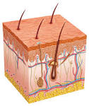
Skin anatomy
Epidermis: openings of glands
Papillary dermis: basal cell layer
Dermis : contains sweat & sebaceous glands

Slide 3
Benign skin tumours
papilloma (wart):
. Finger like projection of all skin layers
. usually infective ( papilloma virus)
. pedunculated or sessile
Rx : .Cauterization (small or multiple)
.Excision (large)

Slide 4
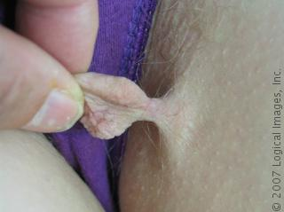
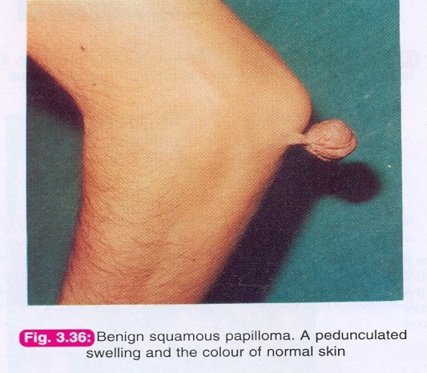
Pedunculated papilloma

Slide 5
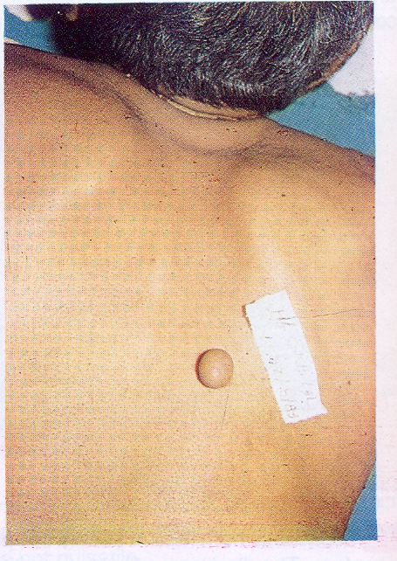
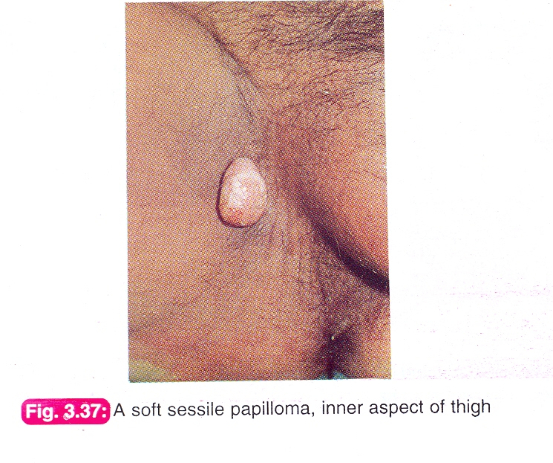
Sessile papilloma

Slide 6
SCAR
Fibrous tissue proliferation following :
. trauma
.surgery
.infection
.It is usually flat.

Slide 7
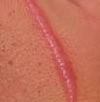
Hyper trophic scar
  Excessive fibrous tissue in a scar
. confined to the scar
. no neovascularization
.wound infection is an important factor
.clinically it is a raised , non tender swelling with no itching
.it may regress gradually in six months
. does not usually recur after excision

Slide 8
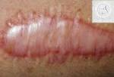

Hyper trophic scars:

Slide 9
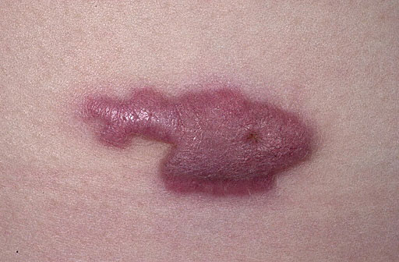

Keloid
  Excessive fibrous and collagen tissue with neovascular proliferation in a scar .usually extends beyond the original scar

Slide 10
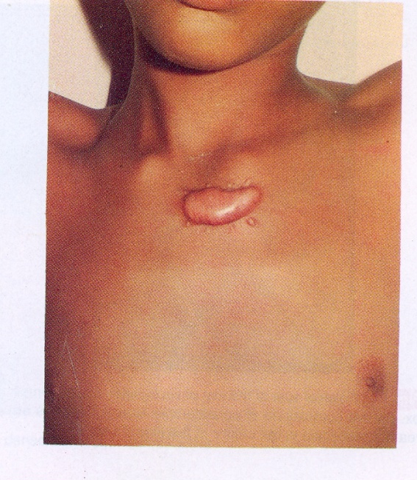
Keloid continue
Initially raised , pink , tender , itchy and may ulcerate.
More common in dark skinned people
Progressive v.s. non progressive
Aquired v/s spontaneous
Rx
.Injection ( hyaluronidase , steroides etc.)
.Excision & grafting

Slide 11

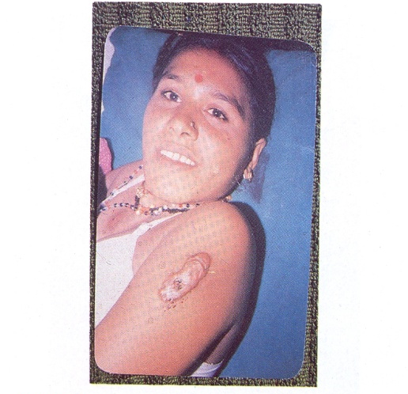
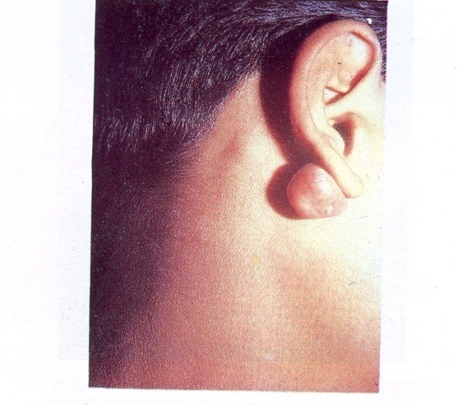

Slide 12
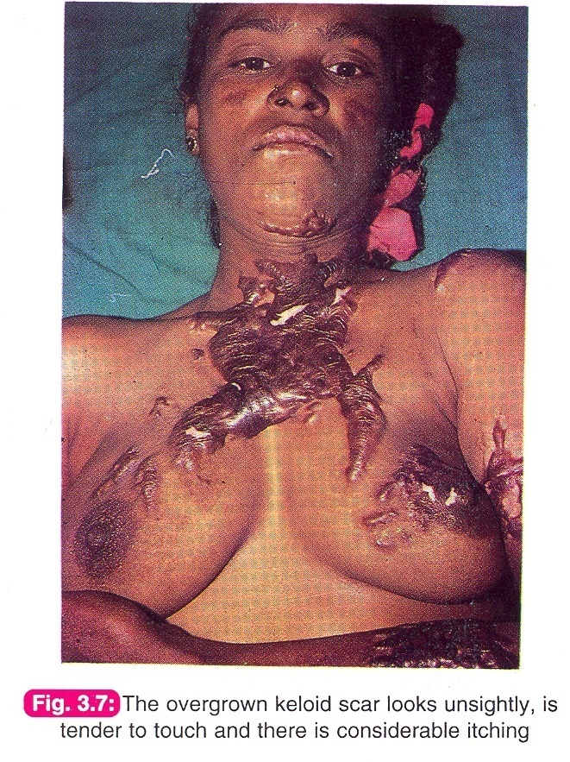

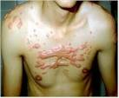

Slide 13
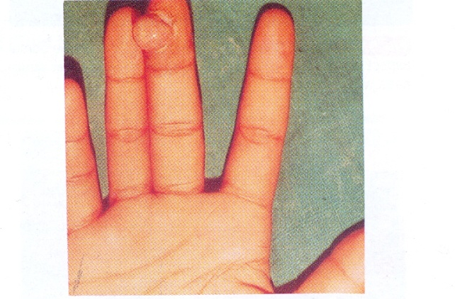
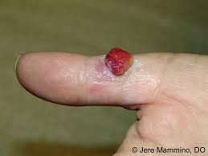
Pyogenic granuloma
. Excessive granulation tissue growth in ulcers.
. Firm, bright , red selling that bleeds on touch.
. recurrent bleeding when exposed to Trauma.
Rx : cauterization v.s excision .

Slide 14
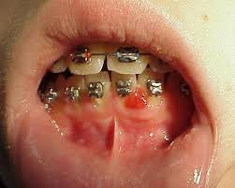
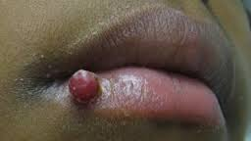

Slide 15
Haemangioma
It is a developmental malformation of blood vessels rather than a tumour.
Types: capillary , cavernous ,arterial.
It commonly occurs in skin & sub cutaneous tissue
but other organs ( e.g lips , tongue ,liver ,brain) may be affected.

Slide 16
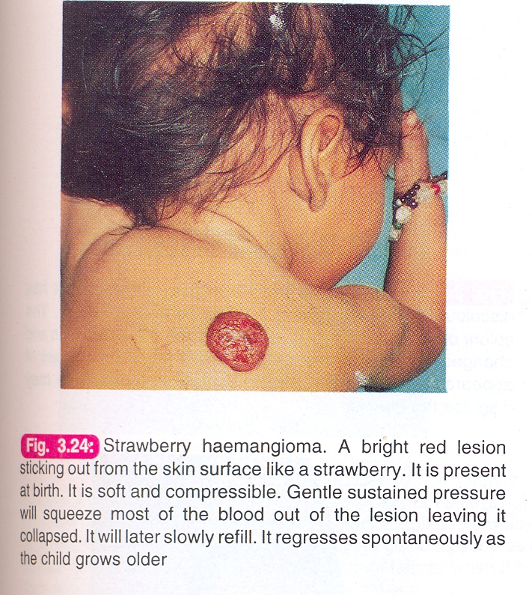
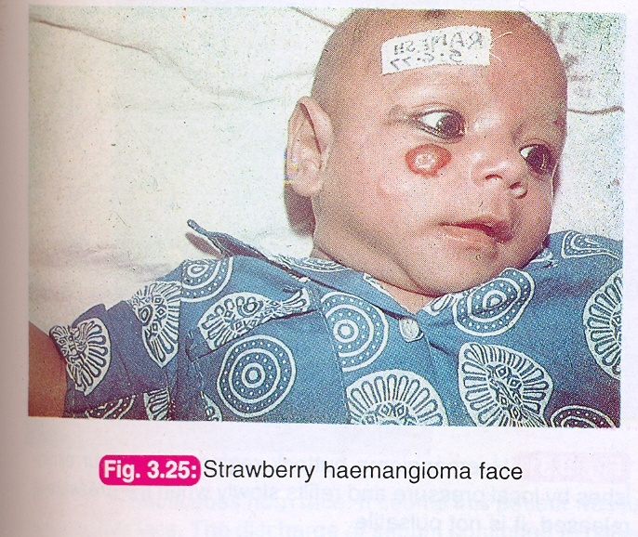
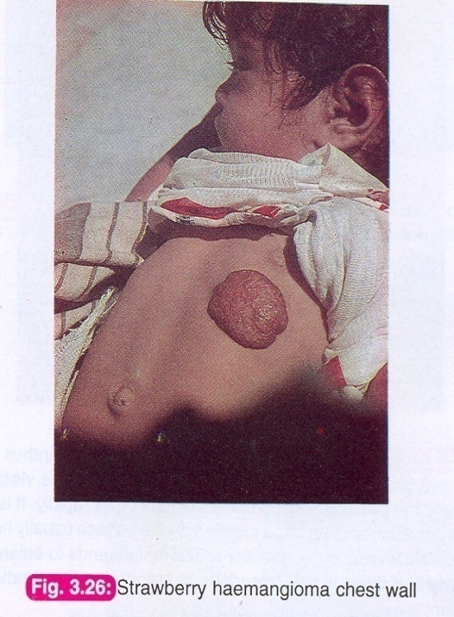

Slide 17
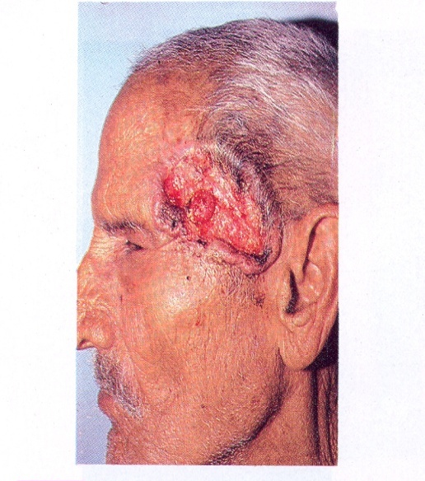
Malignant skin tumours
Basal cell carcinoma (BCC) :
.Ulcerated tumour of basal cell layer of skin.
. Middle aged white tropical males (Australia).
. common in face.
. low grade and slowly growing tumour (years)
.
Clinically:
. Rolled-in edges (inverted ) with attempts of
healing .
. floor shows an un healthy granulation with a scab.
.The base is indurated and may be fixed to bone.
. spreads locally ( usually no L.N metastases).
Rx : radio therapy & surgery

Slide 18
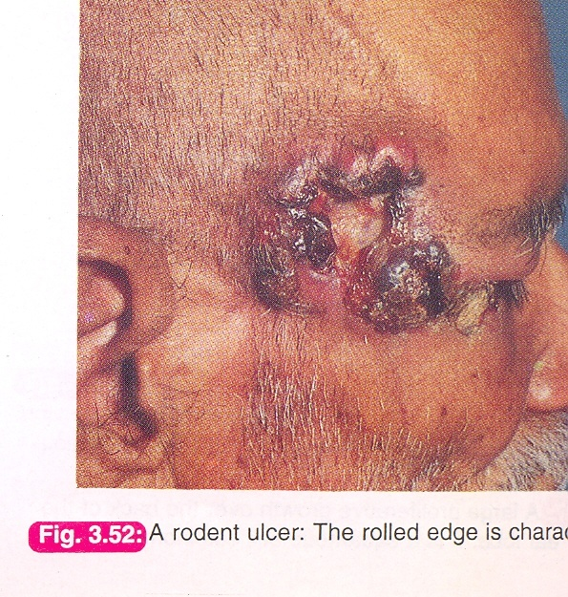
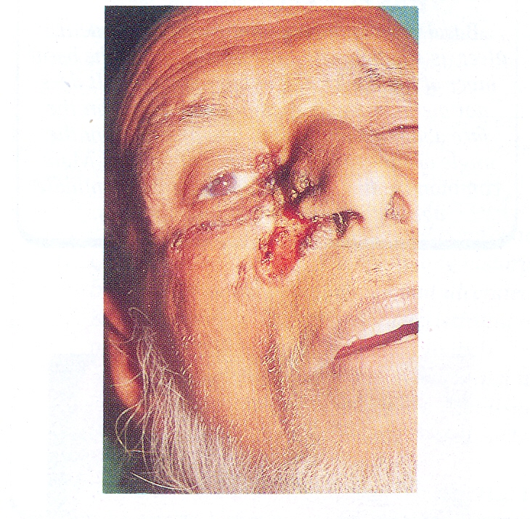
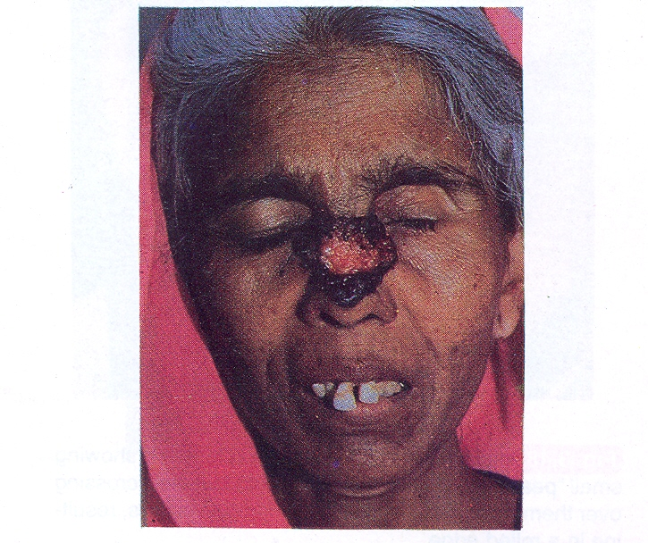

Slide 19
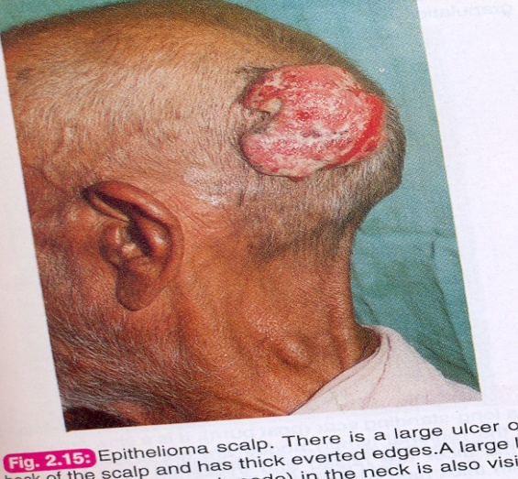
Squamous cell carcinoma
(Epithelioma)
.Arise from squamous cell layer of skin or mucus membrane.
.It may arise from metaplasia of columnar epitheleum
due to chronic irritation ( gall bladder, bronchus, stomach .etc.)
.It can occure any where in the body, M>F .
.More malignant and rapidly growing than BCC.
.Edges are rolled out ( everted )
Spreads :
locally , L.N ,and blood
Rx:
Radiotherapy & Surgery

Slide 20
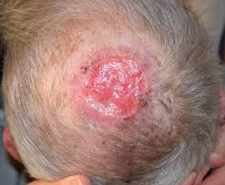
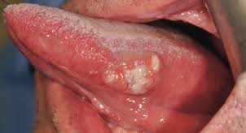
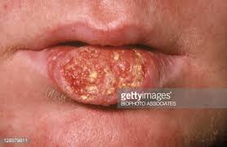
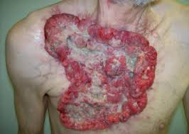

Slide 21
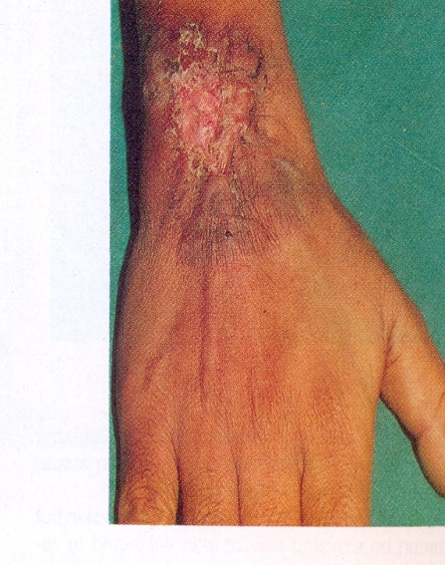
Marjolin ulcer
It is a low grade squamous cell carcinoma arising in chronically inflammed ulcers or scars.
Rx:
Radiotherapy & Surgery

Slide 22
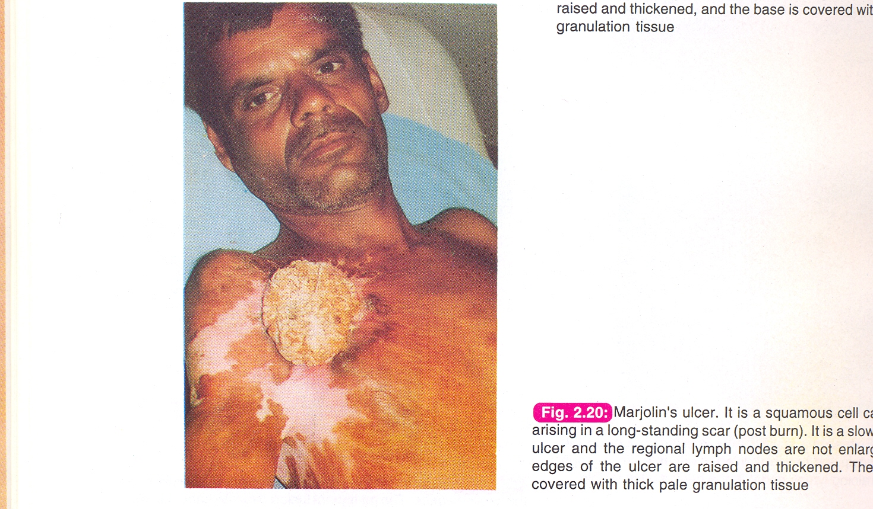

Slide 23
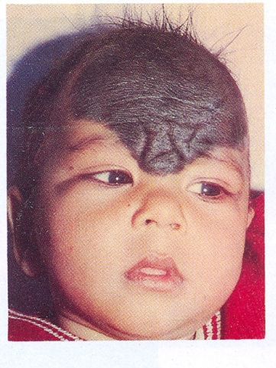
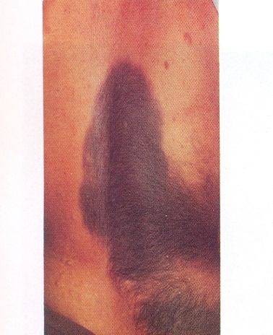
Naevus ( mole)
.A localised cutaneous malformations.
.Includes moles & birth marks.
.They may present at birth ,or even later.
Types:
Junctional , intradermal , compound, bluenaevus, juvenile and freckle
.

Slide 24
Naevus cont;
Evidences of malignant change :
(very important )
.Increase in size
.change to irregular edge
.change in thickness
.change in colour
.change in surrounding tissue
.symptoms e.g: itching, bleeding discharge
.lymphadenopathy
.microscopic evidence

Slide 25
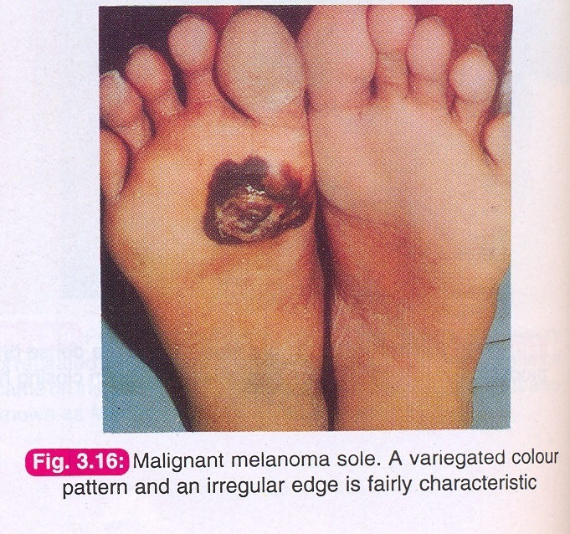
Malignant Melanoma
It is rare but most rapidly infiltrating skin tumour
De-novo ( 10 %) , Pre-existing naevus (90 %).
Metastasis :
Local & satellite nodules.
Lymphatic.
Blood ( liver, lung, bone etc;.

Slide 26
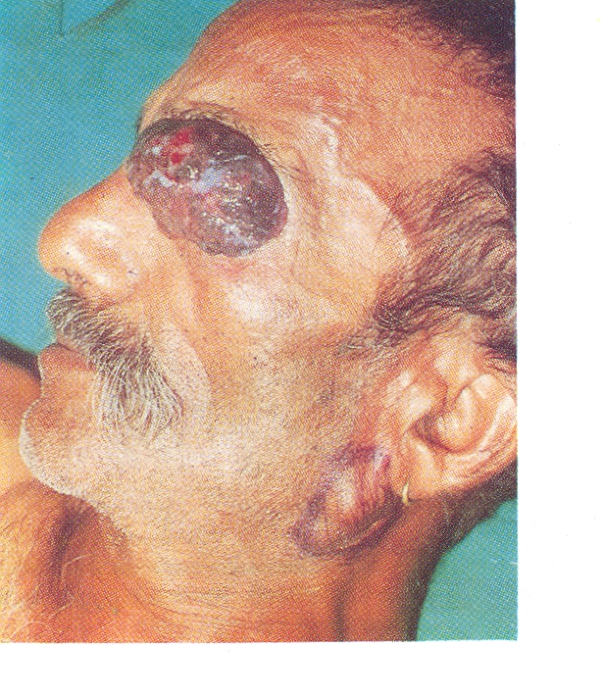
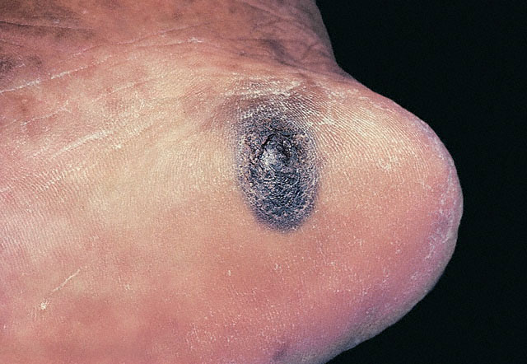

Slide 27
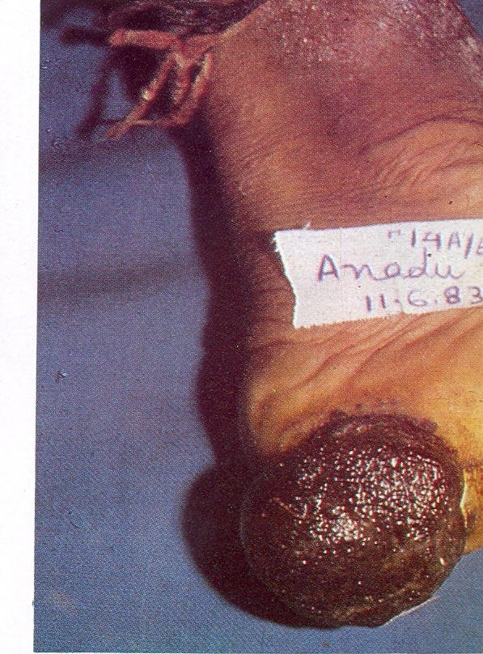
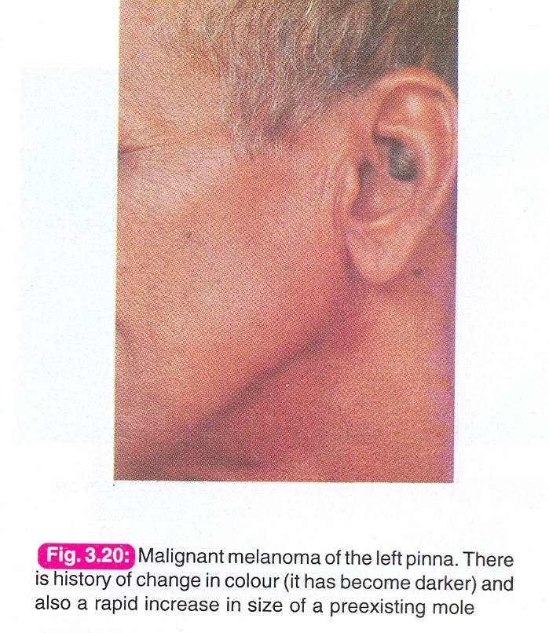

Slide 28
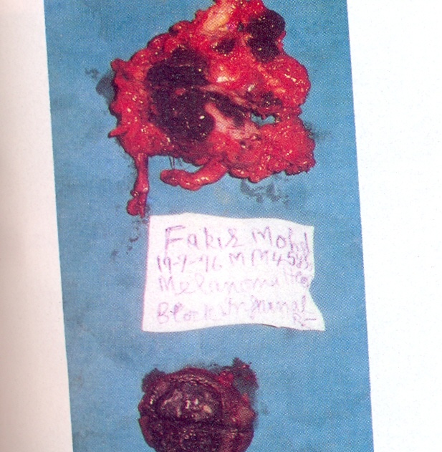
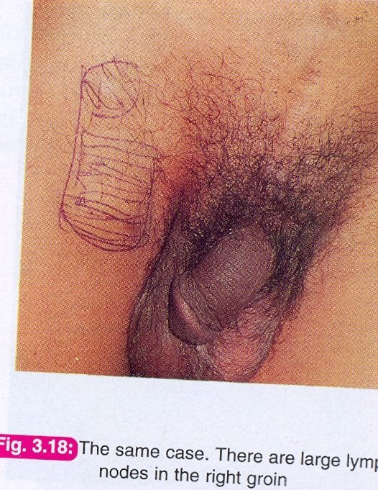

Slide 29
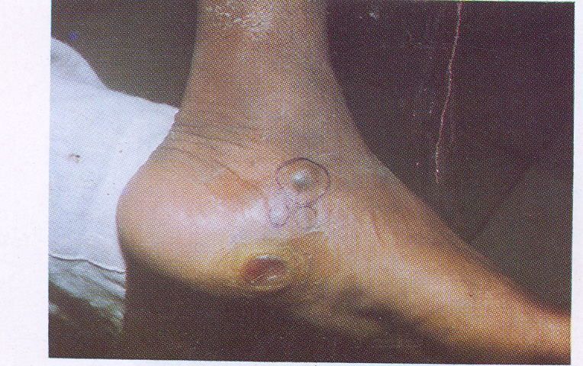
Satellite nodule

Slide 30
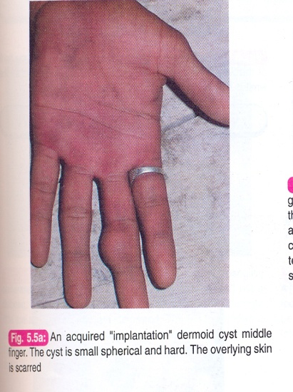
Skin Cysts
Implantation Dermoid :
.It is a post traumatic dermoid.
.Commonly in fingers and hands of farmers & taylors.
.Tense , may be hard tender swelling.
.Attached to skin which may be scarred
.Contains desquamated epithelial cells.
.pain and ulceration may occur following repeated trauma
RX:
Excision is curative.

Slide 31
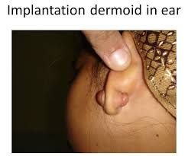

Slide 32
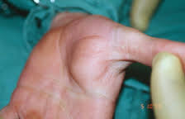

Slide 33
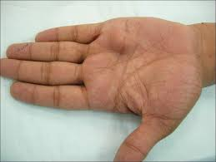
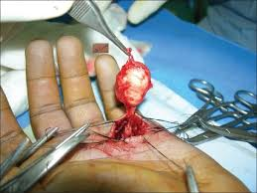

Slide 34
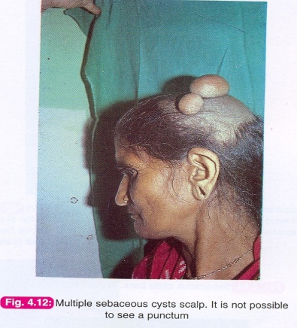
Sebaceous Cyst
It is a retention cyst due to blockage of its duct.
Lined by squamous epithelium and contains sebum
and desquamated epithelium.
Commonly in scalp , Face , scrotum and vulva
( never in palm & sole).
Clinically:
Spherical, cystic or tense swelling , attached to skin with punctum that may discharge sebum upon squeezing.
NB :Indentation and fluctuation tests may be positive .But
transillumination test is negative
.

Slide 35
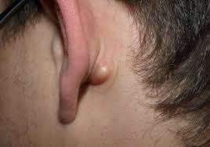
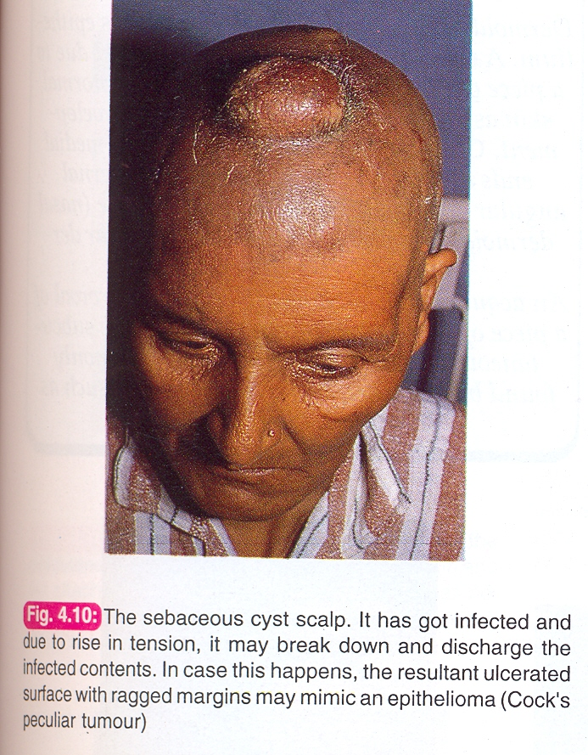

Slide 36
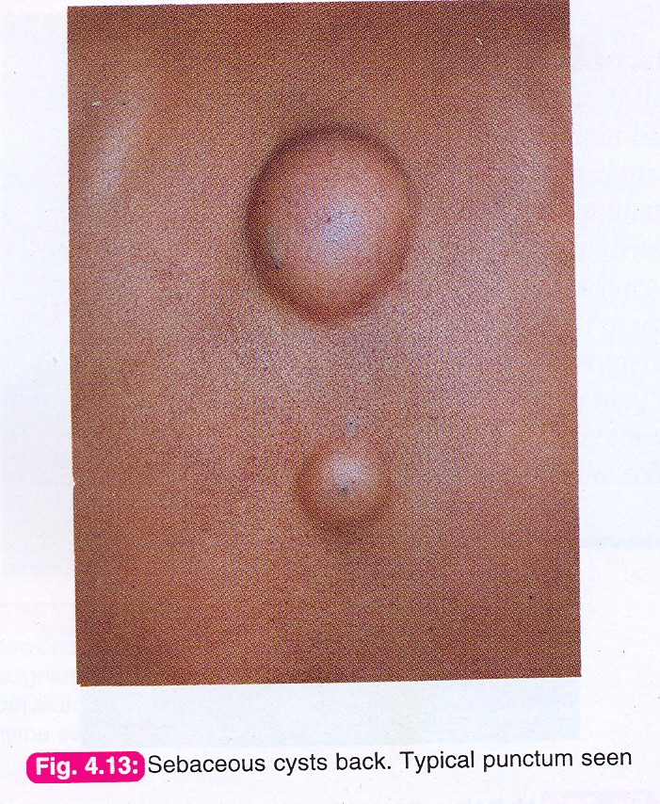


Slide 37


Slide 38

Seb. Cyst cont;
Complications:
cosmotic
Infection
ulceration
Cock peculiar tumour ( granuloma due to ulceration)
sebaceous Horn (inspissated secreted sebum )
Rx :
.Excision for un infected cyst .
.Drainage followed by excision for infected cyst.

Slide 39

sebasceous horn

Slide 40

Infected sebasceous cyst.

Slide 41


Sebasceous cyst excision

Slide 42
Subcutaneous Lumps
Cystic swellings:
Congenital Aquired
dermoid cyst abcess
cystic hygroma parasetic
haemangioma haematoma
Solid swellings:
commonly benign:
shwanoma, neurofibroma,lipoma
( rarely malignant)

Slide 43

Traumatic haematoma

Slide 44
Dermoid cyst
Clinically four varaieties:
1.Sequestration dermoid.
2.Implantation dermoid.
3.Tubulo-dermoid.
4.Terato-dermoid.

Slide 45
Sequestration dermoid
.It is a true congenital cyst .
Ectodermal tissue burried in mesoderm forming a
cyst lined by squamous epith.and contains paste-like desquamated epith.
.Common at lines of Embryonic fusion sites:
. Midline: neck & root of nose.
. Scalp.
. Inner or outer angles of eyes.

Slide 46

Sequestration dermoid cont;
Clinical features:
Painless, spherical,cystic mass.
Appears in childhood or adults.
Smooth surface.
Not attached to skin cf. seb. cyst
No punctum cf. seb. cyst.
Not compressible cf. meningocele.
Bone indentation (scalp)
Trans-illumination test - ve .
.

Slide 47


Occipital dermoid

Slide 48

nasal root dermoid

Slide 49

nasal root dermoid

Slide 50

fore head dermoid

Slide 51

External angular dermoid

Slide 52

External angular dermoid

Slide 53

Submental dermoid

Slide 54

complications: infection

Slide 55

Tubulo-dermoid
Cystic swelling arising from the non-obliterated part of congenital duct or tube which fills up by secretions of lining epith.
Examples
Thyrpglossal cyst (remnant of thyroglossl duct).
Post-anal dermoid (remnant of neuro-enteric canal).
Epindymal cys tin brain (rem. of neuro-ectoderm canal).

Slide 56
Teratomatous dermoid
Cystic swelling arising from the toti-potent cells with ectodermal preponderance.
Ovary ;Ovarian cyst.
Testes :Teratoma
Mediastinum.
ReteroperItoneum.
Pre-sacral area
They usually contain derivatives of mesoderm
(cartilage, bone, hair, cheesy material).

Slide 57

Cystic hygroma
A congenital malformation affecting lymphatic channels.
.appears early , multilocular , filled with clear fluid ( trans-illumination + ve ).
.lined by columnar epith.
.Common in : neck, axilla, groin, medistinum and tongue.

Slide 58


Slide 59


Slide 60

Branchial cyst
A congenital cyst in persistent cervical sinus
Below angle of mandible, behind mid s.mastoid.m
Tense ,distinct edges, +ve fluctuation and –ve transillumination.
Contains cholesterol crystals ( diagnostic ).
Differential diagnosis:
cold abscess, dermoid cyst , plunging rannula, cystic hygroma,
carotid body tumour, lymph node, sub.mand.salivary gland.

Slide 61



Slide 62

Ganglion
It a cystic swelling of synovial membrane of tendon or capsule in small joints.
. myxomatous degeneration.
. may be communacating.
Common sites
. dorsum of wrist
. dorsum of foot and ankle.
.palmar aspect of wrist & fingers.

Slide 63


Slide 64



Slide 65
Ganglion cont;
Clinically:
Slowly growing lump.
Common in females.
Spherical, firm, cystic swelling.
Mobile across tendon axis but limited along longitudinal axis.
Rx:
Asymptomatic: reassurance.
Symptomatic: aspiration or excision.

Slide 66

transillumination test

Slide 67

aspiration of ganglion

Slide 68

excision of ganglion

Slide 69

Lipoma
It is a benign tumour of adipose tissue.
The most common benign tumour in subcutaneous tissue.
Common in trunk,neck and limbs.
Encapsulated v.s. diffuse.
May be mixed e.g: fibrolipoma , neurolipoma , haemangio-lipoma.
Dercums disease ( multiple lipomatosis ).

Slide 70

lipoma cont,
clinical features:
Painless ,non tender, soft and lobulated lump.
Well defined edges and skin is free.
Slipping sign positive.
Freely mobile.
Fluctuation test is negative.
Trans-illumination test is negative.

Slide 71
Lipoma cont,
Complication
necrosis, calcification, haemorrhage, infection ,and rarely transform in to liposarcoma.
  Treatment:
  Small asymptomatic lipoma: re-assurance
  Symptomatic lipoma :
  -surgical excision for encapsulated
  - liposuction for diffuse type.

Slide 72


Slide 73


Slide 74


Slide 75


Slide 76



Slide 77




Slide 78

multiple lipomatoses (Dercum”s disease)

Slide 79

ulcerated lipoma

Slide 80

Gluteal liposarcpma

Slide 81



Slide 82
NEUROFIBROMA
Tumour of nerve connective tissue ( not neurons)
Types:
Localised or solitary NF.
Generalized ( Von-Recklinghausen”s disease)
Plexiform NF
Elephantiasis NF
Cutaneous NF

Slide 83

Neurofibroma cont:
Clinical features of N.F:
Encapsulated, rounded or elliptical swelling.
Smooth, firm with well defined edges.
Tenderness and parasthesia may be present.
Mobility may be deminished along nerve-axis.
Rx:
excision

Slide 84
Multiple neurofibromatosis ( V-R disease)
Inherited as an autosomal dominant disease.
More common in males.
Multiple tumors- with Cafe-au-leit spots.
Peripheral and cranial nerves may be affected.
May be associated with other tumors (eg, endocrine).

Slide 85


Slide 86


Slide 87


Slide 88



Slide 89
Examples of exam cases :

Slide 90
A 25 years old patient presented to the surgical clinic complaining of a painless swelling at the front of the left thigh for 3 years and no other swellings . Examination revealed a spherical, soft ,lobulated , non tender lump which is freely mobile in subcutaneous tissue.
The most likely diagnosis is:
a .lipoma
b. sebasceous cyst
c. fibroma
d.branchial cyst

Slide 91
A 25 years old patient presented to the surgical clinic complaining of a painless swelling at the front of the left thigh for 3 years and no other swellings . Examination revealed a spherical, soft,lobulated, non tender lump which is freely mobile in subcutaneous tissue.
The most likely diagnosis is:
a. lipoma
b. sebasceous cyst
c. fibroma
d. branchial cyst

Slide 92
.
A 16 years old girl presented to the clinic with a 2cm painless, cystic swelling
lateral to the left eyebrow.
it was first noticed 5 years ago and was gradually increasing in size.
The most likely diagnosis is?
a.Haemangioma.
b. Abscess.
c. External angular dermoid.
d. Ganglion

Slide 93
.
A 16 years old girl presented to the clinic with a 2cm painless, cystic swelling
lateral to the left eyebrow.
it was first noticed 5 years ago and was gradwally increasing in size.
The most likely diagnosis is?
a.Haemangioma.
b. Abscess.
c. External angular dermoid.
d. Ganglion

