Slide 1
COmmon Neck swellings
Dr Mohammad AlShehri, Can. Board, FACS, D Med Edu.
Professor of Surgery

Slide 2
Thyroid

Slide 3
Causes of Goiter
Thyroid cyst
Physiological goiter
Multinodular goiter
Inflammatory
Benign tumor
malignancy

Slide 4
Causes of a solitary thyroid nodule
Thyroid cyst
Dominant nodule in a multinodular goiter
Degeneration or hemorrhage into a colloid cyst or nodule
Benign tumor
malignancy

Slide 5
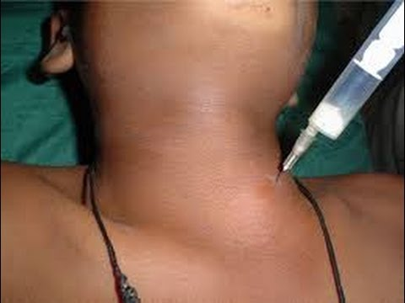
Thyroid cyst

Slide 6
Multinodular Goiter

Slide 7
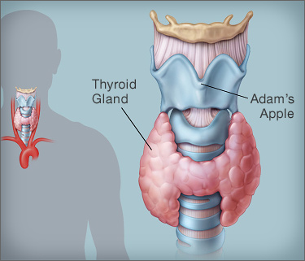
Inflammatory Thyroiditis
Commonest is Hashimoto’s Thyroiditis

Slide 8
Malignant tumors of the Thyroid

Slide 9
Characteristics
Painless enlarging nodule
Lymphadenopathy
Hoarseness of voice
Dysphagia
Function is usually normal

Slide 10
Thyroid Malignancy
85% | Papillary
10% | Follicular
< 5% | Lymphoma
 | Medullary
1% | Undifferentiated

Slide 11
Papillary Carcinoma
Commonest
Incidence is increasing
Exposure to radiation
Familial types
Painless nodule

Slide 12
Papillary Carcinoma
Young age
F : M 3:1
Spreads to lymphatics
Mets to lung & bone
Good prognosis

Slide 13
Follicular Carcinoma
Older patients than papillary
Mets by blood to lung & bone
Takes radio-nuclear iodine

Slide 14
Lymphoma
Approximately 1-5% of all thyroid malignancy
Risk increased in Hashimoto’s thyroiditis
Usually diagnosed by pathology
Treat as lymphoma any where

Slide 15
Medullary Carcinoma
From C-cells
25% heredetary
MEN 2 syndrome
Bad prognosis

Slide 16
Undifferentiated
Elderly patients
Locally invasive
Worst prognosis

Slide 17
Investigations

Slide 18
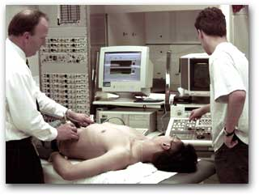
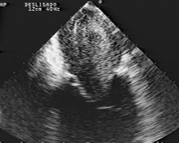

Slide 19
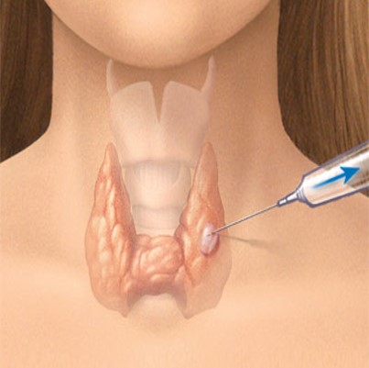
Fine Needle Aspiration (FNA)

Slide 20
FNA Bethesda System
Risk (%) | Diagnostic Category
1-4 | Non-diagnostic
0-3 | Benign
5-15 | Atypia of undetermined significance or Follicular lesion of undetermined Significance
15-30 | Follicular Neoplasms or Suspicious for a Follicular Neoplasm
60-75 | Suspicious for Malignancy
97 -99 | Malignant

Slide 22
Primary Hyperparathyroidim

Slide 23
Statistics from Western countries indicate a 0.1-0.5% prevalence rate for PHP.
No evidence for geographical variation

Slide 24
Physiology
Parathormone hormone
Vitamin D
ca

Slide 25
Clinical presentation
In the west 60 - 70% detected by routine screening.
Many are asymptomatic

Slide 26
40 y old lady
# Lt humerous
Lt Ureteric stone removed 6 y back
Rt Ureteric stone removed 3 y back
Non functioning Lt kidney
S Ca 11.2mg/dl P 2.2mg/ dl

Slide 27
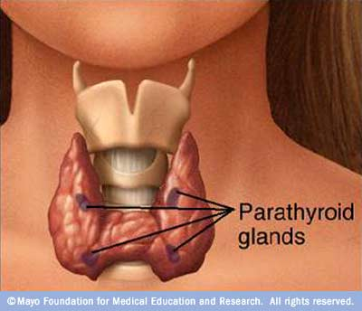

Slide 28
84% | Adenoma
15% | Hyperplasia
1% | Carcinoma

Slide 30
Clinical manifestations
Renal stones
Bone and joint pains
Abdominal groans
Psychic moans
Fatigue overtones

Slide 31
No symptoms
Mild symptoms
Renal symptoms
Bone symptoms

Slide 32
Commonest cause of Hpercalcaemia in society
Uncommon in children
2-3 times in females

Slide 33
Investigations
Serum Calcium
PTH
Serum Phosphate
Chloride

Slide 36
Management
All symptomatic patients should be treated
Asymptomatic ??
Ca Increased +++
Bone density Decreased +++

Slide 37
Recommendations
PHP is a very underdiagnosed disease in Saudi Arabia.
Patients are not diagnosed early
Complications could be serious and these are avoidable.

Slide 38
Recommendations
Specifically the diagnosis should be considered in patients with
bilateral or recurrent renal stones
patients with suggestive radiological bone changes
and naturally in patients with high serum calcium level

Slide 40
Thyroglossal Cyst

Slide 41
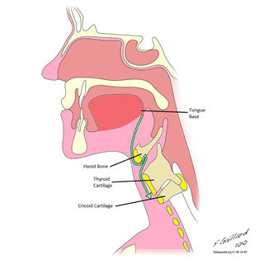

Slide 42
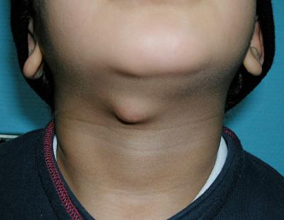

Slide 43
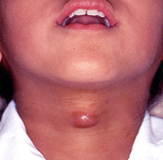

Slide 44
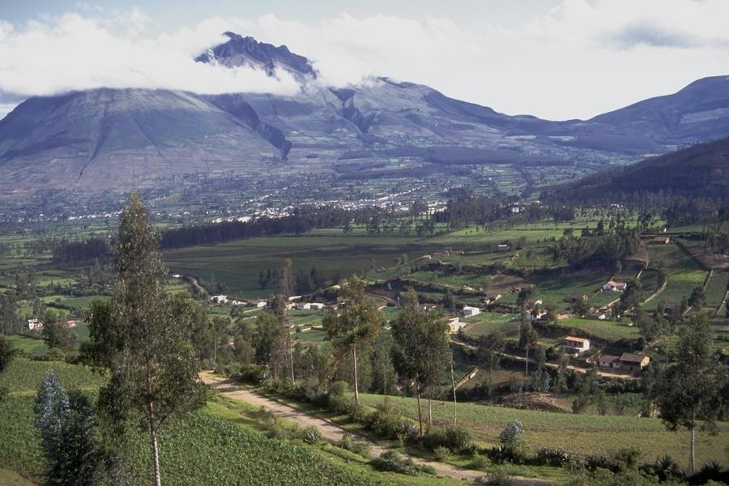
Than you
myshehri@ksu.edu.sa
@myshehri

Slide 45
Hyperthyroidism
Nervousness
Wt loss + Increased appetite
Heat intolerance
Sweating
Muscular weakness
Menstrual irregularities

Slide 46
Hyperthyroidism
Goiter
Tachycardia +/-Arrhythmias
Warm moist skin
Bruit & thrill
Eye signs

Slide 47
Laboratory
Increases T4, T3
Decreased TSH

Slide 48
Case 1
Fatima is a 30-year old Saudi lady that presented to the Outpatient clinic, complaining of a swelling in the midline of her neck that she had for 2 months.

Slide 49
Case 1
What could this be?
Is it a thyroid swelling?

Slide 50
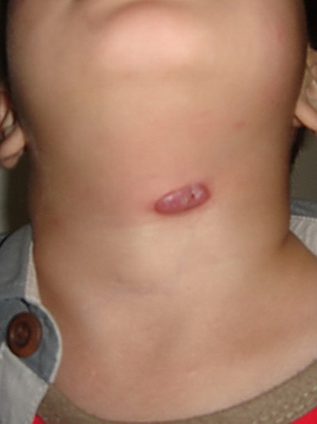
Movement with swallowing
Thyroid
Thyroglossal cyst

Slide 51
Case 1
What could this be?
Is it a thyroid swelling?
If it is a thyroid swelling, what could be the cause of this swelling?

Slide 52
Case 2
Ahmed ( age 28 years) came to the Outpatient clinic complaining of nervousness, palpitations, sweating, and weight loss. Clinical examination revealed the presence of a goitre.

Slide 53
Graves disease
Toxic multinodular goiter
Toxic follicular adenoma
Others

Slide 54
Management
Medical
Radio-nuclear iodine
Surgery

Slide 55
Agenda
Thyroid
Parathyroid
Thyroglossal cyst
Others

Slide 56
Causes of neck swellings
Midline
Goiter
Thyroglossal cyst
Submental lymph nodes
Parathyroid gland (very rare)
Lateral
Lymph nodes
Salivary glands ( stones, tumor)
Skin ( sebaceous cyst, lipoma)
Lymphatics (cystic hygroma)
Carotid body tumor
Pharynx (pharyngeal pouch, branchial cyst)

