Slide 1
Introduction to Toxicology
Dr Abdulaziz Alrabiah, MD
Department of Emergency Medicine
King Saud university Medical City
college of Medicine, KSU

Slide 2
Topics
Definition
Terminology
Classification of Toxic agents
assessment
history
Examination
investigation
Management
Disposition
Poison center No.

Slide 3
Definition
a science that deals with the adverse effects of chemicals on living organisms and assesses the probability of their occurrence

Slide 4
Terminology

Slide 5
Toxicants
substance that produce adverse biological effects of any nature
it may be chemical or physical
effects may be acute or chronic

Slide 6
Toxins
specific portions produced by living organisms (i.e. mushroom toxin or tetanus toxin)
most exhibit immediate effects

Slide 7
Poisons
Toxicants that cause immediate death or illness when experienced in very small amounts

Slide 8
Toxic Agents
anything that can produce an adverse biological effect
may be:
chemical ( i.e. Cyanide)
Physical (i.e. radiation)
Biological (i.e. snake venom)

Slide 9
Toxic substance
a material which has toxic properties

Slide 10
Systemic Toxin
toxin that affects the entire body or many organs rather than a specific site
for example: Cyanide

Slide 11
Organ toxin
toxin that affects only specific tissue or organs
example: Lead, Paracetamol

Slide 13
Why people get toxic?
intentional i.e. suicide
wrong dose (i.e. Insulin)
symptoms control (i.e. paracetamol for pain)
exposure i.e. radiation, organophosphate
bite i.e. snake bite

Slide 14
what are the routes of exposure?
inhalation (i.e. Nitrous oxide, CO)
skin or eye absorption (i.e. organophosphate)
ingestion : major one (i.e. paracetamol….etc)
injection (i.e. Opioids, insulin)

Slide 15
Assessment

Slide 16
History
may be unclear
substance
dose
rout of exposure
collateral Hx (i.e. family, friends, medical records)
Prehospital medical staff (i..e empty containers)
other (i..e hobbies, occupation, suicide note, change in behaviour recently)

Slide 17
Examination
Organ system | example of finding
General appearance | Malnurished (IV drug user, HIV infection)
CNS | Miosis (Opioids, organophsophate) Nystagmus/ataxia (ethanol)
CVS | Murmur (Endocarditis/IV drug user)
Respiratory system | Bronchorrhea/crepitations/hypoxia ( Organophosphate)

Slide 18
Examination
Organ system | Example of finding
GIT | oral cavity burns ( corrosive ingestion hyper salivation (cholinergic toxidrome
Urology | urinary retention ( anticholinergic toxicity)
Peripheral nerves | tremor (Lithium) Lead pipe rigidity (NMS) clonus/hyperreflexia (serotonin toxicity)
Dermal | bruising (anticoagulant) flush, dry skin(anticholinergic toxicity) warm, moist skin(sympathomimetic toxicity)

Slide 19
Do not forget …!
examine skin folds, clothes and bags for retained tablets or substances

Slide 21
Toxidrome
Cluster of symptoms and signs
enabling the identification of potential toxins when a clear history is unavailable

Slide 22
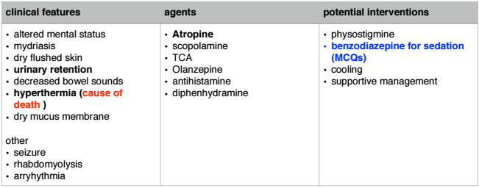
Anticholinergic = Antimuscarinic

Slide 23
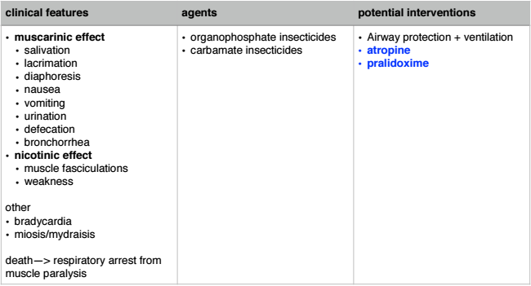
Cholinergic = Muscarinic

Slide 24
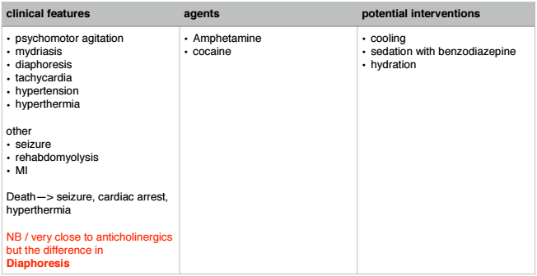
Sympathomimetics

Slide 25
Opioid

Slide 26
Sedative-hypnotic

Slide 27
Hallucinogenic

Slide 28
Other toxidromes
Toxidrome | Examination finding
Hypoglycemic(i.e.insulin) | altered mental status, diaphoresis, tachycardia, HT
Serotonin (i.e.SSRIs) | altered mental status, hyperreflexia, hypertonia(LL>UL), clonus, tachycardia
Neuromuscular Malignant(i.e.antipsychotics) | sever muscle rigidity, hyperpyrexia, altered mental status
Extrapyramidal (i.e.haloperidol) | Dystonia, torticollis, muscle rigidity
Ethanol | CNS depression, ataxia, dysartheria, smell of ethanol
Salicylate(i.e. Aspirin) | AMS, Resp Alkalosis, Metabolic Acidosis, Tinnitus, Tachypnoea, Tachycardia, diaphoresis, nausea vomiting

Slide 29
Diagnostic tests
Bedside :
Blood Glucose level : hypoglycaemia
ECG: Arrhythmias
VBG: i.e. metabolic acidosis —> paracetamol

Slide 30
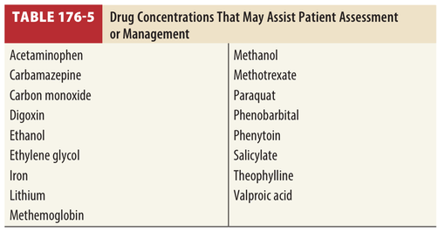
Diagnostic tests
Laboratory:
blood / urine drug level

Slide 31
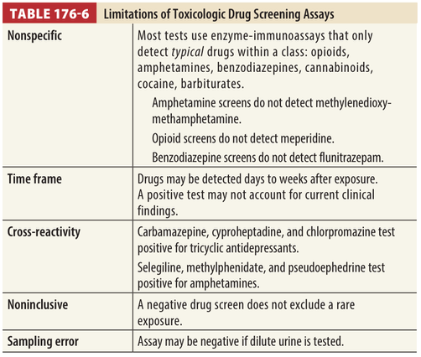
Diagnostic tests
what are the limitation of Drug screening assays?

Slide 32
Diagnostic tests
Electrolytes:
K level : i.e. hyperkalemia in digoxin overdose
LFT:
elevated liver enzymes in Paracetamol toxicity

Slide 33
Management:

Slide 34
Resuscitation
Airway:
intubation: if compromised
Breathing:
O2 administration, if hypoxic (i.e. O2sat <94%)
mechanical ventilation if intubated
Circulation :
hypotension
IV fluid ( 10-20ml /Kg ) , avoid excess fluid administration
specific antidote
inotropic support ( i.e.Adrenaline infusion)
aim : systolic BP > 90mmHg or MAP >65 mmHg

Slide 35
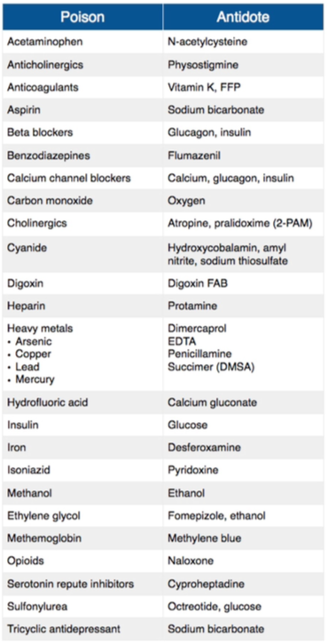
Resuscitation
Antidotes list

Slide 36
Resuscitation
some specific presentations

Slide 37
Hypoglycemia
BGL : < 4mmol
give IV dextrose (Glucose)

Slide 38
Cardiac Arrhythmias
Anti-arrythmic drugs are not first line treatment in toxin induced arrhythmias
treatment:
O2 sat
antidote (i.e. digoxin Fab in digoxin overdose)

Slide 39
Seizure
treatment
1st : IV benzodiazepine ( except in Isoniazed toxicity —> Pyridoxine)
2nd: Barbiturates
treat hypoglycaemia and hyponatremia
No rule for Phenytoin in toxin induced seizure

Slide 40
Agitation
1st line treatment : benzodiazepine
2nd line treatment : antipsychotic agents

Slide 41
Hyperthermia and hypothermia
core temperature > 39* —> aggressive cooling
core temperature <32* —> aggressive rewarming

Slide 43
Decontamination
two ways
GIT Decontamination
Enhanced Elimination

Slide 44
GIT decontamination
Activated Charcoal
whole bowel irrigation (WBI)
Gastric lavage
Induced emesis ( Syrup or Ipecac)

Slide 45
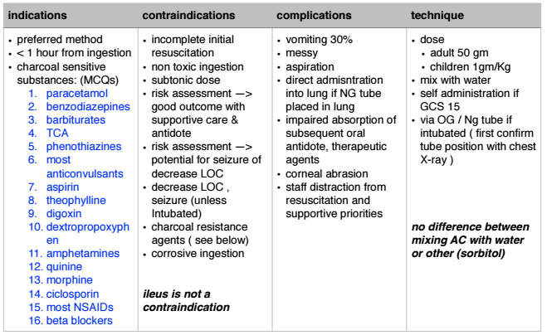
Activated Charcoal (single dose)

Slide 46
Activated Charcoal (single dose)

Slide 47
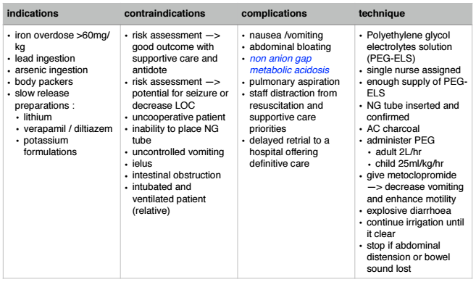
whole bowel irrigation

Slide 48
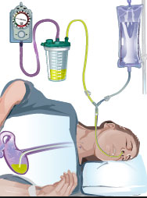
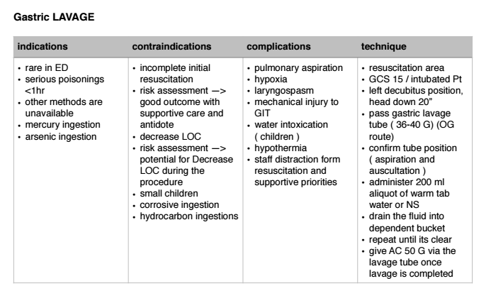
Gastric Lavage

Slide 49
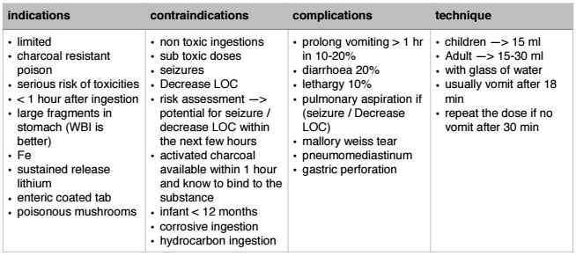
Induced emesis (Syrup or Ipecac)

Slide 50
Enhanced Elimination
Multiple dose activated charcoal
urine alkalisation
extracorporeal technique of elimination
harm-dialysis and haemofiltration
charcoal haemoperfusion

Slide 51
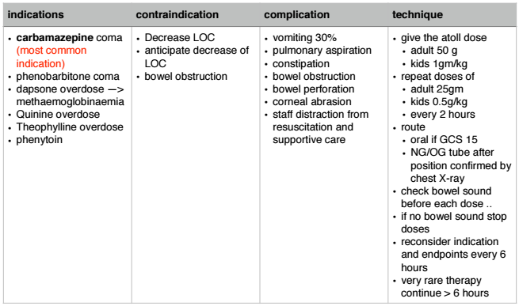
Multiple doses of AC

Slide 52
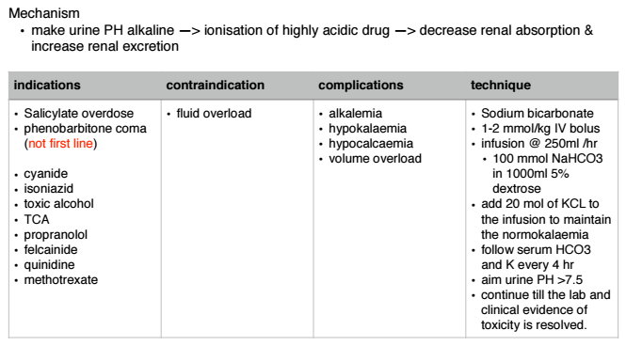
Urinary Alkalinisation

Slide 53
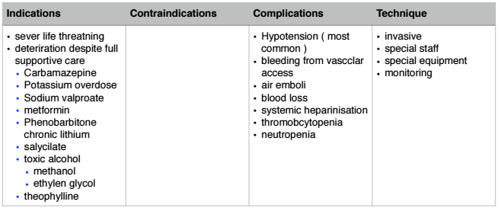
Extracorporeal technique of elimination

Slide 54
Disposition
if asymptomatic for 6 hours in ED —> discharge
otherwise admission to hospital is required

Slide 55
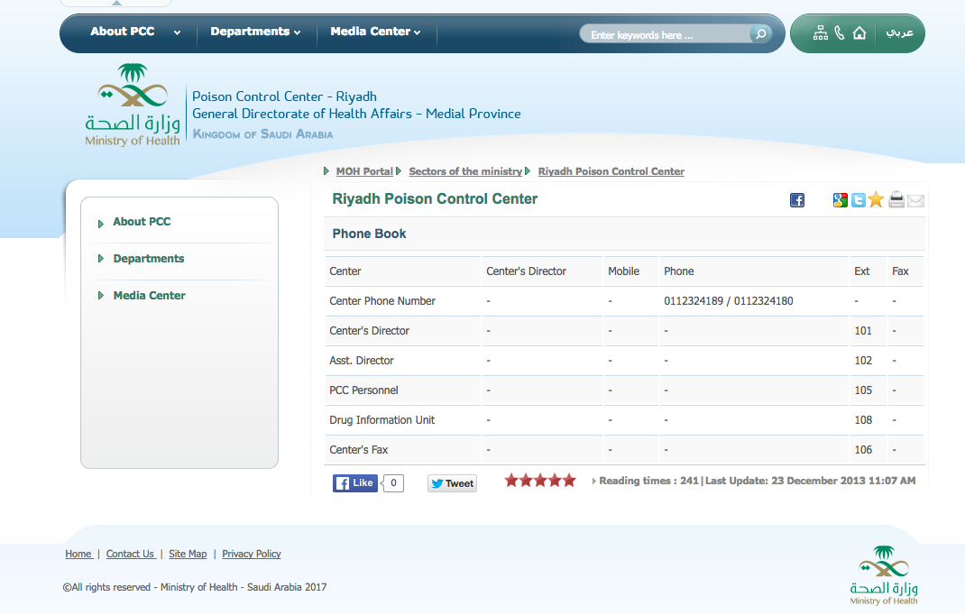

Slide 56
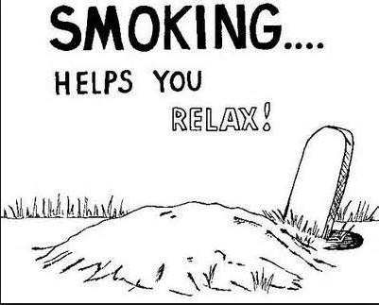
Thank You
All the best !
aalrabiah@ksu.edu.sa

