Slide 1
ATHEROSCLEROSIS PAD,CAROTID STENOSIS, ACUTE LIMB ISCHEMIA
Dr.Elham Khoujah
Consultant vascular/Endovascular surgeon.
Notes by: Khuloud Alenzy
(underlined or in boxes)

Slide 2
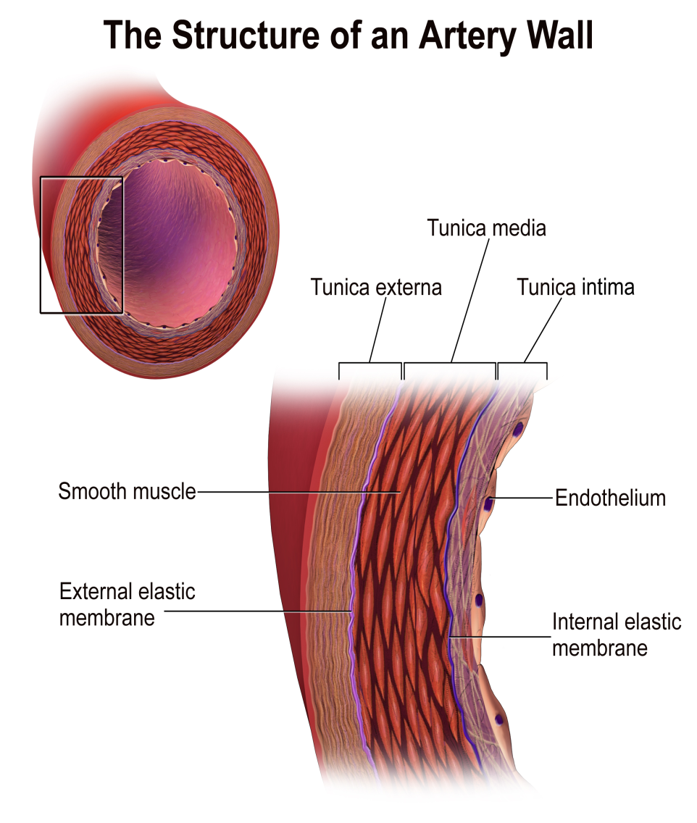
HISTO/ANATOMY

Slide 3
ATHEROSCLEROSIS PATHOPHYSIOLOGY
Definition..
A process of progressive thickening and hardening of the walls of medium-sized and large arteries as a result of fat deposits on their inner lining.

Slide 4
HEAMODYNAMIC FACTS
The endothelial cells that line blood vessels provide an active, dynamic interface between the blood stream and the arterial wall.
provide a semi-permeable barrier that regulates the exchange of fluid, nutrients, gases, and waste between the blood and tissues.
provide unique surface that generally allows the cellular elements of blood to flow with adhering to the vessel lining .

Slide 5
ATHEROSCLEROSIS PATHOPHYSIOLOGY cont.
HEAMODYNAMIC FACTS
Endothelial cells also regulate constriction and relaxation of vessels by releasing vasodilatory molecules (e.g., nitric oxide (NO) and prostacyclin (PGI₂) and vasoconstrictive molecules (endothelin and angiotensin-II).
When injury occurs, endothelial cells secrete cytokines that trigger and maintain an inflammatory response.

Slide 6
ATHEROSCLEROSIS PATHOPHYSIOLOGY cont.
RISK FACTORS OF ENDOTHELIAL INJURIES..
Physical injury or stress as a result of direct trauma or hypertension.
Turbulent blood flow, for example, where arteries branch.
Circulation of reactive oxygen species (free radicals), e.g., from smoking or air pollutants.
Hyperlipidemia (high blood concentrations of LDL or VLDL).
Chronically elevated blood glucose levels.
Homocysteinemia, (familial tendency) which results from an inherited metabolic defect that leads to very high levels of the homocysteine, a metabolite of methionine; high concentrations are toxic to the endothelium.

Slide 7
ATHEROSCLEROSIS PATHOPHYSIOLOGY cont. Atherosclerosis is a disease process which is triggered by sometimes subtle physical or chemical insults to the endothelial cell layer of arteries.

Slide 8
(1) TOXIC INSULT
(modified LPL,heamodynamic insults,
infecious agents,oxidative stress)
(3) INFLAMATORY RESPONS
(adhesion to endothelium,migration to subendothelium,
release of cytokines,platlet activation)
(2) ENDOTHELIAL DYSFUNCTION
(increase adherence,permeability,hypercoagulability, (8) THROMBUS FORMATION
expression of adhesion molecules,release of chemokines) (rupture of fibrous cap or ulceration of plaque,
continuing influx&activation of macrophages)
(5)
(4) FOAM CELL FORMATION (6) INTERMEDIATE LESION (7) FIBROUS PLAQUE
(engulfing of LDL by macrophages) (layers of macrophages & (progression of intermediate lesion with
FATTY STREAKS smooth muscle cells) fibrous cap formation,mixture of inflamatory
(aggregation of lipid-rich macrophages & smooth muscle cells,intra. & extracellular
& T-lymphocytes) lipid,increase matrix proteins & necrotic
cellular debris)

Slide 9
PERIPHERAL ARTERIAL DISEASE It is the sequence of atherosclerosis of peripheral vessels excluding the carotids and coronaries..
PRESENTATION
acute chronic
embolic thrombotic traumatic claudication critical limb ischemia
you have to admit and treat acutely!
Rest pain for 2 consecutive weeks not relieved by SIMPLE analgesics
Loss of tissue can be found in most cases.
You have time to admit the patient to hospital, investigate and then treat.
المريض مايقدر ينام احيانا من الالم, ويصير ينزل رجله المصابة من السرير عشان الجاذبية تنزل الدم للرجل فيخف الالم وينام.
Muscle pain only when walking across a certain distance e.g.150m this pain relieves completely at rest
You can treat as an outpatient

Slide 10
PERIPHERAL ARTERIAL DISEASE
Risk Factors..
Hypertension.
Diabetes.
Hyperlipidemia.
Smoking.
Familial tendency.
Obesity.
Gender.

Slide 11
PERIPHERAL ARTERIAL DISEASE
HISTORY..
Pain..
- location..
- precipating & aggrevating factors..
- frequency & duration..
Rule out other causes of pain of lower limb..
Patients with co-morbid conditions and can not walk, present late with rest pain or gangrene..
Drug/medical history..
Surgical history..
Family history: first degree relative with abdominal aortic aneurysm..

Slide 12
PERIPHERAL ARTERIAL DISEASE

Slide 13
PERIPHERAL ARTERIAL DISEASE
Relationships between pain location and site of occlusion
Buttock & hip----Aortoiliac disease..
*lerich syndrome triad ( claudication, absent femoral pulses,
and erectile dysfunction)
Thigh---Aortoiliac or common femoral artery..
Upper tow-thirds of the calf---Superficial femoral artery..
Lower one-third of the calf---Popliteal artery..
Foot claudication---Tibial arteries..

Slide 14
PERIPHERAL ARTERIAL DISEASE
HISTORY..
Vascular review of symptoms..
- TIA (neurological manifestations that last less than 24 hrs with complete recovery)atherosclerosis everywhere(peripheral)➔carotid➔TIA.(vessels spasm or thromboembolus and then reopened, or good collateral…..neurological manifistation of stroke lasts more than 24 hrs, mostly the symptoms will not recover completely)
Almost always when there is atherosclerosis in periphery there will be in the carotid..
- Difficulty in speech or swallowing..
- Dizziness / drop attacks..
- Blurred vision (transient loss of vision known as (amurosis fugax) )..
- Arm fatigue..
- Pain in abdomen after eating (intestinal angina➔increased intestinal blood demand after eating then there is already atherosclerosis, so no supply➔ pain)..
- Renal insufficiency (poorly controlled DM+/- HTN)
- Impotence (aortoiliac gives the gonadal arteries,so whenever atherscloritic it will decrese blood to the penis so impotence occurs)..
- Claudication/rest pain/tissue loss..

Slide 15
PERIPHERAL ARTERIAL DISEASE
PHYSICAL EXAMINATION..
Inspection:
- Change in color..
- Signs of ischemia..
- Burger's test (pale sole)..
- Capillary filling (1-2 secs then blood will return)..
- Venous refilling (venous guttering)..
- Pregangrenous
/gangrenous part
examination..
Dry scaly skin (atrophic changes, even the sebaceous gland atrophied)

Slide 16
PERIPHERAL ARTERIAL DISEASE

Slide 17
PERIPHERAL ARTERIAL DISEASE (acute)
Very important

Slide 18
PERIPHERAL ARTERIAL DISEASE
PHYSICAL EXAMINATION..
Palpation:
- Skin temperature..
- Venous refilling..
- Peripheral pulses..
- Joint movements /muscle strength..
- Sensation..
Thrill (turbulent blood flow, felt)
Auscultation:
- Bruits (turbulent blood flow, heard) ..

Slide 19
PERIPHERAL ARTERIAL DISEASE

Slide 20
PERIPHERAL ARTERIAL DISEASE
ulcers
Neuro-you can feel the pulse (areas of pressure ]sole of the foot[)
Iscehmic (mostly in the toes,could be anywhere else also)

Slide 21
PERIPHERAL ARTERIAL DISEASE

Slide 22
CAROTID ARTERY DISEASE

Slide 23
CAROTID ARTERY DISEASE
Risk factors..
History..
Symptoms & signs..

