Slide 1
“SURGERY 3rd LECTURE”
Dr.Elham Khoujah NOTES
27/SEPTEMBER DONE BY: Sarah Almubrik
Atherosclerosis: is a progressive process – through out the life
Inflammatory response is the 1st step of atherosclerosis
Hypertension? The blood velocity will injure the wall of the medium to large vessels and start the inflammatory process of atherosclerosis
Peripheral arteries: all blood vessels except carotid and coronary
Claudication: muscle pain (because of the increasing of the O2 demand and that will increase the free radicals) due to exercise (for same distant) and relieved by rest – browse > It is caused by an inadequate blood flow to the muscles. The pain stops the patient using the muscle and, if the affected muscle is in the leg, causes them to limp and then stop walking. Differential diagnosis (osteoarthritis )
CLI or critical limb ischemia: rest pain not relief by analgesia by 2 weeks – hanging the limb out help in relieving the pain temporarily.

Slide 2
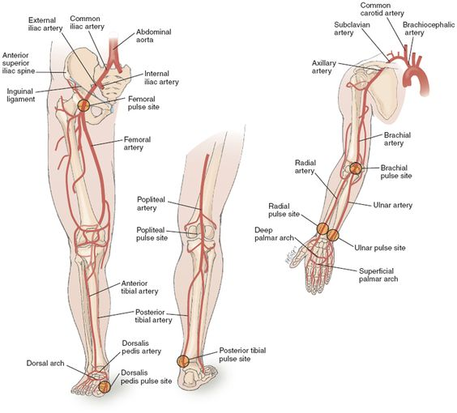
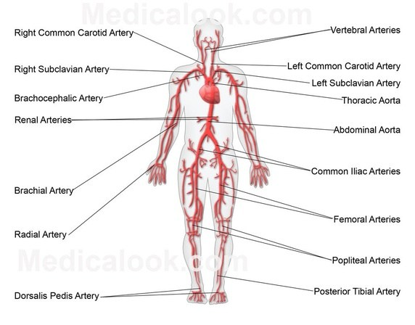
Location of pain is important! Think about the nearest/major arteries.
*The popliteal pulse is difficult to feel because it does not cross a prominent bone and is not superficial
TIA or transit ischemic attack: could be carotid or extra carotid
And it’s a neurologic dysfunction due to ischemia (not like stroke it take less than 24 hours + without infarction – tissue death) but has the same underlying cause as strokes.
Intestinal angina: mechanism is similar to that of the angina pectoris that occurs in individuals with coronary artery disease or the intermittent claudication that accompanies peripheral vascular disease >>>> ^free radicals
*in the physical examination we don’t have ((percussion))*

Slide 3
Buergers test : used in an assessment of arterial sufficiency. The vascular angle, which is also called Buerger's angle, is the angle to which the leg has to be raised before it becomes pale. browse - In normal person toes and sole of the foot stay pink even when the angel is 90 degrees. In ischemic leg elevation to 15 or 30 for 30-60 sec cause pallor. Less than 20 indicates (sever ischemia)
PAD 6 P:
PAIN
PARESTHESIA
PALLOR
PULSELESSNESS
POIKILOTHERMIA
PARALYSIS
Turbulence blood flow: feel > thrill
hear > bruits
Ischemic ulcer not necessary happed in pressure areas
In carotid artery history you most ask about signs of PAD

Slide 4
 | Acute arterial insufficiency | Chronic arterial insufficiency
Symptoms + signs | Pain Paraesthesia and numbness Paralysis Pallor Pulseless Perishing cold | intermittent claudication intermittent claudication Pre-gangrene and gangrene ischemic ulceration
Causes | Causes of acute arterial ischemia An arterial embolus Thrombosis on an athermanous plaque Thrombosis of an aneurysm (usually popliteal) Arterial dissection (usually aortic) Traumatic disruption External compression, e.g. a cervical rib or popliteal entrapment | -

