Slide 1
Cardiac history and exam

Slide 2
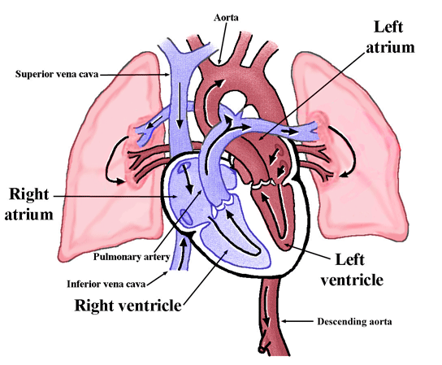

Slide 3
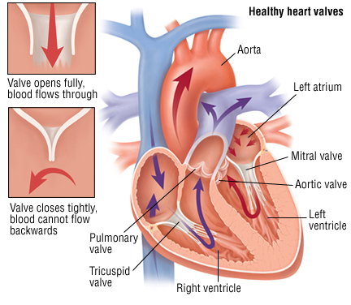

Slide 4
History: chest pain (usually indicated ischemia/myocardial infarction)
Location: usually in the front of the chest (retrosternal) but can also be in the upper abdomen, neck, jaw, left arm or left shoulder.
Radiation: may spread to the neck, jaw, back and left or right arm.
Nature: chest pain due to cardiac ischaemia is typically tight and crushing in quality:

Slide 5
History: Breathlessness; seen with pulmonary oedema, acute myocardial infarction, cardiac arrhythmia, pericarditis and pericardial effusion.
Dyspnoea on exertion indicates chronic heart failure.
Orthopnoea: the patient has to sleep on 2-3 pillows.
breathlessness at rest accompanied by wheezing, sweating, distress and cough with frothy or bloodstained sputum. This is commonly termed 'cardiac asthma’ and indicated acute pulmonary edema

Slide 6
History: Cheyne-Stokes respiration
is an abnormal pattern of breathing characterized by progressively deeper and sometimes faster breathing, followed by a gradual decrease that results in a temporary stop in breathing called an apnea. The pattern repeats, with each cycle usually taking 30 seconds to 2 minutes.
Reported in patients with heart failure or stroke

Slide 7
History: Palpitations
Palpitations do not necessarily indicate any underlying cardiac pathology but may be presentation of a cardiac arrhythmia.
Description may be bumping, or throbbing
Rhythm: ask the patient to tap out the rate and regularity; a missed beat or an extra large bump suggests extrasystoles.
Duration: sudden short episodes suggest paroxysmal tachycardia; longer duration with irregularities suggests atrial dysrhythmia.
Associated symptoms: pain, dyspnoea, feeling faint or syncope.

Slide 8
History: Syncope of cardiac origin
Syncope of cardiac origin may closely resemble benign vasovagal attacks and is usually caused by
1) aortic stenosis or regurgitation or
2) excessively fast or slow ventricular rate (heart block, atrial dysrhythmia, paroxysmal tachycardia).

Slide 9
History: Stroke of a cardiac origin in patients with negative cardiac history-very rare but important
Stroke of a cardiac myxoma origin: Young adults, female predominance, single cerebral vessel (mostly the middle cerebral artery), and solitary left atrial myxoma (the cause of left atrial emboli) constituted the outstanding characteristics of this patient setting. The most common affected cerebral vessel (the middle cerebral artery) and areas (the basal ganglion, cerebellum and parietal and temporal regions) corresponded well to the common manifestations of this patient setting, such as conscious alteration, ataxia, hemiparesis and hemiplegia, aphasia and dysarthria.

Slide 10
History: Stroke of a cardiac origin in known cardiac patients
20 per cent of stokes are related to an embolism of cardiac origin and are accessible to an effective prevention thanks to a quick diagnosis of the heart defect.
Atrial flutter on valve disease, mechanical valve prosthesis, ischemic heart disease, dilated cardiomyopathy.

Slide 11
History: congenital heart disease and pediatric cases
The baby is blue: Main presentation of cyanotic congenital heart disease
In non cyanotic congenital heart disease and post rheumatic fever: May present with failure to thrive in children (although fluid retention caused by heart failure will cause an increase in body weight).
Rheumatic fever: The disease typically develops two to four weeks after a streptococcal throat infection. Signs and symptoms include fever, multiple painful joints, involuntary muscle movements known as Sydenham's chorea (St. Vitus' dance), and occasionally a characteristic non-itchy rash known as erythema marginatum. Damage to the heart valves, known as rheumatic heart disease, usually occurs after repeated attacks but can sometimes occur after one. The damaged valves may result in heart failure, atrial fibrillation and infection of the valves.

Slide 12
Other points in the history
Lower limbs: swelling of feet (in heart failure), ischaemia, intermittent claudication.
Gastrointestinal symptoms: chronic heart failure may cause abdominal discomfort due to liver enlargement and abdominal distension.
Urinary symptoms: oliguria can be an important symptom of heart failure.
CNS symptoms:Dizziness, headache, and mental changes are not uncommon symptoms of severe hypertension, and cardiac failure.

Slide 13
Past history
Drug history
Past surgical/medical history: Past medical history: Enquire about diabetes, any raised blood pressure, heart problems, fainting fits, dizziness or collapses., history of angina and any cardiac procedures or operations, Previous levels of lipids if ever checked, any history of rheumatic fever or heart problems as a child.
Family history: hypertension, coronary heart disease, stroke, diabetes, hyperlipidaemia, congenital heart disease and any early deaths in the family.
Social history: Lifestyle/exercise; Smoking; Obesity, Diet: healthy or unhealthy, Occupation and Stress levels

Slide 14
Examination: General
Build (obesity or wasting); shortness of breath; difficulty in talking; note whether they look ill.
Look for pallor, jaundice, sweatiness and clamminess, and for xanthelasma around the eyes.
Look for any evidence of syndromes or non-cardiovascular conditions associated with cardiovascular abnormalities - eg, Down's syndrome, Marfan's syndrome, Turner syndrome

Slide 15
Cyanosis
This is seen below the fingernails and toenails but also in the lips, cheeks, ears and nose.
It may increase in the cold and on exertion.
In patients with dark skin, cyanosis is best seen on the inner lining of the eyelids or the inner surface of the lips.

Slide 16
Face signs
Malar flush - redness around the cheeks (mitral stenosis).
Xanthomata - yellowish deposits of lipid around the eyes, palms, or tendons (hyperlipidaemia).
Corneal arcus - a ring around the cornea (normal ageing or hyperlipidaemia).
Proptosis - forward projection or displacement of the eyeball (Graves' disease).

Slide 17
Hand signs
Finger clubbing.
Splinter haemorrhages (infective endocarditis).
Janeway lesions - macules on the back of the hands (infective endocarditis).
Osler's nodes - tender nodules in the fingertips (infective endocarditis).
Sweaty palms, tremor (thyrotoxicosis).
Lax joints (Marfan's syndrome).
Visible capillary pulsations in the nail bed (Quincke's sign - often seen in aortic regurgitation)

Slide 18
Pulse
Rate: average 72/minute in adults, faster in children and may slow in old age. Also slower in athletes. Compare with apex rate.
Rhythm:
Respiratory variations are common in healthy individuals (if there is noticeable quickening in inspiration and slowing in expiration, this is termed sinus arrhythmia).
The most common irregularities are atrial arrhythmias and extrasystoles (which may disappear on exertion).

Slide 19
Pulse
Character:Thready, strong, bounding, collapsing ('water hammer' and its 2-stroke, dicrotic/hyperdicrotic variant) or slow-rising (plateau) or anacrotic (variant of slow-rising, with an extra wave on the upstroke).
A pulse that weakens in inspiration is called 'pulsus paradoxus' (as opposed to the normal increase in volume) and is found in constrictive pericarditis, pericardial effusion, restrictive cardiomyopathy and severe asthma.
'Pulsus alternans' (an alternate variation in size of pulse wave) is an important sign of left ventricular failure but may be normal in the presence of a fast ventricular rate.
'Pulsus bigeminus': groups of two heartbeats close together followed by a longer pause. The second pulse is weaker than the first. Pulsus bigeminus is caused by premature ventricular contractions after every other beat. It can be a sign of heart disease, particularly hypertrophic obstructive cardiomyopathy, or may be an innocent and temporary phenomenon.

Slide 20
Pulse
Inequality of pulses of Radial pulses: congenital abnormality, aortic arch aneurysm, a few cases of coarctation of the aorta, supravalvular aortic stenosis (rare), Takayasu's disease and occlusion of the subclavian artery by external pressure.
Femoral pulses (radial femoral delay in coarctation) and foot and ankle pulses (atherosclerosis/ischemic limbs).
Listen over the renal and femoral artery for murmurs.

Slide 21
Blood pressure
This should be measured in the brachial artery, using a cuff around the upper arm.
A large cuff must be used in obese people, because a small cuff will result in the blood pressure being overestimated.
Systolic pressure is at the level when first heard (Korotkoff I) and the diastolic pressure is when silence begins (Korotkoff V).
In patients with chest pain, or if ever the radial pulses appear asymmetrical, the pressure should be measured in both arms because a difference between the two may indicate aortic dissection

Slide 22
Chest examination
Check the level of the jugular venous pressure.
Chest examination:
Look to see if the chest wall is deformed (eg, funnel chest) and moves equally (inequality of expansion is usually due to respiratory disease).
Note the respiratory rate; it is related to the pulse rate in the ratio of about 1:4 and remains constant in the same individual.
Ask the patient to breathe out and, using both hands resting lightly on the side walls of the chest with thumbs meeting in the middle, ask them to breathe in to assess the expansion of the chest on full inspiration by noting how far the examiner's thumbs move apart.
Observe and palpate the trachea to detect any deviation to the left or right (noting any thyroid swelling); otherwise, a false impression may be given of cardiac enlargement if the apex beat is displaced towards the axilla.
Palpate and percuss to find any areas of dullness (fluid or lung collapse); palpate with the flat hand over the 5th intercostal space to feel the maximum impulse (apex of the heart) and note its position; the apex is better defined by the light use of two fingers (noting the rib space and its position relative to an imaginary line dropped from the middle of the clavicle).
Feel over the anterior chest wall for any thrills associated with cardiac murmurs.

Slide 23
Auscultation

Slide 24
Heart sounds: grading of intensity
The intensity of heart sounds and murmurs is graded as follows on Levine's scale:
I - lowest intensity: difficult to hear even by experts.
II - low intensity: however, usually audible to all listeners.
III - medium intensity: easy to hear even by inexperienced listeners, but without a palpable thrill.
IV - medium intensity: with a palpable thrill.
V - loud intensity: with a palpable thrill. Audible even with the stethoscope placed on the chest, with the edge of the diaphragm.
VI - loudest intensity: with a palpable thrill. Audible even with the stethoscope raised above the chest.

Slide 25
Normal heart sounds:
They are called S1 and S2 and are traditionally described as 'lub' and 'dub' respectively. The first sound (S1) is caused by closure of the mitral and tricuspid valves and the two sounds tend to merge as one. When considered separately, the closure of the mitral and tricuspid valves is called M1 and T1 respectively. The second sound (S2) is caused by closure of the aortic and pulmonary valves. They are slightly apart with the aortic component, also called A2, slightly after the pulmonary closure called P2.
The first sound may be split if there is pacing that triggers the right ventricle before the left or if mitral valve closure is delayed by high left atrial pressure or atrial myxoma.
The sounds may be softer than normal where there is severe mitral regurgitation, immobility from calcification, severe aortic regurgitation or left bundle branch block.
Prolapsed mitral valve or significant mitral stenosis may cause a loud M1.
Normally A2 and P2 are so close that they are heard as a single sound, although they may split slightly on deep inspiration as P2 is delayed. Some people have significant splitting on lying down but it disappears on sitting up. This is a normal variation.
Beat to beat variation in the intensity of S2 occurs with complete or incomplete heart block if there is A-V dissociation.
P2 is delayed and will accentuate splitting in pulmonary hypertension, pulmonary stenosis and right bundle branch block.
Ectopic beats and pacing will delay A2 and cause 'reverse splitting' of the sound.

Slide 26
Additional sounds
A 3rd sound occurs in heart failure and produces a cadence like a galloping horse. Hence the term 'gallop rhythm'. An innocent 3rd sound can occur in children and young adults but never over 30 years old.
A 4th sound occurs just before the 1st and is an abnormal sound of the A-V valves opening as the atria contract. Therefore it cannot occur in atrial fibrillation. It occurs with ventricular hypertrophy, coronary heart disease, dilated cardiomyopathy, hyperdynamic circulation, arrhythmia and heart block.
An atrial myxoma can 'plop' during atrial systole and cause a late diastolic sound.

Slide 27
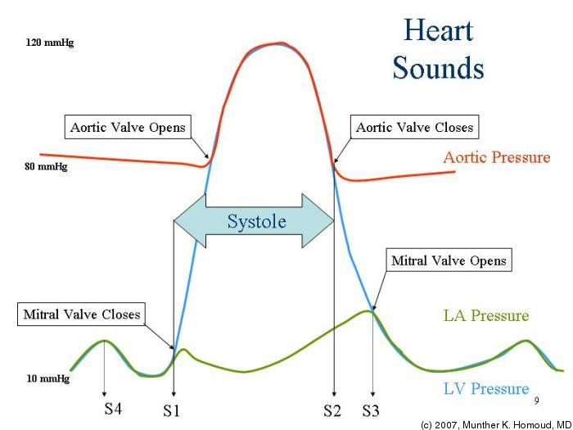
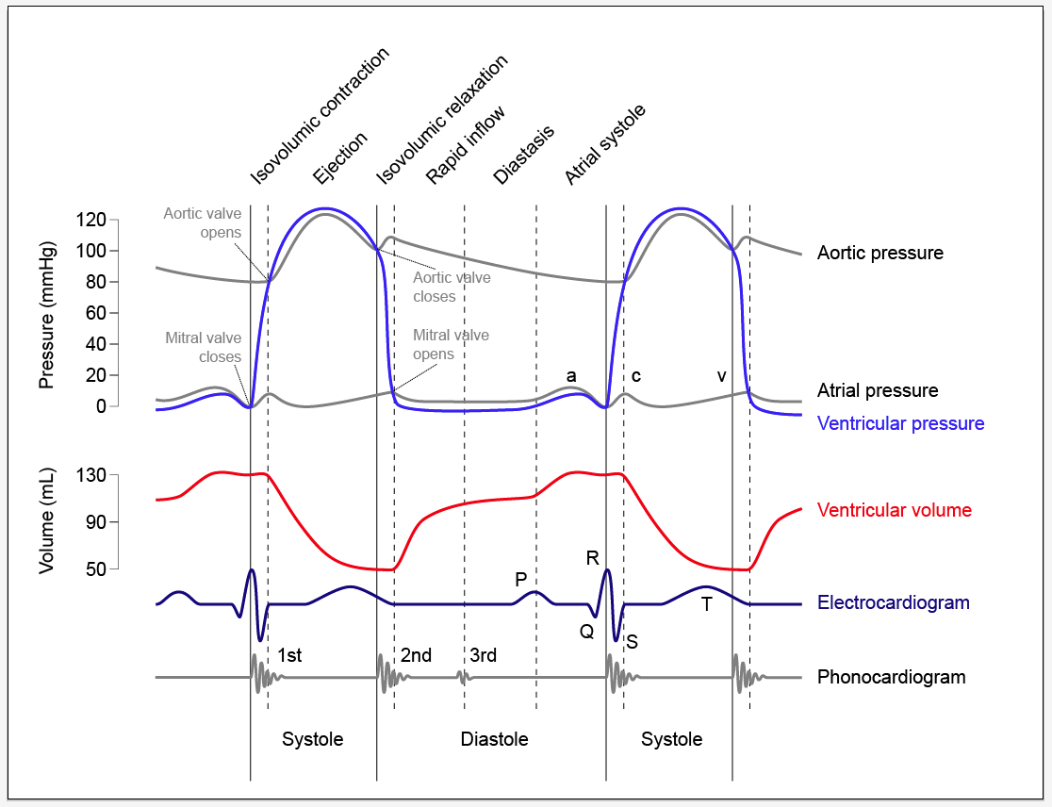

Slide 28
Murmurs
Note the timing of murmurs. Establish whether systolic or diastolic. First listen to the lub dub and then get the timing. Some murmurs may obscure the heard sounds. Systolic murmurs can be innocent but are rarely so unless the patient is a child or pregnant.[2] Diastolic murmurs are always pathological.

Slide 29
Mitral murmurs
Mitral murmurs are best heard at the apex and radiate to the axilla.
Mitral sounds can be accentuated with the patient in the left lateral position.
Hence, to listen to a mitral murmur, first listen to the apex, then listen round to the mid-axillary line at the same level. Return the bell to the apex and, keeping it there, ask the patient to lie on the left side.
Mitral regurgitation produces a pansystolic murmur of roughly even intensity throughout systole. Mitral valve prolapse produces a mid-systolic click. When the valve is weakened it may prolapse, or balloon back, into the atrium as blood is pumped by the ventricle into the aorta. Many people live with this condition without symptoms. But when a prolapsing valve allows blood to leak back into the atrium, this is called regurgitation.
Mitral stenosis produces a A mid-diastolic rumbling murmur with presystolic accentuation (As soon as the murmur finishes, the first sound is heard).
Austin Flint's murmur may occur in aortic regurgitation. This is a soft, rumbling, low-pitched, late diastolic murmur which is heard best at the apex

Slide 30
Tricuspid murmurs
Tricuspid murmurs are uncommon. The timing is as for mitral murmurs but they are best heard at the lower right sternal edge.
Tricuspid Regurgitation: pansystolic murmur
Tricuspid stenosis: Diastolic murmur
Tricuspid stenosis is very rare. Regurgitation may occur in right ventricular hypertrophy and dilated cardiomyopathy.
Tricuspid regurgitation will not radiate to the axilla.

Slide 31
Pulmonary and aortic murmurs
The pulmonary and aortic valves are both best heard in the 2nd intercostal space, to the left and right respectively. This can make differentiation quite difficult. Sound from the aortic valve is often transmitted to the carotid artery
Pulmonary stenosis will produce a flow murmur that gets louder then softer (crescendo-decrescendo) during systole. Pulmonary ejection sounds, unlike aortic ones, tend to diminish or disappear in inspiration.
A similar sound occurs with aortic stenosis but it is transmitted to the carotids.
Aortic sclerosis occurs in the elderly and produces a murmur similar to aortic stenosis but it is poorly transmitted or not transmitted to the carotids. It is transmitted to the apex and the mid-axillary line.
In aortic stenosis, A2 is soft. In aortic sclerosis, A2 is normal or loud. Systolic murmurs in the elderly are quite common. They indicate cardiac disease and are associated with increased cardiac mortality.
Pulmonary regurgitation or aortic regurgitation produces an early diastolic murmur, as this is when the arterial pressure is at its height. An aortic murmur of regurgitation is best heard using the diaphragm of the stethoscope with the patient sitting forward in full expiration. Ask the patient to sit forward, and put the stethoscope in place. Say, 'Take a big breath in - breathe right out - and hold it'. This will give a few seconds to listen for the murmur. Few people can hold their breath in full expiration for more than a few seconds, especially if unfit.

Slide 32
Other murmurs
Atrial septal defect :pulmonary flow murmur.
Ventricular septal defect produces a harsh systolic murmur, heard best along the left sternal edge. Other murmurs
Dilatation of the root of the pulmonary artery or aorta will cause a flow murmur. Aortic aneurysm due to syphilis or Marfan's syndrome are examples. These sounds are not transmitted well to the carotids, nor are they well heard at the apex.
A patent ductus arteriosus causes a late systolic murmur into diastole. It is best heard across the back. There may also be a continuous machinery murmur or a to and fro murmur in both systole and diastole, but louder in systole. It often obliterates the second heart sound.
Pericarditis causes a sound like boots tramping through snow and is best heard at the left sternal edge.
Prosthetic valves, such as the Starr-Edwards or modern variations, produce a very loud sound that can often be heard across a quiet room, without a stethoscope.

Slide 33
Examination of other areas
Palpate the abdomen for hepatomegaly and splenomegaly (congestive cardiac failure), or spleen alone (infective endocarditis).
Feel for enlargement of the aorta (aneurysm); feel with the hands flat either side of the aorta - feel for pulsation and tenderness.
Peripheral oedema: Assess ankle swelling by pressing the thumb firmly (not hard) above the medial malleolus and see if it leaves an impression.
In a bed-bound patient the swelling is likely to be in the sacral area, genitalia and back of the thighs, rather than the ankles.

Slide 34
Fundoscopy
Keith Wagener Barker (KWB) Grades
Grade 1: Vascular Attenuation
Grade 2: As grade 1 + Irregularly located, tight constrictions - Known as "AV nicking" or "AV nipping" - Salus's sign
Grade 3: As grade 2 + Retinal edema, cotton wool spots and flame-hemorrhages "Copper Wiring" + Bonnet's Sign + Gunn's Sign
Grade 4: As grade 3 + optic disc edema + macular star "Silver Wiring"

Slide 35
