Slide 1
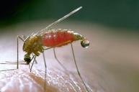
Malaria
Dr. Afnan YOunis

Slide 2
Objectives:
Epidemiology of malaria
Clinical picture
Mode of transmission
Risk factors
Prevention and control

Slide 3
Malaria is a life-threatening disease caused by Plasmodium parasites that are transmitted to people through the bites of infected mosquitoes.
Malaria is responsible for approximately 1-3 million deaths per year
Notes:
3.2 billion people live in areas at risk of malaria transmission in 106 countries and territories.
The World Health Organization estimates that in 2015 malaria caused 212 million clinical episodes, and 429,000 deaths.

Slide 4
Epidemiology
Between 2000 and 2015, malaria incidence fell by 37% globally.
During the same period, malaria mortality rates decreased worldwide by 60% among all age groups, and by 65% among children under 5.
An estimated 6.2 million malaria deaths have been averted globally since 2000.
In 2014, 13 countries reported zero cases of the disease and 6 countries reported fewer than 10 cases.

Slide 6
An approximation of the parts of the world where malaria transmission occurs.

Slide 7
Malaria in Saudi Arabia
Areas at the southern region are at risk of malaria transmission, specifically Asir and Jizan. The Dominant Malaria Species in Saudi Arabia is P. Falciparum .
Saudi Arabia achieved a decrease in malaria cases and case incidence rates of ≥75%.

Slide 8
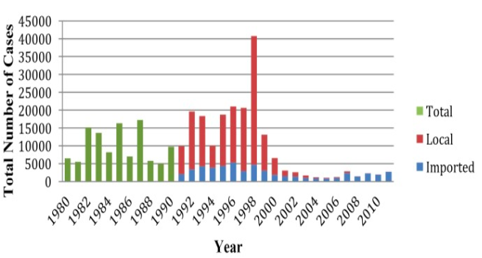
Indigenous cases of malaria Saudi Arabia 2014 :

Slide 9
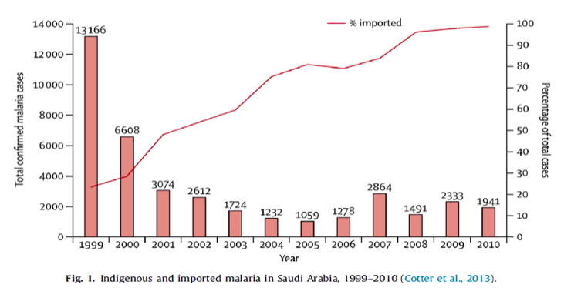
Imported malaria in Saudi Arabia 1999-2010 :

Slide 10
Malaria in Saudi Arabia
Malaria outbreak in 1998.
Since then, only a few cases were reported
In 2012 , only 82 cases of malaria were reported..
The proportion of imported malaria has increased from 23% to 99% of total detected cases.
Notes:
In Saudi Arabia there are considerable reduction in disease morbidity and parasite rate were achieved in the past two decades.

Slide 11
Imported malaria: via asymptomatic travelers from malaria endemic areas, sustains a threat for possible resurgence of local transmission:
Workers, immigrants, pilgrims.

Slide 12
Analytical Epidemiology Triad:
HOST
AGENT
ENVIRONMENT

Slide 13
Plasmodium Parasites:
The parasites are spread to people through the bites of infected female Anopheles mosquitoes (vector).
Five parasite species that cause malaria in humans
P. falciparum and P. vivax pose the greatest threat.
Other modes of transmission:
From mother to unborn child
Blood transfusion
Notes:
P. falciparum is the most prevalent malaria parasite on the African continent. It is responsible for most malaria-related deaths globally.
P. vivax is the dominant malaria parasite in most countries outside of sub-Saharan Africa.

Slide 14
Plasmodium Parasites transmission and lifecycle:
Notes:
When an Anopheles mosquito bites an infected person, a small amount of blood infected with microscopic malaria parasites is taken.
The parasite grows and matures in the mosquito's gut for 7 days or more, then travels to the mosquito's salivary glands.
When the mosquito next takes a blood meal, these parasites mix with the saliva, are injected with the bite, and the transmission of malaria is complete.
Once in the blood, the parasites travel to the liver and enter liver cells, to grow and multiply.
After as few as seven days or as long as several years, the parasites leave the liver cells and enter red blood cells, which normally carry oxygen in the blood to tissues that need it.
Once in the red blood cells, the malaria parasites continue to grow and multiply. After they mature, the infected red blood cells rupture, freeing the parasites to attack and enter other red blood cells.

Slide 15
Symptoms
Early symptoms |  | Severe illness
Fever | If not treated early might progress to | Severe anemia
Headache |  | Respiratory distress
Chills |  | Cerebral malaria
 |  | Multiorgan failure
Notes:
acute febrile illness., symptoms usually appear 10–15 days after the infective mosquito bite.
The first symptoms – fever, headache, and chills– may be mild and difficult to recognize as malaria.
If not treated within 24 hours, can progress to severe illness, often leading to death.
severe anaemia, respiratory distress, cerebral malaria. In adults, multi-organ involvement is also frequent.

Slide 16
Risk factors:
The most vulnerable are persons with no or little immunity against the disease in areas with high transmission (such as Africa south of the Sahara).
Young children, who have not yet developed partial immunity to malaria
Pregnant women, whose immunity is decreased by pregnancy.
Travelers or migrants coming from areas with little or no malaria transmission, who lack immunity.

Slide 17
Immunity against malaria (protection)
Genetic Factors: Biologic characteristics present from birth can protect against certain types of malaria: (having the sickle cell trait)
Acquired Immunity: newborns in endemic areas will be protected during the first few months by maternal antibodies.
Repeated attacks of malaria
Notes:
having the sickle cell trait) are relatively protected against P.falciparum malaria
3- Behavioral Factors:
War
migrations
tourism.
may expose non-immune individuals to an environment with high malaria transmission

Slide 18
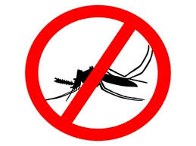
Control:
The main way to reduce malaria transmission at a community is vector control
Insecticide-treated mosquito nets (ITNs)
Indoor spraying with residual insecticides
Antimalarial medications
Vaccination

Slide 19
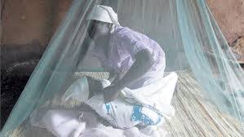
Insecticide-treated mosquito nets (ITNs)
For all at-risk persons
Provision of free LLINs
Everyone sleeps under a LLIN every night.

Slide 20
Indoor spraying with residual insecticides
At least 80% of houses in targeted areas are sprayed
Protection depends on type of insecticide.
Notes:
Indoor spraying:
Its full potential is realized when at least 80% of houses in targeted areas are sprayed.
Indoor spraying is effective for 3–6 months, depending on the insecticide used and the type of surface on which it is sprayed.
DDT can be effective for 9–12 months in some cases.

Slide 21
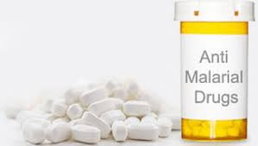
Antimalarial medications
To travelers
Pregnant women
Infants in endemic areas
Seasonal chemoprevention
Notes:
For travellers, malaria can be prevented through chemoprophylaxis, which suppresses the blood stage of malaria infections, thereby preventing malaria disease.
sulfadoxine- pyrimethamine for pregnant women living in high transmission areas, at each scheduled antenatal visit after the first trimester.
Infants living in high-transmission areas of Africa, 3 doses of intermittent preventive treatment with sulfadoxine- pyrimethamine is recommended delivered alongside routine vaccinations.
Seasonal Malaria Chemoprevention as an additional malaria prevention strategy for areas of the Sahel sub-Region of Africa. Involves the administration of monthly courses of amodiaquine plus sulfadoxine- pyrimethamine to all children under 5 years of age during the high transmission season

Slide 22
Vaccine
Still under trial
Notes:
Mosquirix – is an injectable vaccine that provides partial protection against malaria in young children

Slide 23
Prevention And Control Of malaria in KSA
The current elimination strategy in Saudi Arabia focuses mainly on:
Targeting high risk areas for sustained preventative measures such as (Long lasting insecticide treated nets, Indoor residual spraying)
Management of infection through rapid confirmed diagnosis and treatment.
Individual case follow up and reactive surveillance with appropriate treatment and vector control.
Active case detection at borders with screening and treatment.

Slide 24
References:
http://www.who.int/mediacentre/factsheets/fs094/en/.
http://www.cdc.gov/malaria/about/biology/human_factors.html

