Slide 1
DEMOGRAPHY

Slide 2
Learning objectives
Define demography
Describe the process of counting of the population
State methods of estimation of the population size in inter-census years
List and explain demographic elements
List demographic forces and explain how it affects demographic elements
Describe a given population using the population pyramid
Define and distinguish between young and old dependency ratio

Slide 3
DEFINITION OF DEMOGRAPHY
“Demo” = population “graphy”=measurement
Demography is the science concerned with the study of and the changes taking place in population size, distribution and composition

Slide 4
Demographic elements
Size (how many)
Composition (characteristics)
Distribution (place of residence)
Demographic forces
Mortality
Natality
Migration

Slide 5
Population census is
enumeration of all persons of a country in a specified time
collection of demographic & socioeconomic data
analysis and publication of the data
Usual timing of population census
Census is carried every ten years at a time of minimal movement of the population (international and national travel)

Slide 6
De Facto Census
Counting individuals wherever they are on the census day.
It is easier
More economic
Main disadvantages
Persons in transit may be missed
False information of the population size of areas with high migration or high seasonal mobility
De Jure Census
Counting individuals at their legal permanent residence regardless of their physical presence.
Gives a factual figure
Main disadvantages
Expensive and time consuming
People may be missed or counted twice in view of the definition of "permanent residence" for population of high mobility

Slide 7
Inter-census estimate
Population in inter-census years is estimated relying on “actual population”
Use the preceding census population as starting point
Adding the births and the immigrants
Subtracting the deaths and the emigrants

Slide 8
Mid Year Population
The population count is adjusted to represent the population as of July the 1st of the year
The mid year population is used to compute indicators related to population

Slide 9
Uses of population census
Provides information on the changes of population size
Population size is needed to compute morbidity, mortality and fertility rate
Related to “health status” of the population as it depends on the dynamic relationship between number of people, their characteristics and the space they occupy
Planning of health services is guided by demographic variables as number of health units required, their distribution and the number of healthcare workers required for service delivery

Slide 10
POPULATION PYRAMID

Slide 11
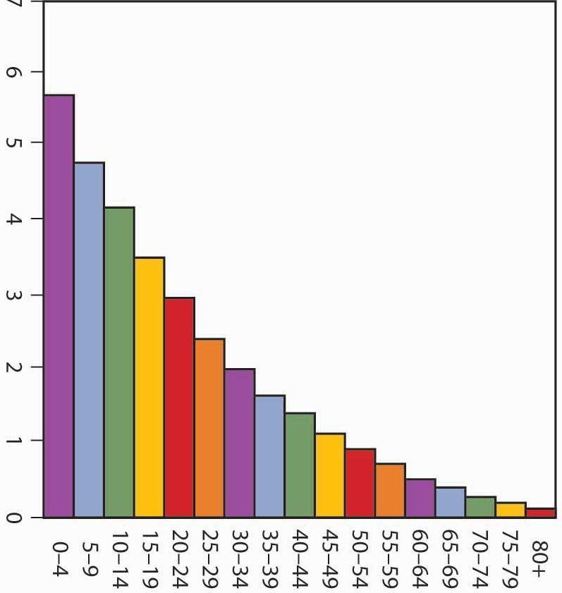
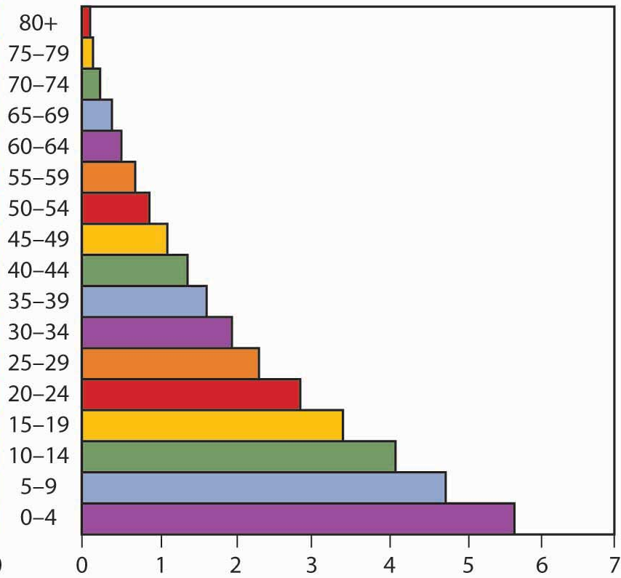
Population (in millions)
Population (in millions)
Male
Female
Age in years

Slide 12
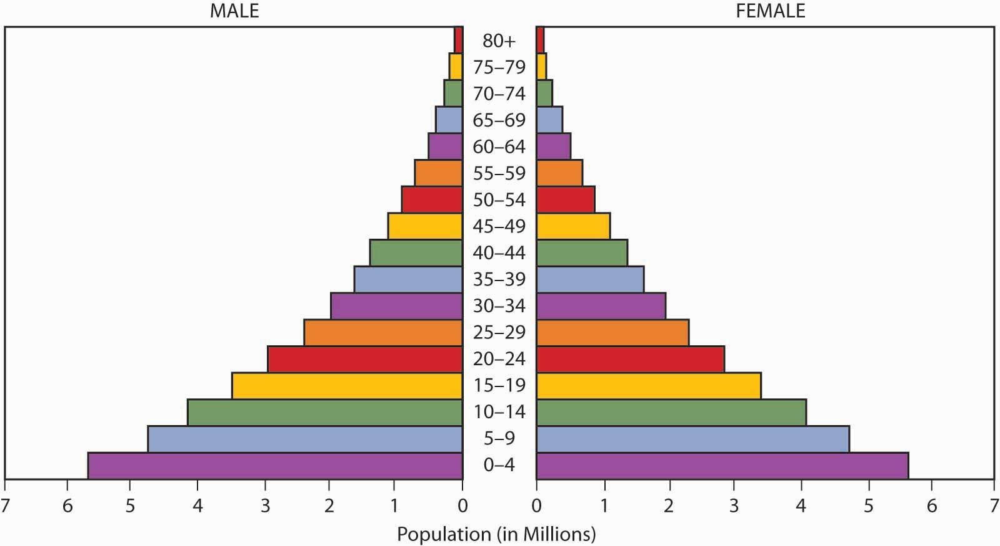
Population pyramid is a graphical presentation of the age and sex composition of the population represented by two histograms (one for male and the second for female) of the age distribution of the population set at 5-year interval and placed back to back

Slide 13
Apex= People living to old age
People ≥ 60 years=
Old dependency
Side= mortality and migration
Height= life span
Median age
People < 15 years=
Young dependency
Base= births

Slide 14
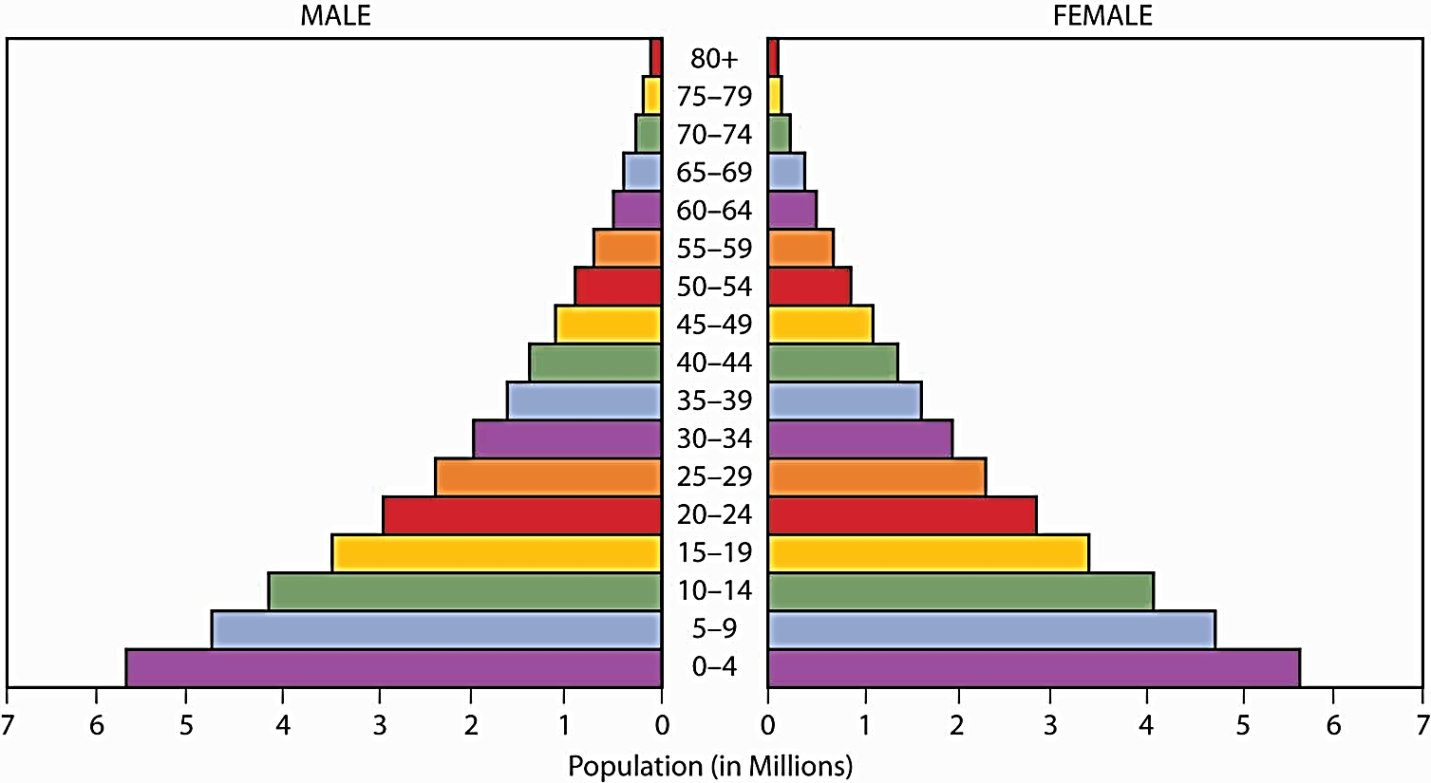
Halves -Proportion of males and females
Base -Births; population adding to itself
-Wide base reflects high births
-Narrow base reflects low births
Apex -Oldest people; reflects those living old age
-Tapering apex reflects few living to old age
-Broad apex reflects many living to old age
Height -Life span; increase height reflects increase life span
Side -Change in population size due to death or migration
-Steep slope reflects rapid decrease
-Almost straight side reflects slow decrease

Slide 15
Less than 15 -Represents the size of people below 15 years
-Represents the size of dependent youth
-Large size in rapidly growing population
-Small size in slowly growing population
60 + years -Represents the size of people ≥ 60 years
-Represents the size of dependent old
-Large size in population with longer life span
-Small size in population with short life span
Median age -Age that divide the population into two halves
-Small in population with high births
-Large in population with low births

Slide 16
Dependency ratio reflects the proportion of those who depends on the working group (15 to less than 60 years)
Young dependency ratio = $\frac{Population <15 years}{Population 15 to<60 years}x100$
Old dependency ratio = $\frac{Population ≥ 60years}{Population 15 to<60 years}x100$
Total dependency ratio = $\frac{Population <15 years \&≥60 years}{Population 15 to<60 years}x100$

Slide 17
SAUDI POPULATION

Slide 18
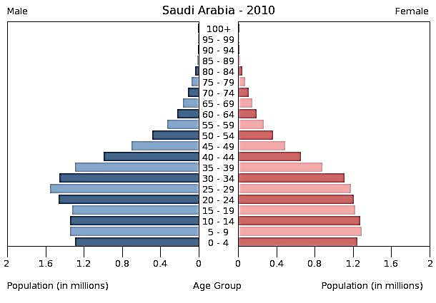
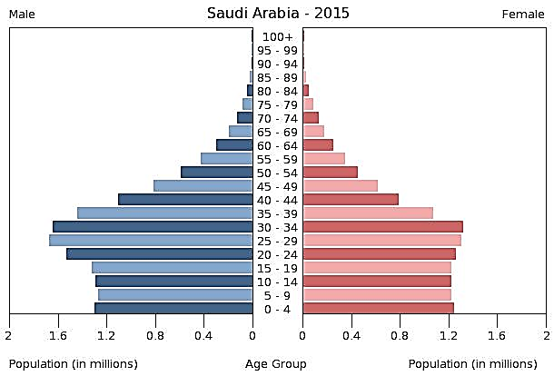
Population 25 732 000
CBR 19 per 1000 population
TFR 2.4 per woman
Growth rate 1.5%
CDR 3 per 1000 population
Life expectancy 74 years
Population 27 752 000
CBR 19 per 1000 population
TFR 2.1 per woman
Growth rate 1.5%
CDR 3 per 1000 population
Life expectancy 75 years

Slide 19
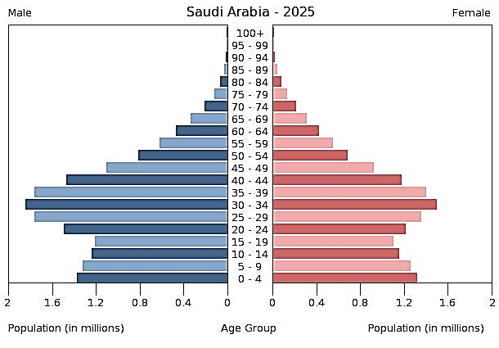
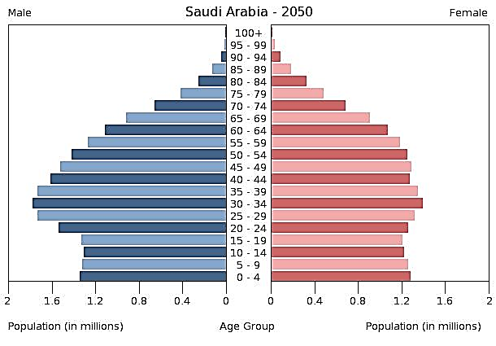
Population 31 877 000
CBR 17 per 1000 population
TFR 2 per woman
Growth rate 1.3%
CDR 4 per 1000 population
Life expectancy 77 years
Population 40 251 000
CBR 13 per 1000 population
TFR 2 per woman
Growth rate 0.7%
CDR 6 per 1000 population
Life expectancy 81 years

Slide 20
Growth%
Years
Population growth in KSA 1960 - 2015

Slide 21
Total population 27 752 316
Male population 15 105 575
Female population 12 646 741
Sex ratio (M/F) 119.4/100
Below 15 years 7 512 186
15 to < 60 years 18 802 626
≥ 60 years 1 437 504
Young dependency ratio 39.95%
Old dependency ratio 7.64%
Total dependency 47.59%

