Slide 1
DEMOGRAPHIC TRANSITION

Slide 2
Learning objectives
Describe the stages of Demographic Transition Model
Link the type of population pyramid to the stage of Demographic Transition Model
Define, compute and interpret mortality indicators
Define, compute and interpret fertility indicators
Explain the phenomenon of migration and its effect on population size
Define, compute and interpret the rates of population increase and population doubling time

Slide 3
Demographic Transition Model
Description of the changes in the population that occurred in western countries in the past two centuries
Changes in fertility trend
Changes in mortality trend
Reason for this changes

Slide 4
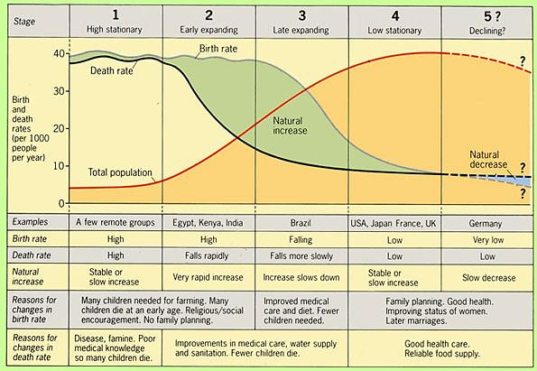
Phases of Demographic Transition Model

Slide 5
Early expanding
Late expanding
Low stationary
Declining
Population Pyramid Corresponding To Phases of demographic transition

Slide 6
Demographic forces
Mortality
Natality/ Fertility
Migration

Slide 7
Mortality indicators
Crude death rate
Age specific mortality rate
Infant mortality rate
Perinatal mortality rate
Neonatal mortality rate
Post-neonatal mortality rate
Mortality rate of children below 5 years of age
Maternal mortality rate and ratio
Cause specific mortality rate
Proportionate mortality rate
Life expectancy
Review “Health Indicators” lecture for these indicators

Slide 8
Fertility indicators
Crude Birth Rate (CBR)
General fertility rate (GFR)
Age specific fertility rate
Total Fertility Rate (TFR)
Gross Reproduction Rate (GRR)

Slide 9
Crude Birth Rate (CBR) is the number of live births per 1000 population in a specific year and locality
CBR= $\frac{Total number of live births in a year and locality }{Estimated mid year population in the same year and locality}x 1000$
Crude index of fertility as it relates births to total population (males and females outside the reproductive age period, as well as unmarried females)
It is useful for
Making annual comparison
Illustrating fertility trend

Slide 10
General Fertility Rate (GFR) is the number of live births per 1000 women in the reproductive age (15 to 49 years) in a specific year and locality
GFR= $\frac{Total number of live births in a year and locality }{women in the age of 15 to 49 years in the same year and locality}x 1000$
GFR eliminates the effect of male and women outside the reproduction age
It doesn’t consider
The marital status of women
The variation in reproductive pattern at different age group of reproduction

Slide 11
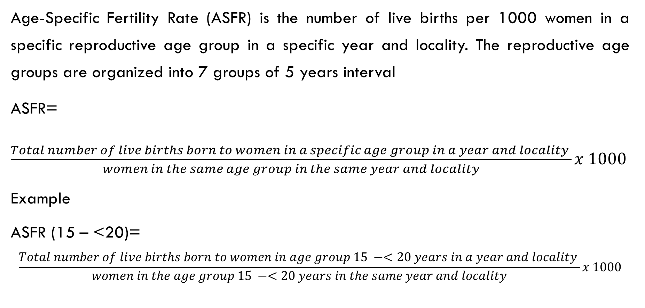
Age-Specific Fertility Rate (ASFR) is the number of live births per 1000 women in a specific reproductive age group in a specific year and locality. The reproductive age groups are organized into 7 groups of 5 years interval
ASFR=
$\frac{Total number of live births born to women in a specific age group in a year and locality }{women in the same age group in the same year and locality}x 1000$
Example
ASFR (15 – <20)=
$$\frac{Total number of live births born to women in age group 15 −<20 years in a year and locality }{women in the age group 15 −<20 years in the same year and locality}x 1000$$

Slide 12
Total Fertility Rate (TFR) represents the average number of children a woman will have during her reproductive span
TFR= ∑$(ASFRx5)$ expressed as children per woman
Refined fertility rate which illustrate the variation in the rate of births at different age group

Slide 13
Gross Reproduction Rate (GRR) is the average number of female births that would be born to a woman throughout her reproductive period expressed as daughters per woman.
GRR= TFR $x$ 48.0% (the percentage of females to the total birth)
It predicts fertility of the next generation
But it doesn’t take into consideration the deaths among females

Slide 14
Factors affecting live births
Number of female population in the reproductive age group
The rate and age of marriage
Level of infant and preschool mortality rates
The rates of using and continuation of contraceptive methods
Economic value of the child

Slide 15
Migration
It is the movement of the population across a geographic borders for the purpose of residence. The purpose is usually for better life and higher standard of living.
The term “immigration” and “emigration” are used to refer to internal migration; movement between countries
The terms “in-migration” and “out-migration” are used to refer to internal migration; movement between different areas within a country
“Immigration” and “in-migration” is moving to an area while “emigration” and “out-migration” is moving out of the area

Slide 16
Internal migration
It is the movement within the boundary of a given country which may be
Rural-urban migration; movement from rural to urban area and the reverse
Urban-urban migration; movement from one urban area to another
Movement of nomadic population governed by rain and climate
Movement of temporary and seasonal nature; temporary worker

Slide 17
International migration is the movement from one country to another. It may be
Permanent migration
The movement across borders with no eventual return as the movement of the population from less developing to developed countries of Europe, USA, Canada and Australia.
Temporary migration
The movement across borders with the aim of working for a number of years, with the intent of an eventual return to the motherland as the migration of professionals and laborers to countries requiring their contribution
The effect of migration on population size compared to fertility and mortality.

Slide 18
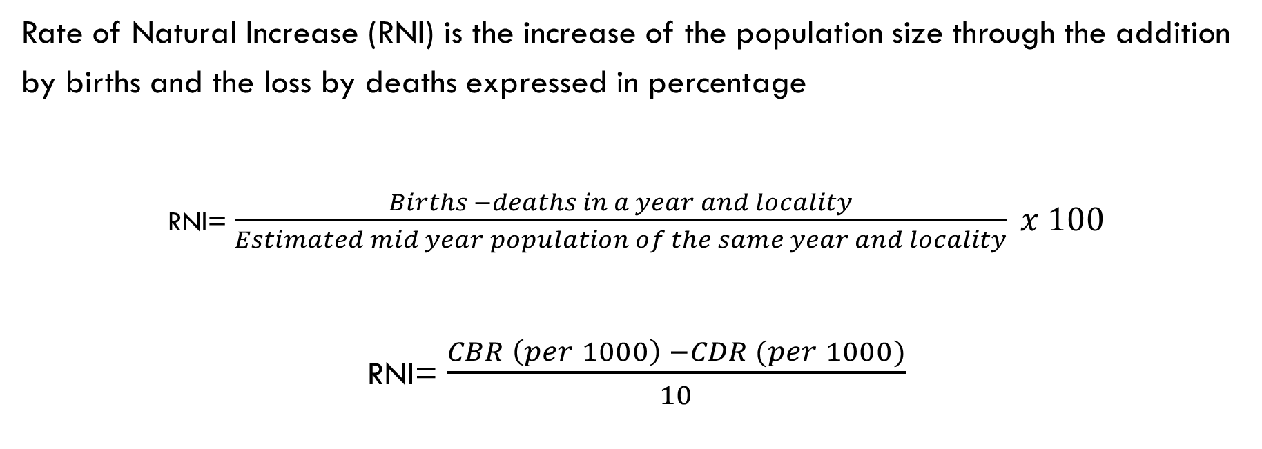
Rate of Natural Increase (RNI) is the increase of the population size through the addition by births and the loss by deaths expressed in percentage
RNI= $\frac{Births −deaths in a year and locality}{Estimated mid year population of the same year and locality} x 100$
RNI= $\frac{CBR \left(per 1000\right) −CDR (per 1000)}{10}$

Slide 19
Annual Growth Rate is the increase of the population size considering the births and deaths and the migration
Annual Growth Rate= $RNI+Net migration$
Net migration is the difference between emigration and immigration

Slide 20
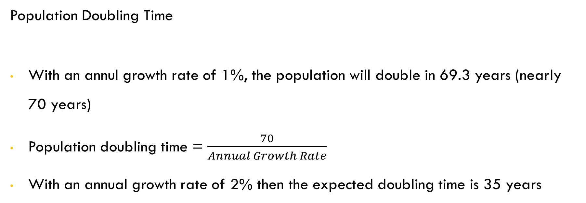
Population Doubling Time
With an annul growth rate of 1%, the population will double in 69.3 years (nearly 70 years)
Population doubling time = $\frac{70}{Annual Growth Rate}$
With an annual growth rate of 2% then the expected doubling time is 35 years

