Slide 1
Natural history OF DISEASE DEVELOPMENT AND PREVENTION

Slide 2
LEARNING OBJECTIVES
Describe the natural history of disease development
Define the terms prevention, control, elimination and eradication
Give examples of classes of diseases in relation to severity
Explain the relation between disease severity and reporting
Identify the level of prevention in relation to the natural history of disease development
Identify the measures applied at each level of prevention

Slide 3
NATURAL HISTORY OF DISEASE
It refers to the progress of a disease process in an individual over time, in the absence of intervention.
It describes the course of the disease in an individual starting from the moment of exposure to the causal agents till one of the possible outcomes occurs.

Slide 4
NATURAL HISTORY PHENOMENON
Induction Time to disease initiation
Incubation Time to symptoms (infectious disease)
Latency Time to detection (non-infectious diseases)
Notes:
Several important landmarks in natural history are the initiation of the disease itself (however we are defining it), the onset of symptoms, the point where a disease can be and/or is usually detected, and for communicable diseases, the point when the disease becomes transmissible.
Epidemiology is still working on standardizing its terminology. The terms presented here are used by a major epidemiology textbook (Rothman and Greenland, Modern Epidemiology) to represent these four stages:
Rothman applies the term induction period to the period of time between exposure to a causal agent and the initiation of the disease. Since the etiology of many diseases involves a combination of factors, Rothman considers each causal agent as having its own induction period. The beginning of actual disease, even if it can be defined, is often unobservable. Nevertheless, the concept of the induction period is a useful one.

Slide 5
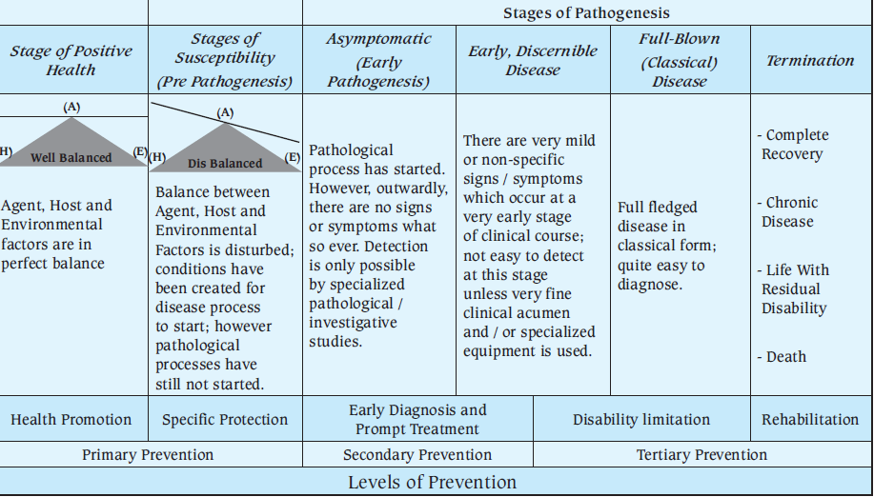
NATURAL HISTORY OF DISEASE AND LEVELS OF PREVENTION

Slide 6
IMPORTANCE OF STUDYING THE NATURAL HISTORY OF DISEASES
Understanding the progress from disease onset to final end point (cure or death) is important for epidemiologists.
Knowledge of the natural history is necessary for the prevention and control of disease
The intervention early in the course of the disease (asymptomatic stage) is likely to change the course of the disease favourably

Slide 7
CLASSES OF DISEASES IN RELATION TO CLINICAL SEVERITY (SPECTRUM OF DISEASE)
Class A- INAPPARENT INFECTION FREQUENT e.g. Tuberculosis, Poliomyelitis, Hepatitis A, Meningitis, HIV.AIDS
Class B- CLINICAL DISEASE FEQUENT WITH FEW DEATHS e.g. Measles, chicken pox
Class C- INFECTIOUS DISEASES USUALLY FATAL e.g. Rabies, hemorrhagic fevers caused by Ebola and muberg virus
Scale/ legend
In-apparent Mild Moderate Severe Fatal Zero 100

Slide 8
RELATION BETWEEN DISEASE SEVERITY AND STATISTICS
Scale/ legend
In-apparent Mild Moderate Severe Fatal Zero 100
Likely to be seen by a doctor and likely to be recorded
Likely to be hospitalized and recorded

Slide 9
PUBLIC HEALTH ASPECTS OF NATURAL HISTORY OF DISEASE AND DISEASE SEVERITY
Persons with in-apparent or undiagnosed infections can transmit infections to others.
Control measures must be directed toward all infections capable of being transmitted to others;
both clinically apparent cases and
those with in-apparent or undiagnosed infections.

Slide 10
PREVENTION
Averting a disease or ill-health before its occurrence
Control of Communicable Diseases in Men, 2013

Slide 11
PREVENTION
Actions aiming at eradicating, eliminating, or minimizing the impact of disease and disability, or if none of these is feasible, retarding the progress of disease and disability.
The concept of prevention is best defined in the context of levels of prevention; primary, secondary, and tertiary prevention.
Oxford Dictionary, 2008

Slide 12
NATURAL HISTORY OF DISEASE AND LEVELS OF PREVENTION
Stage of
Susceptibility
Stage of
Subclinical Disease
Stage of Clinical Disease
Early Advanced
Termination
Positive health
Onset of Symptoms
Pathological
Change
Time of Diagnosis
Health promotion
Specific protection
Early detection and treatment
Disability limitation
Rehabilitation
Primary prevention aims at reducing occurrence
Secondary prevention aims at reducing severity
Tertiary prevention aims at reducing disability and mortality
Levels of prevention

Slide 13
LEVELS OF PREVENTION
Primordial Prevention
Primary Prevention
Secondary Prevention
Tertiary Prevention
Policies & legislations to address behavior of the population and environment
Health promotion & specific protection
Screening & mass treatment
Disability limitation & rehabilitation

Slide 14
PRIMARY PREVENTION
HEALTH PROMOTION
SPECIFIC PROTECTION
Health education
Nutrition intervention
Sanitation of the environment
Life style modification
Immunization
Chemoprophylaxis
Specific micronutrient
Protection from unintentional injuries
Protection from environmental hazards

Slide 15
DISABILITY LIMITATION & REHABILITATION
Disability limitation ======= Prevent progress
Rehabilitation ======= Attain highest level of functional abilities
Medical rehabilitation
Vocational rehabilitation
Social rehabilitation
Psychological rehabilitation

Slide 16
REFERENCES
Principles of Epidemiology in Public Health Practice. Third Edition. An Introduction to Applied Epidemiology and Biostatistics. Centers for Disease Control and Prevention (CDC)
Gordis L. Epidemiology. 2009

