Slide 1
Infective Endocarditis
DR. MOSTAFA ALSHAMIRI
ASSOCIATE PROFESSOR KSU
CONSULTANT CARDIOLOGIST
HEAD OF ADULT CARDIOLOGY
Director of Coronary Care
KING FAHED CARDIAC CENTER
KKUH
KKUH October 2017

Slide 2
AGENDA
Definition
Path-physiology
The risk factors
Clinical features
Diagnosis
Treatment
Complication
Prevention

Slide 3
QUESTIONS ?
Q 1 WHICH PATIENTS IS CANDIDATE FOR IE ?
Q2 WHAT IS THE PATHOPHYSIOLOGY OF IE ?
Q3 WHICH PATIENTS NEED PROPHYLAXIS FOR IE ?
Q4 WHAT IS THE DIAGNOSTIC CRITERIA FOR IE ?
Q5 WHAT ARE THE ORGANISMS COMMONLY CAUSING IE ?

Slide 4
Infective Endocarditis
Definition :
Infection of endothelium surface of heart either of
1. Heart valves .
2. Septal defects.
3. Chordae Tontine .
4. A.V shunt.
It remains a life-threatening disease with significant mortality (about 20%) and morbidity.

Slide 5
Pathogenesis of IE-1
The IE is the net result of the complex interaction between the bloodstream pathogen with matrix molecules and platelets at sites of endocardial cells damage.

Slide 6
Pathogenesis of IE-2
Endothelial damage
Turbulent blood flow produced by certain types of congenital or acquired heart disease, such as flow from a high- to a low-pressure chamber or across a narrowed orifice, traumatizes the endothelium.
Formation of nonbacterial thrombotic endocarditis ( NBTE )
Endothelial damage creates a predisposition for deposition of platelets and fibrin on the surface of the endothelium, which results in NBTE.
Bacteremia
Invasion of the bloodstream with a microbial species that has the pathogenic potential to colonize this site ,then result in Proliferation of bacteria within a vegetation and form IE.

Slide 7
Pathogenesis of IE-3
Transient Bacteremia
Mucosal surfaces are populated by :
Dense endogenous microflora.
Trauma to a mucosal surface like:
Gingiva around teeth,
Oro-pharynx,
GI tract,
Urethra,
Vagina,
This will releases many different microbial species transiently into the bloodstream which will leads to Transient bacteremia caused by organism e,g Veridans group streptococci

Slide 8
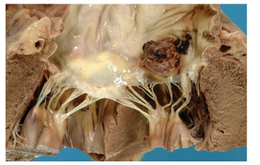
Pathogenesis: summery-1
Endothelial damage
1.High velocity jet
2.Flow from high pressure to low pressure chamber
3.Flow across narrow orifice of high velocity
Platelet-fibrin thrombi (Nonbacterial Thrombotic endocarditis)
Microorganism adherence (BTE)
Local vegetation
EXTENSON , Perivalvular ,Destructive valve, fistula and embolization

Slide 9
Determining Risk
Cardiac conditions
Type of Procedure

Slide 10
Prophylaxis against IE ACC 2017
It is reasonable before dental procedures that involve manipulation of:
Gingival tissue,
Peri-apical region of teeth, or
Perforation of the oral mucosa
In patients with the following:
1. Prosthetic cardiac valves, including trans-catheter-implanted prostheses & homografts.
2. Prosthetic material used for cardiac valve repair, such as annuloplasty rings & chords.
3. Previous IE.
4. Unrepaired cyanotic congenital heart disease or repaired congenital heart disease, with residual shunts or valvular regurgitation at the site of or adjacent to the site of a prosthetic patch or prosthetic device.
5. Cardiac transplant with valve regurgitation due to a structurally abnormal valve.

Slide 11
2015 recomendations

Slide 12
2015 recommendations

Slide 13
CLASSIFICATION OF ie
Type of lesion Native. Congenital
Prosthetic.
Onset & progress Acute.
Sub acute.
Acquire of infection Nosocomial .
community

Slide 14
DIAGNOSIS OF IE
Clinical suspension
Blood culture
Echocardiography

Slide 15
Clinical Features-1
Onset usually within 2 weeks of infection
› Indolent course:
-fever
- Malaise
- Fatigue
- Night sweats
- Anorexia
- Weight loss
› Explosive course:
- CCF , murmur new onset or changing characters,
with severe systemic sepsis

Slide 16
Other Clinical Features-2
Spleno-megaly ~ 30%
Petechiae 20 - 40%
Conjunctivae
Buccal mucosa
palate
Skin in supra-clavicular regions
Osler’s Nodes 10 - 25%
Splinter Haemorrhages 5 - 10%
Roth Spots ~ 5%
Musculoskeletal (arthritis)

Slide 17
Immonuligical
Vascular and septic emboli
Osler nodes
Roth spot
Gomeriolo-nephritis
Rheomatoid factor +
Splinter hemorrhage
Janway lesion : painless skin lesion in the palm and sole.
Sub-conjuctival hemorrhage
Mycotic aneurysm
Arthritis
hematurea

Slide 18
Clinical features- immunological phenomina (glumerolo-nephriti, osler nodes, roth spot , RF +ve)
Osler nodes , painful lesion in distal finger

Slide 19
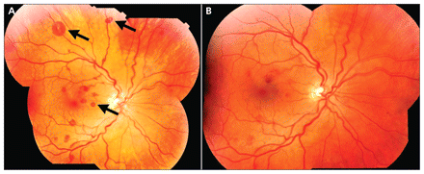
Roth Spots

Slide 20
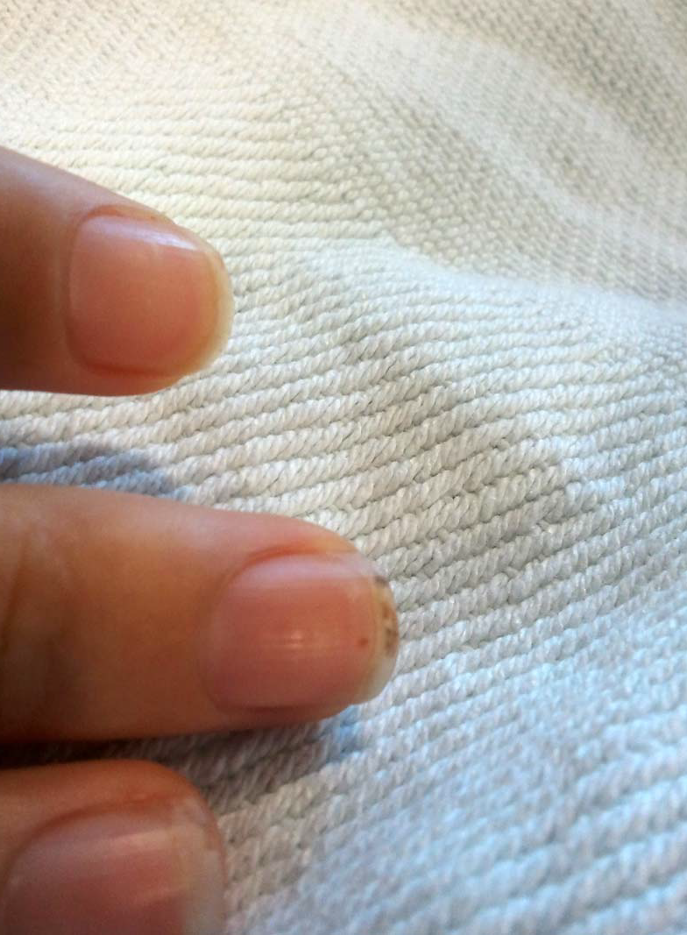
Vascular Phenomina -Septic emboli
Janway , vascular Painless hemorrhagic cutaneus lesion in the palm and sole
Splinter hg
SUB-CONJUCTIVAL HG

Slide 21
AA common mnemonic for the signs and symptoms of endocarditis is FROM JANE:
F- FEVER
R- ROTH SPOT
O- OSLER NODE
M- MURMER
J- JEANWAY LESION
A- ANEMIA
N- NAIL HG (SPLINTER HG)
E- EMBOLI

Slide 22
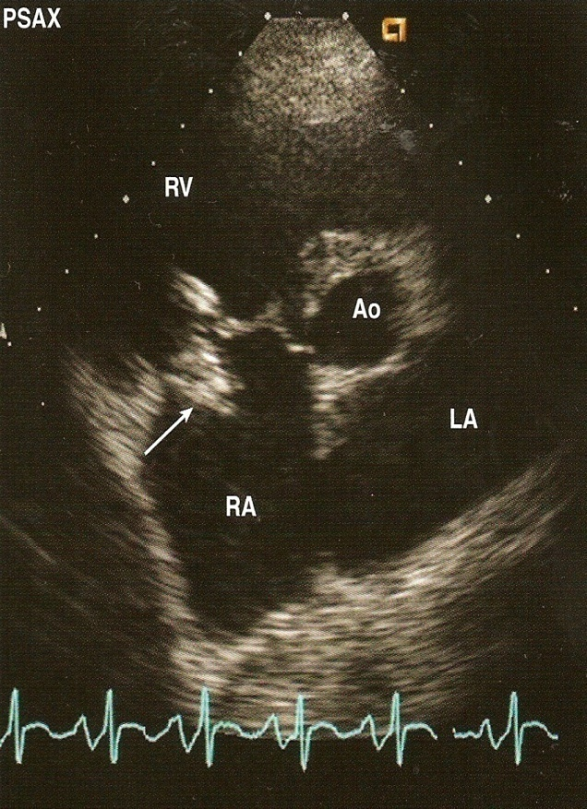
INVESTIGATIONS
C.B.C
ESR
Blood cultures
RFT
URINE
ECG
CXR
ECHO

Slide 23
TEE

Slide 24
NATIVE -Endocarditis ORGANISMS Microbiology
›› Streptococci 50 - 70%
Viridans Streptococci (50% of all Strep)
›› Staphylococci ~ 25%
Mostly Coagulase +ve Staph. Aureus
Staph. Epidermidis
›› Enterococci ~ 10%
HACEK
Haemophilus species,
Actinobacillus
Actinomycetemcomitans,
Cardiobacterium hominis,
Eikenella,
Kingella

Slide 25
IE in IV Drug Abusers ORGANISMS
Skin most predominant source of infection
70 - 100% of Rt. sided IE results in pneumonia and septic emboli
Microbiology
Staph aureus ~60%
Streptococci and Enterococci ~20%
Gram -ve bacilli ~10%
Fungi (Candida and Aspergillus ~5%

Slide 26
Prosthetic Valve Endocarditis ORGANISMS Classification
Early ( < 60 days )
Reflects perioperative contamination
Incidence around 1%
Microbiology
Staph (45 - 50%)
Staph. Epiderm (~ 30%)
Staph. Aureus (~ 20%)
Gram -ve aerobes (~20%)
Fungi (~ 10%)
Strep and Entero (5-10%)
Late ( > 60 days)
After endothelialization
Incidence 0.2 -0.5 % / pt. year
Transient bacteraemia from dental, GI or GU
Microbiology
resembles native valve endocarditis

Slide 28
clinic inf disease 2000

Slide 29
DUKE CRITERIA BE-FEVEER(SUMMARY)
MAJOR
B-BLOOD CULTURE +VE >2 TIMES 12 HOUR APART
E- ENDOCARDIAL INVOLVEMENT FROM ECHO
MINOR CRITERIA
F- FEVER
E- ECHO FINDING NOT MAJOR
V- VASCULAR PHENOMINA
EE- EVIDENCE FROM MICROBIAL STUDY /IMMUNOLOGICAL- 2 EVIDENCE
R- RISK FCTOR FOR IE CONGEITAL OR PROSTHETIC VALVE/CONGEITAL DRUG ABUSER

Slide 30
Diagnostic (Duke) Criteria
Definitive infective endocarditis
Pathologic criteria
Microorganisms or pathologic lesions: demonstrated by culture or histology in a vegetation, or in a vegetation that has embolized, or in an intracardiac abscess
Clinical criteria (as above)
Two major criteria, or
One major and three minor criteria, or
Five minor criteria

Slide 31
Diagnostic (Duke) Criteria
Possible infective endocarditis
findings consistent of IE that fall short of “definite”, but not “rejected”
IE considered in presence of 1 major + 1 minor or 3 minor
Rejected
Firm alternate Dx for manifestation of IE
Resolution of manifestations of IE, with antibiotic therapy for ≤ 4 days
No pathologic evidence of IE at surgery or autopsy, after antibiotic therapy for ≤ 4 days

Slide 33
Treatment
Medical
Surgical
antibiotic

Slide 34
Principles of Medical Management
Sterilization of Vegetations with antibiotics
prolonged , high dose and bactericidal.
Acute onset:
blood culture and start treatment within three hours.
Sub acute onset ;
Blood culture then antibiotic can be started within three days.

Slide 35
Treatment
Pre-antibiotic era - a death sentence
Antibiotic era
Microbiologic cure in majority of patient
Highly penicillin-susceptible Streptococcus viridans or bovis
Once-daily ceftriaxone for 4 wks
cure rate > 98%
Once-daily ceftriaxone 2 g for 2wks followed by oral amoxicillin qid for 2 wks
Prosthetic valve may need longer treatment durations.

Slide 36
Complications-1
Congestive Cardiac Failure (Commonest complication)
Valve Destruction
Myocarditis
Coronary artery embolism and MI
Myocardial Abscesses
Neurological Manifestations (1/3 cases)
Major embolism to MCA territory ~25%
Mycotic Aneurysms 2 - 10%

Slide 37
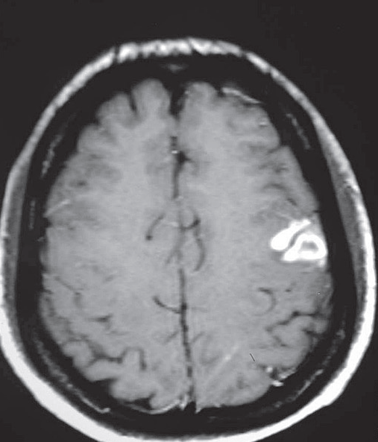
Neurological Complication

Slide 38
Complications-2
Metastatic infections
Rt. Sided vegetations
Lung abscesses
Pyothorax / Pyo-pneumothorax
Lt. Sided vegetations
Pyogenic Meningitis
Splenic Abscesses
Pyelonephritis
Osteomyelitis
Renal impairment , Glomerulonephritis

Slide 39
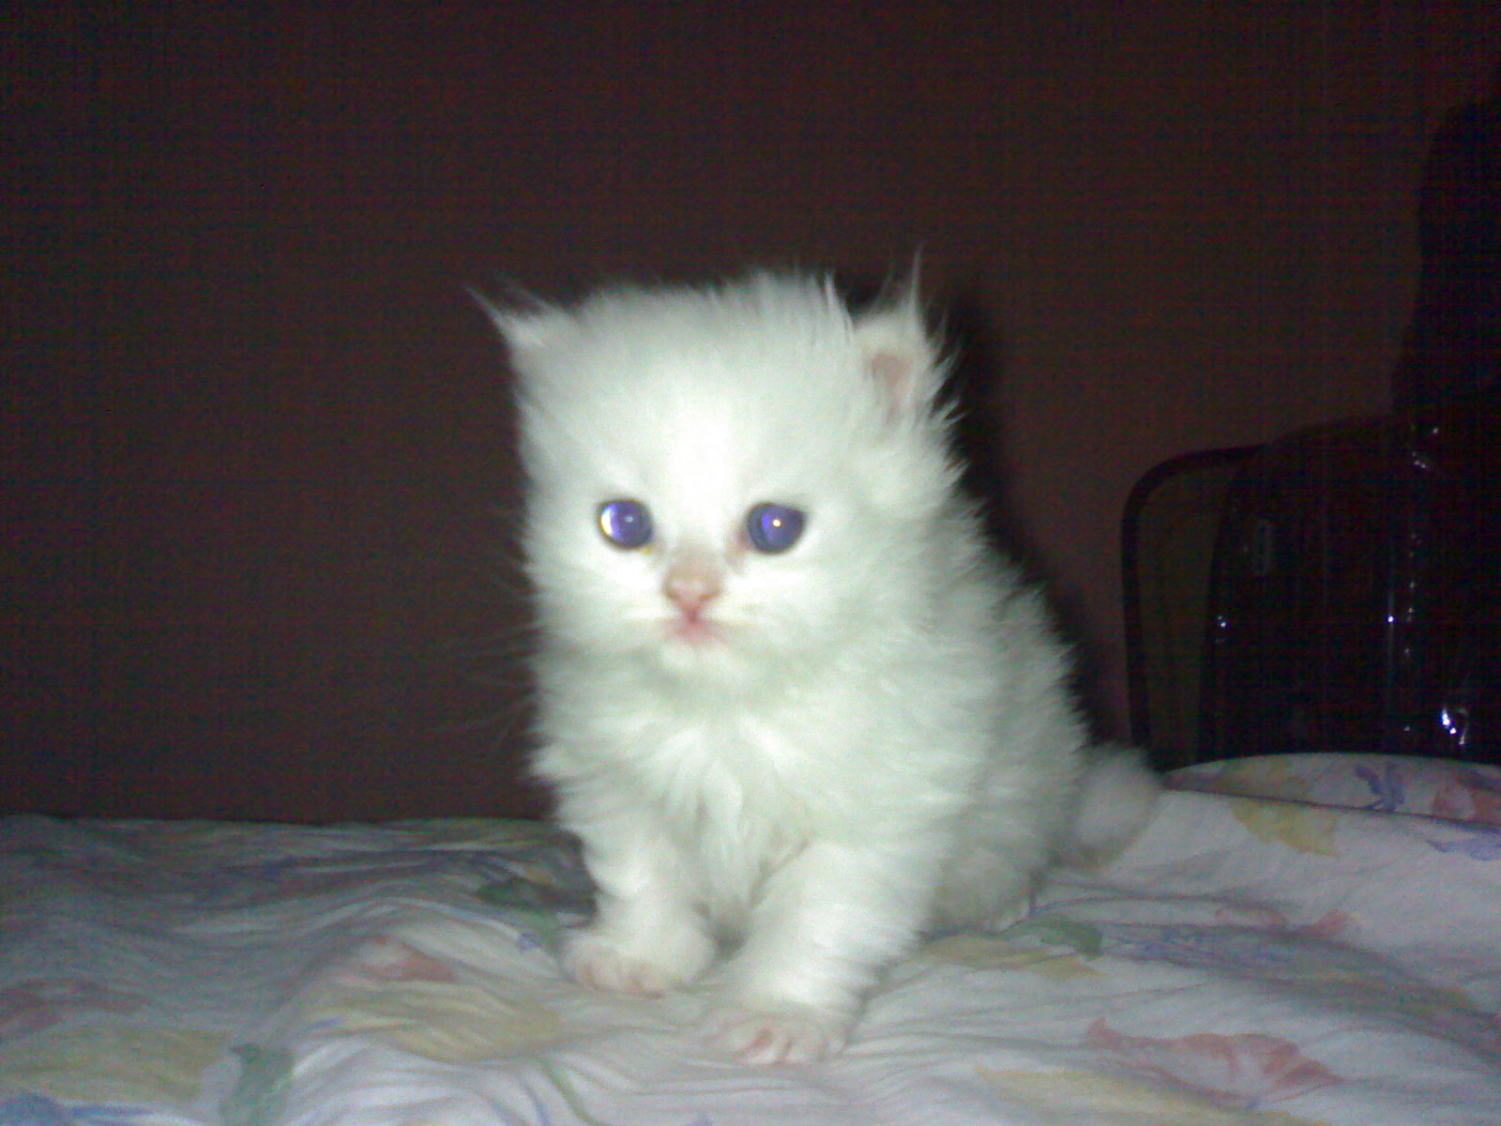
Prevention

Slide 42
Staphylococcus
Flocloxacillin
Or
Vancomycin

Slide 43
QUESTIONS ?
Q 1 WHICH PATIENTS IS CANDIDATE FOR IE ?
Q2 WHAT IS THE PATHOPHYSIOLOGY OF IE ?
Q3 WHICH PATIENTS NEED PROPHYLAXIS FOR IE ?
Q4 WHAT IS THE DIAGNOSTIC CRITERIA FOR IE ?
Q5 WHAT ARE THE ORGANISMS COMMONLY CAUSING IE ?

