Slide 1






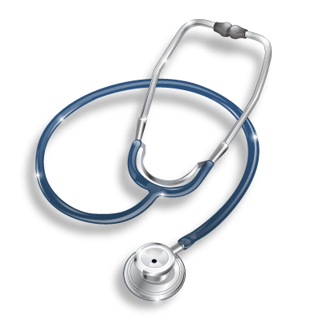

AHMAD AMER Al-BOUKAI
Associate Professor & Consultant Radiologist
Radiology & Medical Imaging Department King Khalid University Hospital
2017

Slide 2


Introduce the various Medical Imaging Modalities
Understand the basics of image generation
Relate imaging to gross anatomy
Appreciate constraints and limitations
Develop imaging vocabulary in the interpretation

Slide 3
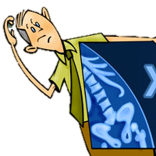


ü Medical specialty imaging studies.
that
supervises,
perform
and interprets
ü Reports findings to referring physicians to help in the patients management.

Slide 4


PLAIN X-RAY
COMPUTED TOMOGRAPHY (CT)
MAGNETIC RESONANCE IMAGING (MRI)
ULTRASOUND (US)
NUCLEAR MEDICINE (NM)
ANGIOGRAPHY (ANG)

Slide 5
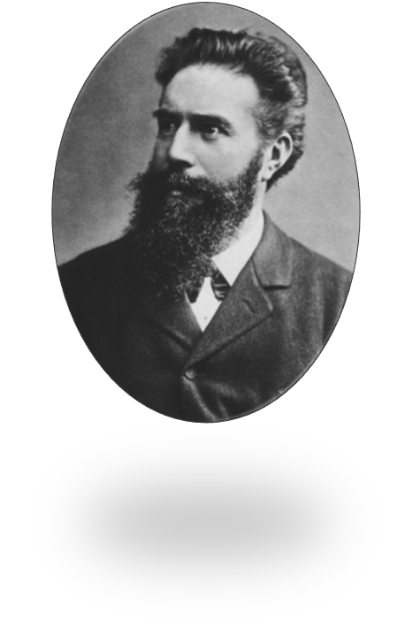


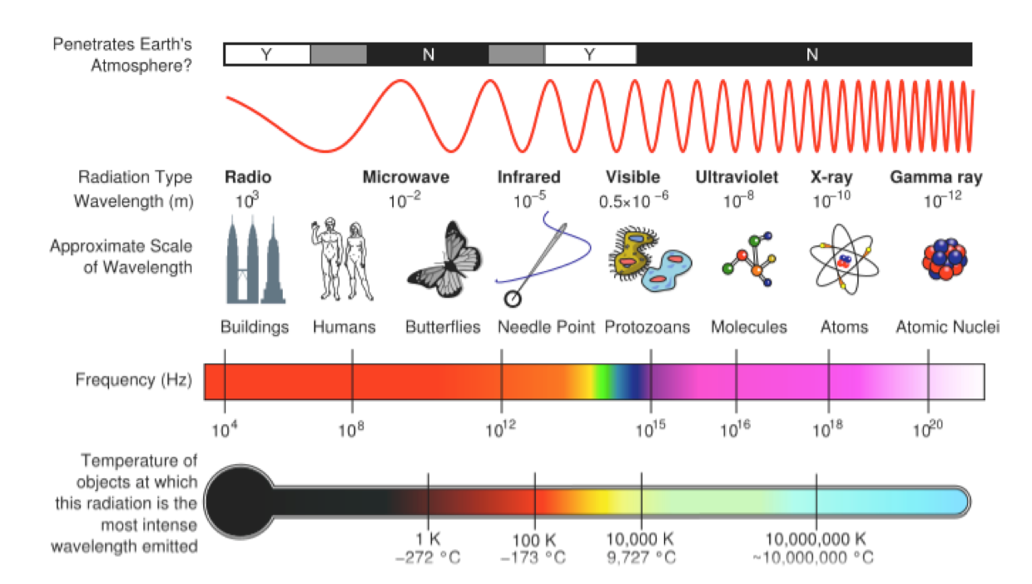

ü
It is a form of electromagnetic energy that travel at the speed of light
Discovered and named by Dr. W. C. Röentgen at University of Würzburg, 1895
Electromagnetic energy wave spectrum
ü
ü
Gamma Rays
X-rays
Visible light
Infrared light
Microwaves
Radar
Radio waves

Slide 6
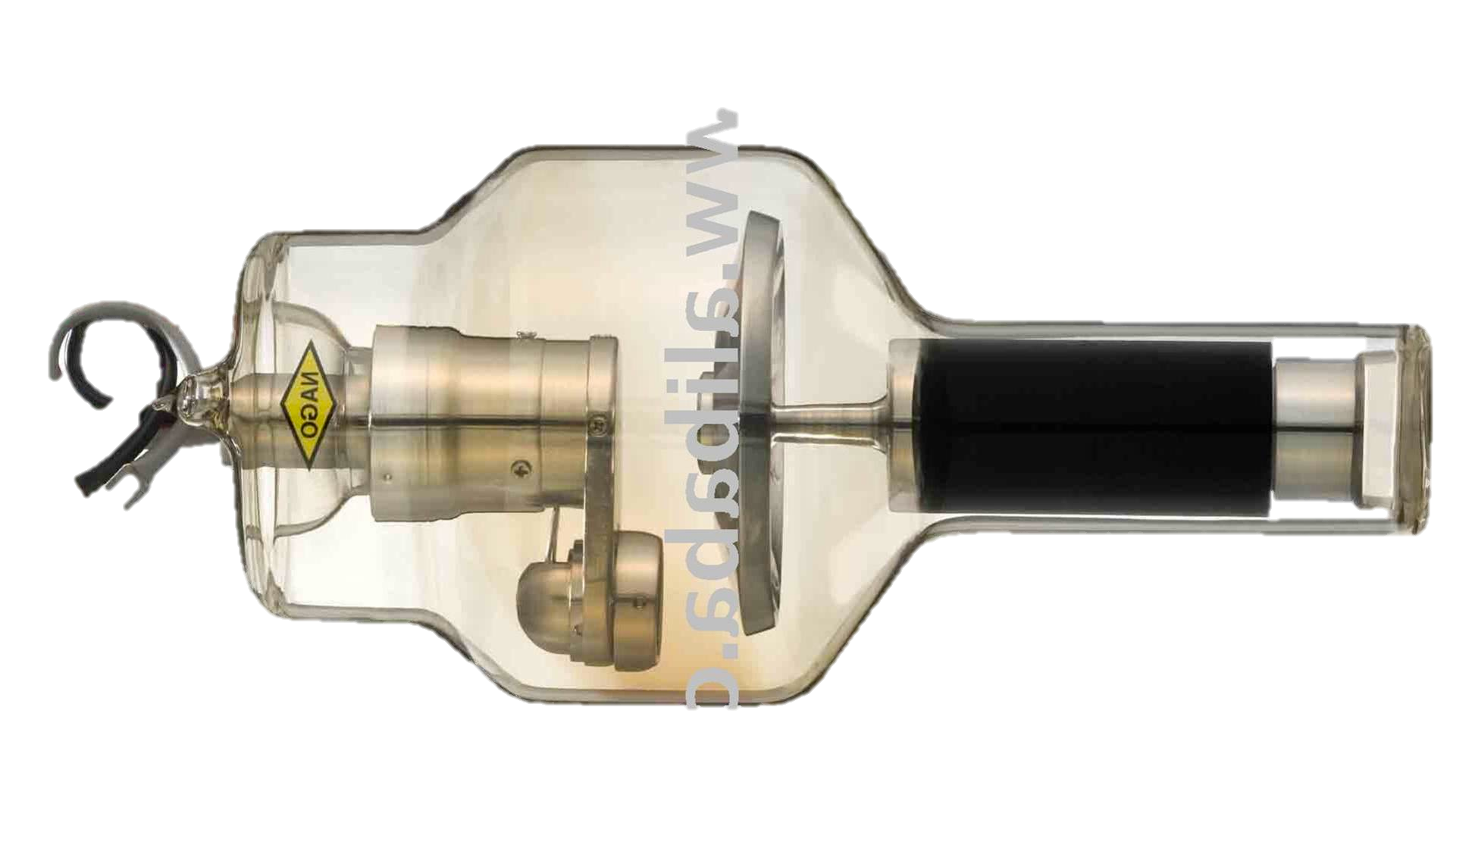
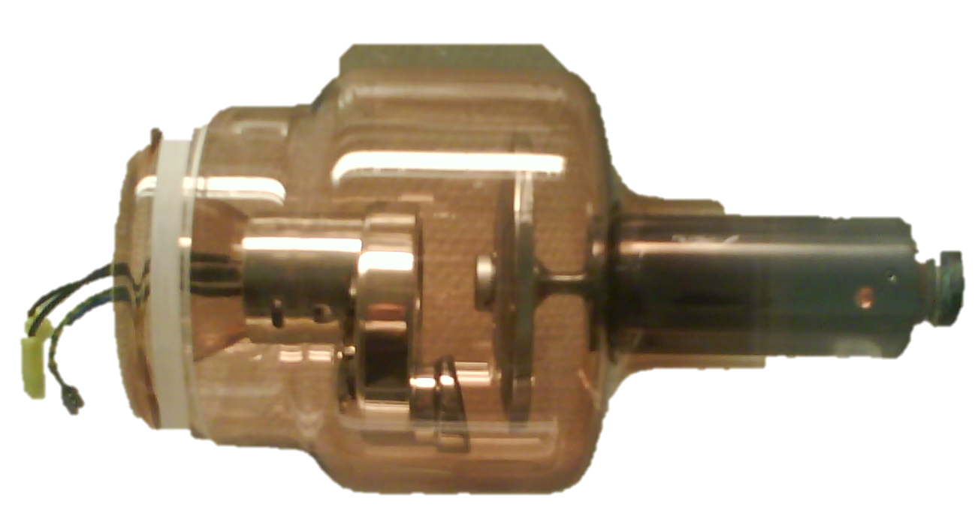
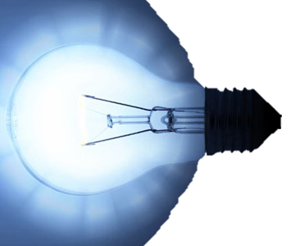
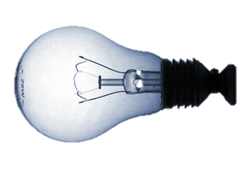
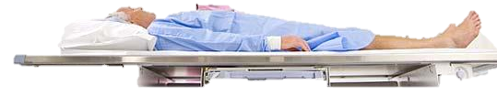

X-RAY
VISIBLE LIGHT

Slide 7
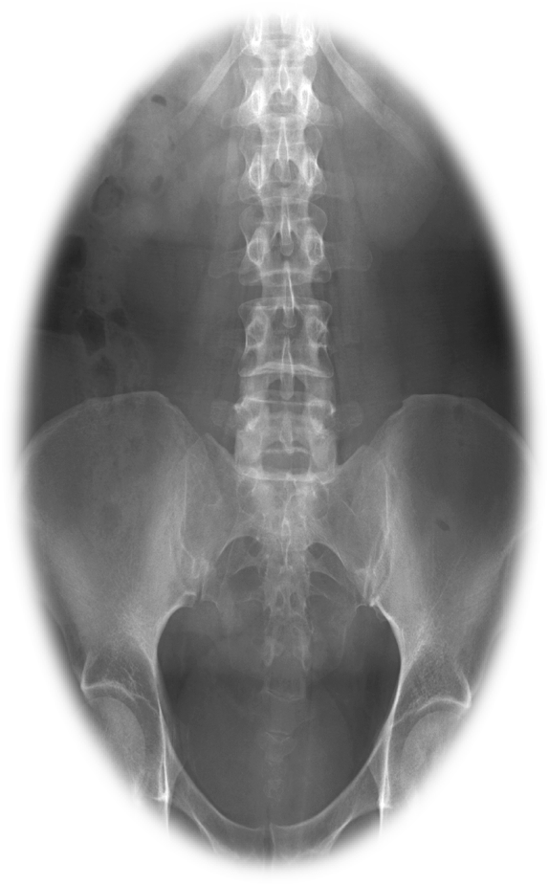
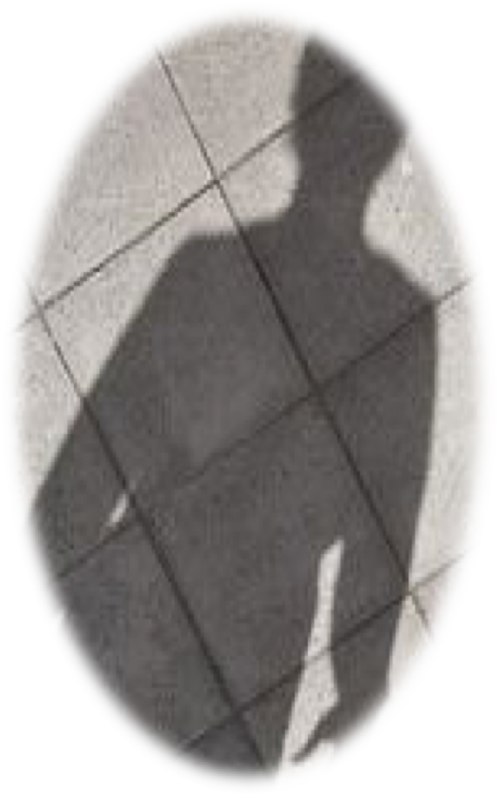

X-RAY
VISIBLE LIGHT

Slide 8

X-rays are emitted and detected in cassette which generate either a hard copy film or a digital image
X-ray beam interaction with body tissue can:
² Pass all the way through the body à render the film dark (black)
² Be deflected or scattered
² Be absorbed
}
à render the film light (white)
Air = low atomic # = x-rays get through = image is dark
Metal = high atomic # = x-rays blocked = image is light (white)

Slide 9



Widely available Inexpensive
Doesn‘t require advanced technologist knowledge
Can be performed quickly Portable
Ionizing Radiation Relatively insensitive
Requires patient cooperation

Slide 10
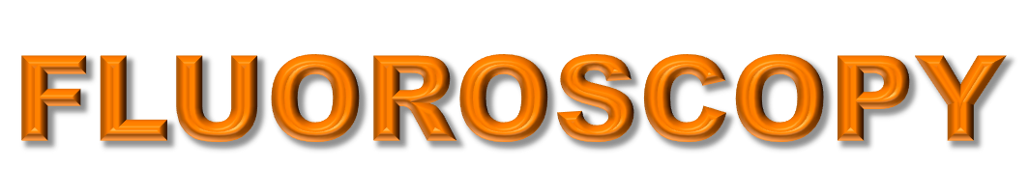

ü ü ü ü
Utilizes X-Rays
Real-time imaging (Dynamic) Utilizes image intensifier
Involves use of contrast agents

Slide 11
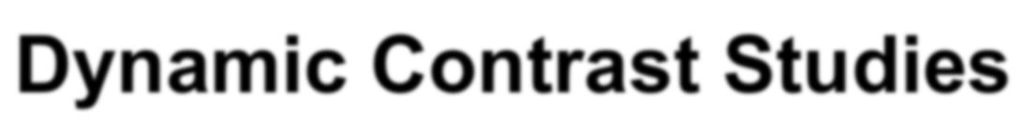
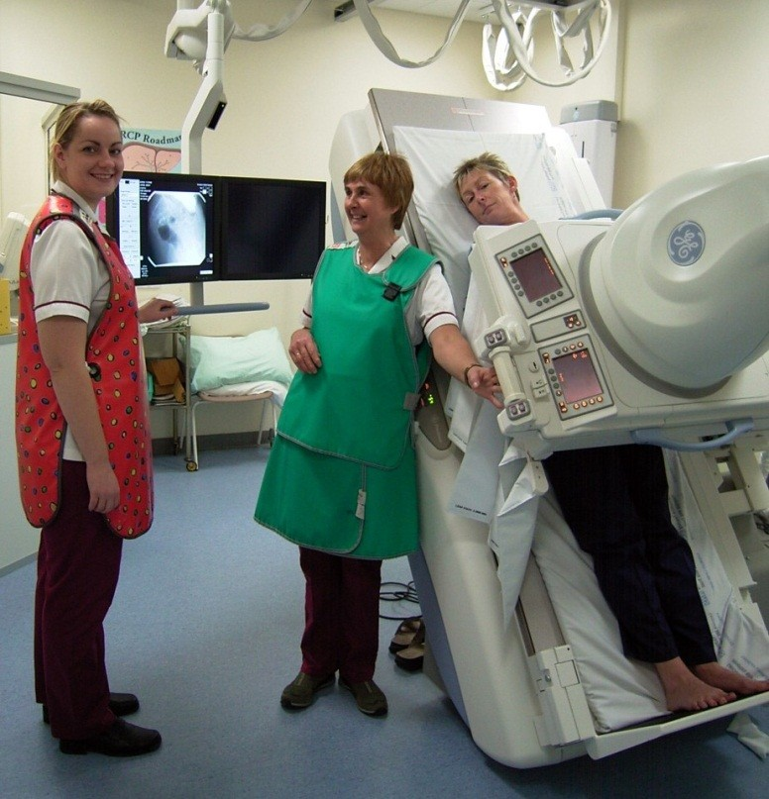
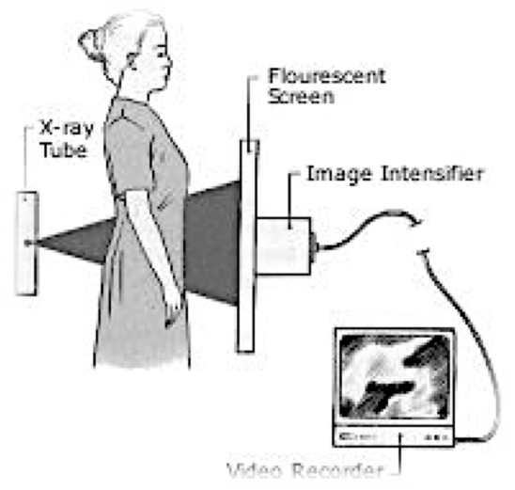

A modality utilized in evaluation of Gastrointestinal Tract:
Dynamic Contrast Studies

Slide 12
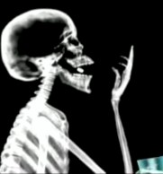
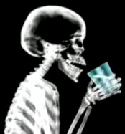
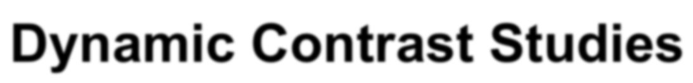
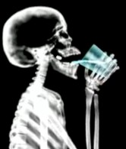
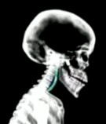

Dynamic Contrast Studies

Slide 13
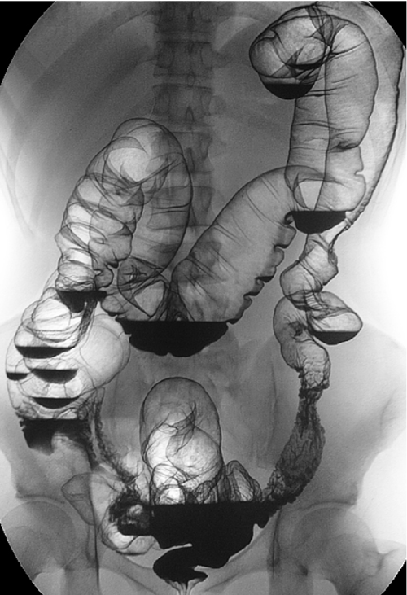
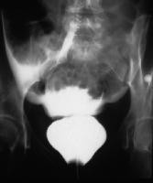
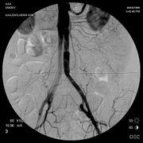

Main Uses of Fluoroscopy
Gastrointestinal Imaging Genitourinary Imaging Angiography
Other:
l Intraoperative
l Foreign body removal
l Musculoskeletal

Slide 14

Widely Available Inexpensive
Functional and Anatomic No sedation required
Requires ingestion/injection of contrast medium
Patient cooperation Time consuming

Slide 15

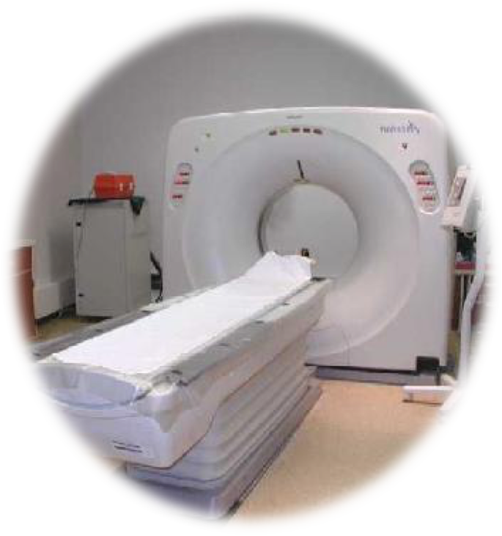

ü ü ü ü
Cross Sectional imaging modality
Mobile X-ray tube that rotates around a patient.
Data displayed in multiple window settings (lungs parenchyma, bone, etc.) Density measurements analyze chemical component of tissue “Hounsfield Unit (HU)” :
Image key = shades (Densities)
Fat Air Water
= -150
= -1000
= 0
Soft tissue Blood Bone/calcium
= 20-80
= 45-75
= >100- >1000

Slide 16
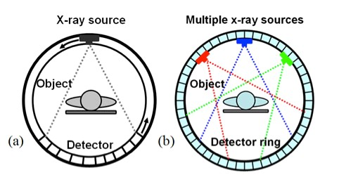

A A Al-BOUKAI-16

Slide 17
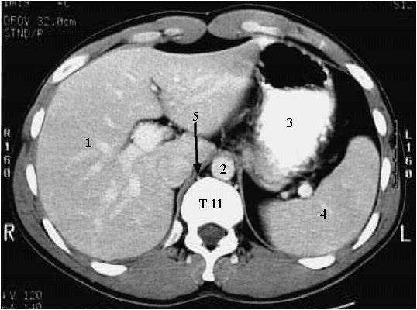
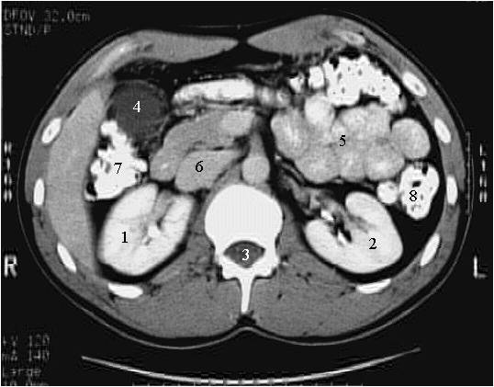
A A Al-BOUKAI-16

Slide 18
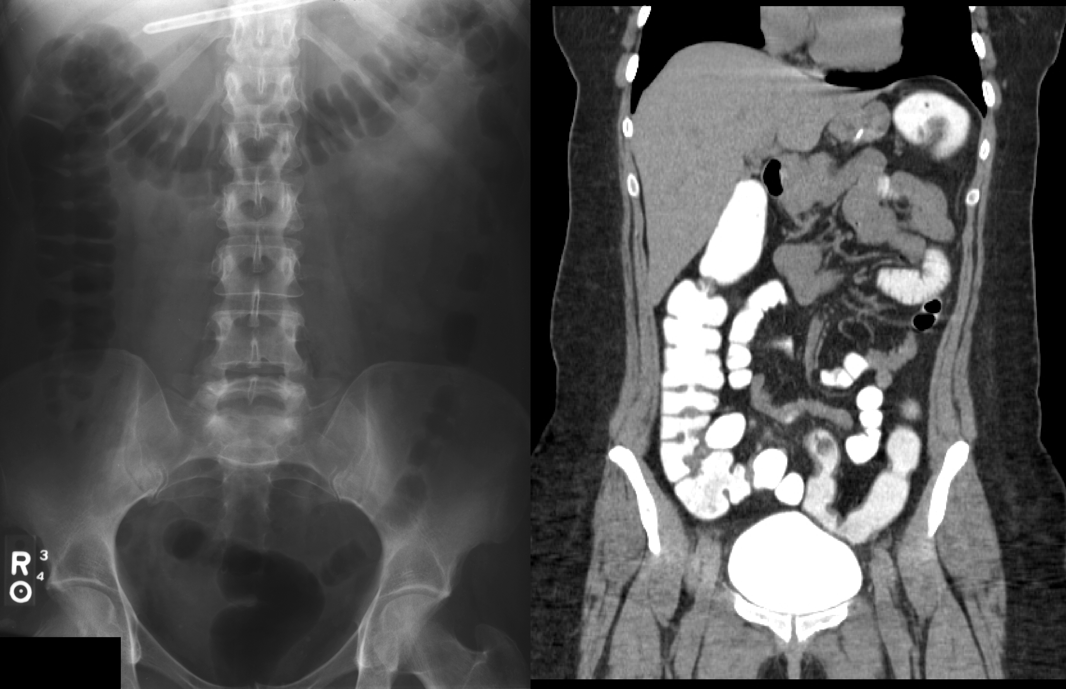


Slide 19

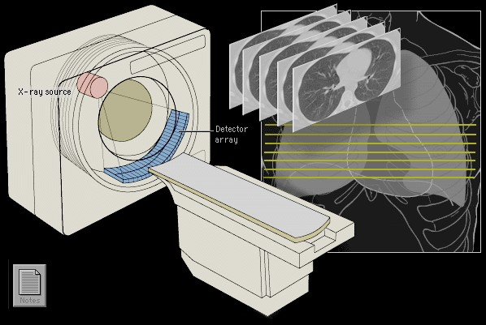
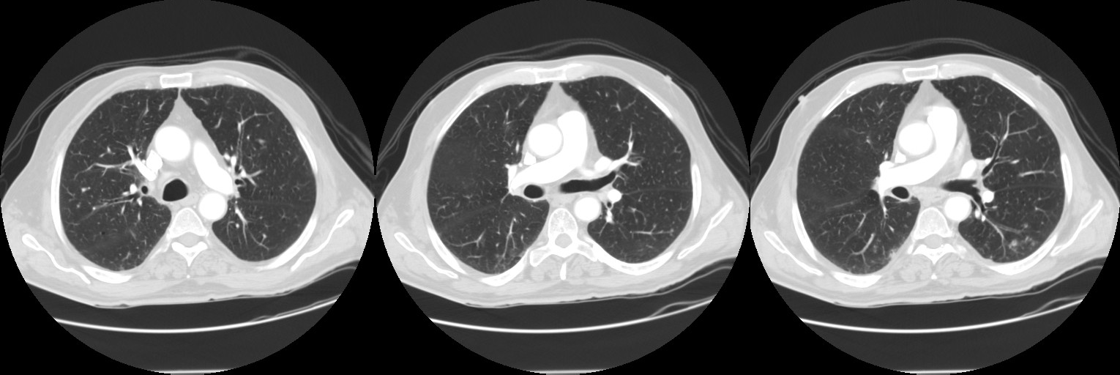
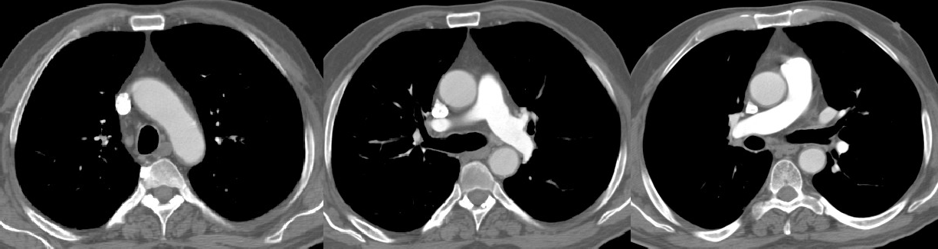

Lung Window
Mediastinal Window
Relies on x-rays transmitted through the body.
Differs from conventional radiography in that a more sensitive x-ray detection system is used.
Images consist of sections (slices) through the body, and the data are manipulated by a computer.
Has very small differences in x-ray absorption values compared with conventional radiography; the range of densities recorded is increased
approximately 10-fold.

Slide 20

Lung Window
Mediastinal Window
So gradations of density within soft tissues can be recognized, e.g. brain substance from cerebrospinal fluid, or tumor from surrounding normal tissues.
There is major risk behind CT scan, 1 Brain CT scan radiation = 200 x-ray radiation , pelvic CT radiation = 400 x-ray radiation which means don’t request a CT scan unless it is needed and we can't use it for a pregnant women unless it is necessary
Wide window to visualize more structure within certain organ such as bronchi, vessels and alveoli in the lung (Lung window).
Narrow window to visualize certain structures within certain region such as major vessels and heart in mediastinum (Mediastinal window).

Slide 21


NEURO-IMAGING
-Acute head trauma, acute intracranial hemorrhage
-Low sensitivity for early ischemic stroke, intracranial metastatic disease, white matter degenerative disease
HEAD AND NECK IMAGING
-Soft tissue of neck, paranasal sinuses, temporal bone imaging, orbital wall imaging

Slide 22

BODY IMAGING
  Chest, Abdomen, Pelvis (with enteric and IV contrast)
  Pulmonary nodules, Renal Calculi (without contrast)
  Acute appendicitis (with enteric and IV contrast)
SPECIALIZED PROTOCOLS:
-Liver masses, pancreatic tissue, renal masses, adrenal masses

Slide 23

ACUTE ABDOMEN
-decrease rate of false laparotomy procedures
TRAUMA SPINE IMAGING (cervical, thoracic, lumbar)
OTHER OSSEOUS STRUCTURES (pelvis, extremities)
VASCULAR IMAGING
-CT angiography--- i.e. coronary arteries

Slide 24
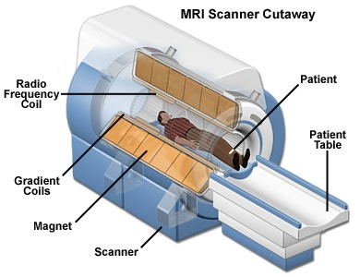

A A Al-BOUKAI-23

Slide 25
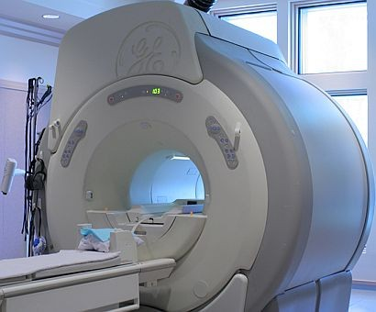
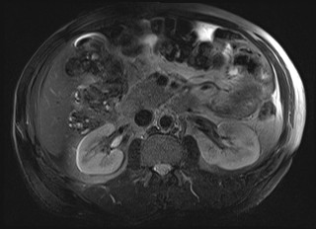
Simply, hydrogen atoms (protons) in water molecules and lipids >> magnetism affects all protons causes them to line up in one direction >> magnets can be switched on and off to change the direction of the magnetic field
>> whenever the water molecule spin around they give a light radio wave >> MRI machine can detect it >> show it as images
So gradations of density within soft tissues can be recognized, e.g. brain substance from cerebrospinal fluid, or tumor from surrounding normal tissues.
Image key = shades (Intensities)
A A Al-BOUKAI-23

Slide 26
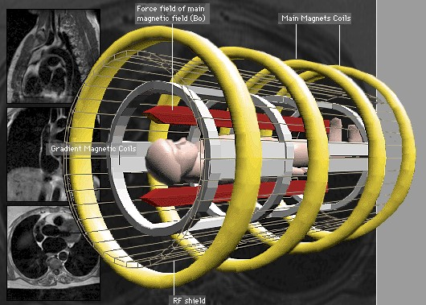
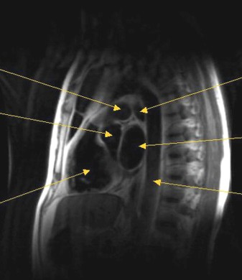
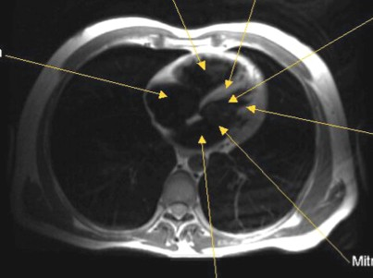
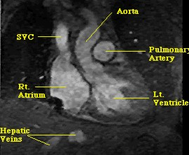

Sagittal
Axial
Coronal
ADVANTAGES
Best for soft tissue imaging
No ionization
Can be done for pregnant women
Images can be obtained in any plane
Useful for soft tissue pathology (Tumor, infection)
DISADVANTAGES
Expensive
Time consuming
Phobia (narrow place)
No metals allowed
Motion
A A Al-BOUKAI-24

Slide 27

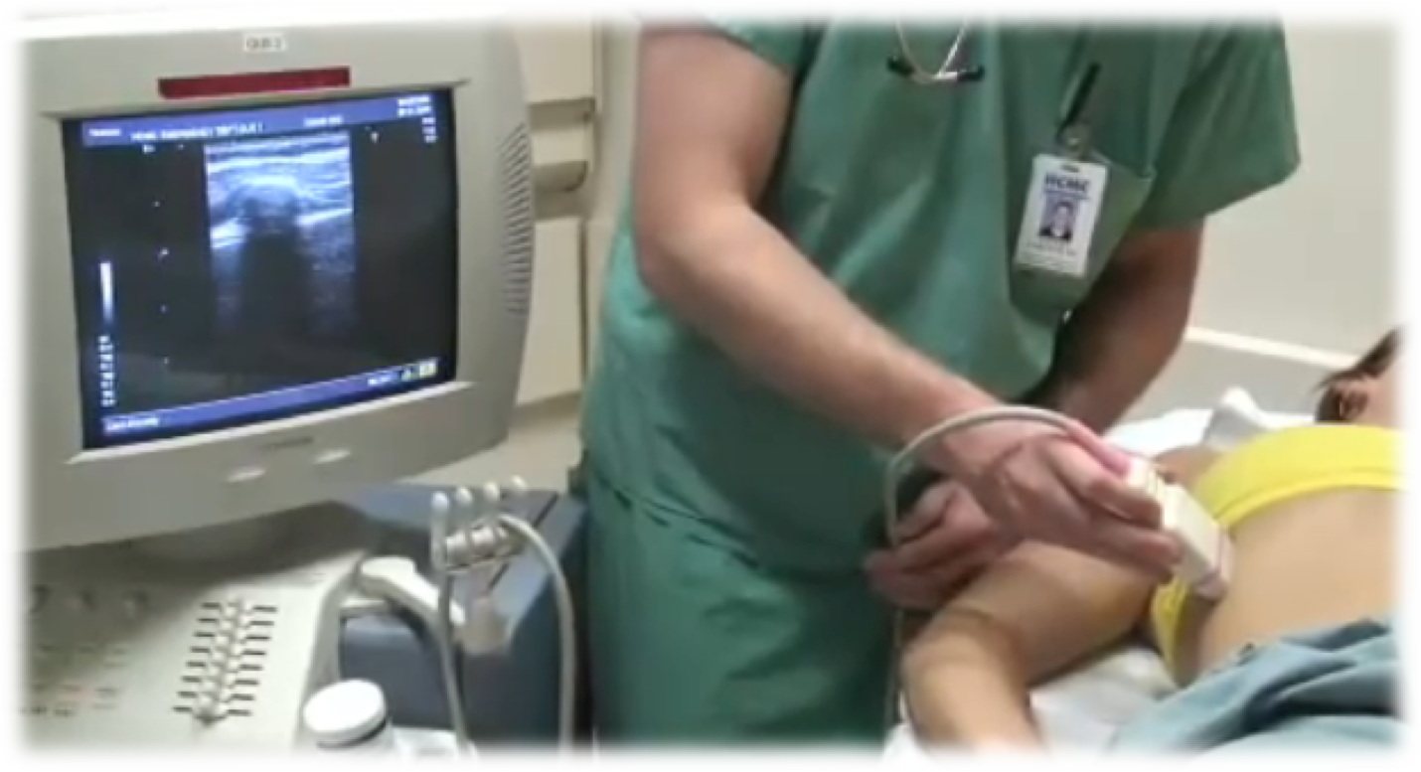

A A Al-BOUKAI-26

Slide 28
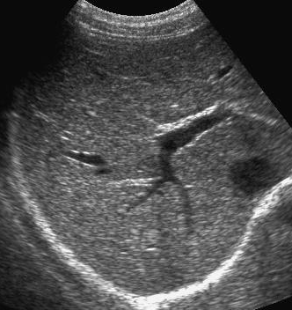
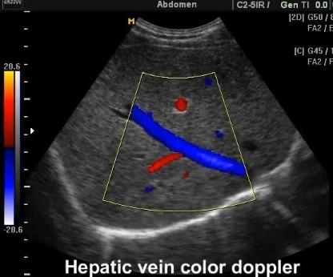
ULTRASOUND
Echogenicity Shadowing Doppler for flow
ADVANTAGES
No radiation Can be portable
Relatively inexpensive
A A Al-BOUKAI-26

Slide 29

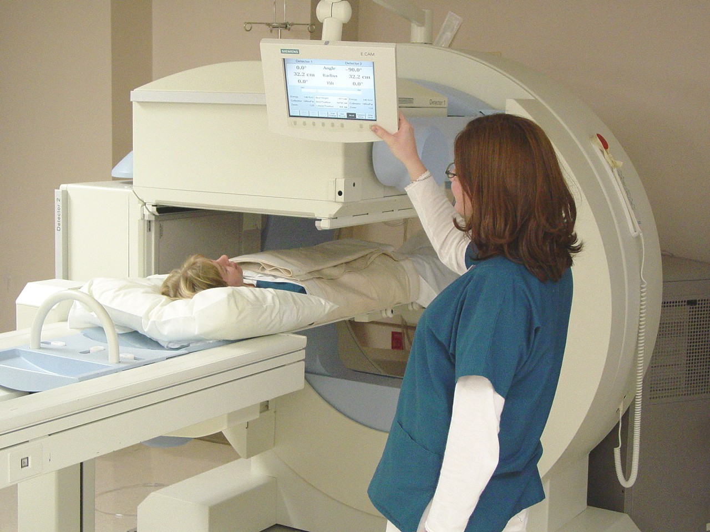
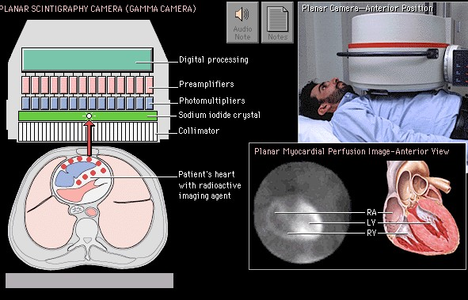

A A Al-BOUKAI-27

Slide 30
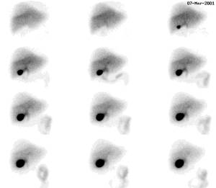
Uses gamma rays to produce an image (Counts or Activity).
Radioactive nuclide given IV, per os, per rectum etc.
Rays emitted from the patient
Physiologic imaging (Abnormal function, metabolic activity).
Poor for anatomical information.
Radioactivity stays with the patient until cleared or decayed
A A Al-BOUKAI-27

Slide 31

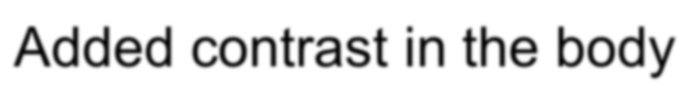
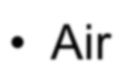
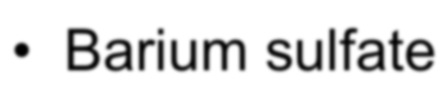
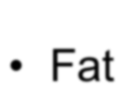
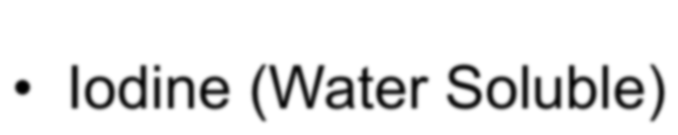
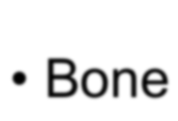

Added contrast in the body
Natural contrast in the body
Air
Fat
Bone
Barium sulfate
Iodine (Water Soluble)

Slide 32







Iodine (Water Soluble)
Barium sulfate
A A Al-BOUKAI

Slide 33





