Slide 1
GIT Radiological investigations and anatomy
Dr. Sultan Alharbi
Assistant Professor and Consultant Interventional Radiologist

Slide 2
Objectives:
 To know various radiological investigations used for GIT.
 To understand step wise approach in requesting GIT radiology investigations.
 To be familiar with radiological appearance (anatomy)
seen in various imaging modalities.
 To interpret plan x-ray radiograph of abdomen with common pathologies.

Slide 3

Reference:
 Diagnostic imaging:
Chapter 5 and 6

Slide 5
IMAGING MODALITIES:
 X-RAY.
 FLUOROSCOPY ( CONTRAST STUDY).
 ULTRASOUND.
 CT.
 MRI.
 NUCLEAR MEDICINE.
 ANGIOGRAPHY.

Slide 7
GIT characteristics:
 Hallow viscus ( not solid).
 Usually filled with gas.
 Motility.

Slide 8
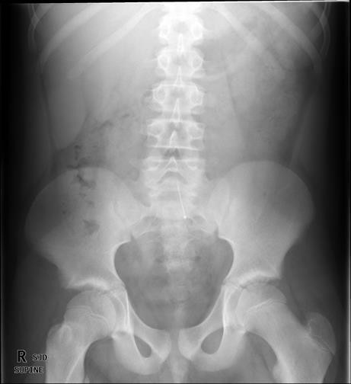
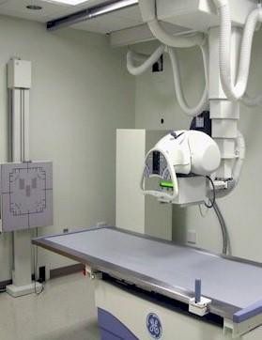
X-ray ( plain radiography)
 Often used as first
imaging modality.
 Cheap.
 Fast.
 Can be done bedside
(portable)
 Useful for free gas or bowel obstruction.

Slide 9
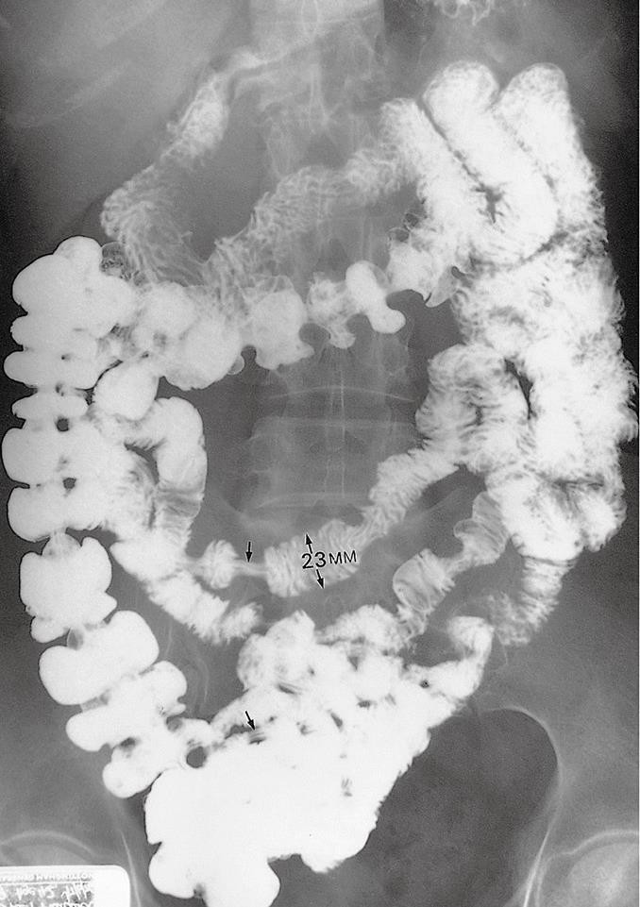
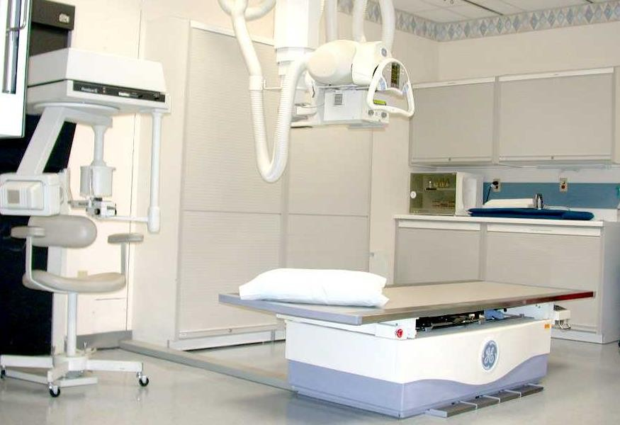
Fluoroscopy (contrast study)
 Can be used as first
imaging modality.
 Cheap.
 Use of contrast.
 Recently replaced by
CT and MRI
 Useful for intraluminal pathology.
 Can give clue about
the motility (function)

Slide 10
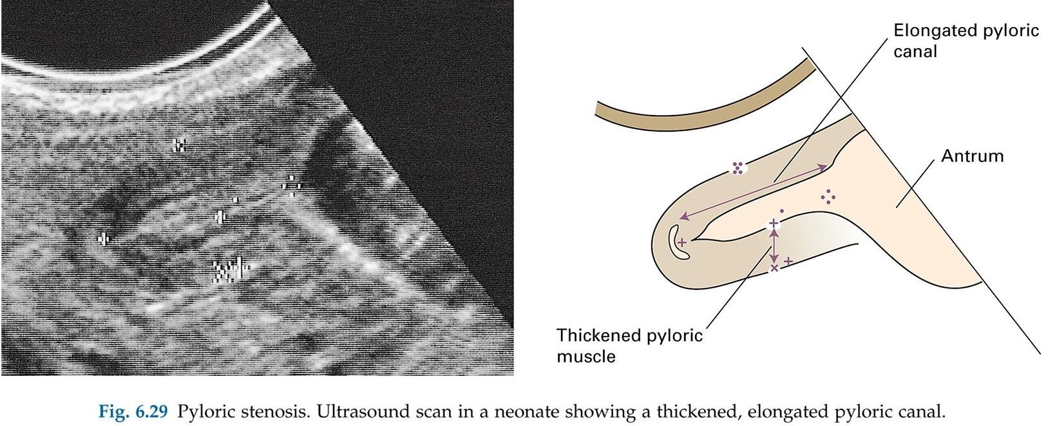
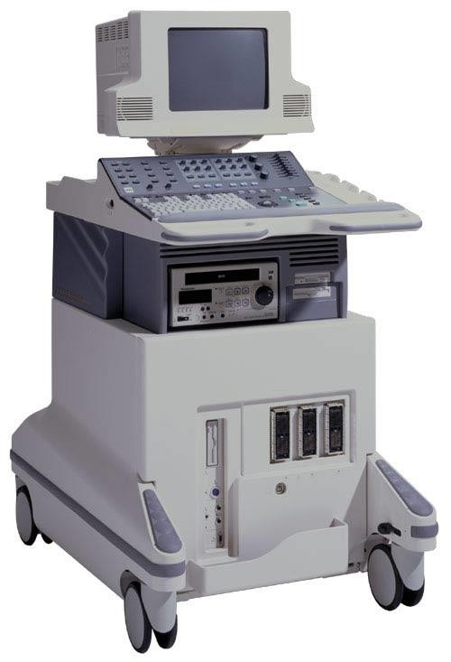
Ultrasound
 Relatively cheap.
 No radiation.
 Limited uses (gas filled structures).
 Used in pediatrics and pregnant ladies

Slide 11
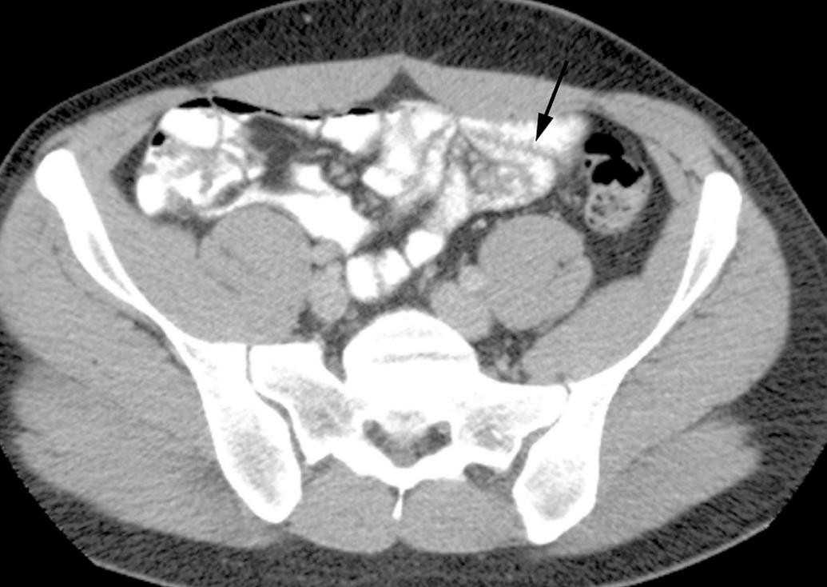
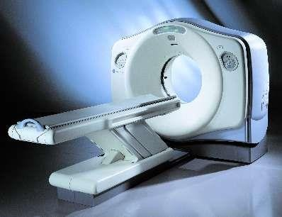
CT ( computer tomography)
 Expensive.
 More radiation.
 Fast.
 Contrast (iv, oral &rectal) usually used.
 Used in emergency department.

Slide 12
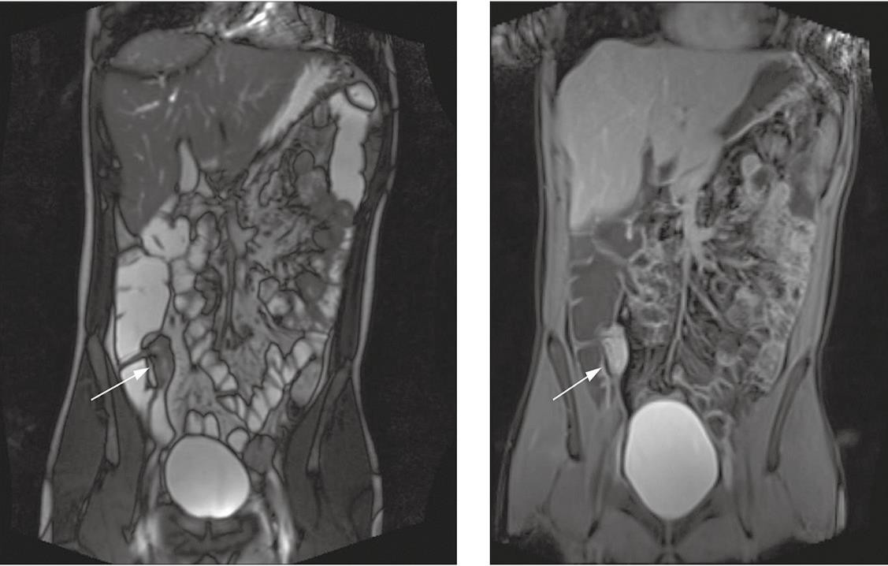
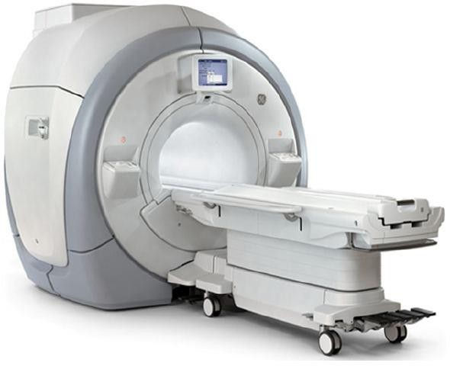
MRI ( Magnetic resonance imaging)
 More expensive
than CT.
 No radiation.
 Slow and affected by artifacts.
 Excellent for soft tissue.

Slide 13
Radiological appearance of GIT

Slide 14
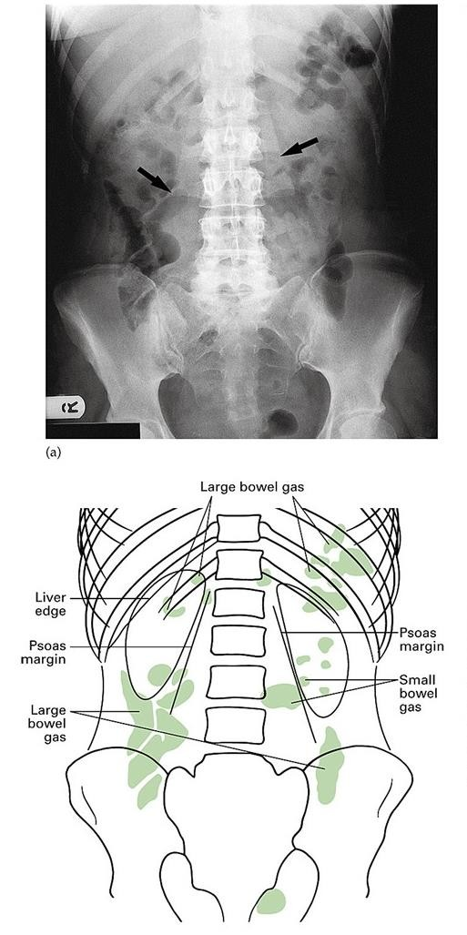

Slide 15
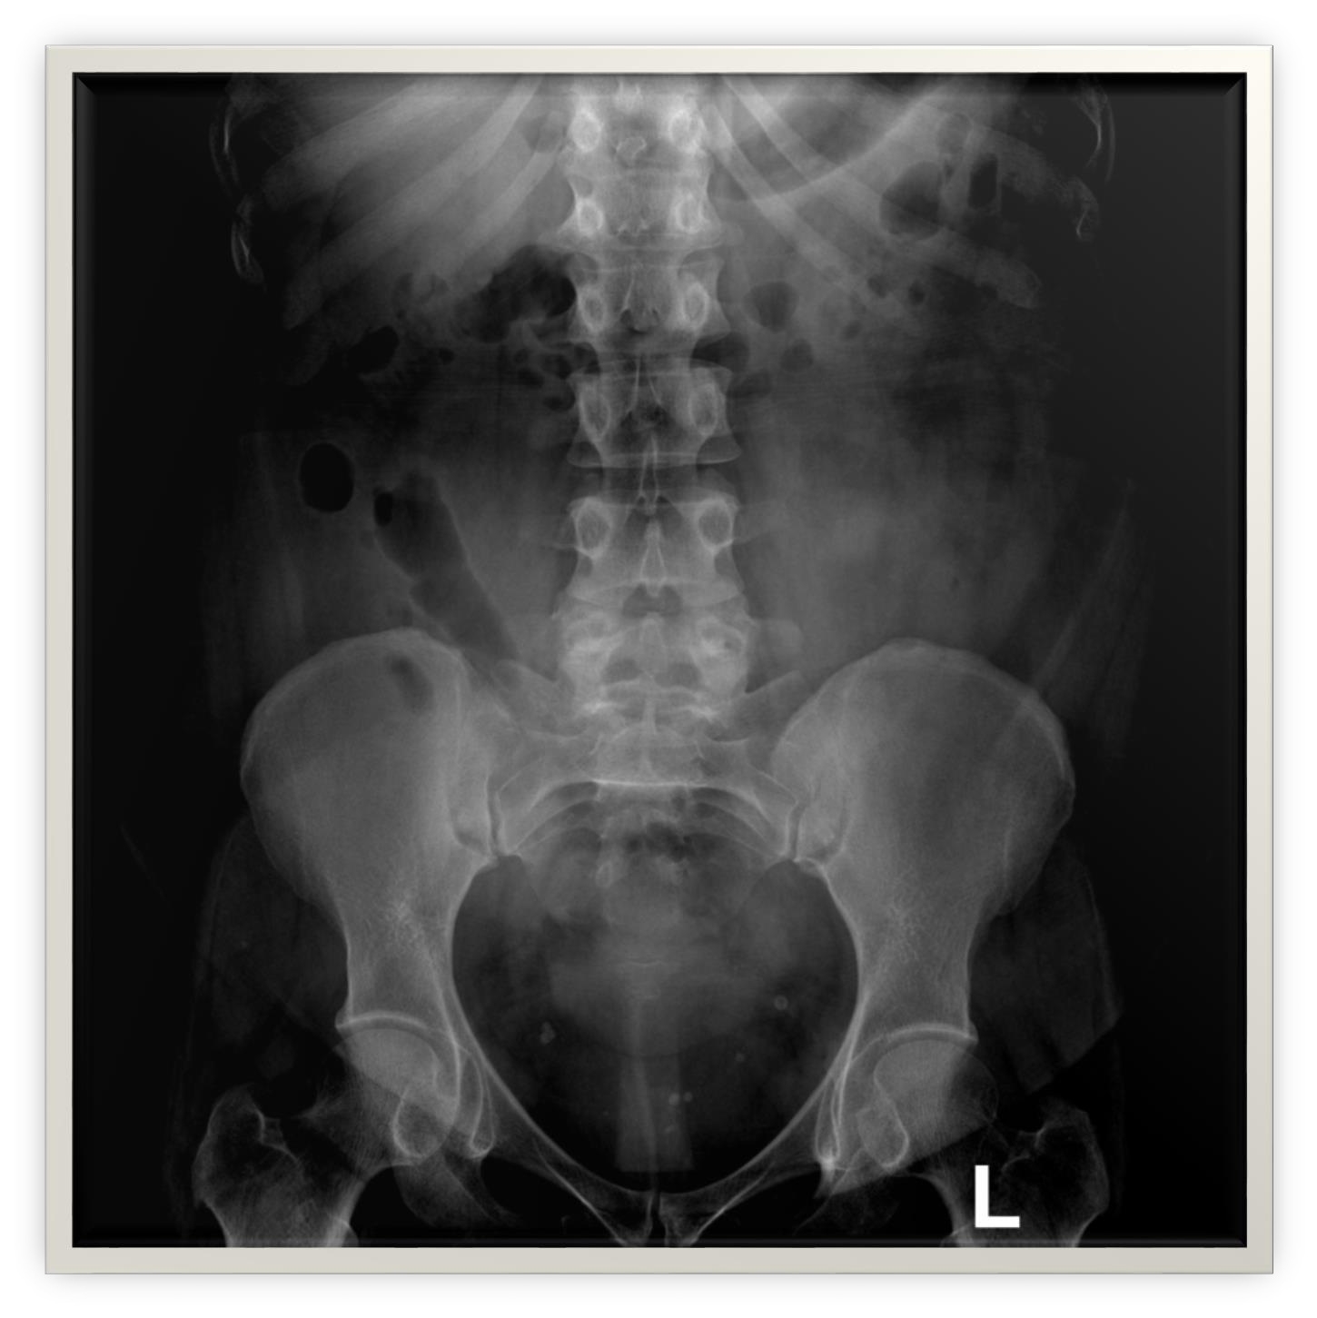
2
1
5
3
4

Slide 16






Transverse colon
stomach
Small bowel
cecum
Descending colon

Slide 17
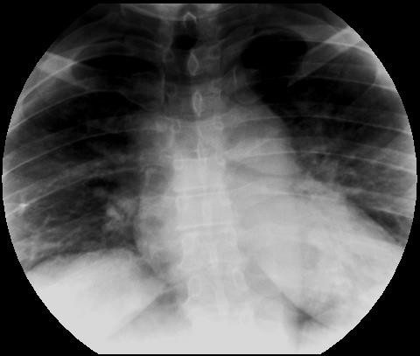
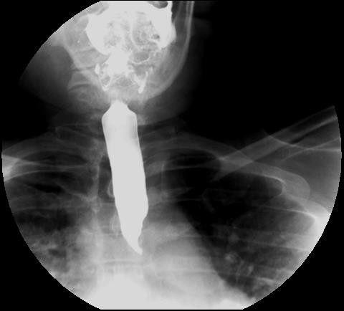
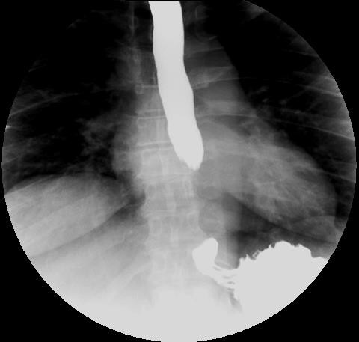
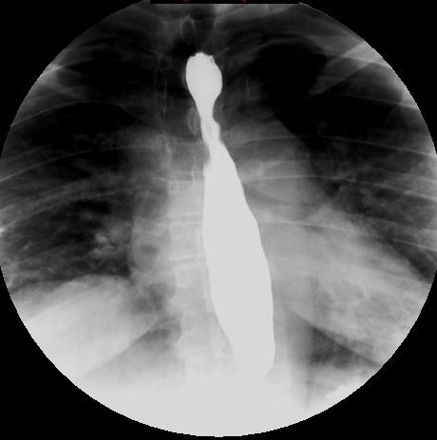

Slide 18
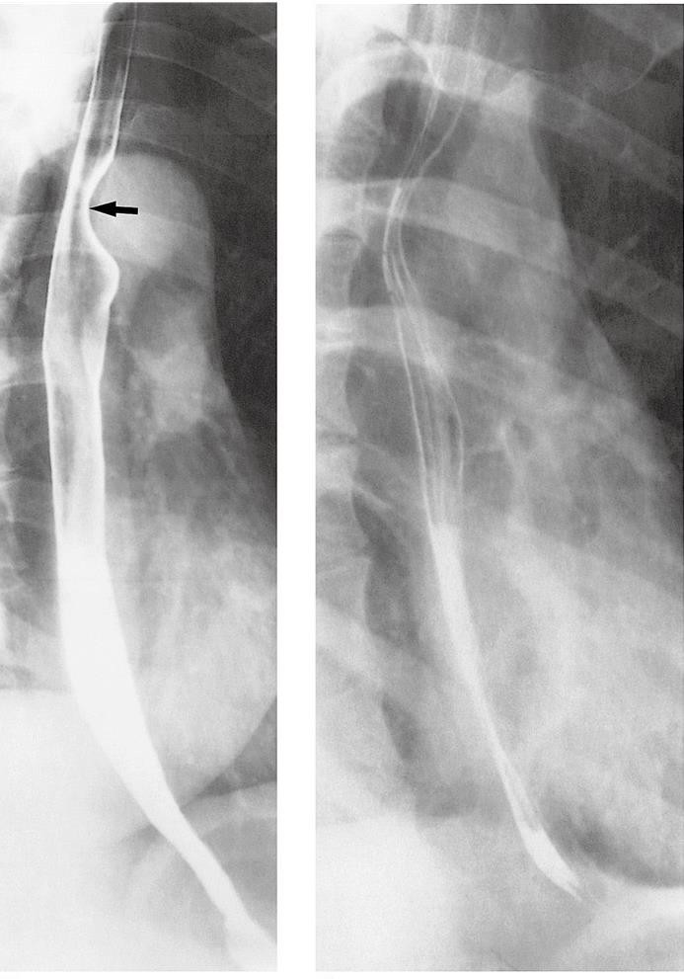
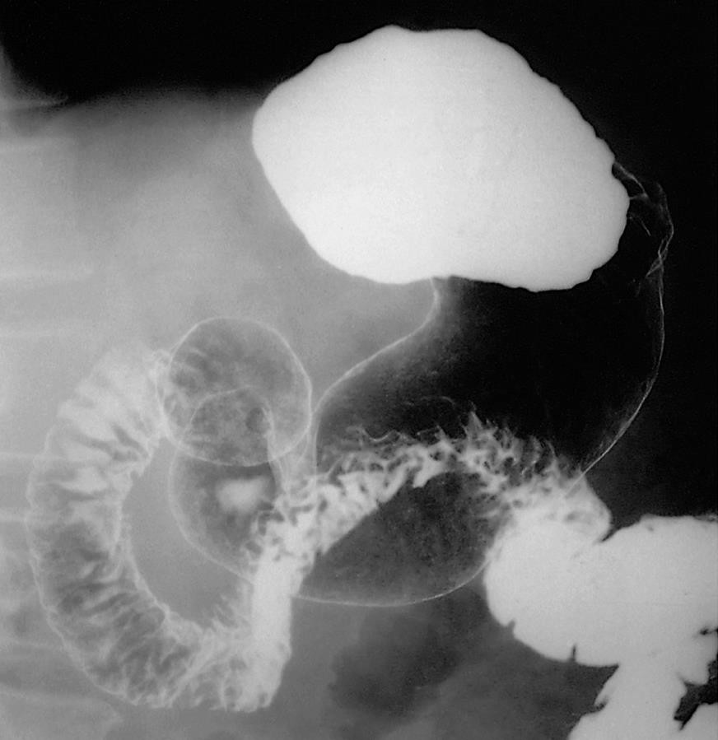

Slide 19
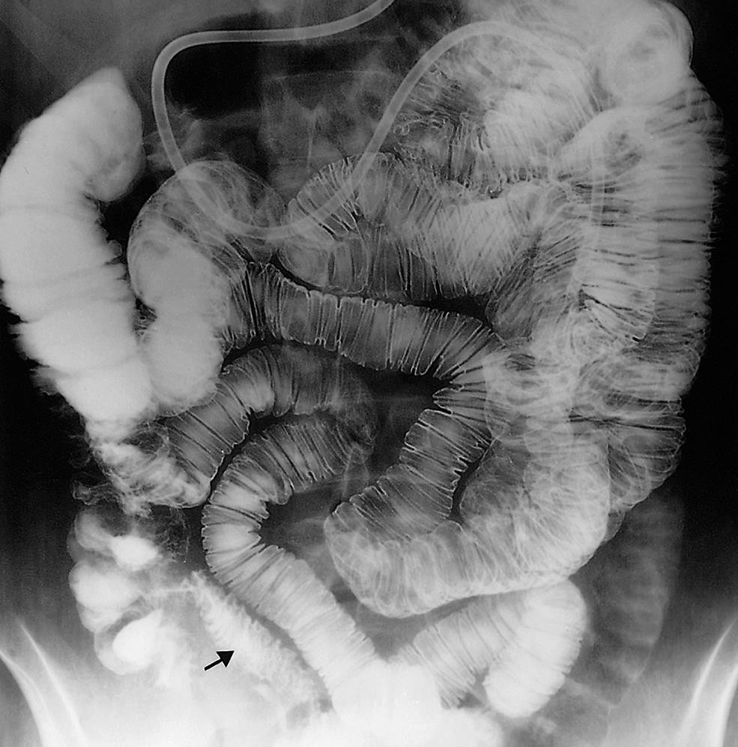

Slide 20
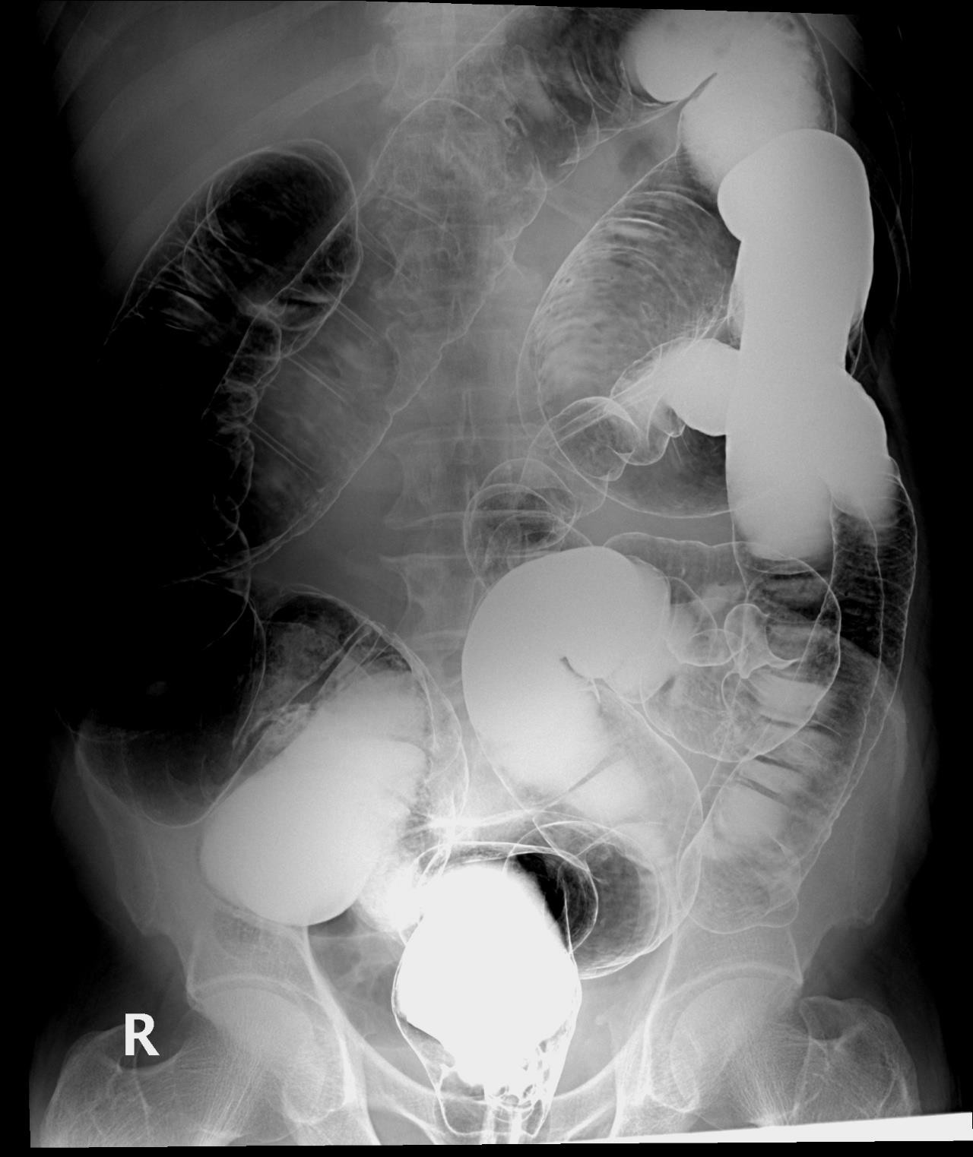


5
4
6
3
7
2
8
1

Slide 21
5
4
6
Rectum
Sigmoid colon
Descending colon
3
4. Splenic flexure
Transverse colon
Hepatic flexure
Ascending colon
cecum
7
2
8
1

Slide 22
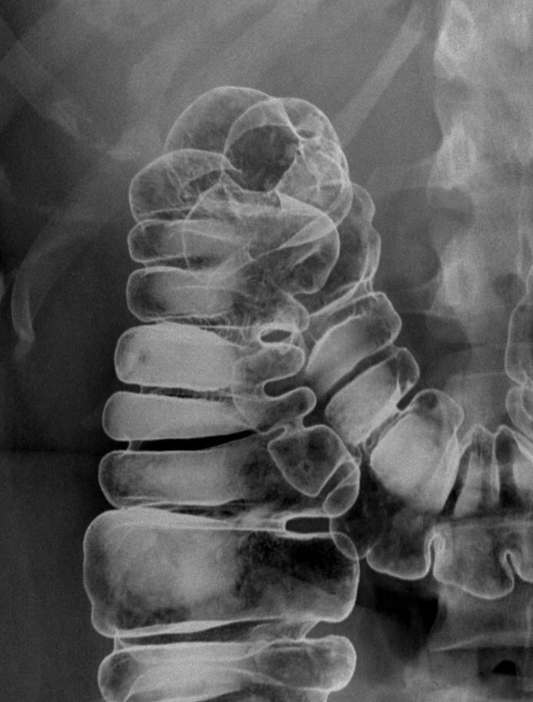
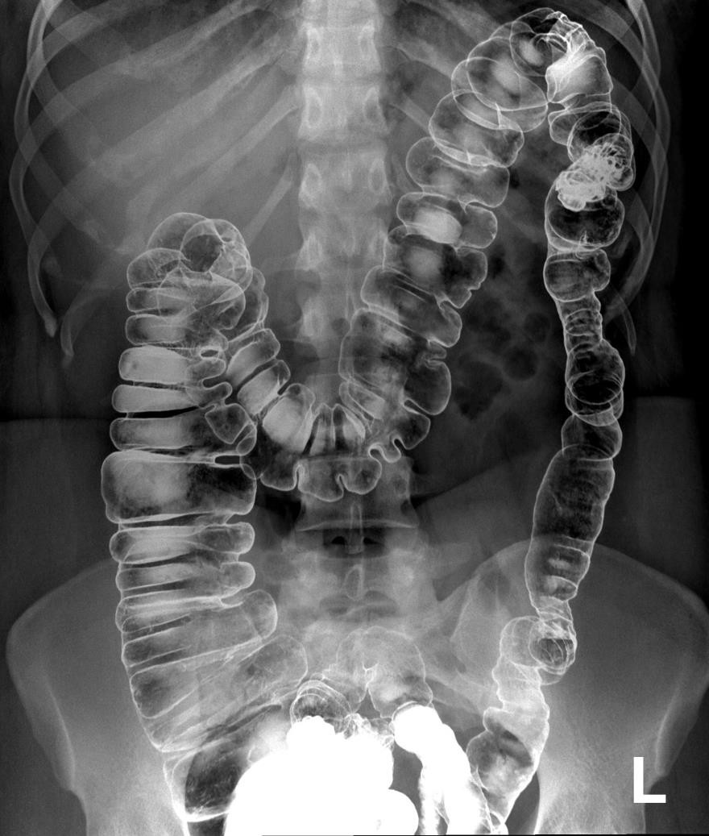

?

Slide 23
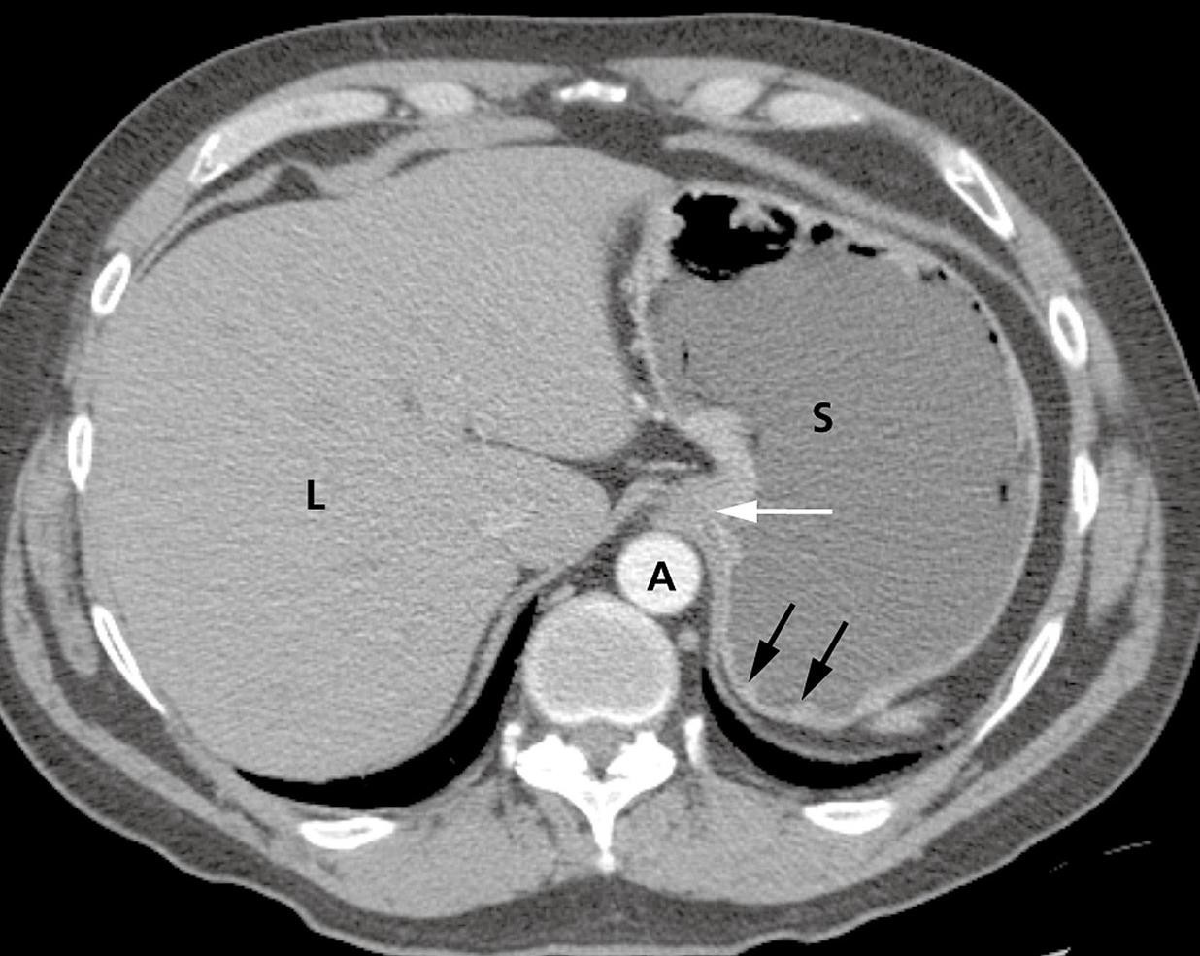
S stomach. L liver.
A aorta.

Slide 24
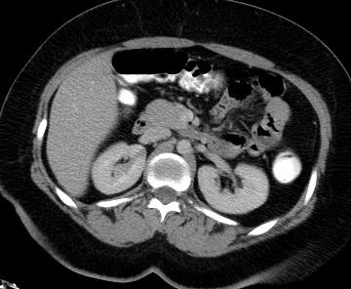
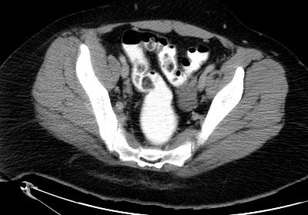


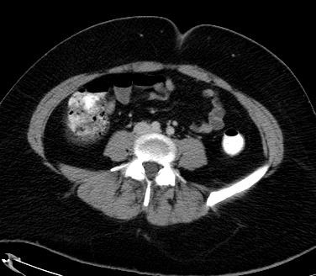
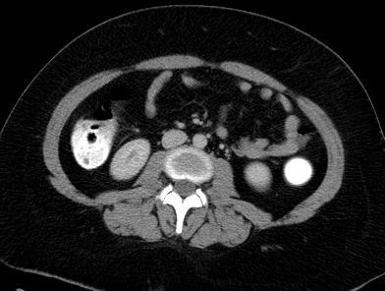



5
2
1
6
4
3

Slide 25

5
2
1
6
4
3
4-Ascending colon
3-Descending colon
6-Cecum
2-Sigmoid colon
1- Rectum
5-Transverse colon

Slide 26
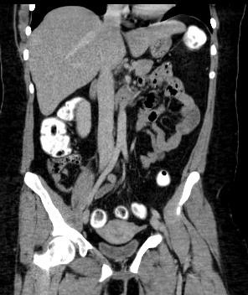
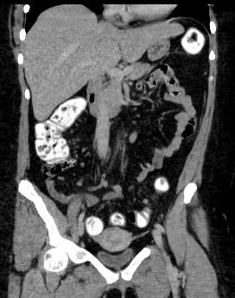
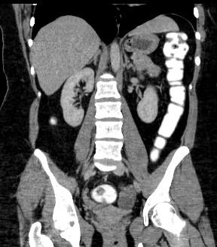





3
2
4
1
5
6

Slide 27
3
2
4
1
5
6
Descending colon
Splenic flexure
Hepatic flexure
Ascending colon
cecum
Sigmoid colon

Slide 28
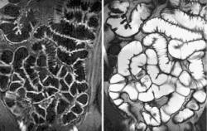
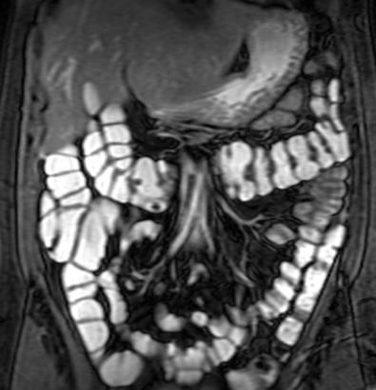
MRI enterography

Slide 29
Common plain x-ray abdomen radiograph findings

Slide 30
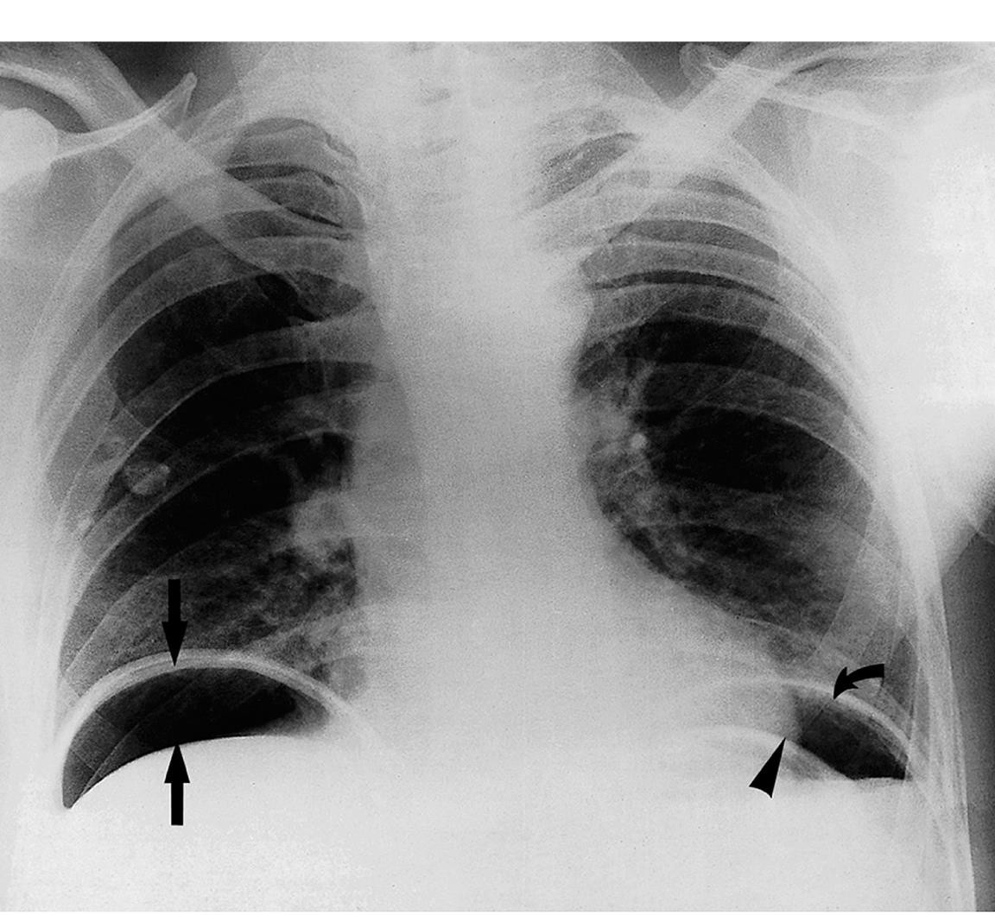
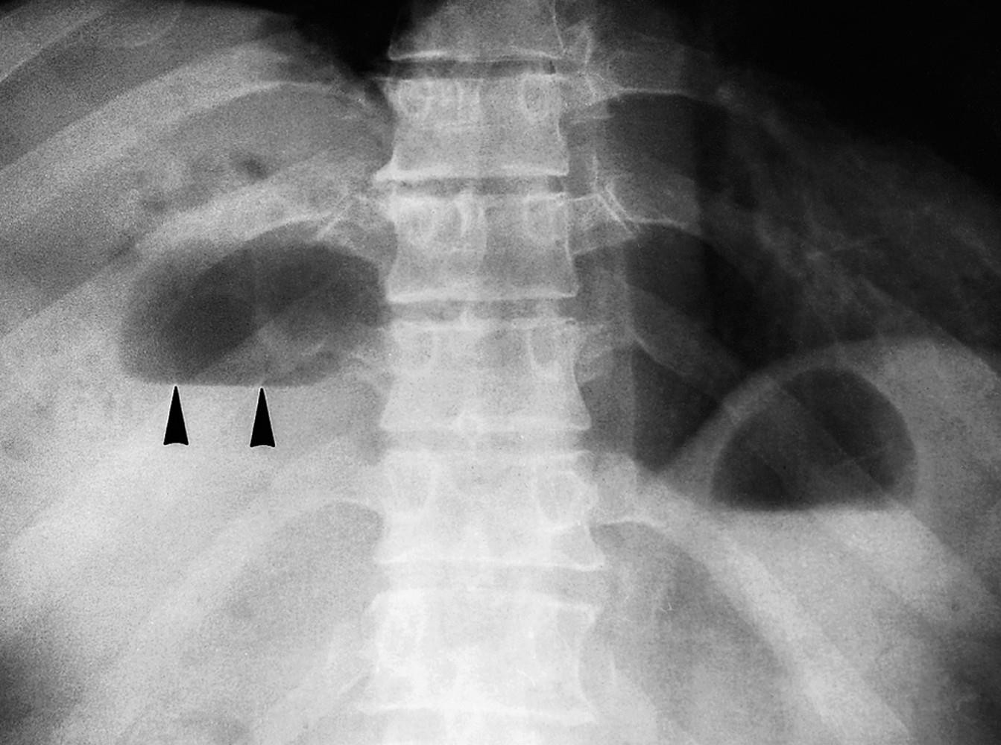

Slide 31
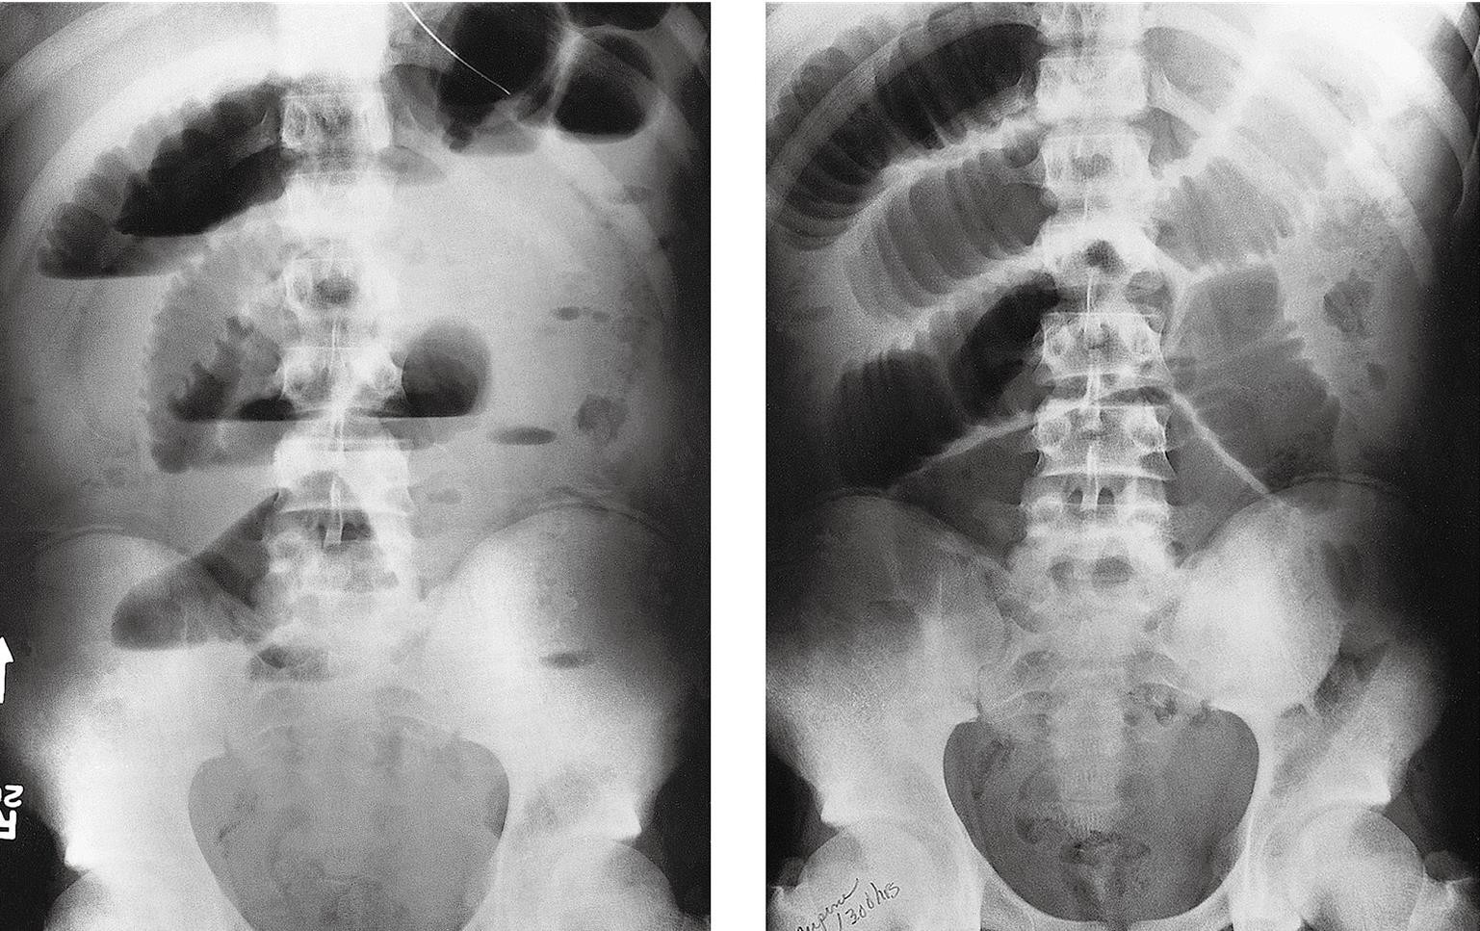

Slide 32
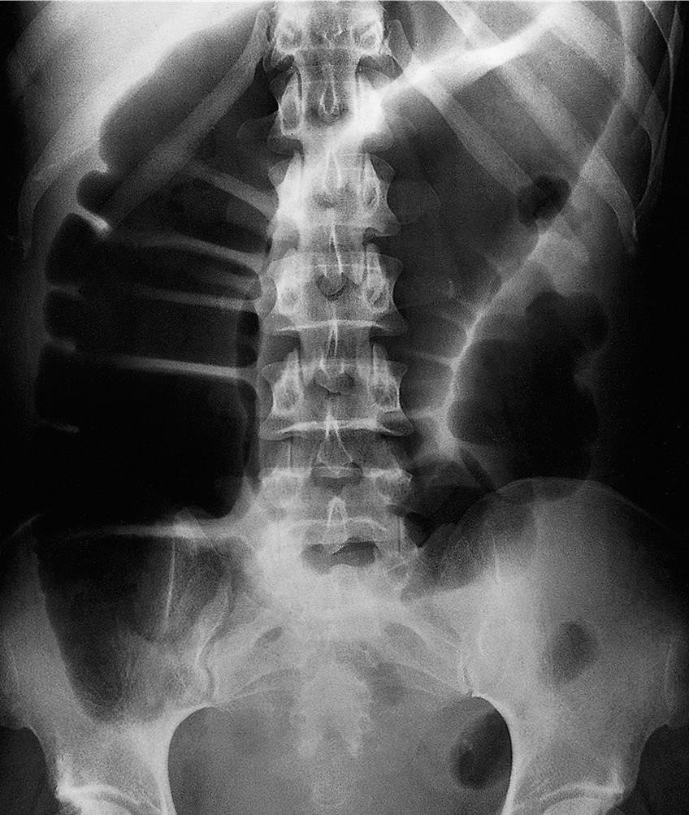
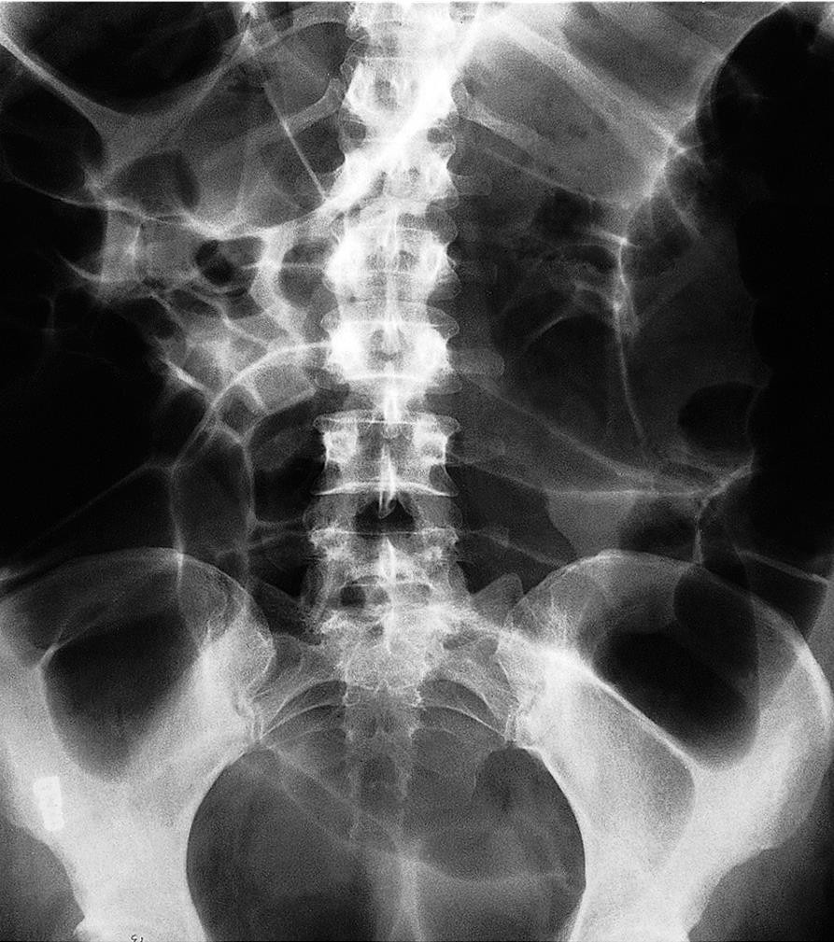

Slide 33
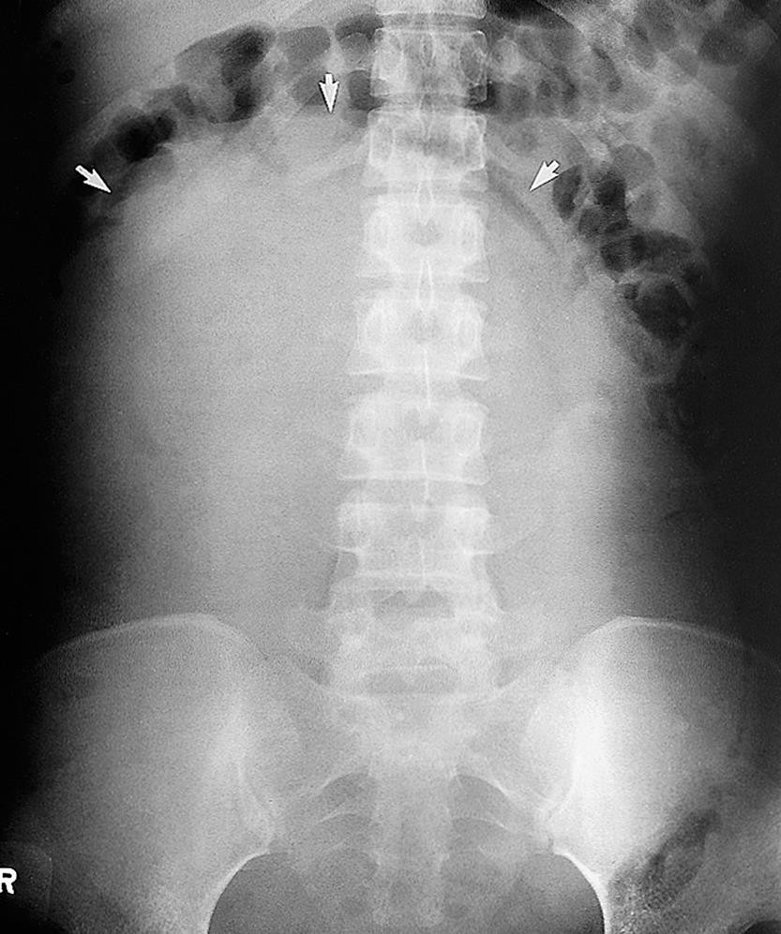
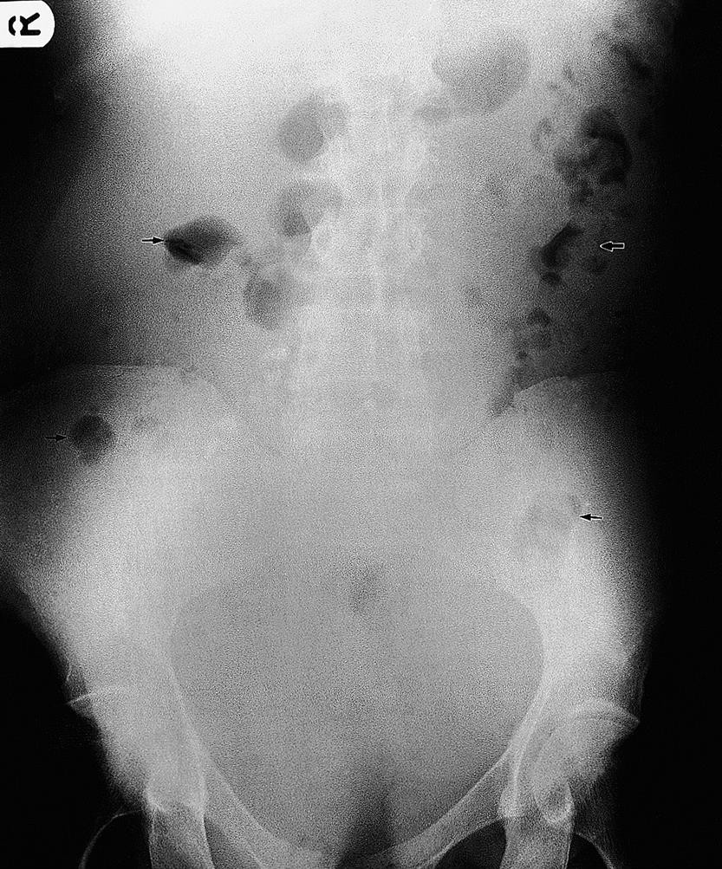

Slide 34
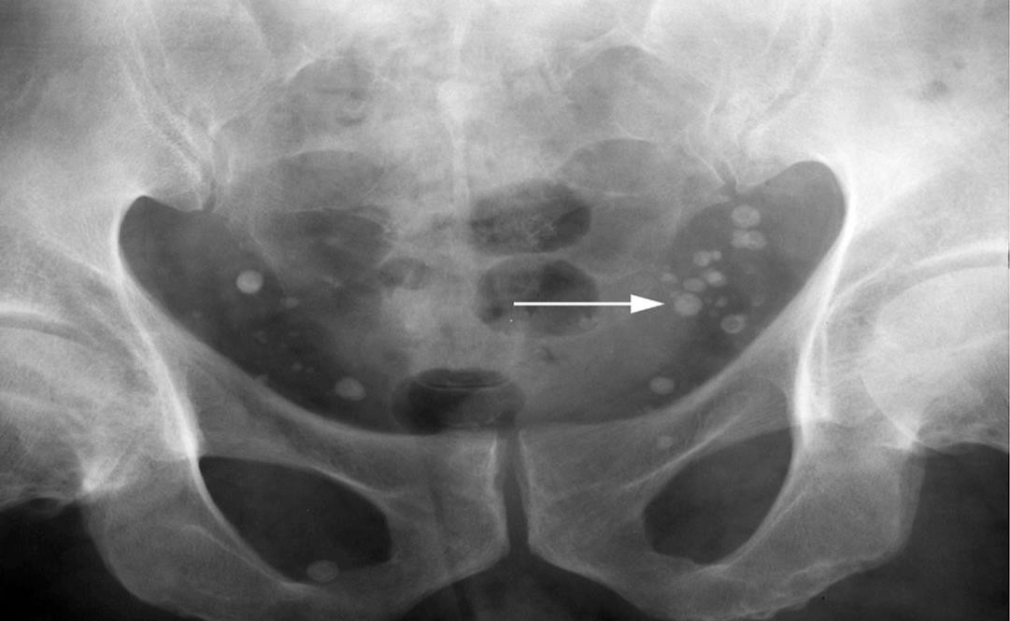
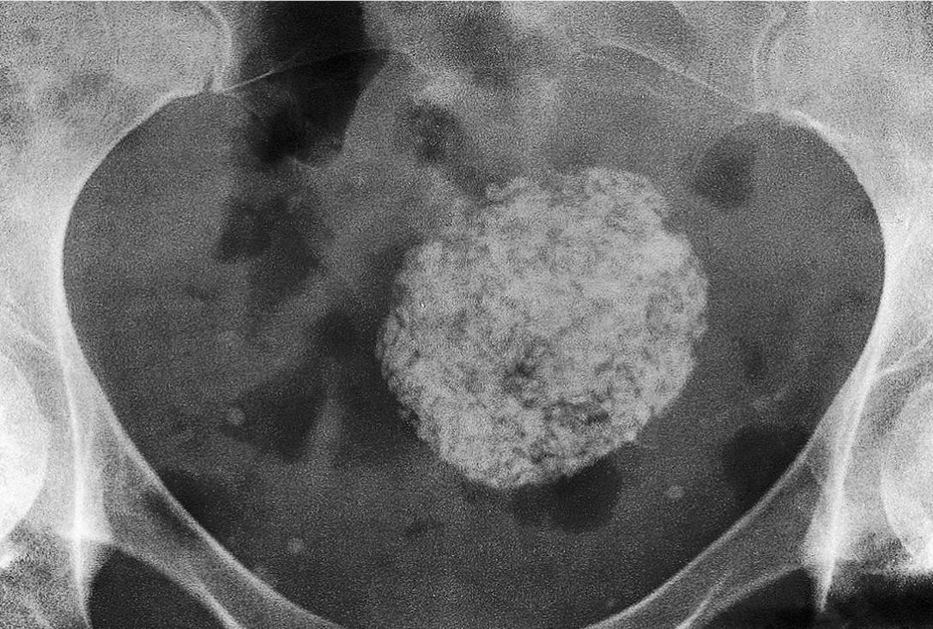
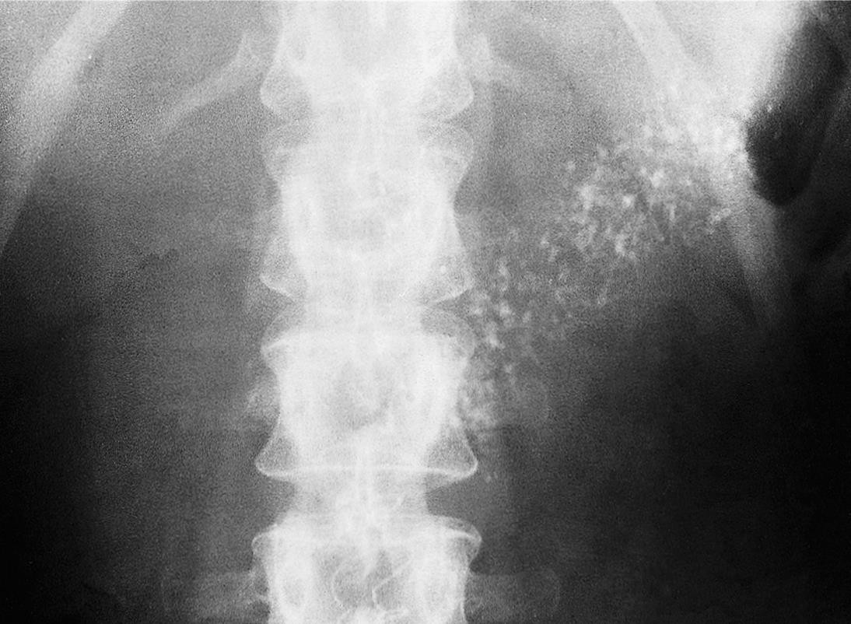
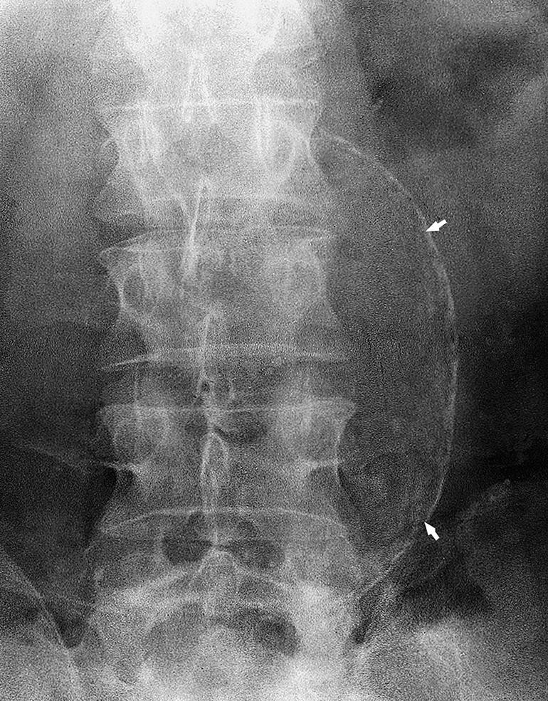

Slide 35



