Slide 1

Radiologic investigation of Chest and CVS diseases
By
Dr Mohamed Sherif El-Sharkawy
ASSOCIATE PROF. and Consultant Radiologist KKUH
KING SAUD UNIVERSITY
LAST UPDATE
October 2016 5 LECTURES SERIES

Slide 2
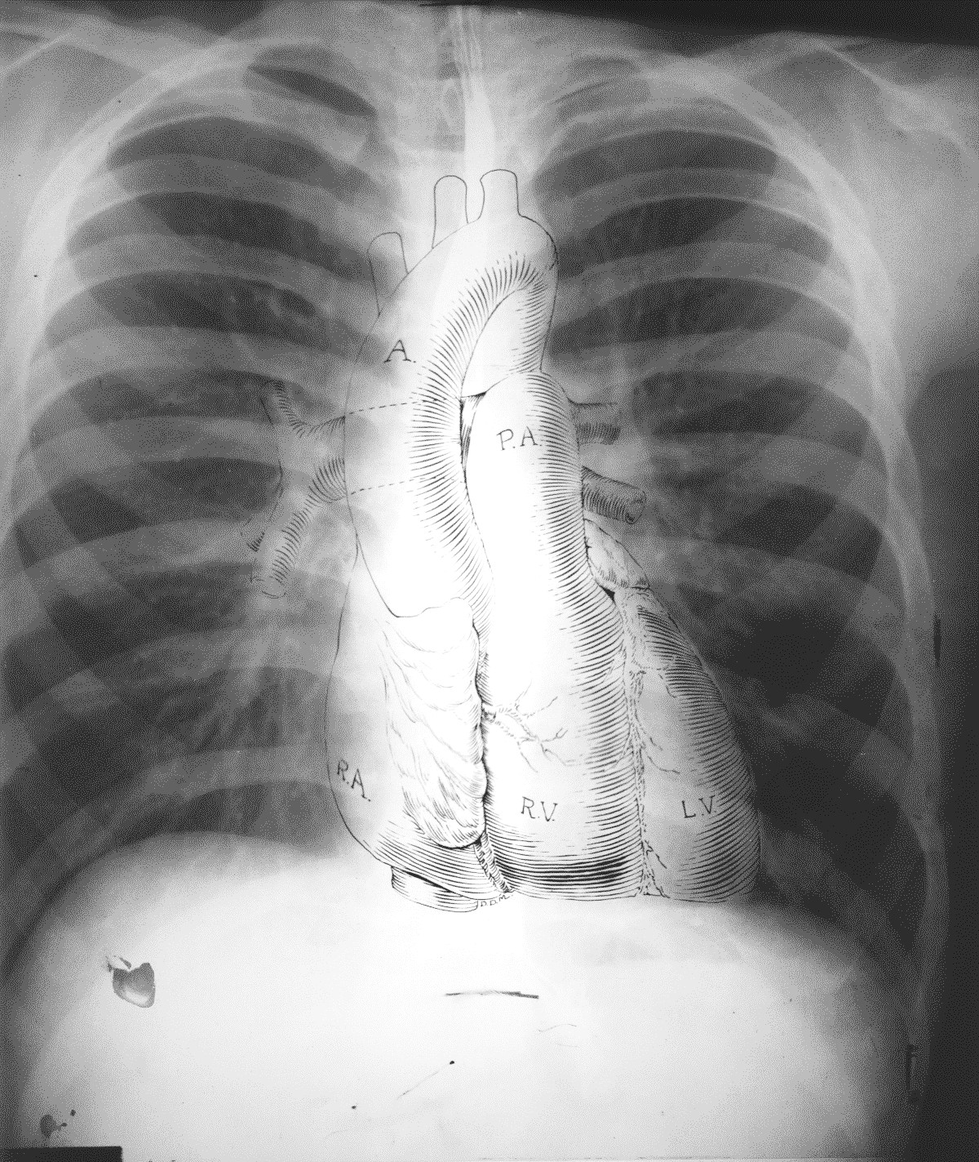

What do we mean by chest
We mean study of thoracic cage contents

Slide 3

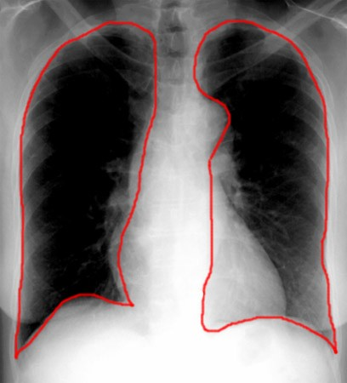




LUNGS
Pleural lining

Slide 4
BASIC CHEST EXAMS
PLAIN FILM=CHEST X-RAY(CXR)
CT FOR CHEST AND MEDIASTINUM
CT FOR LUNG PARENCHYMA HRCT
MRI
ANGIOGRAMS

Slide 5

BASIC CHEST EXAM FOR THE HEART
PLAIN FILM=CHEST X-RAY(CXR)
CT FOR HEART AND MEDIASTINUM
ANGIOGRAMS
MRI
ULTRASOUND (ECHOCARDIOGRAPHY)
ISOTOPIC SCANNING

Slide 6

Imaging Modalities for chest and CVS examinations
Plain films
COMPUTED TOMOGRAPHY
CT LUNGS AND MEDIASTINUM
CT- angiography (CTA)
High resolution CT of the chest (HRCT)
Angiography 4- MRI

Slide 7
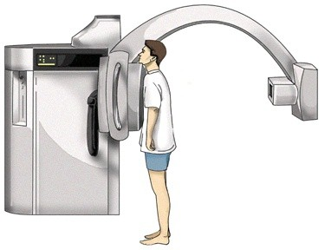

Basic Chest X-Ray

Slide 8

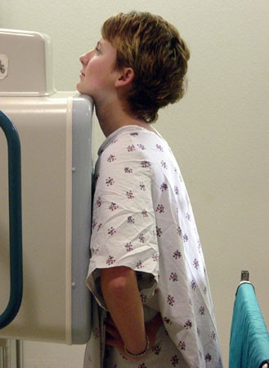
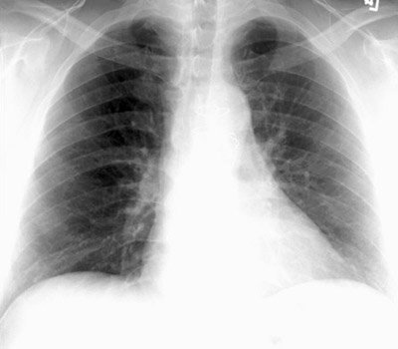
PA VIEW
FILM OR DETECTOR
X-RAY BEAM

Slide 9

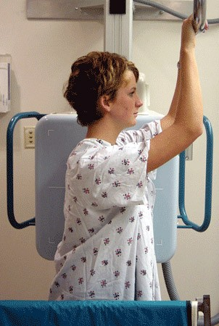
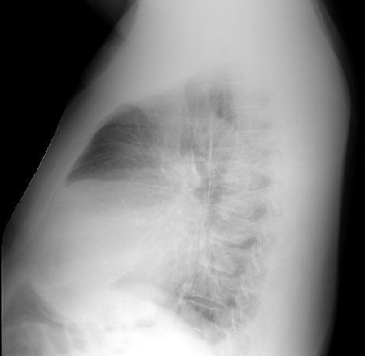

LATERAL VIEW

Slide 10

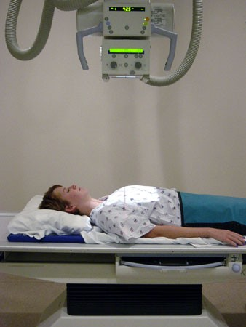
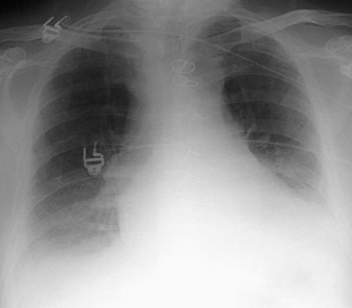
AP VIEW

Slide 11
OPTIMAL EXAMINATION

Slide 12

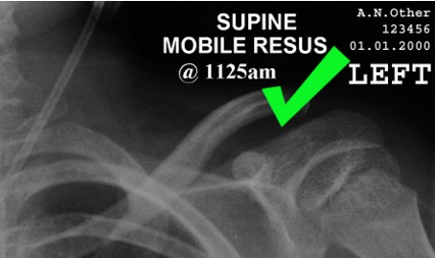
Patient data

Slide 13
PA
vs.
AP
FALSE ELARGEMENT

Slide 14
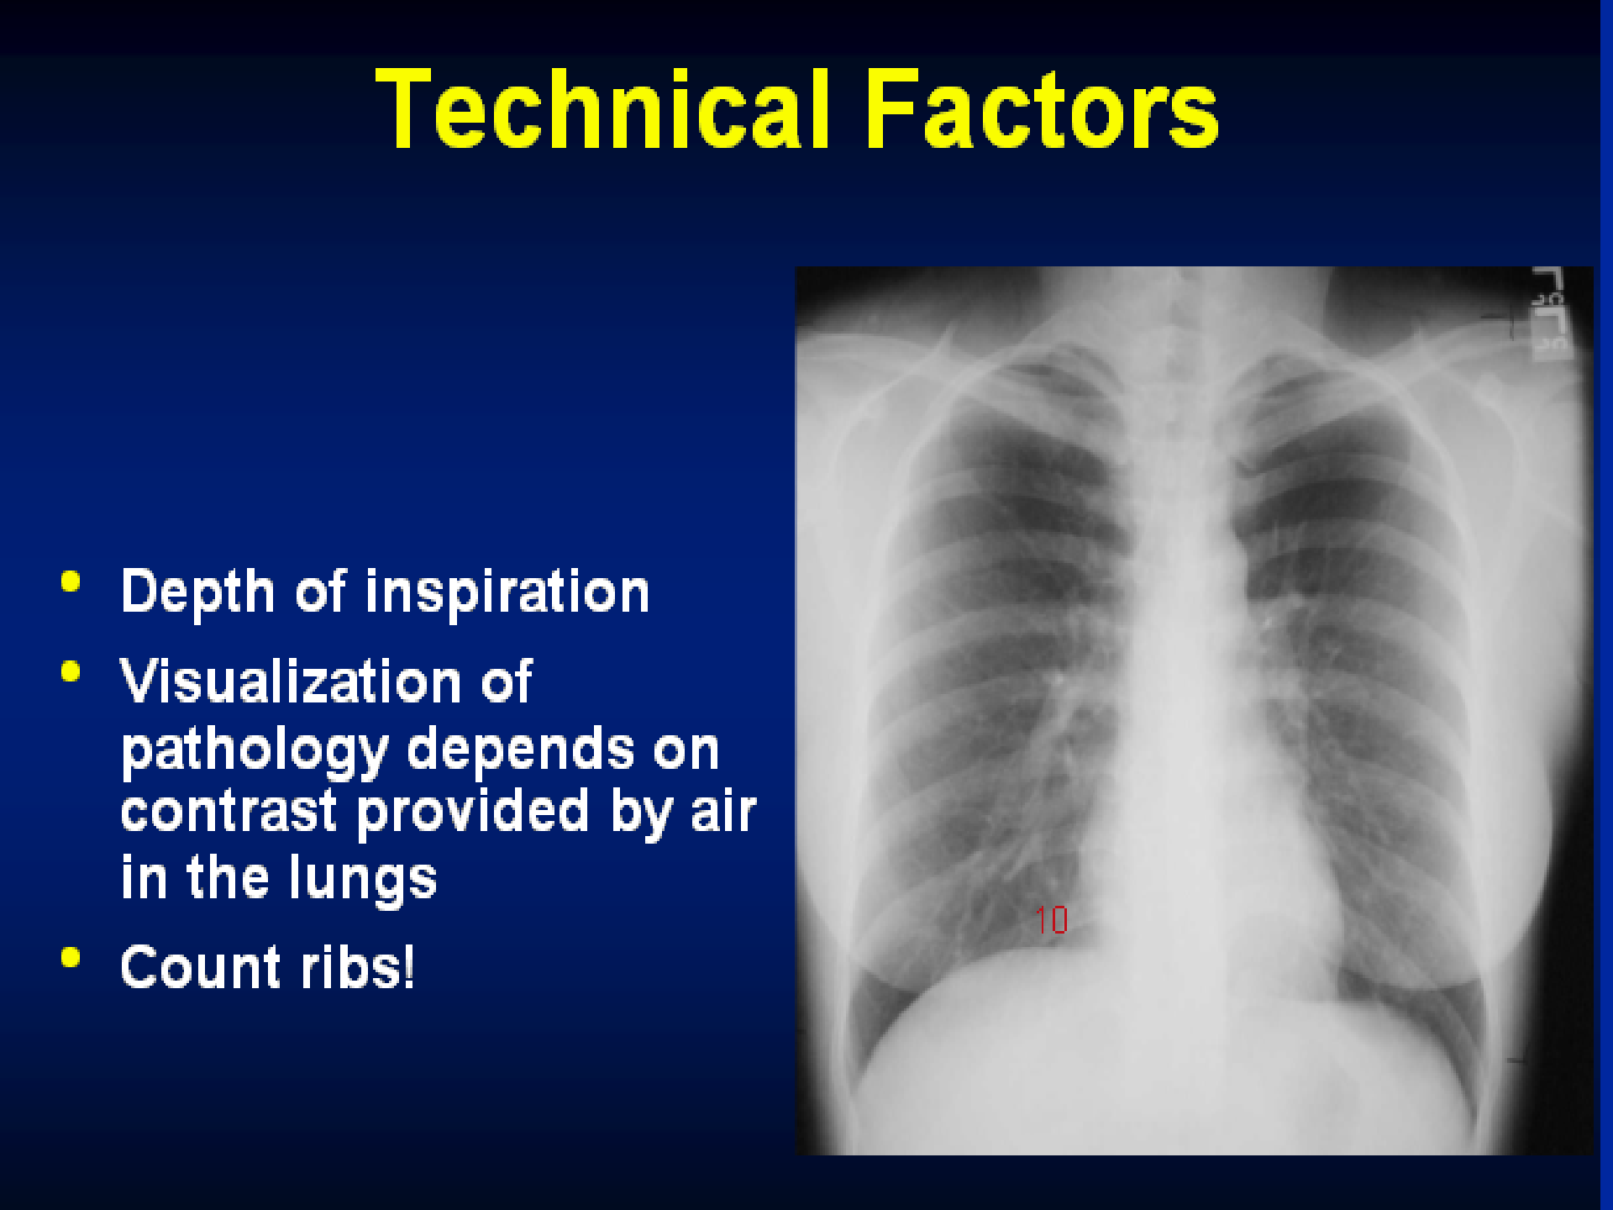
PATIENT NOT ROTATED

Slide 15
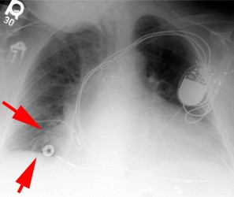
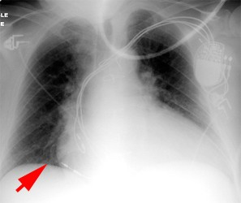
Hypo-inspiratory vs inspiratory

Slide 16

Inspiration
This greatly helps the radiologist to determine if there are intrapulmonary abnormalities.
The diaphragm should be found at about the level of the 8th - 10th posterior rib or 5th - 6th anterior rib on good inspiration.

Slide 17
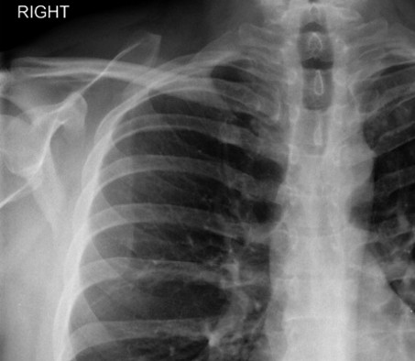
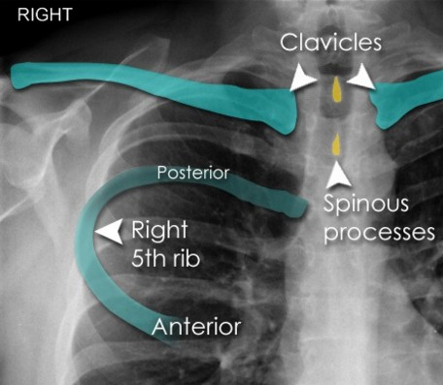

Slide 18

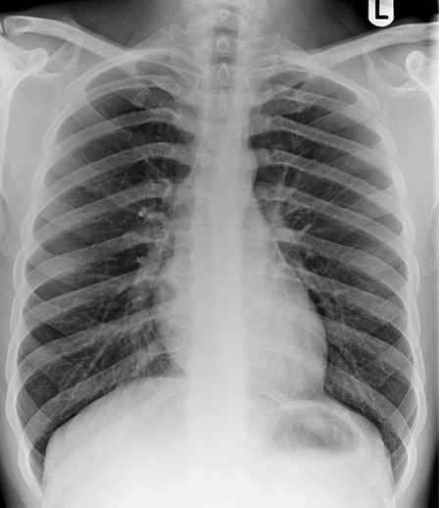
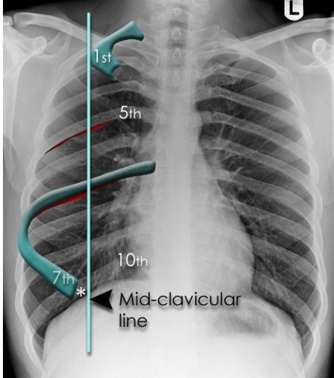
RIBS

Slide 19
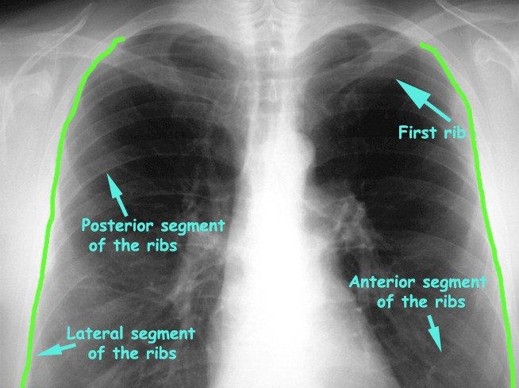

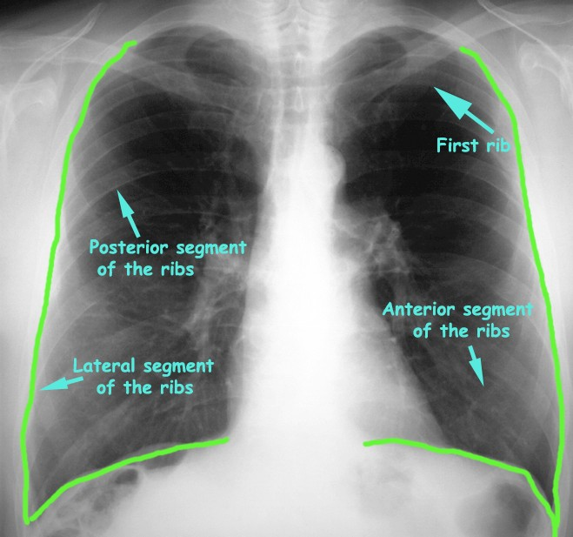
Frontal Chest X-Ray

Slide 20
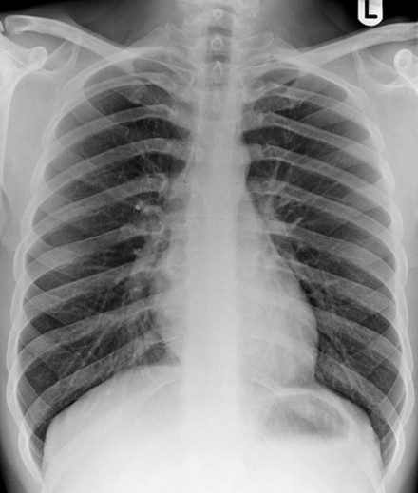
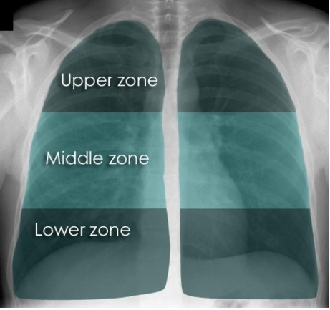
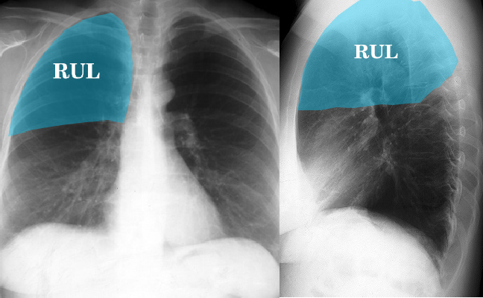
DIVIDING LUNG FIELDS 1-BY ZONES
2-BY LOBES
FOR DIAGNOSTIC REASONS
1
2

Slide 21
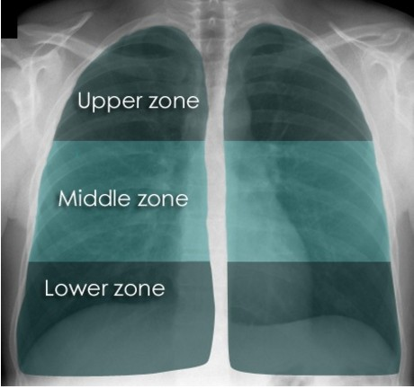
Assessing the lung zones
BY ZONES
Each zone is compared with its opposite side paying attention to any asymmetry.
If the lungs appear asymmetrical, it should be determined if this can be explained by asymmetry of normal structures, technical factors such as rotation, or lung pathology.
If there is genuine asymmetry, decide which side is abnormal. Often a dense (whiter) area is abnormal, but some diseases cause reduced density (blacker). If there is an area that is different from the surrounding ipsilateral lung, then this is likely to be the abnormal area.You should also be aware that some diseases result in bilateral lung abnormalities, making comparison of left with right difficult. In these cases it is still important to assess each zone in turn, to avoid missing subtle abnormalities on the background of abnormal lung.
Lung zones
Dividing the lungs into zones allows more careful attention to be paid to each smaller area. If this is not done it is easy to ignore important abnormalities.
Note that the lower zones reach below the diaphragm. This is because the lungs pass behind the dome of the diaphragm into the posterior sulcus of each hemithorax. Normal lung markings can be seen below the well defined edges of the diaphragm.

Slide 22
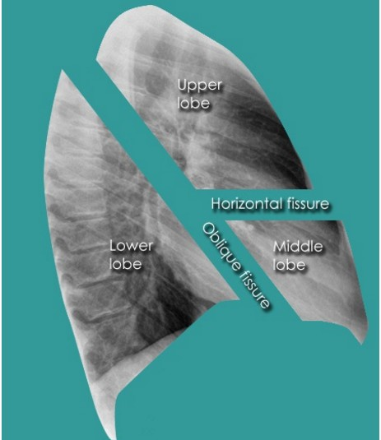
ASSESING LUNG FIELDS
BY LOBES
The surface of the visceral pleura that covers the lung, is continuous with the visceral pleura that covers the fissures.The left lung is divided into two lobes, upper and lower. These lobes have their own pleural covering and these lie together to form the oblique (major) fissure.In the right lung there is an oblique fissure and a horizontal fissure, separating the lung into three lobes - upper, middle, and lower. Each lobe again has its own visceral pleural covering.
Lateral chest X-rays are helpful in demonstrating the oblique fissures (also known as the major fissures)
Lobes and fissures
This cut-out of a lateral chest X- ray shows the positions of the lobes of the right lung
On the left the oblique fissure is in a similar position but there is usually no horizontal fissure, and so there are only two lobes on the left.

Slide 23

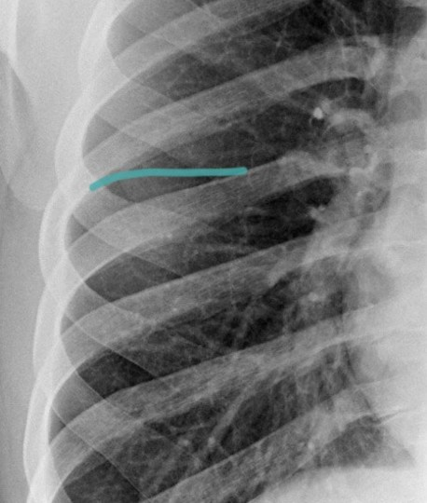
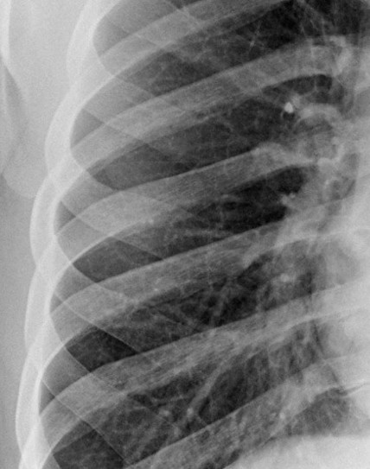
Transverse fissure

Slide 24

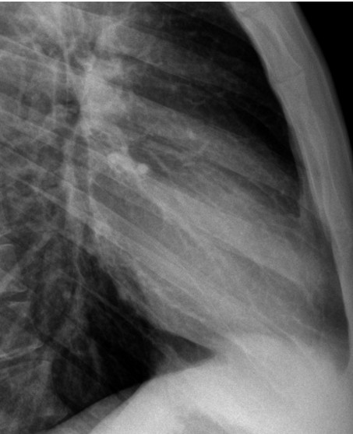
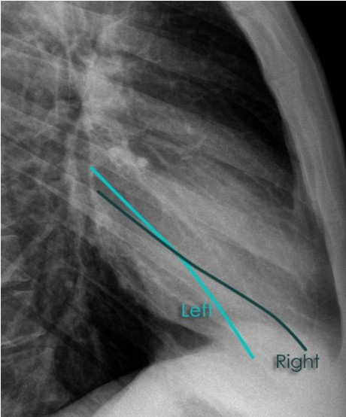
Oblique fissure

Slide 25
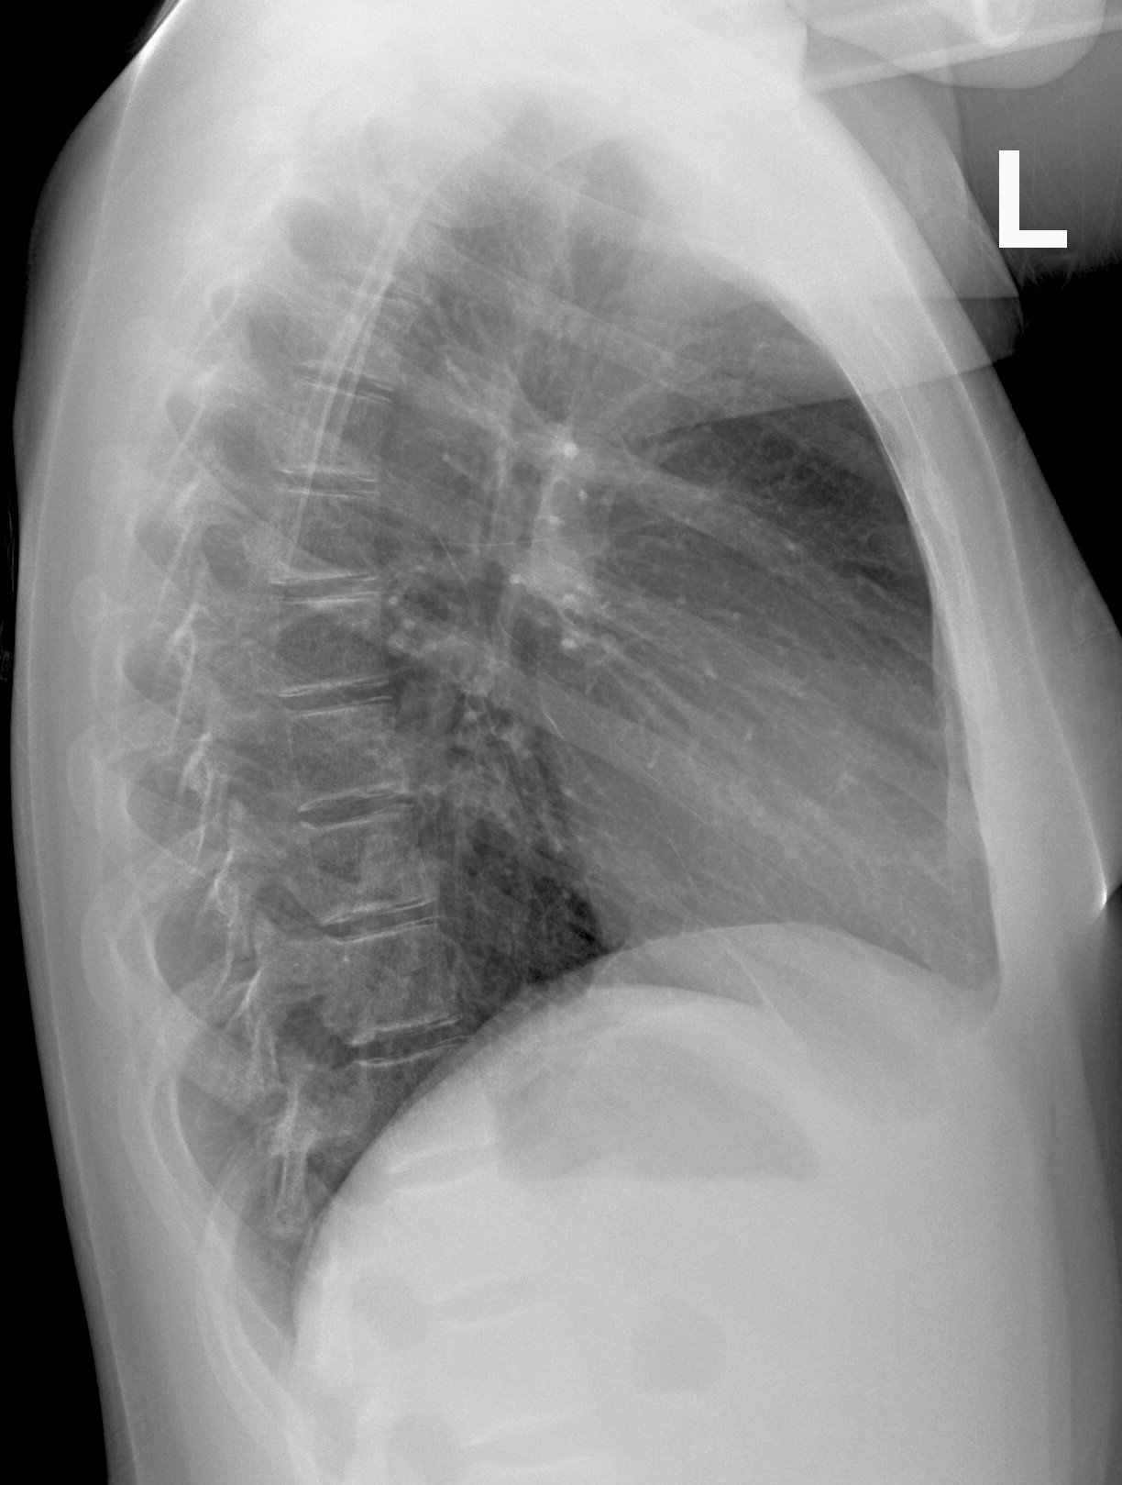

Radiological Anatomy of the Chest
L
R
Upper Lobe
Upper Lobe
Minor Fissure
Middle Lobe
Lower Lobe
Major Fissure
Lower Lobe
Major Fissure
LEFT LUNG
RIGHT LUNG

Slide 26

Radiological Anatomy of the Chest
Fissures

Slide 27
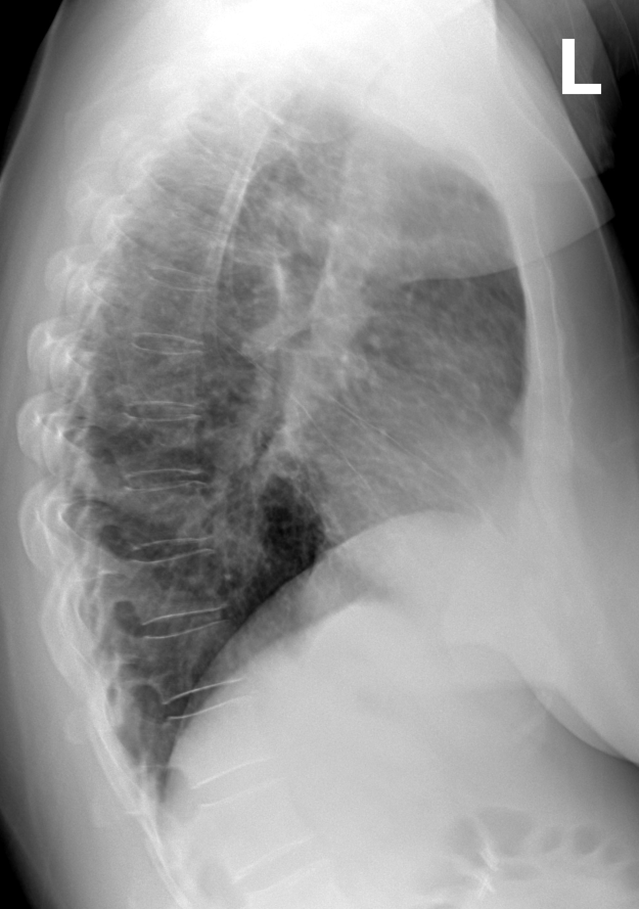
Radiological Anatomy of the Chest
Fissures

Slide 28
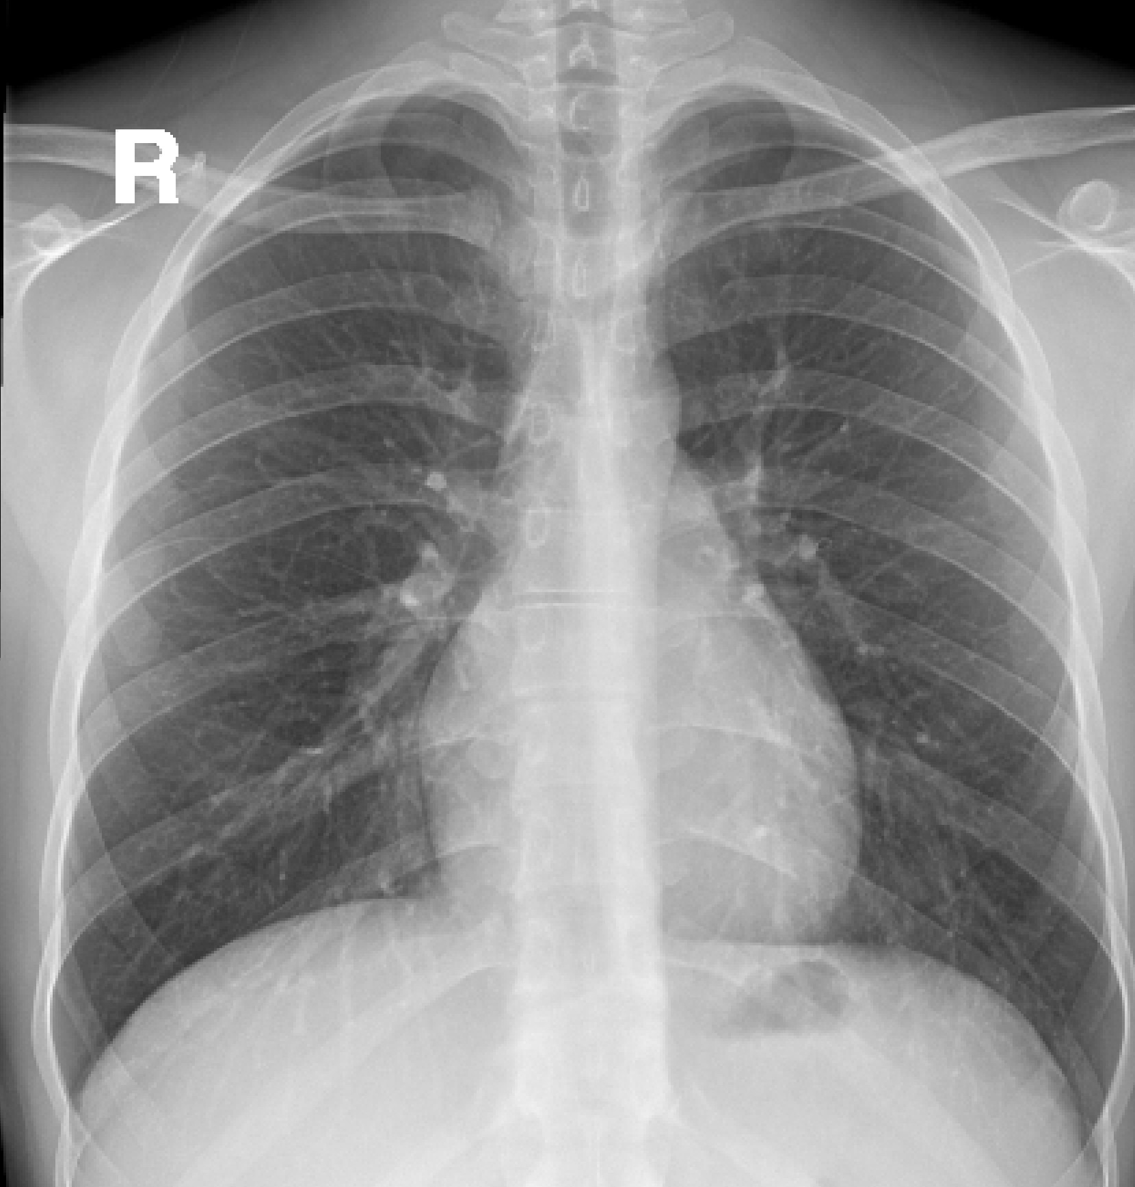

Slide 29

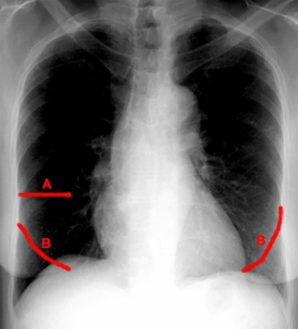
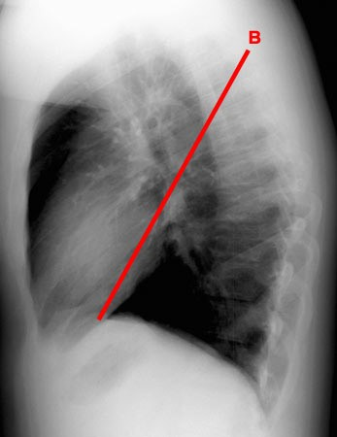
FISSURES

Slide 30
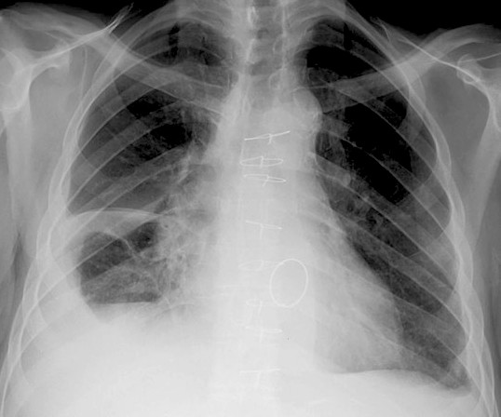

FISSURES
Encysted effusion of the fissure
Encysted effusion of the fissure

Slide 31
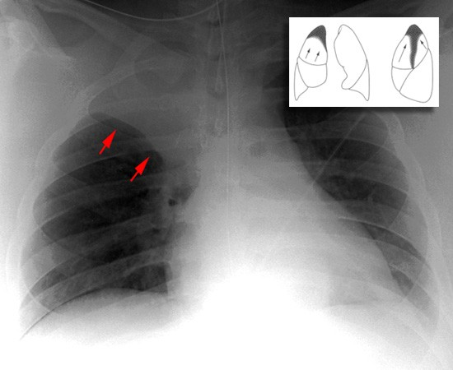
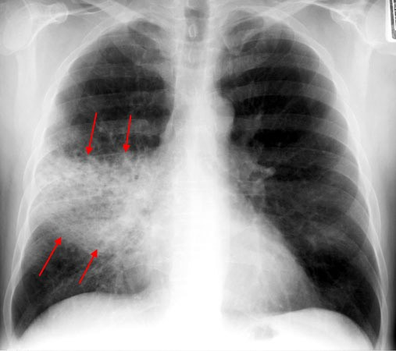
Fissures outlines segments ATELECTASIS Vs PNEUMONIA

Slide 32
Localizing disease by fissures
Radiological Anatomy of the Chest
L
R
Upper Lobe
Upper Lobe
Minor Fissure
Middle Lobe
Lower Lobe
Major Fissure
Lower Lobe
Major Fissure
LEFT LUNG
RIGHT LUNG

Slide 33
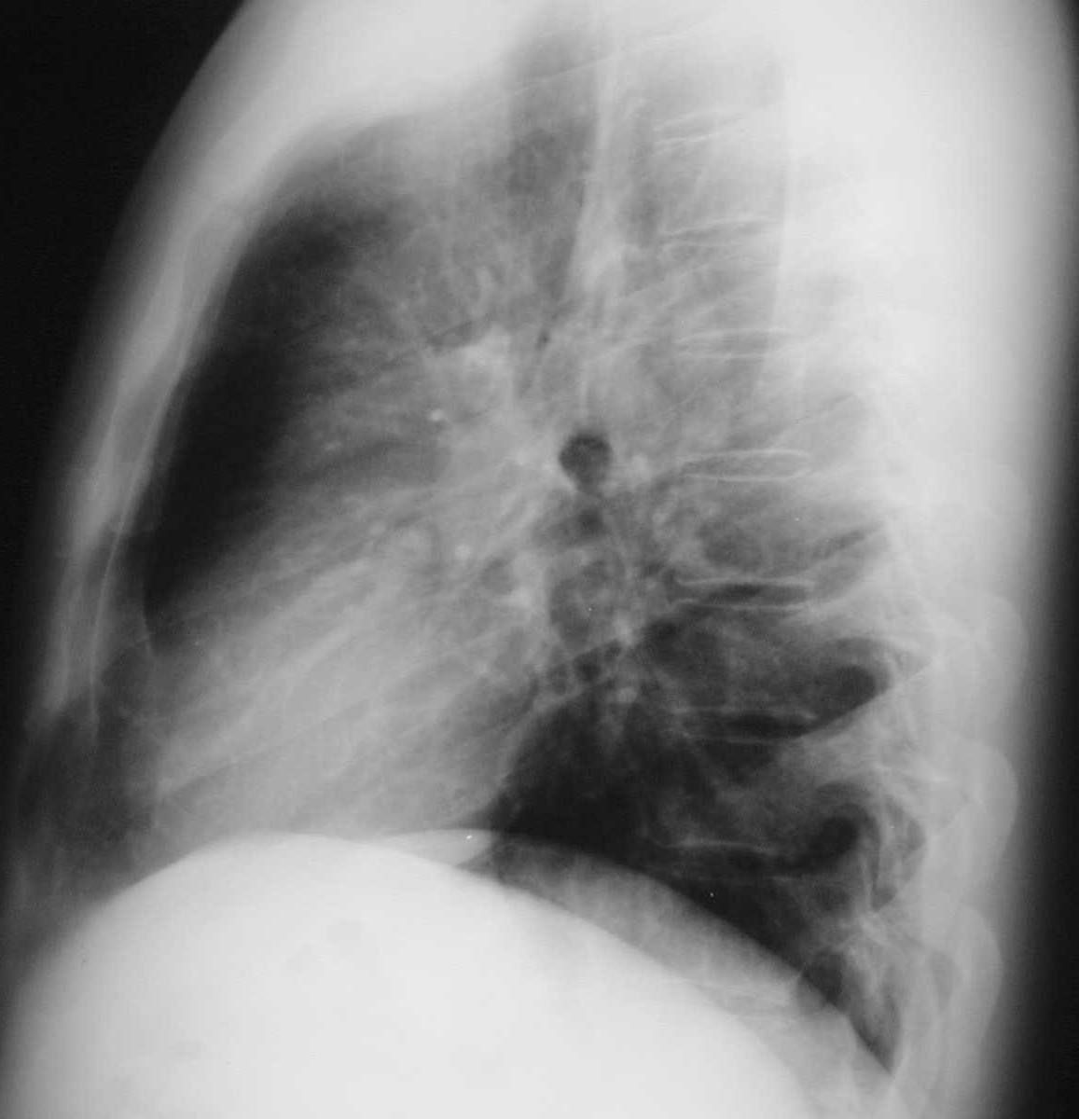
Localizing disease by fissures
UL
RUL
LL
RML
RML or lingula

Slide 34
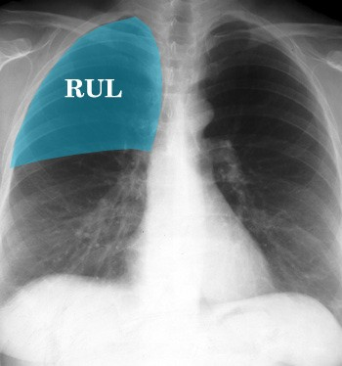
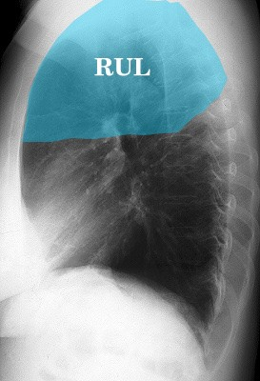
Radiological Anatomy of the Chest

Slide 35

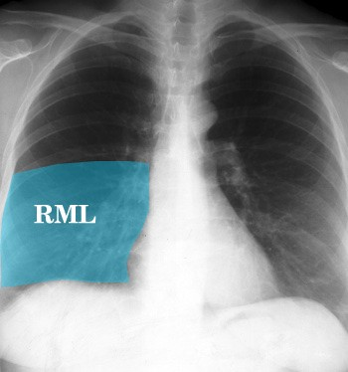
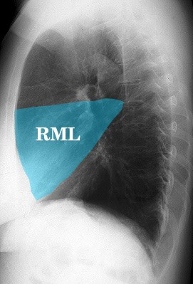
Radiological Anatomy of the Chest

Slide 36

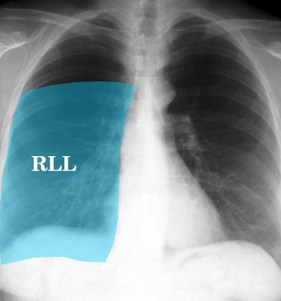
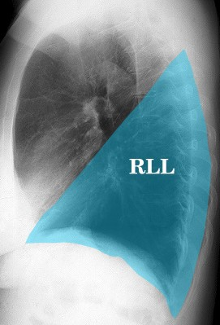
Radiological Anatomy of the Chest

Slide 37
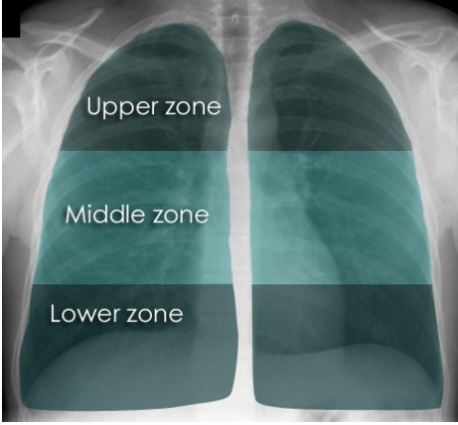

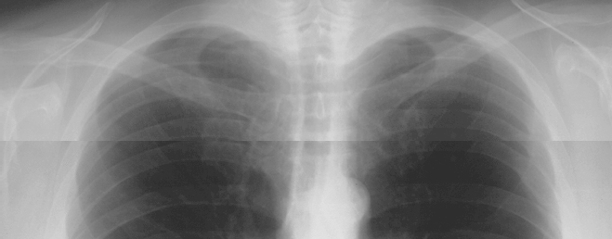
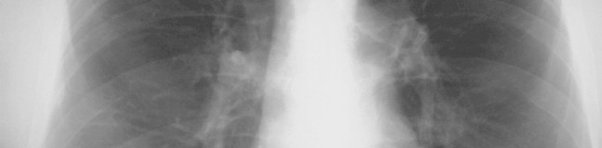

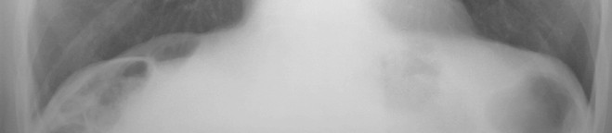
How to read Frontal Chest X-Ray

Slide 38
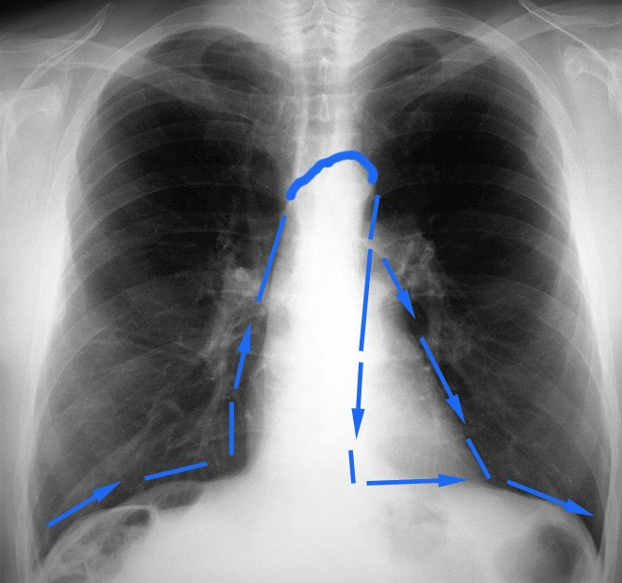
Frontal Chest X-Ray
SILHOUETTE
See
Section on the Silhouette Sign

Slide 39
LUNGS

Slide 40
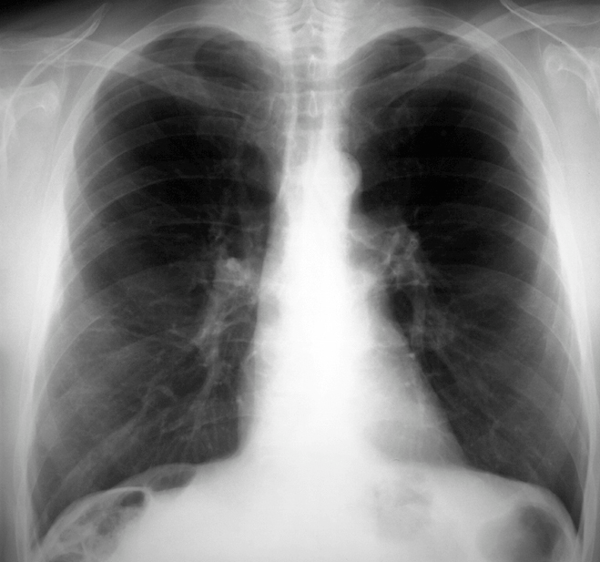
Frontal Chest X-Ray
MEDIASTINUM

Slide 41

CT EXAMINATION OF THE CHEST

Slide 42
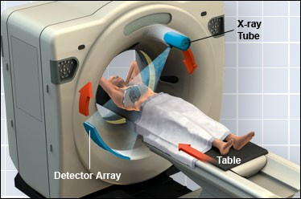
The Examination

Slide 43


Slide 44


Slide 45


Slide 46









Radiological Anatomy of the Chest
Lung Window
Sagittal
Axial
Coronal
Mediastinal Window

Slide 47




Radiological Anatomy of the Chest

Slide 48

High Resolution CT Scan
HRCT uses very thin slices (1mm) to achieve better spatial resolution & precision.
HRCT is indicated after normal CXR in a symptomatic patient - the setting of high clinical suspicion of disease.
Advantages
  High sensitivity for adenopathy, infiltrates, and architectural distortion.
  HRCT can identify areas of reversible vs. irreversible lung damage.

Slide 49



Normal Lung Anatomy
Tracheobronchial Tree
Normal lung at level inferior
pulmonary veins
L inferior pulmonary vein
R inferior pulmonary vein
Lower lobe bronchi

Slide 50


HRCT
Normal

Slide 51


Anatomy on Normal
CXR-PA
22
1
Chest X-Ray
Key:
1. Right 1st rib
³ 2. Right 2nd rib
Scapula
Trachea
Carina
Bronchus seen end on
Bilateral hila
Branch of right main descending pulmonary artery
Right minor (horizontal fissure)
Right hemi diaphragm
Left hemi diaphragm
Gastric air bubble
Left clavicle
4
13
5
6
7
7
9
8
10
11
12

Slide 52

PA VIEW ANATOMY

Slide 53



Nipple shadows

Slide 54





Frontal Chest X-Ray
Intrapulmonary nodule: hamartoma
Nodule or right nipple ?

Slide 55







Remember
It’s a chest x-ray,
not a lung x-ray.

Slide 56

LUNG DISEAES

Slide 57

=COLLAPSE

Slide 58


MASS Vs DIFFUSE INFILTERATION
The basic diagnostic instance is to detect an abnormality.
In both of the cases, there is an abnormal opacity.
In each of the cases, there is an abnormal opacity in the left upper lobe.
In the case ABOVE , the opacity would best be described as a mass because it HAS EDGES well-defined 3-D STRUCTURE
The case BELOW has an opacity that is poorly defined. This is airspace disease such as pneumonia.

Slide 59


solitary nodule in the lung
A solitary nodule in the lung can be totally innocuous or potentially a fatal lung cancer. After detection the initial step in analyis is to compare the film with prior films if available. A nodule that is unchanged for two years is almost certainly benign. Be sure to evaluate for the presence of multiple nodules as this finding would change the differential entirely.
If the nodule is indeterminate after considering old films and calcification, subsequent steps in the work-up include ordering a CT and a tissue biopsy.

Slide 60




MASS

Slide 61




PLEURAL BASED LESION

Slide 62
FISSURES

Slide 63
FISSURES

Slide 64

DEFINITIONS
ATELECTASIS
Loss of volume of lobe, segment or sub segment of the lung.
Example collapse (lung)
Consolidation
Loss of air in lobe, segment or sub segment of the lung.
Example= pneumonia (lobe)

Slide 65

Major differentiating factors between atelectasis and pneumonia

Slide 66




PNEUMONIA VS ATELECTASIS

Slide 67




PNEUMONIA Vs ATELECTASIS

Slide 68



ATELECTASIS Vs PNEUMONIA

Slide 69
Recognizing air space disease
Alveolar spaces filled with…something.
Radiologist's report:
  “consolidation”
  “air space opacity”
  “fluffy density”
  “infiltrate”
Nonspecific:
  Atelectasis, pneumonia, bleeding, edema, tumor

Slide 70

Lobar Atelectasis
Best sign – shift of a fissure
Rapid development and clearance
Air bronchograms if non-obstructive
Secondary signs:
  Mediastinal shift
  Elevated diaphragm
  Ribs closer together
  Vague increased density

Slide 71



RUL Atx

Slide 72

RML Atx

Slide 73


LUL Atx

Slide 74




LLL COLLAPSE

Slide 75

Pneumonia
Signs:
– Air bronchogram
– Silhouette - “positive” or “negative”
Dense hilum
“Spine” sign
All are signs of any air space process
Dx of pneumonia depends on appropriate clinical scenario.

Slide 76

AIR-BRONCHOGRAM

Slide 77

Air bronchogram sign
Pseudomonas pneumonia

Slide 78

Air bronchograms — CT
Pneumonia

Slide 79



Right middle lobe

Slide 80



Right upper lobe

Slide 81

PLEURAL EFFUSION

Slide 82
COMPARE COSTO-PHRENIC ANGLES

Slide 83

PLEURAL EFFUSION
On an upright film, an effusion will cause blunting on the lateral and if large enough, the posterior costophrenic sulci. Sometimes a depression of the involved diaphragm will occur. A large effusion can lead to a mediastinal shift away from the effusion and opacity the hemithorax. Approximately 200 ml of fluid are needed to detect an effusion in the frontal film vs. approximately 75ml for the lateral. Larger effusions, especially if unilateral, are more likely to be caused by malignancy than smaller ones.

Slide 84
BLUNTED C/P ANGLE BOTH SIDES

Slide 85


PLEURAL EFFUSION

Slide 86



SEVER PLEURAL EFFUSION
FLUID

Slide 87




A pneumothorax is defined as air inside the thoracic cavity but outside the lung.
A spontaneous pneumothorax is one that occurs without an obvious inciting incident.
PNEUMOTHORAX
HEART AND MEDIASTINUM IS NO MORE CENTRAL

Slide 88

PNEUMOTHORAX
AIR IN PLEURAL CAVITY

Slide 89

PNEUMOTHORAX
LUNG
AIR

Slide 90


Hydro-pneumo-thorax
A Fluid
fluid

Slide 91


EMPHYSEMA
Increased Lung Volume
Flattened Diaphragms
Increase in Retrosternal Airspace Barrel chest
Small Vessels
Small, narrow cardiac SHADOW
Emphysema is loss of elastic recoil of the lung with destruction of pulmonary capillary bed and alveolar septa. It is caused most often by cigarette smoking and less commonly by alpha-1 antitrypsin deficiency.

Slide 92



Emphysema is commonly seen on CXR as diffuse hyperinflation with flatteni of diaphragms, increased retrosternal space, bullae (lucent, air-containing spaces that have no vessels that are not perfused)
Normal
ng
EMPHYSEMA

Slide 93
EMPHYSEMA
Emphysema is commonly seen on CXR as diffuse hyperinflation with flattening of diaphragms, increased retrosternal space, bullae (lucent, air-containing spaces that have no vessels that are not perfused) and enlargement of PA/ RV (secondary to chronic hypoxia) an entity also known as cor pulmonale. Hyperinflation and bullae are the best radiographic predictors of emphysema.

Slide 94



CT anatomy

Slide 95



CT

Slide 96


Air bronchograms — CT
Bronchus
vessel
Healthy lung
Pneumonia

Slide 97

Air bronchograms — CT

Slide 98
CARDIOVASCULAR IMAGING

Slide 99
Radiologic investigation of Chest and CVS diseases
By
Dr Mohamed Sherif El-Sharkawy
ASSOCIATE PROF. and Consultant Radiologist KKUH
KING SAUD UNIVERSITY
LAST UPDATE SEPT 2013

Slide 100

HEART

Slide 101

BASIC CHEST EXAM FOR THE HEART AND GREAT VESSELES
PLAIN FILM=CHEST X-RAY(CXR)
CT FOR HEART AND MEDIASTINUM
ANGIOGRAMS
MRI
ULTRASOUND (ECHOCARDIOGRAPHY)
ISOTOPIC SCANNING

Slide 102
Basic Chest X-Ray

Slide 103








The Cardiac Contours
Aortic knob
Main pulmonary artery
Indentation for LA
Left ventricle
Ascending Aorta
“Double density” of LA enlargement
Right atrium

Slide 104



Slide 105


Hilar levels
look for increase in density as well as size. If the hila are out of position, ask yourself if they are pushed or pulled, just as you would when assessing the trachea.

Slide 106



Cardiac contours

Slide 107


Cardiac displacement

Slide 108


Cardiac displacement
KKUH
Pectus excavatum

Slide 109



DEXTROCARDIA

Slide 110



Slide 111


Slide 112


Slide 113



Slide 114


TRANS-THORACIC ECHOCARDIOGRAPHY

Slide 115



Slide 116

Cardiac Magnetic Resonance

Slide 117


Viability Assessment
CMR Delayed Hyper-Enhancement

Slide 118



Hazards of MRI
Magnet-Seeking Projectiles

Slide 119
CARDIAC CT
FOR THE HEART AND CORONARY VESSLES

Slide 120



PERICARDIUM
PERICARDIUM
AXIAL
SAGITTAL
SEPTUM
CONTRAST
CONTRAST
MYOCARDIUM

Slide 121



Slide 122


CARDIAC CHAMBERS

Slide 123



4 to 64 Slice Scans
Five Heart Beats
10 mm detector Pitch ~0.25
20 mm detector Pitch ~0.25
40 mm detector Pitch ~0.25
3 cm in 5 sec
6.2 cm in 5 sec
12.5 cm in 5 sec

Slide 124

3-D Volume Rendered Image

Slide 125

Maximum Intensity Projection
Soft Plaque in Proximal LAD

Slide 126


Curved Planar Image

Slide 127


Slide 128


Slide 129




Slide 130


STENT
STENT

Slide 131

Soft Plaque Visualization

Slide 132


Slide 133


Slide 135


Slide 137


Slide 138


Slide 139


Slide 140


Slide 141


Slide 142



Slide 143

AORTIC DISSECTION

Slide 144




Vascular anatomy of the chest

Slide 145

Vascular anatomy of the chest

Slide 146



Pulmonary artery

Slide 147


V/Q SCAN
NORMAL
HIGH PROBABILITY OF PE

Slide 148


Pulmonary embolism

Slide 149
Pulmonary embolism

Slide 150

THE GOLD STANDARD FOR DIAGNOSIS OF PE IS CTA

Slide 151



Slide 152

CTA PULMONARY VASCULATURE

Slide 153


CTA
(Coronal Reconstruction)
Embolus in left main pulmonary artery
Embolus in descending right pulmonary artery
NORMAL HOMOGENOUS FILLING OF THE VESSLES

Slide 154

CT Agiogram

Slide 155


AORTIC ARCH ANATOMY
KKUH

Slide 156

The Aortic arch/great vessels
“Man’s Anatomy by Tobias & Arnold

Slide 157


Aortic aneurysm
Aortic knob/knuckle

Slide 158




Heart and Vessels
Cardiomegaly plus early Congestive Heart Failure (CHF)
Key:
Inferior vena cava (IVC)
Superior vena cava (SVC)
*3. Azygos vein
Carina
Trachea
Right main stem bronchus
Prominent pulmonary vessels
7
7
2
5
7 7
3
4
Any and or all heart chambers may enlarge when the heart becomes diseased. Cardiomegaly = a big heart.
A patient’s heart enlarges due to a number of diseases
e.g. valve disease, high blood pressure, congestive heart failure.
1
If the heart fails, the lung often become congested. Early on the pulmonary vessels appear more prominent as in this case. More advanced failure can result in a condition of pulmonary edema which is fluid flooding into the alveoli of the lungs causing the patient marked shortness of breath.

Slide 159


Cardio-thoracic Ratio
One of the easiest observations to make is something you already know: the cardio-thoracic ratio which is the widest diameter of the heart compared to the widest internal diameter of the rib cage
50%>

Slide 160
Sometimes, CTR is more than 50%
But Heart is Normal
Extracardiac causes of cardiac enlargement
–Portable AP films
–Obesity
–Pregnant
–Ascites
–Straight back syndrome
–Pectus excavatum

Slide 161


50%<
Here is a heart that is larger than 50% of the cardiothoracic ratio, but it is still a normal heart. This is because there is an extracardiac cause for the apparent cardiomegaly. On the lateral film, the arrows point to the inward displacement of the lower sternum in a pectus excavatum deformity.

Slide 162
Sometimes, CTR is less than 50%
But Heart is Abnormal
Obstruction to outflow of the ventricles
–Ventricular hypertrophy
Must look at cardiac contours

Slide 163

Anatomy on Normal Chest X-Ray
Heart borders and chambers of the heart on PA and lateral views.

Slide 164

The Cardiac Contours
Aortic knob
Ascending Aorta
Main pulmonary artery
Indentation for LA
“Double density” of LA enlargement
Right atrium
Left ventricle
There are 7 contours to the heart in the frontal projection in this system.

Slide 165
The Cardiac Contours
Aortic knob
Ascending Aorta
Main pulmonary artery
Indentation for LA
“Double density” of LA enlargement
Right atrium
Left ventricle
But only the top five are really important in making a diagnosis.

Slide 166

Ascending Aorta
Low density,
almost straight edge represents size
of ascending aorta

Slide 167


Ascending Aorta
Small
Prominent

Slide 168


Aortic Knob
Enlarged with:
Increased pressure
Increased flow
Changes in aortic wall
42mm

Slide 169




Main Pulmonary Artery
Important
The next bump down is the main pulmonary artery and is the keystone of this system.

Slide 170

Finding the Main Pulmonary Artery

Slide 171
Finding the Main Pulmonary Artery
Adjacent to left pulmonary artery
We can measure the main pulmonary artery . . .

Slide 172

Left atrial enlargement
Concavity where L atrium will appear on left side when enlarged

Slide 173


The Pulmonary Vasculature

Slide 174
Five States of the Pulmonary Vasculature
Normal
Pulmonary venous hypertension
Pulmonary arterial hypertension
Increased flow
Decreased flow

Slide 175
What to Evaluate
2
1
2
3

Slide 176

2. Normal Distribution of Flow
Upper Versus Lower Lobes
In erect position, blood flow to bases
> than flow to apices
Size of vessels
at bases is normally
> than size of vessels at apex
You can’t measure size of vessels at the left base because the heart obscures them

Slide 177

3. Normal Distribution of Flow
Central versus peripheral
Central vessels give
rise to progressively smaller peripheral branches
Normal tapering of vessels from central to peripheral

Slide 178
Normal Vasculature - review
2
Gradual tapering of vessels from central to peripheral
RDPA
< 17 mm in diameter
1
3
Lower lobe vessels larger than upper lobe vessels
2

Slide 179





Venous Hypertension
RDPA usually
> 17 mm
Upper lobe vessels equal to or larger than size of lower lobe vessels = Cephalization

Slide 180
The Pulmonary Vasculature
Normal
Pulmonary venous hypertension
Pulmonary arterial hypertension Increased flow
Decreased flow - mostly unrecognizable even when it is present
•
•
•
•
•

Slide 181


KKUH
CHF

Slide 182


ACUTE PULMONARY EDEMA

Slide 183



CLEARED APE

Slide 184

KERELY’S B-LINES

Slide 185


THANK YOU
DR SHARKAWY

