Slide 1
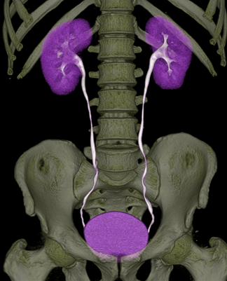
Radiological Anatomy & Investigations of Urinary System
DR. HUSAIN ALTURKISTANI
ASSISTANT PROFESSOR & CONSULTANT

Slide 2
Objectives
- Introduction about medical imaging
- To know the anatomic location and normal size of structures of the urinary tract
- To know the different types of modalities used in imaging the urinary tract
- To identify the kidneys, ureters, urinary bladder and urethra on different imaging modalities

Slide 4
Basic understanding of the image and its reflection is important

Slide 5
What is medical imaging?
A medical specialty that employs the use of imaging to both diagnose and treat diseases within the human body

Slide 6
Urinary System
Kidneys
Ureters
Urinary bladder
Urethra

Slide 7
Imaging Modalities
Plain X-Ray
Intravenous Urogram (IVU)
US
CT
MRI
Scintigraphy

Slide 8
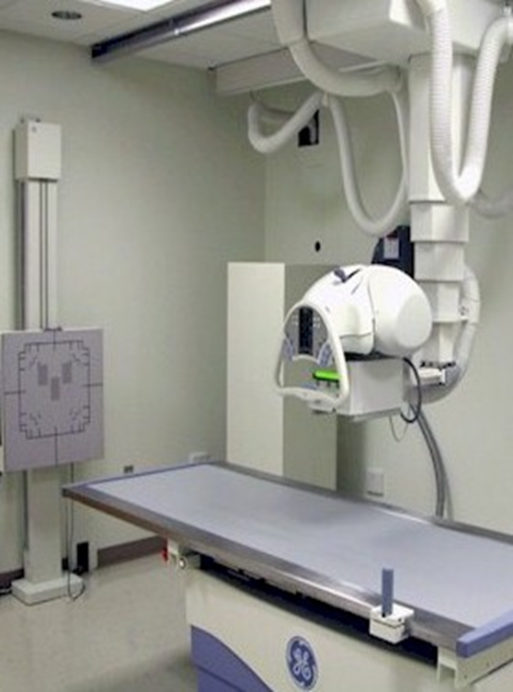
Plain X-Ray
First imaging modality
Cheap
Useful for radio-opaque stones

Slide 9
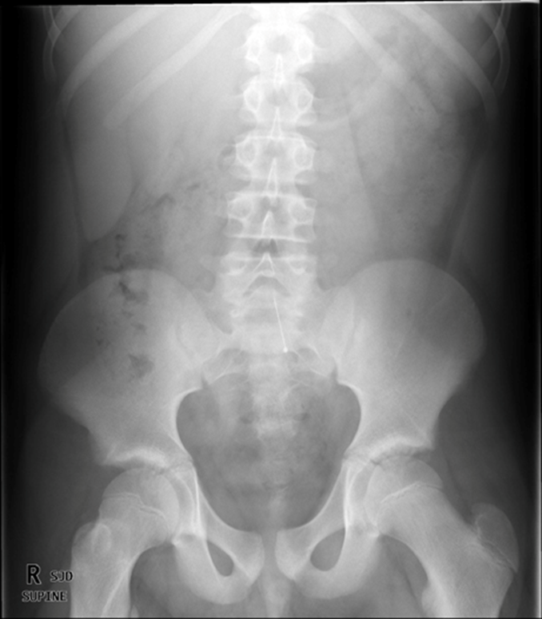
Image features:
Projectional image
Image contrast determined by
tissue density
Good evaluation of radio-opaque
stones

Slide 10
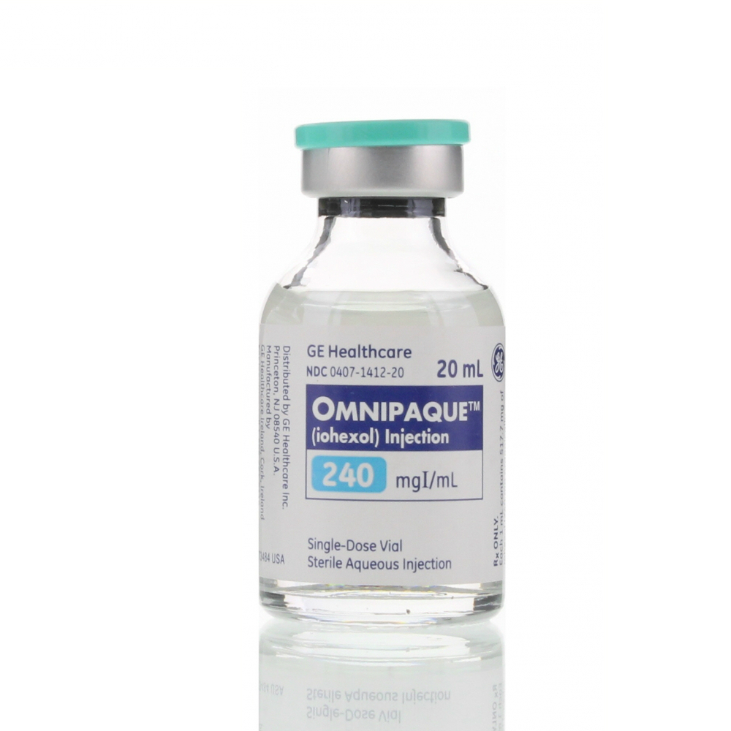
IVU
Conventional x-ray + IV contrast
Cheap
Recently replaced by CT and MRI
Provides functional and anatomical
information
+

Slide 11
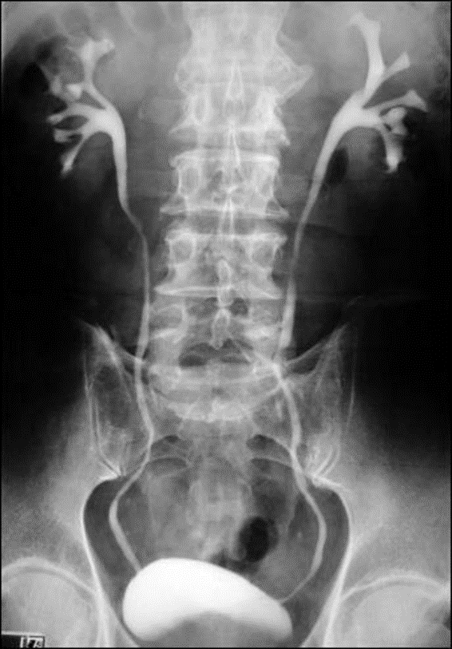
Image features:
Projectional image
Image contrast determined by tissue
density and IV contrast
Good evaluation of collecting system and
radio-opaque stones

Slide 12
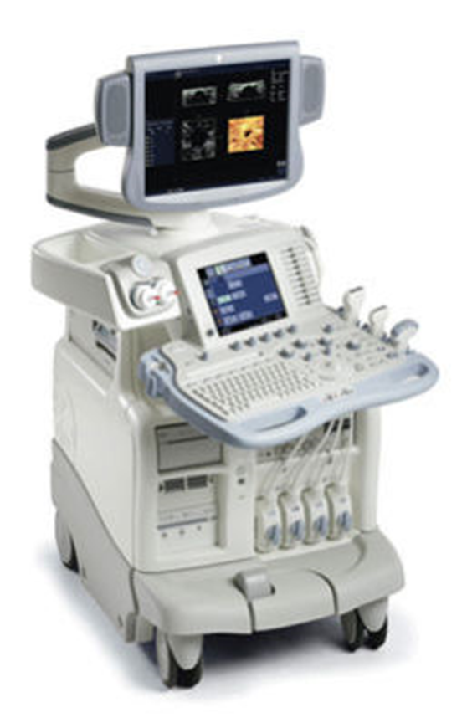
US
Uses high frequency sound waves
(NO RADIATION)
Contrast between tissue is determined
by sound reflection

Slide 13
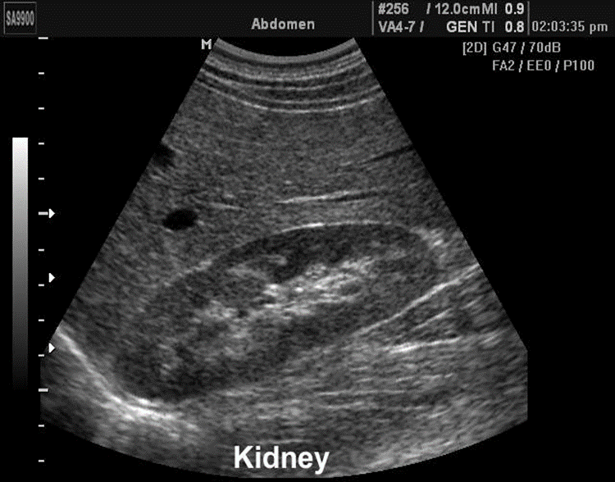
Image features:
Operator dependant
Good resolution
Used for stones, hydronephrosis,
and focal lesions

Slide 14
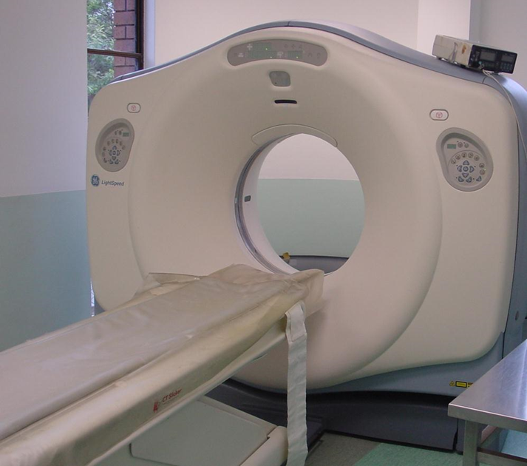
CT
Same basic principle of radiography
More precise
Costly
+/- contrast
Useful for trauma, stone, tumor
and infection

Slide 15
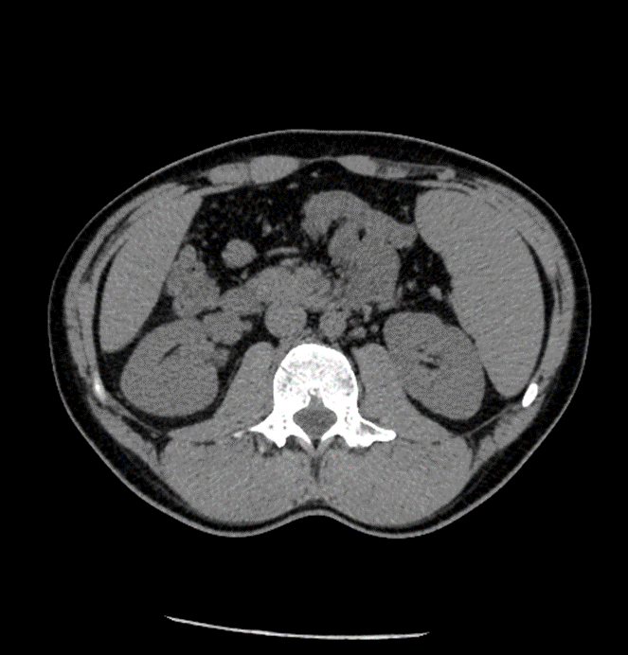
Image features:
Cross sectional images
Image contrast determined by tissue
density +/- contrast
Better evaluation of soft tissue
Q) Where is the left kidney?
A B
C D

Slide 16
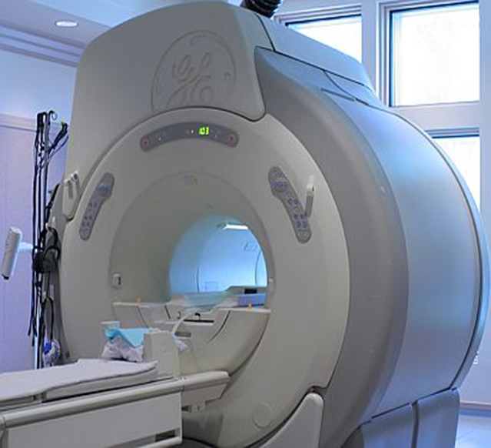
MRI
Better evaluation of soft tissue
Uses magnetic field
(NO RADIATION)
Expensive
Useful for soft tissue pathology:
tumor, infection

Slide 17
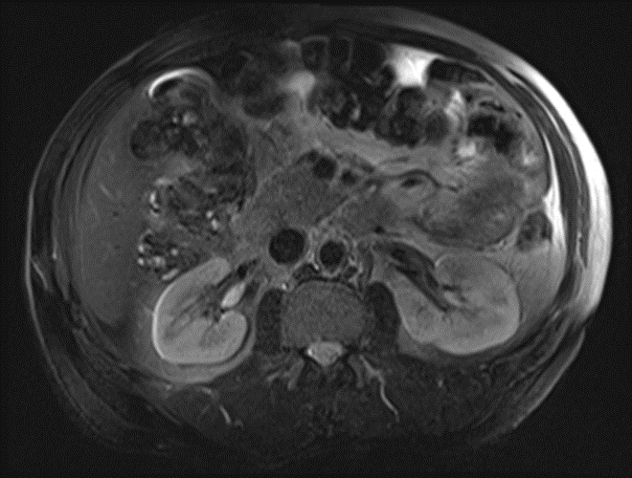
Image features:
Cross sectional images
Image contrast determined by tissue
properties
Excellent for soft tissue evaluation

Slide 18
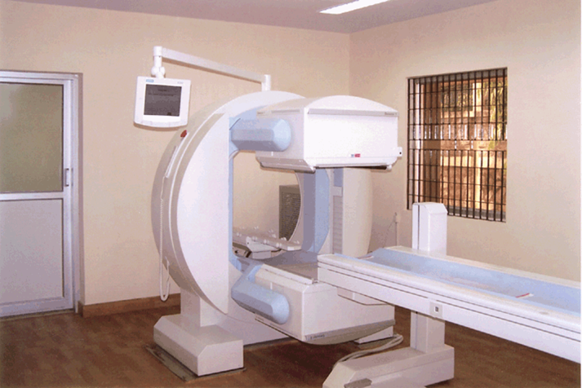
Nuclear medicine
Utilizes a gamma camera and
radioactive isotopes
Functional test
Less expensive
Useful for: obstruction and
split function

Slide 20
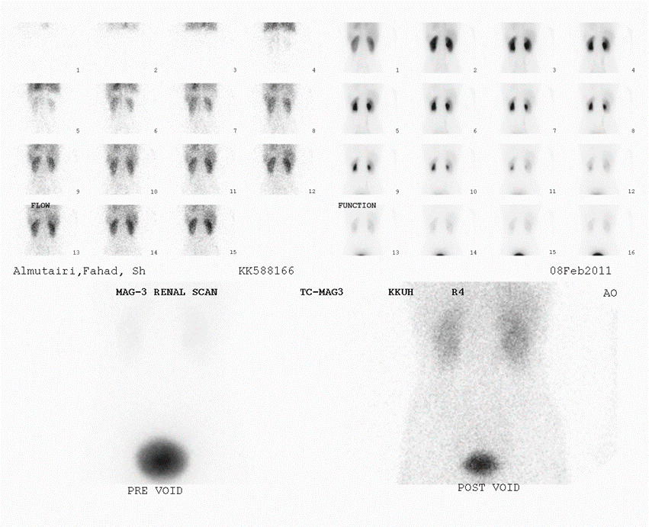
Image features:
Projectional image
Image contrast by tissue uptake
and metabolism

Slide 21
Anatomy

Slide 23
To know the abnormal in radiology
You should know the normal in radiology
You should know anatomy

Slide 25
Kidneys
Bean shaped structure
On either side of the lower thoracic and upper lumbar
spine
Usual location – between (T11-L3)

Slide 27
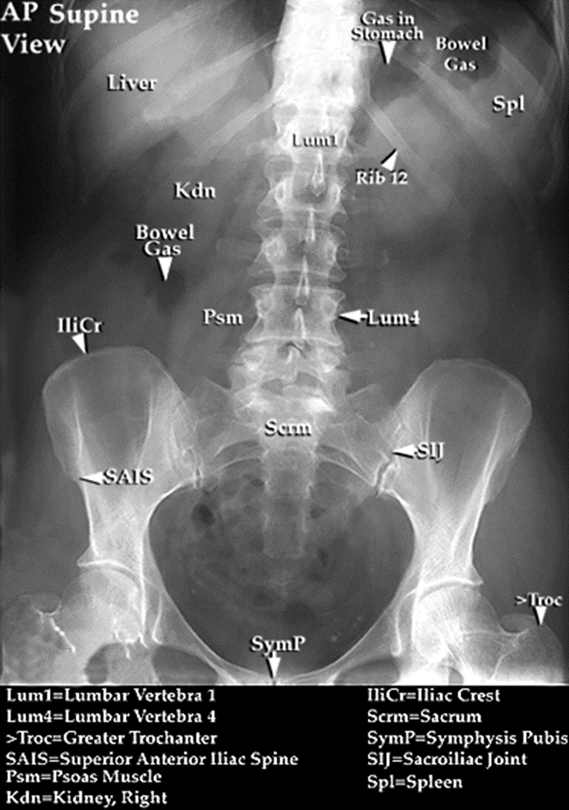
Useful when we suspect renal stone

Slide 28
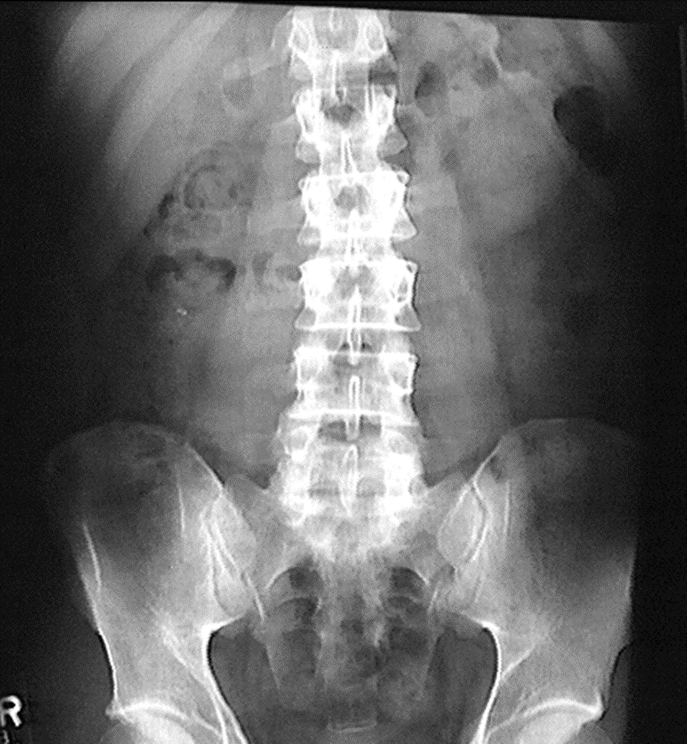
Kidneys are retroperitoneal organs and may be obscured by bowel loops

Slide 29
Kidneys
Right kidney is 2 cm lower than the left kidney
Long axis of the kidneys is directed downward and outward, parallel to the lateral border of the psoas muscles
Lower pole is 2-3 cm anterior to the upper pole

Slide 30
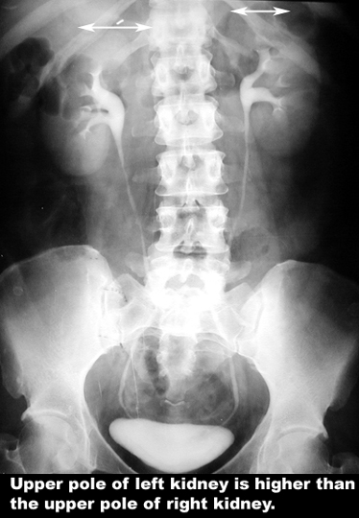

Slide 31
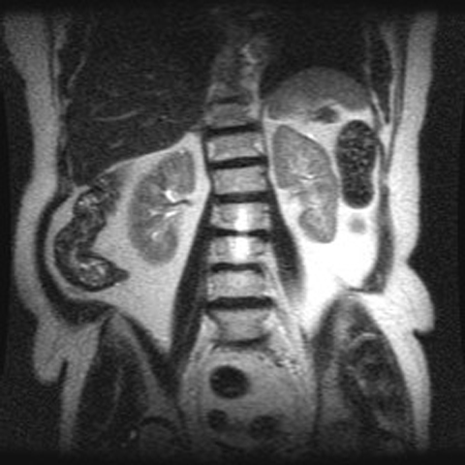
MRI showing Left Kidney is higher than Right Kidney

Slide 32
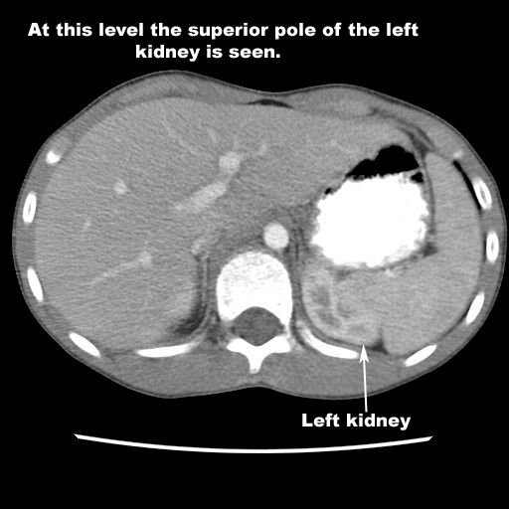
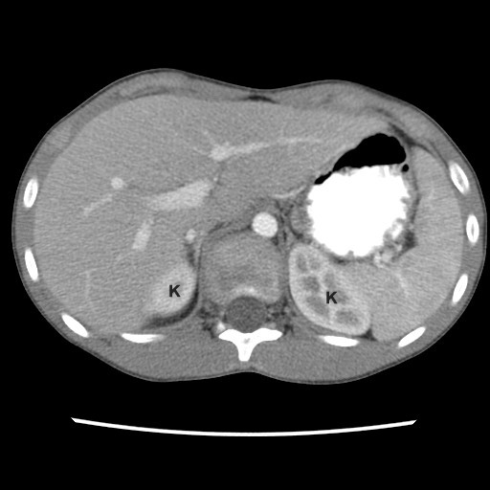
CT Scan showing left kidney higher than right

Slide 33
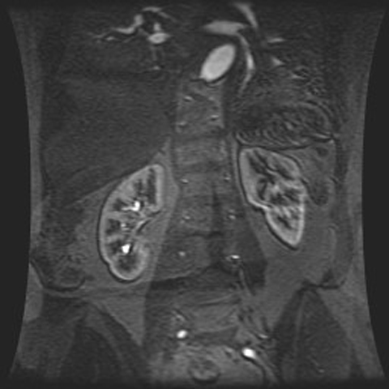
Long axis of the kidneys is directed downward and outward, parallel to the lateral border of the psoas muscles

Slide 34
Kidneys
Normal size : in adults 9-12 cm
Why is it important to know the normal size?

Slide 35
(GN)
iv. Acute GN

Slide 36
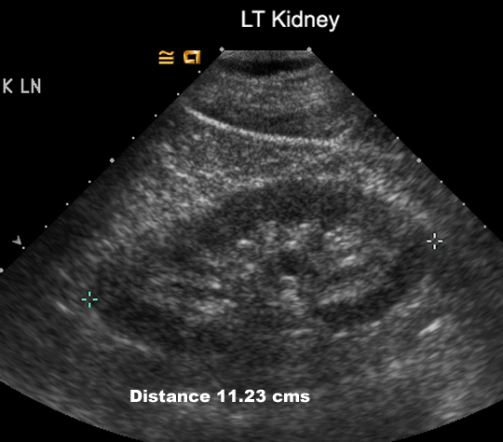
Ultrasound is the best method to measure the size of the Kidney

Slide 37
Kidneys
Kidneys are visualized on the X-Ray due to presence of perirenal fat
They are contained within the renal capsule and surrounded by perirenal fat and enclosed within the Gerota’s fascia
Perirenal hemorrhage, pus and urine are contained within the fascia and detected on CT and US

Slide 38
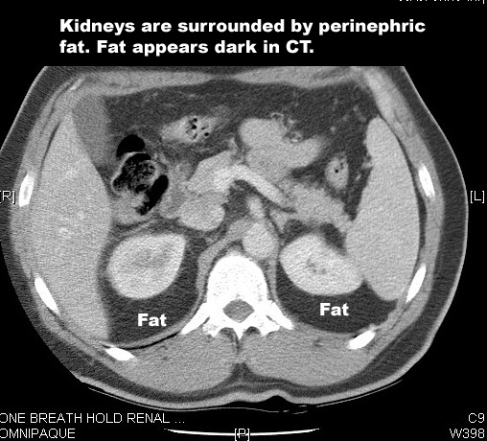

Slide 39
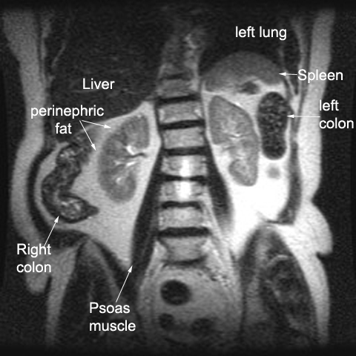
MRI: Fat is bright in T2

Slide 40
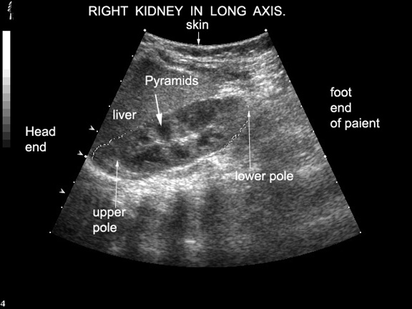
Ultrasound of Right Kidney

Slide 41
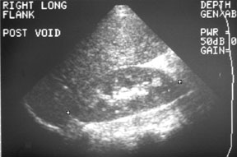
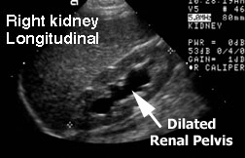
ULTRASOUND OF KIDNEYS
NORMAL STUDY
DILATED RENAL PELVIS

Slide 42
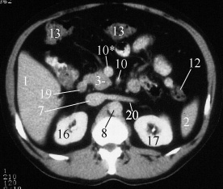
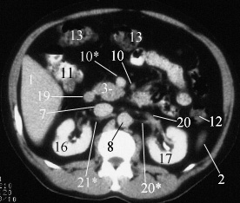
CT Scan of the Kidneys

Slide 43
Renal Vasculature

Slide 44
Renal Vasculature
Renal arteries branch from the abdominal aorta laterally between L1 and L2, below the origin of the superior mesenteric artery
The right renal artery passes posterior to the IVC
There may be more than one renal artery (on one or both sides) in 20-30% cases

Slide 45
Renal Vasculature
Renal veins drain into inferior vena cava
Renal veins lie anterior to the arteries
Left renal vein is longer and passes anterior to the aorta before draining into the inferior vena cava
The left gonadal vein will drain into to left renal vein while the right gonadal vein drains directly into the inferior vena cava

Slide 46
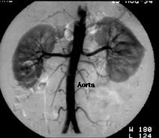
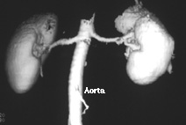
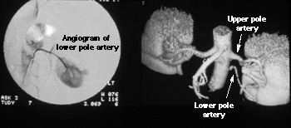
RENAL ANGIOGRAPHY
NORMAL SUPPLY OF BOTH KIDNEYS BY SINGLE RENAL ARTERY
LEFT KIDNEY SUPPLIED BY TWO RENAL ARTERIES

Slide 47
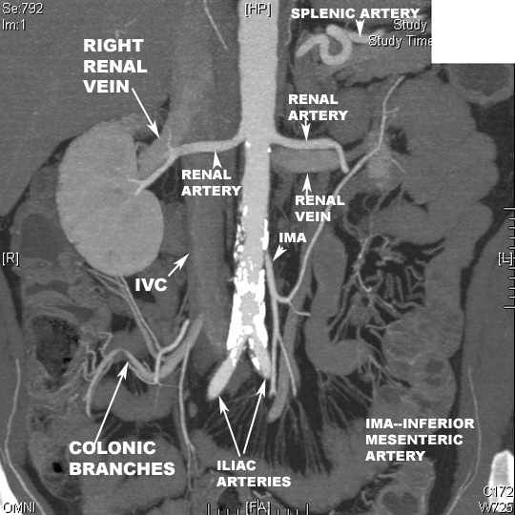
Coronal CT reformat

Slide 48
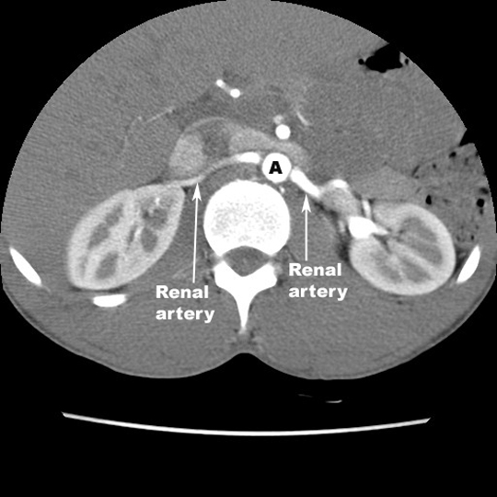
IVC

Slide 49
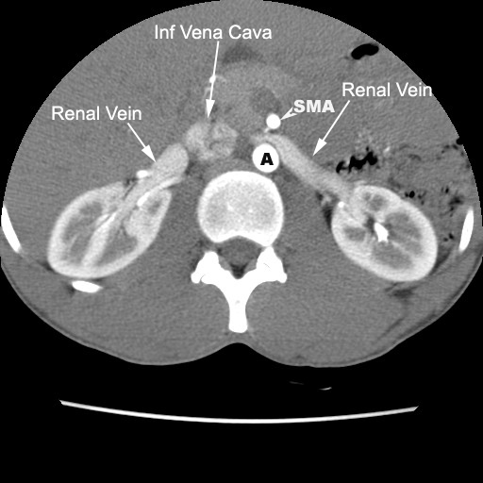
Left Renal Vein Passes Anterior to the Abdominal Aorta

Slide 50
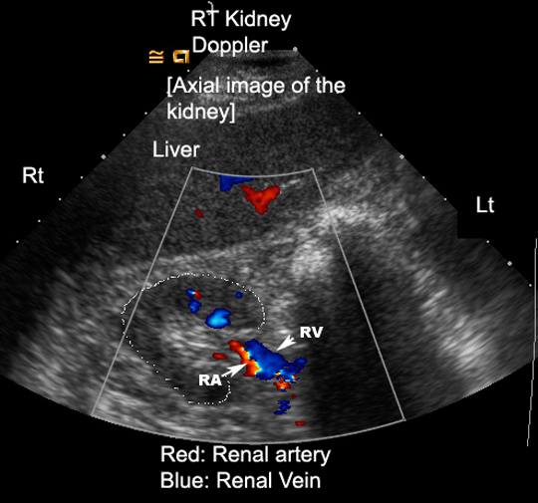
Renal Veins Lie Anterior to the Arteries

Slide 51
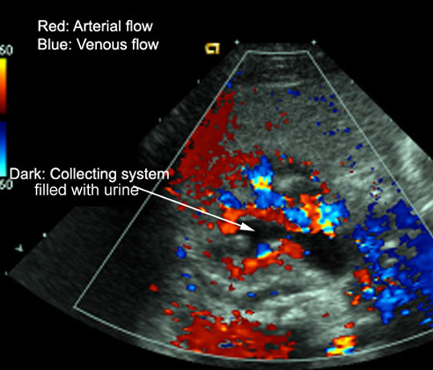

Slide 52
Relationships of the Kidneys

Slide 53
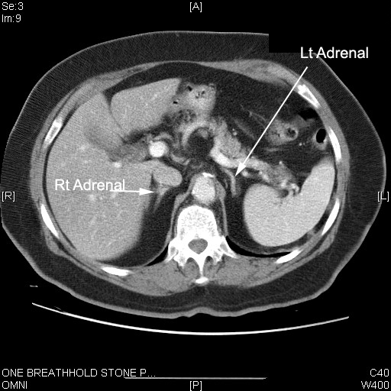
Adrenal Glands are superior to the Kidneys

Slide 54
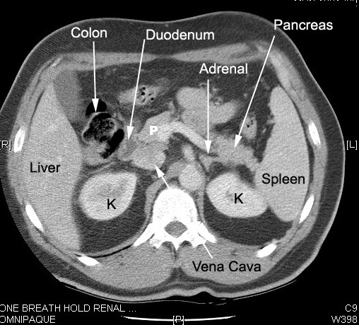

Slide 55
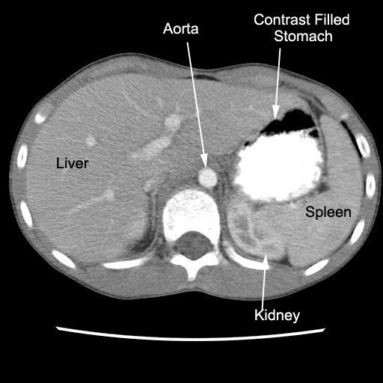

Slide 56
Renal Structure
Cortex
Renal cortex consists of glomeruli and renal tubules
Normal thickness is 2.5 cm
Medulla
Consists of multiple renal pyramids

Slide 57
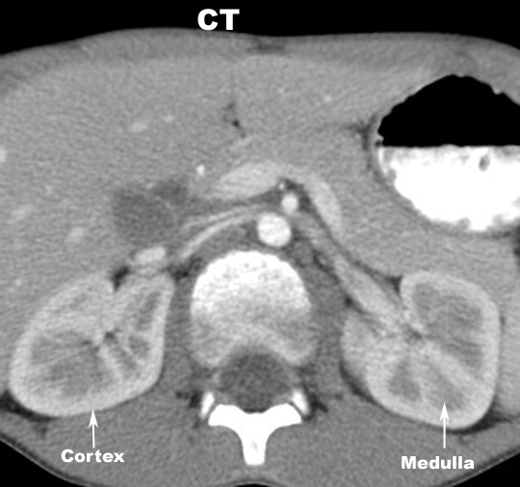

Slide 58
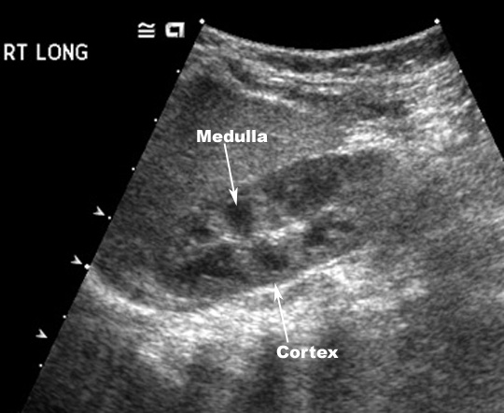
Ultrasound of Right Kidney

Slide 59
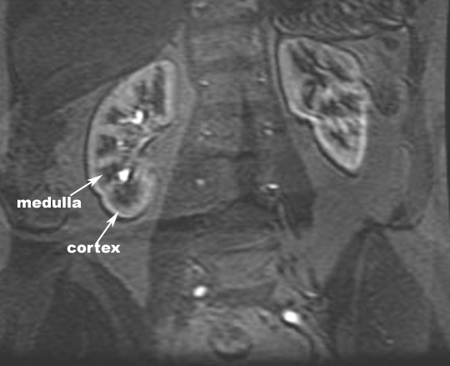
MRI of Kidneys

Slide 60
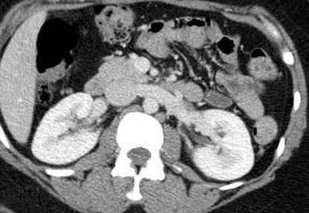
Contrast enhanced CT scan through the kidneys in nephrogram phase (showing corticomedullary differentiation)
This is approximately 100 seconds following contrast administration and would show renal lesions well

Slide 61
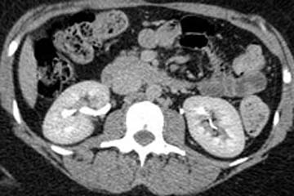
Contrast enhanced CT scan through the kidneys in pyelogram phase (showing excretion of contrast into the collecting system)
This is approximately 8 minutes following contrast administration and would show urothelial lesions well, such as transitional cell carcinoma, stones, blood clots

Slide 62
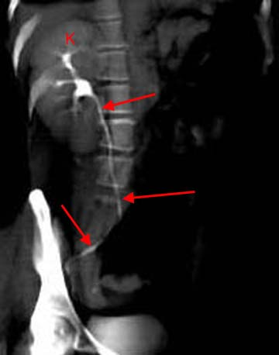
3D reconstructed image from CT scan of the abdomen and pelvis known as CT urography
Nowadays, this exam is quickly replacing the conventional IVU
3D reconstruction is performed through the right kidney (K) and follows the normal ureter (arrows) all the way to the ureter's insertion into the bladder

Slide 63
Renal Collecting System
Calyces
Medulla sits in the fornix of the minor calyx
Papillae drain into minor calyces
Minor calyces coalesce to form 3 or 4 major calyces
Major calyces combine to form the pelvis

Slide 64
Renal Collecting System
Pelvis
broad dilated part of the urine collecting system, located in the hilum
renal pelvis drains into the ureter

Slide 65
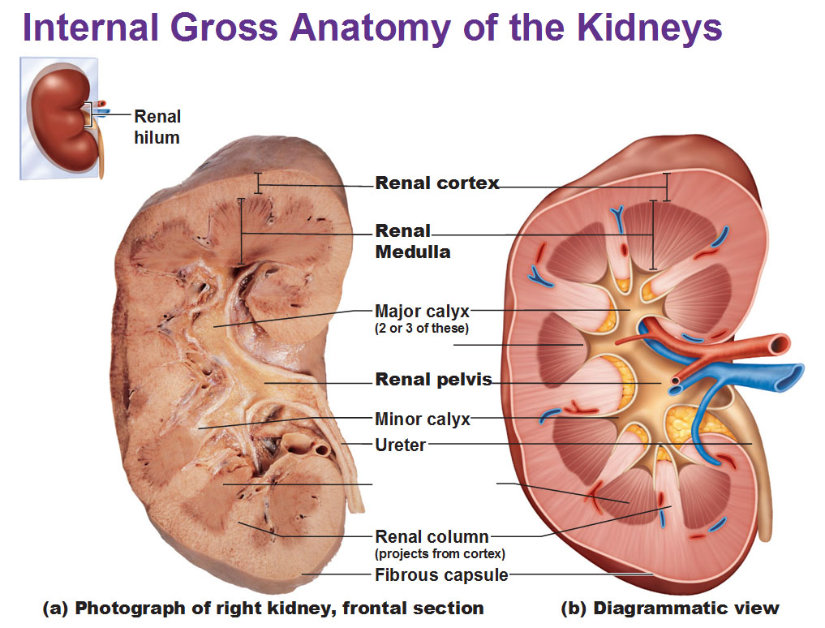

Slide 66
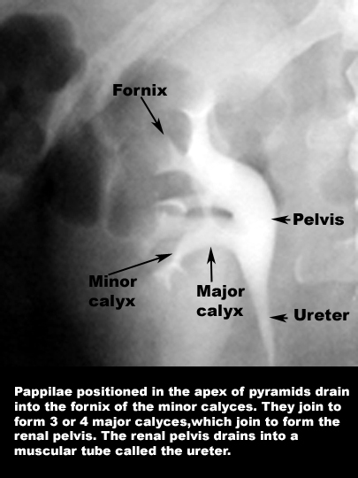

Slide 67
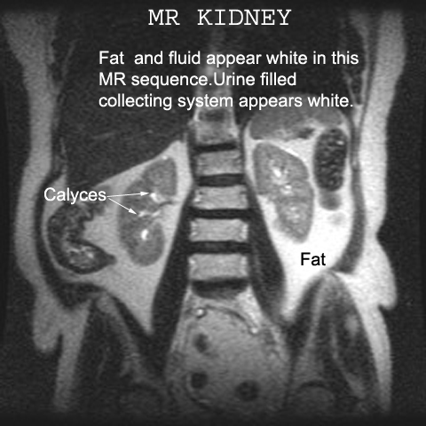

Slide 68
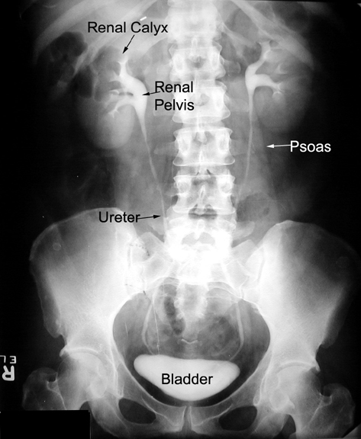

Slide 69
Ureters

Slide 70
Ureters
25-30 cm in length and 3 mm diameter

Slide 71
Areas of Narrowing
Three areas of normal narrowing:
Ureteropelvic Junction
Bifurcation of the iliac vessels
Ureterovesical Junction

Slide 72
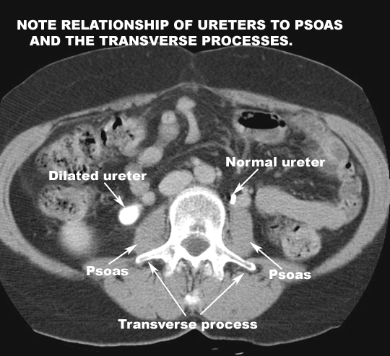

Slide 74
Urinary Bladder

Slide 75
Urinary Bladder
Size and shape vary considerably
When empty, it is completely within the pelvis
Dome is rounded in male and flat or slightly concave in female

Slide 76
Urinary Bladder
Bladder is relatively free to move except at the neck which is fixed by the puboprostatic ligaments (males) and pubovesicle ligaments (females)
Peritoneal reflection - Rectovesicle pouch in males and vesicouterine and rectouterine pouch in females

Slide 77
Anatomy of Female Pelvis showing the Urinary Bladder

Slide 78
Anatomy of Male Pelvis showing the Urinary Bladder

Slide 81
Voiding Cystourethrogram

Slide 82
Urinary Bladder
Unenhanced CT scan through a normal bladder (B) shows a normal fluid density structure (less than 10 Hounsfield units on CT density scale)

Slide 83
Urinary Bladder
3D reconstructed image of a normal bladder in the sagittal plane following CT urography
This is delayed image 10 minutes following IV contrast administration, excreted contrast fills an otherwise normal bladder (B)

Slide 84
Urinary Bladder
Transverse image through a normal urinary bladder using ultrasound shows normal anechoic structure (anechoic = no echoes = black)

Slide 85
Prostate Gland

Slide 86
Prostate Gland
Largest accessory gland of male reproductive system
Lies around the first part of the urethra at the base of the bladder
(Tr) 4 cm x 3 cm (height) x 2 cm (AP) in size
Surrounded by dense fibrous capsule

Slide 87
Prostate Gland
Base – closely related to neck of bladder
Apex
Posterior surface
Anterior surface
Anterolateral surfaces

Slide 88
Prostate Gland
Prostate gland can be divided into
An inner gland –transition zone
An outer gland – central and peripheral zones
Transition zone which lies in periurethral location is the site of benign prostate hypertrophy which can occlude the urethra
Peripheral zone is the primary tumor site in 70% patients

Slide 97
Thank You For Your Attention

