Slide 1
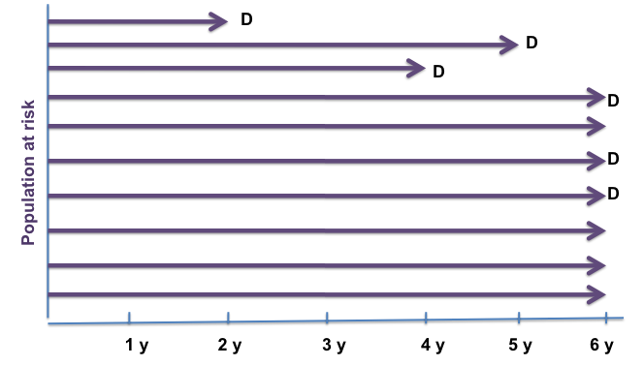
Dr. Rufaidah Dabbagh
Cohort Studies
11/10/2017
CMED 305

Slide 2
Most of the content in this presentation has been retrieved from a previous lecture:

Slide 3
Learning Objectives
To understand what a cohort design is
To differentiate between “a cohort” and a “cohort study”
To differentiate between types of cohort studies; prospective cohort, retrospective cohort
To learn the advantages and disadvantages of a cohort study
To calculate the appropriate measures of disease frequency in cohort studies: incidence, RR, RD

Slide 4
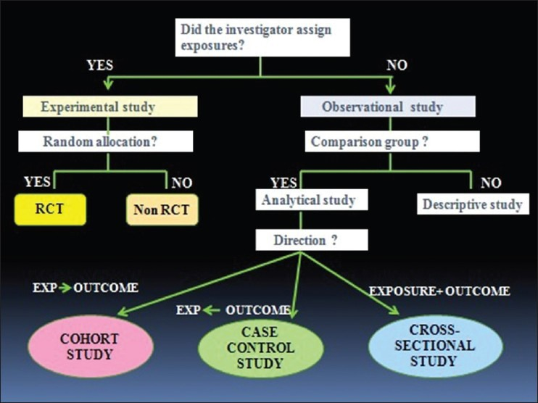
Source: Avila H, Pandey R, Bolla V, Roa H, Avula JK. Periodontal research: basics and beyond –part 1 (defining the research problem, study design and levels of evidence). J Indian Soc Periodontol 2013; 17(5): 565-70.

Slide 5
Design of Cohort Studies What is a cohort ?
Cohort: group of individual with a common characteristic who are followed over a period of time e.g. A smoker’s cohort means all are smokers in that group; birth cohort; class cohort
Cohort study design: selection of cohorts based on exposed and unexposed individuals, and following them over specified time or until development of outcome (disease/death)

Slide 6
Design of Cohort Studies cont.
And so in a cohort study we select individuals based on their exposure to a specific risk factor (exposed group and non-exposed group)
It I important that these people are free of the disease at the beginning of the study
then we follow them over a certain period of time and record the following measures:
Total number of people at risk at the beginning (total at risk at baseline)
Time until the development of the disease (time at risk)
Number of new cases that have developed the disease
Number of people who were lost to follow-up

Slide 7
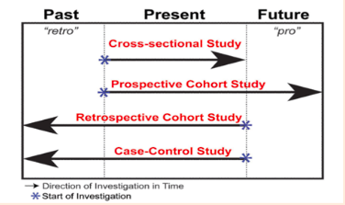
Direction of Investigation Time in Study Designs
Etikan I, Abubakar S, Alkassim R (2017) Frequency Measures of Epidemiological Studies. Biom Biostat Int J 5(1): 00124.

Slide 8
What is a Risk?
Risk is the possibility of harm
In epidemiology risk is the likelihood of an
individual in a defined population to develop a
disease or other adverse health problem
It is usually used to refer to the incidence proportion

Slide 9
What is a Risk Factor?
A risk factor is a characteristic associated with disease.
In cohort studies, we measure the exposure to a certain risk factor (exposure or non-exposure), and then we calculate the risk for developing the disease based on the exposure
We then assess the association between risk factor exposure and development of disease by comparing the Risks in the two groups (exposed and non-exposed); i.e. compare the incidence proportions

Slide 10
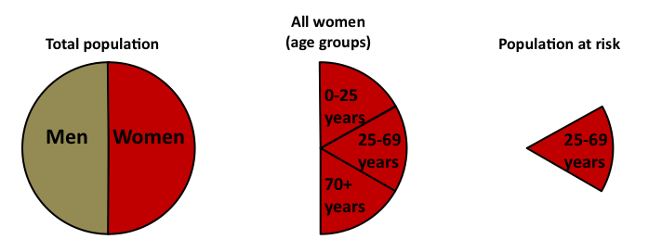
Population at Risk
The population at risk in a cohort study is a well-defined population that is free of the disease at the beginning of the study and has certain characteristics that put them at risk for developing the disease
Eg. Population at risk in a study of carcinoma of cervix

Slide 11
Follow-up in a Cohort Study
D
D
D
D
D
Population at risk
D
1 y
2 y
3 y
4 y
5 y
6 y
# of people at risk at baseline?
# of cases developed during the 6 year follow-up period?
Total person-time at risk?

Slide 12
Follow-up in a Cohort Study
D
D
D
D
D
Population at risk
D
1 y
2 y
3 y
4 y
5 y
6 y
# of people at risk at baseline? 10
# of cases developed during the 6 year follow-up period? 6 cases
Total person-time at risk? 2+5+4+6+6+6+6+6+6+6= 53 person-years

Slide 13
Follow-up in a Cohort Study
D
D
D
D
D
Population at risk
D
1 y
2 y
3 y
4 y
5 y
6 y
What is the risk at year 4?

Slide 14
Follow-up in a Cohort Study
D
D
D
D
D
Population at risk
D
1 y
2 y
3 y
4 y
5 y
6 y
What is the risk at year 4? 2 / 10 = 0.2

Slide 15
Follow-up in a Cohort Study
D
D
D
D
D
Population at risk
D
1 y
2 y
3 y
4 y
5 y
6 y
What is the risk between 3y and 5y?
What is the prevalence between 3y and 5y?

Slide 16
Follow-up in a Cohort Study
D
D
D
D
D
Population at risk
D
1 y
2 y
3 y
4 y
5 y
6 y
What is the risk between 3y and 5y? 2/ 9 = 0.22
What is the prevalence between 3y and 5y? 3 / 10 = 0.33

Slide 17
What are we assessing in a Cohort study?
Are exposure and disease linked?
Direction of inquiry in cohort study
E
D
Exposure
Risk factor e.g.
Tobacco chewing
Disease (outcome)
e.g. Myocardial
Infarction (MI)

Slide 18
Design of a Cohort Study
EXPOSED
NOT EXPOSED
DEVELOP
DISEASE
DO NOT
DEVELOP DISEASE
DEVELOP
DISEASE
DO NOT
DEVELOP
DISEASE

Slide 19
Defined population
2011 Current time
Data from 1995/
Retrospective
Select based on exposure
Prospective
EXPOSED
NOT EXPOSED
Current time 2011
2025
DEVELOP
DISEASE
DO NOT
DEVELOP DISEASE
DEVELOP
DISEASE
DO NOT
DEVELOP
DISEASE
There are two types of cohort studies:
1. Prospective
2. Retrospective
Notes:
There are two types of cohorts (Perspective and retrospective)

Slide 20
Prospective Cohort Study
Disease occurs
Exposed
No disease
Disease occurs
Unexposed
No disease
2011 Present
Future time

Slide 21
Prospective Cohort Study cont.
In a prospective cohort the investigator identifies the population at risk at the beginning of the study, and their exposure to the risk factor (determine who is exposed and who is not)
Then follows them up through a period of time to see who develops the disease and who does not

Slide 22
Retrospective Cohort Study
Disease occurs
Exposed
No disease
Disease occurs
Unexposed
No disease
Examine exposure in historical data (medical records, survey data….etc)
1995 Past
Present 2011

Slide 23
Retrospective Cohort Study cont.
In a retrospective cohort, the investigator searches in the medical records (already collected data) to see who had the exposure and who did not and also who developed the disease and who did not
Note that here the recording of the exposure and the disease all happened in the past, but the records have enough information to determine the timeline of events (that the exposure happened before the disease)
Notes:
Sometimes people can use a combination of both prospective and retrospective approaches. For example, collecting information of exposure from previous medical records and following up
people for only one year until they develop the disease.

Slide 24
Retrospective Cohort compared to Prospective Cohort
Advantages:
In retrospective there is less time consumed for the study (the data is already there)
Retrospective is cheaper than prospective cohort
Retrospective is suitable for diseases that take a long time to develop (e.g. cancers, Parkinson's, etc.)
Disadvantages:
Some times difficult to determine the accuracy of the historical data in retrospective studies

Slide 25
Examples of Famous Cohort Studies

Slide 26
The Framingham Study
Began in 1948 for Cardiovascular disease
A small town 20 miles from Boston in Massachusetts, USA
Population under 30,000
Participants between 30-62 years of age ..why?
Follow up for 20 years
Sample size of 5000
Other famous cohorts include; British Physicians Cohort UK; Nurses Health Study USA,
Women Health Initiative (WHI), Study of women across the nation (SWAN) in USA
Notes:
One of the most famous cohorts.

Slide 27
Framingham Study
Exposure
Outcome
Smoking
Obesity
Elevated blood pressure
Elevated Cholesterol levels
Physical activity
New Coronary events determined by
-Daily surveillance
-Examination / 2 years

Slide 28
Nurses Health Study
Nurses' Health Study, a large cohort study involving over121,700 women, who enrolled in 1976 from eleven states of USA; using a questionnaire in mail every two years to determine
Exposure
Biological
Demographic
Hormonal
Lifestyle
Nutritional and
Other risk factors.
Outcomes in
Chronic diseases,
Cancer in general
Cancers related to female reproductive tract

Slide 29
Meta-analysis and systematic reviews of RCTs
RCTs followed by non-randomized CTs
Cohort studies
Case-control studies
Cross-sectional Studies
Case-series
Case-reports
Traditional Evidence-based Medicine Pyramid
Source: Murad MH, Asi N, Alsawas M, Alahdab F. New evidence pyramid. Evid Based Med 2016; 21(4): 125-7

Slide 30
The Cohort study design provides the best evidence compared to other observational studies
Why?
The temporal relationship between exposure and disease is clear (i.e. we know that the exposure occurred before disease, so it provides stronger evidence for possible causation relationship)

Slide 31
What can measure in cohort study?
D
D
D
D
D
Population at risk
D
1 y
2 y
3 y
4 y
5 y
6 y
# of people at risk at baseline
# of cases developed during the 6 year follow-up period
Total person-time at risk

Slide 32
What can we measure in a Cohort study?
Risk (incidence proportion)
Rate (incidence rate)
Prevalence
Risk Ratio (relative risk)
Risk Difference
Attributable Risk Fraction

Slide 33
Analysis in Cohort Studies
The basic analysis involves:
Calculation of incidence proportion among the exposed
Calculation of incidence proportion among the non-exposed
Compare the two by calculating the Risk Ratio
We can also calculate the “incidence rates”, because we measure the time during which individuals were at risk (i.e. person-time at risk)

Slide 34
Risk Ratio (RR)
 | Disease | No disease | Total
Exposed | a | b | a+b
Unexposed | c | d | c+d
RR = Incidence in exposed = a/a+b
Incidence in unexposed c/c+d
What does RR=1 means ?
What does RR > 1 mean? RR < 1?

Slide 35
Interpretation of Risk Ratio (RR)
RR=1: No association between exposure and disease
incidence proportions are identical between groups
RR> 1: Positive association (increased risk in exposed)
exposed group has higher incidence than unexposed group
RR< 1: Negative association (decreased risk in exposed)
unexposed group has higher incidence than exposed group. This means the exposure could probably be protective

Slide 36
Example: Risk Ratio Calculation
Cohort study following up individuals for 1 year
 | Develop CHD | Not Develop CHD | Total
Smokers | 84 | 2916 | 3000
Non-smokers | 87 | 4913 | 5000
Incidence in smokers = 84/3000 = 0.028
Incidence in non-smokers = 87/5000 = 0.0174
Risk ratio = 0.028/0.0174 = 1.61

Slide 37
Risk Difference and Attributable Risk Fraction

Slide 38
Risk Difference
The difference between the Risk of the disease in the exposed to unexposed
RD= R _{e} – R_{u}
Attributable Risk Fraction (Excess Fraction)
The excess proportion of cases that is attributed to exposure
ARF= (R _{e} – R_{u} ) / R_{e}
R=Risk. e= exposed, u=unexposed

Slide 39
Attributable Risk Fraction
 | Develop CHD | Not Develop CHD | Total
Smokers | 84 | 2916 | 3000
Non-smokers | 87 | 4913 | 5000
What is the excess proportion of CHD cases that is attributed to smoking?
ARF= (84/3000) – (87/5000) ≈ 0.38 = 38%
(84/5000)
This means that 38% of excess CHD cases are attributed to smoking in this study

Slide 40
Potential Biases in Cohort Studies
Bias refers to any systematic error in the study (design or analysis) that results in a mistake in our estimates
In a cohort study bias can arise from:
Non response => people do not participate
Loss to follow up => people leave
Error in measuring exposure or outcome => mistakes in the classification of the exposure or the disease
In addition to other sources of bias encountered in other study designs

Slide 41
Advantages of Cohort studies
Useful in rare exposures.
Can study multiple outcomes of a single exposure / risk factor.
Certain about the temporality of exposure and disease (disease occurs after exposure)
We can calculate incidence proportion and rate
Can quantify Risk Ratio and Risk Difference
Provides better evidence than case-control study, and cross-sectional study
Can establish a natural history of disease when not known

Slide 42
Disadvantages of Cohort studies
There is potential for loss to follow up, especially in diseases that take a long time to develop
Measurement errors, multiple interviews, tests
Not suitable for evaluation of rare diseases
Takes a long time (if prospective)
More expensive than case-control and cross-sectional studies
Provides weaker evidence than RCTs

Slide 43
Summary
Cohort studies are observational in nature ( but also analytical) and are useful in comparing risks in subgroups of populations within a specific time frame
Availability of data from previous years can lead to less expensive estimates for Risk, RR, and RD, using a retrospective cohort study
Prospective Cohort studies are expensive in time and resources
When a cohort is conducted accurately, estimates of Risk, RR and AR can help make inferences about a causal link between risk factors and disease/other outcomes e.g. cancer.

Slide 44
References
Gordis L. Epidemiology. 4th Edition. Philadelphia, PA: Saunders Elsevier; 2009.
Rothman KJ, Greenland S, Lash TL. Modern Epidemiology. 3rd Edition. Philadelphia, PA: Lippincott Williams and Wilkins; 2008.

