Slide 1
Presentation and management of cardiac surgical diseases
Division of Cardiac Surgery
Department of Cardiac Sciences
King Saud University Medical city
King Saud University, Riyadh.

Slide 2
Objectives of the lecture
Overview of diseases of heart, where surgery can play a role
Surgical indications
Understanding of the Basic Principles of Cardiac Surgery

Slide 3
Cardiac Diseases
Coronary Artery Disease
Valvular Heart Diseases
Congenital Heart Diseases
Miscellaneous :
Aortic Diseases
Pericardial Disease
Cardiac Tumors
Trauma
Heart failure
Arrhythmia surgery

Slide 4
Approach:
1. History
2. Physical examination
3. Chest x-ray
4. E.C.G.
5. Investigations
Surgery for Cardio-thoracic Diseases

Slide 5
Modes of Presentation of Cardiac Diseases
Chest pain
Shortness of Breath
Palpitations
Dizziness, Syncope
Congestive Cardiac Failure
Cyanosis and Clubbing in Congenital Defects
Other Symptoms (fever, sweating, G.I. symptoms, embolic symptoms, loss of weight)

Slide 6
Chest pain
Differential diagnosis:
1. Cardiac causes
2. Non-cardiac causes
Life threatening causes:
Myocardial infarction
Aortic dissection
Pulmonary embolism.
Surgery for Cardio-thoracic Diseases

Slide 7
Shortness of breath
Cardiac causes: Heart failure, myocardial ischemia, congenital heart disease, arrhythmias, pericardial diseases, and valvular heart diseases.
Respiratory causes: COPD, pneumothorax, infections, pulmonary embolism, pleural effusion, restrictive ling disease.
Surgery for Cardio-thoracic Diseases

Slide 8
Shortness of breath
Others:
Anemia, renal failure, obesity, anxiety and hyperthyroidism.
Surgery for Cardio-thoracic Diseases

Slide 9
Ischemic Heart Disease
Clinical manifestations:
1. Asymptomatic
2. Symptomatic:
-angina pectoris: stable- unstable
-myocardial infarction
-V.S.D., Ischemic mitral regurge, Ventricular aneurysm, Heart failure, Conduction defects.

Slide 10
Ischemic Heart Disease
Indications of surgery:
1. Failure of medical therapy or percutaneous intervention.
2. Left main disease more than 50%.
3. proximal LAD & proximal Cx more than 70%.
4. 3-vessel disease with left ventricular dysfunction
5. Mechanical complications of myocardial infarction.
6. Associated valve disease

Slide 12
Coronary conduits:
1. Arterial: Internal thoracic artery
2. Venous : Long saphenous vein.
Types of surgery:
1. Conventional: using the heart lung machine, and cardioplegic arrest
2. Off-pump (beating heart surgery)
Surgery for Cardio-thoracic Diseases

Slide 14
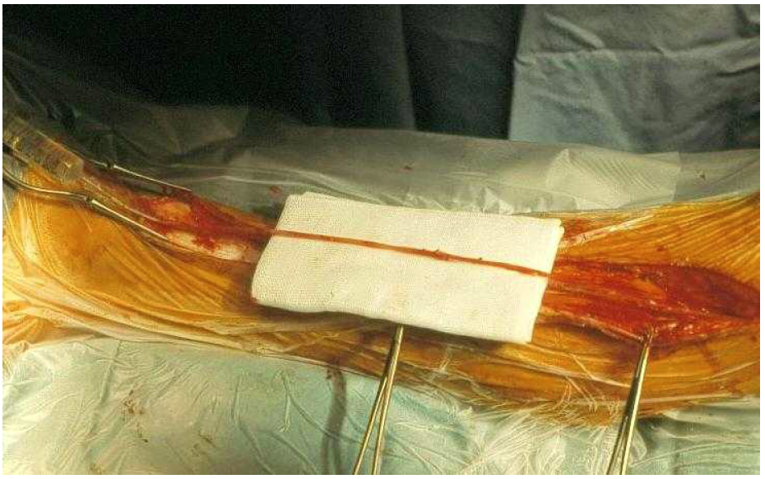

Slide 16
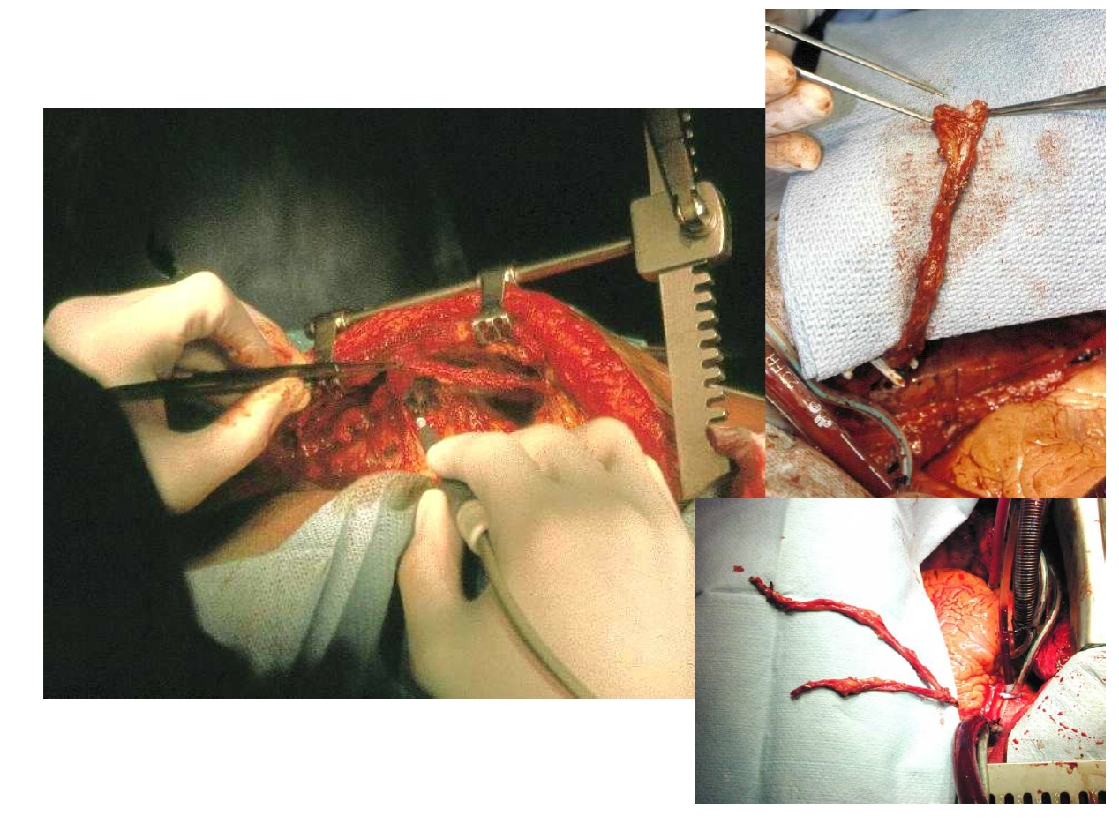

Slide 18
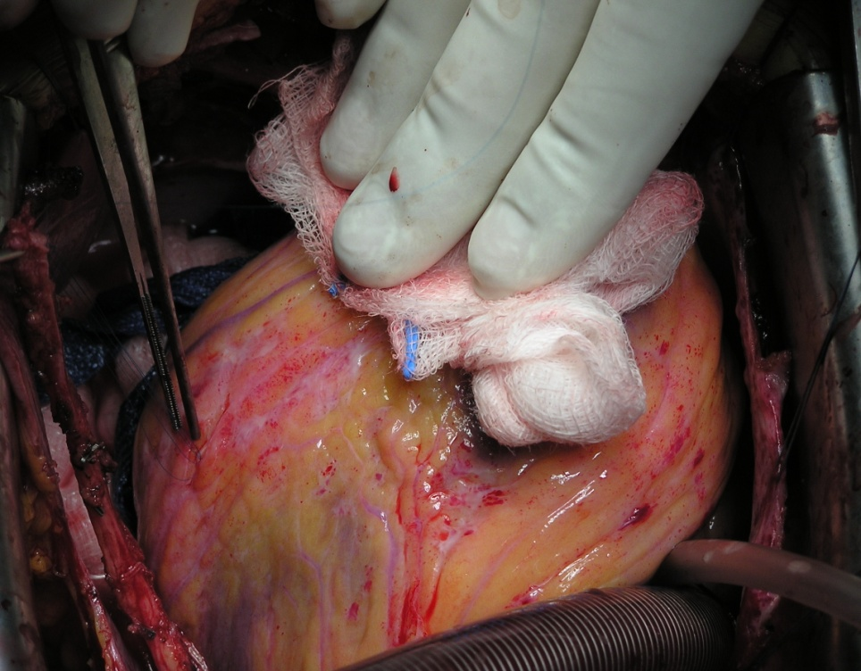
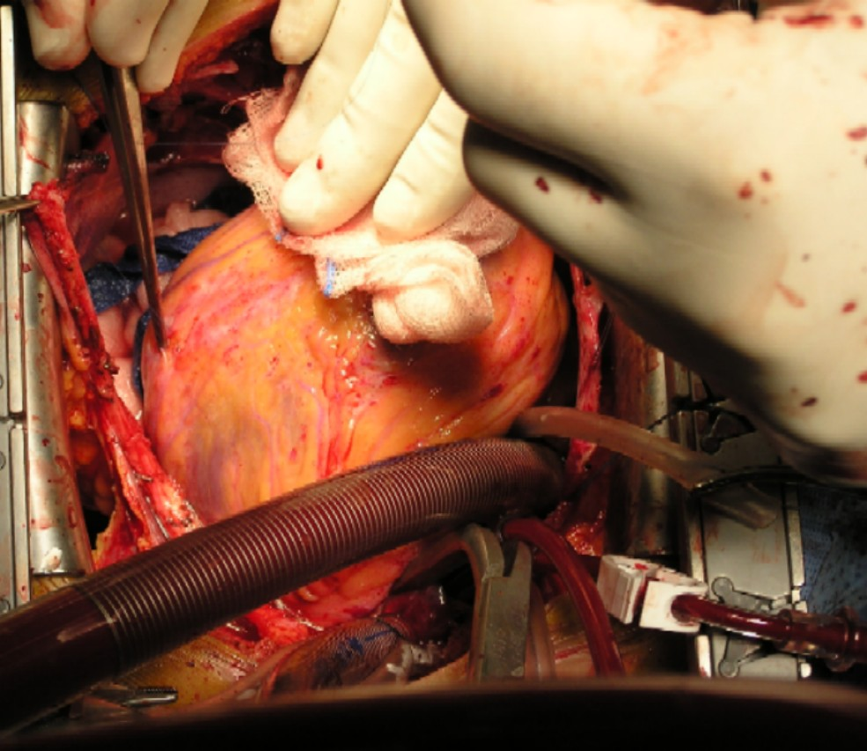
Coronary Artery Bypass Grafting

Slide 19
Coronary Artery Bypass Surgery

Slide 21
Valvular Heart Diseases
1. Mitral stenosis:
Etiology: Rheumatic, Congenital
The natural progression of MS causes the mitral valve area to reduce by 0.1-0.3 cm per year.
The progression from the onset of rheumatic fever to onset of signs of MS takes 10-20 years.
The progression from signs of MS to mild symptoms of MS takes 10-20 years.
The progression from mild symptoms to decompensation takes 10-20 years
In patients with severe PH the mean survival is 3 years.
Surgery for Cardio-thoracic Diseases

Slide 22
Symptoms of mitral stenosis
1.Asymptomatic for many years.
2. Easy fatiguability.
3. Dyspnea, Orthopnea and PND.
4. Palpitations
5. Dysphagia, compression of left main bronchus
Surgery for Cardio-thoracic Diseases

Slide 23
Signs of mitral stenosis
1. Low volume pulse.
2. Irregular pulse.
3. Tapping non-displaced apex beat.
4. Loud S1
5. Mid-diastolic rumbling murmur.
6. signs of PH: central cyanosis, Loud P2, T.R. P.R.
Surgery for Cardio-thoracic Diseases

Slide 24
Mitral Stenosis
Treatment:
1. Medical
2. Balloon valvuloplasty
3. Closed mitral commissurotomy
4. Open mitral commissurotomy
5. Mitral valve replacement.
Surgery for Cardio-thoracic Diseases

Slide 25
Mitral Valve

Slide 26
2. Mitral Regurgitation:
Etiology: Rheumatic, Degenerative, Endocarditis, Ischemic, Traumatic
Chronic mitral regurgitation: Rheumatic fever, Myxomatous degeneration, ischemic cardiomyopathy.
Acute mitral regurgitation: chordal rupture, infective endocarditis, papillary muscle rupture following MI.
Surgery for Cardio-thoracic Diseases

Slide 27
Mitral Regurgitation
Asymptomatic patients can have a long latent period before the onset of symptoms as chronic M.R is well tolerated if L.V function is still preserved.
Surgery for Cardio-thoracic Diseases

Slide 28
Mitral Regurgitation
Symptoms of mitral regurgitation:
1. asymptomatic
2. fatigue and weakness
3. Dyspnea, Orthopnea, PND
4. Pulmonary hypertension and right heart failure.
Surgery for Cardio-thoracic Diseases

Slide 29
Mitral Regurgitation
Signs of mitral regurgitation:
1. displaced apex beat
2. apical thrill
3. apical pan-systolic murmur
4.signs of pulmonary hypertension
Surgery for Cardio-thoracic Diseases

Slide 30
Mitral Valve

Slide 31
Mitral Valve replacement

Slide 32
Mitral Valve Repair

Slide 33
Aortic stenosis
Etiology: Rheumatic, Congenital, Degenerative.
Symptoms:
Asymptomatic
Chest pain
Syncopal attacks
Dyspnea and CHF
Surgery for Cardio-thoracic Diseases

Slide 34
Aortic stenosis
Signs of aortic stenosis:
1. slow-rising pulse
2. small amplitude pulse
3. sustained apical pulse
4. harsh ejection systolic murmur.
Surgery for Cardio-thoracic Diseases

Slide 35
Aortic Valve

Slide 36
Aortic Stenosis

Slide 37
Aortic regurgitation
Etiology: Rheumatic, Endocarditis, Connective tissue disorders, Aortic dissection or aneurysm.
Surgery for Cardio-thoracic Diseases

Slide 38
Aortic Valve

Slide 39
Aortic Regurgitation

Slide 40
Valvular Prostheses

Slide 41
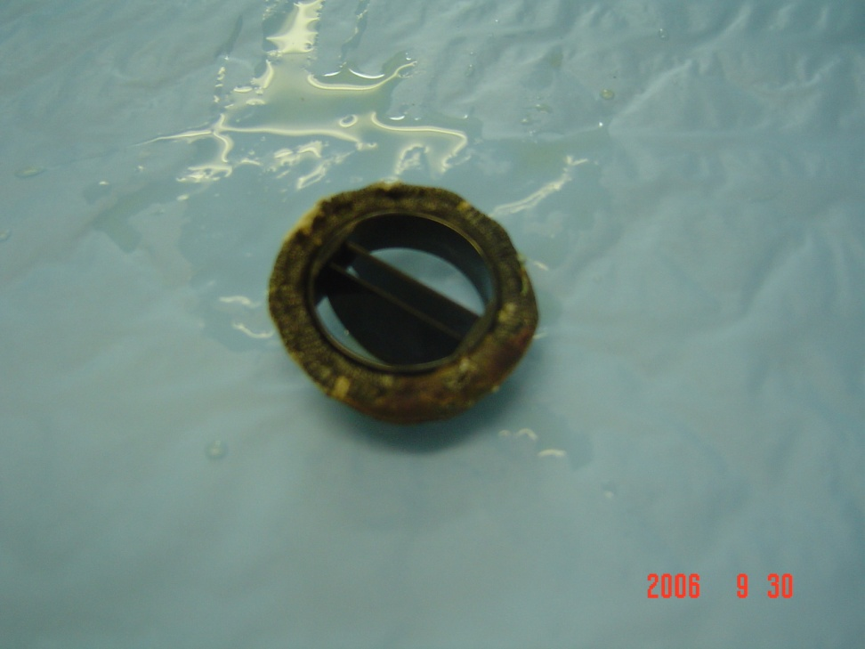
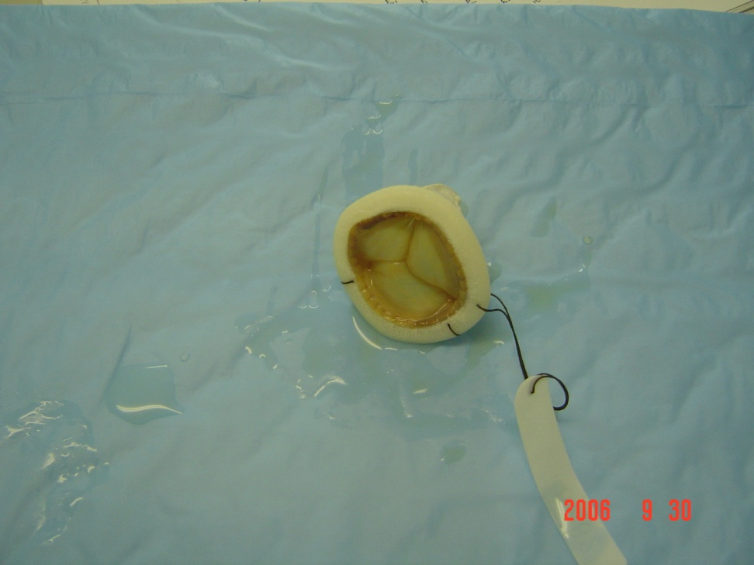
Valvular Prostheses
Surgery for Cardio-thoracic Diseases

Slide 42
Valvular Prostheses
Complications of prosthetic valves:
1. Thrombosis
2. Bleeding complications
3. Infective endocarditis
4. Paravalvular leak
5. Degeneration of biological valves
Surgery for Cardio-thoracic Diseases

Slide 43
Endocarditis

Slide 44
Heart Failure
Ventricular Assist Devices:

Slide 45
Heart Failure
Indications for Heart Transplant:

Slide 46
Heart Failure

Slide 47
Arrhythmia

Slide 48
Thoracic Aortic Disease
1. Thoracic aortic aneurysm
Symptoms are usually due to pressure on surrounding stuctures.
2. Aortic dissection:
Tear in the intima allowing blood to enter and flow in a false channel. There are 2 lumens separated by the dissecting membrane
Surgery for Cardio-thoracic Diseases

Slide 49
Type A dissections
Arising in the ascending aorta
Are a medical emergency and require immediate surgery.
Mortality rate up to 5% per hour.
Surgery for Cardio-thoracic Diseases

Slide 50
Type B dissections
Arising in the descending aorta
Carry a lower mortality rate and can be managed medically
May cause symptoms due to vascular compromise to other areas e.g. acute limb ischemia, renal ischemia, paraplegia, mesenteric ischemia.
Surgery for Cardio-thoracic Diseases

Slide 51
Aortic Disease

Slide 52
Aortic Disease

Slide 53
Aortic Surgery

Slide 54
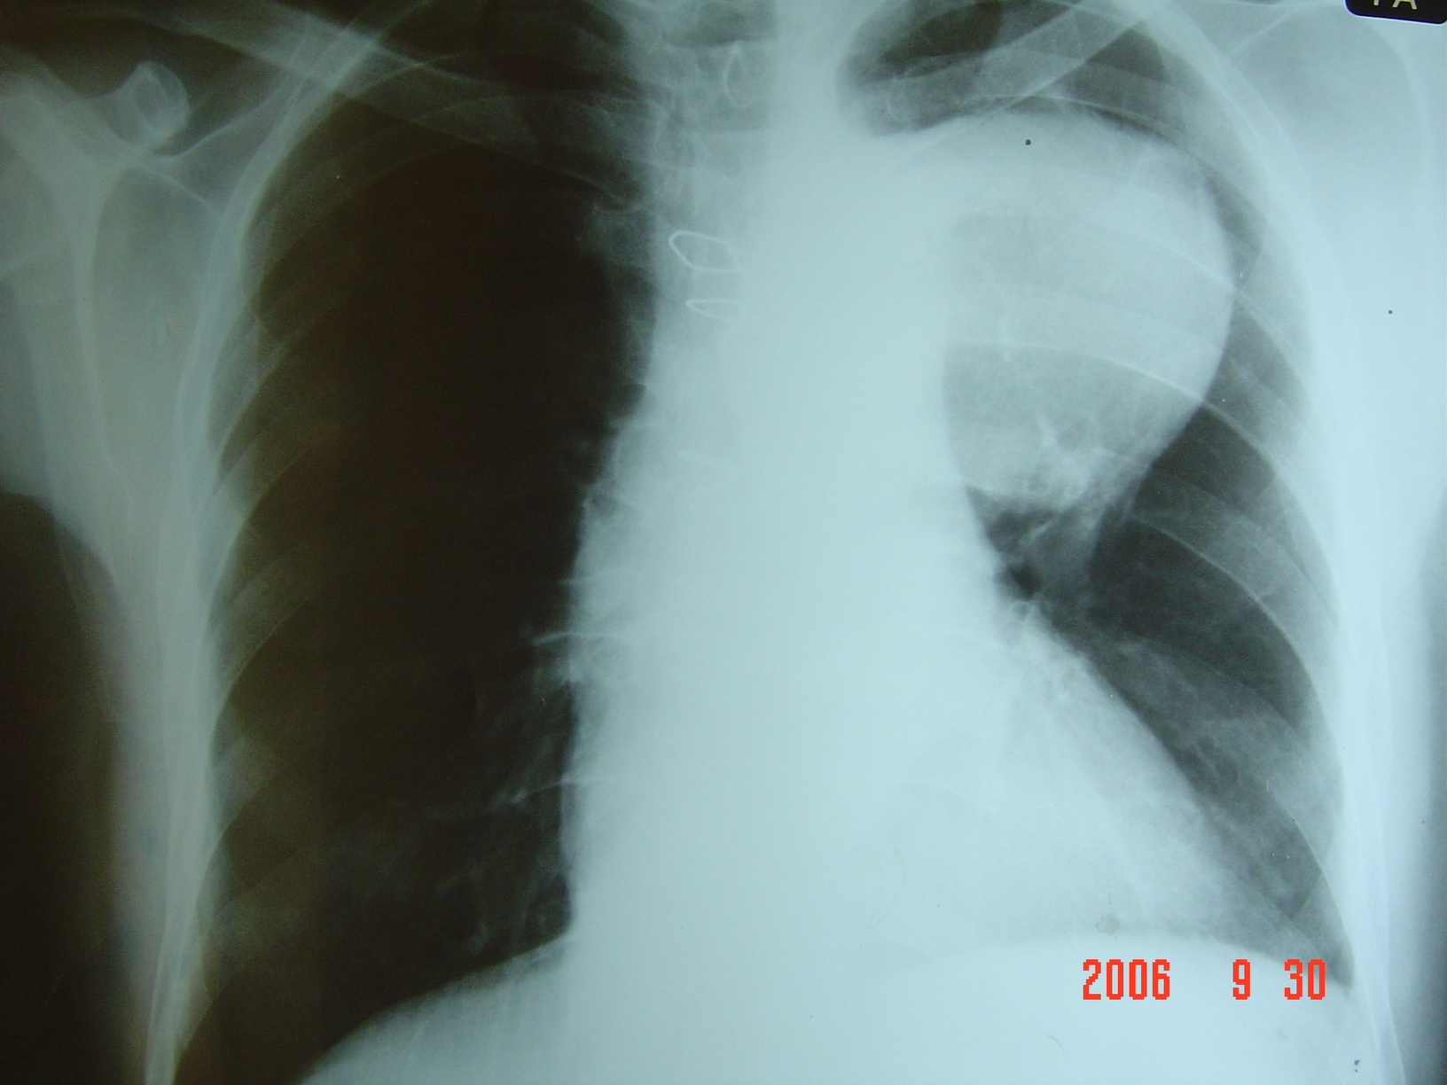
Surgery for Cardio-thoracic Diseases

Slide 55
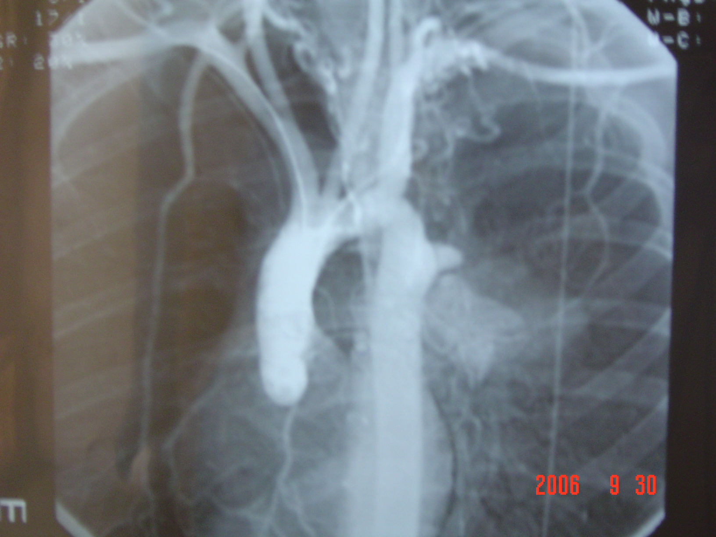
Surgery for Cardio-thoracic Diseases

Slide 56
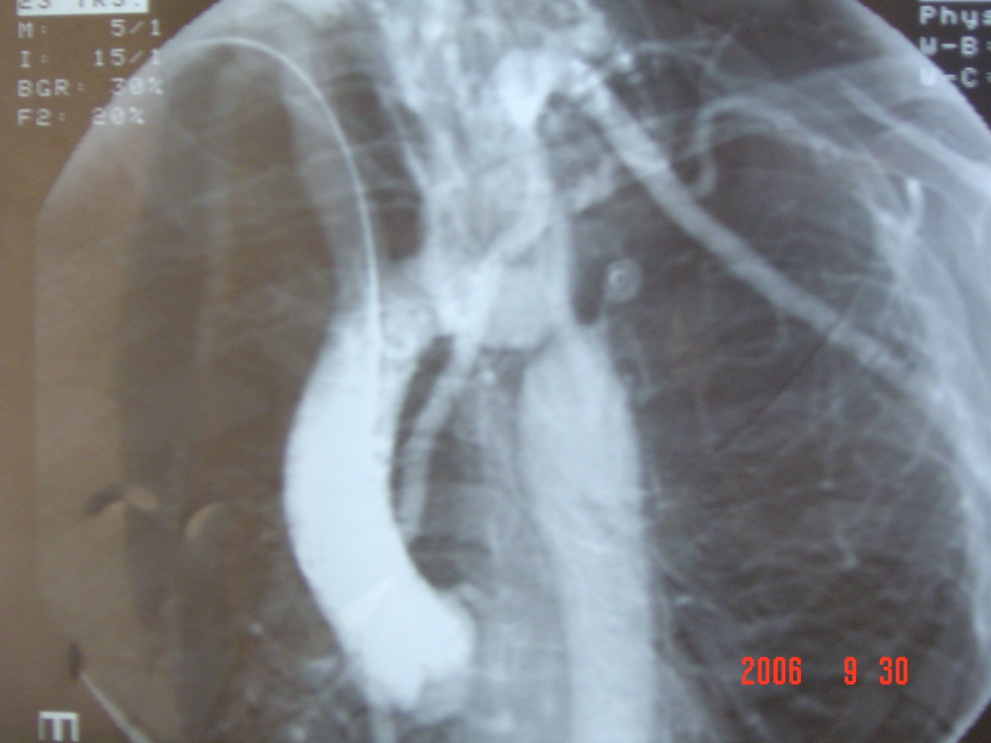
Surgery for Cardio-thoracic Diseases

Slide 57
Cardiac Tumors

Slide 58
Basic Principles of Cardiac Surgery
Adequate Exposure
Full or Partial Sternotomy / Thoracotomy / Robotic or Endoscopic
Bloodless Operative Field
Suction and re-transfusion / Snaring or clamping of bleeding vessels
Static Operative Target
Cardiac Arrest / Ventricular Fibrillation / Mechanical Stabilizers
Preservation of body perfusion
Use of Heart Lung Machine / Off-pump Techniques
Preservation of Myocardium
Off-pump Techniques / Hypothermia / Cardiac Arrest with cardioplegia
Surgery for Cardio-thoracic Diseases

Slide 59
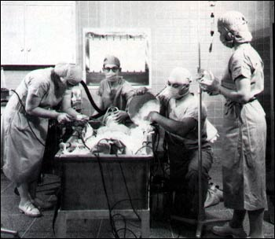
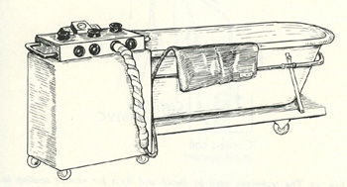
Surface Cooling Hypothermia (28c˚) for ASD Closure in Children, 1952

Slide 61
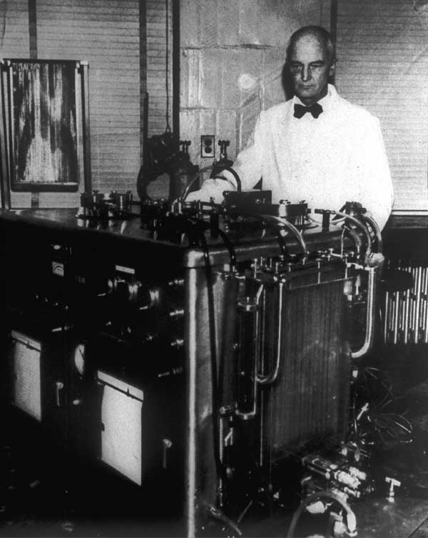
In 1953, John Gibbon reported the first successful ASD closure using his heart-lung machine. It took him 20 years of work and experiments!

Slide 62
Heart Lung Machine
Aim of cardiopulmonary bypass:
The principal aim of CPB is to facilitate cardiac and thoracic aortic procedures by excluding the heart and lungs from the circulation whilst providing:
1. adequate gas exchange
2. systemic organ perfusion
3. controlling body temp.
Surgery for Cardio-thoracic Diseases

Slide 63
Heart Lung Machine
Components :
Roller pumps
Blood Reservoir (cardiotomy reservoir)
Oxygenator
Heater-cooler unit
Tubing and Monitoring console etc
Limitation/Problems :
Requires full anticoagulation
Can cause micro embolism
Initiates Systemic Inflammatory Response
Surgery for Cardio-thoracic Diseases

Slide 64
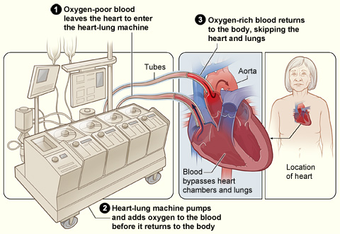

Slide 69
Complications of CPB
1. systemic inflammatory response due to contact of blood with the foreign surface of CPB circuit resulting in increased capillary permeability, interstitial edema, and subsequent organ dysfunction.
2. coagulopathy caused by platelet dysfunction as well as dilution and consumption of coagulation factors.
Surgery for Cardio-thoracic Diseases

Slide 70
Complications of CPB
3. hemolysis.
4. renal and splanchnic hypoperfusion
5. cerebrovascular accident
Surgery for Cardio-thoracic Diseases

Slide 71
Coronary Artery Bypass Surgery

Slide 72
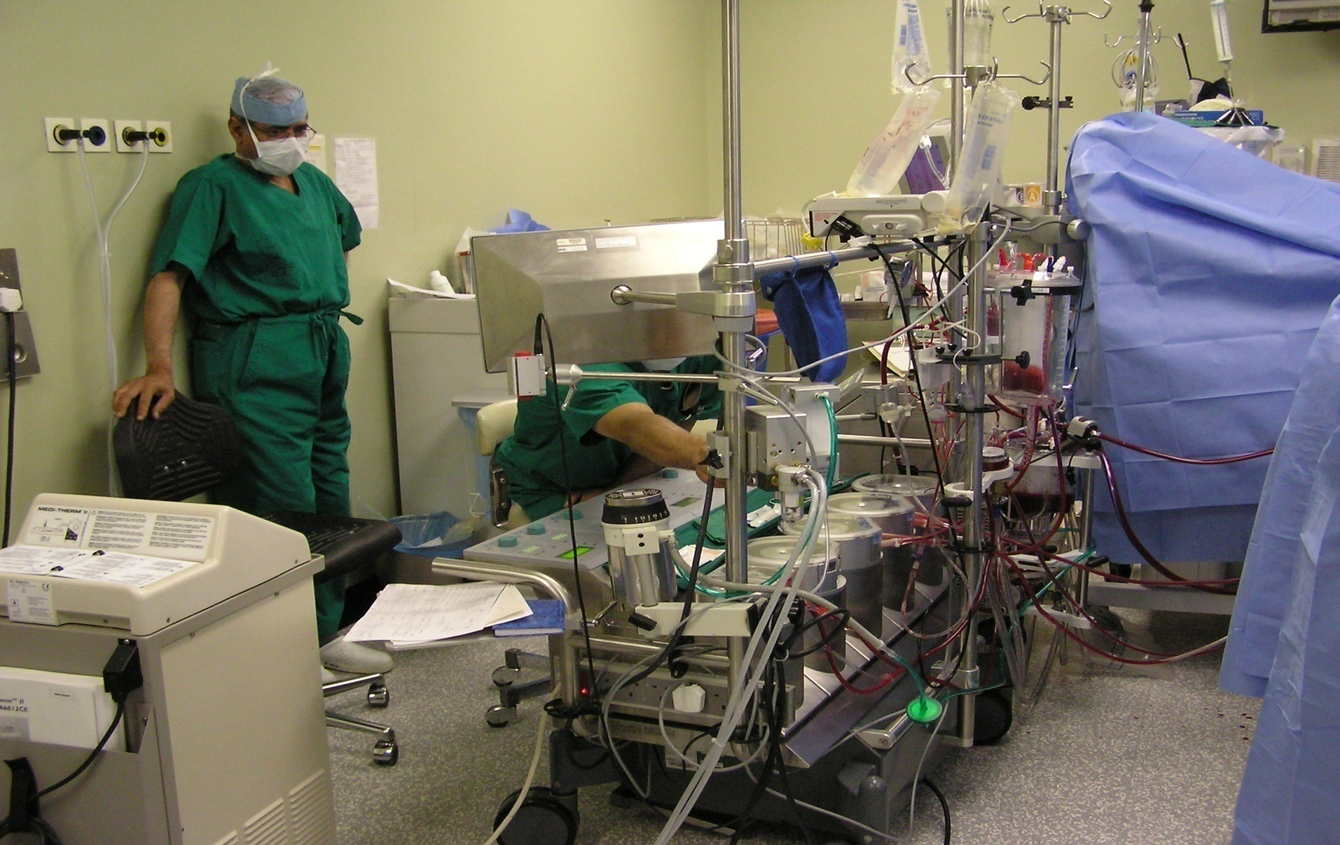
Heart Lung Machine
Surgery for Cardio-thoracic Diseases

Slide 73
Pericardial effusion
Progressive accumulation of fluid inside the pericardial cavity, may compress the cardiac chambers.
Etiology:
-Traumatic
-pericarditis
-malignancy
-uremia, post irradiation
-postoperative.
Surgery for Cardio-thoracic Diseases

Slide 74
Pericardial effusion
Investigations:
-Plain x-ray chest
-Echocardiography
-CT scan
Management:
- treat the cause
-Aspiration
-Pericardiostomy
Surgery for Cardio-thoracic Diseases

Slide 75
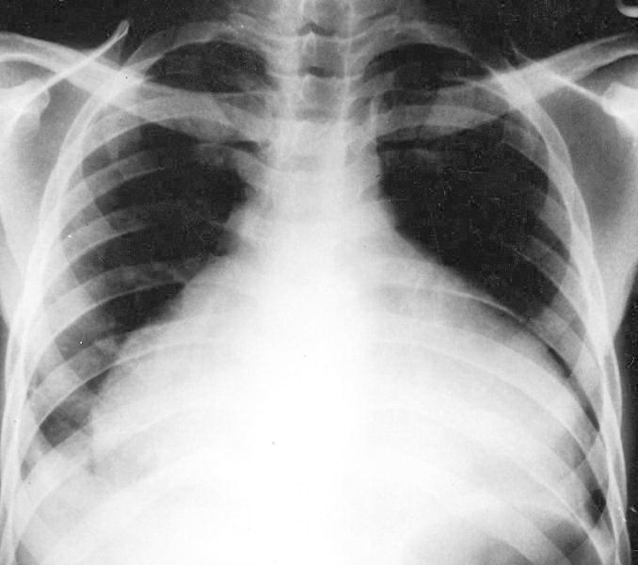
Surgery for Cardio-thoracic Diseases

Slide 76
Congenital Heart Diseases
1. Acyanotic:
-Patent ductus arteriosus
-Coarctation of the aorta
-Pulmonary stenosis
-Atrial septal defect
-Ventricular septal defect
Surgery for Cardio-thoracic Diseases

Slide 77
Congenital Heart Diseases
2. Cyanotic:
-Tetralogy of Fallot
-Transposition of the great vessels
-Tricuspid atresia
-Total anomalous venous drainage
-Truncus arteriosus
Surgery for Cardio-thoracic Diseases

Slide 78
Pre-Operative Investigations for Cardiac Surgery
Full Blood Count
Blood Biochemistry
ECG
Chest X-ray
Pulmonary Function Tests.
Other test according to systemic review of patient
Echocardiography
Angiography
Carotid Duplex Scan
Peripheral Duplex Scan
Surgery for Cardio-thoracic Diseases

Slide 79
Usual Duration of Stay in Hospital
One day before surgery
3-6 hours OR time
One day in ICU
4-5 Days in Ward
Total 5-7 days
Surgery for Cardio-thoracic Diseases

