Slide 1
Burn injury and wound healing
Dr.khalid Al-zahrani
Assitant Prof.& consultant plastic surgeon.

Slide 2
Skin Function
Body Covering
Permit movement of underlying muscles & joint
Sensors for touch, pain, and temperature
Vitamin D production
Temperature regulation
sweating, blood flow
Sun protection
Detoxification/activation of drugs and chemicals
Immunoserveillance
Langerhaus cells, t-lymphocytes

Slide 3
Skin layers

Slide 4
Epidermis
Outer layer contains the stratum corneum
The rate limiting step in dermal or percutaneous absorption is diffusion through the epidermis
Dermis
Much thicker than epidermis
True skin & is the main natural protection against trauma
Contains
Sweat glands
Sebaceous glands
Blood vessels
Hair
Nails
Subcutaneous Layer
Contains the fatty tissues which cushion & insulate

Slide 5
Burns
Causes of death
– Smoke inhalation, sepsis, pneumonia,shock
More common in elderly
(age+BSA=%mortality), most with>70% die
Risk factors for death:
– > 40% BSA, > 60 years, inhalation injury

Slide 6
Pathophysiology of Burns
Dynamic injuries
Cellular damage at >45° C
– Dependent on temperature and duration
Three zones of injury
– Central necrosis
– Zone of stasis (at risk of necrosis)
– Zone of hyperemia

Slide 8
Burn Pathophysiology
Thermal injury triggers intense inflammatory response SIRS
Initial release of histamine, bradykinin
Release of prostanoids, free radicals, proteases
Leading to:
Hypermetabolism.
Bacterial translocation.
MOF.

Slide 14
Determining Extent of Injury
Burn extent determines therapy and prognosis
Burn size estimate often inaccurate
Extent of injury described using percentage of total body surface area that is burned (TBSA)
For patients > 9 “rule of nines” may be used
For small burns, the patient’s palm covers 1%
With young children proportions differ

Slide 17
Evaluation of Burns – cont
Look for circumferential burns to chest, neck and limbs that may compromise
ventilation or circulation
Loss of distal pulses late
– Assess for warmth, sensation, motor, rigidity
– Doppler exam helpful
Identify potential abuse
– Well circumscribed, feet, ankles, buttocks

Slide 20
Inhalation Injury
Smoke inhalation
– Carbon Monoxide Poisoning
• CO has stronger affinity for HGB than O2
• Signs of CO poisoning:
– Confusion, dizziness, HA, NV, flushed skin
• Treatment 100% FiO2
– Upper Airway Obstruction
• Common in head and neck burns and smoke inhalation
• Edema continues at least 24 hours
• Protect airway with intubation
• Edema usually decreases by post burn day 3
– Pulmonary Injury from Chemical Inhalation
• Develops ARDS within 24 hours post injury
• Pneumonia may occur as late as post burn day 10

Slide 23
Fluid Resuscitation
Hypovolemia was major cause of death
Massive transudation of fluids from
vessels due to increased permeability
Edema intensifies over 8-48 hours
Goal: preservation of organ perfusion and urine output

Slide 25
Electrical Burns
Caused by passage of electric current
Damage increased in small bony areas
– Fingers, feet, lower legs, forearm
Systemic effects
– Low voltage (<1000 V)
– High voltage (>1000): Massive tissue damage, respiratory and cardiac arrest
ECG, CPK, UA, monitor
Local care often necessitates grafting and
amputation

Slide 26
Chemical Burns
Delayed and progressive injury
Deceptively superficial at first
Acid more limited (coagulation necrosis)
Alkalis more destructive (liquefaction)
HFl: significant necrosis, arrhythmias,
hypoCa
Removal of causative agent
– Brush off metals and powders
– Copious irrigation with water

Slide 27
Wound healing

Slide 28
Wound: a disruption of normal anatomic relations as a result of injury intentional or unintentional. Regardless of causation or tissue type, wound healing presents with identical biochemical and physiologic processes, though wound healing may vary in timing and intensity.

Slide 30
Inflammatory
Substrate or reactive phase, immediate
typically days 1-10
Response to limit and prevent further injury, inflammation, hemostasis, sealing surface, removing necrotic tissue and debris, migration of cells into wound by chemotaxis, cytokines, and growth factors
Initial intense local vasoconstriction of arterioles and capillaries followed by vasodilation and vascular permeability

Slide 31
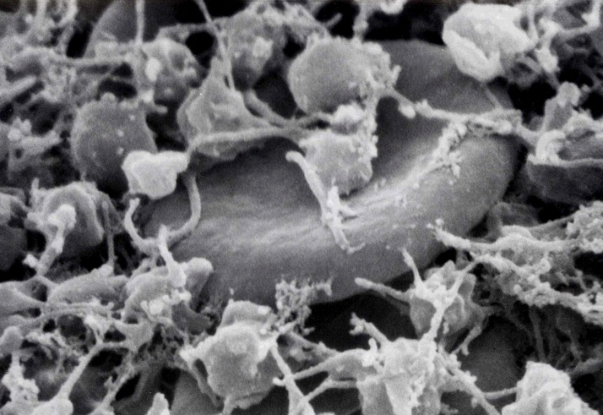
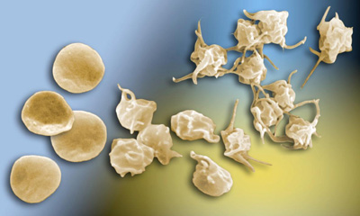
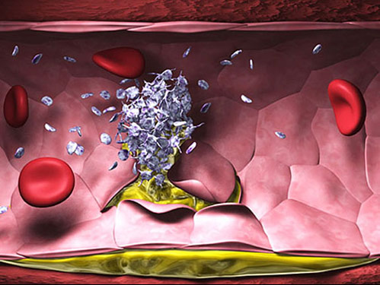
Inflammatory
•Tissue injury & blood vessel damage
exposure of subendothelial collagen
to platelets and vWF activates
the coagulation pathway
•Plugging: Platelet and fibrin
•Provisional matrix:
platelets, fibrin, and fibronectin
•Platelet aggregation:
Thromboxane (vasoconstrict),
thrombin, platelet factor 4

Slide 32
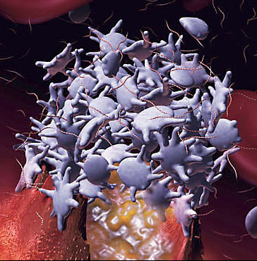
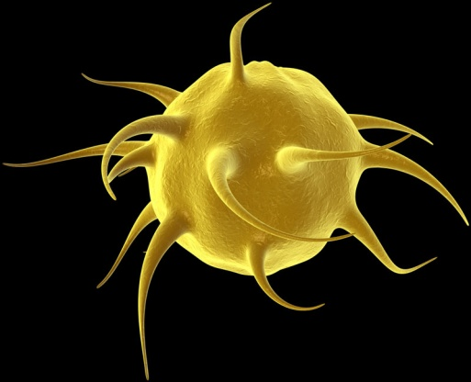
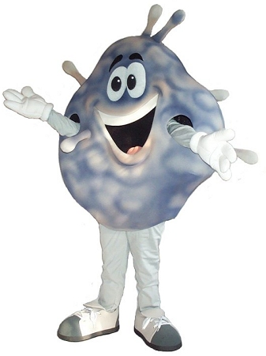
Platelets
Alpha granules contain:
-platelet factor 4: aggregation
-Beta-thrombomodulin: binds
thrombin
-PDGF: chemoattractant
-TGF-beta: key component tissue repair
Dense granules contain vasoactive substances: adenosine, serotonin, and calcium
Other factors released: TXA, Platelet activate
factor, Transform. growth factor alpha, Fibroblast growth factor, Beta lysin (antimicrobial), PGE2
and PGI2 (vasodilate) and PGF2 (vasoconstrict).
Notes:
Paltelets disintegrate
Pg’s are prostaglandins
Gary Carlson pics

Slide 33
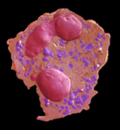
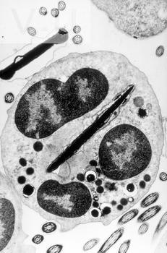
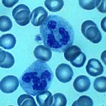
Polymorphonuclear Cells
Chemotaxins attract after extravasation
Migrate through the ECM by transient interaction with integrins
PMNs scavenge, present antigens,
provide cytotoxicity-free radicals (H2O2)
Migration PMNs stops with wound contamination control usually a few days
Persistant contaminant: continuous influx PMN’s and tissue destruction, necrosis, abscess, & systemic infection
PMNs are not essential to wound healing
Notes:
But Macrophages can do it all

Slide 34
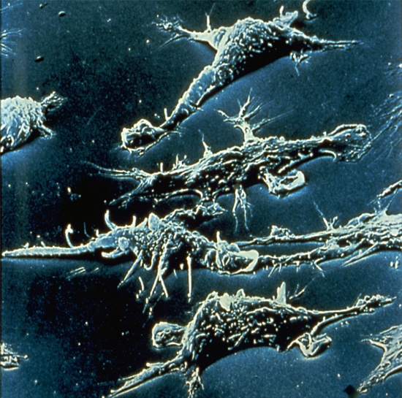
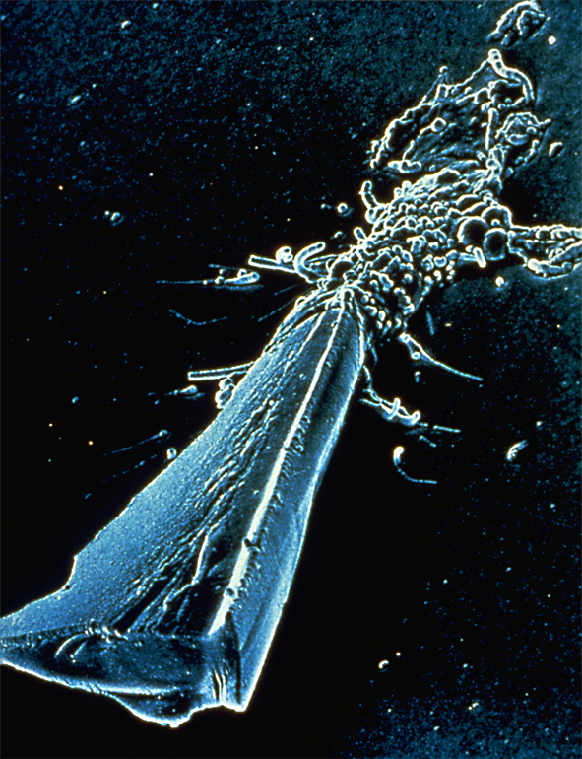
Macrophages Necessary
Monocytes migrate &
activate: Macrophages
Appear when PMN’s
disappear 24-48 hr
Do the same activities as PMN’s
Plus orchestrate release of enzymes (collagenase, elastase), PGE’s,
cytokines (IL-1, TNF alpha,
IFN ), growth factors (TGF
& PDGF), and fibronectin (scaffold/anchor for fibroblasts)
Activate Fibroblasts, endothelial and epithelial cells to form Gran. Tissue
Notes:
One cell truly necessary to wnd healing as per sabistan
Macrophages induce pmn apoptosis
Migrate similar to PMN’s secrete enzyme to degrade and alter ECM instigate fibroblast
Fibronectin attract more phages too

Slide 36
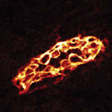
Proliferative
Regenerative or Reparative
day 5- 3 weeks
Angiogenesis: endothelial
cells activate & degrade
Basement membrane,
migrate, and divide to form more tubules
Granulation Tissue: capillary ingrowth, collagen, Macrophages, Fibroblasts, Hyaluronic acid (GAG)
Notes:
Growth factors Tgf beta, PDGF & cytokines IL1, TNF alpha as well as thrombin, elastin,leukotriene b4, complement trigger fibroblast formtn and migratn from wound edge (do not arrive by diapedesis)
GAG glycosaminoglycan
Activation of endothelial cells that line blood vessel walls

Slide 37
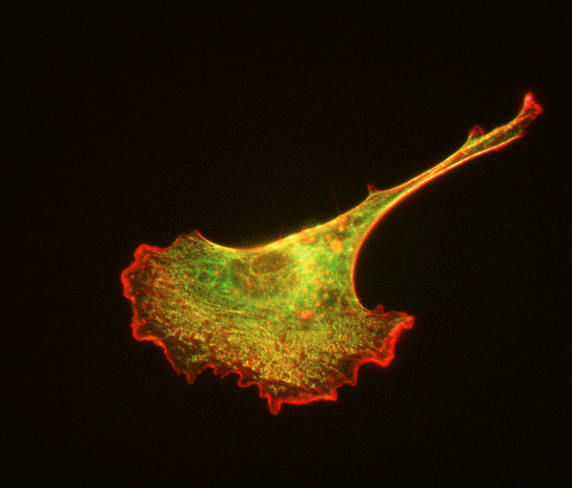
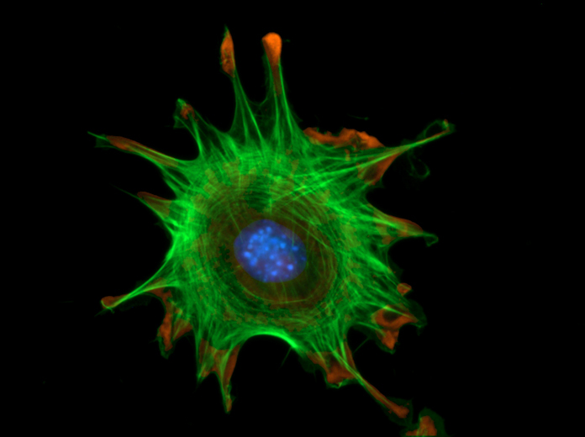
Proliferative Cont…
Fibroblasts
differentiate from resting
mesenchymal cells in connective
tissue
3-5 days migrate from wound
edge
Fibroplasia: Fibroblasts
proliferate replace
fibronectin-fibrin with
collagen contribute ECM

Slide 38
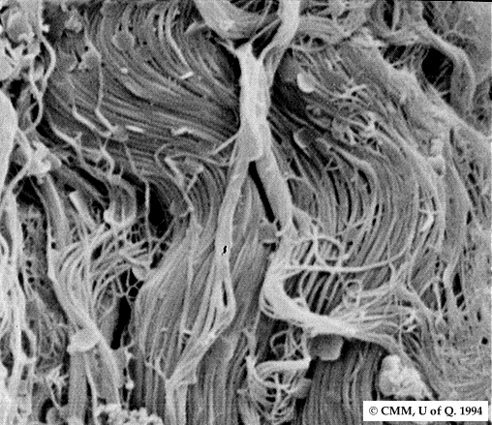
Collagen
I (80% skin) | Most Common: skin, bone, tendon. Primary type in wound healing.
II | Cartilage
III (20 % skin) | Increased Ratio in healing wound, also blood vessels and skin
IV | Basement Membrane
V | Widespread, particularly in the cornea
Type III predominant collagen synthesis days 1-2
Type I days 3-4
Type III replaced by Type I in 3 weeks

Slide 39
Wound strength
6 Week = 60% original, 80% final strength
8 Week-1 year ≈ 80% original (Max)
Net Collagen = 6 weeks amount stays the same but cont. crosslink increase strength = maturation

Slide 40
Maturational
Remodeling of wound 3 week-1+year
Type I replaces Type III Collagen: net amount doesn’t change after 6 weeks, organization & crosslinking
Decreased vascularity, less fibroblasts & hyaluronic acid
Peripheral nerves regenerate @ 1mm/day
Accelerated Wound Healing: reopening results in quicker healing 2nd time around
Notes:
(8:1) NL skin
Raised red scar flattens
Scar always more brittle devoid rete pegs
Accelarated: healing cells already there

Slide 41
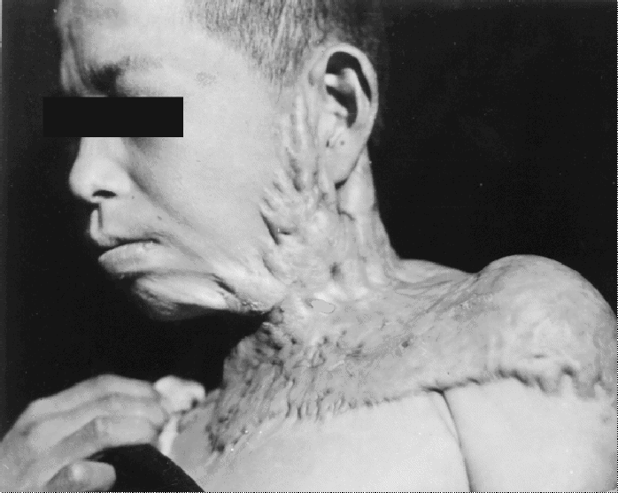
Contraction: centripetal movement of the whole thickness of surrounding skin reducing scar
Myofibroblasts: special Fibroblasts express smooth muscle and bundles of actin connected through cellular fibronexus to ECM fibronectin, communicate via gap junctions to pull edges of the wound
Contracture: the physical constriction or limitation of function as the result of Contraction (scars across joints, mouth, eyelid)
Burn/Keloid causing
contracture
Notes:
NL fibroblasts don’t have gap junctions
Myofibroblasts also possibly respons for duptyren’s contracture, renal and pulm fibrosis, hepatic chirrosis

Slide 42
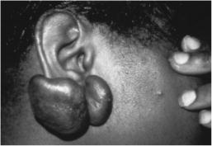
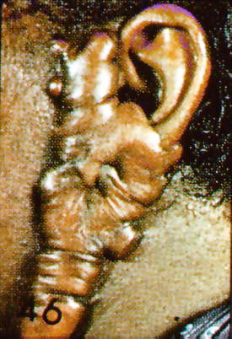
Keloids: Beyond the Borders
Excess Deposition of Collagen Causes Scar Growth Beyond the Border of the Original wound
Tx: XRT, steroids, silicone sheeting, pressure, excise. often Refractory to
Tx & not preventable
Autosomal Dominant, Darker Pigment, Often above clavicle but not always
Notes:
XRT=radiation Tx

Slide 43
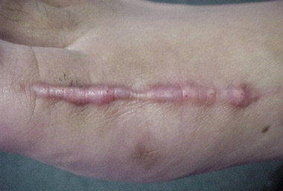
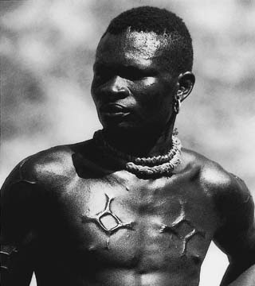
Hypertrophic Scar: confined within
Excess collagen deposit causing raised scar remains within the original wound confines
Darker pigmented skin & flexor surfaces of upper torso
Often occurs in burns or wounds that take a long time to heal, sometimes preventable
Can regress spontaneously
Tx: steroids, silicone, pressure garments

Slide 44
Impediments to Wound Healing
Bacteria>10⁵/cm² : Decreased O₂ content, collagen lysis, prolonged inflammation
Devitalized Tissue & Foreign Body: Retards Granulation Tissue formation and healing
Cytotoxic drugs: 5FU, MTX, Cyclosporine, FK-506 can impair wound healing. D-Penicillamine- inhibit collagen x-linking
Chemotherapy: no effect after 14 days
Radiation: Collagen synthesis abnormal, fibrosis of vessel

Slide 45
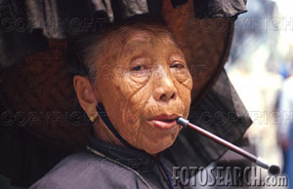
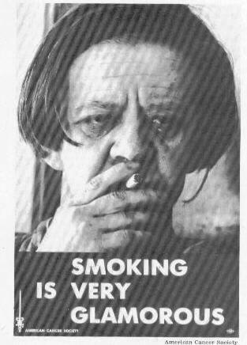
More Impediments
Diabetes: impedes the early phase
response
Malnurishment: Albumin<3.0, Vit-C
Smoking: vasoconstriction, atherosclerosis, carboxyhemoglobin, decreased O₂ delivery
Steroids: inhibit macrophages, PMNs, Fibroblast collagen synthesis, cytokines, and decreased wound tensile strength
-Vit A (25,000 IU QD) counteracts effect of steroids
DENERVATION has NO EFFECT on Wound Healing

Slide 46
Diseases Assoc With Abnormal Wound Healing
Osteogenesis Imperfecta: Type I Collagen defect
Ehler-Danlos syndrome: Collagen disorder, 10 types
Marfan Syndrome: fibrillin defect (collagen)
Epidermolysis Bullosa: Excess fibroblasts Tx: phenytoin
Scurvy: Vit C req. for proline hydroxylation

Slide 47
Thank you

