Slide 1



“In the name of Allah, Most Gracious, Most Merciful”

Slide 2




BLOOD TRANSFUSION
Salah N. El-Tallawy
Prof. of Anesthesia and Pain Management
Faculty of Medicine - Minia University & NCI - Cairo University – Egypt
College of Medicine, King Saud University, Riyadh, KSA

Slide 3


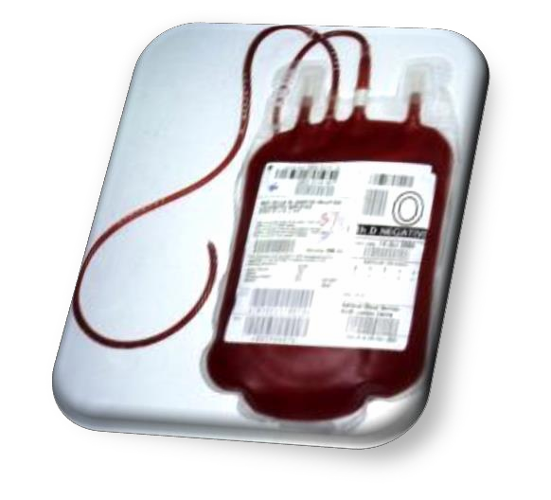
Blood Transfusion:
Introduction.
Sources of Blood Transfusion
Blood groups
Transfusion Triggers
Blood & Component Transfusion
Complications of Blood transfusions
Summary

Slide 4


Blood Transfusion:
Definition:
– Is the transfer of Blood or Blood Products
from one person (Donor)
⇒ into another Person's Blood, (Recipient).

Slide 5
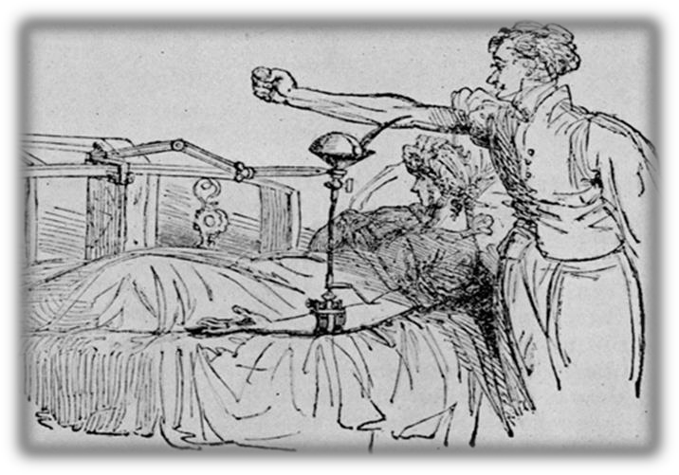
Blood Transfusion:
Q.) What are the sources of blood?
Autologous blood:
  Using your own blood.
Donor blood (Allogenic):
  Using someone else’s blood.

Slide 6



Blood Transfusion:
1. Autologous blood:
Preoperative donation.
Intraoperative autologous transfusion.
Postoperative autologous transfusion.
Hemodilution.
Apheresis.
Description
Indication
Advantage
2. Donor blood (Allogenic).
Disadvantage
Volunteer blood
Designed donor blood

Slide 7


Blood Transfusion:
Autologous blood:
  Preoperative donation:
Description:
  By donating your own blood before surgery.
  The blood bank draws your blood and stores it until you need it.
Indications
  This option is only for elective procedures.
Advantages:
  Eliminating / minimizing the need for someone else's blood.
Disadvantage:
  It requires advanced planning which may delay surgery.
  Some medical conditions may prevent the pre-op donation.
  Non suitable for emergency situations.

Slide 8
Blood Transfusion:
1. Autologous blood:
b) Intraoperative autologous transfusion.
Description:
  It is a method of “Recycling Your Blood” during surgery.
  Blood loss during surgery is filtered, and put back during surgery.
Indications
  This can be done in Emergency and Elective surgeries.
Advantages:
  Eliminating or minimizing the need for someone else's blood.
  Large amounts of blood can be recycled.
Disadvantage:
  This process cannot be used if Cancer or Infection is present

Slide 9
Blood Transfusion:
1. Autologous blood:
c) Postoperative autologous transfusion.
Description:
  Also, it is a type of “Recycling Your Blood” after surgery.
  Blood lost after surgery is collected, filtered and returned to your
body. (Cell Saver)
Indications
  This can be done in Emergency and Elective surgeries.
Advantages:
  Eliminating or minimizing the need for someone else's blood.
Disadvantage:
  This process cannot be used if cancer or infection is present

Slide 10
Blood Transfusion:
1. Autologous blood:
d) Hemodilution.
Description:
  Donating pt’s own blood During or Immediately before surgery,
  Some of pt’s blood is taken and replaced with IV fluids.
  After surgery, this blood is filtered and returned to the pt.
  This process dilutes pt’s blood, so he loses less concentrated blood.
Indications
  This option is only for elective procedures.
Advantages:
  Eliminating or minimizing the need for someone else's blood.
Disadvantage:
  Only a limited amount of blood can be removed,
  Certain medical conditions may prevent the use of this technique.

Slide 11


Blood Transfusion:
1. Autologous blood:
e) Apheresis.
Description:
  donating pt’s own Platelets and Plasma.
  Before surgery, pt’s platelets and plasma, are withdrawn, filtered
and returned to the pt. when he need it later.
Indications
  This option is only for elective procedures.
Advantages:
  Eliminating the need for donor platelets and plasma.
Disadvantage:
  Some medical conditions may prevent apheresis.
  And in actual practice it has limited applications.

Slide 12
Blood Transfusion:
1. Autologous blood:
Preoperative donation.
Intraoperative autologous transfusion.
Postoperative autologous transfusion.
Hemodilution.
Apheresis.
Description
Indication
Advantage
2. Donor blood (Allogenic).
Disadvantage
Volunteer blood
Designed donor blood

Slide 13


Blood Transfusion:
Donor blood (Allogenic):
  Volunteer blood:
Description:
  Blood collected from the community blood supply
(e.g blood banks).
Indication:
  Both Elective & Emergency situations.
Advantages:
  This has the advantage of being readily available,
  And can be life-saving when your own blood is not available.
Disadvantage:
  There is a risk of disease transmission e.g hepatitis & AIDS
  Allergic reactions.

Slide 14

Blood Transfusion:
2. Donor blood:
b) Designated donor blood:
Description:
  Blood is collected from the donors you select (e.g. friends or family).
  You can select people with your own blood type &
  And you feel safe donors.
Indications:
  Usually elective procedures
  May be in less emergency category (CAT 2 or 3)
Advantages:
  Can be life-saving when volunteer donor blood is not available,
  Or when your own blood is not available.
Disadvantages:
  There is still a risk of disease transmission, e.g. hepatitis & AIDS
  Allergic reactions.
  This process usually requires several days for advanced donation.

Slide 15







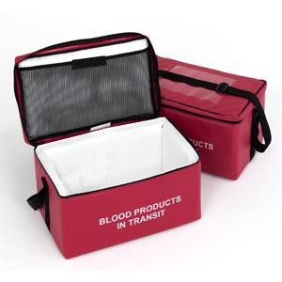
Blood Transfusion:
Blood bank:
  Collect,
  Screening,
  Test,
  Store blood,
  Prepare blood
Donor
SAFE TRANSFUSION PROCESS
Recipient
& components.

Slide 16
Blood Transfusion:
Anticoagulants in the Blood:
  Blood collection bags contain an anticoagulant- preservatives:
Citrate, Phosphate, Dextrose & Adenine (CPDA-1)
  Ensuring a shelf life of 35 days
  And hematocrit of 70 to 80% for PRBCs.
Additive solutions (Adsol, Nutricel, Optisol):
  Provide additional nutrients,
  Extending maximum storage to 42 days,
  ↓ Viscosity → makes infusion easier.

Slide 17
Blood Transfusion:
Storage of the Blood:
  Storage impairs red cell function.
    Transfused blood delivers less oxygen to the tissues.
  Refrigerated at 1 to 6° C (usually 4° C),
    Cell metabolism continues and changes occur.
    ↓ in “pH” and ↓ in the level of “2,3-DPG”.
  The deformability of RBCs:
    makes them more Spherical & Rigid,
⇒ ↑ resistance to capillary flow.
  Cell leakage of K⁺ (≈ 6 mEq/U).

Slide 18
Blood Transfusion:
Blood Type:
Patient’s Blood is sent for the following tests:
  ABO grouping:
    The recipient’s RBCs be tested with anti-A & anti-B serum,
    Their serum be tested with A & B red cells
  Rh typing:
    Adding “Anti-D” ➔ recipient RBCs
  Antibody screen for unexpected (non-ABO/Rh) antibodies.

Slide 19










Blood Transfusion:
In addition, each person's blood is either:
  Rh-positive:
    Can receive Rh-ve or Rh+ve
blood.
  Rh-negative:
    Should only receive Rh-
negative blood
    Can be used for emergencies.
Q.) How many blood group we have?
O+ | 39.0%
A+ | 34.0%
B+ | 8.5%
AB+ | 3.5%
O- | 6.6%
A- | 6.3%
B- | 1.5%
AB- | 1.0%

Slide 20



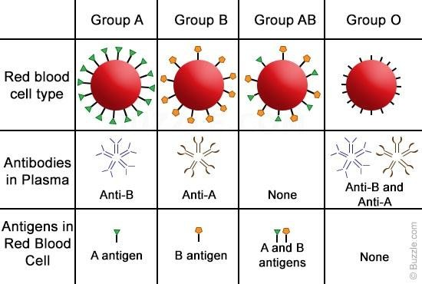






Blood Transfusion:
O Rh -ve
Donates | A & AB | B & AB | AB | A, B, AB & O
Receives | A & O | B & O | A, B, O & AB | O

Slide 21











Blood Transfusion:
Formal cross-match

Slide 22




Q.) Why ?
Increase “Oxygen Carrying Capacity”
Restoration of “Red Cell Mass”
Correction on “Anemia”
Correction of “Bleeding” caused by:
“Platelet Dysfunction”
“Factor Deficiencies”
Q.) How ?

Slide 23


Oxygen Delivery (DO₂):
“Is the oxygen that is delivered to the tissues”
DO ₂ = CO P
(Cardiac Output
x C a O ₂
X Arterial Oxygen Content)
Oxygen Content (C a O ₂ ):
= ( Hb x 1.39 ) O ₂ Saturation + Pa O ₂ ( 0.003 )
“Hb” is the main determinant of CaO₂ in the blood.

Slide 24


(cont.)
DO ₂ = CO P x C a O ₂
Cardiac Output = “H R ” (Heart Rate) x “ SV ”
Therefore:
(Stroke Volume)
DO ₂ = “ H R x SV ” x C a O ₂
If HR or SV are unable to compensate,
Hb is the major determinant factor in DO₂

Slide 25


Blood Transfusion:
Legal Aspects:
  60% of transfusions occur perioperatively.
  Responsibility of “Perioperative Transfusion” is with the Anesthesiologist
  “2” qualified staff ➔ check the blood
    Identification: “Recipient and Unit”
    Confirmation of: “Compatibility & Expiration Date”
➔ To prevent a potentially fatal & critical error.

Slide 26



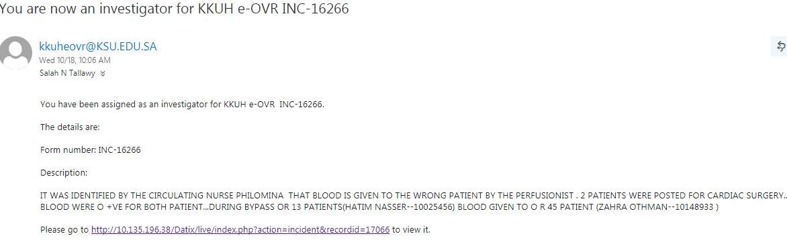
Blood Transfusion:
Legal Aspects:
Q. ???

Slide 27


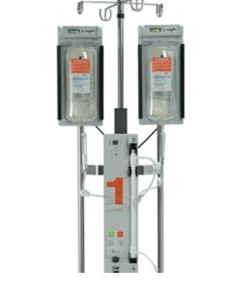
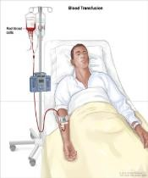
Blood Transfusion:
Urgent transfusion:
– Require flow rates faster than gravity can provide.
1.) Pressure bags:
➔ Apply pressure evenly to the blood bag surface.
2.) Level (1) transfusion system.
If external pressure is anticipated:
➔ Large-bore “IV cannula” is recommended to prevent hemolysis.

Slide 28



Blood Transfusion:
Patient’s age,
Severity of symptoms,
Cause of the deficit,
Underlying medical condition,
Ability to compensate for:
– ⬇ “O₂ carrying capacity”
Tissue oxygen requirements.
Determinant
Factors

Slide 29
Blood Transfusion:
Clinical evaluation:
  Appearance (pallor, diaphoresis),
  Mentation (alert, confused),
  Heart Rate,
  Blood Pressure,
  Nature of the bleeding: (active, controlled, rate )
Laboratory evaluation :
  CBC
    Hb,
    Hematocrit,
    Platelets,
  Coagulation profile.

Slide 30








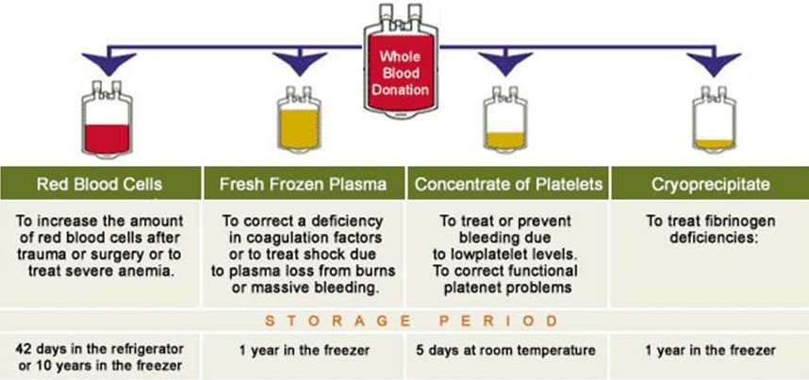

Slide 31
Transfusion Requirements In Critical Care Trial
“T R I C C ”
Demonstrated that in the critical care setting,
a transfusion threshold of 7 g/dL was as safe as a threshold of 10 g/dL.
A subgroup analysis generated some concern that patients with “Ischemic Heart Disease”
➔ more intolerant of anemia,
➔ benefit from higher transfusion threshold.

Slide 32
Packed Red Blood Cells “PRBCs”
PRBCs ➔ improve DO₂ to tissues.
American Society of Anesthesiologists “ASA”
  Transfusion is rarely needed with Hb >10 g/dL .
  Always needed when the Hb < 6 g/dL.
  Patients with: Hb (6 – 10) mg/dL
➔ require careful clinical judgment.

Slide 33
Whole Blood:
  It is not as economical as component therapy,
  In modern transfusion medicine is rarely used. Although,
  There has recently been renewed interest in the benefits of using fresh whole blood in “Military Field Hospitals”.

Slide 34






PRBCS
“1” U of PRBCs:
  ↑ the Hb ➔ 1 g/dL
  or the hematocrit ➔ 3%.
PRBCs are run through a filter with a large-bore IV line.
  ➔ With normal saline.
 Lactated Ringer’s ➔ clotting due to the added Ca⁺⁺
 Hypotonic solution ➔ hemolysis.
Most transfusions are given: 60 – 90 min & (not > 4 h).

Slide 35
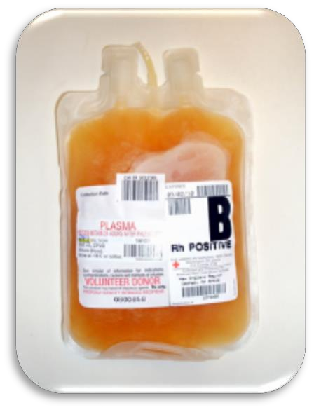
Fresh Frozen Plasma “FFP”
“1” u “FFP” = 200 – 250 ml.
“FFP” is ABO compatible.
“FFP” ➔ through blood tubing.
within 2 to 6 hrs of thawing.
It contains all clotting factors.
Dose of “FFP”
  It should be given to achieve a minimum of 30% of plasma factor conc.
  Calculated as 10 to 15 mL/kg.

Slide 36
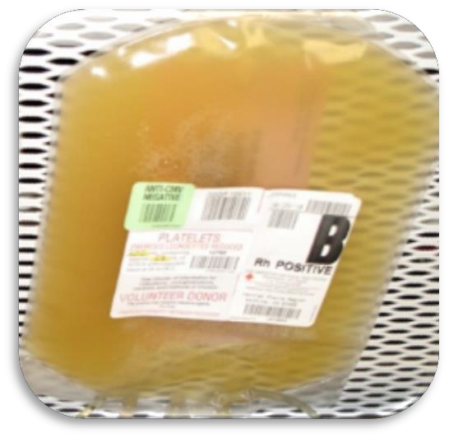
Platelets
Cross-matching is unnecessary, But,
  Rh-negative patients should receive Rh-negative platelets.
Platelets dose:
  Adults: 4 to 6 U (6 packs of platelets).
  Children: 1 U/10 kg body weight.

Slide 37
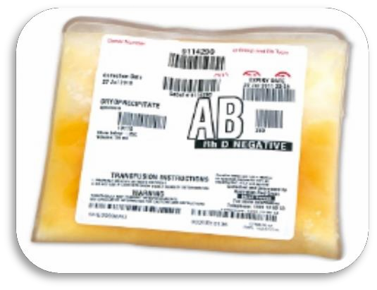

Cryoprecipitate
Cryoprecipitate is a source of:
  Fibrinogen, Factor VIII, and vonWillebrand factor (vWF).
  It is ideal for supplying fibrinogen to the volume- sensitive patient.
When factor VIII concentrates are not available,
  Cryoprecipitate may be used
    (each unit contains ≈ 80 units of factor VIII)

Slide 38
Adverse Reactions of Blood Transfusion
The most common reactions are
“Not Life Threatening”
Although,
Serious reactions can present with mild symptoms and signs.
Reactions can be reduced or prevented by:
– Modified Blood Components.
e.g (filtered, washed, or irradiated)

Slide 39
Adverse Reactions of Blood Transfusion
IMMUNE-MEDIATED REACTIONS
I) Acute Hemolytic Transfusion Reactions “AHTR”
Immune-mediated hemolysis occurs when the recipient has preformed Antibodies that lyse Donor Erythrocytes.
The ABO isoagglutinins are responsible for the majority of these reactions,

Slide 40
Adverse Reactions of Blood Transfusion
Presentation of AHTR:
  Clinical:
    Hypotension, tachycardia, tachypnea,
    Fever, chills, …..
    Chest / flank pain,
    Discomfort at the infusion site.
  Laboratory:
    C B C ➔ Hemoglobinemia, ?
    Urine ➔ Hemoglobinuria. ?

Slide 41
Adverse Reactions of Blood Transfusion
The laboratory evaluation for hemolysis :
  Serum haptoglobin,
  Lactate dehydrogenase (LDH),
  Indirect bilirubin levels
  Coagulation studies e.g.
    Prothrombin Time (PT),
    Activated Partial Thromboplastin Time (aPTT),
    Fibrinogen and Platelet Count.

Slide 42
Adverse Reactions of Blood Transfusion
Managements of AHTR:
  Transfusion must be stopped immediately,
  IV access maintained, IV fluids started
  The reaction reported to the blood bank.
  The immune complexes that result in RBC lysis can cause renal dysfunction and failure.
    So, Diuresis should be induced with:
– IV fluids and furosemide or mannitol.
  Tissue factor released from the lysed RBCs → DIC.

Slide 43
Adverse Reactions of Blood Transfusion
II.) Febrile Non-Hemolytic Transfusion Reaction
“FNHTR”
The most frequent reaction associated with the transfusion of cellular blood components.
These reactions are characterized by:
  Chills and rigors
  Rise in temperature (≥1°C).

Slide 44
Adverse Reactions of Blood Transfusion
III. Allergic Reactions:
It is mainly related to plasma proteins found in transfused components.
Mild reactions treated symptomatically by:
  Temporarily stopping the transfusion
  And administering antihistamines
e.g. (diphenhydramine, 50 mg orally or IM).

Slide 45
Adverse Reactions of Blood Transfusion
IV. Anaphylactic reaction
This severe reaction presents after transfusion of a few ml of the blood component.
Symptoms and signs:
  Difficulty in breathing, Coughing & Bronchospasm
  Nausea and Vomiting,
  Hypotension,
  Shock, Loss of consciousness & Respiratory arrest.
Managements:
  Stopping the transfusion,
  Maintaining vascular access, IV fluids
  Administering epinephrine (0.5–1 mL of 1:1000) S.C.
  Glucocorticoids may be required in severe cases.
  O₂ & symptomatic ttt

Slide 46
Adverse Reactions of Blood Transfusion
V. Graft-versus-host disease (GVHD)
It is a frequent complication of: “Allogeneic Stem Cell Transplantation”
In which T- Lymphocytes from the donor attack the immune-deficient host.
Manifested clinically by:
  Fever & a characteristic cutaneous eruption,
  Diarrhea, and liver function abnormalities.

Slide 47
Adverse Reactions of Blood Transfusion
VI.) Transfusion-related “Acute Lung Injury”:
Presents as:
  Acute respiratory distress,
  During or within 6 h of transfusion.
Characterized by:
  Respiratory compromise,
  Signs of non-cardiogenic pulmonary edema,
  X-ray chest ➔ bilateral interstitial infiltrates.
Treatment:
  Mainly supportive ttt,
  Patients usually recover without complications,

Slide 48
Adverse Reactions of Blood Transfusion
VII.) NON-IMMUNOLOGIC REACTIONS:
Fluid overload
  Blood components are excellent volume expanders,
  And transfusion may quickly lead to volume overload.
  Monitoring the Rate and Volume of the transfusion
  And using a diuretic ➔ can minimize this problem.

Slide 49
Adverse Reactions of Blood Transfusion
VII.) NON-IMMUNOLOGIC REACTIONS:
Hypothermia
  Refrigerated (4°C) or frozen (–18°C or below) blood components ➔ can result in hypothermia when rapidly infused.
  Cardiac dysrhythmias can result from exposing the
Sinoatrial Node to cold fluid.
  Use of an in-line warmer will prevent this complication.

Slide 50
Adverse Reactions of Blood Transfusion
Electrolyte toxicity
  RBC leakage during storage:
→ ↑ the conc. of potassium.
  Citrate → chelates calcium
→ thereby inhibits the coagulation cascade.
  Multiple & Rapid Transfusions:
→ Hypocalcemia, manifested by:
    circumoral numbness and/or tingling sensation of the fingers and toes.
* Citrate is quickly metabolized ➔ Bicarbonate,
So, Calcium infusion is seldom required in this setting.

Slide 51
Adverse Reactions of Blood Transfusion
4. Iron overload (Hemochrmatosis)
1 unit of RBCs = 200–250 mg of iron.
Symptoms and signs:
  Affecting endocrine, hepatic, and cardiac function are common after
large # of RBC units (e.g. Thallassemia).
Preventing this complication:
  By using alternative therapies (e.g. Erythropoietin).
  Chelating agents: e.g
    Deferoxamine and deferasirox, are available,
    But the response though is often suboptimal.

Slide 52
Adverse Reactions of Blood Transfusion
VIII.) INFECTIOUS COMPLICATIONS
Viral infections
  Hepatitis C virus
  Human immunodeficiency virus type 1
  Hepatitis B virus
  Cytomegalovirus
  Parvovirus B-19
Bacterial contamination

Slide 53
Adverse Reactions of Blood Transfusion
Other infectious agents
  Various parasites, including those causing malaria, babesiosis, and Chagas disease.
  Dengue, chikungunya virus, variant Creutzfeldt- Jakob disease, and yellow fever.
* Geographic migration and travel of donors shift the incidence of these rare infections.

Slide 54


Blood Transfusion:
Blood transfusion ➔ can be a life saving measure.
Types ➔ Autologous & Allogenic.
Blood bank plays the major role e.g.
➔ Collection, Screening & testing and Storing of blood
The majority of blood transfusion:
➔ perioperative sitting.
No transfusion is ➔ a “Zero-risk Event”.
Errors and bacterial contamination remain potential complications even with
➔ Autologous transfusions.

Slide 55
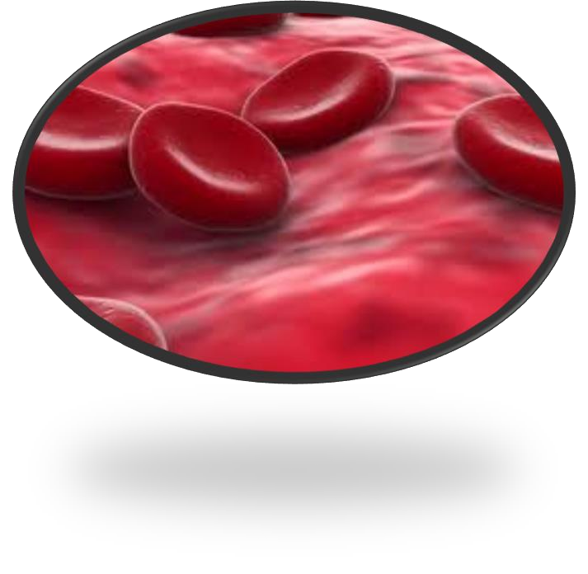



Salah N. El-Tallawy
Prof. of Anesthesia and Pain Management
Faculty of Medicine - Minia University & NCI - Cairo University – Egypt College of Medicine, King Saud University, Riyadh, KSA

