Slide 1
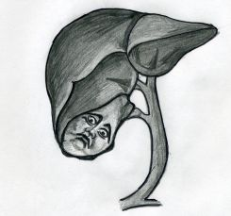
Cholelithiasis
Dr. Abdulsalam Alsharabi

Slide 2
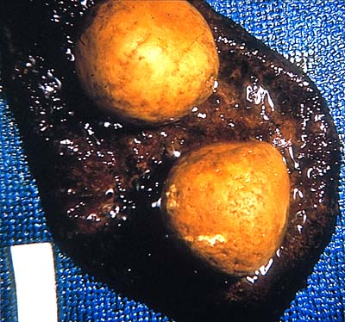
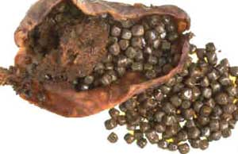
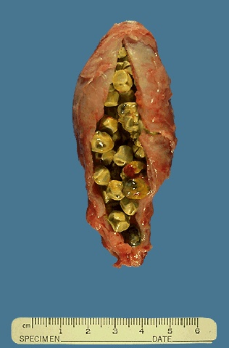
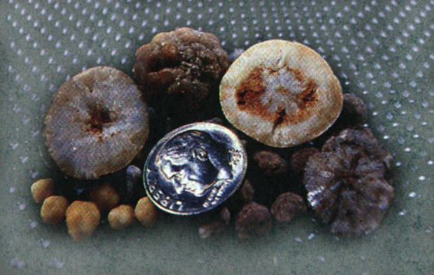
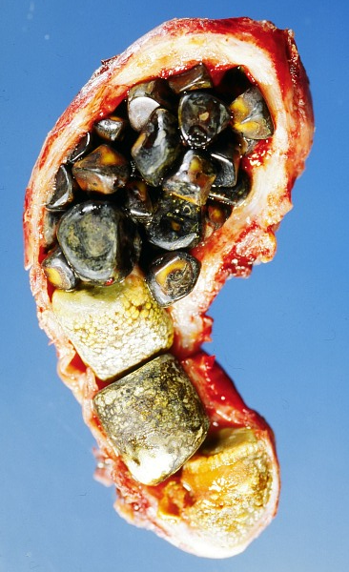
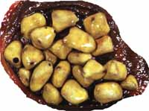
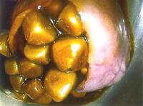
Harvest Time

Slide 3
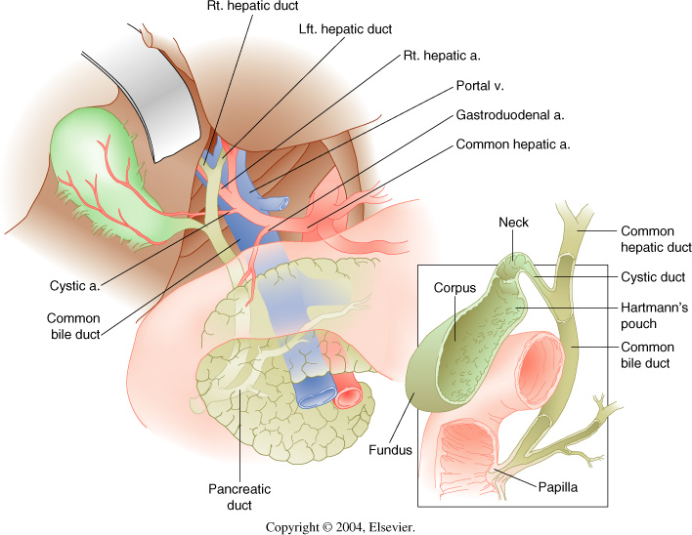
Anatomy

Slide 4
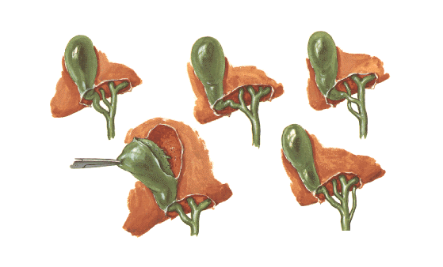
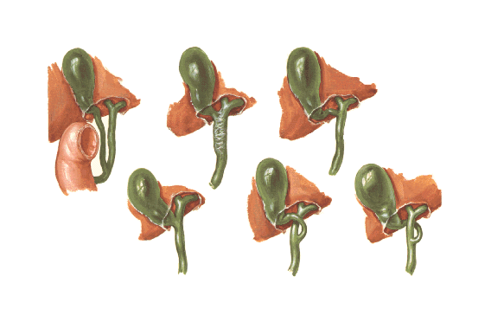
Variations in Bile Ducts

Slide 5
Gallstone Pathogenesis

Slide 10
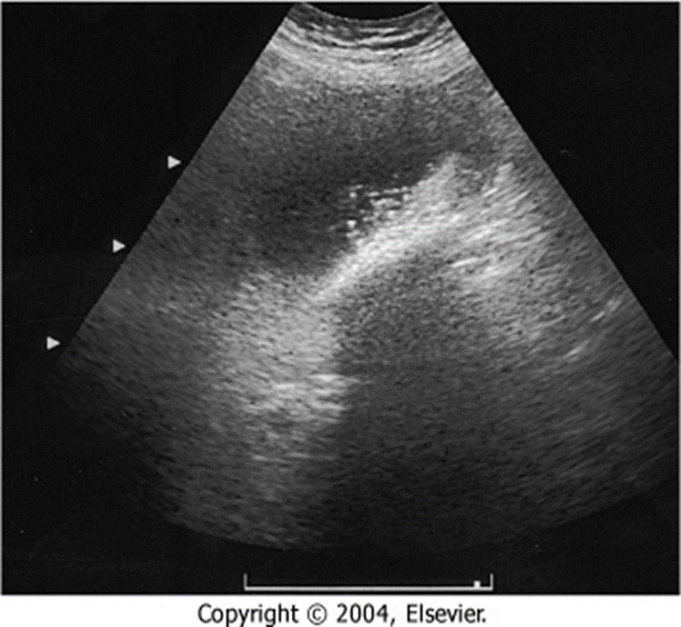

Slide 11
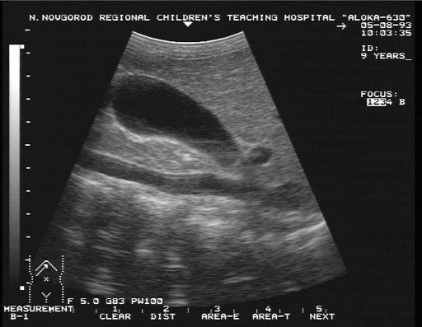
Ultrasound

Slide 12
Ultrasound

Slide 14
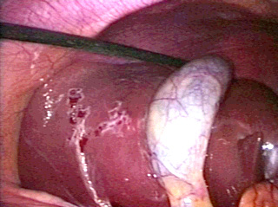

Slide 15
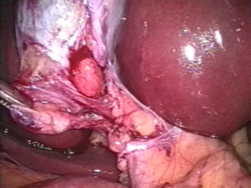

Slide 17
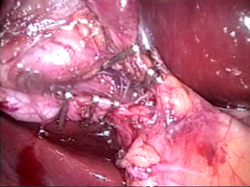

Slide 22
Ultrasound is the first choice for imaging
- Distended gallbladder
- Increased wall thickness (> 4 mm)
- Pericholecystic fluid
- Positive sonographic Murphy’s sign (very specific)

Slide 23
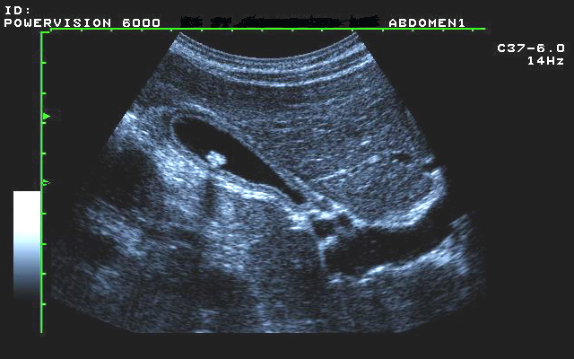
Ultrasound

Slide 24
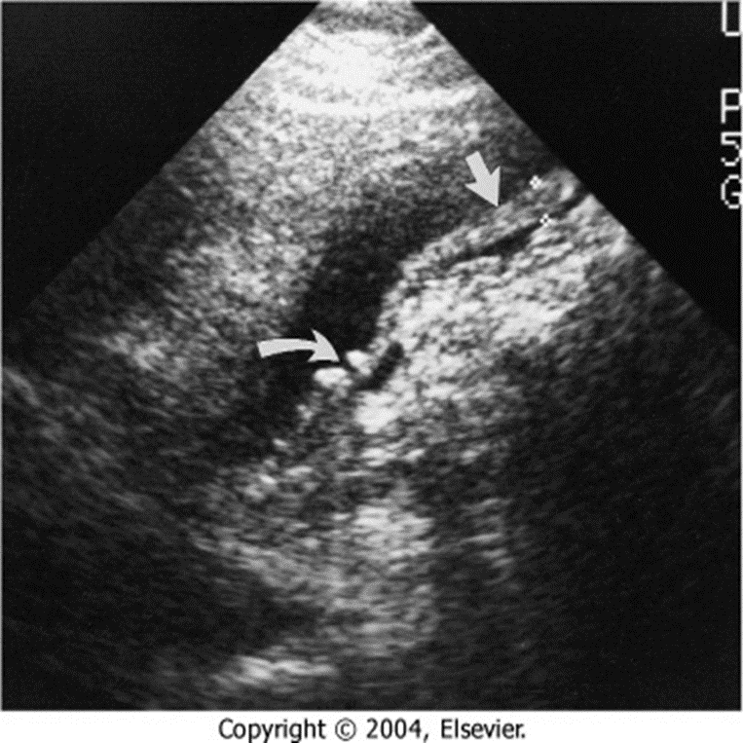

Slide 25
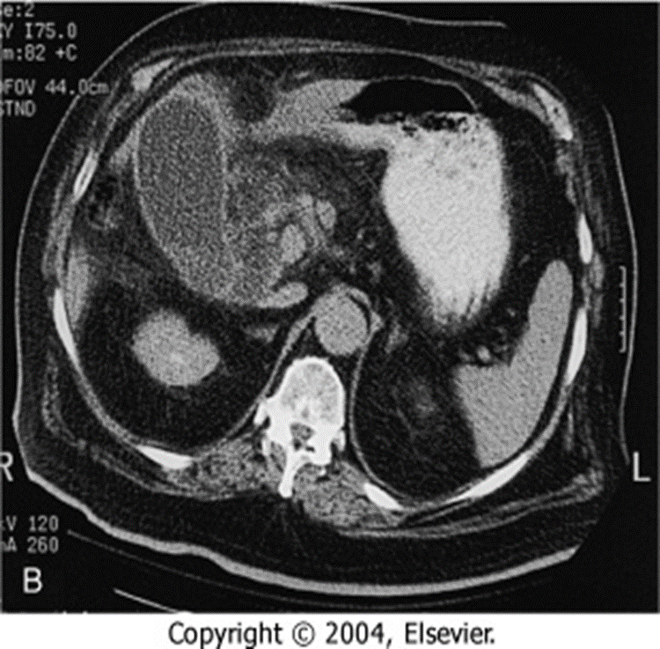

Slide 26
Complications of acute cholecystitis

Slide 29
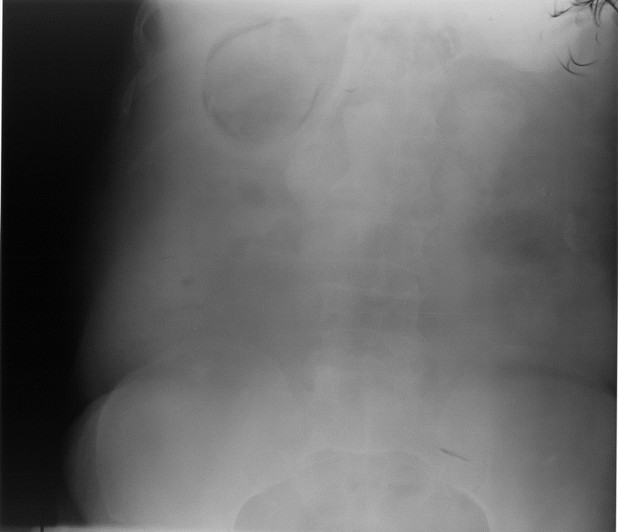

Slide 30
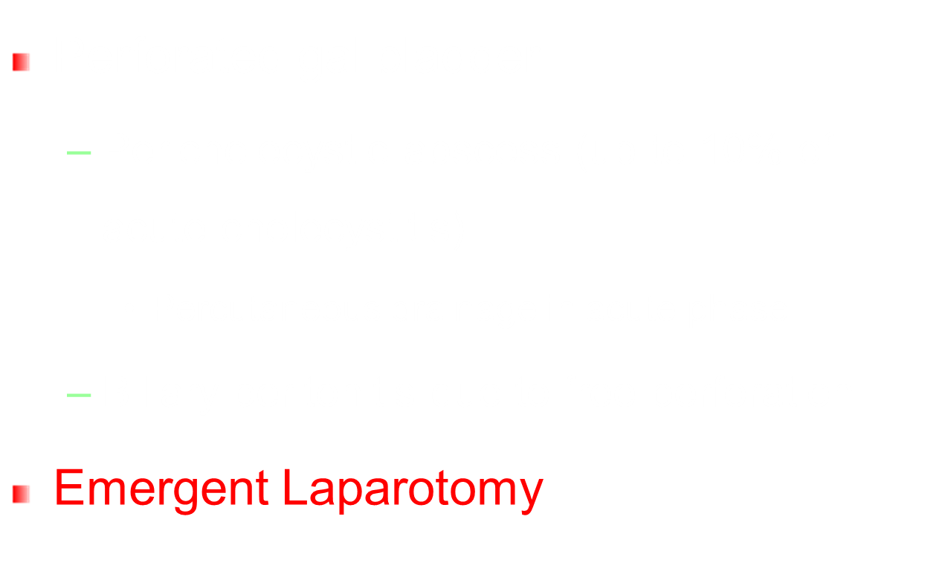

Slide 32
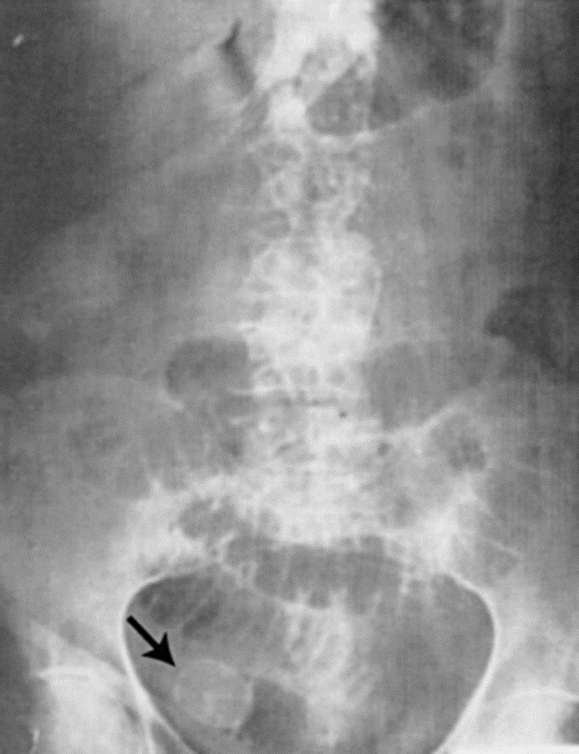
Gallstone Ileus

Slide 33
Acalculous cholecystitis
- A form of acute cholecystitis
- GB inflammation due to biliary stasis(5% of time) and not stones(95%).
- Often seen in critically ill patients

Slide 35
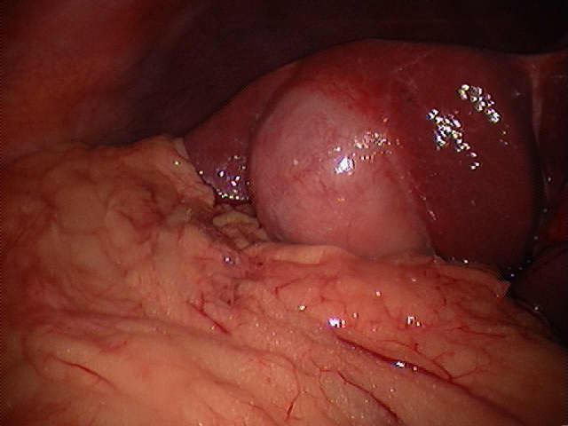

Slide 36
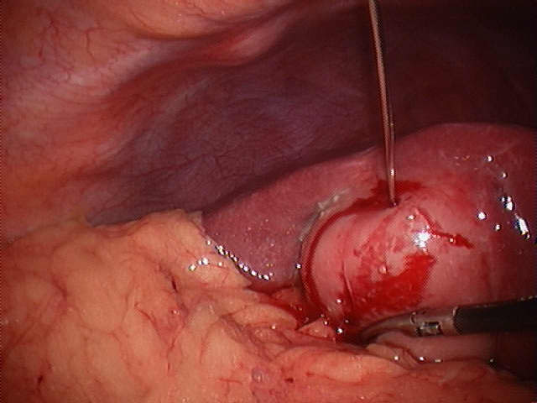

Slide 37
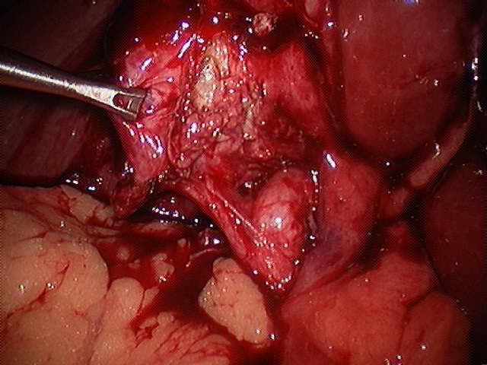

Slide 38
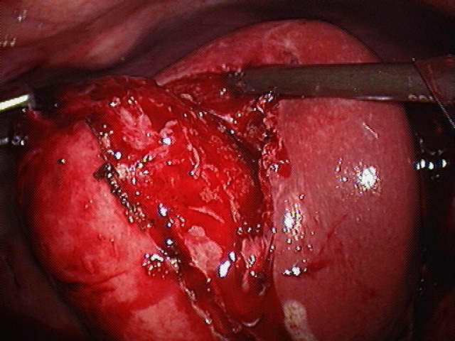

Slide 39
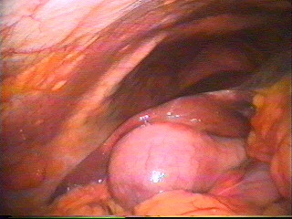
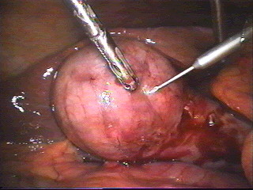
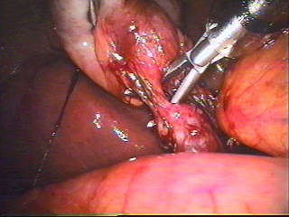
Laparoscopic Cholecystectomy

Slide 40
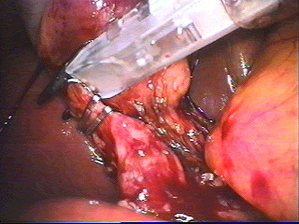
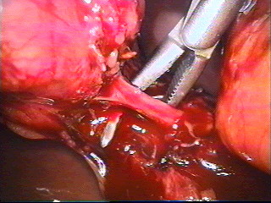
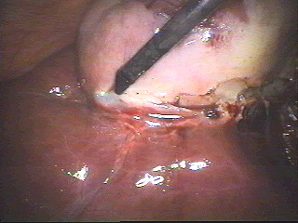
Laparoscopic Cholecystectomy

Slide 41
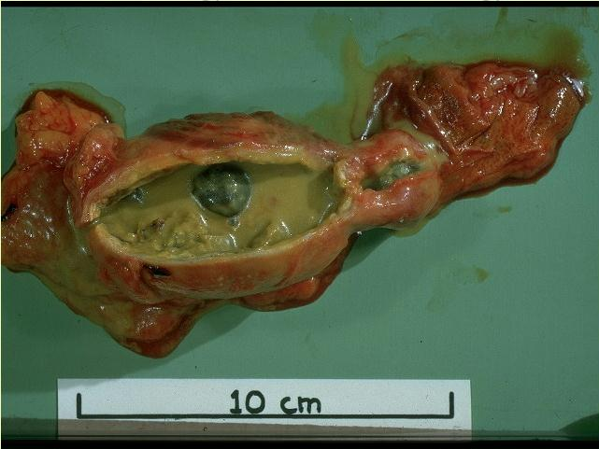

Slide 42
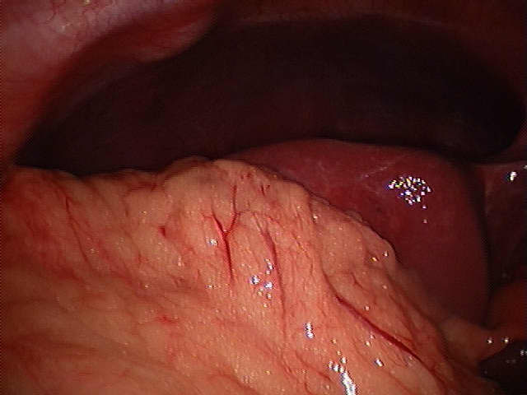

Slide 43
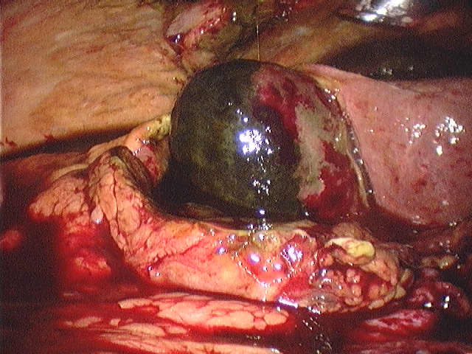

Slide 44
Pathogenesis:
Stone obstructing CBD (bear in mind there are other causes for obstructive jaundice) – danger is progression to ascending cholangitis.
USS
Will confirm gallstones in the gallbladder
CBD dilatation i.e. >8mm (not always!)
May visualise stone in CBD (most often does not)
MRCP
In cases where suspect stone in CBD but USS indeterminate
E.g.1 obstructive LFTs but USS shows no biliary dilatation and no stone in CBD
E.g. 2 normal LFTS but USS shows biliary dilatation
ERCP
If confirmed stone in CBD on USS or MRCP proceed to ERCP which will confirm this (diagnostic) and allow extraction of stones and sphincterotomy (therepeutic)
Treatment
Must unobstruct biliary tree with ERCP to prevent progression to ascending cholangitis
Whilst awaiting ERCP monitor for signs of sepsis suggestive of cholangitis

Slide 45
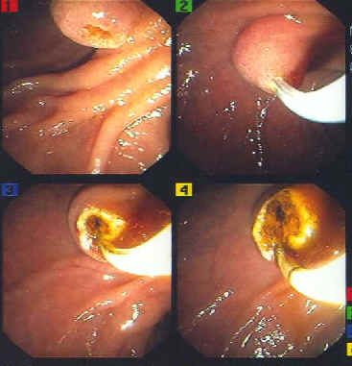
ERCP

Slide 47
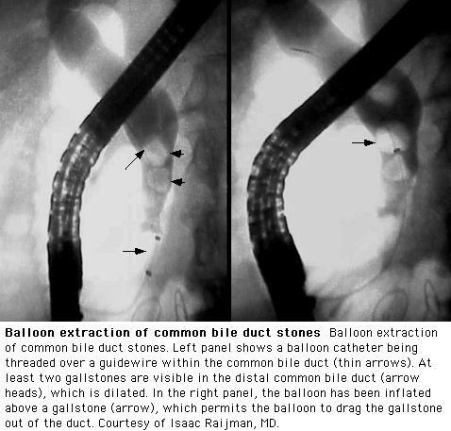
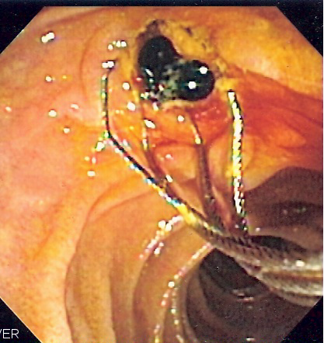
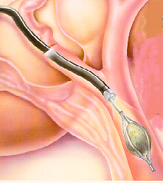

Slide 48
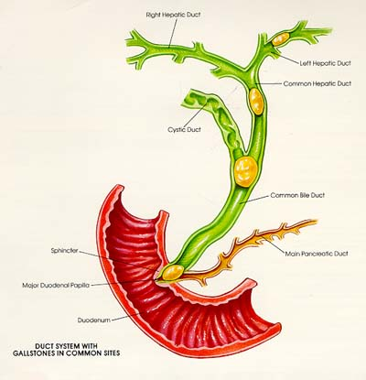
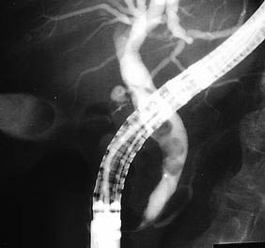
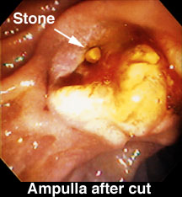

Slide 49
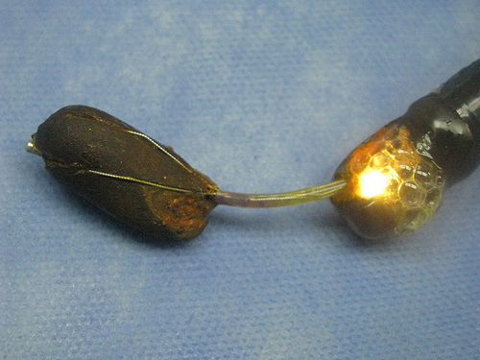
STONE EXTRACTION BY BASKET

Slide 50
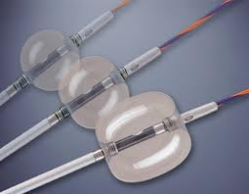
STONE EXTRACTION BY BALLON

Slide 52
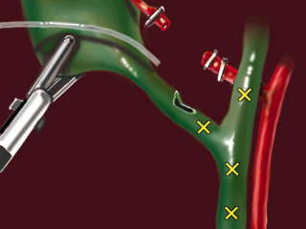

Slide 53
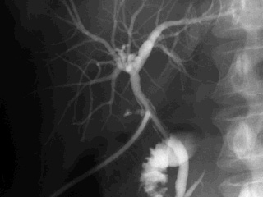

Slide 54
