Slide 1
Introduction to
ENVIRONMENTAL AND
OCCUPATIONAL HEALTH
YEAR
1439-1438 Hajji
2017 - 2018 Gregorian
session Description | Environmental & Occupational health
Topics covered | Concepts of environment and health Environmental hazards Control of environmental hazards Mass gathering and health Principals of occupational health Examples of occupational diseases

Slide 2
 | group | day | date | time start | time End |  | subject
 | F | Thursday | 1-Mar-18 | 15 | 16 |  | Environmental Health and Environment Hazards
 | F | Sunday | 4-Mar-18 | 8 | 9 |  | Introduction to Occupational Health
 | F | Tuesday | 6-Mar-18 | 10 | 11 |  | Prevention and Control of environmental hazards
 | F | Tuesday | 6-Mar-18 | 11 | 12 |  | Occupational diseases
 | F | Thursday | 8-Mar-18 | 10 | 11 |  | Epidemiology of Heat stroke and Heat exhaustion
 | F | Thursday | 15-Mar-18 | 10 | 11 |  | Students' lead Seminar
 | M G A | Wednesday | 14-Feb-18 | 9 | 10 |  | Environmental Health and Environment Hazards
 | M G A | Thursday | 15-Feb-18 | 15 | 16 |  | Introduction to Occupational Health
 | M G A | Tuesday | 20-Feb-18 | 9 | 10 |  | Prevention and Control of environmental hazards
 | M G A | Tuesday | 20-Feb-18 | 11 | 12 |  | Occupational diseases
 | M G A | Wednesday | 21-Feb-18 | 9 | 10 |  | Epidemiology of Heat stroke and Heat exhaustion
 | M G A | Sunday | 4-Mar-18 | 11 | 12 |  | Students' lead Seminar
 | M G B | Wednesday | 14-Feb-18 | 10 | 11 |  | Environmental Health and Environment Hazards
 | M G B | Tuesday | 20-Feb-18 | 8 | 9 |  | Introduction to Occupational Health
 | M G B | Tuesday | 20-Feb-18 | 13 | 14 |  | Prevention and Control of environmental hazards
 | M G B | Wednesday | 21-Feb-18 | 8 | 9 |  | Occupational diseases
 | M G B | Wednesday | 21-Feb-18 | 10 | 11 |  | Epidemiology of Heat stroke and Heat exhaustion
 | M G B | Monday | 26-Feb-18 | 8 | 9 |  | Students' lead Seminar

Slide 3

WHAT IS Health?
State of Health

Slide 4
Health is
"a state of complete physical, mental and social well-being and not merely the absence of disease or infirmity“

Slide 5
Public health
is
"the science and art of preventing disease, prolonging life and promoting health
through the organized efforts and informed choices of society, organizations, public and private, communities and individuals. “

Slide 6
part | Environmental Health
1
1.1. Environment:
1.2. Pollution:
1.3. Environmental health
1.4. Concepts of Environment and health
EXAMPLE
    EXAMPLE I: Air quality
    EXAMPLE II: WATER Pollution
    EXAMPLE III: Water Disinfection
1.5. Epidemiologic Triangle
  Exercises:
    Pandemic (H1N1) 2009
    Giardia lamblia
    Escherichia coli
1.6. Risk Assessment

Slide 7

1.1. Environment:
In general, environment refers to the surroundings of an object

Slide 8
Ecology
Environment
Health

Slide 9
Ecology
The science of the relationships between organisms and their environments.
Also called BIONOMICS.

Slide 10
The ultimate goal of ecology is to understand the
nature of environmental influences on individual organisms,
their populations and communities, on landscapes and, ultimately, the biosphere (all life on Earth).
If ecologists can achieve an understanding of these relationships, they will be able to contribute to the development of systems by which humans will be able to wisely use ecological resources, such as forests, agricultural soils, and hunted animals such as deer and fish.

Slide 11
Environment
In general, environment refers to the surroundings of an object.
Health
A state of complete physical, mental and social well-being and not merely the absence of disease or infirmity

Slide 12
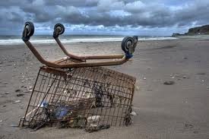
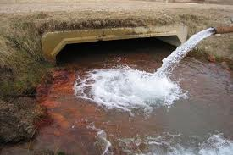
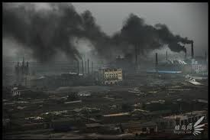
Pollution:
Pollution is the introduction of pollutants or contaminants into a natural environment that causes instability, disorder, harm or discomfort to the ecosystem i.e. physical systems or living organisms.

Slide 13
Pollution can take the form of chemical substances or energy, such as noise, heat, or light.
Pollutants, the elements of pollution, can be foreign substances or energies, or naturally occurring;
When naturally occurring, they are considered Pollutants when they exceed natural levels.

Slide 14

1.3. Environmental health
Environmental health is the branch of public health that is concerned with all aspects of the natural and built environment that may affect human health.

Slide 15
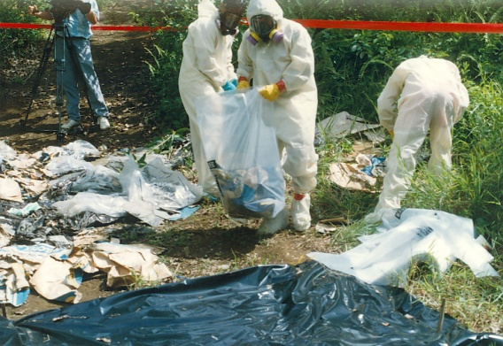
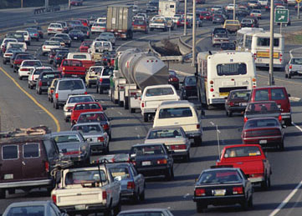
Environmental health:
Those aspects of the human health and disease that are determined by factors in the environment.
It also refers to the theory and practice of assessing and controlling factors in the environment that can potentially affect health.

Slide 16
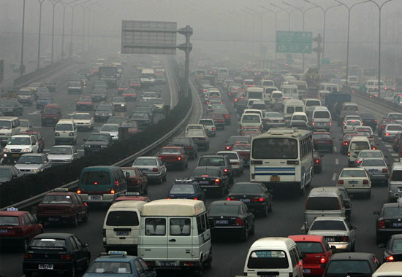
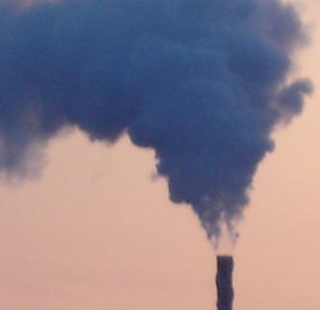
1.4. Concepts of Environment and health
Air quality, including both ambient outdoor air and indoor air quality, which also comprises concerns about environmental tobacco smoke.

Slide 17
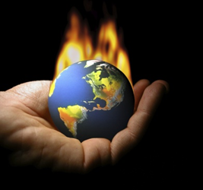
Climate Change And Public Health
What Causes Climate Change?
“Climate forcing”
whether natural or manmade (anthropogenic) are events that cause changes in the atmosphere and are a significant cause of global climate change.

Slide 18
Greenhouse gases trap heat in the atmosphere and warm the Earth.
While some greenhouse gases occur naturally, human activities are amplifying the natural greenhouse effect and impacting the concentrations of gases in the atmosphere, thereby contributing to climate change.

Slide 19
Global Emissions by Gas
Carbon dioxide (CO2) - Fossil fuel use is the primary source of CO2.
Methane (CH4) - Agricultural activities, waste management, and energy use all contribute to CH4 emissions.
Nitrous oxide (N2O) - Agricultural activities, such as fertilizer use, are the primary source of N2O emissions.
Fluorinated gases (F-gases) - Industrial processes, refrigeration, and the use of a variety of consumer products
Black carbon (BC) is a solid particle or aerosol, not a gas, but it also contributes to warming of the atmosphere.

Slide 20
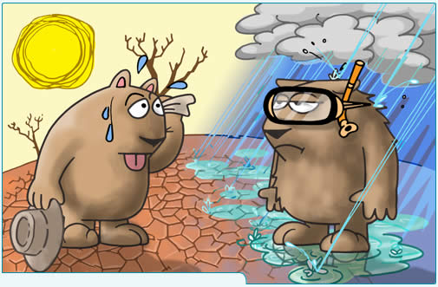
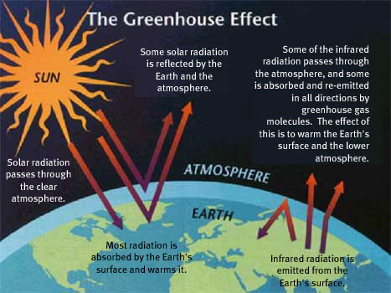

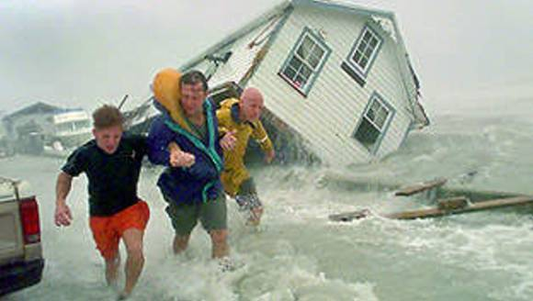
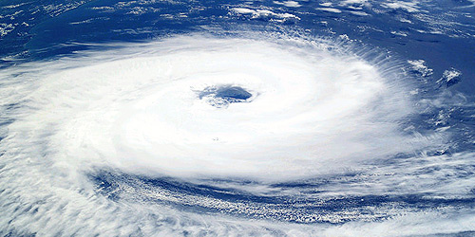
Climate change and its effects on health.

Slide 21
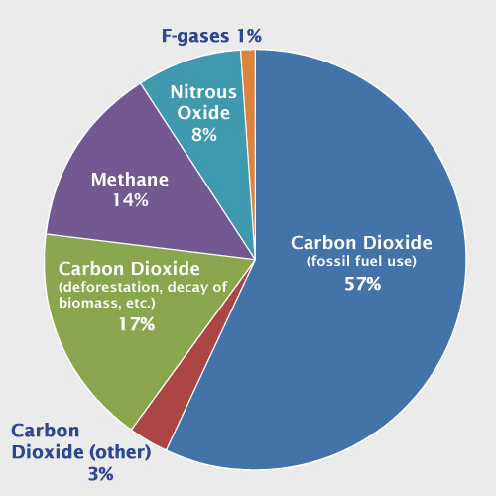
Global Emissions by Gas

Slide 22
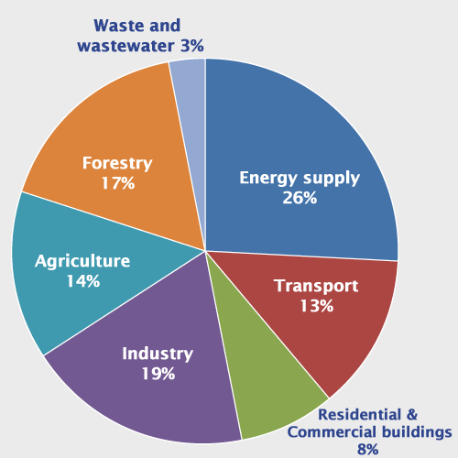
Global Emissions by Source

Slide 23
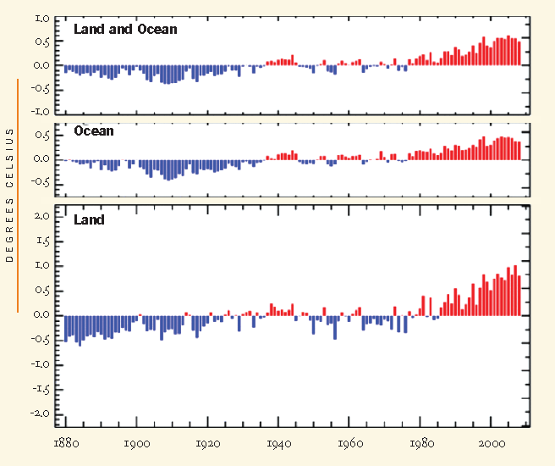
Projecting the Future of Climate Change
January–December Global Surface Mean Temperature Anomalies

Slide 24
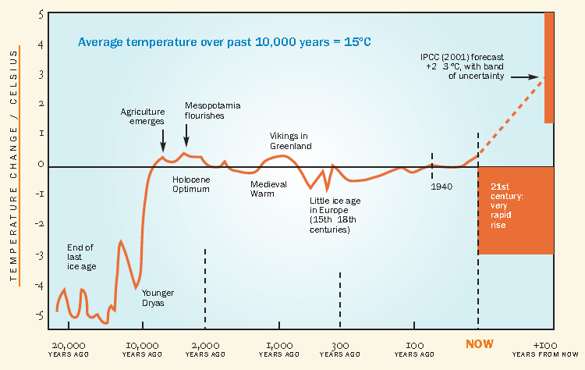
Variations in Earth’s Average Surface Temperature Over the Past 20,000 Years

Slide 25
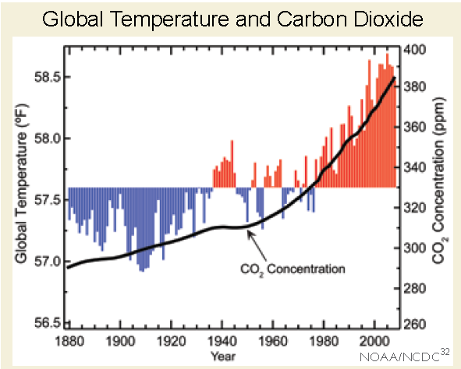

Slide 26
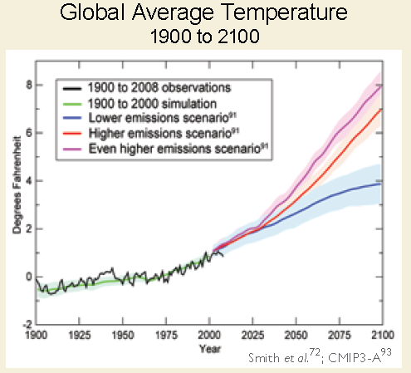

Slide 27
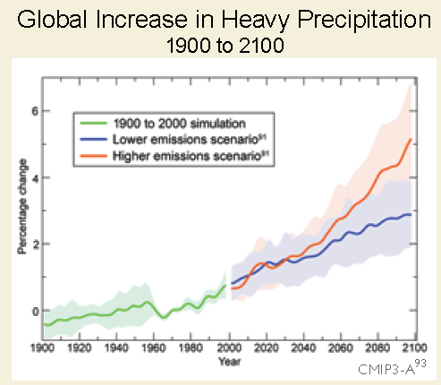

Slide 28
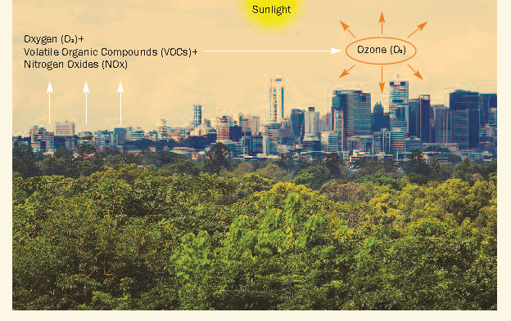
Ground-level Ozone Formation

Slide 29
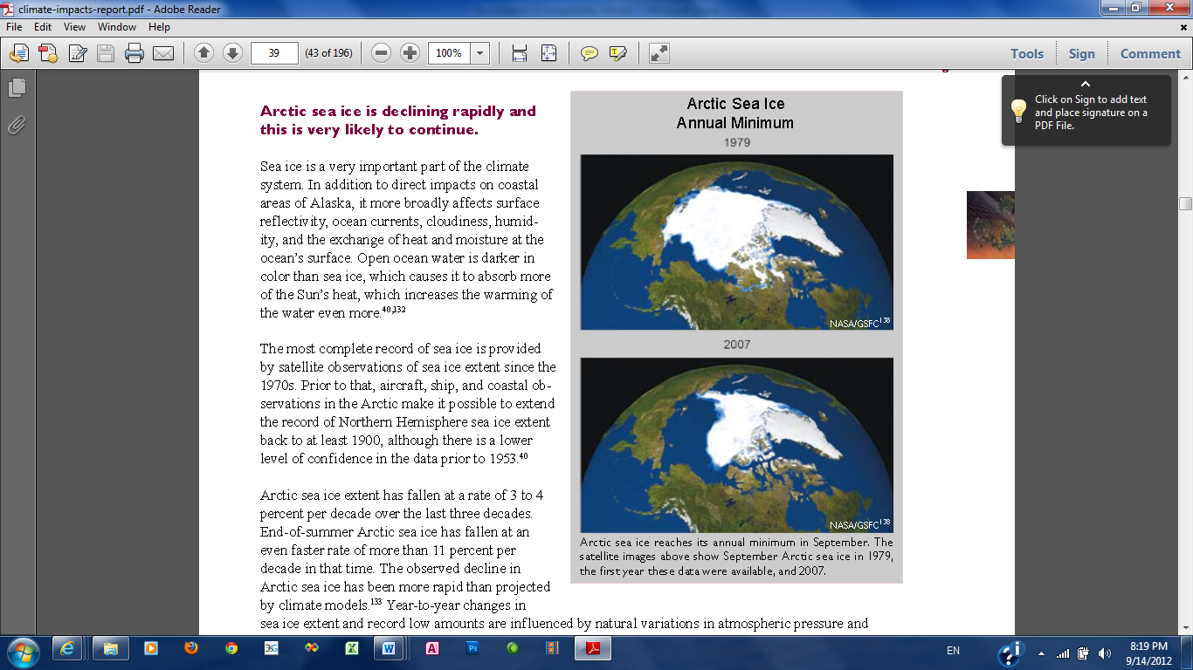

Slide 30
Categories of human health consequences of climate change:
Asthma, Respiratory Allergies, and Airway Diseases
Cancer
Cardiovascular Disease and Stroke
Foodborne Diseases and Nutrition
Heat-Related Morbidity and Mortality
Human Developmental Effects
Mental Health and Stress-Related Disorders
Neurological Diseases and Disorders
Vectorborne and Zoonotic Diseases
Waterborne Diseases

Slide 31
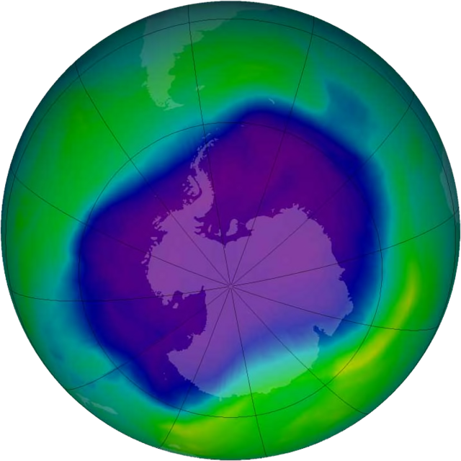
Image of the largest Antarctic ozone hole ever recorded (September 2006), over the Southern pole

Slide 32
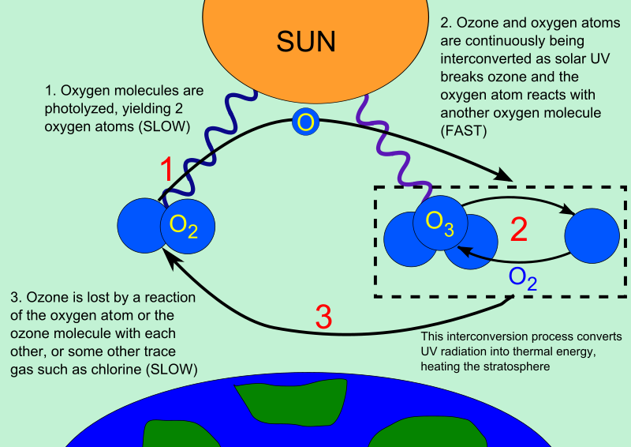

Slide 33
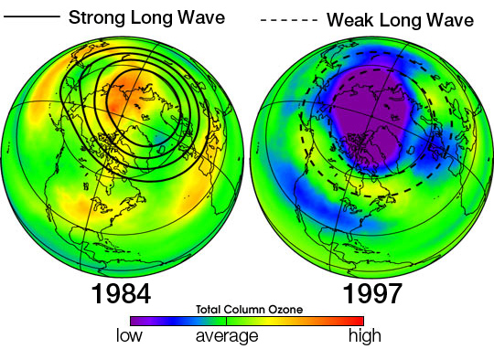

Slide 34
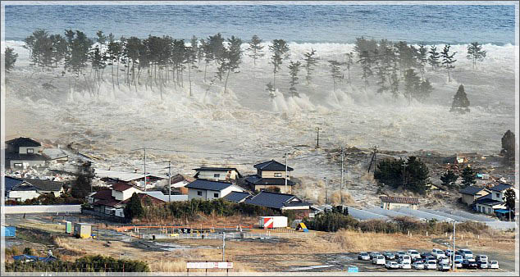
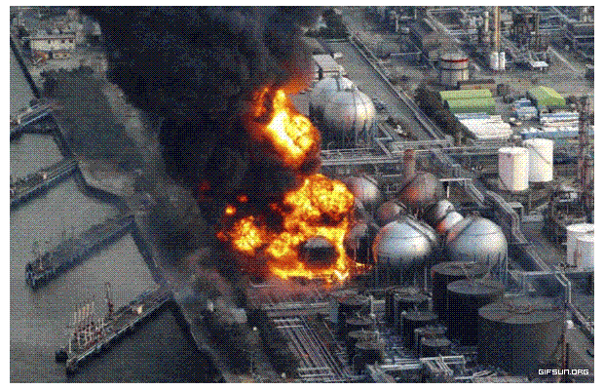
Disaster preparedness and response.

Slide 35
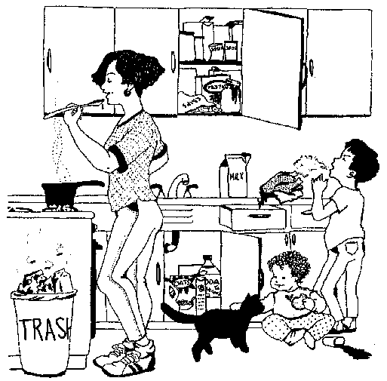

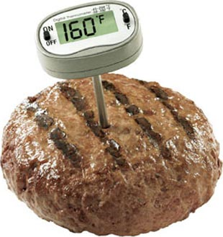

Food safety,
including in agriculture, transportation, food processing, wholesale and retail distribution and sale.

Slide 36
Hazardous materials management
including hazardous waste management, contaminated site remediation, the prevention of leaks from underground storage tanks and the prevention of hazardous materials releases to the environment and responses to emergency situations resulting from such releases.

Slide 37
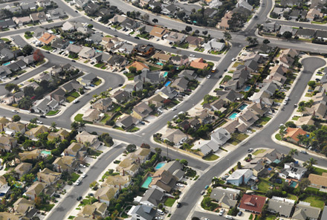
Housing, including substandard housing abatement
Childhood lead poisoning prevention.
Land use planning, including smart growth.

Slide 38
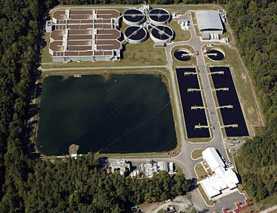
Liquid waste disposal, including city wastewater treatment plants and on-site waste water disposal systems, such as septic tank systems and chemical toilets.

Slide 39

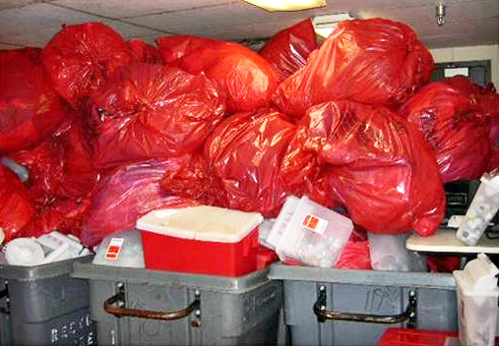
Medical waste management and disposal.

Slide 40
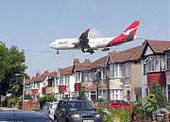
Noise pollution control.
Occupational health and industrial hygiene.
Radiological health, including exposure to ionizing radiation from X-rays or radioactive isotopes.

Slide 41
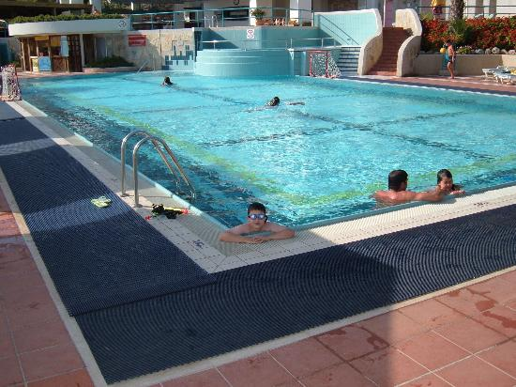
Recreational water illness prevention, including from swimming pools, spas and ocean and freshwater bathing places.

Slide 42
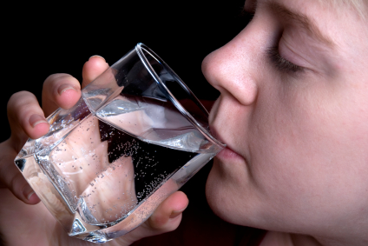
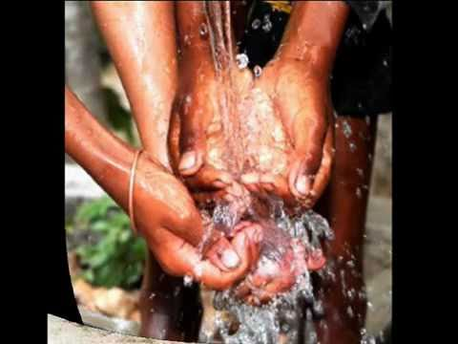
Safe drinking water.

Slide 43
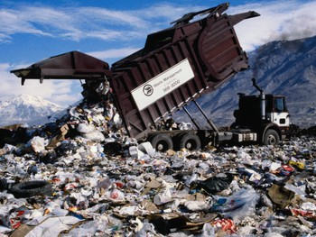
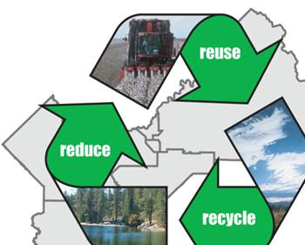
Solid waste management, including landfills, recycling facilities, composting and solid waste transfer stations

Slide 44
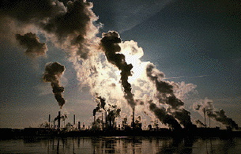
Toxic chemical exposure whether in consumer products, housing, workplaces, air, water or soil.

Slide 45
Household Hazardous Waste
Paints and solvents
Automotive wastes (used motor oil, antifreeze, etc.)
Pesticides (insecticides, herbicides, fungicides, etc.)
Mercury-containing wastes (thermometers, switches, fluorescent lighting, etc.)
Electronics (computers, televisions, cell phones)
Aerosols / Propane cylinders
Cleaning agents
Refrigerant -containing appliances
Some specialty Batteries (e.g. lithium, nickel cadmium, or button cell batteries)
Radioactive waste (some home smoke detectors are classified as radioactive waste because they contain very small amounts of a radioactive isotope of americium).

Slide 46
END OF LECTURE 1

Slide 47
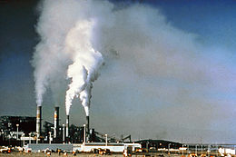
Sulphur oxides (SOx) - especially sulphur dioxide, a chemical compound with the formula SO2.
EXAMPLE I: Air quality
primary pollutants include
Nitrogen oxides (NOx) - especially nitrogen Carbon monoxide - is a colourless, odorless, non-irritating but very poisonous gas
Carbon dioxide (CO2) - a colourless, odorless, non-toxic greenhouse gas associated with ocean acidification, emitted from sources such as combustion, cement production, and respiration

Slide 48
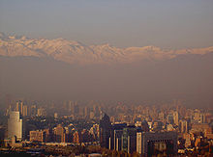
Particulate matter - Particulates, alternatively referred to as particulate matter (PM) or fine particles, are tiny particles of solid or liquid suspended in a gas.
Toxic metals, such as lead, cadmium and copper.

Slide 49
Chlorofluorocarbons (CFCs) - harmful to the ozone layer emitted from products currently banned from use.
Ammonia (NH3) - emitted from agricultural processes.

Slide 50
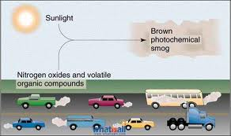
Secondary pollutants
are not emitted directly. Rather, they form in the air when primary pollutants react or interact.
include:
Particulate matter formed from gaseous primary pollutants and compounds in photochemical smog.

Slide 51
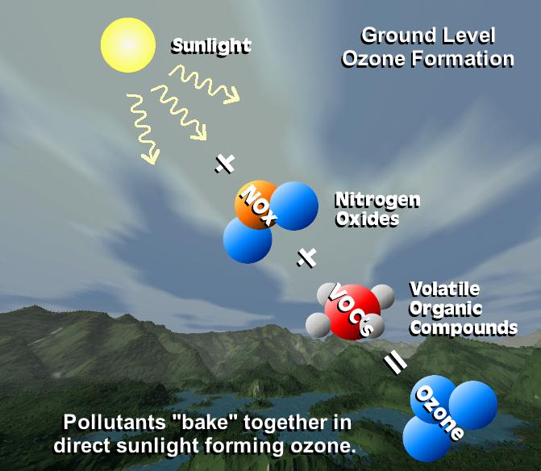
Secondary pollutants
Ground level ozone (O3) formed from NOx and VOCs. Ozone (O3) is a key constituent of the troposphere.

Slide 52
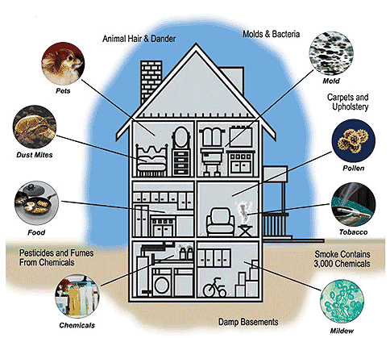

Slide 53
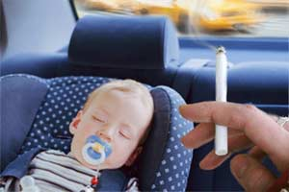
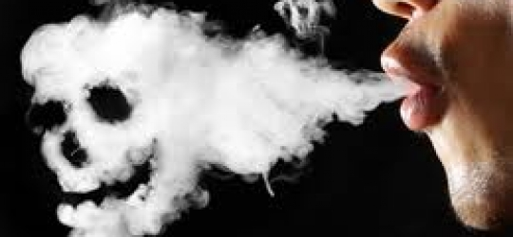
SECOND-HAND SMOKE
Second-hand smoke is tobacco smoke which affects persons other than the 'active' smoker.

Slide 54
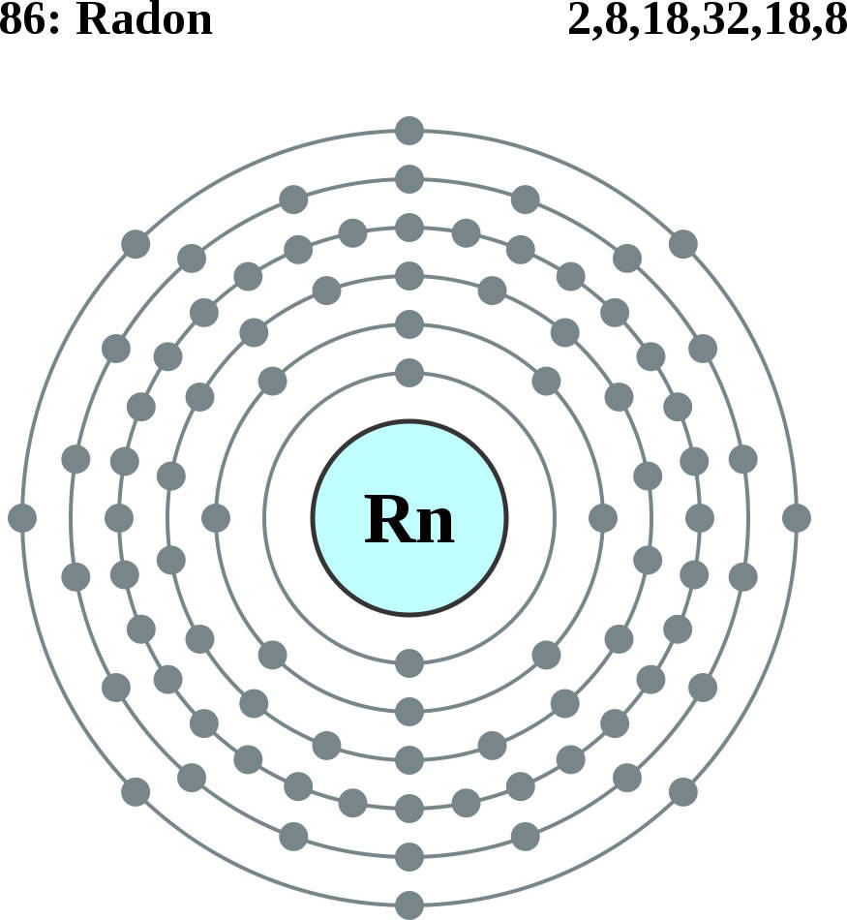
RADON
Radon is an invisible, radioactive atomic gas that results from the radioactive decay of radium, which may be found in rock formations beneath buildings or in certain building materials themselves.

Slide 55
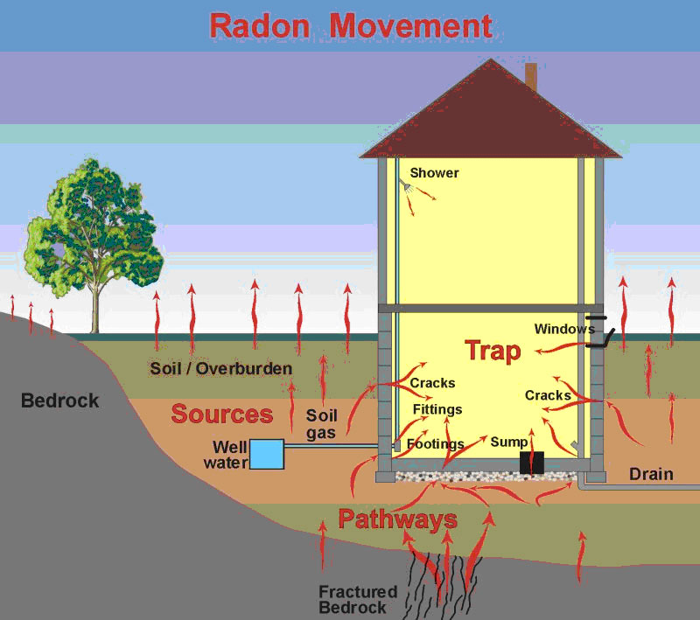
Radon is probably the most pervasive serious hazard for indoor air in the United States and Europe, probably responsible for tens of thousands of deaths from lung cancer each year.

Slide 56
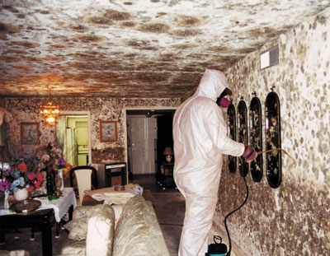
MOULDS AND OTHER ALLERGENS
These biological chemicals can arise from a host of means, but there are two common classes:
Moisture induced growth of mold colonies and
Natural released into the air such as animal dander and plant pollen.

Slide 57
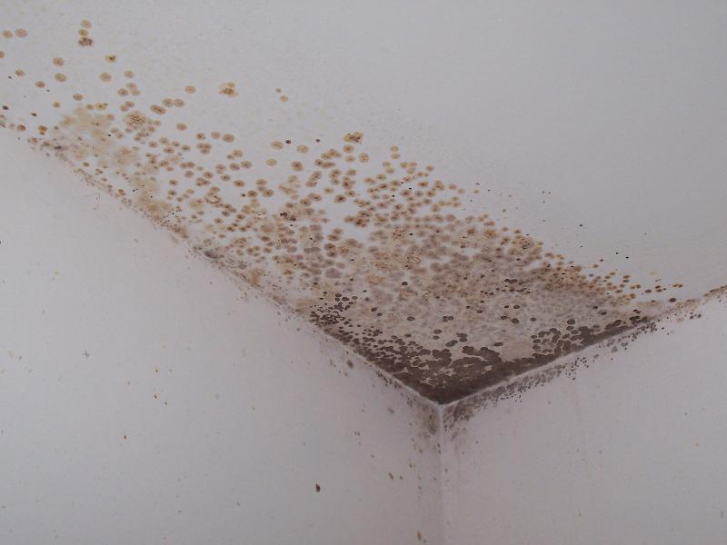
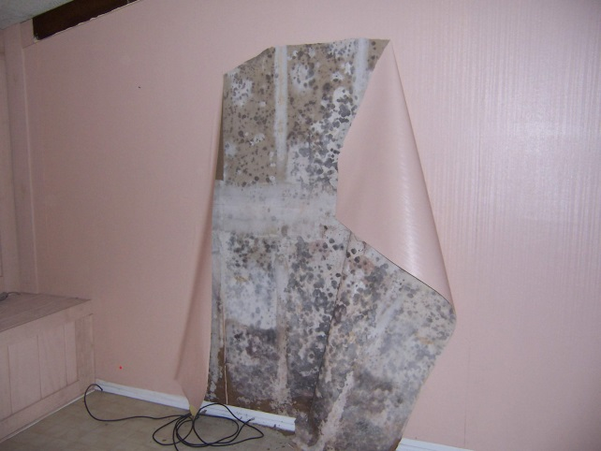

There are some varieties of mould that contain toxic compounds (mycotoxins).

Slide 58

CARBON MONOXIDE
A colourless, odourless gas that is a byproduct of incomplete combustion of fossil fuels.
Common sources of carbon monoxide are tobacco smoke, space heaters using fossil fuels, defective central heating furnaces and automobile exhaust.

Slide 59
VOLATILE ORGANIC COMPOUNDS
Concentrations of many VOCs are consistently higher indoors (up to ten times higher) than outdoors.
Examples include: paints and lacquers, paint strippers, cleaning supplies, pesticides, building materials and furnishings, office equipment such as copiers and printers, correction fluids and carbonless copy paper, graphics and craft materials including glues and adhesives, permanent markers, and photographic solutions.

Slide 60


LEGIONELLA
Legionellosis or Legionnaire's Disease is caused by a waterborne bacterium Legionella that grows best in slow-moving or still, warm water.
The primary route of exposure is through the creation of an aerosol effect, most commonly from evaporative cooling towers or showerheads.

Slide 61


Legionella testing typically involves collecting water samples and surface swabs from evaporative cooling basins, shower heads, and other locations where warm water collects

Slide 62

ASBESTOS FIBRES
Asbestos is found in older homes and buildings, but it is most dangerous in schools and industrial settings

Slide 63

EXAMPLE II: WATER:

Slide 64

Evaporation and Transpiration
Condensation and Precipitation
Runoff and infiltration
Streams
Groundwater – held in aquifers

Slide 65
Sources of Pollution & Causes of Contamination
  Improper Waste Disposal
  Improper Well Construction
  Poor Site Selection
  Wells Not Properly Abandoned
  Improper Waste Storage
  Lack of Information on Hazardous Sites or Activities

Slide 66


Slide 67


Slide 68
Water Disinfection
1. Chlorination. using chlorine
2. Ozonization. using ozone
3. Bromination. using bromine.
4. Iodination. using iodine.
5. Exposure to Ultra Violet Rays using UV Rays.
6. Heating. By boiling
7. Addition of lime. using lime.
8. Exposure to Ultra Sonic Waves.

Slide 69



Chlorination is the most common method for ease of control and low cost in addition to its effectively.
Applying Chlorination in rural areas:
This could be carried out with any powder or solution containing Cl2 as:
a. Chlorinated lime = Bleaching powder, 25-35% Cl2
b. HTH = High test hypochlorite powder, 70-75% CI2.
c. Sodium hypochlorite solution, 15% Cl2

Slide 70
Ex. Water quantity = 100 m³/day.
Residual Cl₂ required = 0.5 ppm
Cl₂ demand = 0.6 ppm
Cl₂ dose = 1.1 ppm
So every 1 m³ needs 1.1 gm CI₂­
100 m3 need 100 x 1.1 = 110 gm Cl₂/day
for one month 110 x 30 = 3300 gm Cl₂
Every 1 gm of HTH contains 0.75 gm CI₂
100x1.1x30
So amount of HTH needed = --------------= 4400 gm HTH / month
0.75
= 4.4 Kg HTH / month

Slide 71
1.5. Epidemiologic Triangle

Slide 72


Slide 73
Pandemic (H1N1) 2009 Virus Viewed from an Epidemiological Triangle Model

Slide 74
Risk Assessment
Potential for risk
HAZARD
EVENT
CONSEQUENCE
E. Coli 0157
Chlorinator
fails
People are
Sick
(some die)
74

Slide 75
For each event:
How severe would the public health consequences be? [Severity]
How likely is the event to happen ? [Frequency]
Importance = Severity X Frequency

Slide 76
Risk scoring matrix

Slide 77


Slide 78
END Of PART | Environmental Health
1
THANK YOU

