Slide 1
People living with disabilities

Slide 2
Learning objectives
Distinguish between health and quality of life
Portray with a diagram the spectrum of health
Develop an understanding to the concept of disability
Recognize that the term “handicap” doesn’t exist anymore
Compare between the medical model and social model of disability
Explain the strengths of the ICF in mapping disabilities, prevention and interventions
Distinguish between capacity and performance
State the main health conditions associated with disability
List the disabling barriers
Outline the interventions for prevention of disabilities and rehabilitation
Give an account on CBR

Slide 3
Definition of health
“State of complete physical, mental, and social well-being, not merely the absence of disease or infirmity"(WHO, 1948). In recent years, this statement has been amplified to include the ability to lead a "socially and economically productive life”

Slide 4
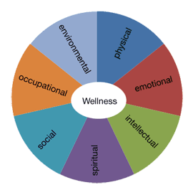
Dimensions of health

Slide 5
Dimensions of health
RIGHT BASED APPROACH TO HEALTH
Notes:
Right versus need for health

Slide 6
Health – Disease spectrum
POSITIVE | POSITIVE HEALTH Better health Freedom from disease
NEGATIVE | Unrecognized disease Mild disease Severe disease DEATH

Slide 7
Quality of life
“Individual's PERCEPTION OF THEIR POSITION in life in the context of the culture and value systems in which they live and in relation to their goals, expectations, standards and concerns.” (WHO)

Slide 8
QUALITY OF LIFE

Slide 9
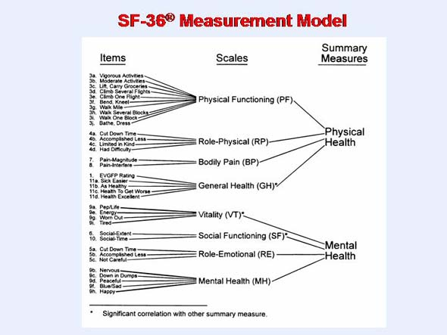

Slide 10
Summary - 1
A single definition of health referring to the level of health that people and nations strives to achieve
Health is multidimensional
People are moving across the spectrum of health
Health is a right and not a need
Quality of life is a subjective state and should be considered

Slide 11
OVERVIEW OF DISABILITIES

Slide 12
Disability
A long-term physical, mental, intellectual, or sensory impairment which in interaction with various barriers may hinder their full and effective participation in society on an equal basis with others.

Slide 13
Magnitude of disability - Global
Nearly 10% of the world’s population lives with disabilities (650 millions)
80% of persons with disabilities live in developing countries
Nearly 200 million children are living with disability
In any population at least 2.5% of children below the age of 15 years have an overt moderate to severe degree of physical or intellectual impairment and an additional 8% are expected to have learning or behavioral difficulties or a combination of both learning and behavioral difficulties
Expected increase in the number of persons with disabilities as a result of population growth, the advances in medical technology and the ageing process.
In countries with life expectancies exceeding 70 years, individuals spend on average 8 years or 11.5% of their life span living with disabilities
World Report on Disabilities, 2011

Slide 14
Magnitude of disability - KSA
It is estimated that 3.73% of the population has functional disabilities which limit their independence.
Data from national census indicates that approximately 135,000 or nearly 0.8% of the total Saudi population has disability.
The main causes of disabilities are cerebral palsy and developmental delay followed by road traffic accident.
The main care gaps are low access to poor families, low service coverage, and low quality of services in public agencies.
Al Jadid M. Disability in Saudi Arabia. Saudi Med J 2013; 34 (5): 453-60

Slide 15
Persons living with disability
The needs of persons living with disabilities have been recognized more than three decades ago.
1981: Declared by the UN as the “International Year of Disabled Persons” with the theme of “full participation and equality”
1983 – 1993: “International Decade of Disabled Persons”
2007: “Convention on the Rights of Persons with Disabilities”, a legally binding document by international law.

Slide 16
Persons living with disability - KSA
(1987) the legislation of disability (LD) passed as the first legislation for people with disabilities in KSA with provision to warrant equal rights
(2000) the disability code was passed by the Saudi government to pledge that people with disabilities have access to free and appropriate medical, psychological, social, educational, and rehabilitation services through public agencies.

Slide 17
OCCUReNCE OF DISABILITIES

Slide 18
Disability
A long-term physical, mental, intellectual, or sensory impairment which in interaction with various barriers may hinder their full and effective participation in society on an equal basis with others.

Slide 19
Development of disability
Disease Departure from health
Impairment loss/damage of a body part or
aberration of physiological functions
Disability Inability to carry out function or activity
Handicap limitation of person’s role

Slide 20
Handicap
“ Reduction in person’s capacity to fulfill a social role as a consequence of an impairment, inadequate training for the role, or other circumstances”.
Applied to children, the term usually refers to: “the presence of an impairment or other circumstances that are likely to interfere with normal growth and development or with the capacity to learn.”

Slide 21
Medical model of disability
DISEASE
IMPAIRMENT
DISABILITY
HANDICAP
Departure from health
Anatomical/physiological changes
Inability to carry out function or activity
Role limitation

Slide 22
New approach to disability
IMPAIRMENT IS THE BARRIER
MEDICAL MODEL
COMMUNITY ATTITUDES
STRUCTURES OF THE SOCIETY ARE THE BARRIERS
ENVIRONMENTAL BARRIERS
SOCIAL MODEL
INSTITUTIONAL BARRIERS

Slide 23
International Classification Of Functioning, Disability & Health (ICF)
ACTION
Health Condition (disorder/disease)
Body function & structure (Impairment)
Activities
(Limitation)
Participation
(Restriction)
Environmental Factors
Personal Factors
The International Classification of Functioning, Disability and Health (ICF)
Source: Mont D. Measuring disability prevalence. World Bank Special Protection No. 0706, 2007
ACTION

Slide 24
Summary - 2
Disability is the consequence of an impairment caused by a health problem
Handicap is the result of the barriers imposed on the disable; handicapped doesn’t exist under the social model

Slide 25
ESTIMATION AND CLASSIFICATION OF DISABILITIES

Slide 26
International Classification Of Functioning, Disability & Health (ICF)
ACTION
Health Condition (disorder/disease)
Body function & structure (Impairment)
Activities
(Limitation)
Participation
(Restriction)
Environmental Factors
Personal Factors
The International Classification of Functioning, Disability and Health (ICF)
Source: Mont D. Measuring disability prevalence. World Bank Special Protection No. 0706, 2007
ACTION

Slide 27
International Classification Of Functioning, Disability & Health (ICF)
Activity limitations
Refers to the difficulties in executing activities such as walking, eating, taking transport, counting money
Participation restrictions
Limitation or lack of involvement in any area of life such as education, gainful employment, spending leisure time.

Slide 28
ICF – Estimation of disabilities
A shift from “impairment” approach to a “difficulties in functioning” approach

Slide 29
ICF- Estimation of disabilities: Core questions
Do you have difficulty seeing, even if wearing glasses?
Do you have difficulty hearing, even if using a hearing aid?
Do you have difficulty walking or climbing steps?
Do you have difficulty remembering or concentrating?
Do you have difficulty with self-care, such as washing all over or dressing?
Using your usual (customary) language, do you have difficulty communicating (for example, understanding or being understood by others)?

Slide 30
ICF- Estimation of disabilities: Response and scoring
Core domain
Seeing
Hearing
Mobility
Cognition
Self-care
Communication
Response: Self report
No difficulties
Mild difficulties
Moderate difficulties
Severe difficulties
Extreme difficulties
Scoring: composite
Range is 0 – 100
Score of 40= significant difficulties
Score of 50= very significant difficulties

Slide 31
ICF – Estimation of disabilities: Further details
ICF determines
The FUNCTION in which difficulties are experienced
The body STRUCTURE affected
Restriction in ACTIVITIES and PARTICIPATION
Contributing ENVIRONMENTAL factors

Slide 32
ICF – Estimation of disabilities: Further details
Function
Mental
Sensory and Pain
Voice and Speech
Cardiovascular, Haematological, Immunological and Respiratory Systems
Digestive, Metabolic, Endocrine Systems
Genitourinary and Reproductive
Neuromusculoskeletal and Movement-Related
Functions of the Skin and Related Structures

Slide 33
ICF – Estimation of disabilities: Further details
Structure
Structure of the Nervous System
The Eye, Ear and Related Structures
Structures Involved in Voice and Speech
Structure of the Cardiovascular, Immunological and Respiratory Systems
Structures Related to the Digestive, Metabolic and Endocrine Systems
Structure Related to Genitourinary and Reproductive Systems
Structure Related to Movement
Skin and Related Structures

Slide 34
ICF – Estimation of disabilities: Further details
Activities and participation
Learning and Applying Knowledge
General Tasks and Demands
Communication
Mobility
Self Care
Domestic Life
Interpersonal Interactions and Relationships
Major Life Areas
Community, Social and Civic Life

Slide 35
ICF – Estimation of disabilities: Further details
Environmental factors
Products and Technology
Natural Environment and Human-Made Changes to Environment
Support and Relationships Attitudes
Services, Systems and Policies

Slide 36
ICF – Estimation of disabilities: Further details
Environmental factors: capacity versus performance
Capacity indicates what a person can do in a standardized environment, often a clinical setting, without the barriers or facilitators of the person’s usual environment;
Performance indicates what a person does in the current or usual environment, with all barriers and facilitators in place

Slide 37
Health conditions associated with disability
Infectious diseases
HIV/AIDS
Malaria
Poliomyelitis
Leprosy
Trachoma
Non-communicable diseases
Diabetes
Cardiovascular
Mental disorders
Cancers
Respiratory illnesses
Children
learning disabilities (associated with autism, attention deficit)
Hearing problems
Vision disorders
Speech problems
Dyslexia
Cerebral palsy
Injuries
Arthritis and back pain

Slide 38
Health conditions associated with disability
Primary
Starting problem
Reason for impairment, activity limitations, or participation
Secondary
Developed as a result of the primary
Results in reducing functioning, lower quality of life, increase health care cost, and pre-mature death
Co-morbidity
Unrelated condition
Results in difficulties in managing and aggravation of disability

Slide 39
ICF – Estimation of disabilities: Examples
Health condition | Impairment | Activity | Participation
Leprosy | Loss of sensation | Difficulties grasping | Unemployment
Epilepsy | Neurologic | Being on his own | No schooling
Vitiligo | Disfigurement | None | Social relations
Past mental disorders | None | None | Unemployment, social relations

Slide 40
ICF – Estimation of disabilities: Examples for intervention and prevention
 | Intervention | Prevention
Health condition | Medical treatment or care | Health promotion, Nutrition, Immunization
Impairment | Medical treatment or care Surgery | Prevention of the development of further activity limitations
Activity limitation | Assistive devices Personal assistance Rehabilitation therapy | Preventive rehabilitation, Prevention of the development of participation restrictions
Participation restriction | Accommodations, Public education Anti-discrimination law Universal design | Environmental change, Employment strategies, Accessible services, Universal design, Lobbying for change

Slide 41
Summary - 3
ICF
Universal tool for classification and reporting of disabilities
It is a shift from cause to impact
It is based on the perception of individual functioning or disability as a dynamic interaction between health status, personal factors, environmental condition and will have an impact on disability policy and services
Basis for intervention and prevention

Slide 42
DISABLING BARRIERS AND THEIR EFFECTS

Slide 43
Disabling barriers
Inadequate policies and standards which does not consider the needs of people with disabilities, or existing policies and standards are not enforced.
Insufficient funding for implementation of policies and plans
Negative attitudes leading to rejection and marginalization
Specialized services: availability, accessibility and quality
Lack of accessibility to transport and information system (sign language)
Lack of consultation and involvement of persons with disability
Lack of statistics = persons with disabilities are not seen

Slide 44
Effects of disabling barriers
Poor health outcomes (preventable secondary and co-morbid conditions)
Low education attainment
Lower economic participation
Higher rates of poverty
Higher rates of dependency and restricted participation

Slide 45
ADDRESSING DISABILITIES

Slide 46
Prevention of disabilities
Major interventions provided by general services for prevention of childhood disabilities
Pre-marital genetic counseling (hereditary conditions)
Maternal and neonatal care (ante-natal and natal events)
Screening of neonates for hypothyroidism (cretinism – preventable cause of mental disability)
Expanded program on immunization
School services (growth monitoring and medical evaluation)
Primary prevention of disabilities entails all interventions required for the prevention of underlying health problems

Slide 47
ICF – Estimation of disabilities: Examples for intervention and prevention
 | Intervention | Prevention
Health condition | Medical treatment or care | Health promotion, Nutrition, Immunization
Impairment | Medical treatment or care Surgery | Prevention of the development of further activity limitations
Activity limitation | Assistive devices Personal assistance Rehabilitation therapy | Preventive rehabilitation, Prevention of the development of participation restrictions
Participation restriction | Accommodations, Public education Anti-discrimination law Universal design | Environmental change, Employment strategies, Accessible services, Universal design, Lobbying for change

Slide 48
Rehabilitation
Prevent activity limitation ======= Rehabilitation
Outcome of rehabilitation
Prevention of the loss of function
Slowing the rate of loss of function
Improvement or restoration of function
Compensation for lost function
Maintenance of current function

Slide 49
Rehabilitation Services - KSA
(1960’S) Modern medical rehabilitation following an outbreak of poliomyelitis with many victims, mainly children.
(1970’s) the government availed some prosthesis and orthotic centers in some of the MOH hospitals.
(1980’s) the Ministry of Defense and Aviation (MODA) commissioned many medical rehabilitation centers within the Military Hospitals.
(1980’s) Some private hospitals also allocated some rehabilitation beds for people who sustained work related disability and were insured by general organization for social insurance.
(21st century) rehabilitation centers were opened in few of the MOH hospitals. In addition, there have been some private for non-profit centers, which opened, including Sultan Bin Abdulaziz Humanitarian City
(Present) many rehabilitation hospitals/ centers, mainly in large cities, such as Rehabilitation Unit of Prince Sultan Military Medical City of Riyadh, Rehabilitation Unit of King Abdulaziz Medical City, National Guard (Riyadh), Rehabilitation Hospital of King Fahad Medical City (Riyadh), King Saud Medical Complex, Rehabilitation Hospital of Al-Hada Military Hospital (Taif ) and Riyadh Care Hospital (Private), and Abdulatif Jameel Rehabilitation Center (Jeddah).
(Present) Disabled Children Association has 7 centers and provides medical, social, and vocational services for children.
(Present) most of MOH hospitals in different regions of KSA have Medical Rehabilitation Department. Their services are mainly physiotherapy for outpatients.
Al Jadid M. Disability in Saudi Arabia. Saudi Med J 2013; 34 (5): 453-60

Slide 50
Addressing barriers to participation restriction
Rehabilitation: Building capacity of persons with disabilities
Support and assistance: living in a community with provision of assistance services for meeting the needs including day care programs and home support system
Environment: Policies and legislation and interventions for public facilities and transport system to promote participation and decrease dependency and social isolation
Education: Policies and legislation to complete basic education, inclusion and mainstreaming
Employment: Policies and legislation regarding employment, training for capacity building, inclusion in employment

Slide 51
Addressing barriers to participation restriction
Ministries
Social development, health, education, employment, environmental planning
Non-governmental organizations
Governmental organizations
JOINT RESPONSIBILITY

Slide 52
Community based rehabilitation - Overview
It is a right-based approach (Convention on the Rights of Persons with Disabilities)
A strategy within general community development for rehabilitation
Intended to address the needs of people living with disabilities and their families
Implemented in over 90 countries throughout the world
CBR aims to
Provide rehabilitation,
Reduce poverty,
Equalize opportunities and
Promote the inclusion of persons with disabilities in their communities.

Slide 53
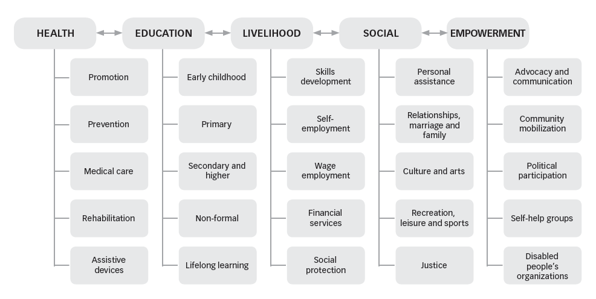
CBR matrix
Link: http://www.who.int/disabilities/cbr/en/

Slide 54
Community based rehabilitation - Overview
The implementation of CBR is multi-sectorial involving people with disabilities, their families, organizations, and communities, and the relevant governmental and non-governmental sectors
The expected outcomes are to provide health, education, vocational, social, and other services.

Slide 55
Community based rehabilitation – Success story
Succeeded in challenging negative attitudes in rural communities, leading to greater visibility of and participation by people with disabilities
A three-year project in a disadvantaged community near Allahabad, India, resulted in children with disabilities attending school for the first time, more people with disabilities participating in community forums, and more people bringing their children with disabilities for vaccination and rehabilitation.

Slide 56
Resources
Al Jadid M. Disability in Saudi Arabia. Saudi Med J 2013; 34 (5): 453-60
World Report on Disability. WHO, 2011
The International Classification of Functioning, Disability and Health (WHO, 2002)
Community Based Rehabilitation (http://www.who.int/disabilities/cbr/en/)

