Slide 1
Nutrition in Health and Disease
Dr. Afnan Younis

Slide 2
Objectives
To define nutrition and community nutrition
To identify the functions of different nutrients and the conditions caused by their deficiency.
To identify the components of a healthy diet.
To differentiate between different types of malnutrition and their assessment
To understand the double burden of malnutrition
To identify risk factors and complications of different types of malnutrition

Slide 3
Definitions:
Nutrition:
Is the process of consuming foods, digesting and absorbing nutrients and using these nutrients for growth, development, and maintenance of a healthy life.
Basically, nutrition consists of diet (what you take in) and metabolism (what happens to it after it enters your body).

Slide 4
Community Nutrition:
Examines the role of nutrition in the etiology of disease
Monitors the nutritional status of populations.
Identification of nutritional needs of population groups and available resources.
Develops and evaluate interventions to achieve and maintain healthful eating patterns among populations.

Slide 5
Importance of community nutrition
Nutrition is important for good health
Nutrition is a human right
Poor nutrition has adverse intergenerational effect
Dietary factors are associated with some of leading causes of death
Vulnerable subgroups are at high risk
Behavior change is challenging
Good nutrition is a building block to help countries meet many development goals: health, education, gender equality, and poverty alleviation

Slide 6
Goal is to provide adequate nutrition to all.
By health promotion and disease prevention, (therapeutic and rehabilitative services too)
Needs multiple coordinated strategies to reach and influence the community and organizations.

Slide 7
Assessing eating behaviors
Hunger
Appetite
Cultural and social meaning of food
Habit or custom
Emotional comfort
Convenience and advertising

Slide 8
NUTRIENTS
Macronutrients:
-Proteins
-Fats
-Carbohydrates
Micronutrients:
-Vitamins
-Minerals

Slide 10
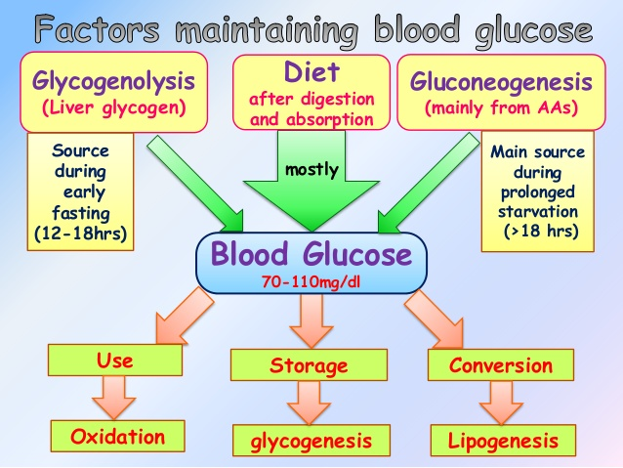
Carbohydrates
Carbohydrate is the main source of energy
Notes:
Oxidation of fats
Synthesis amino acids
Carbohydrates

Slide 11
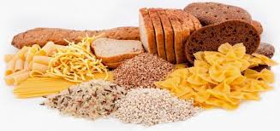
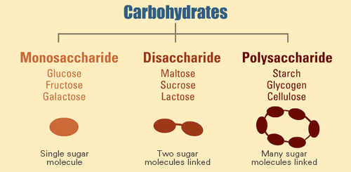
Notes:
The carbohydrate reserve (glycogen) of a human adult is about 500g. This reserve is rapidly exhausted when a man is fasting. If the dietary carbohydrates do not meet the energy needs of the body, protein and glycerol from dietary and endogenous sources are used by the body to maintain glucose homeostasis.

Slide 12
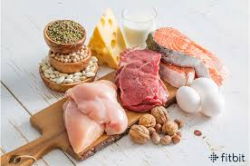
Proteins
20 amino acids → 8 are “essential”
Functions:
Body building
Repair and maintenance of body tissues
Maintenance of osmotic pressure
Synthesis of bioactive substances and other vital molecules
Notes:
Proteins are complex organic nitrogenous compounds.
“ESSENTIAL” AS THEY ARE NOT SYNTHESIZED IN HUMAN BODY AND MUST BE OBTAINED FROM DIETARY PROTIENS.

Slide 13
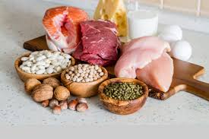
Sources of protein:
Eggs, meats, peanuts, milk, chicken, beans, seafood, soy products, and fish.
Notes:
It should be more than 3.5 g/dl.
Less than 3.5 g/dl shows mild malnutrition.
Less than 3.0 g/dl shows severe malnutrition.

Slide 14
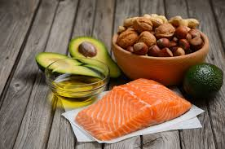
Fat
Fat is a concentrated source of energy.
Fatty acids
Saturated
(animal sources)
Unsaturated
(vegetable sources)
Monounsaturated
Polyunsaturated
Omega-9 fatty acid
Olive oil/ Avocados/
Peanuts/ almonds
Omega-3
Fish/ Flaxseed
Soybean/ Walnut
Most of the body fat (99 per
Notes:
Classification:
Simple lipids: triglycerides
Compound lipids: phospholipids
Derived lipids: cholesterol
Can’t be synthesized in human body:
Linoleic acid (an omega-6 fatty acid)
Sunflower oil Corn oil Soya bean oil Sesame oil Groundnut oil Mustard oil Palm oil Coconut oil
Arachidonic acid
Meat, eggs, milk
Linolenic acid (an omega-3 fatty acid)
Soya bean oil, Leafy greens
Fat

Slide 15
Essential fatty acids (EFA)
Can’t be synthesized in human body:
Linoleic acid (an omega-6 fatty acid)
Sunflower oil Corn oil Soya bean oil Sesame oil Groundnut oil Mustard oil Palm oil Coconut oil
Arachidonic acid
Meat, eggs, milk
Linolenic acid (an omega-3 fatty acid)
Soya bean oil, Leafy greens

Slide 16
Functions of fats
Source of high energy
Vehicles for fat-soluble vitamins
Support for visceral organs
Insulation against cold.
Growth, structural integrity of the cell membrane.
Notes:
Diets rich in EFA reduce serum cholesterol
Polyunsaturated fatty acids are precursors of prostaglandins.

Slide 17
Micronutrients
Micronutrients
Vitamins
Fat soluble vitamins
Water soluble vitamins
Minerals

Slide 18
Fat soluble vitamins

Slide 19
Vitamin | Function | Deficiency | Sources
A | Structure and function of epithelial tissue, normal vision, Growth and Reproduction. | Nightblindness Xerophthalmia May affect immunity dry skin, hair and fingernails | liver, beef, chicken, fortified milk, carrots, leafy and green vegetables and eggs
D | Bone reabsorption, collagen maturation | Rickets (in children) Osteomalacia osteoporosis | liver, beef, chicken, fortified milk, carrots, leafy and green vegetables and eggs
E | brain and nervous system, heart and RBC, skin and eye | Arrhythmia, neurological symptoms | Almonds, Spinach, Sweet Potato, Avocado, Sunflower seeds, Palm Oil, Olive oil
K | Blood clotting, Antioxidant, Brain function | bleeding, bruises | Green leafy vegetables kale, spinach, parsley, broccoli

Slide 20
Water soluble vitamins

Slide 21
Vitamin | Function | Deficiency | Sources
C | Antioxidant Collagen formation | Scurvy | Lemon, Strawberry, Spinach, Broccoli, Chili pepper
Thiamin (B1) | Carbohydrate utilization | Wernick's encephalopathy. Beriberi | Lentils, red meats, nuts, sunflower seeds, peas, milk, cauliflower, spinach
Pyridoxine (B6) | Metabolism, Healthy nervous system. | Neurological symptoms. | Meat, poultry, eggs, bananas, fish, potatoes and cooked spinach.
Cobalamin B12 | synthesis of DNA Healthy RBC and nervous system | Macrocytic anemia, pernicious anemia, peripheral neuropathy, palpitation, memory loss depression, and lack of appetite. | Chicken, beef, fish, milk and eggs

Slide 22
Minerals

Slide 23
Vitamin | Function | Deficiency | Sources
Iron | Hemoglobin formation O2 binding to RBC | Iron deficiency anemia | Meat Chicken Liver Spinach Tomato Beets Kale
Iodine | Component of the thyroid hormones | Goiter Hypothyroidism In children (intellectual impairment, speech loss, short stature) | Sea Vegetables. Seafood

Slide 24
Healthy diet

Slide 25
MALNUTRITION
Malnutrition is a medical condition resulting from a deficiency or excess of one or more essential nutrients (WHO, 1999)
Excess nutrients intake results in overweight, which could lead to obesity
Deficiency of nutrients intake leads to malnourishment or undernutrition

Slide 26
Double Burden of Malnutrition!!

Slide 27
Notes:
The double burden of malnutrition is characterised by the coexistence of undernutrition along with overweight and obesity, or diet-related noncommunicable diseases, within individuals, households and populations, and across the lifecourse.
This double burden of malnutrition offers a unique and important opportunity for integrated action on malnutrition in all its forms. Addressing the double burden of malnutrition will be key to achieving the Sustainable Development Goals (in particular Goal 2 and Target 3.4)

Slide 30
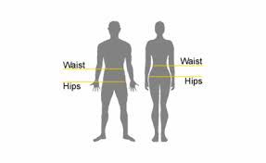
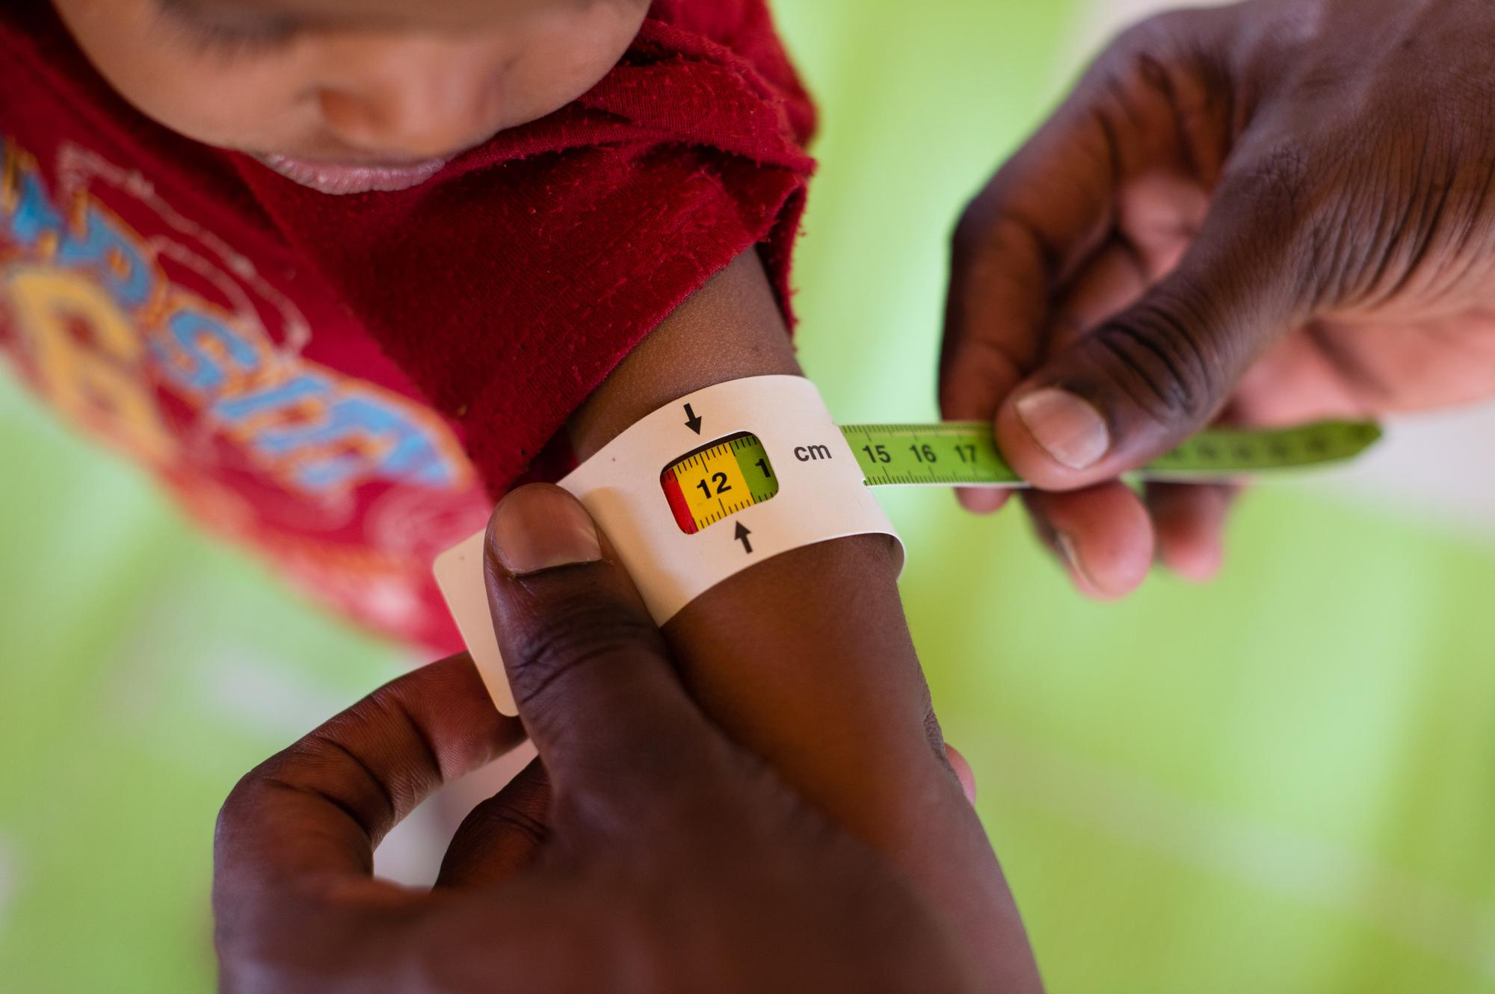
ASSESSMENT OF NUTRITION STATUS
ANTHROPOMETRIC MEASURES
Weight and height (under nutrition and over nutrition)
Waist – hip ratio (central obesity)
Mid arm circumference (lean body mass)
Skin fold thickness (caloric reserve)
Physical examination
Blood tests

Slide 31
Obesity
Results from excess nutrients intake resulting in overweight, which could lead to obesity
Obesity could also be influenced by genetic factors
Classification: | BMI (Kg/M2)
Overweight | >25
Pre-obese | 25-29.99
obese | >30
Obese class 1 | 30-34.99
Obese class 2 | 35-39.99
Obese class 3 | >40

Slide 32
Obesity prevalence
About 13% of the world’s adult population (11% of men and 15% of women) were obese in 2016
In 2016, 39% of adults aged 18 years and over (39% of men and 40% of women) were overweight.
The worldwide prevalence of obesity nearly tripled between 1975 and 2016
Data sources: (WHO, 2017)

Slide 33
Prevalence of obesity in adults- 2017

Slide 36
Health implication of obesity
Hypertension
CHDs
Type-2 diabetes
Morbidity and mortality

Slide 37
Determining factors of obesity
Dietary factors and lifestyle
Lack of regular physical activities
Genetic factors
Urbanization and globalisation - influences diet change

Slide 38
Undernutrition
Lack or inadequate intake of essential nutrients
Loss of these essential nutrition from the body through disease and/ or malabsorption
Classification | BMI cut-points (kg/M2)
Underweight/thinness | <18.50
Severe thinness | <16
Moderate thinness | 16-16.99
Mild | 17-18.49
Normal | 18.50-24.99

Slide 39
Two types of undernutrition
Protein-energy undernutrition
Micronutrients Deficiency Undernutrition (MDMS), often referred to as "silent killer”

Slide 40
Vulnerable groups at risk of undernutrition
Women (pregnant, lactating)
Children (<5yrs)
Adolescent girls
Chronically ill people (e.g. people suffering from chronic tuberculosis, HIV etc),
People affected by emergencies such as natural disasters – conflicts, floods and earthquake

Slide 41
Prevalence of undernutrition
Nearly 1 billion people around the world are undernourished (are underweight)
Undernutrition is more common in low and middle income countries
Source: WHO, 2009; UNICEF, 2009)

Slide 42
Prevalence of undernutrition cont…
30% of world population (2 billion people) suffer from iron deficiency anaemia
43 million people worldwide are suffering from varying degrees of brain damage due to iodine deficiency
Vitamin A is a clinical problem in 45 countries, and sub-clinical problem in 122 countries around the world
Source: (WHO, 2009; UNICEF, 2009

Slide 44
IDA in Saudi Arabia
In 2011, the overall prevalence of iron deficiency anemia in Saudi Arabia was → 30–56%
Children (% of children under 5) → 39.10 %.
Non-pregnant women → 40.30%
Pregnant women → 40.40 %

Slide 45
Source: Hwalla et al., 2017)

Slide 46
Vitamin D deficiency

Slide 47
Vitamin D activation
Notes:
Vitamin activation

Slide 48
Signs of vitamin D deficiency
Classical vitamin D deficiency disease
Rickets (in children)
Osteomalacia
Osteoporosis

Slide 49
Increased risk of vitamin D deficiency
People with limited sun exposure
Overweight people
Dark-skinned people
Pregnant women
Infants
The elderly
Chronic illnesses
Insufficient intake

Slide 50
Source: (Hwalla et al., 2017)

Slide 51
National nutrition programs

Slide 53
References
WHO, 2018. Double Burden of Malnutrition: Infographics [online] available at: http://www.who.int/nutrition/double-burden-malnutrition/infographics/en/
Hwalla, N. et al.(2017) ‘nutrients The Prevalence of Micronutrient Deficiencies and Inadequacies in the Middle East and Approaches to Interventions’, pp. 1–28.
MOH, 2018. Ministry of health portal. Available at: https://www.moh.gov.sa/endepts/Nutrition/Pages/Palmfood.aspx
Hamad; M. and Dkheel; A. (2012) ‘Dietary Guidelines for Saudis The healthy Food Palm General Directorate of Nutrition Director of General Directorate of Nutrition’; pp. 1–32.
Park, 1997. Preventive and Social Medicine.

