Slide 1
Travel Medicine
Dr. Afnan Younis
Community medicine

Slide 2
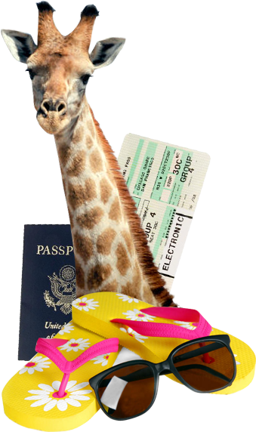

Slide 3
Objectives
Define travel medicine and its importance
Levels of travel medicine (pre, during, post)
Pre-travel consultation (risk assessment, risk management, immunization, prophylaxis, self-medications)
Immunization (required, recommended, routine)
Other infections (malaria, zika, traveler’s diarrhea)
Prevention (food, water and personal precautions, environmental precautions, vector and animal precautions, injury precautions)
Travel emergency kit
Post-travel care

Slide 4
What is travel medicine?
An interdisciplinary specialty concerned with prevention, early detection, and research of health problems associated with travel.

Slide 5
What does travel medicine do?
Seeks to prevent illnesses and injuries occurring to travelers going abroad
Manages problems arising in travelers coming back or coming from abroad
Impact of tourism on health and to improve health and safety services to tourists
Refugee and migrant health

Slide 6
Why travel medicine?
WORLDWIDE
1950 - 25 million international tourist arrivals
2000 - 664 million international tourist arrivals
2010 - 940 million international tourist arrivals (growth rate 7% from 2009)
2030 – forecast 1.8 billion
World Tourism Organisation

Slide 7
International Travel

Slide 8
Importance of travel medicine
Of 100,000 travellers to the developing world for 1 month
50.000 will develop some sort of health problem during their trip
8000 will see a physician
5000 will have to stay in bed
300 will have to b ae admitted to hospital either during their trip or on return
50 will need to be air evacuated
1 will die
Ref. Spira AM Lancet. Vol 361. April 19, 2003

Slide 9
Concerns
International travel carries a risk for travelers, community of origin and community of destination
The risk for travelers includes diseases, injuries and death

Slide 10
Types of travelers
Tourists
VFRs (visiting friends and relations)
Business travellers
Migrant workers
Military
Aid and Development workers
Expatriates
Students
Gap Year travel
Asylum seekers
Refugees
Pilgrims

Slide 11
Special populations
Elderly travellers
Infants and children
Pregnant women
Travellers with chronic diseases
Travellers with disability
Immunocompromised traveller

Slide 12
Special itineraries
Cruise ship travel
Diving
Extended stay
Extreme travel
Mass gatherings (eg. The Hajj)
Wilderness/remote regions travel
Risk depends on destination

Slide 13
Components of travel medicine
Pre-travel
During travel
Post-travel
Notes:
-travel

Slide 14
Pre-travel consultation
Risk assessment (potential hazards)
Risk management (advice to reduce exposure to health risks)
Service delivery: immunization, prophylaxis or self-medications
Empower traveler to manage his health

Slide 15
Risk assessment
Information about travelers
Age and sex
Medical history
Information about trip
Destination
Length of stay
Medications
Allergies
Immunization history
Special health needs
Mode of transport
Purpose of trip and planed activities
Financial budget, accommodation, insurance
Healthcare in destination

Slide 16
Risk factors and health problems facing international travelers
RISK
HEALTH PROBLEMS
Overcrowding
Low sanitation
Climatic change
Vector of diseases
Stray animals
Unsafe roads
Security problems
Aggravation of existing problem
Food and water borne infections
Air borne infections
Unintentional & Intentional Injuries
Vector borne diseases
Zoonotic diseases

Slide 17
Common diseases associated with international travel
Gastrointestinal
Traveler’s diarrhea
Respiratory diseases
Vector borne diseases
Typhoid fever
Hepatitis A
Cholera
Poliomyelitis
Yellow fever
Influenza
Meningitis
Mers-Cov
Tuberculosis
Malaria
Dengue fever
Leishmaniosis
Japanese encephalitis
Soil borne
Tetanus
Behavior related
Zoonotic diseases
Blood borne
Sexually transmitted diseases
Rabies
Hepatitis B

Slide 18
Unintentional and intentional injuries
Road traffic injuries
Inter-personal violence
Injury in recreational water
Animal bites (domestic and wild animals)

Slide 19
Risk management (give advise)
Food and water safety and hand hygiene
Insect bite prevention
Immunization
Malaria prevention

Slide 20
Risk management (give advise)
Traveler’s medical insurance
Environmental risks (sun exposure, heat, high altitude, motion sickness, DVT)
Travelers with special needs (chronic disease, children, pregnant)
Personal safety (RTA, fall, drowning, fire, robbery, STD)
Notes:
Environmental: DVT, altitude, sea sickness, heat, sun
Injury: RTA, fall, drowning, fire

Slide 21
Preventive measures for common diseases among international travelers
Immunization or Chemoprophylaxis
and
General measures for the prevention of infectious diseases

Slide 22
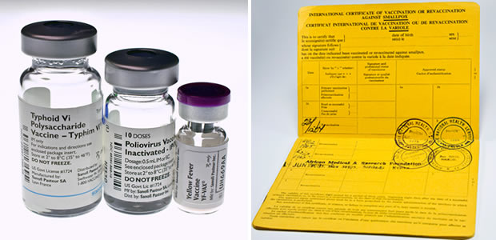
Immunization
Routine
Childhood immunizations
Recommended
According to risk of infection
Required
Yellow fever vaccine
Meningococcal vaccine

Slide 23
Immunization for travelers
Weeks before travel
Departure
6
5
4
3
2
1
0
1st consultation
2nd consultation
4-6 weeks before travel
Booster doses

Slide 24
Routine immunizations
In KSA | Others in other countries
Hepatitis A | Human papilloma virus
Hepatitis B | Tick borne encephalitis
BCG | Influenza
DPT
MMR
Polio
Pneumococcal
Meningococcal
Rota virus
Varicella
Hemophilus influenza

Slide 25
Required immunizations
Yellow fever (international health regulation)
Meningococcal meningitis: by Saudi Arabia for Hajj and Umrah and seasonal workers.

Slide 26
Yellow fever vaccine
Required for travelers to a country under the International health regulations.
Recommended: for travelers to endemic area.
Notes:
Countries under the IHR can change at any time.. Travelers are advised to check updated regulations

Slide 27
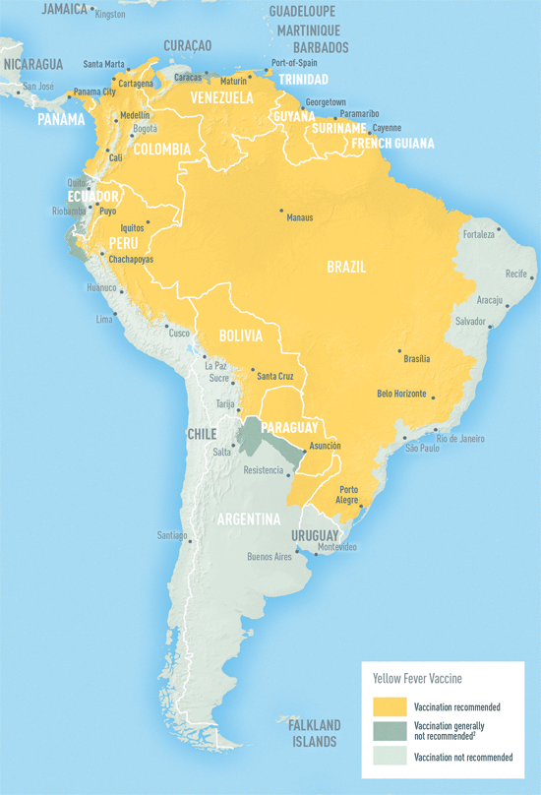
Yellow fever vaccine recommendations

Slide 28
Yellow fever vaccine
Not recommended for
Infants < 9 months
Immune compromised patients
Pregnant women
Egg allergies
HIV-positive individuals
Live attenuated virus vaccine
Single subcutaneous injection
Immunity starts after 10 days
Valid for 10 years

Slide 29
Meningococcal meningitis
Required: by Saudi government for Hajj or Umrah.
Recommended: for travelers to endemic area.
Risk:
Sub-Saharan Africa (seasonal)
Saudi Arabia (Hajj)
Crowded student dormitory situations
Notes:
Protection
Not effective for children below2 years
Protection is for 3–5 years in adults and older children

Slide 30
Meningitis belt

Slide 31
Meningococcal vaccine
Quadrivalent polysaccharide (MPSV4; A, C, Y, W-135) or conjugated with diphetheria
Single dose (injection)
Protection
Protection is for 3–5 years in adults and older children
Not effective for children below2 years

Slide 32
Recommended immunizations (according to risk)
Hepatitis A, B
Typhoid
Cholera
Poliomyelitis
Meningococcal meningitis
Japanese encephalitis
Rabies
Tick-borne encephalitis

Slide 33
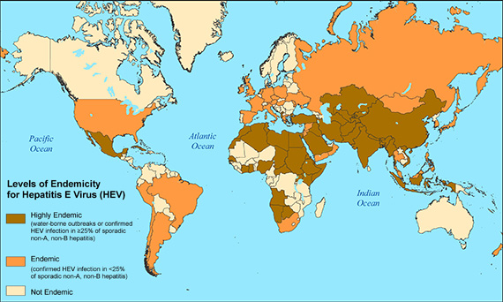
Hepatitis A
Endemic in many developing countries
High mortality in elderly and pregnant women.
Prevention by food, water, personal hygiene and immunization

Slide 34
Hepatitis A vaccine
Two doses of inactivated vaccines (HAVRIX® or VAQTA®)
First dose: 70 – 85% develop antibodies within two weeks
Second dose: after12 to 18 months leading 100% sero-conversion
If traveling in <4 weeks after 1st dose: immune globulin should be administered at a different anatomic injection site
Protection
14 – 20 years in children
25 years among adults
Recommended
Travelers to the developing countries
2 years and older
Notes:
Travelers in less than four weeks after the 1st dose (0.02 mL/kg) **
A combined hepatitis A and hepatitis B vaccine is also available

Slide 35
Hepatitis B
Transmission: Blood-borne, sexual contact
Prevention: Avoid risk factors, immunization

Slide 36
Hepatitis B vaccine
Recombinant vaccine given by intramuscular injection
Monovalent or combined with hepatitis A (for those ≥ 18 years)
Regular schedule: 0-, 1-, and 6-month with no booster dose
Accelerated schedule for the combined vaccine only (FDA)
0-, 7-, and 21- days
Booster dose at 1 year
Recommended for travelers to endemic areas and travelers with special risk

Slide 37
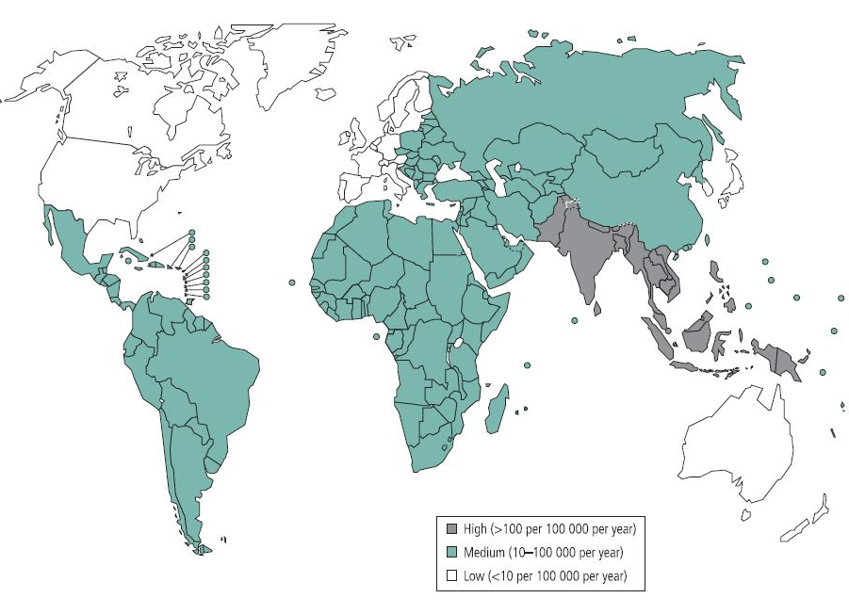
Typhoid
Transmission: by contaminated food and water
Prevention: food, water, personal hygiene and vaccination
Notes:
Transmission:

Slide 38
Typhoid vaccine
Live attenuated (Ty21a)
Oral vaccine
Four doses (One capsule on alternating days not with antibiotics)
Schedule should be completed at least one week before traveling
Booster every 5 – 7 years
Vi capsular polysaccharide vaccine (ViCPS)
Single dose intramuscular injection
At least two weeks before traveling
Booster at 2 years intervals
Both vaccines are effective but differ in duration of immunity
Compliance may be a problem with oral vaccine
Recommended to travelers to developing countries

Slide 39
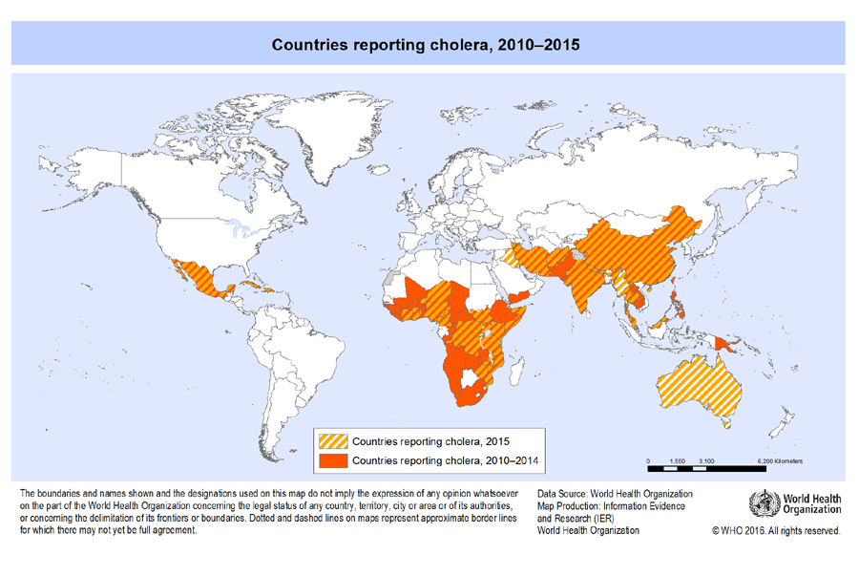
Cholera
Transmission by contaminated food or water
Rare in travelers
Prevention:
food, water and Personal hygiene
Vaccination (oral)
Notes:
Prevention: by

Slide 40
Cholera vaccine
Live attenuated oral vaccine
Result in 60–80% protection for 6 to 12 months
Not effective against the new serotype O139 (spread rapidly through Asia in mid 90s)

Slide 41
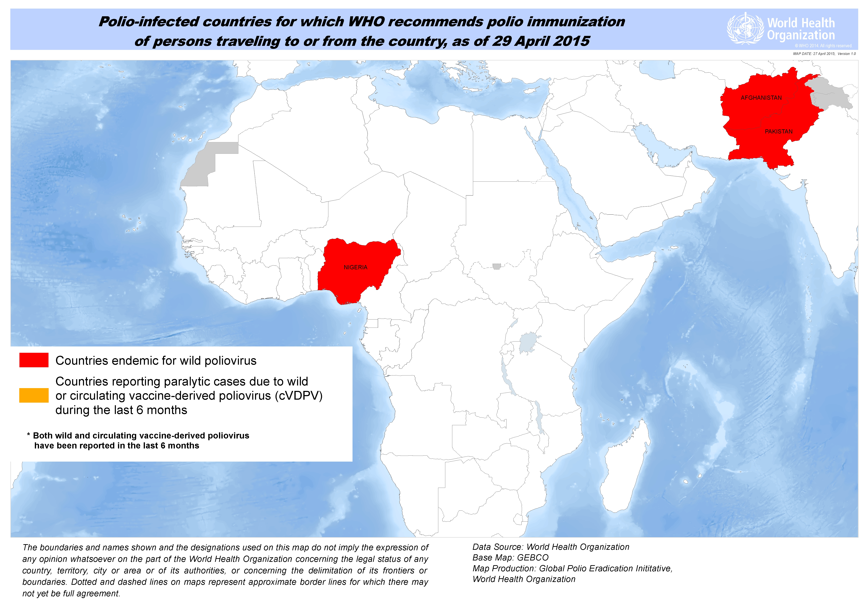
Polio
Transmission: contaminated food and water.
Rare in travelers
Prevention:
Food, water, personal hygiene
Vaccination (injectable, oral)

Slide 42
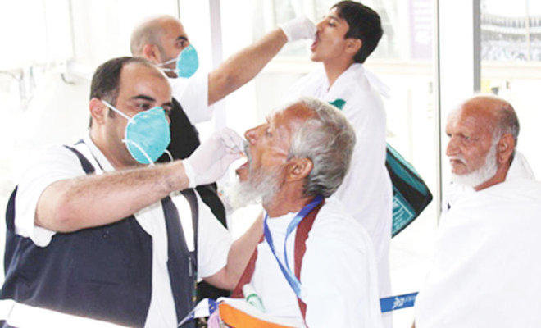
Polio in Saudi Arabia
In Saudi Arabia, proof of receipt of polio vaccine is required from travelers from endemic countries or countries vulnerable to infection or re-infection.
All travelers from these countries will also receive 1 dose of OPV at border points on arrival in Saudi Arabia
Notes:
proof of receipt of a dose of oral polio vaccine (OPV), or inactivated poliovirus vaccine (IPV), within the previous 12 months and at least 4 weeks prior to departure, is required to apply for an entry visa for Saudi Arabia for travellers arriving from the following countries, territories or areas:
States infected with Wild Polio Virus 1 or circulating Vaccine Derived Polio Virus with potential risk of international spread: Afghanistan, Nigeria and Pakistan;
States no longer infected but remain vulnerable to reinfection: Cameroon, Central African Republic, Chad, Guinea, Laos People’s Democratic Republic, Madagascar, Myanmar, Niger, and Ukraine;
States which remain vulnerable to Polio: Democratic Republic of the Congo, Equatorial Guinea, Ethiopia, Iraq, Kenya, Liberia, Sierra Leone, Somalia, South Sudan, Syrian Arab Republic and Yemen.

Slide 43
Japanese encephalitis
Transmission: by mosquito bite
Risk increases in travelers to rural Asia or long stay travelers.
Prevention: vector control and vaccination
Notes:
By

Slide 44
Japanese encephalitis vaccine
Two available vaccines
Given as three doses: 0, 7 and 30 days
Accelerated schedule of two doses at 0 and 7 days (80% conversion)
The last dose should be at least 10 days before departure
Booster dose at 24 months if the risk continues
Vaccine should be given at least 10 days prior to departure because of the possible serious adverse reactions
Notes:
(generalized itching, respiratory distress, angioedema, and anaphylaxis) up to one week after vaccination and adequate immune response is not achieved for several days.

Slide 45
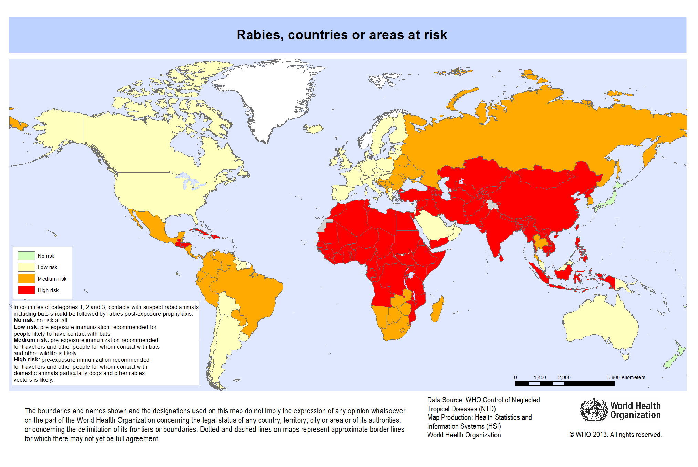
Rabies
Transmission: animal bite or scratch
Risk: occupational , travel to rabies risk countries
Prevention; immunization
Preexposure
Post exposure
Immunoglobulin
Notes:
Human rabies immunoglobulin

Slide 46
Rabies vaccine
Inactivated vaccine
Three doses on 0, 7, and 21 or 28 (intramuscular)
Note:
Pre-exposure vaccine eliminates the need for rabies immune globulin (RIG) after exposure, but does not eliminate the need for additional post exposure rabies vaccinations.

Slide 47
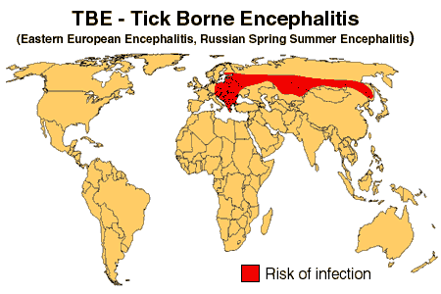
Tick-borne encephalitis
Transmission by:
Ixodes sp. Ticks
Ingestion of unpasteurized dairy products
Rural forested areas of east and central Europe, Russia and parts of Asia
March – November

Slide 48
Tick-borne encephalitis
Prevention:
Tick prevention
Avoidance of unpasteurized dairy products
Vaccination
Self check and removal ASAP (tweezers)

Slide 49
Other vaccines – influenza
The risk
Risk of exposure to the virus is throughout the year in tropical and subtropical areas
The attack rate is 1.2–2.8% in travelers of all age groups
The vaccine
Inactivated parenteral vaccine
live attenuated vaccine administered by nasal spray (for healthy persons 5–49 years)
Recommended to travelers to
tropics and subtropics at risk of serious related complications
Southern Hemisphere from April through September

Slide 50
Other vaccines - Tuberculosis
The vaccine
BCG vaccine
Live attenuated
Single intradermal injection
Recommended to long stay in developing countries
Baseline tuberculin before travel with a follow up every 1 year

Slide 51
Chemoprophylaxis

Slide 52
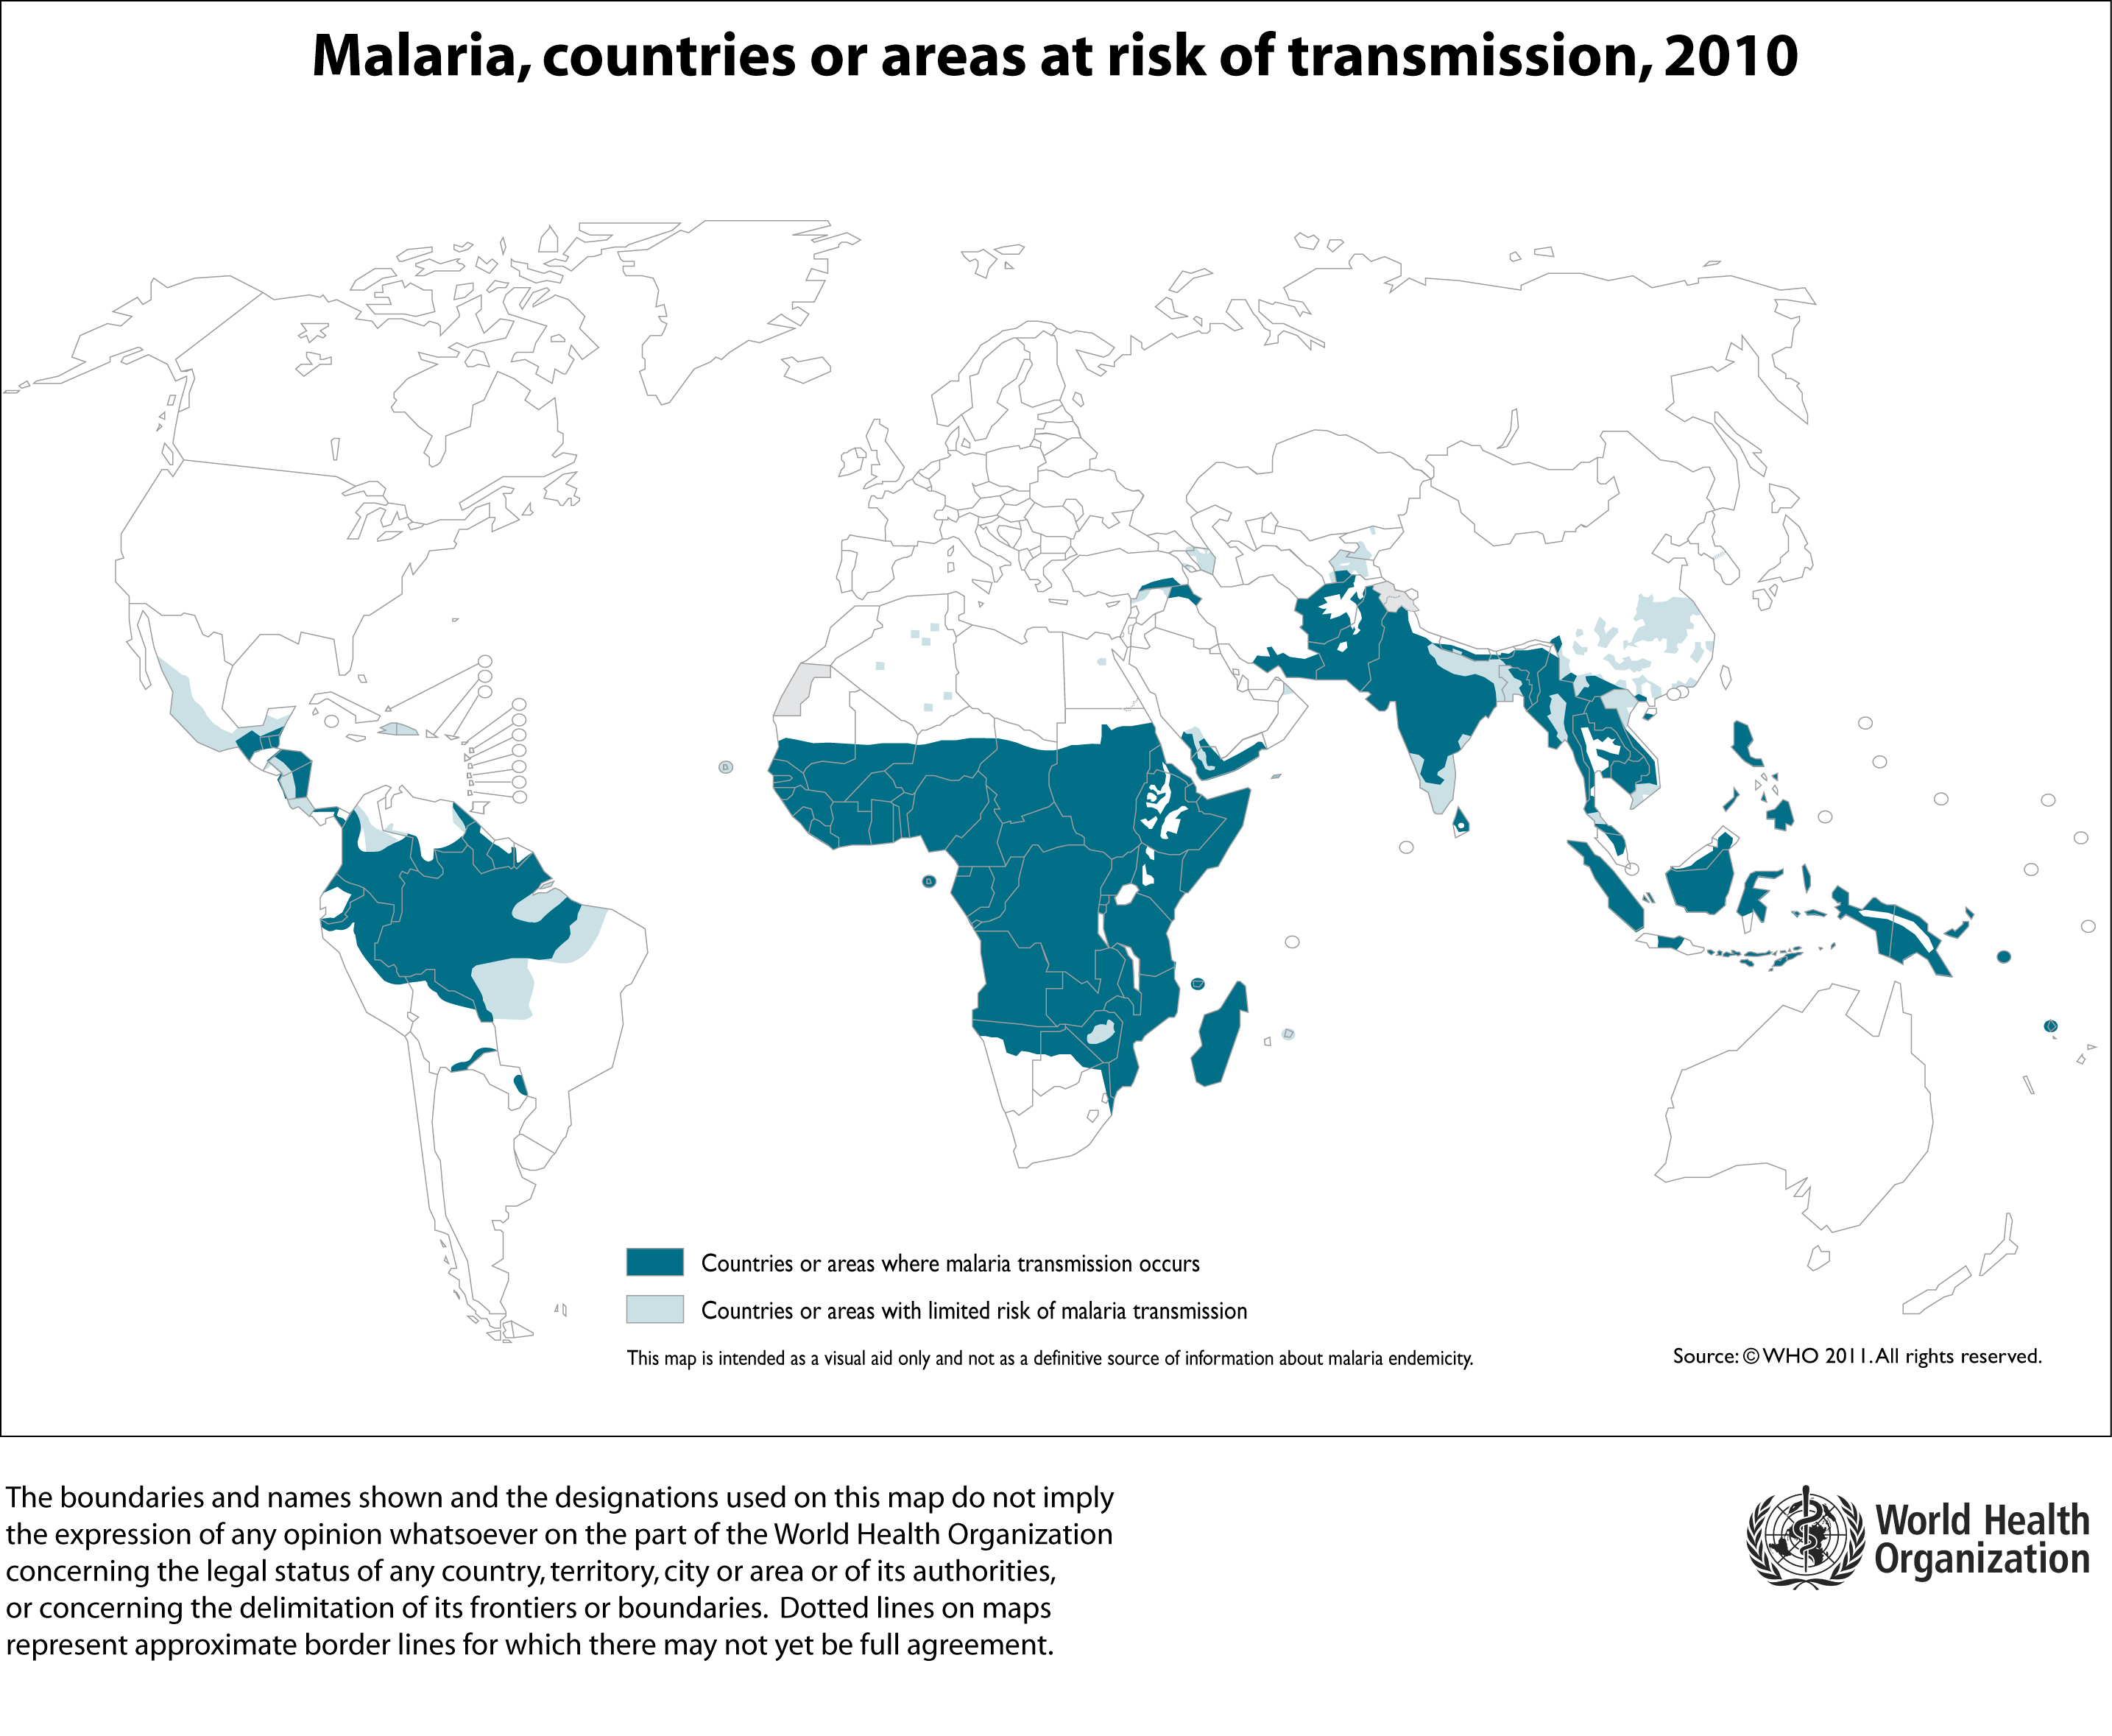
Malaria
Transmission by mosquito bite
Prevention:
Awareness
Bite avoidance
Chemoprophylaxis
Diagnosis of febrile illness
Fever in returned traveler is a medical emergency considered malaria until proven otherwise

Slide 53
Malaria chemoprophylaxis
Proguanil (all areas)
1 – 2 days before departure, daily during the journey and 7 days after return
Doxycycline (all areas)
1 – 2 days before departure, daily during the journey and 4 weeks

Slide 54
Malaria chemoprophylaxis
Chloroquine (chloroquine sensitive areas)
1 – 2 weeks before departure, daily during the journey and 4 weeks after return
Primaquine (predominant vivax areas and ovale)
1 – 2 days before departure, daily during the journey and 7 days after return
Mefloquine (mefloquine sensitive areas)
2 weeks before departure, daily during the journey and 4 weeks after return
Notes:
For more information http://wwwnc.cdc.gov/travel/yellowbook/2014/chapter-3-infectious-diseases-related-to-travel/malaria#3939

Slide 55
Other infections

Slide 56
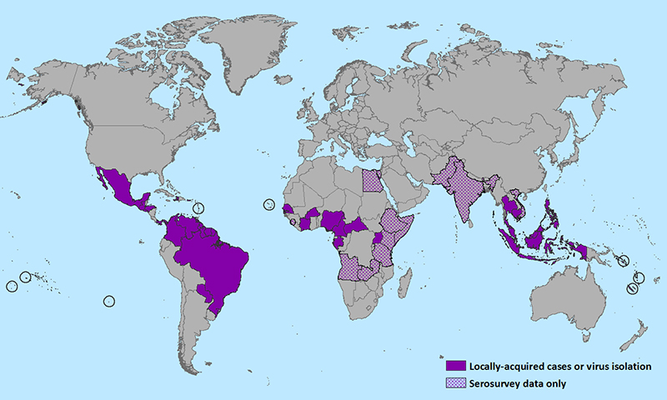
Zika virus
Transmission by mosquito bite
Risk to pregnant women → microcephaly and other brain abnormalities
Prevention: preventing mosquito bites

Slide 57
Traveler’s diarrhea
Cause:
Bacterial (60-80%
Viral (10-20%)
Parasitic (5-10%)

Slide 58
Traveler’s diarrhea
Prevention:
Wash It, Peel It, Cook It, or Forget It
Only Drink Bottled Water
Wash hands frequently

Slide 59
Post-Travel Care
Post-travel checkup
Long term travelers
Adventure travelers
Expatriates in developing world
Post-travel care
Fever, chills, sweats
Persistent diarrhea
Weight loss

Slide 60
Travelers’ responsibilities

Slide 61
Responsibilities of traveler
Decide on the travel destination and timing
Recognize and accept risk
Visit the general practitioner prior to traveling
Obtain travel insurance
Adhere to the preventive precautions
Carry medical kits and understand its use
Assume the responsibility of the health and safety of children
Respect people and culture in country of destination
Visit the general practitioner upon return

Slide 62
Responsibility of traveler: check status of destination
Warning level 1: Practice usual precautions
Presence of usual risk for infectious diseases as diarrheal diseases and malaria
Warning level 2: Practice enhanced precautions
Presence of MERS-CoV is Arabian Peninsula
Warning level 3: Avoid non-essential travel
Presence of outbreak (Ebola) and adverse security situation

Slide 63
Responsibility of traveler: consult general practitioner
Before departure
After arrival
Timing: 4 to 6 weeks
Purpose
Medical evaluation
Risk assessment
Receive preventive interventions
Travel advice
Have chronic diseases
Spent >3 months in a developing country
Received treatment for malaria while travelling
Exposed to a serious infectious disease while travelling
Experienced illness in the weeks following return (fever, persistent diarrhea, vomiting, jaundice, urinary disorders, skin disease or genital infection)

Slide 64
Responsibility of traveler: carry emergency medical kits
Usual prescription medications in sufficient quantities
Essential over the counter medicines to meet common illnesses
Analgesics
Decongestant, cold medicine, cough suppressant
Antibiotic/antifungal/hydrocortisone creams antacid
First aid kits
Band-Aids, gauze bandages, tape, Ace wraps
Tweezers, scissors, thermometer
Special items according to destination
Insect repellant, sunscreen, lip balm
Notes:
Copy of medical records and extra pair of glasses
Prescription medications
Over-the counter medicines and supplies
Analgesics
Decongestant, cold medicine, cough suppressant
Antibiotic/antifungal/hydrocortisone creams
Pepto-Bismol tablets, antacid
Band-Aids, gauze bandages, tape, Ace wraps
Insect repellant, sunscreen, lip balm
Tweezers, scissors, thermometer

Slide 65
Responsibility of traveler: issue travel insurance
Required in case of
Illness
Accident
Death
Covers
Changes to the itinerary
Emergency repatriation for health reasons
Medical care (illness and accidents)
Hospitalization
Repatriation of the body in case of death.

Slide 66
Precautions

Slide 67
Food and Water Precautions
Bottled water
Selection of foods
well-cooked and hot
Avoidance of
salads, raw vegetables
unpasteurized dairy products
street vendors
ice

Slide 68
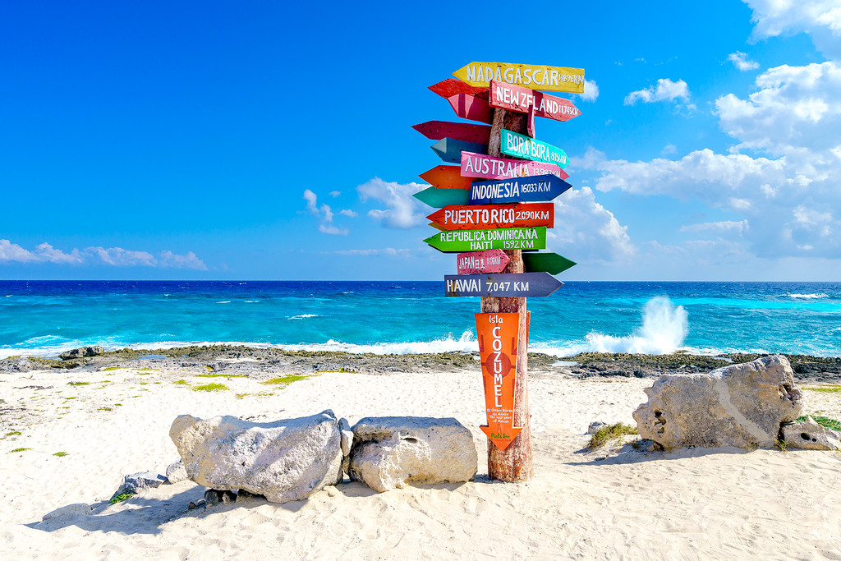
Environmental Precautions
Air Travel
Jet Lag
Sun Protection
Extreme Heat and Cold
dehydration, heat stroke
hypothermia, frostbite
Altitude
Water recreation
Drowning, boating & diving accidents
Risk of schistosomiasis or leptospirosis
Biological and chemical contamination

Slide 69
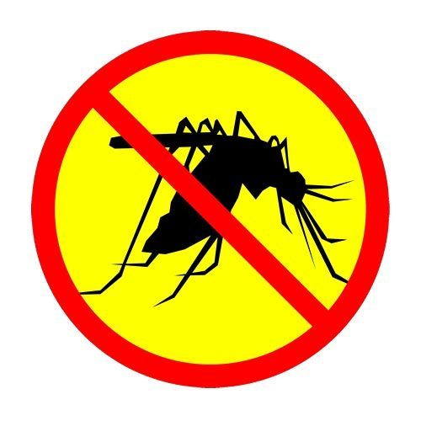
Vector Precautions
Covering exposed skin
Insect repellent containing DEET 25 – 50%
Treatment of outer clothing with permethrin
Use of permethrin-impregnated bed net
Use of insect screens over open windows
Air conditioned rooms
Use of aerosol insecticide indoors
Use of pyrethroid coils outdoors
Inspection for ticks

Slide 70
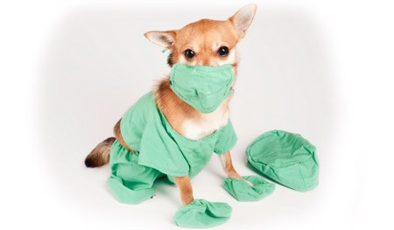
Animal Precautions
Animal avoidance
Rabies
Specific animal threats
Medical evaluation of bites/scratches
Post exposure immunization and immunoglobulin
Envenomations
Snakes, scorpions, spiders
Maritime animals

Slide 71
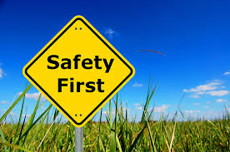
Injury and Crime
Vehicles
Risk of road and pedestrian accidents
Night travel
Seat belts and car seats
Avoid the use of drugs and alcohol
Understanding local crime risks
Scam awareness
Situational awareness
Location avoidance
Notes:
Avoid

Slide 72
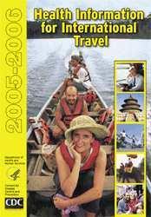
Travel Health Resources
CDC Travelers’ Health Website
www.cdc.gov/travel
World Health Organization
www.who.int/int
State Department
travel.state.gov
International Society of Travel Medicine
www.istm.org
Health Information for International Travel
CDC “Yellow Book”
International Travel and Health
WHO “Green Book”

Slide 73
References
World Health Organization. International Health Regulations, 2005. Geneva: World Health Organization; 2008 [cited 2016 Sep. 27]. Available from: http://whqlibdoc.who.int/publications/2008/9789241580410_eng.pdf
TravellersDiarrhoea.co.uk
WHO. World Health Organization. Available at: http://www.who.int/ith/en/ (Accessed: 14 March 2018).
The Pretravel Consultation - Chapter 2 - 2018 Yellow Book | Travelers’ Health | CDC (no date). Available at: https://wwwnc.cdc.gov/travel/yellowbook/2018/the-pre-travel-consultation/the-pre-travel-consultation (Accessed: 13 March 2018).

Slide 74
Exercise

Slide 75
HEAT-STROKE | POLIO | MALARIA
CHOLERA | TYPHOID | YELLOW-FEVER
ANALGESICS | COUGH-SYRUP | RABIES
ZICA | HEPATITIS-B | MANINGITIS
HORIZONTAL:
1- Vector borne infection
2- Important in your travel tool kit
3- Oral and injectable vaccines
4- Environmental risk for travelers
5- Special risk to pregnant women
6- Required vaccine
VERTICAL:
1- Special importance in hajj
4- Blood borne infection
7- Main way to prevent it is water food and personal hygiene
8- Animal borne infection

Slide 76
 |  |  |  | 1
2
 | 3
 | 4 |  |  |  |  |  | 7
 |  |  |  |  |  |  | 6 |  |  |  |  |  |  |  |  |  |  | 8
5

Slide 77
 |  |  |  | M | A | L | A | R | I | A
 |  |  |  | E
 |  |  |  | N
 |  |  |  | I
 |  |  |  | N
A | N | A | L | G | E | S | I | C | S
 | P | O | L | I | O
 | H | E | A | T | - | S | T | R | O | K | E
 | E |  |  | I |  |  | Y | E | L | L | O | W | - | F | E | V | E | R
 | P |  |  | S |  |  | P |  |  |  |  |  |  |  |  |  |  | A
 | A |  |  |  |  |  | H |  |  |  |  |  |  |  |  |  |  | B
 | T |  |  |  |  |  | O |  |  |  |  |  |  |  |  |  |  | I
Z | I | K | A |  |  |  | I |  |  |  |  |  |  |  |  |  |  | E
 | T |  |  |  |  |  | D |  |  |  |  |  |  |  |  |  |  | S
 | I
 | S
 | -
 | B

