Slide 1
Human Herpes Viruses (HHV)
Mazin Barry, MD, FRCPC, FACP, DTM&H
Assistant Professor and Consultant Infectious Diseases
KSU

Slide 2
HERPES VIRUS INFECTIONS
objectives:
      To know the clinically important HHVs.
      To know the common characteristics of HHVs.
      To know the common modes of transmission of different HHVs
      To know the clinical features of these infections, diagnostic methods and treatment.

Slide 3
HERPES VIRUSES
Herpes Simplex Virus type1 (HSV-1)
Herpes Simplex Virus type2 (HSV-2)
Varicella Zoster Virus (VZV)
Cytomegalovirus (CMV)
Epstein-Barr Virus (EBV)
Human Herpes Virus 6 (HHS-6)
Human Herpes Virus 7 (HHS-7)
Human Herpes Virus 8 (HHS-8)

Slide 4
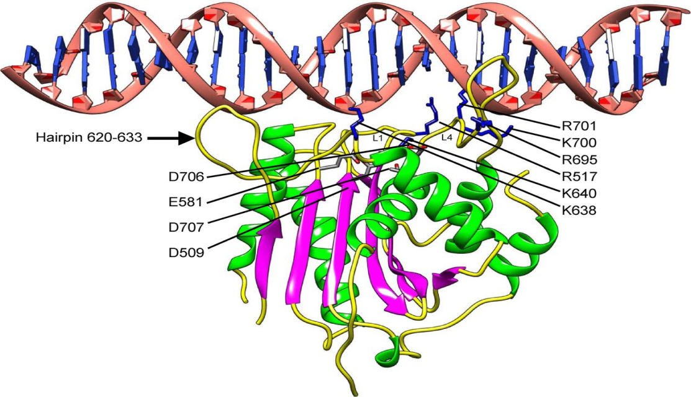
HERPES VIRUSES
Characteristics:
All DNA viruses
All encapsulated
All have latency after the initial infection
Mostly require close contact for transmission
Human is the only reservoir

Slide 5
Virus | Infection
HSV Type 1 | Herpes labialis ('cold sores') Keratoconjunctivitis Finger infections ('whitlows') Encephalitis Primary stomatitis Genital infections
HSV Type 2 | Genital infections Neonatal infection (acquired during vaginal delivery)
Varicella zoster virus (VZV) | Chickenpox Shingles (herpes zoster)
Cytomegalovirus (CMV) | Congenital infection Disease in immunocompromised patients Pneumonitis Retinitis Colitis systemic infection
Epstein-Barr virus (EBV) | Infectious mononucleosis Burkitt's lymphoma Nasopharyngeal carcinoma Oral hairy Cell leucoplakia (AIDS patients)
Human herpes virus 6 (HHV-6) and 7 (HHV-7) Roseolovirus | Exanthem subitum (Roseola): three day fever ? Disease in immunocompromised patients
Human herpes virus 8 (HHV-8) | Associated with Kaposi's sarcoma

Slide 6
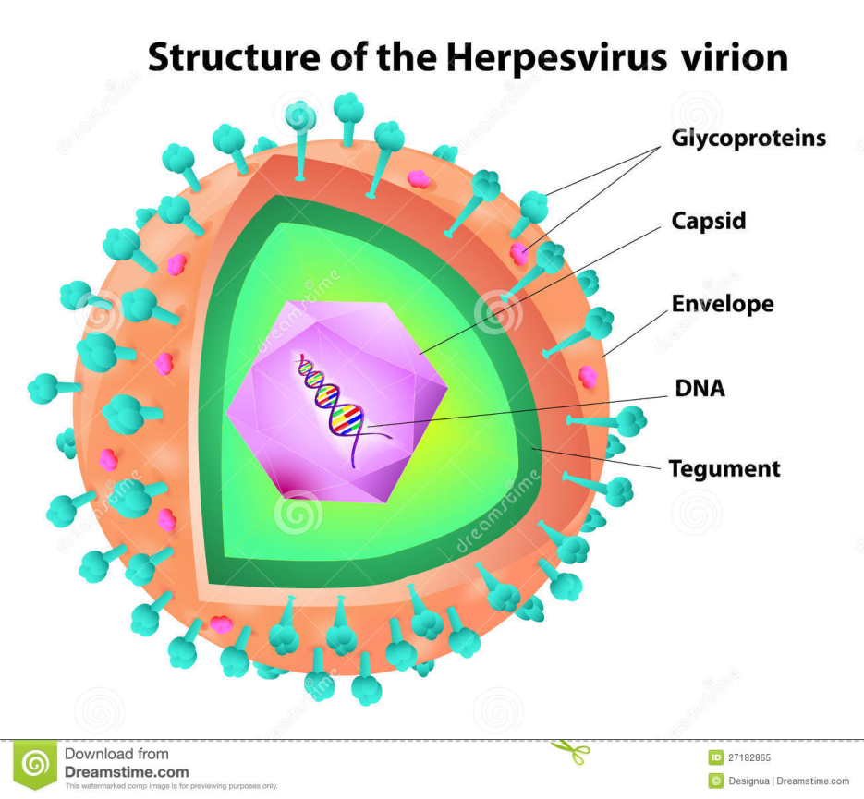
HERPES VIRUSES
Structure
Herpesviruses have a unique four-layered structure:
  A core containing the large double-stranded DNA genome
  Genome is enclosed by an icosapentahedral capsid which is composed of capsomers
  The capsid is surrounded by an amorphous protein coat called the tegument
  It is encased in a glycoprotein-bearing lipid bilayer envelope

Slide 7
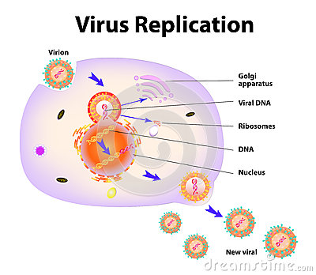
Viral Replication
Upon entry into the host cell nucleus, three distinct phases of gene transcription and protein synthesis are initiated producing the immediate-early, early, and late proteins
Viral nucleocapsid assembly occurs within the host cell nucleus.
The virus acquires its final envelope by budding into cytoplasmic vesicles

Slide 8
HERPES VIRUSES
HSV-1 vs HSV-2
Non-genital vs Genital Herpes infection
Primary vs Recurrent infections
Neonatal infection

Slide 9
HERPES VIRUSES
Transmission is by close contact with body secretions
Exposure to HSV at mucosal surfaces or abraded skin sites permits entry of the virus and initiation of its replication in cells of the epidermis and dermis
After initial infection the virus infect the sensory and autonomic nerves and become dormant in the ganglion (trigeminal nerve for HSV1 and sacral rout for HSV2)

Slide 10
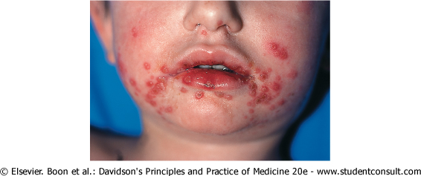
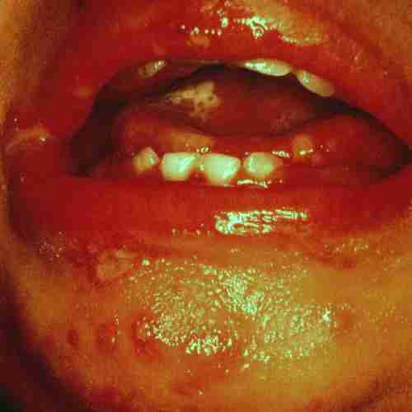
HSV Gingivostomatitis
Gingivostomatitis and pharyngitis are the most frequent clinical manifestations of first-episode HSV-1 infection

Slide 11
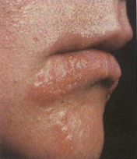
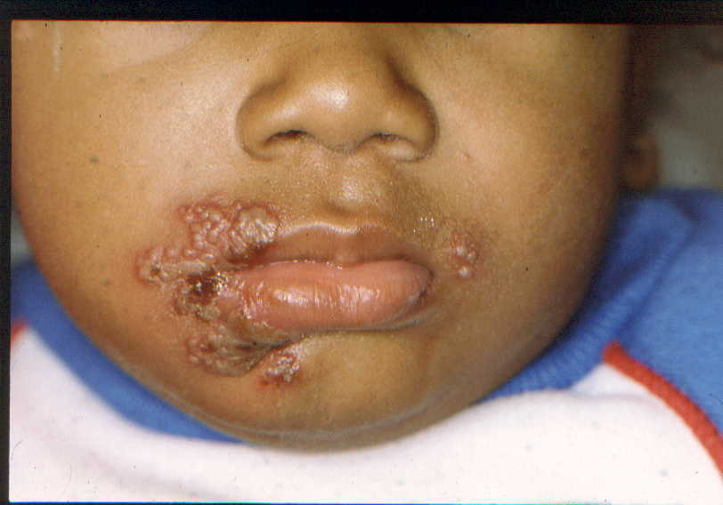
Herpes Labialis
Recurrent herpes labialis is the most frequent clinical manifestation of reactivation HSV infection

Slide 12
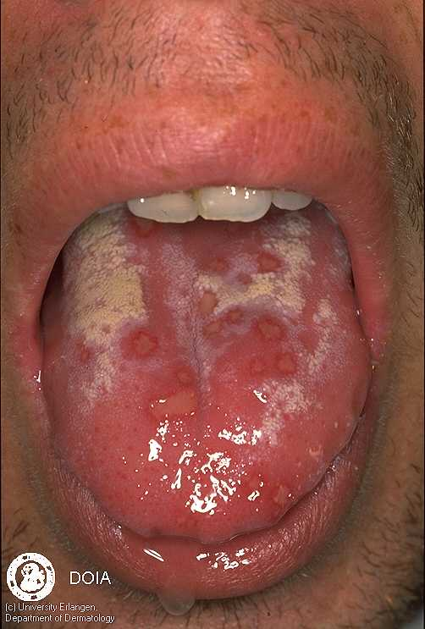
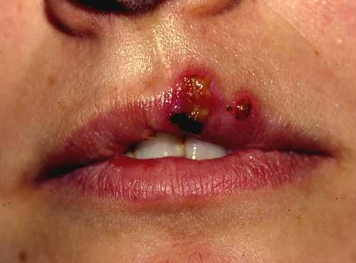
NON-GENITAL HSV

Slide 13
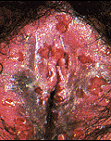
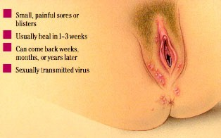
GENITAL HSV
Fever, headache, malaise, and myalgias. Pain, itching, dysuria, vaginal and urethral discharge, and tender inguinal lymphadenopathy

Slide 14
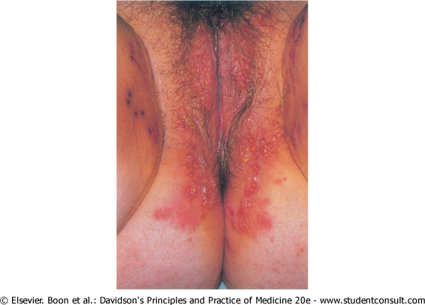
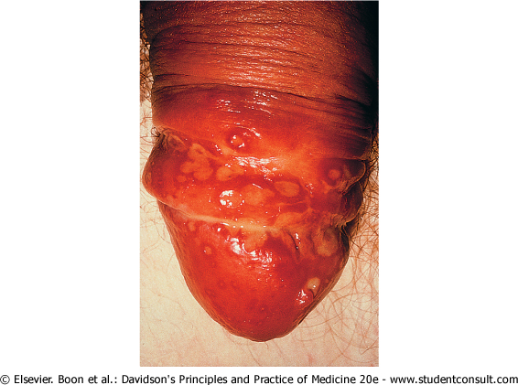
Genital HSV
Herpetic ulceration of the vulva
Penile herpes simplex (HSV-2) infection

Slide 15
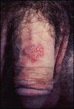
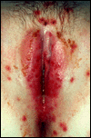
GENITAL HSV

Slide 16
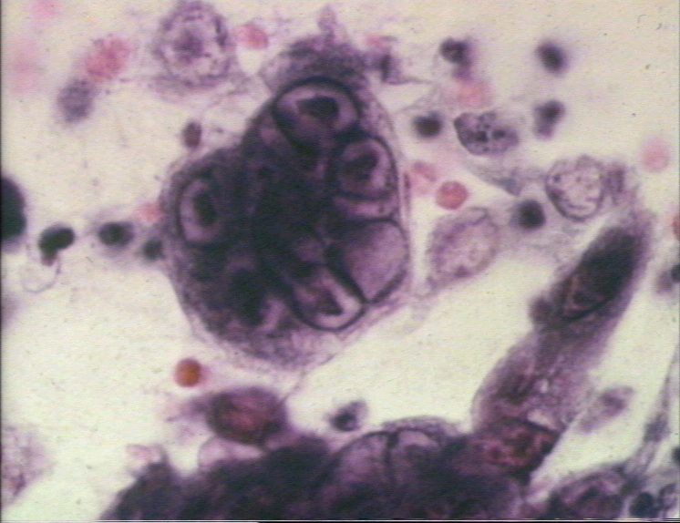
Diagnosis of HSV
Clinical picture
Viral culture
Cytology
Serology
PCR

Slide 17
HSV TREATMENT
Acyclovir, PO, IV, topical
Penciclovir topical
Famciclovir PO
Valacyclovir PO
Route, dose, duration depends on clinical picture and whether immunocompromised or competent

Slide 18
VARICILLA ZOSTER VIRUS (VZV)
Primary infection
Chickenpox
Recurrent infection
Herpes zoster (shingles)

Slide 19
VARICILLA ZOSTER VIRUS
The virus is spread by the respiratory route ( airborne and contact) and replicates in the nasopharynx or upper respiratory tract.
Followed by localized replication at an undefined site, which leads to seeding of the reticuloendothelial system and, ultimately, viremia.
The virus establishes latency within the dorsal root ganglia.

Slide 20
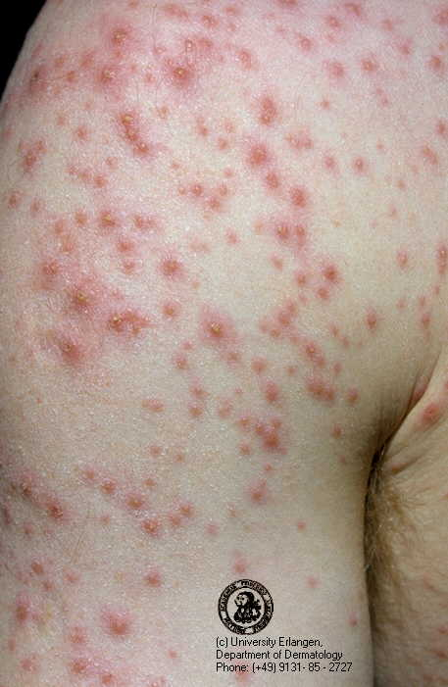
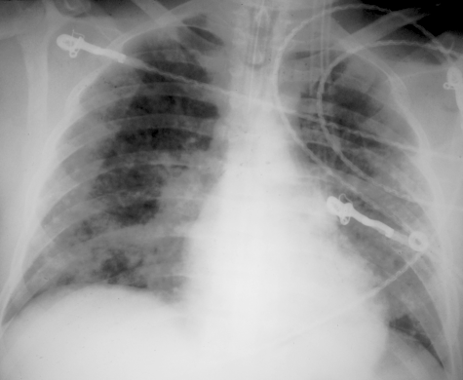
CHICKENPOX
Overall, chickenpox is a disease of childhood, because 90% of cases occur in children younger than 13 years of age.

Slide 21
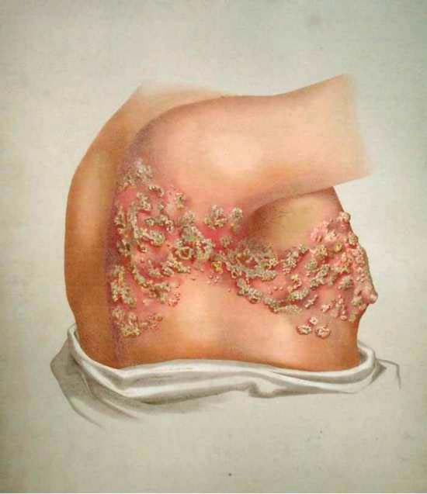
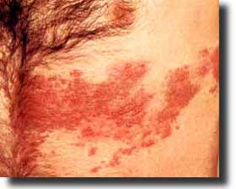
VARICILLA ZOSTER
Reactivation of VZV leads to VZ

Slide 22
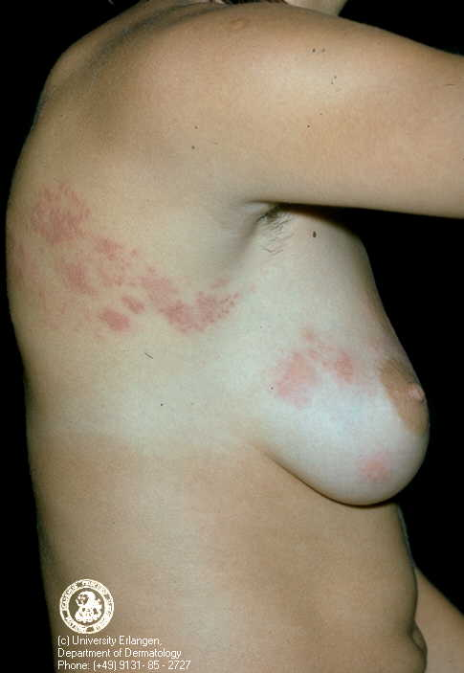
VARICILLA ZOTER

Slide 23

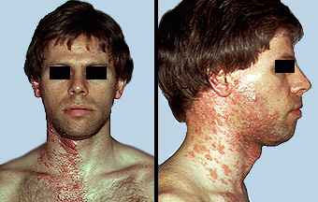
VARICILLA ZOSTER

Slide 24
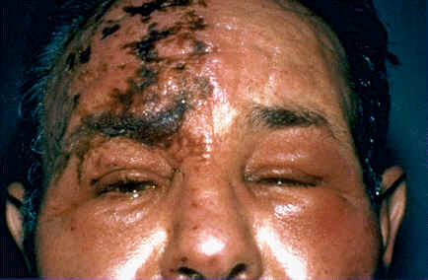
VARICILLA ZOTER

Slide 25
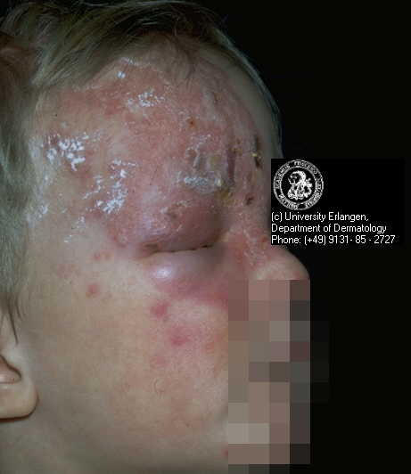
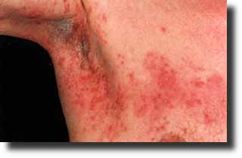
VARICILLA ZOTER

Slide 26
VZV Diagnosis
Clinical picture
Viral culture
PCR
Serology

Slide 27
VZV treatment
Acyclovir
Valacyclovir
Famciclovir
Prevention
VZV vaccination
VZV immunoglobulin (VZIG)

Slide 28
Cytomegalovirus (CMV)
The largest virus that infects human beings
World wide distribution
Latency after primary infection
Infection ranges from asymptomatic to severe multisystemic disease

Slide 29
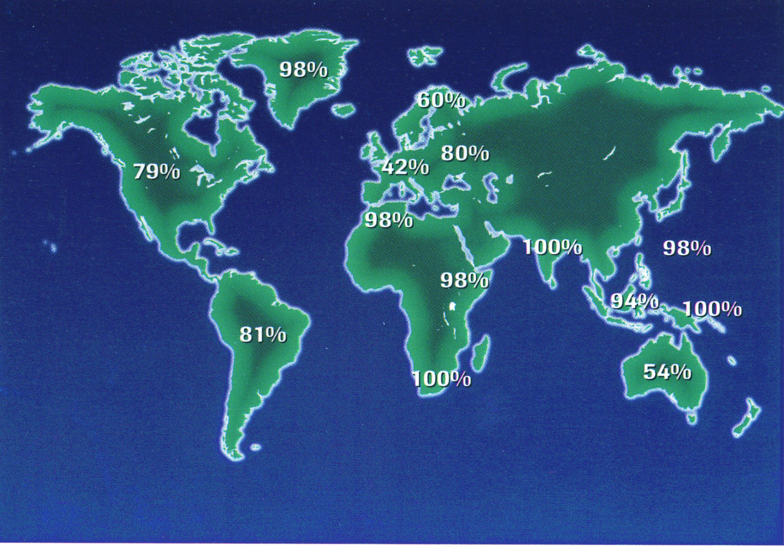
CMV
Seroepidemiology

Slide 30
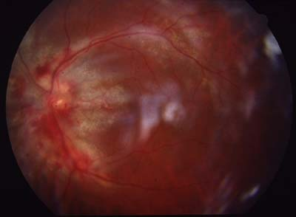
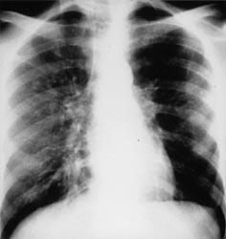
Cytomegalovirus (CMV)
Primary infection
Asymptomatic
Infectious mononucleosis
Secondary infections in Immunocompromised patients:
Pneomonitis
Retinitis
Colitis
Multisystem

Slide 31
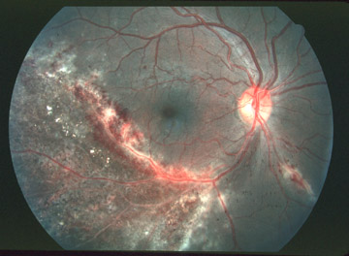
CMV Retinitis

Slide 32
Cytomegalovirus (CMV)
Diagnosis
Diagnosis almost always depends on laboratory confirmation and cannot be made on clinical grounds alone.
♦Viral cultures from blood ,urine ,tissue.
♦Serologic tests (antigen detection)
♦ PCR

Slide 33
Cytomegalovirus (CMV)
TREATMENT
ganciclovir
foscarnet
cidofovir

Slide 34
Epstein-Barr Virus (EBV)
Ubiquitous human herpes virus.
By adulthood 90 to 95% of most populations are positive.
Spread occurs by intimate contact between susceptible individuals and asymptomatic shedders of EBV.
Mostly causes asymptomatic infections.
Strong association with African Burkitt's lymphoma and Nasopharyngeal carcinoma.

Slide 35
Epstein-Barr Virus (EBV)
Infectious mononucleosis
Clinical
Fever, Sore throat ,Lymphadenopathy
Hematologic
>50% mononuclear cells
>10% atypical lymphocytes
Serologic
Transient appearance of heterophile antibodies (weak antibodies)
Permanent emergence of antibodies to EBV

Slide 36
Epstein-Barr Virus (EBV)
Diagnosis:
Heterophile Antibodies (monospot test) 70–92% sensitivty and 96–100% specificity
Hematologic Findings
Lymphocytosis, neutropenia , thrombocytopenia
EBV specific antibodies

Slide 37
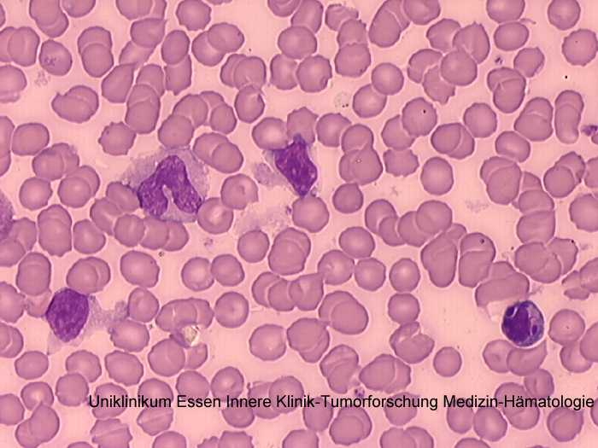
EBV Infection
Atypical Lymphocytes

Slide 38
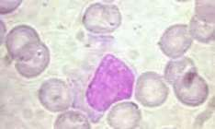
EBV Infection
Atypical Lymphocytes

Slide 39
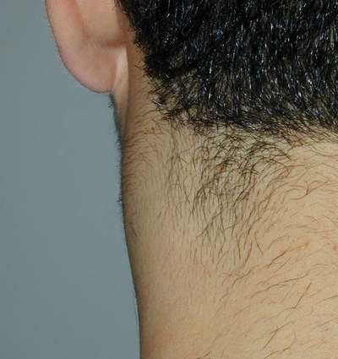
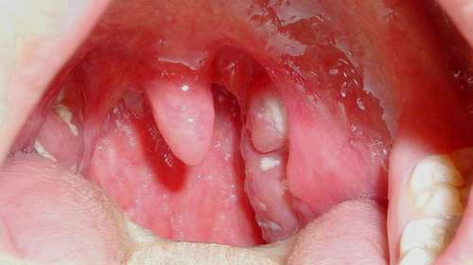
EBV Infection

Slide 40
Epstein-Barr Virus (EBV)
Treatment:
Treatment of infectious mononucleosis is largely supportive because more than 95% of the patients recover uneventfully without specific therapy
Corticosteroids

Slide 41


