Slide 1
Movement Disorders

Slide 2
Abnormality of movement
Hyperkinetic
Myoclonus
Chorea
Hypokinetic
Bradykinesia
Tremor
Dystonia
Others

Slide 3
definitions
Chorea: Involuntary movements resulting from a continuous flow of random muscle contractions.
Dystonia: Dystonia is a movement disorder characterized by sustained or intermittent muscle contractions causing abnormal, often repetitive, movements, postures, or both.
Myoclonus: Involuntary single quick contraction of a muscle group (or its inhibition). Can be repeated but not rhythmic.
Tremor: Involuntary rhythmic oscillatory movement around a joint axis
Bradykinesia: Involuntary slowness of movement

Slide 4
Parkinsonism: Features of rigidity, bradykinesia, rest tremor
Parkinson’s Disease: The most common condition to present with parkinsonism
Core features of Parkinsons disease: rigidity, bradykinesia, rest tremor +/- Postural instability.
PD occurs due to the loss of substantia nigra dopamine releasing neurons.

Slide 5
Rigidity
Abnormally increased resistance to movement that is independent of the velocity of the movement.

Slide 6
Bradykinesia
Slowness of initiation with progressive reduction in speed and amplitude of repetitive action

Slide 7
Parkinsonian tremor
4-6 Hz
Predominantly rest
Re-emergence with maintained posture
Increases with mental concentration

Slide 8
Non-motor symptoms Seen in Parkinson’s Disease
REMBD
Anosmia
Depression/anxiety
Autonomic dysfunction
Hallucinations
Cognitive impairment

Slide 9
Parkinsonism and ……
Impaired vertical gaze→Progressive Supranuclear Gaze Palsy
Involvement of other neurological systems (cerebellar signs and severe autonomic dysfunction) →Multiple System Atrophy
Cortical impairments (Sensory: Astereognosis, agraphesthesia, apraxia) →Corticobasal degeneration
Upper motor neuron signs → Vascular Parkinsonism
Drug induced Parkinsonism (ALWAYS ask about medication history, eg: metoclopramide and neuroleptics)

Slide 10
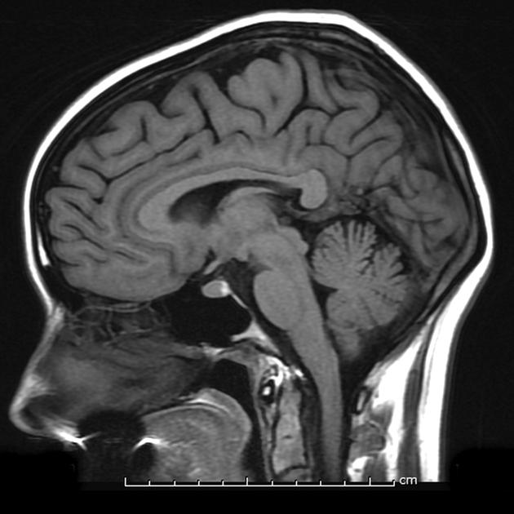
Investigations
Investigations and Imaging is normal in typical PD
Diagnosis is clinical

Slide 11
Management of PD
Levodopa/Carbidopa (LD/CD)
Dopamine agonists (Pramipexole, rotigotine)
MAO B inhibitor (Selegeline, rasagaline)
COMT inhibitors (Entacapone)-Prolongs activity of LD in blood
Amantadine
Anticholinergics
Deep brain Stimulation-Used in (LD/CD responsive patients)

Slide 12
Red Flags
If present suspect conditions other than PD:
Neuroleptic/anti-emetic drug use
Early/prominent autonomic dysfunction
Limited eye movements
Pyramidal, cerebellar or sensory symptoms
Cognitive impairment

Slide 13
Essential tremor
Most common movement disorder
Slowly progressive action tremor, disappears at rest
Worse with physical activity, caffeine, stress
May temporarily improve after alcoholic beverages
Hereditary, autosomal dominant
Responds well to propranolol

Slide 14
Other disorders
Chorea commonly associated with Huntington's disease and Seydenham’s chorea
Dystonia, could be generalized or focal, could be lesional, drug or idiopathic
Ballismus, a large amplitude choreaform movement, seen after subthalamic strokes usually
Myoclonus, seen during encephalopathies or drug related

