Slide 1
Introduction to SPA
Dr. Mohamed Kamel Bedaiwi
Rheumatology consultant King Khalid University Hospital

Slide 2
Introduction
SpA disease information Pathogenesis
Clinical features

Slide 3
Miss diagnosed

Slide 4
We must (early diagnose)

Slide 13
Pathogenesis of spondyloarthritis

Slide 14
Pathogenic mechanisms of new bone formation
Genetic influences
Microbes effects
Biomechanical stress

Slide 15
Pathogenic mechanisms of new bone formation
The cause of AS is not completely understood
Theory → genetic mechanisms →major role in to AS.
Genome-wide studies have NOT revealed strong insights on the pathogenesis of new bone formation in AS

Slide 16
Genetic influences
The major gene product associated with AS and the other forms of SpA is human leukocyte antigen (HLA)-B27.
(HLA)-B27 gene was recognized in 1973.
HLA-B27 is present in about 80 to 95 percent of patients with AS in most ethnic groups.
6 percent of the general population.
Fewer than 5 %of HLA-B27 carriers in the general population develop disease
Brown MA, Kennedy LG, MacGregor AJ, Darke C, Duncan E,et al. Susceptibility to ankylosing spondylitis in twins 489, Page 6 of 9 Curr Allergy Asthma Rep (2015) 15:489 genes, HLA, and the environment. Arthritis Rheum. 1997;40:1823–8.

Slide 17
Genetic influences
Many genes other than HLA-B27.
First-, second-, and third-degree relatives of patients with AS have markedly increased risks of developing the disease (relative risks of 94, 25, and 4, respectively)

Slide 18
Axial-SpA Features
SIJ MRI
Eye inflammation
Crohn’s/ Colitis
Neck Stiffness
Inflammatory Back Pain (IBP)
Psoriasis
Good response to NSAIDs
Alternative Buttock Pain
X-Ray - Sacroiliitis
Peripheral Arthritis
Dactylitis Enthesitis
Age at onset < 45 years
Family History of SpA
Elevated CRP levels
• +ve HLA-B27
AS
Nr Ax-SpA

Slide 21
Peripheral arthritis
Predominantly involves the lower extremities.
Arthritis is frequently asymmetrical and often affects only one to three joints.
The severity ranges from mild to disabling .
The presence of asymmetrical oligoarthritis is very suggestive of SpA, but its absence would not be helpful in excluding this possibility.

Slide 25
Enthesitis
Relatively specific to SpA
The most common → at the insertion of the Achilles tendon
Plantar fascia ligament into the calcaneus
severe pain and tenderness

Slide 28
Dactylitis
known sausage toe or sausage finger
Psoriatic arthritis
Occasionally reactive arthritis
Unlike synovitis, in which swelling is confined to the joints, with dactylitis, the entire digit is swollen.
Dactylitis is not specific for SpA and may also be seen
tuberculosis
syphilis
sarcoidosis
sickle cell disease
tophaceous gout

Slide 33
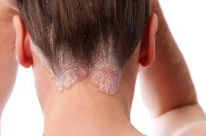
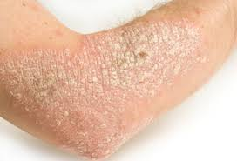
Psoriasis
Psoriasis is associated with all forms of SpA.
Psoriasis is present in up to approximately 10 percent of patients with AS.

Slide 34
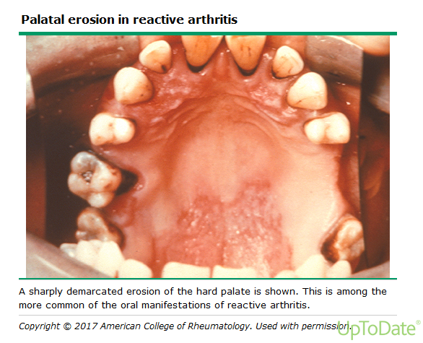

Slide 37
SpA LAB
HLA-B27
90 percent of patients with ankylosing spondylitis
50 to 70 percent of patients with other forms of SpA
a positive HLA-B27 by itself is not diagnostic of SpA
Acute phase response
Erythrocyte sedimentation rate (ESR) and levels of C-reactive protein (CRP
increased in between 35 and 50 percent of patients with axial SpA
Elevated levels of CRP are also a predictor of radiographic progression and for a good response to tumor necrosis factor (TNF)-blocker therapy

Slide 47
