Slide 1
Dr. Awadh Al-Anazi 1439-2018
MALARIA & TRAVEL MEDICINE

Slide 2
EDUCATIONAL OBJECTIVES
At the end of this lecture students are expected to know:
Epidemiology & Etiology
Clinical presentation
Risk to travelers
Malaria and pregnancy
Diagnostic work up
Treatment & prophylaxis

Slide 3
ETIOLOGY
4 plasmodia:
• P. Falciparum
• P. Vivax
• P. Ovale
• P. Malariae

Slide 4
EPIDEMIOLOGY
Endemic disease
Usually does not occur at altitudes – 1500 m
World wide ease of travel
Most important parasitic disease of humans
Transmitted in over 100 countries
Affecting more than 3 billion people world wide
Causing 1-2 billion deaths per year

Slide 5
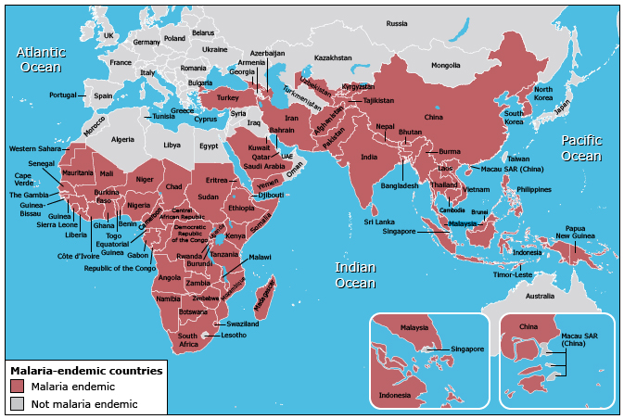

Slide 6
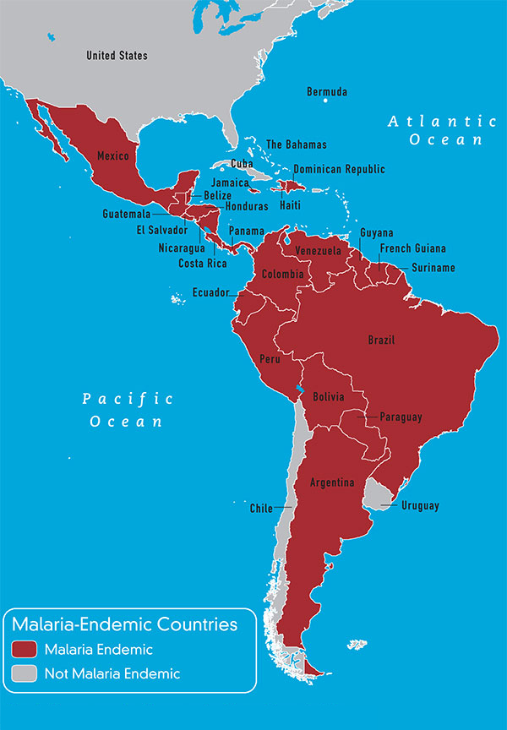

Slide 7
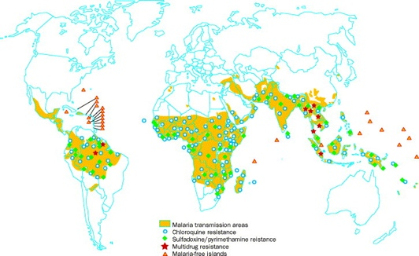

Slide 8
PATHOGENESIS
P.F. invades RBC at all ages
P. Mal: only old RBC
P. ovale and P. vivax invade young RBC’s.
Microvascular patholody: secondary Ischemia Adherence of
Non-deformable parasitezed RBC to endothelium
Renal failure: hemalysis, Ischemia secondary microvascular pathology
Deep Coma: hypoglycemia, microvascular adherent parasitized RBC
Pulmonary edema; 2 o: Capillary leak Synd (without C.C.F.)
Immune complex Neph. Syndrome 2 o P. Malariae

Slide 9
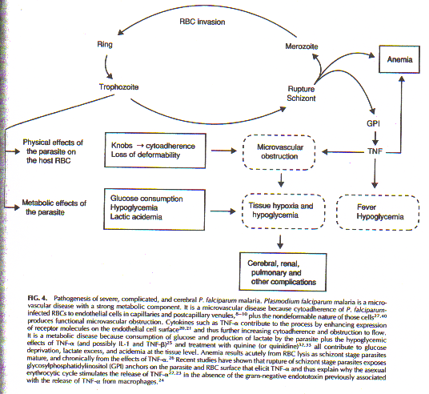

Slide 10
CLINICAL FEATURES
CF vary with:
Geography
Epidemiology
Age
High risk includes
Children
Pregnant women
Non-immune travelers to malarious areas

Slide 11
INCUBATION PERIOD
Sporozoites reach the liver within 1-2 hours following female Anopheles mosquito bite.
Pt. asymptomatic for 12-35 days until RBCs stage of parasite life cycle.

Slide 12
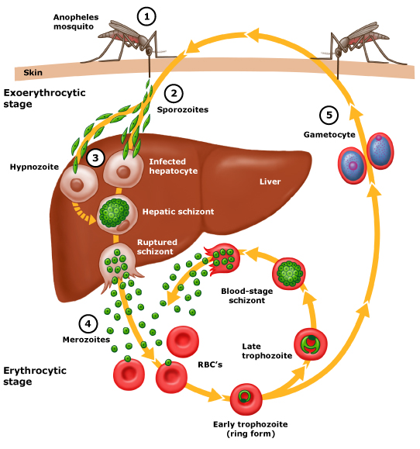
LIFE CYCLE

Slide 13
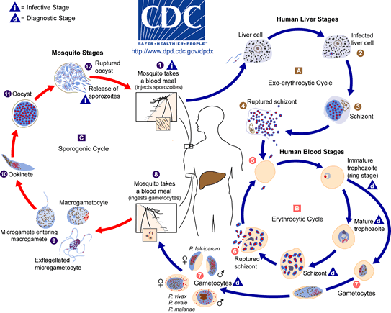

Slide 14
CLINICAL FEATURES
Major
· Recurring fevers
· Chills (Assoc. RBC lysis – mature zchisonts)
2) Periodicity S/O
· 48 hours: P. Vivax & Ovale
· 72 hours: P. Malaria
· Non-regular/hectic in P.F. especially in non- immune
- Patients (who are at highest risk of complications and death)

Slide 15
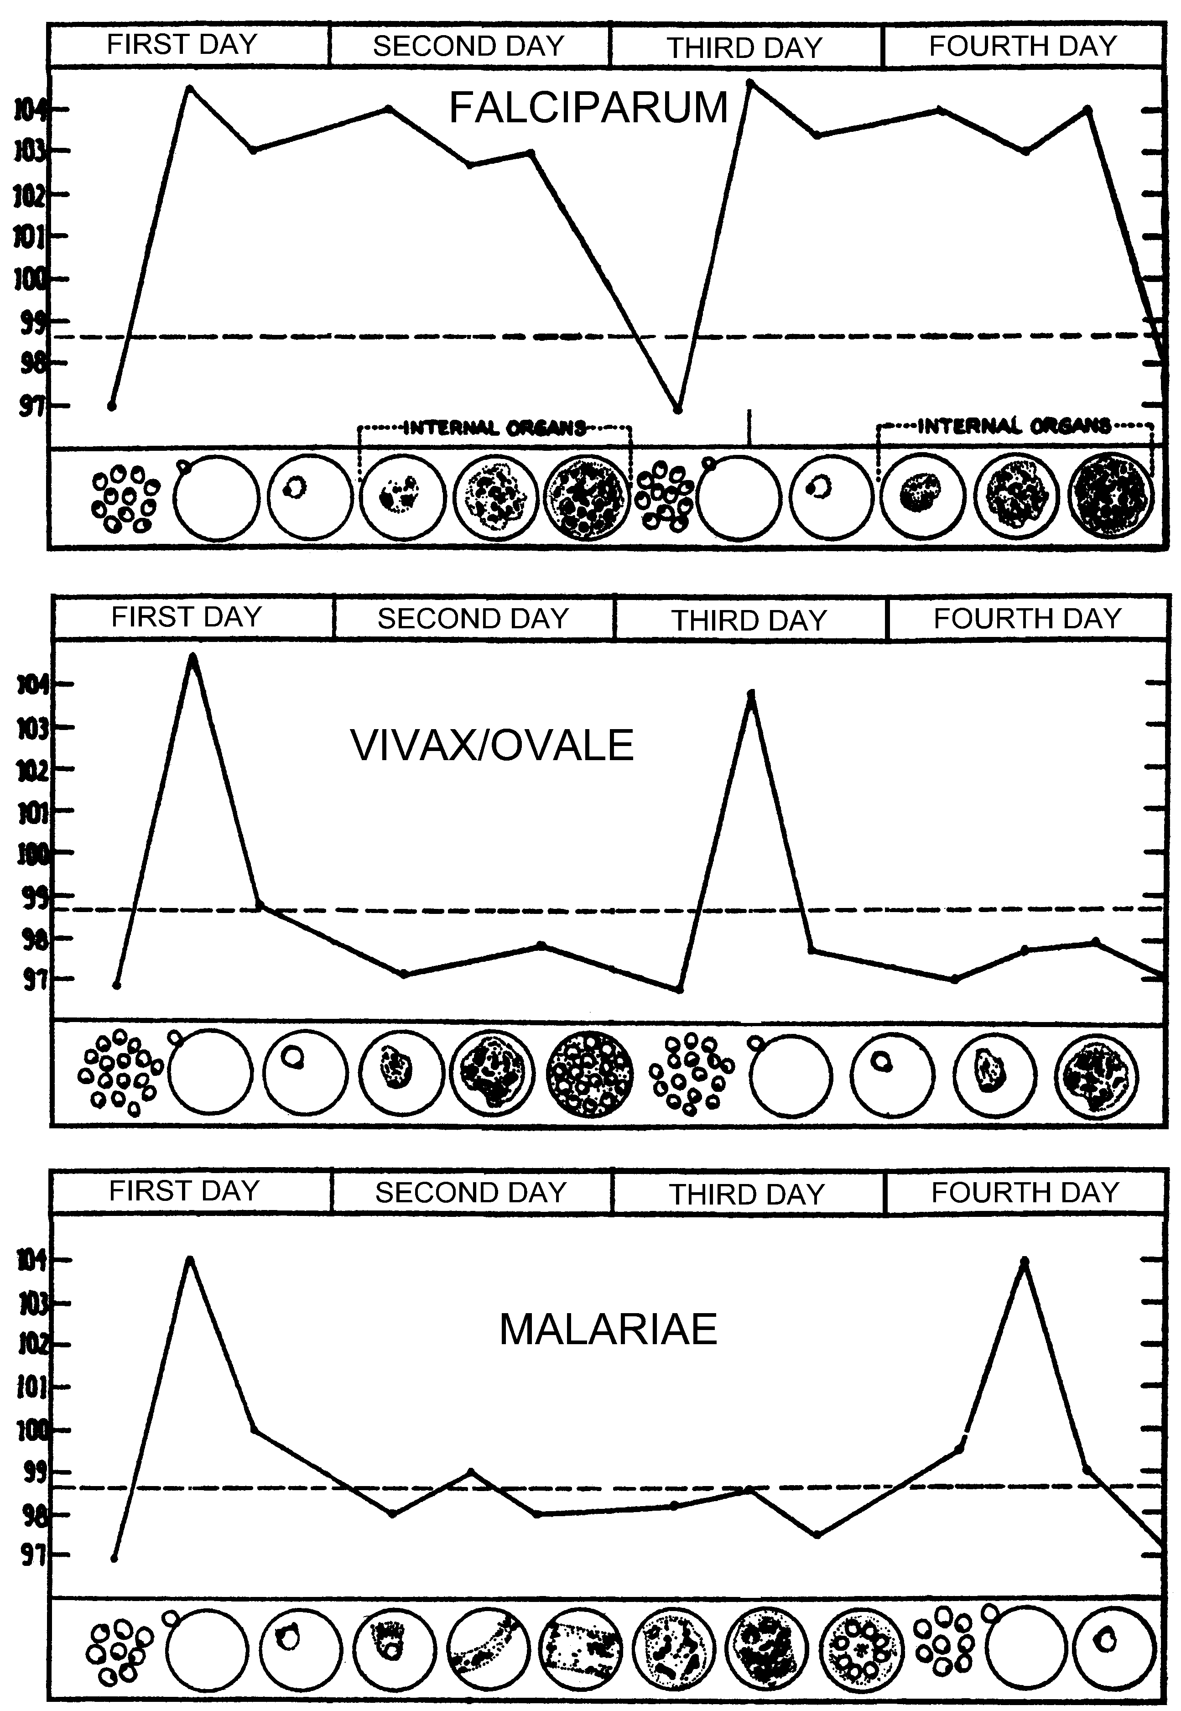
Malaria Paroxysm
paroxysms associated with synchrony of merozoite release
between paroxysms temper-ature is normal and patient feels well
falciparum may not exhibit classic paroxysms (continuous fever)
tertian malaria
quartan malaria

Slide 16
CLINICAL FEATURES
1) Severe P.F. (> 10 parasite/ mcl): AC Complications
· Renal failure
· Coma 2 o: hypoglc; TNF, or microvascular pathology
· Pul. Edema
· Thombrocytopenia
· G. Enteritis – especially diarrhea
· Ch. P. Falcuparum infection
Splenomegaly – typically resolves after treatment with anti-malarial meds. 6-12 mon.
· P. Malariae assoc. Immune compl. N. Synd.
· P. Vivax – late splenic rupture with trauma 1-3 mon. after
initial infection

Slide 17
MALARIA FEVER PAROXYSMS
Rigors, headache
associated with pale cold skin
(1-2 hours)
I
Delirium, Tachypnoea,
Hot Skin
(Several hours)
II
III
Fever
Marked sweating and fatigue
Patient often symptoms free between paroxysms

Slide 18
DIAGNOSIS
Detailed targeted history including travel hx and clinical examination together with:
High Index of Suspicion (HIS)

Slide 19
DX: Blood film stained with
Giemsa stain or wright’s stain
Correct identification of malarial Spp is essential for treatment because of P. Falciparum R to Chloroquine&others
On Giemsa stain – Cytoplasm: light blue, nucleus: dark blue
In P.F
(a) only ring stage a sexual parasite and gametocytes seen in periph. Blood.
(b) While RBC with Trophozoites or Schixonts stage – sequestered in peripheral, Microvasculature, and NOT circulating P-blood.
All asexual erythrocytic stages of P. Vivax, Ovale & malariae circulate in peripheral blood, thus seen on Blood Smear
Acutely ill patients
DDX: P.F. vs P. Vivax, because
(a) P. Ovale – Vivax – clinical, morphological
(b) P. malariae - ch. Infeciton

Slide 20
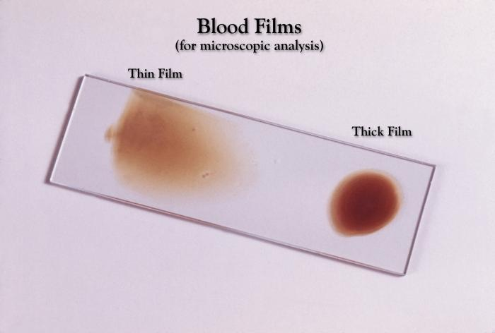

Slide 21
Thin blood film (RBC morphology preserved):
P. Vivax; infected RBC
RBC enlargement with parasite maturation
Scuffner’s dots (eosinophilic dots in RBC cyto.)
May see Maurer’s clots in RBC eytoplasm
Infection with more than one parasite spp: 5-7%
Thick Blood Film (RBC lysed)
You may examine 10X. Blood more than in thin film
More diagnostic in lower degree of parasitemias
Serology: not useful in managing acutely ill patient
DNA probe: similar thick film sensitivity

Slide 22
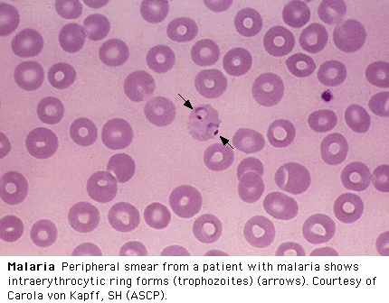

Slide 23
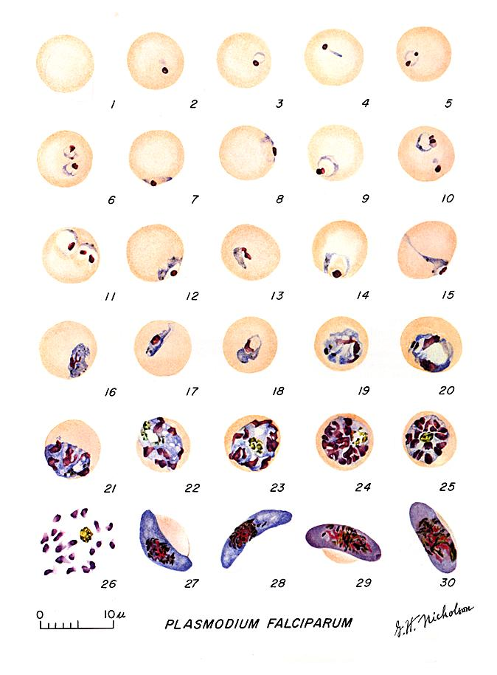
Plasmodium falciparum: Blood Stage Parasites Thin Blood Smears
1: Normal red cell
2-18: Trophozoites
( 2-10: ring-stage trophozoites)
19-26: Schizonts ( 26 is a ruptured
schizont)
27, 28: Mature macrogametocytes
(female)
29, 30: Mature microgametocytes
(male)

Slide 24
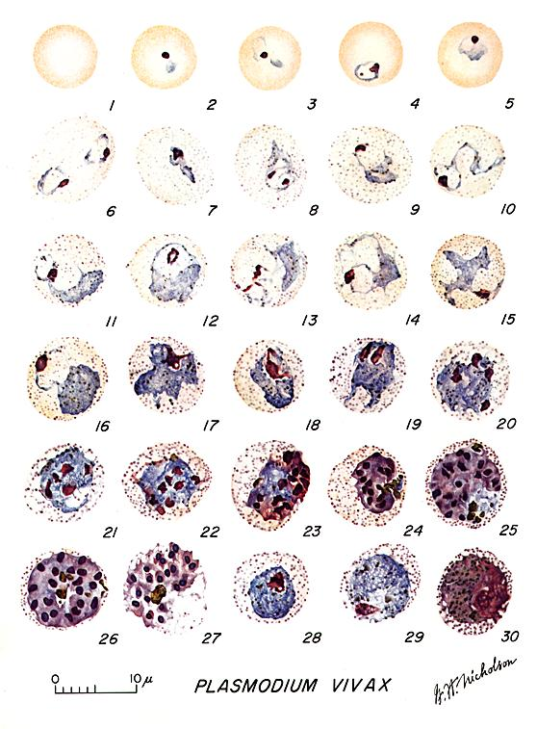
Plasmodium vivax: Blood Stage Parasites Thin Blood Smears
1: Normal red cell
2-6: Young trophozoites
(ring stage parasites)
7-18: Trophozoites
19-27: Schizonts
28,29: Macrogametocytes
(female)
30: Microgametocyte
(male)

Slide 25
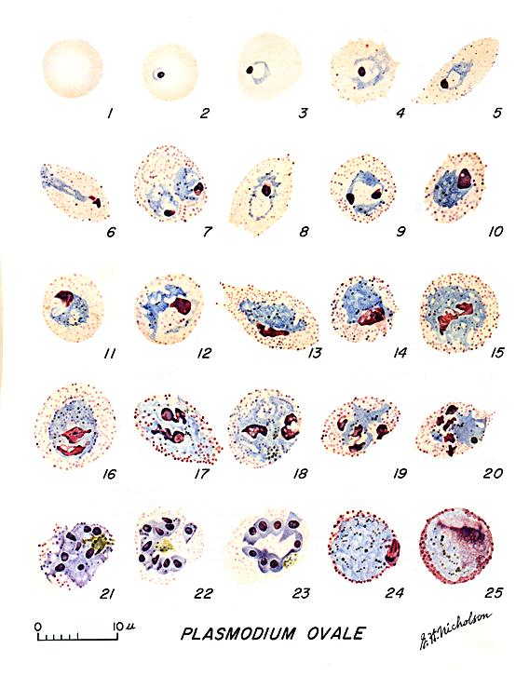
Plasmodium ovale: Blood Stage Parasites Thin Blood Smears
1: Normal red cell
2-5: Young trophozoites
6-15: Trophozoites
16-23: Schizonts
24: Macrogametocytes
(female)
25: Microgametocyte
(male)

Slide 26
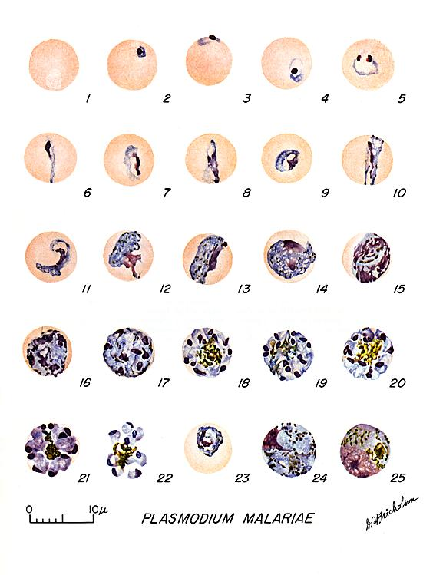
Plasmodium malariae: Blood Stage Parasites Thin Blood Smears
1: Normal red cell
2-5: Young trophozoites
(rings)
6-13: Trophozoites
14-22: Schizonts
23: Developing
gametocyte
24: Macrogametocyte
(female)
25: Microgametocyte
(male)

Slide 27
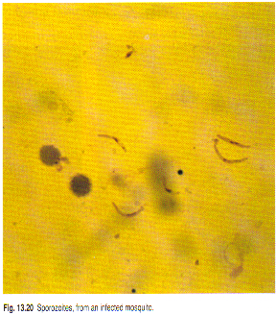
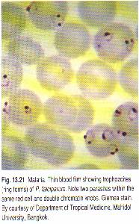

Slide 28
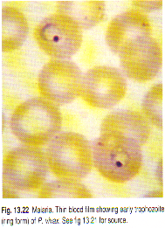
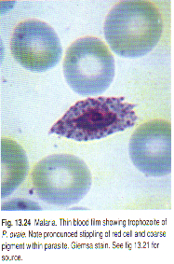

Slide 29
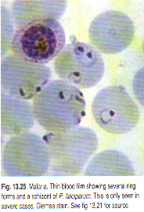
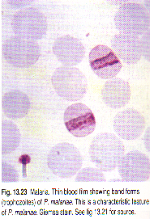

Slide 30
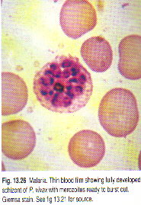
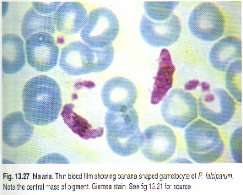

Slide 31
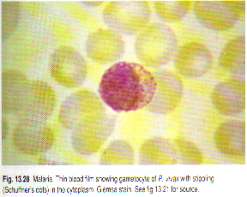
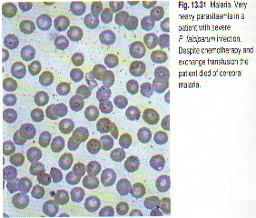

Slide 32
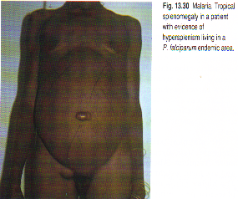
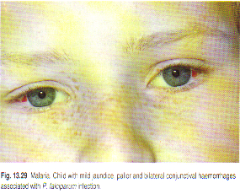

Slide 33
DIFFERENTIAL DIAGNOSIS OF MALARIA IN ACUTELY
III PATIENTS BASED ON P.B. SMEAR
P. Vivax
P. Falciparum P. Ovale
Multiply Infected RBC Common Rare
Mature (Trophozoite and schizont) parasites Absent Common
RBC enlargement with later parasite stages Absent Common
Mature (trophozoites & schizont) stage P. falciparum. Typically sequestered in
the peripheral microvasculature.
RBC enlargement in P. vivax typically occurs with later stage parasites that do not
circulate in P. falciparum infection.

Slide 34
MALARIA COMPLICATIONS
Depth of coma
Temp
Vomiting Do not modify outcome
Seizures
Parasite load
Anemia
HIV infection did not affect clinical or biological presentation of cerebral malaria and appears not to affect outcome.
(Niyongabo et al, Acta Tropica Apr 1994)

Slide 35
RISK FACTORS FOR POOR PROGNOSIS IN CEREBRAL MALARIA
Creatinine
Bilirubin
Lactates

Slide 36
MALARIA COMPLICATIONS
Major clinical features of malaria are those of the complications.
Majority of complications (apart from anemia) associated with P. Falciparum)

Slide 37
MALARIA COMPLICATIONS
Majority of complications (apart from anemia) associated with P. falciparum
* Anemia: presents in most severe infections and parallels
parasitaemia
Hemolysis of infected RBC
Delayed retics. release from BM
Immune – mediated hemolysis of non-infected RBC

Slide 38
MALARIA COMPLICATIONS
Majority of complications (apart from anemia) associated with P. falciparum
Non-immune: (primary infection)
Haemoglobinuria
Black water fever
Exaggerated haemolytic response to quinine – sensitized RBC

Slide 39
MALARIA COMPLICATIONS
Majority of complications (apart from anemia) associated with P. falciparum
Mild unconjugated jaundice common, and parallels hemolysis. Hepatocellular dysfunction may contribute to jaundice.

Slide 40
MALARIA COMPLICATIONS
Majority of complications (apart from anemia) associated with P. falciparum.
Tissue hypoxia related complications
Hypoxia results from altered microcirculation + anemia.
Maturation of erythyrocyte schizonts in P. falciparum takes
place in tissue capillaries and venules.
P. falciparum parasitized RBC sequestered in micro circulation
because:
Altered deformability of parasitized RBC
Adhesion involving parasite – derived proteins within RBC and glycoproteins on vascular endothelium.

Slide 41
Cerebral Malaria
à Most severe common complication
Renal Failure
à Most severe common complication
à ATN
à Dehydration
à Hypotension
à Hypervescosity
Pulmonary Edema
à ARDS – may complicate acute phase of severe malaise. Fluid overload may contribute.

Slide 42
Hypoglycemia
à Glucose consumption
à Lactic acidosis
à Quinine/quinidine --- insulin secretion
Bleeding
à Thrombocytopenia
à Consumption coagulopathy
Shock: Endotoxemia
Diarrhea
Hyponatremia (? SIADH)

Slide 43
LATE COMPLICATION
Tropical splenomegaly in P. Falciparum endemic areas.
N. syndrome with P. malariae.
Burkett’s lymphoma (PF - EBV)

Slide 44
MALARIA & PREGNANCY
à Mortality
à Anemia, hypoglycemia, pulmonary edema: > common
à Abortion
à Stillbirth
à Premature delivery high infant mortality
à LB wt.
à Placental insufficiency
à High parasitaemia - ? placenta favorable site for P. falciparum.

Slide 45
CONGENITAL MALARIA
Transplacental infection
Can be all 4 species
Commonly P.v. and P.f. in endemic areas
P.m. infections in nonendemic areas due to long persistence of species
Neonate can be diagnosed with parasitemia within 7 days of birth or longer if no other risk factors for malaria (mosquito exposure, blood transfusion)
Fever, irritability, feeding problems, anemia, hepatosplenomegaly, and jaundice
Be mindful of this problem even if mother has not been in malarious area for years before delivery

Slide 46
MALARIA AND
HEMOGLOBINOPATHIES
Heterozygous sickle cell train children less likely to contract P. falciparum
C.S. disease: no such protection, rather mortality is higher > normal
Thalassemics: partially protected (? Fetal Hb)
G-6-phosphatase RBC : less prone to P. falciparum.

Slide 47
Principles of Treatment
Treatment should be guided by three main factors (CDC):
The infecting Plasmodium species
The clinical status of the patient
The drug susceptibility of the infecting parasites as determined by the geographic area where the infection was acquired and the previous use of antimalarial medicines

Slide 48
If treatment must be initiated before the species is known treat as P .falciparum
P falciparum should be presumed to be chloroquine resistant, except in a few areas of Central America and the Middle East
Primaquine should be given if Plasmodium vivax or Plasmodium ovale is likely

Slide 49
RESISTANCE PATTERNS
-Chloroquine-resistant P falciparum:
Eastern Hemisphere: All of sub-Saharan Africa, Saudi Arabia, Yemen, Iran, Pakistan, Afghanistan, China, Nepal, and all of Southeast Asia
Western Hemisphere: Panama, Haiti, Brazil, Peru, Bolivia, Colombia, Venezuela, Ecuador, French Guiana, Guyana, and Suriname
-Chloroquine-sensitive P falciparum:
Eastern Hemisphere: Turkey, Iraq, Syria, Georgia, Azerbaijan, Tajikistan, Turkmenistan, and Kyrgyzstan
Western Hemisphere: Argentina, Paraguay, Mexico, Guatemala, Costa Rica, Honduras, Nicaragua, El Salvador, and Dominican Republic
-Mefloquine-resistant P falciparum:
Southeast Asia: Regions of Vietnam, Laos, Thailand, Burma, and Cambodia
-Chloroquine-resistant P vivax:
Papua New Guinea and Indonesia

Slide 50
TREATMENT
Uncomplicated P falciparum infection :
Artemether-Lumefantrine or,
Atovaquone-proguanil or,
Quinine or,
Mefloquine.
Uncomplicated Plasmodium malariae, Plasmodium knowlesi, or chloroquine-sensitive P falciparum infection:
Chloroquine phosphate or,
Hydroxychloroquine.
Uncomplicated P vivax or P ovale infection, expected to be chloroquine-susceptible:
Chloroquine phosphate or,
Hydroxychloroquine.

Slide 51
Uncomplicated P vivax infection, expected to be chloroquine-resistant:
Quinine or,
Atovaquone-proguanil or,
Mefloquine or,
Amodiaquine.

Slide 52
COMPLICATED MALARIA
Quinidine gluconate 10 mg/kg loading dose over 1-2h, then 1.2 mg/kg/h for at least 24h
Once parasitemia is < 1% and patient can take oral medication, switch to quinine 650 mg PO TID to complete 3-d course (7-d course if malaria was acquired in southern Asia)
In addition, give doxycycline 100 mg IV or PO BID for 7d.
For pregnant women, instead of doxycycline, give clindamycin 20 mg base/kg/day PO divided TID for 7d

Slide 53
CHEMOPROPHYLAXIS
Atovaquone-proguanil or,
Chloroquine phosphate or,
Doxycycline or,
Mefloquine or,
Primaquine.

Slide 54
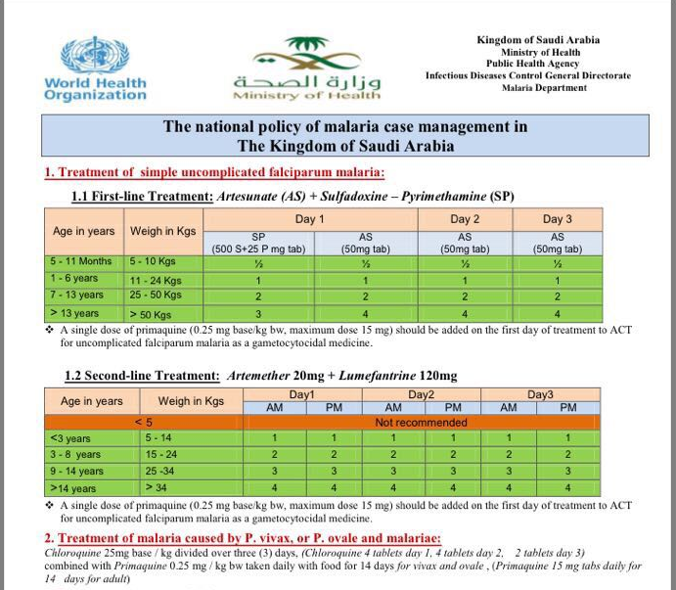

Slide 55
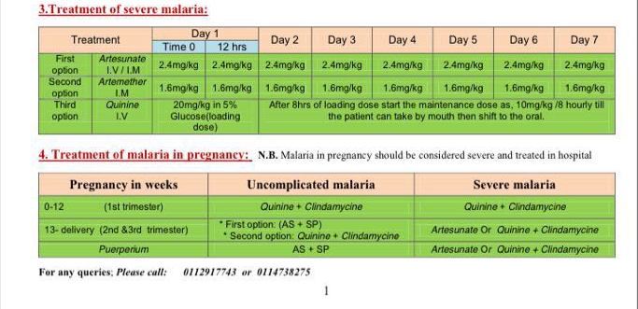

Slide 56
Additional Supportive Measures
Blood Tx / Exchange Tx
Hypoglycemia treatment and prophylaxis especially in
pregnant women.
Avoidance of IVF overload
Dialysis
Heparin for consumption coagulation
Pregnant woman should receive prophylaxis
Non-immune travelers

Slide 57
Other Measures in Treating Severe Malaria
1) Antibodies against TNF - α
→ they fever
→ but no effect on mortality & morbidity
→ ? reason
Effects of other cytokines as IL – 1, TNF- β
On pathogenesis of complicated severe malaria

Slide 58
Other Measures in Treating Severe Malaria
2) Steroids
- Harmful by controlled trials
- Dexamethasone longer duration of coma + worse outcomes than patient receiving quinine alone (NEWJ 1982, Warrel et al)
3) Reducing mosquito – human contact
4) Malaria vaccine

Slide 59
FUTURE PERSPECTIVE
• Success to control or eradicate malaria faced by obstacles:
o Increasing drug resistance in P. falciparum and
appearing ( R ) in P. vivax
o Basis of protection against infection and disease not
understood.
o Biologic basis of vector capacity responsible for
mosquito-borne malaria transmission is unknown.
o Increasing anopheline mosquito resistance to
insecticide.

Slide 60
Further Extra Reading
The following are for interested readers.

Slide 61
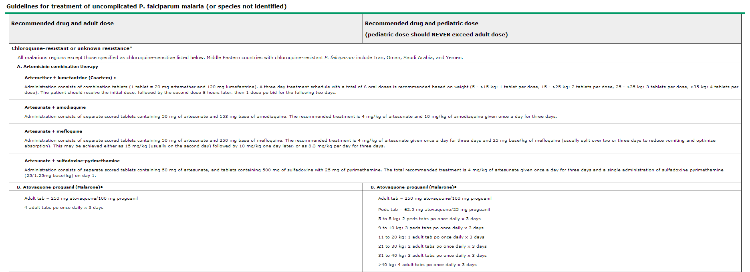

Slide 63
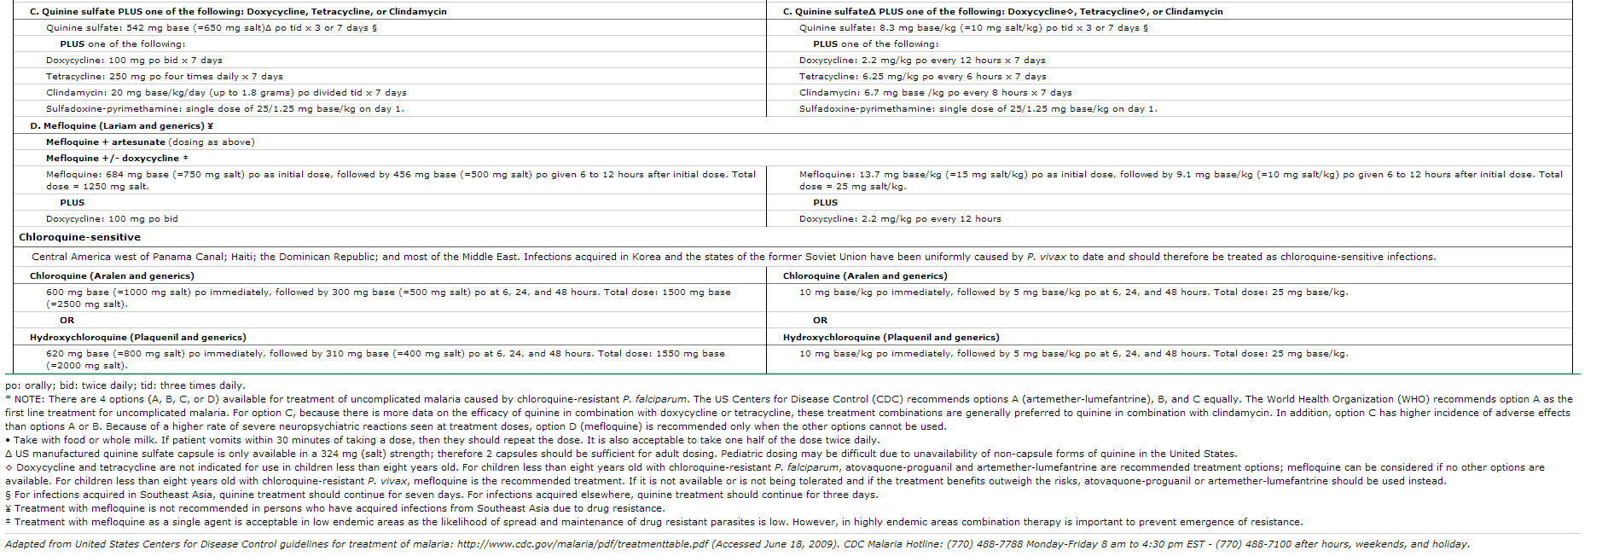

Slide 64
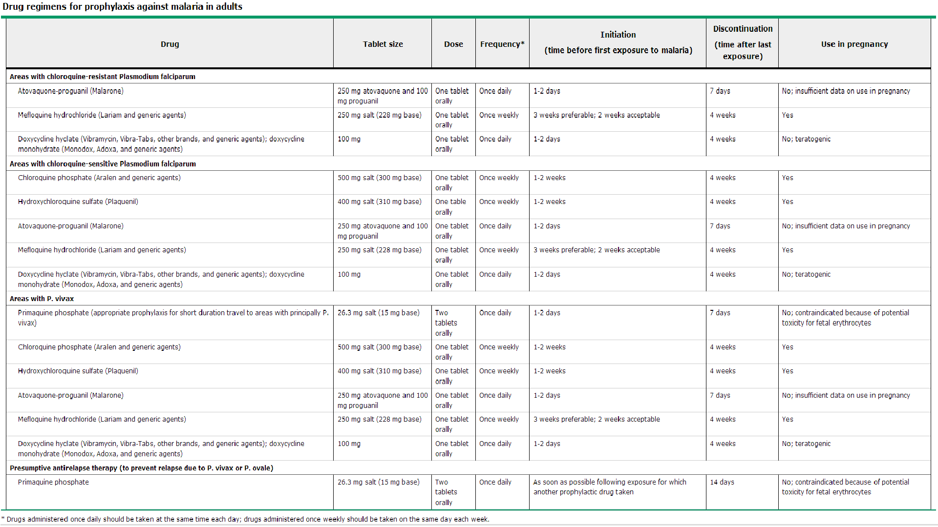

Slide 66
THANK YOU

