Slide 1
Multiple sclerosis
Nora Alfugham
Consultant Autoimmune Neurology
King Khalid University Hospital

Slide 2
Jean- MARTIN charcot: The Father of Neurology
“To take away from neurology all discoveries made by charcot would be to render it unrecognizable”
Joseph Babiinski

Slide 3
Multiple Sclerosis
An inflammatory demyelinating disease of the CNS where there is:
Dissemination in space
Dissemination in time
No alternative neurologic disease
MS is a clinical diagnosis, no laboratory test in isolation confirms the diagnosis of multiple sclerosis

Slide 4
Immunopathology
several basic processes drive the formation of plaques:
inflammation,
myelin breakdown,
Astrogliosis and oligodendrocyte injury
neurodegeneration and axonal loss,
remyelination

Slide 5
Immunopathology
The pathologic hallmark of multiple sclerosis (MS) is multiple focal areas of myelin loss within the CNS called plaques or lesions
Demyelination is accompanied by variable gliosis and inflammation and by relative axonal preservation
Demyelination with relative axonal sparing is important for the diagnosis of demyelinating lesions, (whereas an infarct is more likely if axons and myelin in lesions are depleted to the same extent)
acute axonal injury occurring in early multiple sclerosis lesions likely contributes to the relapse-related disability observed predominantly during the inflammatory disease phases

Slide 6
Immunopathology
Despite relative axonal sparing, axonal injury does occur, evidenced by the presence of axonal swellings (irregularly swollen axons with a beaded appearance), accumulation of amyloid-" precursor protein (a marker of focal accumulations of proteins that are typically moved along axons by fast axonal transport), and mild axonal loss.
The extent of axonal damage in active lesions correlates significantly with the number of lymphocytes and activated microglia

Slide 7
immunopathology
Extensive remyelination, illustrated by the presence of newly formed myelin sheaths and oligodendrocyte precursor cells, is frequently encountered within active plaques of early multiple sclerosis

Slide 8
Immunopathology
T cells comprise approximately 10% of the inflammatory cells populating active demyelinating lesions in MS
Lymphocytic inflammatory infiltrate : mainly CD8-positive cytotoxic T lymphocyte
EAE model can be adoptively transferred by injecting an animal with myelin-specific CD4+ T cells.

Slide 9
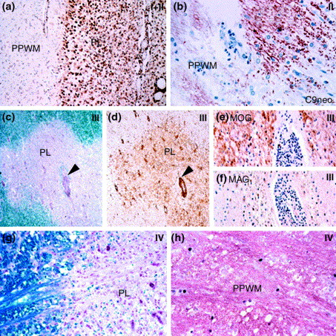
Fig. 2
Trends in Molecular Medicine 2001 7, 115-121DOI: (10.1016/S1471-4914(00)01909-2)
Notes:
Histopathology of different patterns of demyelination in multiple sclerosis. (a) Actively demyelinating lesion following patterns I and II. The active plaque (PL) is filled with activated macrophages and microglia. There is a sharp demarcation between the actively demyelinating lesions and the periplaque white matter (PPWM). Immunocytochemistry for CD68 (to identify activated macrophages/microglia). Magnification×200. (b) Actively demyelinating plaque of pattern II that shows massive deposition of complement C9neo-antigen (brown staining) on degenerating myelin sheaths and in myelin degradation products taken up by macrophages in the zone of active demyelination (ADM). There is faint C9neo reactivity on myelin sheaths in the PPWM. Immunocytochemistry for C9neo-antigen. Magnification×500. (c) Actively demyelinating lesion following pattern III. Myelin staining using Luxol fast blue shows an ill-demarcated demyelinated plaque (PL). In the centre of the lesion is an inflamed blood vessel surrounded by a small rim of preserved myelin (arrow). Magnification×30. (d) The same lesion as shown in (c) stained with the leukocyte marker CD45. Myelin around the central vessel has a lower density of inflammatory cells compared to the rest of the lesion (arrow). In addition, this lesion has an indistinct boundary compared with the lesion in panel (a). Immunocytochemistry for CD45. Magnification×30. (e) Higher magnification of the area indicated by the arrow in panels (c) and (d) stained for myelin-oligodendrocyte glycoprotein (MOG, brown staining). There are numerous MOG-reactive fibers preserved in the lesion. Magnification×300. (f) Higher magnification of the area indicated by the arrow in panels (c) and (d) stained for myelin associated glycoprotein (MAG). There is very little MAG immunoreactivity. Magnification×300. (g) Actively demyelinating lesion following pattern IV. The plaque contains numerous macrophages containing myelin degradation products (stained blue with the Luxol fast blue myelin stain) and has a sharply demarcated edge. Magnification×300. (h) The periplaque white matter of the lesion in (g). The myelin appears vacuolated and contains numerous oligodendrocytes with fragmented DNA (black nuclei) identified using an in situ tailing reaction for DNA fragmentation. Magnification×400.

Slide 12
Immunopathology
Direct proof of an autoimmune response is lacking
No specific autoantibody or autoreactive T cells

Slide 13
Epidemiology
It is the second most common cause of neurological disability in young adults
Female to male ratio 2.3:1
Mean Age of onset 28-31 year (range:15-45 year)
Ethnicity: white population(northern Europe)

Slide 14
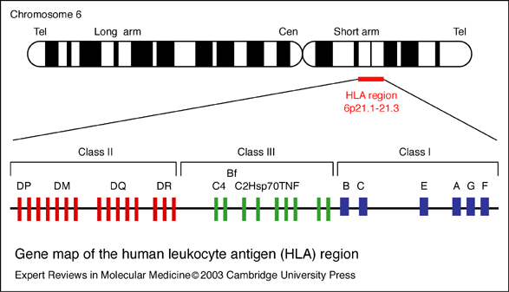
Genetics
Polymorphism of HLA proteins is estimated to account for 17% to 60% of the genetic susceptibility to MS.1
Single nucleotide polymorphisms in the chains of the interleukins 2 (IL-2) and 7 (IL-7) receptors
Notes:
MS susceptibility alleles on chromosome 6, a region that contains the HLA gene complex.

Slide 15
Concordance rate
Dizygotic: 3-5%
Monozygotic: 20%

Slide 16
Environmental Factors

Slide 17
Types of MS

Slide 18
What is Clinical Attack (relapse, exacerbation)?
focal disturbance affecting white matter that last for more than 24 hours and result in functional decline
Preceded by more than 30 days of clinical stability
No better explanation
Role out pseudorelapse

Slide 19
Classic MS symptoms
Sensory symptoms/ lermitte’s phenomena
Vision loss
Eye movement abnormality (internuclear opthalmoplegia)
Bowel and bladder dysfunction
Incoordination
Vertigo & dizziness
Sexual dysfunction
Poly-symptomatic onset

Slide 20
Classic MS symptoms
Fatigue
Heat sensitivity (uthoff phenomena)
Cognitive dysfunction

Slide 21
Optic neuritis
Subacute onset (1-10 days)
Unilateral eye pain accentuated by eye movement (92%)
Mostly unilateral
Median visual acuity 20/60
Afferent pupillary defect

Slide 22
Delayed Visual Evoked Potentials response

Slide 23
Myelitis

Slide 24
myelitis

Slide 25
Myelitis in multiple sclerosis

Slide 26
McDonald Diagnostic Criteria
The McDonald criteria, first developed in 2001 and revised in 2005,and in 2010.
Final revisions of McDonald criteria was in 2017
Diagnosis of “Clinically definite MS” needs demonstration of dissemenination of space and time

Slide 27
Dissemination in space (by MRI brain)
are disseminated throughout the CNS but have a predilection for optic nerves, subpial spinal cord, brainstem, cerebellum, and juxtacortical and periventricular white matter regions
demyelinated lesions are also commonly found in the cortical gray matter of MS patients

Slide 28
Dissemination in space (by MRI brain)
T2 lesion in ≥ 1 of the following locations:
Cortical /Juxtacortical
Infratentorial
periventricular
Spinal cord

Slide 29
Perivenricular (Dawson finger)

Slide 30
Juxtacortical lesion

Slide 31
Infratentorial lesion

Slide 32
Spinal lesion

Slide 33
Corpus callosum lesion

Slide 34
Dissemination in time (MRI)
simultaneous presence of gadolinium-enhancing and non-enhancing lesions at any time
new T2-hyperintense or gadolinium-enhancing lesion on follow-up MRI, with reference to a baseline scan, irrespective of the timing of the baseline MRI

Slide 35
The 2017 McDonald criteria for diagnosis of multiple sclerosis in patients with an attack at onset
 | Number of lesions with objective clinical evidence | Additional data needed for a diagnosis of multiple sclerosis
≥2 clinical attacks | ≥2 | none
≥2 clinical attacks | 1(as well as clear-cut historical evidence of a previous attack involving a lesion in a distinct anatomical location) | none
≥2 clinical attacks | 1 | Dissemination in space demonstrated by an additional clinical attack implicating a different CNS site or by MRI
1 clinical attack | ≥2 | Dissemination in time demonstrated by an additional clinical attack or by MRI§ OR demonstration of CSF-specific oligoclonal bands
1 clinical attack | 1 | Dissemination in space demonstrated by an additional clinical attack implicating a different CNS site or by MRI‡ AND Dissemination in time demonstrated by an additional clinical attack or by MRI§ OR demonstration of CSF-specific oligoclonal bands

Slide 36
Primary progressive MS
1 year of disability progression (retrospectively or prospectively determined) independent of clinical relapse
Plus two of the following criteria:
One or more T2-hyperintense lesions* characteristic of multiple sclerosis in one or more of the following brain regions: periventricular, cortical or juxtacortical, or infratentorial
Two or more T2-hyperintense lesions in the spinal cord
Presence of CSF-specific oligoclonal bands
Notes:
Unlike the 2010 McDonald criteria, no distinction between symptomatic and asymptomatic MRI lesions is required.

Slide 37
Clinically isolated syndrome
A monophasic clinical episode with patient-reported symptoms and objective findings developing acutely or subacutely, with a duration of at least 24 h, with or without recovery, and in the absence of fever or infection; similar to a typical multiple sclerosis relapse (attack and exacerbation) but in a patient not known to have multiple sclerosis.
can be monofocal (reflecting pathology in a single location) or multifocal; the specific manifestations of a clinically isolated syndrome depend on the anatomical location (or locations) of the pathology.
Typical presentations include unilateral optic neuritis, focal supratentorial syndrome, focal brainstem or cerebellar syndrome, or partial myelopathy;

Slide 38
Atypical for CIS
bilateral optic neuritis
complete ophthalmoplegia
complete myelopathy
encephalopathy
headache
alteration of consciousness
meningismus
isolated fatigue.

Slide 39
MS mimicker
Sarcoidosis
Behcet disease
B12 deficiency
Lyme/brucleeosis

Slide 40
Other Disorders
Neuromyelitis Optica (Devic Syndrome)
Relapsing (55%), monophasic (35%)
MRI: cord lesions, chiasmal signal changes
CSF: generally >100 wbc, ↑ protein, rare OCB

Slide 41
Other Disorders
Postinfectious encephalomyelitis or ADEM
Monophasic with preceeding event common (70%)
Most common in children
Altered LOC and seizures common
MRI: bilateral lesions, grey matter involvement

Slide 42
Management of relapsing-remitting multiple sclerosis
Acute attacks (relapses) of MS are typically treated with glucocorticoids (IV methylprednisolone for 5 days).
Indications for treatment of a relapse include functionally disabling symptoms with objective evidence of neurologic impairment.

Slide 43
 | ROUTE | Mechanism of action
Interferon | S/C, IM | Cytokine modulator, decrease expression of matrix metalopproteases
Natalizumab | IV | Alpha-4 integrin monoclonal antibody
Fingolimod | oral | Inhibit egress of lymphocyte from lymph nodes
Dimethyl fumarate | oral | Anti-oxidative, anti-inflammatory
Teriflunamide | oral | Inhibit lymphocytre proliferation (anti-metabolite)
Alemtuzumab | IV | Anti-CD52 (B, T and NK cells)
Ocrelizumab | IV | B cell depletion
Caldribine | oral | Inhibit lymphocytre proliferation (anti-metabolite)
Notes:
Because of the inflammatory nature of early disease as well as the perception that many of the early inflammatory events may occur in the periphery, patients with RRMS are more likely to ben- efit from approved anti-inflammatory therapies, most of which have no bio- availability in the CNS.

Slide 44
Side effects of MS treatment
Injection site reaction (Interferons)
Increase liver enzyme
Lymphopenia
Cardiac conduction abnormalities (fingolimod)
Autoimmunity (alemtuzumab)
Progressive multifocal leukoencephalopathyPML (natalizumab)

Slide 45
Progressive multifocal leukoencephalopathy

Slide 46
Thank you

