Slide 1
Imaging The Musculoskeletal System
Part - 2
Shagran BinKhamis, MBBS, FRCPC, dABR
Assistant Professor & Consultant Musculoskeletal, Vascular & Interventional Radiologist
Radiology & Medical Imaging Department
King Khalid University Hospital

Slide 2
Imaging the Musculoskeletal System 2018
OBJECTIVES
The main focus and objective of this lecture is to help student to be familiar in looking at MSK images and interpreting findings, by learning:
Normal radiological anatomic landmarks
System of analyzing findings
“Where to look & What to look for”
Recognize features of certain disease entity

Slide 3
Imaging the Musculoskeletal System 2018
METABOLIC & ENDOCRINE BONE DISORDERS

Slide 4
Imaging the Musculoskeletal System 2018
CASE NO. 1
54 years- old female with low back pain
X-ray of lumbosacral spine requested

Slide 5
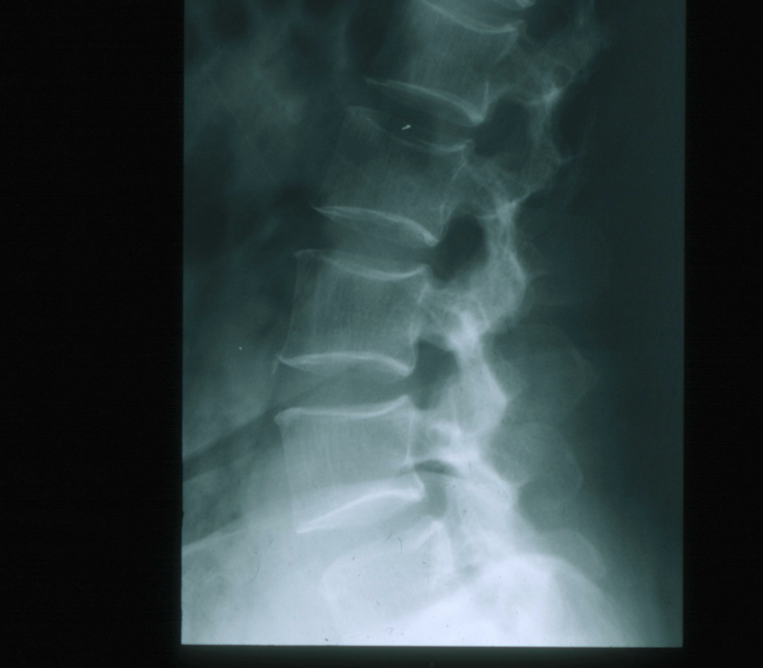
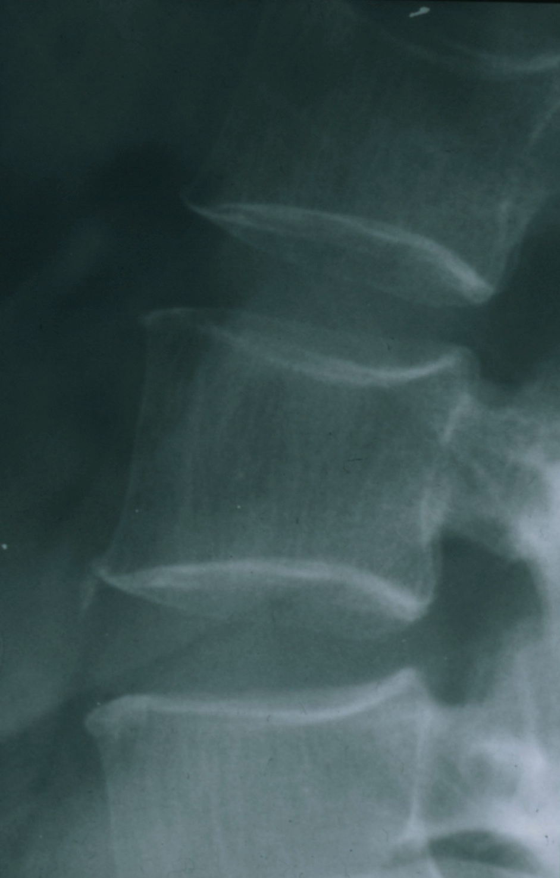
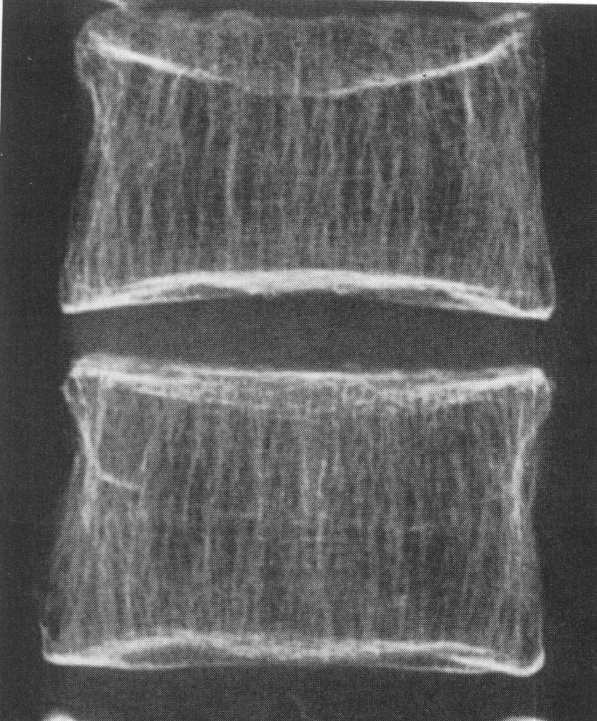
Imaging the Musculoskeletal System 2018
Notes:
Case no.1:
an X-ray of lumbosacralspine that shows a decreased bone density of the vertebra. Which is obvious by looking at the margins which is markedly increased when compared to the body of vertebra
Also, Trabeculaeare seen , which are vertical lines on the vertebral bodies, due to reduction of the matrix “bone density” and the horizontally trabeculae will be lost and vertical ones will be obvious.

Slide 6
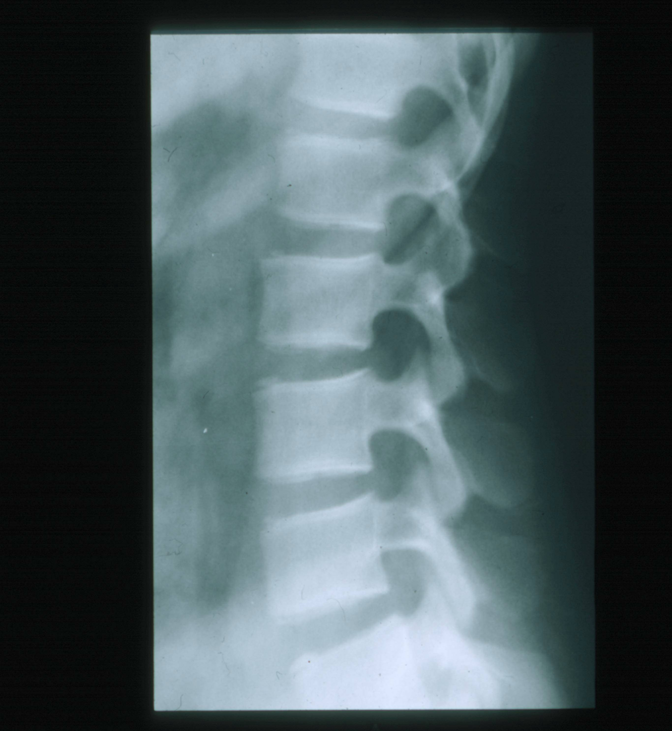
Imaging the Musculoskeletal System 2018
Patient A
Patient B
Osteomalacia
Osteoporosis
Notes:
•Reduction of the bone matrix
•Concave end plates
•Trabeculeare clear and vertical, (lines inside the vertebrae)
•Uneven density
•Cortex is thin and sharp
•Margins are sharp and sclerotic
•Reduction in the height of the vertebrae

Slide 7
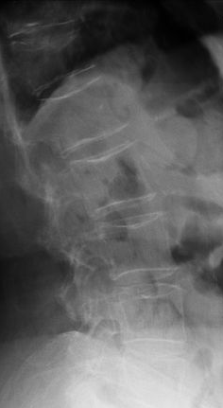
Imaging the Musculoskeletal System 2018
METABOLIC & ENDOCRINE BONE DISORDERS
Osteopenia
Osteoporosis vs. Osteomalacia
Notes:
Patient (A): Osteomalacia”Ricketsin children”Bone density may be normal but bone is soft and there is a defect in mineralization and ill defined margins with no vertically oriented trabeculae.Patient (B): OsteoprosisThere is reduction in bone density , sharp margins of the vertebral body with obvious vertically oriented trabeculae.

Slide 8
Imaging the Musculoskeletal System 2018
CASE NO. 2
27 years- old male with long standing history of renal failure
X-ray of lumbosacral spine requested

Slide 9
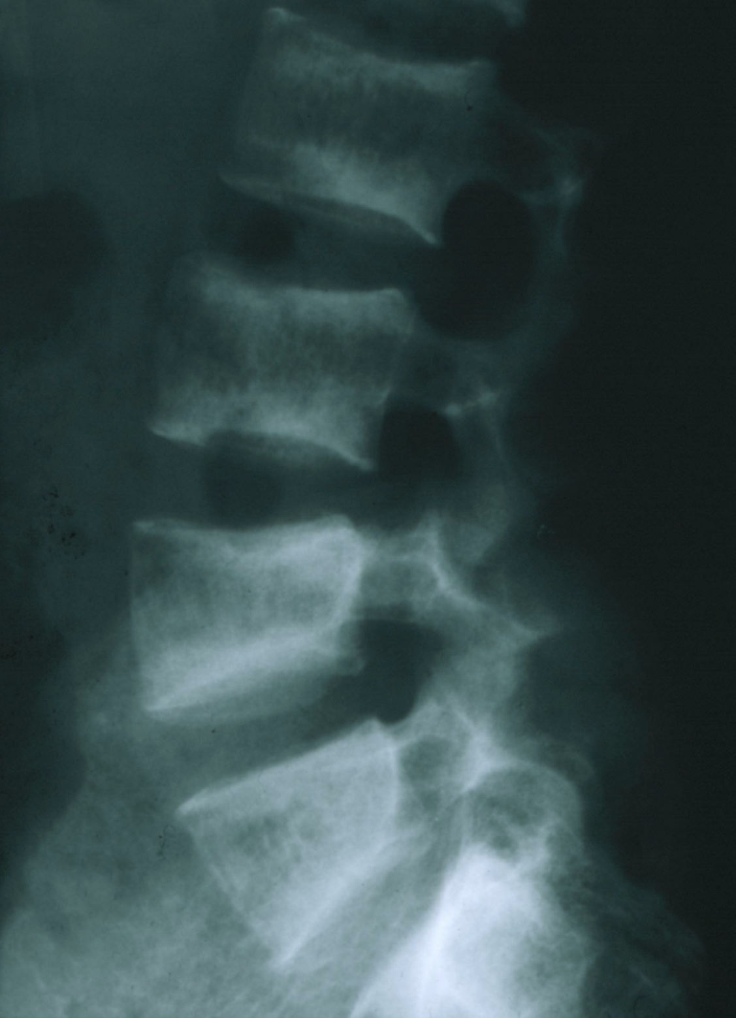
Imaging the Musculoskeletal System 2018
Osteosclerosis
“Rugger Jersey Spine”
Notes:
Case no.2: Patient with renal failure →No absorption & metabolism of vitamin D.lucent with White margins2 ray, -
On xwhich trabeculaeand vertical central), these jersey spineRuggeris called (changes are due to renal dystrophy.
The rugger-jerse
•Decreased bone density of the central portions (black area)
•Sclerotic vertebral end plates
•Caused by reabsorptionof the minerals, but increased activity of the

Slide 10
Imaging the Musculoskeletal System 2018
METABOLIC & ENDOCRINE BONE DISORDERS
Renal Osteodystrophy
Osteoporosis
Osteomalacia
Secondary Hyperparathyroidism
Osteosclerosis

Slide 11
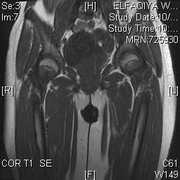
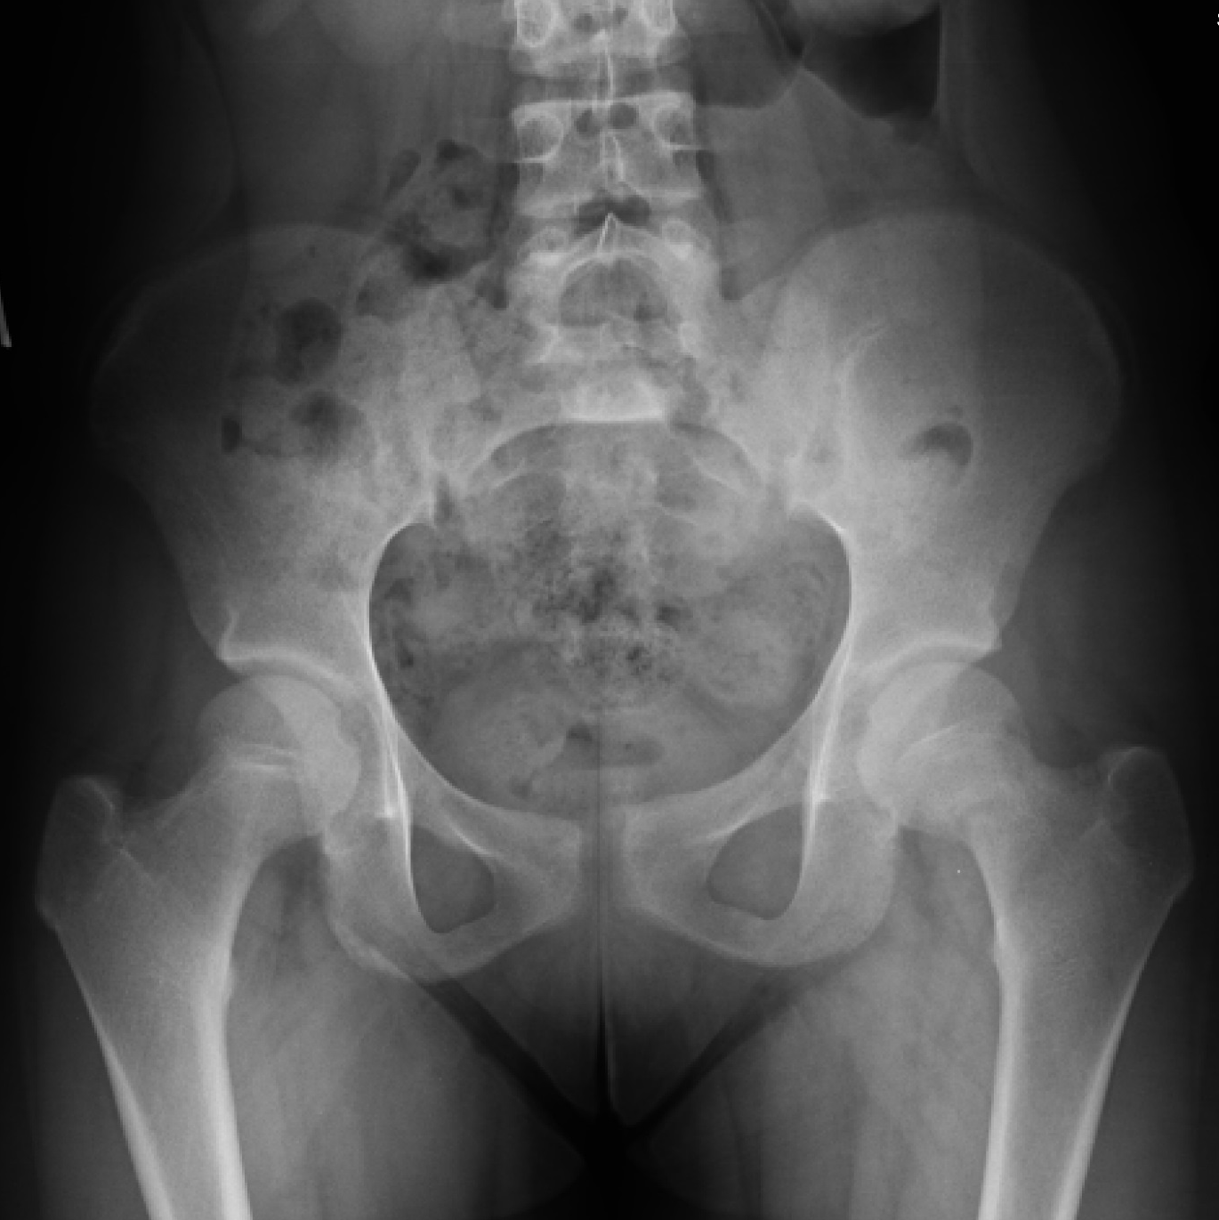
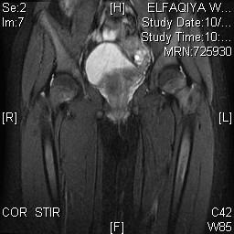
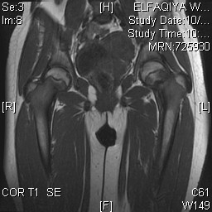
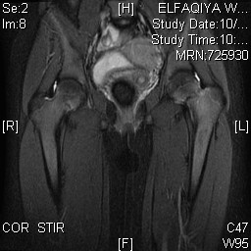
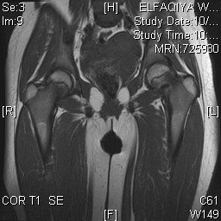
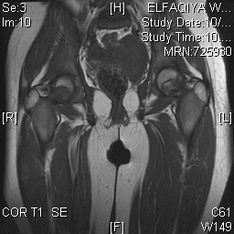
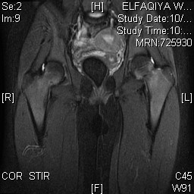
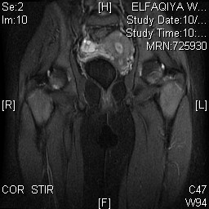
Imaging the Musculoskeletal System 2018
20 years old lady, weakness and lower limbs pain
RT
RT
Looser zones ( OSTEOMALACIA)
Notes:
•Medial aspect of the femur neck
•CT: check texture of the cortex
•MRI: check changes in the bone marrow
•Insufficient fracture of the femur neck due to softening of the bone
•Looser zones: presents as pain during movement, lower limb weakness

Slide 12
Imaging the Musculoskeletal System 2018
HYPERPARATHYROIDISM
Bone Resorption
Bone Softening
Brown Tumors
Osteosclerosis
Soft tissue calcifications

Slide 13
Imaging the Musculoskeletal System 2018
Bone Resorption
Subperiosteal
* Most useful sign
* Virtually Diagnostic
* Location
Hyperparathyroidism
Notes:
In hand, sub periostealbone resorptionin hyperparathyroidism.
Theses changes usually happen in the middle phalanx, radial aspect in the 2ndor 3rdfinger.
Middle phalanx: irregularity of the margin (sub periostealbone reabsortpion) radial aspect

Slide 14
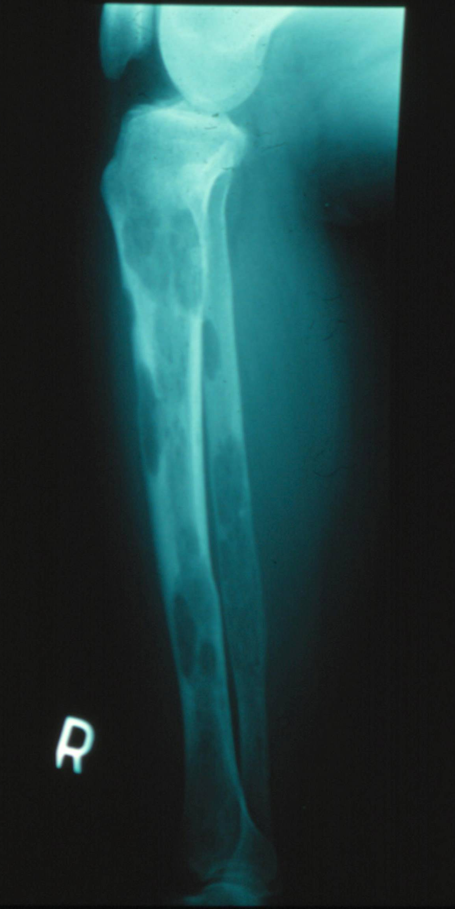
Imaging the Musculoskeletal System 2018
Brown Tumors
Notes:
LyticLesionsBrown tumors features:
.1Affect long or flat bones.
.2Single or multiple
.3Have a sharp outline but with no obvious margins

Slide 15
Imaging the Musculoskeletal System 2018
CASE NO. 3
45 years- old male presented with history of bone enlargement
X-ray of skull and hand are requested

Slide 16
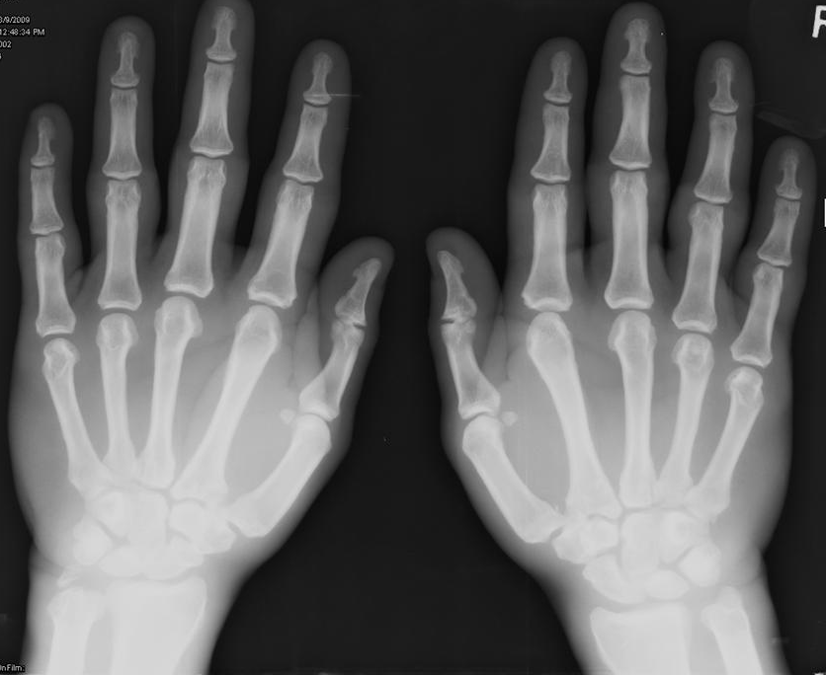
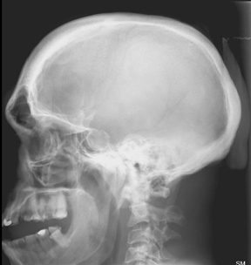
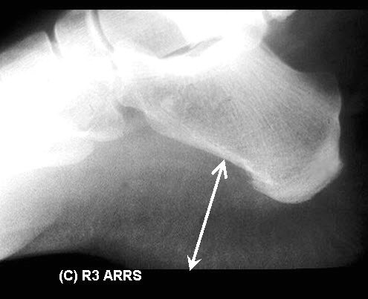
Imaging the Musculoskeletal System 2018
Notes:
•Sellaturcicais rounded & enlarged which may indicate pituitary pathology that caused the acromegaly
•Jaw and frontal sinus are enlarged
•Occipital protuberance
•Thickening of the calvarium
•Sellaeof the pituitary is enlarged due to adenoma
Hands: Enlargement of the soft tissue, early osteoarthritis

Slide 17
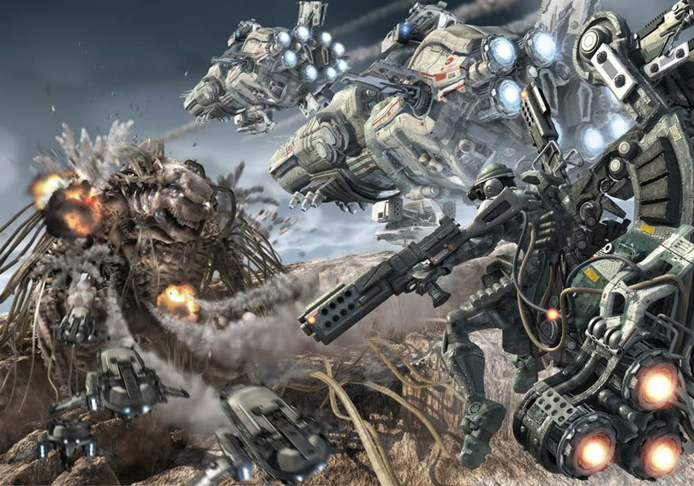

Slide 18
Imaging the Musculoskeletal System 2018
ARTHRITIS

Slide 19
Imaging the Musculoskeletal System 2018
CASE NO. 4
48 years- old female presented with joint pain of the hands & feet
X-ray of hand requested

Slide 20
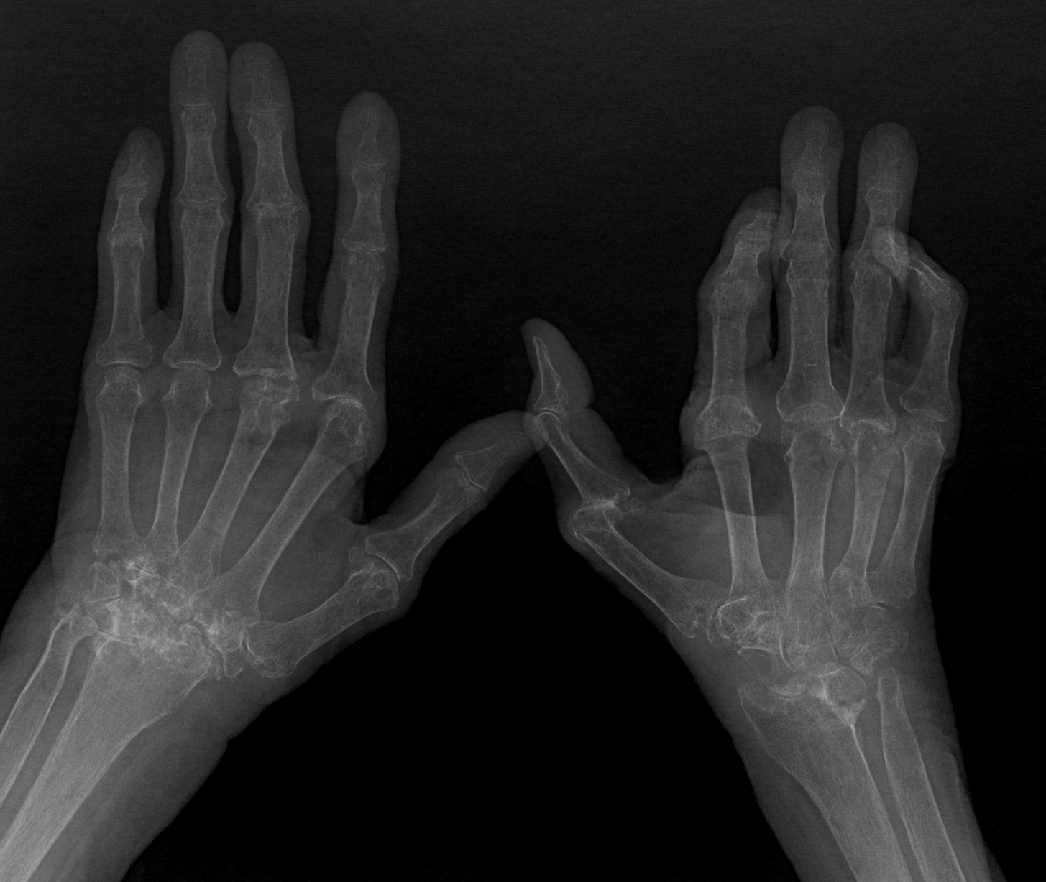
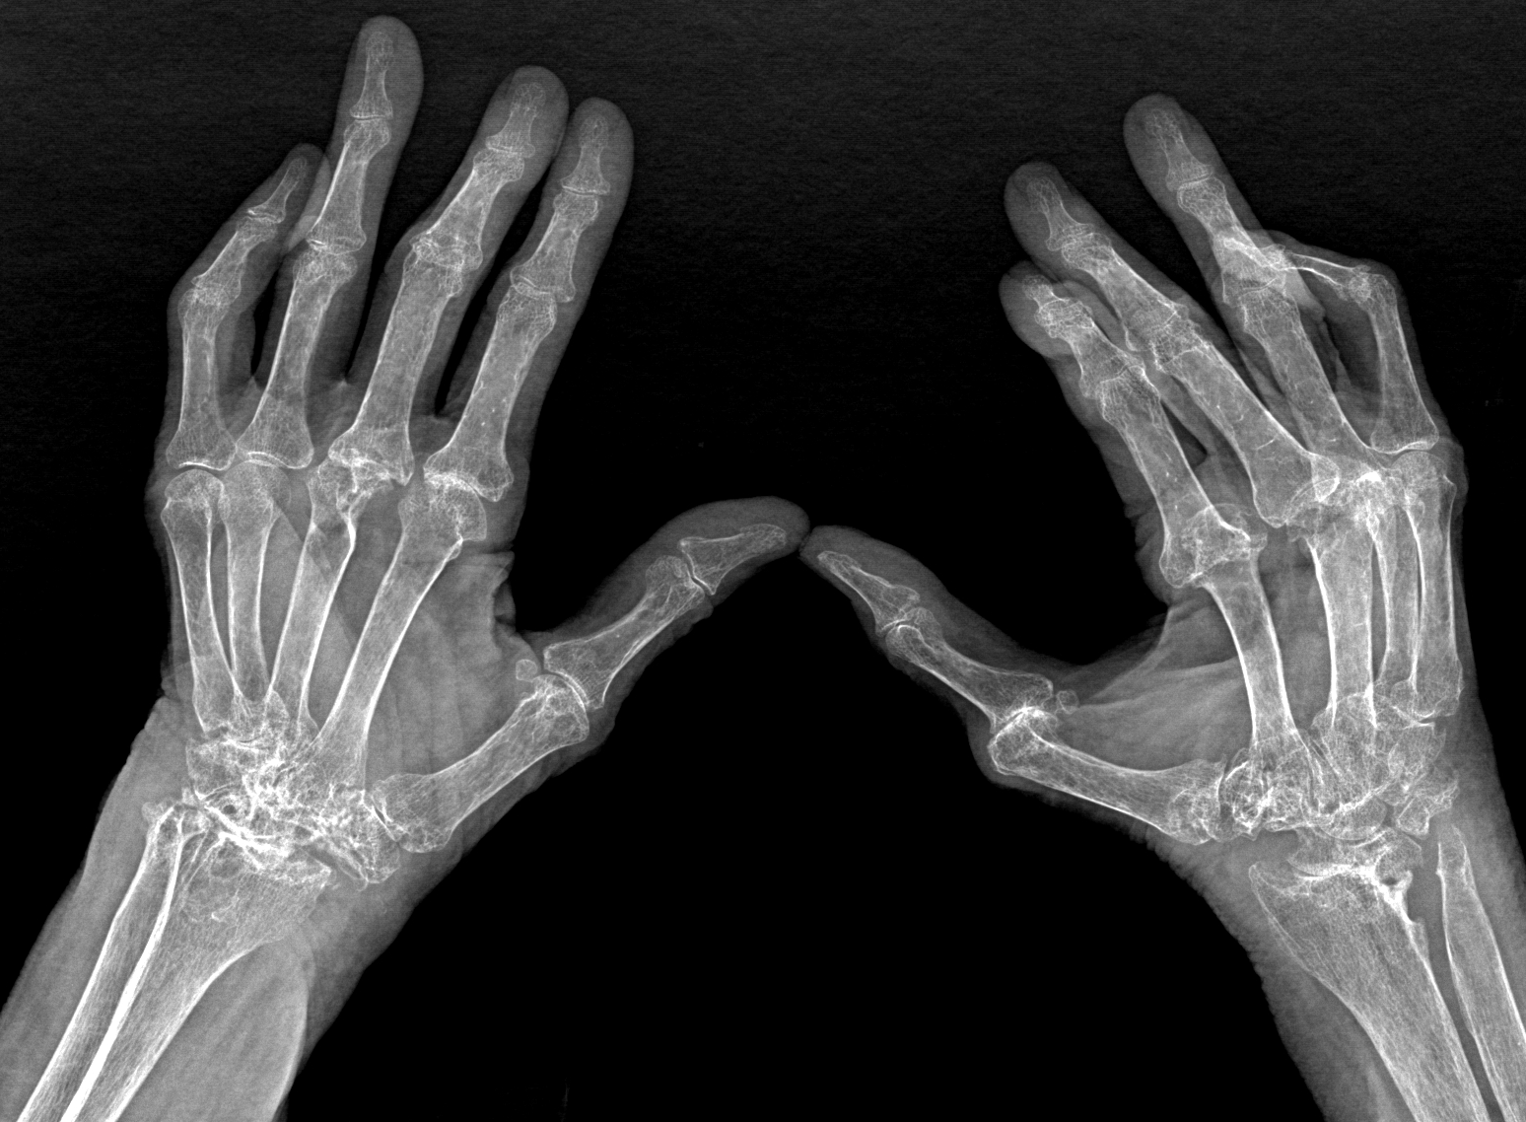
Imaging the Musculoskeletal System 2018
Notes:
•Decreased bone density
•Oblique view: alignment is disturbed (first metacarpal )
•Carpal bones are destroyed and eroded
•Reduced distance between radius and carpal bones

Slide 21
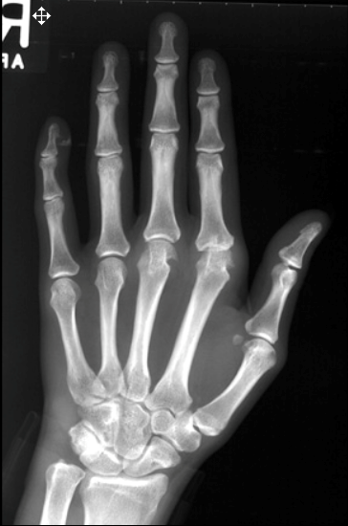
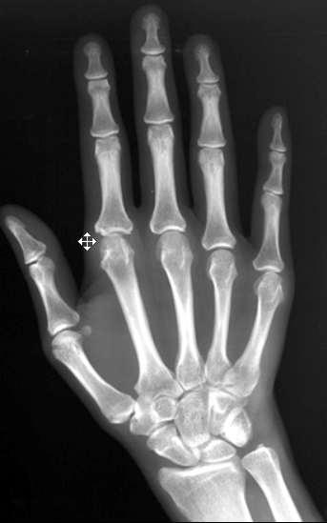
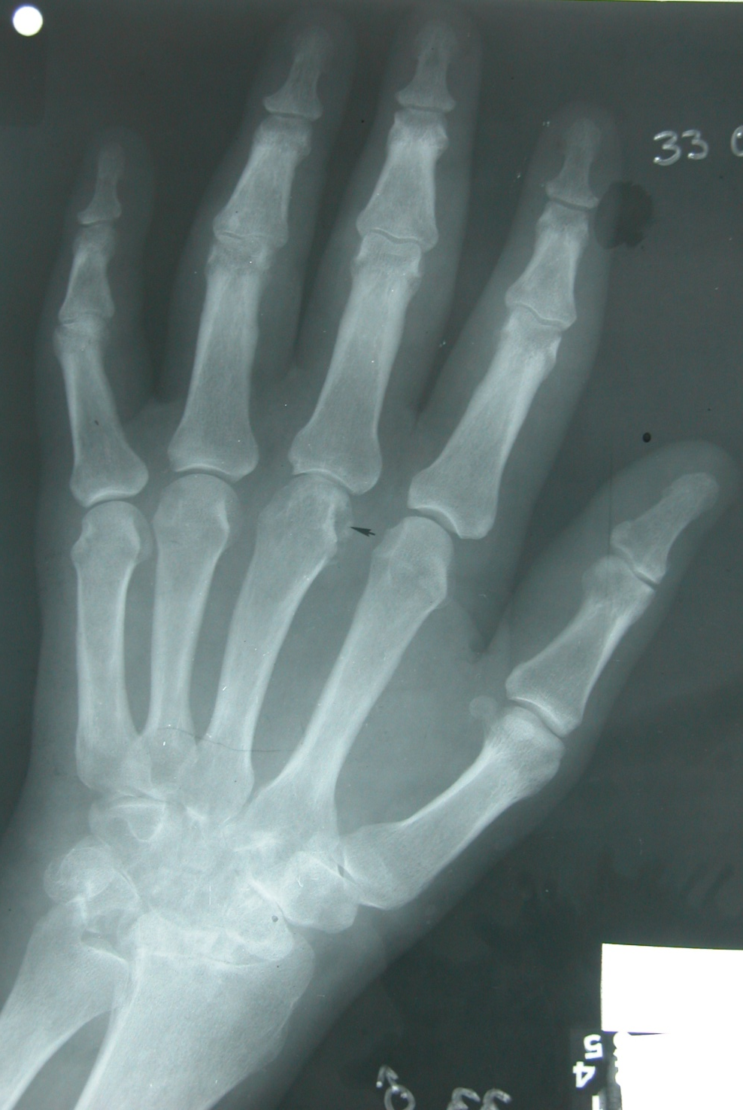
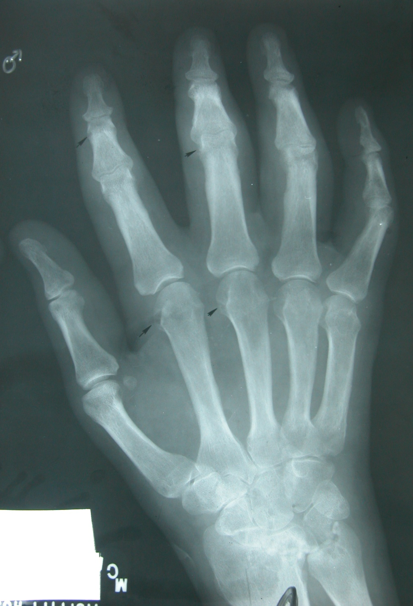
Imaging the Musculoskeletal System 2018
Notes:
•Carpals aren’t clear, proximal disease
•Changes involve the head of the metacarpal, metacarpal pharyngeal joints
•Rheumatoid arthritis:
•Look →Bone density, texture & outline.
•Some of the signs of rheumatoid arthritis are: Periarticularerosions (periarticularosteopenia), loss of joint spaces.

Slide 22
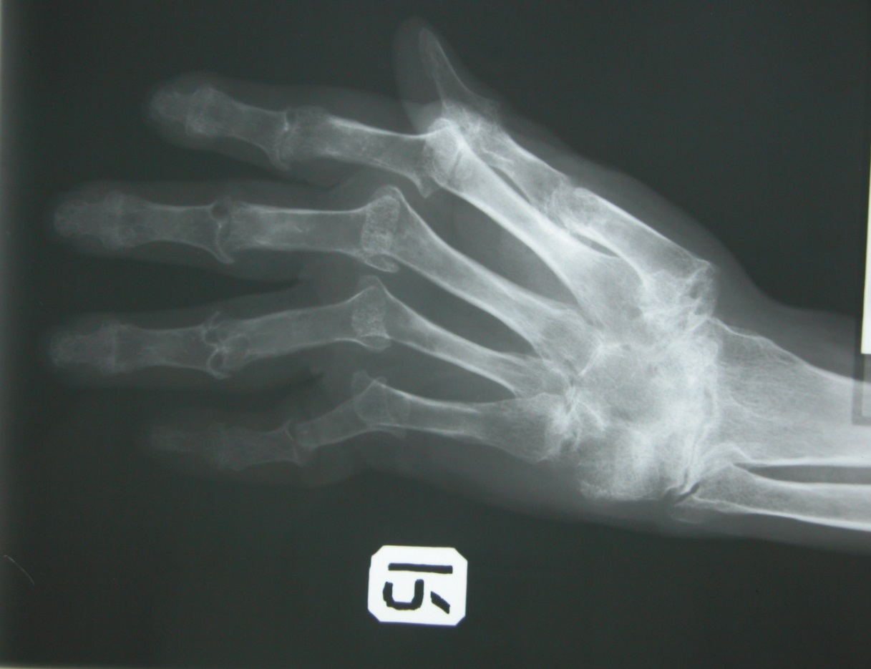
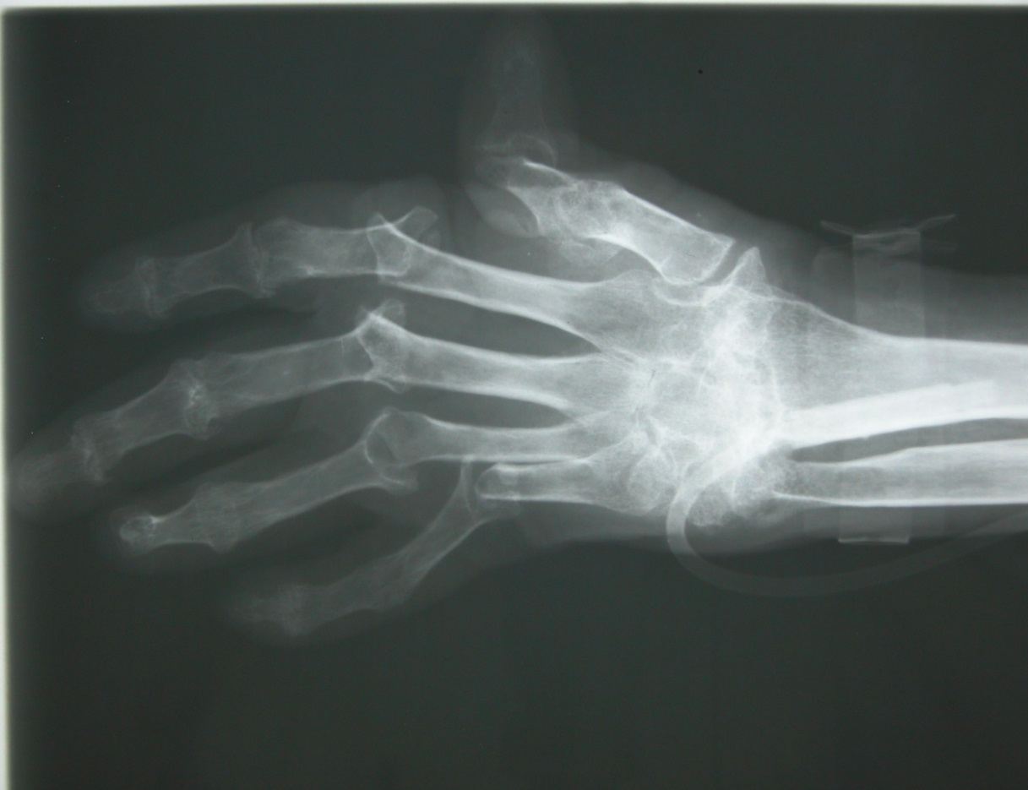
Imaging the Musculoskeletal System 2018
Rheumatoid Arthritis
Notes:
•Around joint, periarticularosteopenia/osteoporos
•Erosive changes
•Erosive arthropathy: caused by the rheumatoid arthritis
•Changes more to the proximal joints than distal
•Dislocation of the joints, swan neck deformity of the neck, extensive erosive
•Early radiological sign: decreased density around the joint
•Mal-alignment of the fingers , ulnardeviation of left hand & dislocation of the thumb of the left hand.

Slide 23
Imaging the Musculoskeletal System 2018
CASE NO. 5
Elderly male patient presented with joint pain of the hands X-ray of hand requested

Slide 24
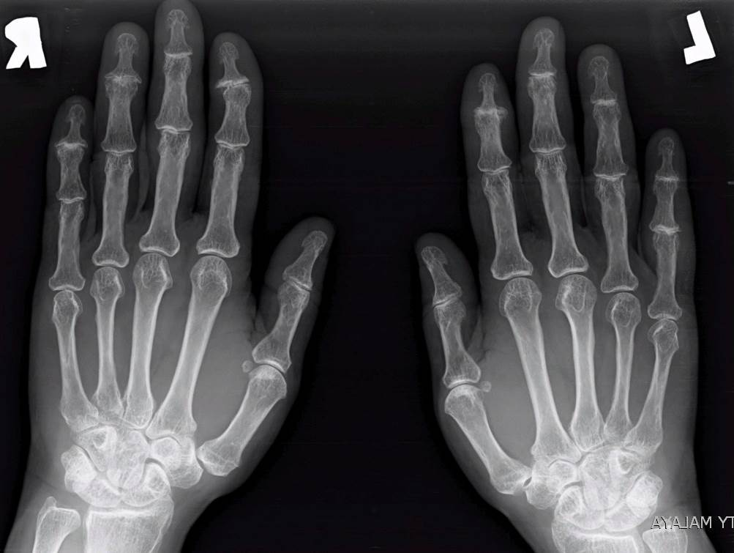
Imaging the Musculoskeletal System 2018
Osteoarthritis
Notes:
•Carpals are clear
•Metacapoparyngeal: no defect or erosive changes
•Proximal inter pharyngeal space
•Distal: osteosclerosis: margins of the bone and extends, osteospike
•Reduction of the joint space, sclerotic changes, osteo

Slide 25
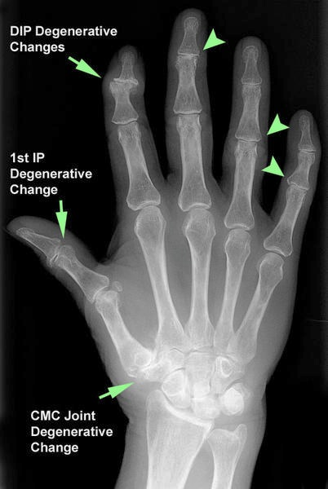
Imaging the Musculoskeletal System 2018
Notes:
•Sclerosis and narrowing of the joint
•First carpal metacarpal joint (thumb)
•If an arthritis is non erosive (osteoarthritis, large joints), erosive (rheumatoid, small joints) synovial jointsOsteoarthritis: Distal interphalangealjoint osteoporosis. Non-erosive.Distal rather than proximal

Slide 26
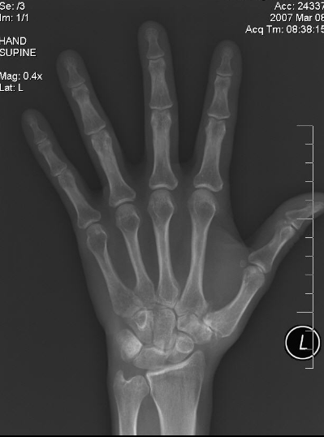
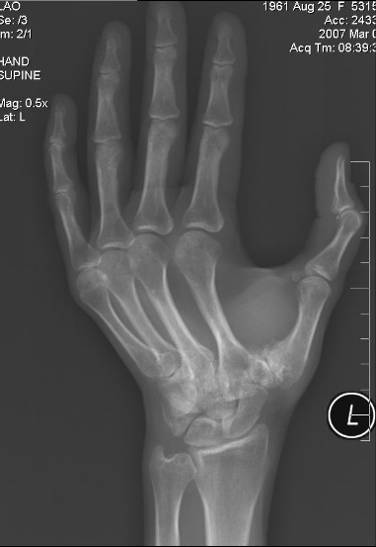
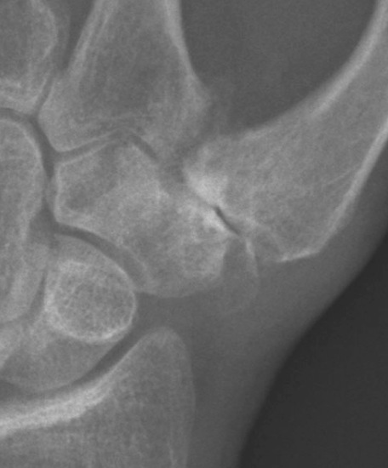
Imaging the Musculoskeletal System 2018
Osteoarthritis
Notes:
•Destruction of the head of the metacarpal
•Ossified joints
•Psoariaisiscan be similar but more severe, affect proximal to distal of one finger, ankylosisof the bone

Slide 27
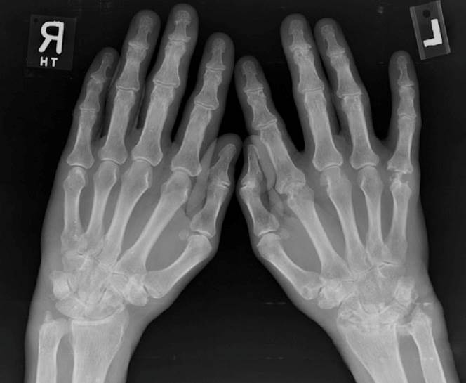
Imaging the Musculoskeletal System 2018
Erosive Osteoarthritis
Notes:
Involvement of middle finger and fusion

Slide 28
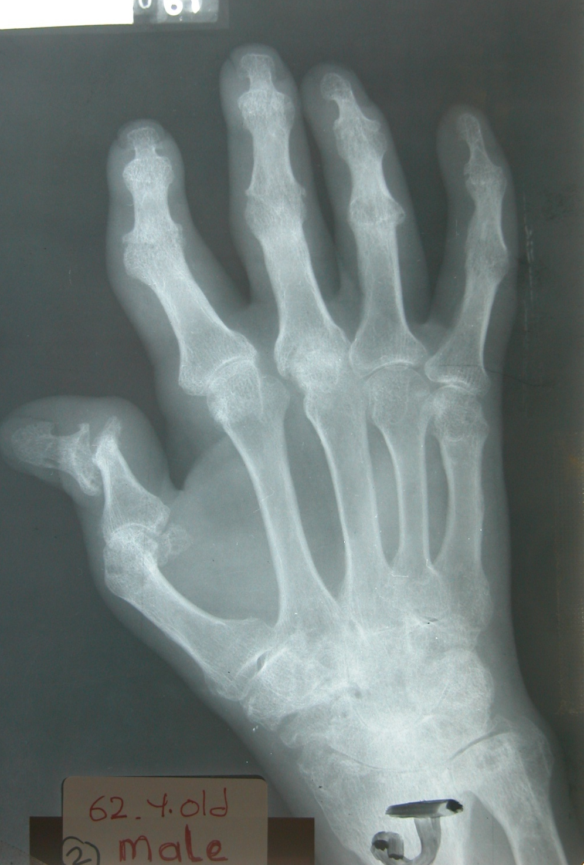
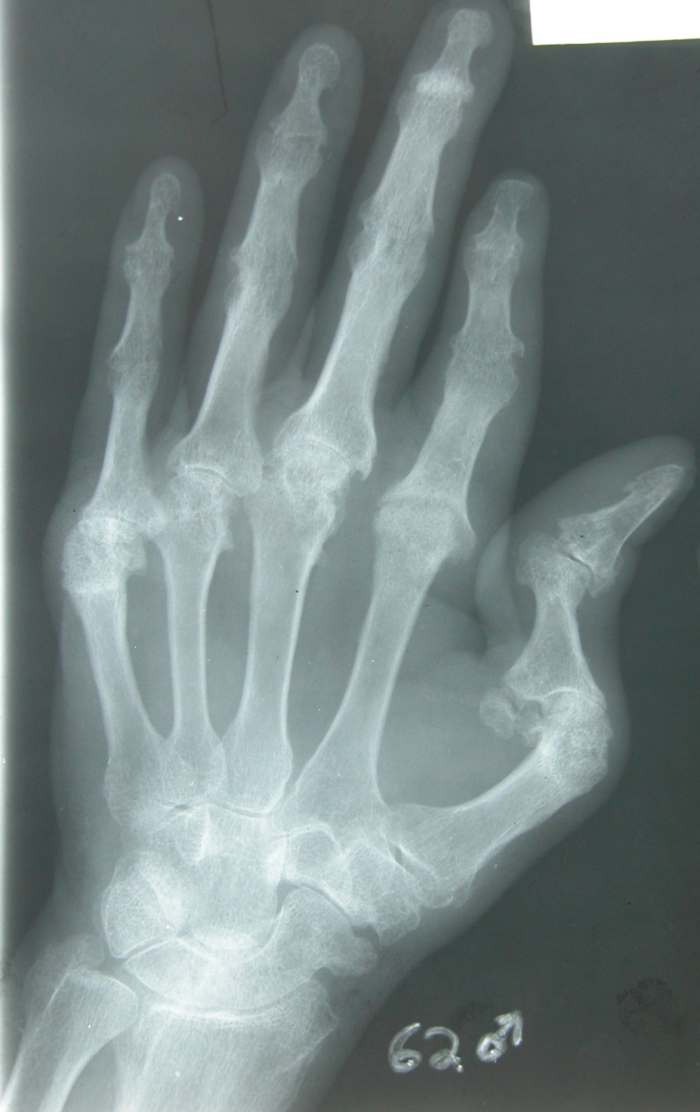
Imaging the Musculoskeletal System 2018
RT
Psoriatic Arthritis – “Sausage Digit”
Notes:
Seen in the x-ray:Erosions.MalalignmentAround the erosion there is a swelling “ Rounded soft tissue enlargement”.
•Erosive changes ring finger
•Soft tissue swelling (white area means it is dense)
•Erosive arthropathwith soft tissue component, seen in Gout

Slide 29
Imaging the Musculoskeletal System 2018
CASE NO. 6
43 year-old male patient presented with hands and feet pain and swelling
X-ray of hand requested

Slide 30
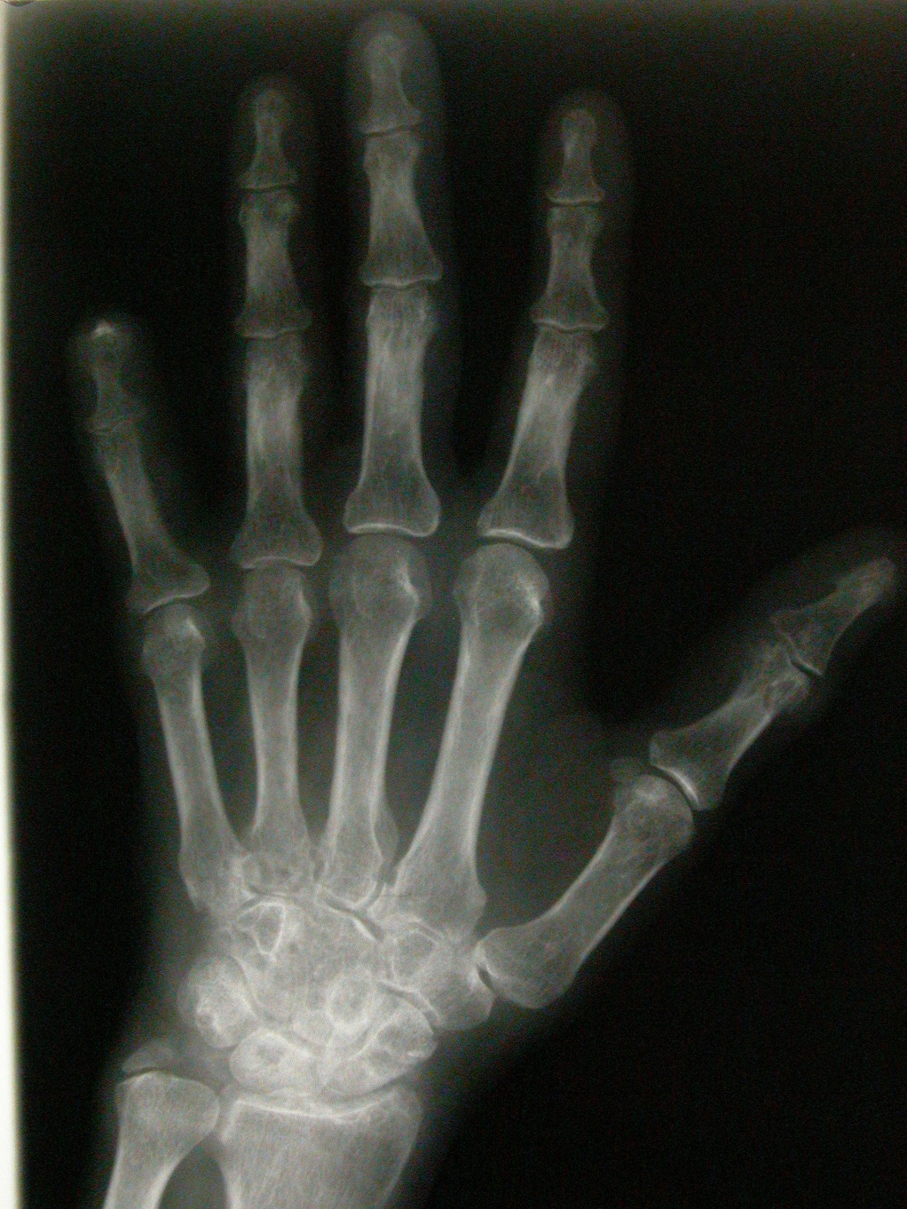
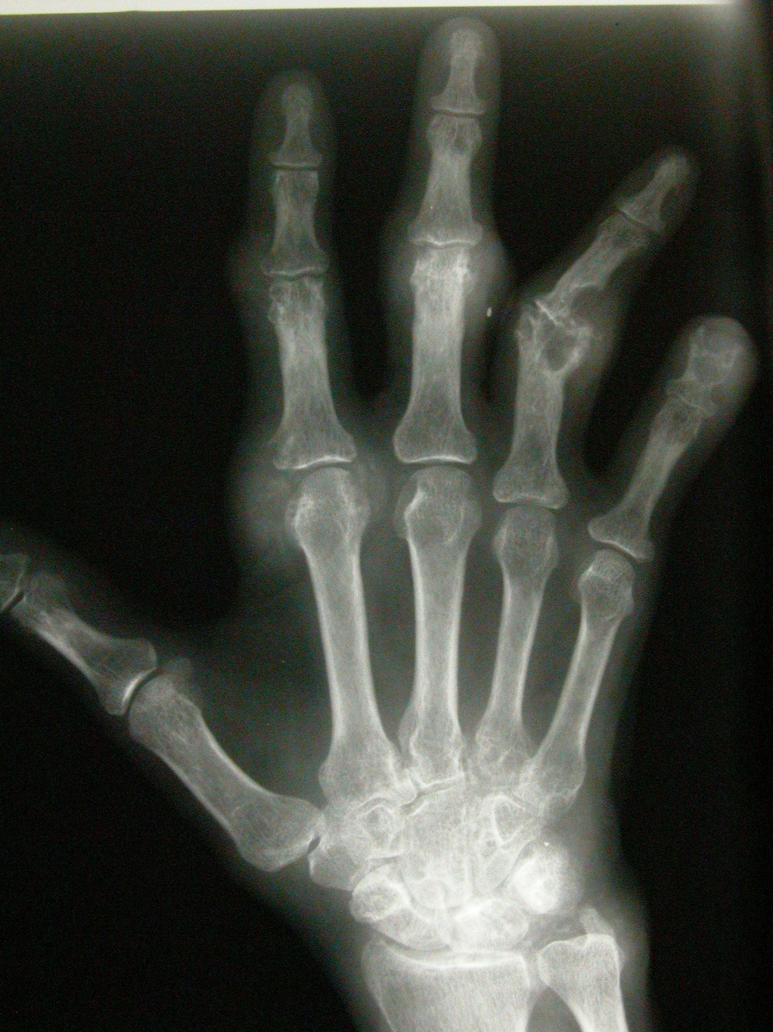
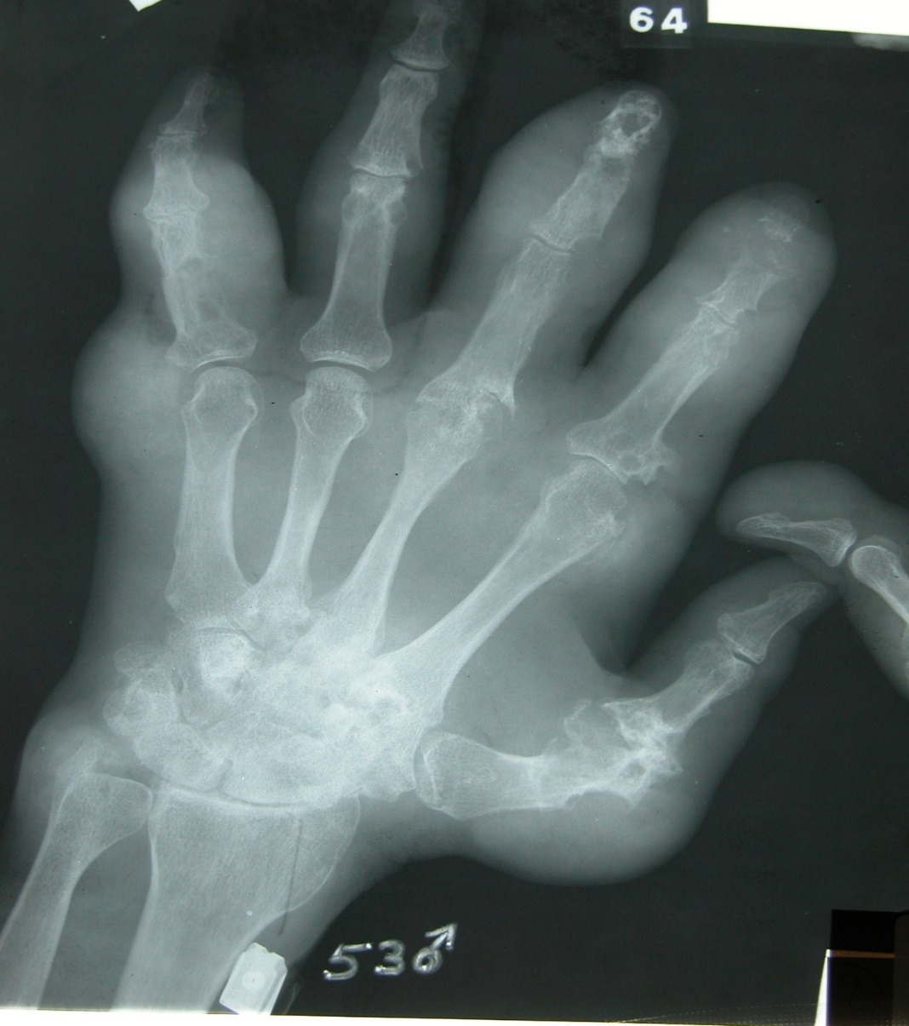
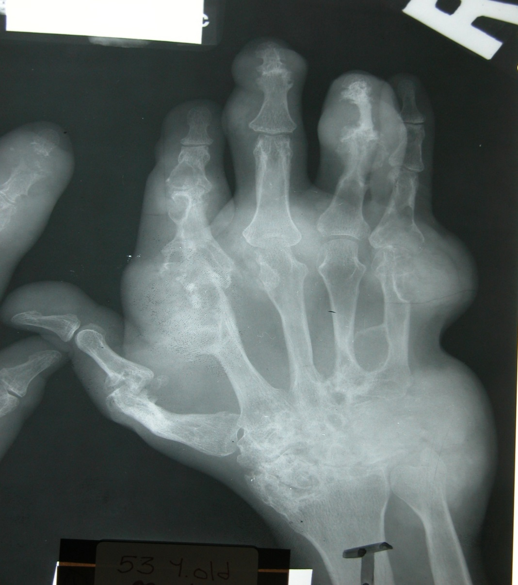
Imaging the Musculoskeletal System 2018
Gouty Arthritis – “Lumpy Bumpy”
Notes:
Seen in the x-ray:Erosions.MalalignmentAround the erosion there is a swelling “ Rounded soft tissue enlargement”.
•Erosive changes ring finger
•Soft tissue swelling (white area means it is dense)
•Erosive arthropathwith soft tissue component, seen in Gout

Slide 31
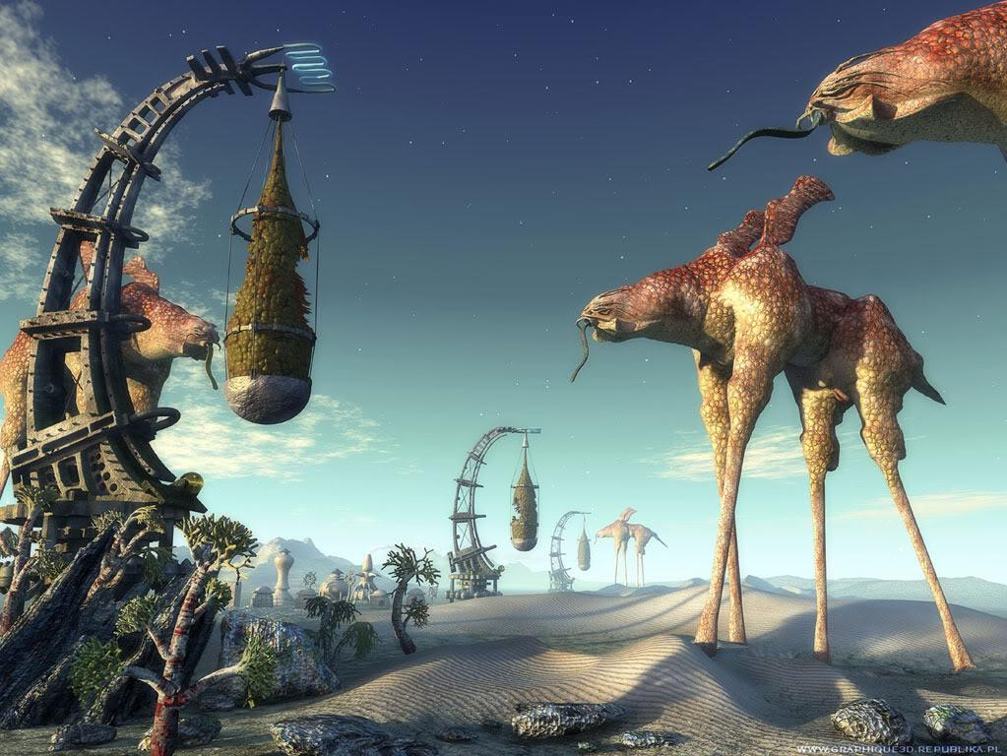

Slide 32
Imaging the Musculoskeletal System 2018
Musculoskeletal Tumors
Osseous
Chondral
Fibrous
Soft tissue

Slide 33
Imaging the Musculoskeletal System 2018
Musculoskeletal Tumors
Pattern of bone destruction
Size, Shape & Margin of lesion
Texture of lesion Matrix
Cortex & Periosteal reaction
KEY FEATURES
Morphology
Behavior of lesion
Age of patient
Site (Location)

Slide 34
Imaging the Musculoskeletal System 2018
Musculoskeletal Tumors
Pattern of bone destruction
Size, Shape & Margin of lesion
Texture of lesion Matrix
Cortex & Periosteal reaction
KEY FEATURES
Morphology
Behavior of lesion
Age of patient
Site (Location)
Permeative
Moth-eaten
Geographic
Geographic
Notes:
Geographic lesions: benign, sharp out line
Moth eaten:
•non-homogenous
•widen margin
•transition zone is wider
•malignant
Permeative:
•ill defined margins
•aggressive lesion
•wide zone transition
•aggressive malignant process or non-malignant as infection
Periostealreaction:
•the periosteumis intact with cortex
•looser in the pediatric
•any violation to the cortex and the bone will react to the tumor by forming callous and periosteom
•slow growing tumors allow the periosteumto grow
•periosteomwill be thick
•benign

Slide 35
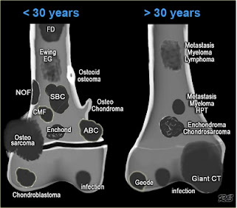
Imaging the Musculoskeletal System 2018
Musculoskeletal Tumors
KEY FEATURES
Morphology
Behavior of lesion
Age of patient
Site (Location)

Slide 36
Imaging the Musculoskeletal System 2018
Musculoskeletal Tumors
Osseous
Sclerotic
Lytic
Mixed

Slide 37
Imaging the Musculoskeletal System 2018
CASE NO. 7
13 year-old boy patient presented with knee pain and swelling
X-ray of knee requested

Slide 38
Imaging the Musculoskeletal System 2018
Notes:
Lytic expansile lesion located on the metaphysis(benign)

Slide 39
Imaging the Musculoskeletal System 2018
Notes:
CT or MRI might be done to check the texture of the lesion.
•Within the metaphysis, doesn’t extent to the epiphysis
•Geographical
•X ray: expansilelyticlesion , cortex is thinned out
•CT: fluid level blood, vascular benign lesion
•Cause: aneurysm bone cyst (age, location, appearance)
On CT there are some spots that suggest that it contains blood →Aneurysmalbone cyst.

Slide 40
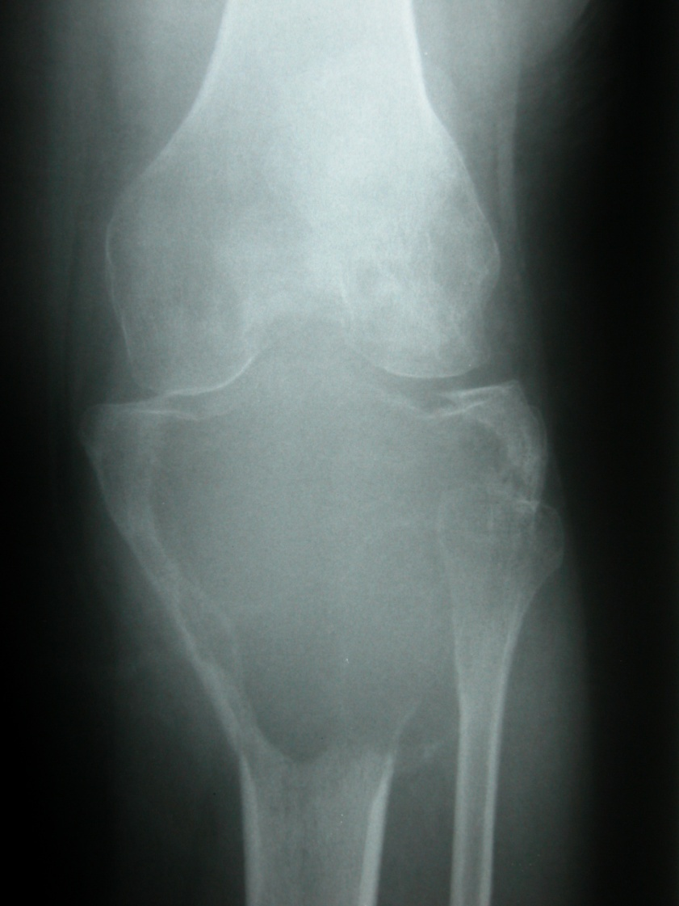
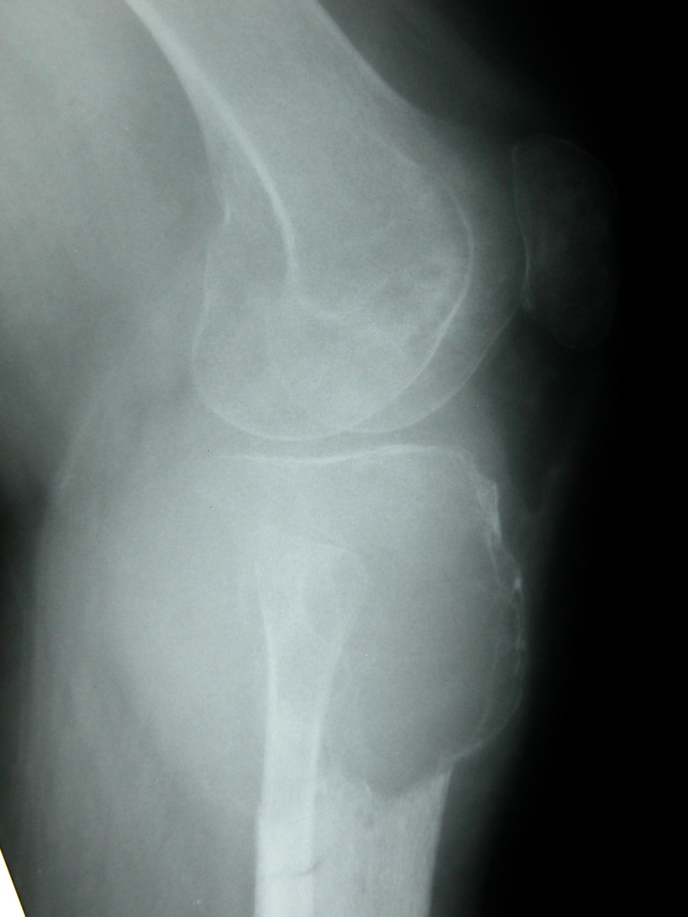
Imaging the Musculoskeletal System 2018
Notes:
•Expansile
•lyticlesion
•sub-articularsurface
•violated cortex
•Aggressive bone lesion

Slide 41
Imaging the Musculoskeletal System 2018

Slide 42
Imaging the Musculoskeletal System 2018

Slide 43
Imaging the Musculoskeletal System 2018

Slide 44
Imaging the Musculoskeletal System 2018

Slide 45
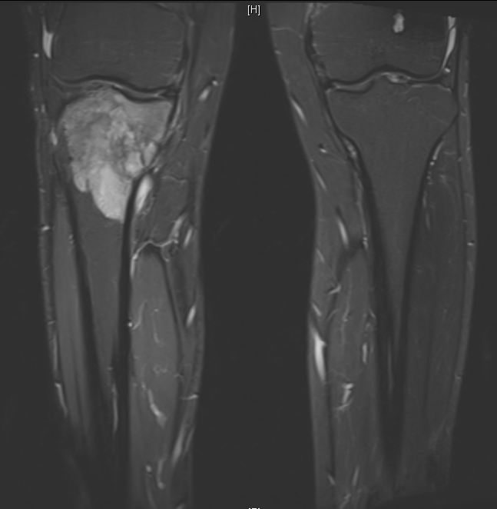
Imaging the Musculoskeletal System 2018
STIR
Notes:
•Moth eaten, permeated (no margins)
•Violating the cortex
•Leukemia, lymphoma, sarcoma

Slide 46
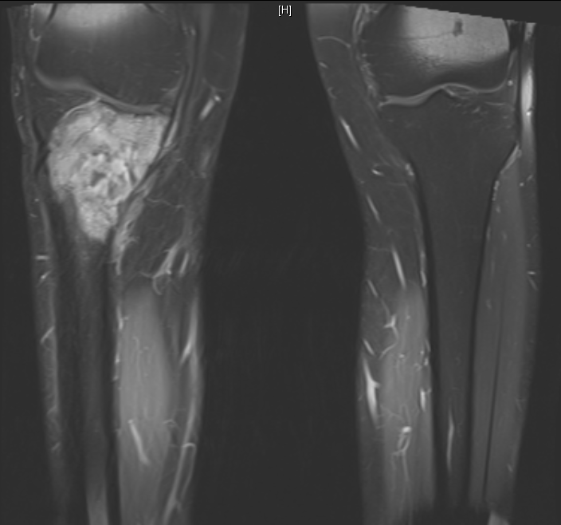
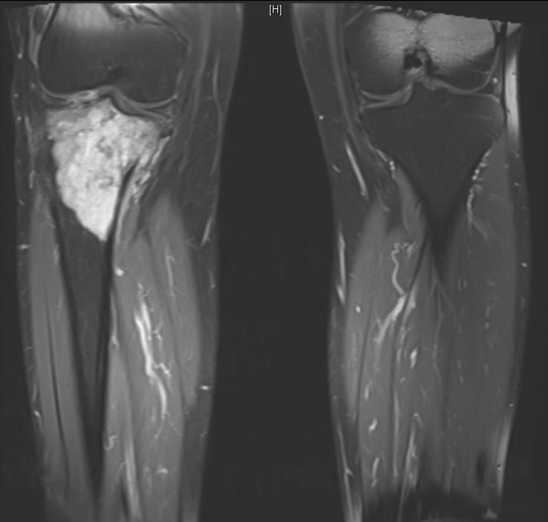
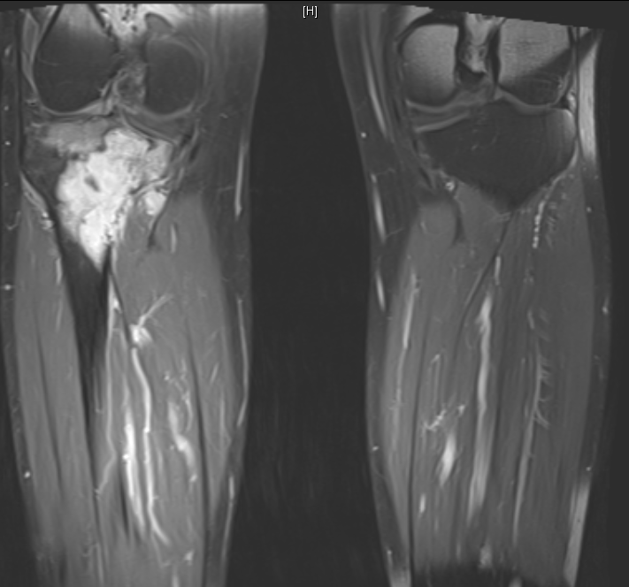
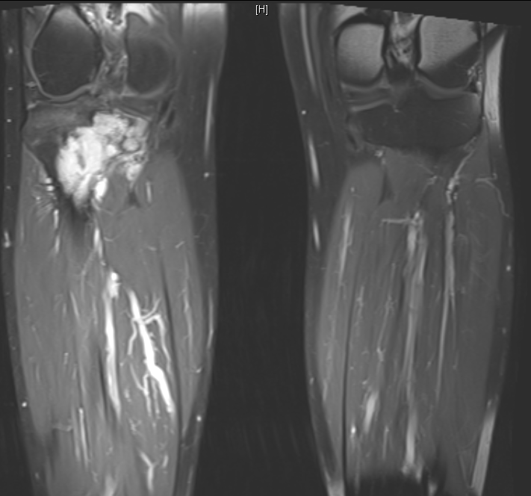
Imaging the Musculoskeletal System 2018
T1 c+
Notes:
MRI: heterogeneous, extends beyond cortex

Slide 47
Imaging the Musculoskeletal System 2018
CASE NO. 8
Adult female patient presented with hand swelling
X-ray of hand requested

Slide 48
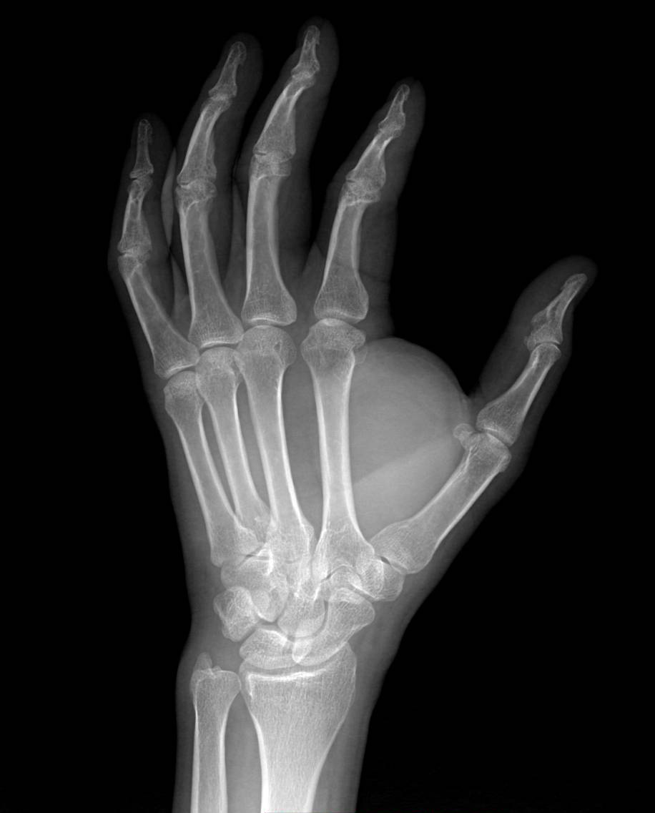
Imaging the Musculoskeletal System 2018
Notes:
•soft tissue swelling of the hand, between thumb and finger
•no bone destruction
•Soft tissue swelling but no bone is disrupted, so it is only a swelling.

Slide 49
Imaging the Musculoskeletal System 2018
Notes:
•MRI: lesion is white
•Another image is adjusted to cancel the fat (black)
•Possible lesions: Lipoma, fibroma, rhabdomyoma, fibrous cystocytoma, hemangioma, neurofibroma
MRI is done and the lesion appeared white “subcutaneous fat”, and to make sure it is a fatty lesion we asked the machine to take off the fat and the lesion became black →supports our hypotheses (lipoma?)

Slide 50
Imaging the Musculoskeletal System 2018
CASE NO. 9
57 years old female patient presented with bone ache
Had history of breast carcinoma

Slide 51
Imaging the Musculoskeletal System 2018
Notes:
Multiple sclerotic lesions.

Slide 52
Imaging the Musculoskeletal System 2018
Summary
Metabolic & Endocrine Disorders:
Osteomalacia.
Osteoporosis.
HPT/ROD.
Acromegaly.
Arthritis.
Rheumatoid Arthritis.
Osteoarthritis.
Psoriatic Arthritis.
Gout.
Musculoskeletal Tumors:
Benign (Non-aggressive).
Malignant (Aggressive).
Notes:
•Matrix is chondroidtissue, deposited with phosphorous and calcium
•Osteopenia: is not a disease, but reduction in bone density
•Osteoporosis: can be secondary to trauma, immobilization, medicine such as heparin because the mass is reduced and not the minerals
•Osteomalacia: caused a by defect in minerals (inadequate amounts of available phosphorus and calcium, or because of overactive reabsorptionof calcium from the bone as a result of hyperparathyroidism)
•Osteomalaciain children is called Rickets

Slide 53
Imaging the Musculoskeletal System 2018
Thank You

