Slide 1
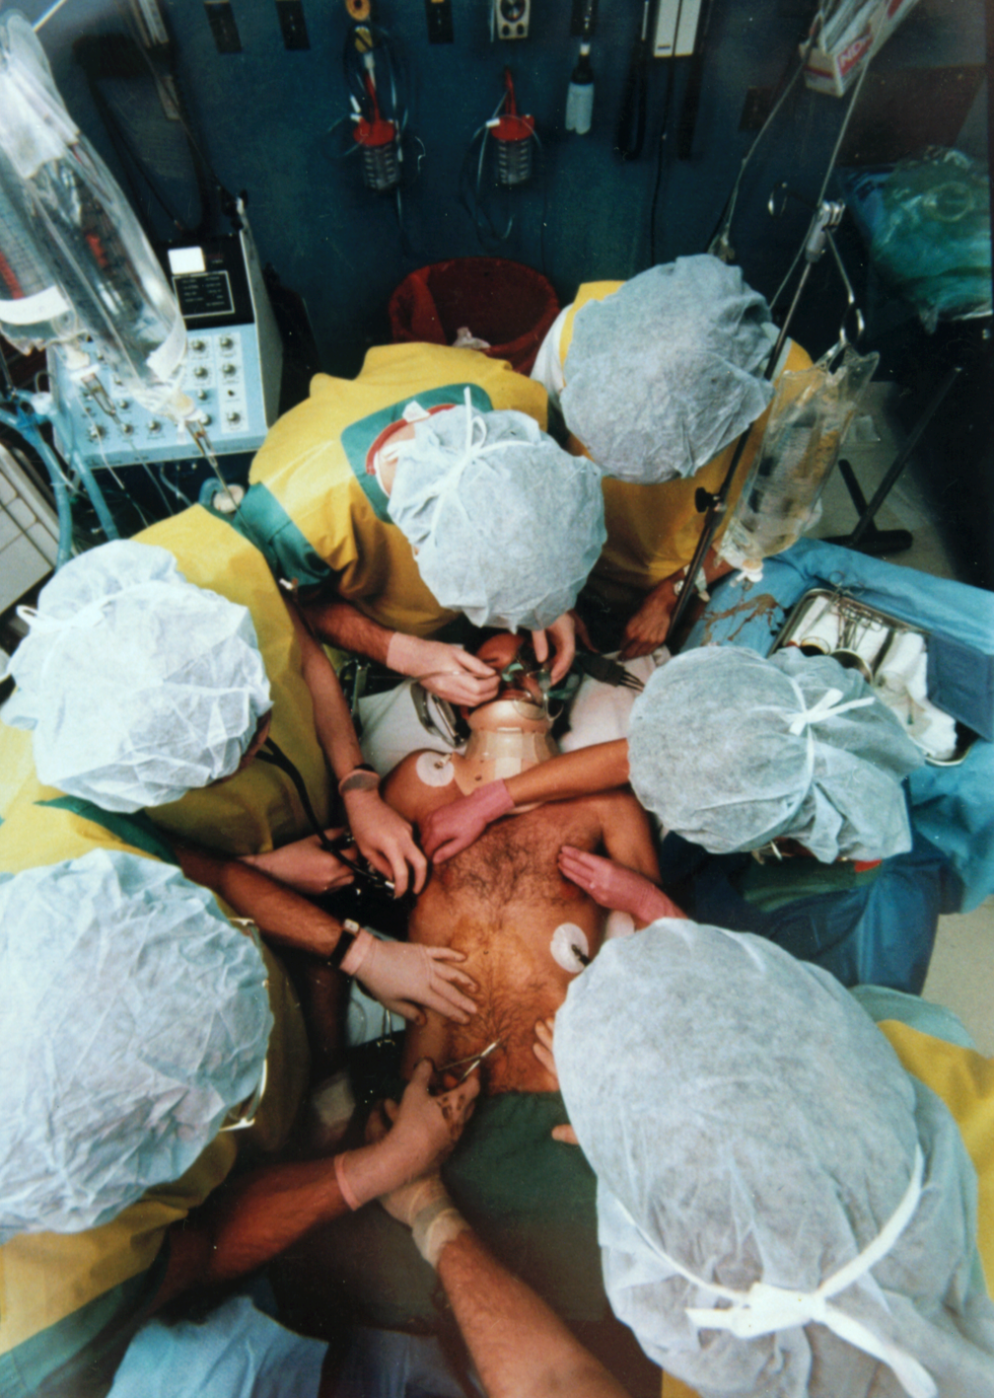
Trauma Care

Slide 2
Course Objectives
Importance of Trauma Care
Principles of primary and secondary assessments
Establish management priorities within the Primary Survey
Notes:
ATLS is primarily directed at providing initial care during the “Golden Hour.”
This is the window of opportunity for the physician to have the greatest impact on morbidity and mortality of the trauma patient.

Slide 3
The Need
The leading cause of death in the first four decades of life.
More than 5 million trauma-related deaths each year worldwide.
Motor vehicle crashes cause over 1 million deaths per year.
Injury accounts for 12% of the world’s burden of disease.

Slide 4

The Need In Saudi
Notes:
Discuss the need in Saudi Arabia.
Discuss that Trauma care in Saudi is not at standard of care
Discuss that we are where the west was in the 1970s regarding organization of Trauma Care

Slide 5
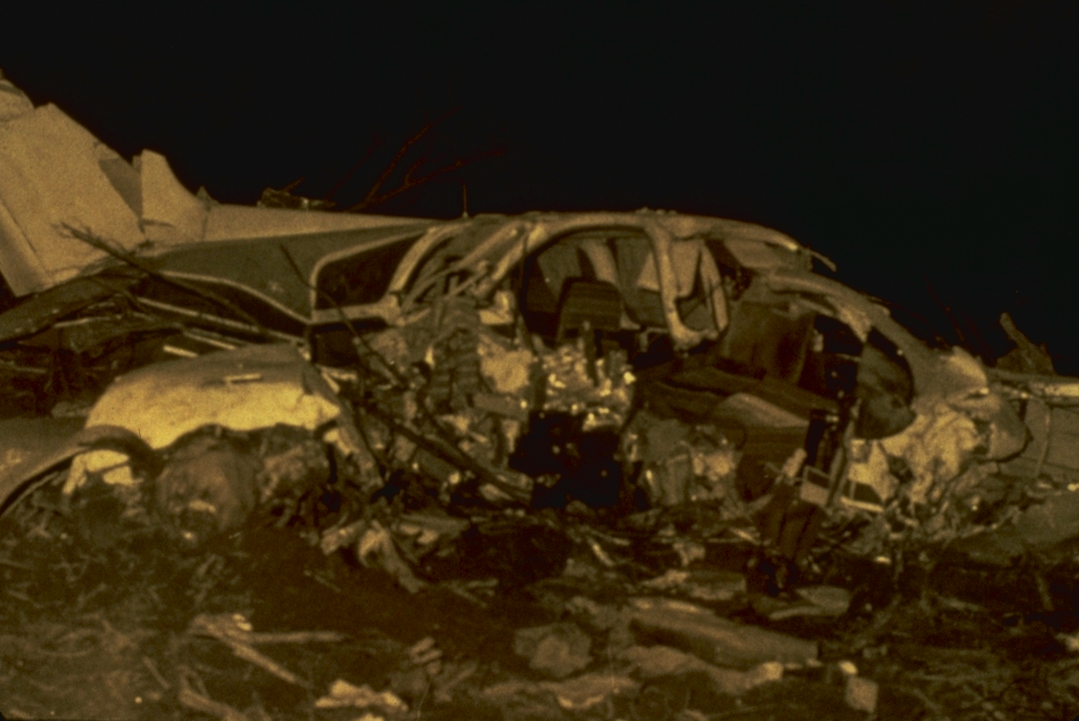
Start of Trauma Organization
Notes:
The Beginning
In 1976 Dr. Styner, an orthopedic surgeon, crashed his plane in rural Nebraska.
Dr. Styner and his three children were seriously injured, and his wife was killed.
He walked to a local road and then took his children to a rural hospital, where they received inadequate care.
This leads into the quote on the next slide.

Slide 6
The Beginning
  “When I can provide better care in the field with limited resources than what my children and I received at the primary care facility there is something wrong with the system, and the system has to be changed.”
James Styner, MD, FACS
1977
Notes:
The Beginning
Dr. Styner then went back to the physicians in Lincoln, Nebraska, and worked to develop the first prototype of the ATLS Course.
Presented in 1978 to the ACS and adopted by the College in 1979.
The course is now presented around the world.

Slide 7
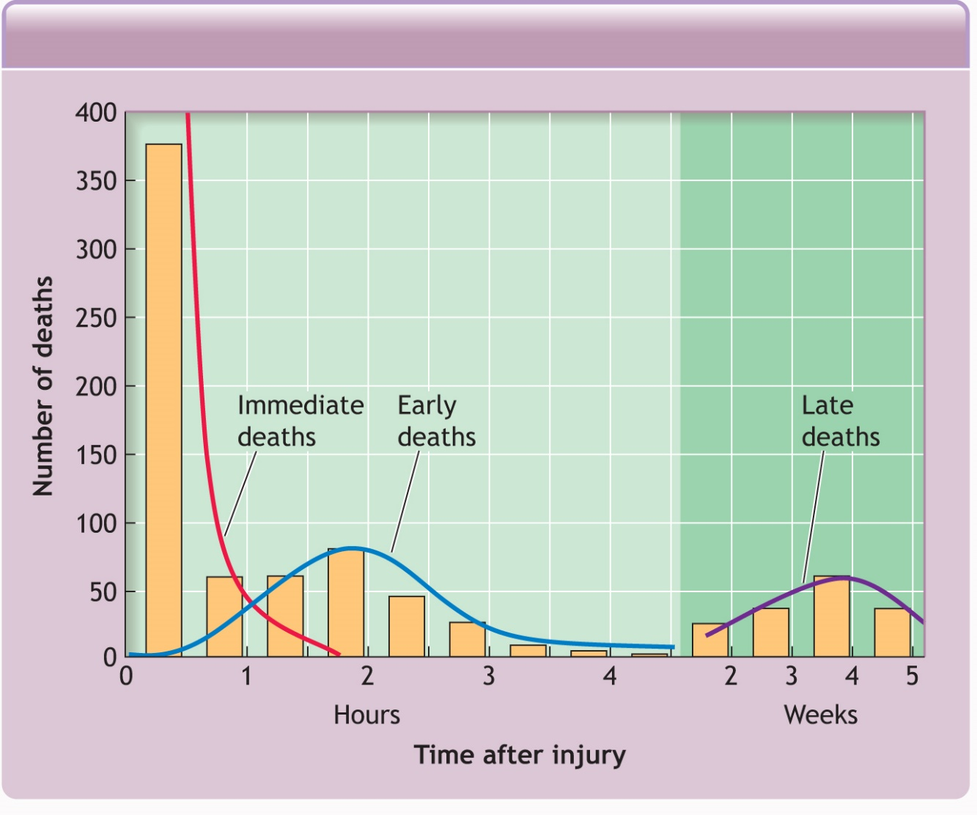
Trimodal Death Distribution
Notes:
Trimodal Death Distribution
There are three peaks of death from trauma.
First peak: Immediate – unsurvivable injuries, impacted by trauma prevention.
Second peak: Early – golden hour of care, impacted by early hospital care.
Third peak: Late – caused by sepsis and multiple organ dysfunction syndrome (MODS), impacted by optimal early care and trauma center management.

Slide 8
Standard Concept
ABCDE approach to evaluation and treatment
Treat greatest threat to life first
Definitive diagnosis not immediately important
Time is of the essence
Do no further harm
Notes:
ATLS (standard course)
ABCDE is the universal language for the primary exam.
ABCDE is the order in which the injuries will kill patients.
Definitive diagnosis and an in-depth history are not required initially.

Slide 9
ATLS Concept
Airway with c-spine protection
Breathing / ventilation / oxygenation
Circulation: stop the bleeding!
Disability / neurological status
Expose / Environment / body temperature

Slide 10
Regular Medical Assessment
Injury
History
Treatment
Physical
Differential Diagnosis
Differential Diagnosis
Investigations
Notes:
A trauma patient would die before receiving treatment if we approach him in the routine way.
All of this is important but is called the secondary survey
In Trauma we start with the primary survey to save the life

Slide 11
Initial Assessment / Management
Injury
Transfer
Primary Survey
Optimize patient status
Resuscitation
Reevaluation
Reevaluation
Detailed
Secondary Survey

Slide 12
Case Scenario
24-year-old male involved in a motorcycle crash in to a truck
Not wearing a helmet
Arrives at hospital with the red crescent
BP 80/40, P140, RR 33, and central cyanosis
C-collar, Oxygen at 8L/min, Dressing to forehead & thigh soaked in blood
Has a wrist splint & is on a spinal board

Slide 13

Case Scenario

Slide 14
Case Scenario
What do you think of the care?

Slide 15
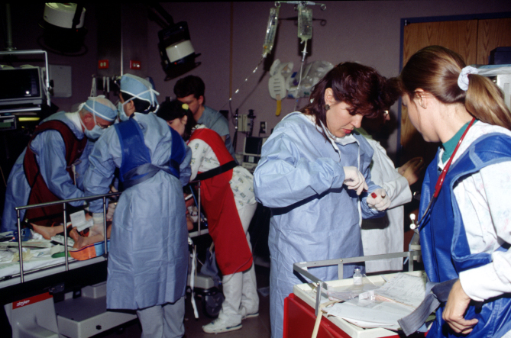
Standard Precautions
Cap
Gown
Gloves
Mask
Shoe covers
Goggles / face shield
Notes:
Standard Precautions
Standard precautions are one component of preparing for the patient in the hospital.
You may query what items are needed to protect the patient and the trauma team members.
Emphasize the need to protect the patient and trauma team members from communicable diseases.

Slide 16
Quick Assessment
What is a quick, simple way
to assess a patient in 10 seconds?
Notes:
1-7 Quick Assessment
What is a quick, simple method to assess the patient in 10 seconds?
After asking this question, allow the students adequate time to consider the most efficient way of assessing for a patent airway, sufficient respiratory reserve to speak, and the level of cognition to process the question and respond appropriately.
Answers appear on next slide.

Slide 17
Quick Assessment
What is a quick, simple way to assess a patient in 10 seconds?
Identify yourself
Ask the patient his or her name
Ask the patient what happened
Notes:
Quick Assessment
What is a quick, simple method to assess the patient in 10 seconds?
After asking this question, allow the students adequate time to consider the most efficient way of assessing for a patent airway, sufficient respiratory reserve to speak, and the level of cognition to process the question and respond appropriately.
Answers appear on next slide.

Slide 18
Appropriate Response Confirms
A Patent airway
B Sufficient air reserve to permit speech
C Sufficient perfusion to permit cerebration
D Clear sensorium
Notes:
1-9 Appropriate Response Confirms…
Emphasize the need for adequate cardiac output to ensure clear sensorium.
The patient who fails this simple test needs immediate attention.

Slide 19
Primary Survey
Airway with c-spine protection
Breathing with adequate oxygenation
Circulation with hemorrhage control
Disability
Exposure / Environment
Notes:
1-10 Primary Survey
This is the student’s first encounter with the “ABCDEs,” so be sure to allow adequate time to discuss why the priorities are ordered in this manner.

Slide 20
Primary Survey
The priorities are the
same for all patients.
Notes:
1-11 Primary Survey
Emphasize that, for the purposes of this course, the ABCDE priority is the standard.
ATLS is intended to guide the assessment and resuscitation of injured patients. Judgment is required to determine what procedures are necessary, because not all patients require all procedures.
This also is an appropriate time to stress that ATLS is intended to guide the assessment and resuscitation of injured patients. Judgment is required to determine what procedures are necessary, because not all patients require all procedures.

Slide 21
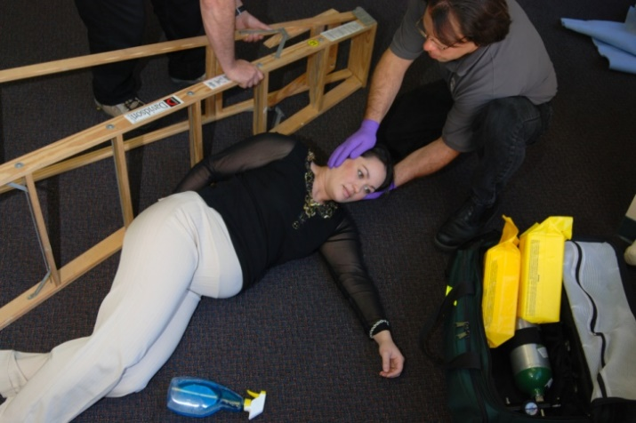
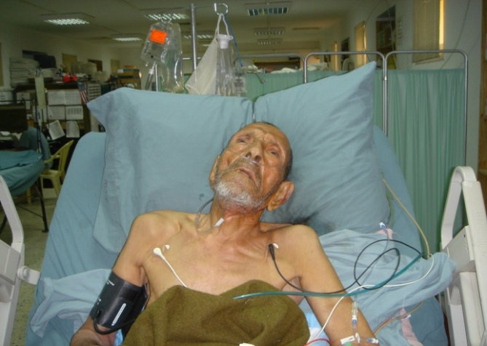
Special Considerations
Trauma in the elderly
Pediatric trauma
Trauma in pregnancy
Notes:
1-12 Special Considerations
Remind the students that there are special issues to consider with each of these types of trauma patients, but that the priorities remain the same.

Slide 22
Primary Survey
Airway
Establish patent airway and protect c-spine
_{Pitfalls}
Occult airway injury
Progressive loss of airway
Equipment failure
Inability to intubate
Notes:
1-13 Primary Survey: Establish patent airway and protect c-spine
Concerns regarding the c-spine may be new to those students who are familiar with cardiac life support procedures, but have not taken the ATLS Course.
Emphasize the need to protect the c-spine during airway management, especially avoiding the ACLS head-tilt maneuver.
You may then query the students about what pitfalls they may encounter with managing the airway or, depending on available time, caution the students to avoid these pitfalls.

Slide 23
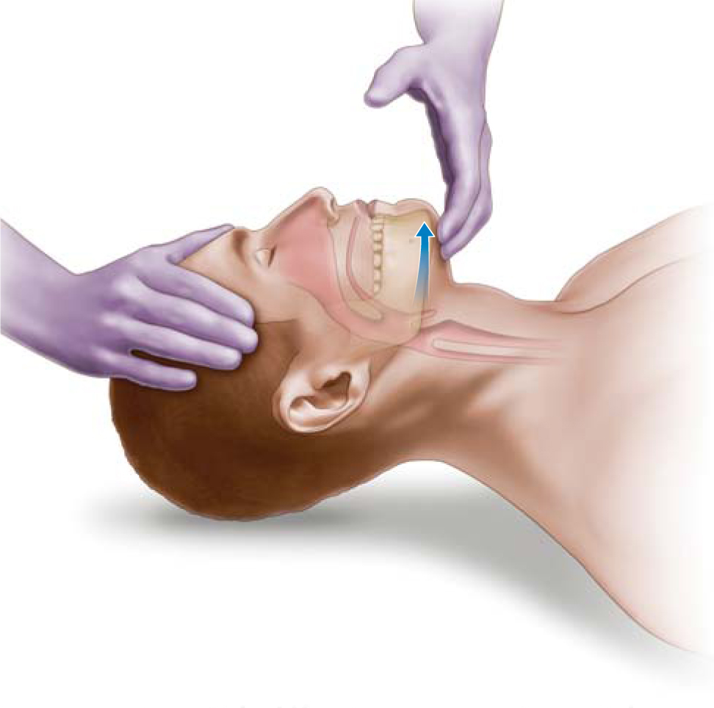
Primary Survey
Basic Airway Techniques
Chin-lift Maneuver
Notes:
No head tilt as this is a trauma patient

Slide 24
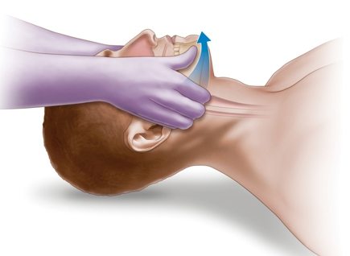
Primary Survey
Basic Airway Techniques
Jaw-thrust Maneuver
Notes:
A better technique

Slide 25
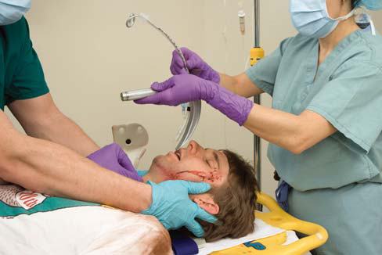
Primary Survey
Advanced Airway Techniques
Orotracheal intubation
Notes:
The definitive airway control
If it fails then surgical

Slide 26
Primary Survey
Breathing
Assess and ensure adequate
oxygenation and ventilation
Respiratory rate
Chest movement
Air entry
Oxygen saturation
Notes:
1-14 Primary Survey: Assess and ensure adequate oxygenation and ventilation
Emphasize the need to attend to adequate oxygenation and ventilation in the injured patient, recognizing that altered chest wall mechanics may be new to those doctors who have taken only the cardiac life support course.
Emphasize that, if the patient is receiving high-flow oxygen, adequate oxygenation is no guarantee of adequate ventilation.

Slide 27
Primary Survey
Breathing
The Immediate life threatening injuries
  Laryngeotracheal injury / Airway obstruction
  Tension pneumothorax
  Open pneumothorax
  Flail chest and pulmonary contusion
  Massive hemothorax
  Cardiac tamponade

Slide 28
Primary Survey
Circulation
Assess for organ perfusion
Level of consciousness
Skin color and temperature
Pulse rate and character
Notes:
1-16 Primary Survey: Assess for organ perfusion
Emphasize the reasons for assessing for signs of inadequate tissue perfusion instead of focusing on the patient’s blood pressure.

Slide 29
Primary Survey
Circulatory Management
Control hemorrhage
Restore volume
Reassess patient
Lethal triad
Notes:
1-17 Primary Survey: Circulatory Management
Emphasize the need to control hemorrhage or stop the bleeding.
Also emphasize that the patient may require an operation to stop the bleeding. Stress the importance of reassessing the patient’s response to treatment.

Slide 30
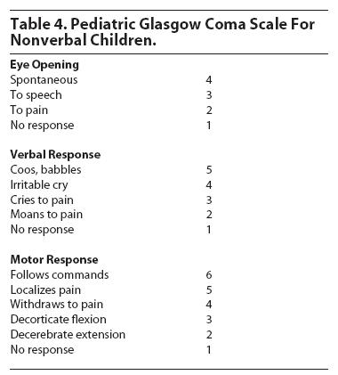
Primary Survey
Disability
Baseline neurologic evaluation
  Glasgow Coma Scale score
Notes:
1-18 Primary Survey: Disability
Emphasize that it is essential to identify neurologic injury using the tools of GCS score and pupil response early in order to avoid secondary brain injury, identify surgically correctible lesions rapidly, and provide a baseline GCS score to identify trends and changes.

Slide 31
Primary Survey
Disability
Baseline neurologic evaluation
  Glasgow Coma Scale score
  Pupillary response
Notes:
1-18 Primary Survey: Disability
Emphasize that it is essential to identify neurologic injury using the tools of GCS score and pupil response early in order to avoid secondary brain injury, identify surgically correctible lesions rapidly, and provide a baseline GCS score to identify trends and changes.

Slide 32
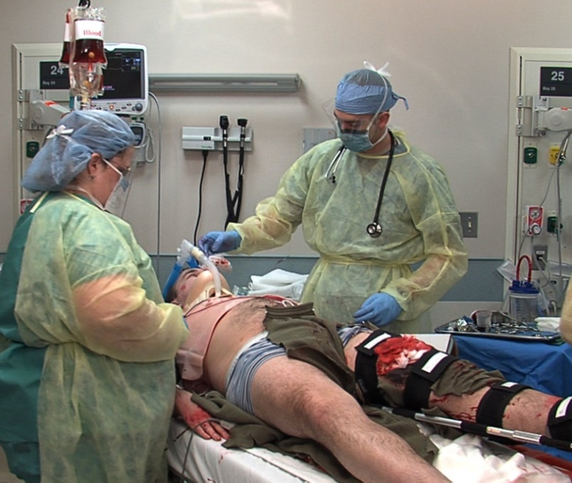
Primary Survey
Exposure / Environment
Completely undress the patient
_{Caution}
Prevent hypothermia
_{Pitfalls}
Missed injuries
Notes:
1-19 Primary Survey: Exposure and Environment
The ‘E’ of the ABCDEs.
Emphasize the need to completely undress the patient to adequately assess the entire patient, while at the same time preventing hypothermia.

Slide 33
Resuscitation
Protect and secure airway
Ventilate and oxygenate
Stop the bleeding!
Vigorous shock therapy
Protect from hypothermia
Notes:
1-20 Resuscitation
Emphasize that treatment is administered at the time the life-threatening problem is identified and that assessment and treatment during the primary survey and resuscitation phases of the initial assessment process often are done simultaneously.

Slide 34
Adjuncts to Primary Survey
Vital signs
ECG
ABGs
PRIMARY SURVEY
Pulse
oximeter
and CO₂
Urinary
output
Urinary / gastric catheters
unless contraindicated
Notes:
1-21 Adjuncts to the Primary Survey
Emphasize that adjuncts are done selectively, depending on the patient’s spectrum of injuries and physiologic responses.

Slide 35
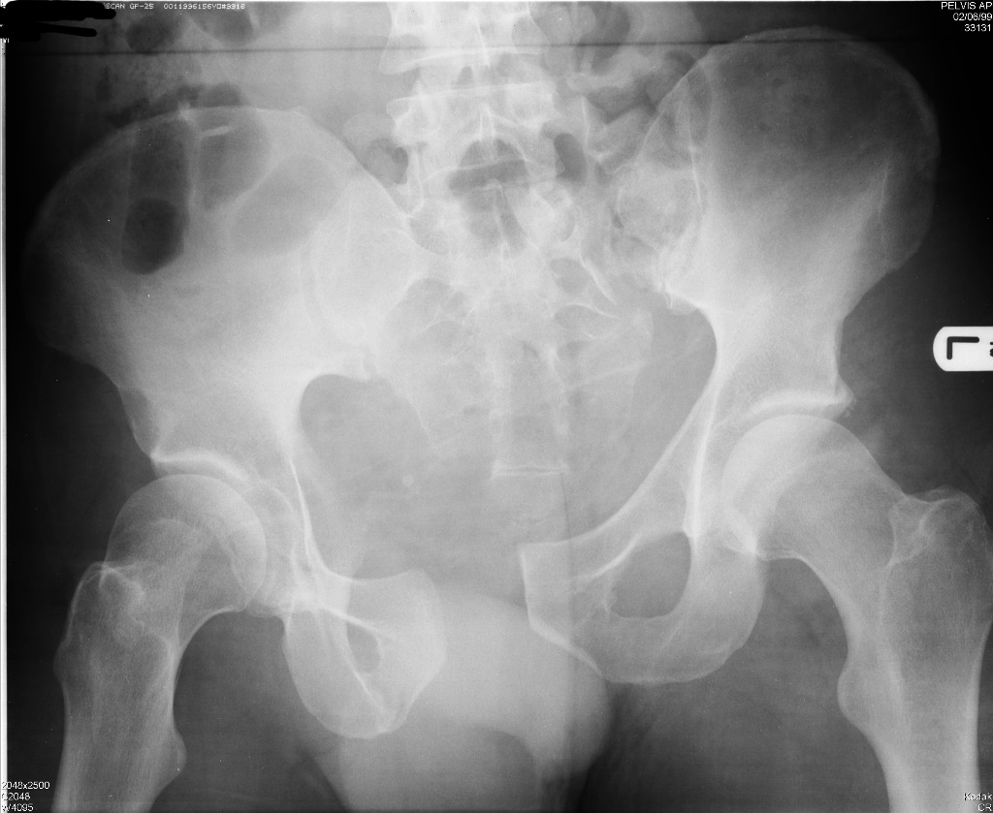
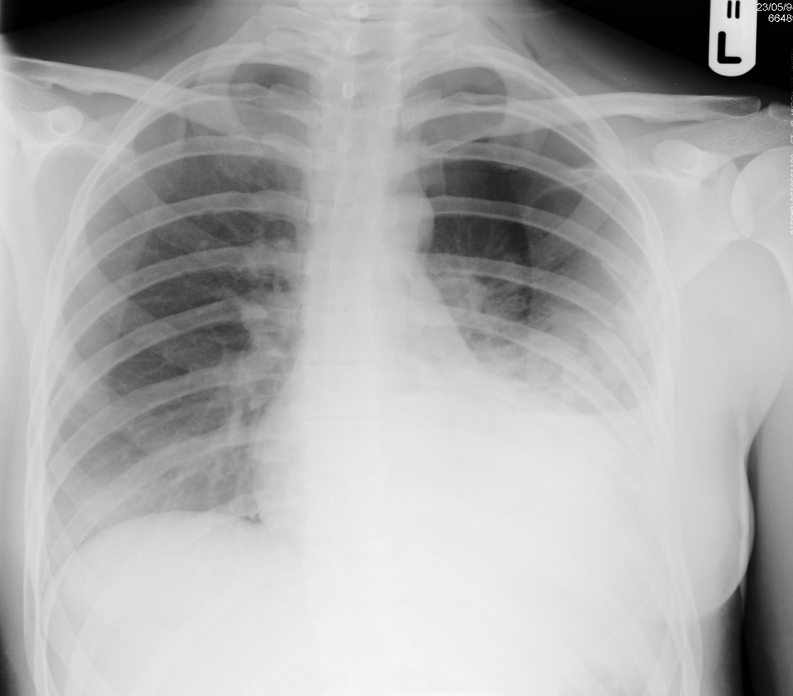
Adjuncts to Primary Survey
Notes:
1-22 Adjuncts to Primary Survey
The primary purpose of these adjuncts during the primary survey is to determine where occult bleeding may be occurring that is not obvious on clinical exam.
Emphasize the need to determine the source of shock.
Portable chest and pelvic x-rays in the emergency department are the ONLY x-rays obtained during the primary survey. Previous editions of the course included lateral cervical spine x-rays, but this film is now obtained selectively and at the appropriate time, based on the doctor’s judgment.
(X-rays courtesy of Dr. Ray McGlone, A&E Consultant, Royal Lancaster Infirmary; UK.)

Slide 36
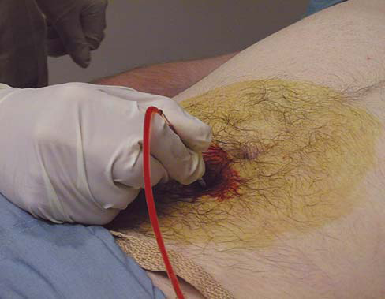
Adjuncts to Primary Survey
Diagnostic Tools
  FAST
  DPL
Notes:
1-23 Adjuncts to Primary Survey
DPL and FAST may also be used during the primary survey to detect intraabdominal blood.

Slide 37
Adjuncts to Primary Survey
Consider Early Transfer
Use time before transfer for resuscitation
Do not delay transfer for diagnostic tests
Notes:
1-24 Adjuncts to the Primary Survey: Consider Early Transfer
Emphasize that the time to initiate the transfer process is when the need is recognized. Therefore, the need to transfer must be considered early. The sooner the need is recognized and communicated, the more efficiently it occurs.
In addition, transfer should not be delayed to perform the secondary survey or to perform diagnostic tests such as CT scans. The time spent waiting for transportation to arrive should be spent stabilizing the patient.

Slide 38

Case Scenario

Slide 39
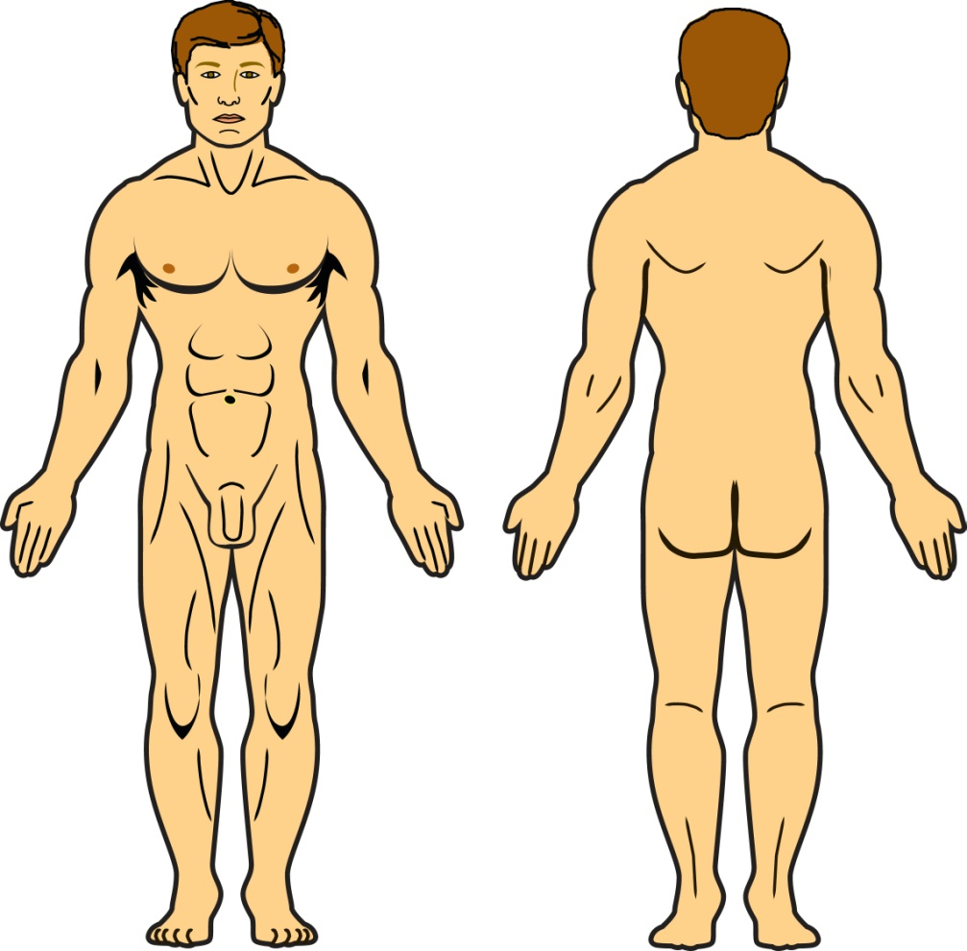
What is the secondary survey?
The complete
history and
physical
examination
Notes:
Like what we would normally do to any other patient after all life threating injuries have been identified and patient stabilized

Slide 40
Secondary Survey
When do I start the secondary survey?
After
Primary survey is completed
ABCDEs are reassessed
Vital functions are returning to normal
Notes:
1-26 Secondary Survey: When do I start it?
These slides transition the student to the secondary survey.
Emphasize that issues identified during the primary survey have been addressed and reevaluated before proceeding to the secondary survey.

Slide 41
Secondary Survey
What are the components of the secondary survey?
History
Physical exam: Head to toe
Complete neurologic exam
Special diagnostic tests
Reevaluation
Notes:
1-27 Secondary Survey: What are the components of the secondary survey?
You may use these items as a summary of the discussion on the components of the secondary survey.
This slide also serves as an introduction to each component of the secondary survey.

Slide 42
Summary
ABCDE approach to trauma care
Do no further harm
Treat the greatest threat to life first
One safe way
A common language

Slide 43
Trauma Care
Questions

