Slide 1
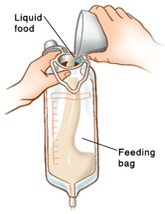
Nutrition in surgical patients Dietitian: Arwa Al.Ajaji

Slide 2
Topic summary
Nutrition therapy and nutrition support
Who needs for nutrition support
Malnutrition in surgical patient
Nutrition status assessment during admission
Nutrition requirements
Administration of nutrition support
Nutrition supplements
Who needs for diet modifications

Slide 3
Nutrition therapy
Nutrition therapy is the provision of nutrition or nutrients either orally (regular diet, therapeutic diet, e.g. fortified food, oral nutritional supplements) or via enteral nutrition (EN) or parenteral nutrition (PN) to maintain optimum nutrition,or to prevent or treat malnutrition

Slide 4
NUTRITION SUPPORT
Nutrition Support Therapy is part of Nutrition Therapy.
Involves the provision of nutrition beyond that provided by normal food intake using oral supplementation, or enteral tube feeding and parenteral nutrition .

Slide 5
WHO NEEDS
Patient at Nutrition risk/or Malnutrished
Postoperative complications:
- Ileus more than 4 days
- Sepsis
- Fistula formation
- Massive bowel resection
Intractable vomiting;
OTHER CONDITIONS :
Maxillofacial trauma
Traumatic coma / multiple trauma;
Burns;

Slide 6
MALNUTRITON
Malnutrition is a broad term that can be used to describe any imbalance in nutrition; from over-nutrition to under-nutrition.
Observed up to40-60% of surgical patient on admission/remines under-diagnose in 70% of patient in hospital settings.
malnutrition seen in hospitalized patients is often a combination of cachexia (disease-related) and malnutrition (inadequate consumption of nutrients) as opposed to malnutrition alone.
Cachexia can be defined as a “multifactorial syndrome characterized by severe body weight, fat and muscle loss and increased protein catabolism due to underlying disease.

Slide 7
Caused by :
- Reduced oral intake
(fasting, pain on swallowing, physical and mental impairment)
- Malabsorption:
(Excessive loss from gut, GI Carcinoma, short gut)
- Altered metabolism :
Trauma, burns, sepsis, surgery.

Slide 8
How to detect patient at risk
Nutritional risk screening in all patients on hospital admission or first contact:
BMI <18kg/m2
Combined: weight loss >10% or >5% over 3 months and reduced BMI or a low fat free mass index (FFMI)
Preoperative serum albumin < 30 g/l (with no evidence of hepatic or renal dysfunction)

Slide 9
General Assessment of Nutritional Status
History:
Weight change
Dietary intake change
GI symptoms
Functional capacity
Underlying disease (+ metabolic demand)
Physical Examination:
loss of subcutaneous fat
Muscle wasting
Ankle edema
sacral edema
ascites

Slide 10
LABORATORY MEASURES
serum proteins such as albumin and prealbumin
retinol-binding protein (RBP),
transferrin,
Nitrogen balance
total cholesterol
indicators of inflammation such as C-reactive protein (CRP) and total lymphocyte count (TLC),

Slide 11
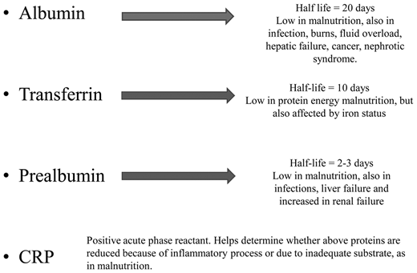

Slide 12
malnutrition adverse effects
Impaired wound healing
Impaired Immune function and increase risk for infection
Thoracic muscle mass wasting depresses respiratory efficiency and increase risk for pneumonia
Albumin level decrease leading to generalized edema.
Small bowel mucosa atrophy
Impired mental function leads to depression
Post operative complications rate is higher
Prolong recovery time and longer hospital stay

Slide 13
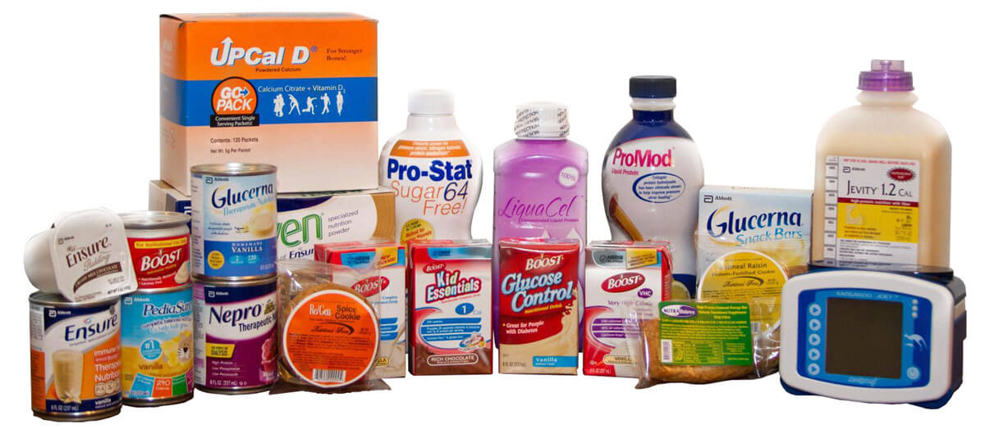
When start

Slide 14
Enhanced recovery of patients after surgery (‘‘ERAS’’) has become an important focus of perioperative management.
From a metabolic and nutritional point of view, the key aspects of perioperative care include:
Avoidance of long periods of pre-operative fasting
Re-establishment of oral feeding as early as possible after surgery
Integration of nutrition into the overall management of the patient metabolic control, e.g. of blood glucose;
Reduction of factors which exacerbate stress-related catabolism or impair gastrointestinal function;
Early mobilization

Slide 15
PRIOPERATIVE | POST OPERATIVE
Patients with severe nutritional risk shall receive nutritional therapy prior to major surgery, appropriate period of (7-14 )days Fasting from midnight is unnecessary in most patients ALLOW clear fluids until two hours before anaesthesia (clear fluids empties the stomach within 60-90 min) | Oral intake, including clear liquids, can be initiated within hours after surgery in most patients. Early normal food or EN, including clear liquids on the first or second postoperative day, does not cause impairment of healing of anastomoses in the colon or rectum Early tube feeding (within 24 h) shall be initiated in patients in whom early oral nutrition cannot be started, and in whom oral intake will be inadequate (patients undergoing major head and neck or gastrointestinal surgery for cancer , severe trauma, including brain injury, patients with obvious malnutrition at the time of surgery )

Slide 16
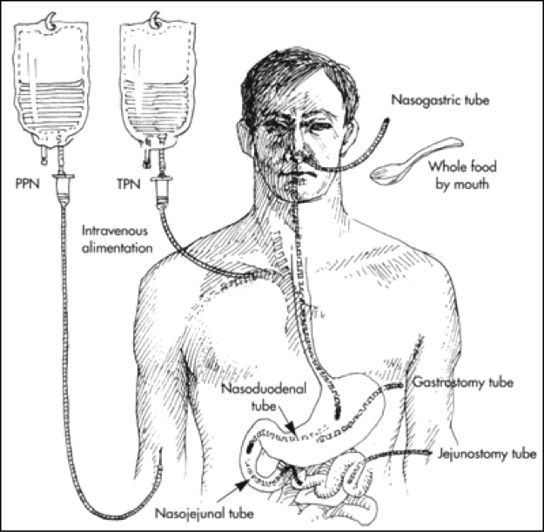
Modes of administration
What Route should be used
EN vs PN

Slide 17
Enteral Nutrition
Enteral nutrition (EN) by means of oral nutritional supplements (ONS) and if necessary tube feeding (TF)
The enteral feeding should always be preferred over Parenteral Nutrition

Slide 18
Enteral Tube feeding
Indications:
Malnourished patient expected to be unable to eat adequately for > 5-7 days
Adequately nourished patient expected to be unable to eat > 7-9 days
Adaptive phase of short bowel syndrome
Following severe trauma or burns
Early oral nutrition cannot be started, (patients undergoing major head and neck or gastrointestinal surgery for cancer , severe trauma, including brain injury, patients with obvious malnutrition at the time of surgery )
Contraindications:
Intestinal obstructions or ileus,
Severe shock
Intestinal ischemia
High output fistula
Severe GI bleed
Sever acute pancreatitis

Slide 19
Parenteral nutrition
For the surgical patient PN is beneficial in the following ;
Undernourished patients in which EN is not feasible or not tolerated
Patients with postoperative complications impairing gastrointestinal function who are unable to receive and absorb adequate amounts of oral/ enteral feeding for 5-7 days
PN should only be initiated if the duration of therapy is anticipated to be >7 days.
provision of PN of 25 kcal/kg and 1.5 g/kg protein presented no increased risk of hyperglycaemia and infectious complications
IN some cases, Combined EN/PN showed clinical benefits when compared with EN or PN alone, NOT necessary if expected time period for PN <4 days

Slide 20
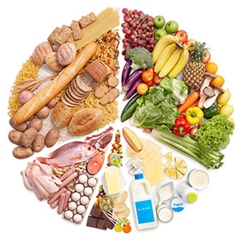
Assess nutrition needs

Slide 21
Energy and protein needs
Stable Non-ICU patients
Ideal body weight: (Male): 50 + 2.3 (height in inches - 60); (Female): 45.5 + 2.3 (height in inches - 60)
Adjusted body weight: IBW + [(actual weight – IBW) x 25%]
ICU patients
BMI (kg/m2) | Weight (kg) | Kcal/kg | Protein* (gm/kg)
< 30 | Actual | 25-30 | 1.2-1.5
≥ 30 | Adjusted | 20-25 | 1.2-1.5
BMI (kg/m2) | Weight (kg) | Kcal/kg | Protein* (gm/kg)
< 30 | Actual | 20-25 | 1.2-2.0
30-50 | Actual | 11-14 | 1.9-2.0 (IBW)
> 50 | Ideal | 22-25 | 2.5 (IBW)

Slide 22
Fluids needs
Age (years) | ml/kg | NOTE: Fluid needs should be determined by evaluating the patient’s clinical condition Decreased fluid needs (20-25 ml/kg actual BW): renal failure, dialysis, edema, CHF. Increased Fluid needs (30-35 ml/kg actual BW): short gut syndrome, high output ileostomy or fistula,excessive diarrhea, high NGT output, large draining wounds, chest tube and JP drain losses.
18-65 | 30-35
65+ | 25 -30
Hemodialysis | 1000 + output
Reference: http:health.qld.gov.au/masters/copyright.asp

Slide 23
Calculating Fluid Needs for Obese (BMI ≥ 30)
Adjusted Weight | Fluid per day | OR 30-35 ml/kg Adjusted body weight with allowances for extra losses via drains (draining wounds, chest tube and JP drain losses)
40-60 kg | 1500 - 2000 ml
60-80 kg | 2000 - 2500 ml
> 80 kg | 2500 - 3000 ml
Reference: http:health.qld.gov.au/masters/copyright.asp

Slide 24
Immunonutrition
Immunonutrition involves the administration of nutrients via enteral or parenteral routes in supranormal amounts, to achieve a pharmacological effect on one or more components of the patient’s response to surgery, trauma or infection.
In the preoperative phase, formulas enriched with arginine, omega-3 fatty acids and nucleotides have been shown to improve postoperative immune response, gut oxygenation and intestinal microperfusion

Slide 25
Glutamine:
Glutamine is essential amino acid and the preferred fuel for rapidly replicating cells such as gastrointestinal mucosal cells (enterocytes and colonocytes) and immune cells (lymphocytes and macrophages)
Further prospective, randomized trials are necessary to recommend widespread utilization of glutamine in nutritional support
Arginine :
L-arginine, a dibasic amino acid, has numerous important roles in the transport, storage, and excretion of nitrogen; formation of nitric oxide; mediation of macrophage function after injury; and regulation of wound healing
Antioxidants, including vitamins C and E, betacarotene, and selenium are often added in an effort to reduce oxidative stress among patients with acute metabolic stress.

Slide 26
The European Society for Clinical Nutrition and Metabolism (ESPEN) has established guidelines for use of enteral nutrition that included a consideration of “immunonutrient”.
Use enteral nutrition with immuno-modulating substrates (arginine, nucleotides and long-chain n-3 fatty acids) perioperatively in:
patients undergoing major neck surgery for cancer
patients undergoing major abdominal surgery for cancer.
Majer upper GI surgery
Elective upper gastrointestinal surgical patients
Patients with mild sepsis/AVOID in sever sepsis
Patients with trauma
Patients with acute respiratory distress syndrome
Avoid Immune Enhancing formulas in actively septic patients.
No recommendation for immune-modulating formulae can be given in burned patients due to insufﬁcient data.
ICU patients with very severe illness who do not tolerate more than 700ml enteral formula per day should not receive an immune-modulating formula

Slide 27
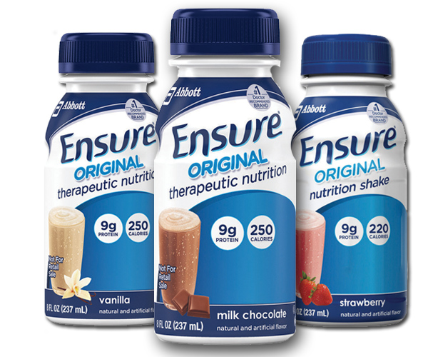
Select Formula

Slide 28
Standard 1kcal/1ml | Ensure Nutren 1.0 Osmolite RTF Energy zip 1.0 Jevity Trophic with fiber | Standard formula can be used via ENETRAL FEEDING OR orally - Can be used for all cases
Dens-calories 1.5g/ml | Ensure Plus Fortisip Resource Plus Ensure Two-Cal | for stressed patients and those requiring low-volume feedings
Modified carbohydrate 1kcal/1ml | Glucerna Resource Diabetic Diamax | Diabetes Mellitus, Hyperglycemia, Glucose Intolerance
Low elctrolyets 1.5-2kcal/1ml | Novasource Renal HD Max | Dialysis / Renal Failure / Renal Disease, Electrolyte and Fluid restriction

Slide 29
Branched-Chain Amino Acid 1.5kcal/1ml | Nutrihep | Hepatic Encephalopathy, Nutrition support for hepatic disease with elevated ammonia level
Low carbohydrate 1.5kcal/ml | Oxepa Pulmocare | modulate the inflammatory response in critically ill, mechanically ventilated patients, especially those with SIRS (systemic inflammatory response syndrome, eg, sepsis, trauma, burns), ALI (acute lung injury) or ARDS (acute respiratory distress syndrome)
Nutrient Dense/ Immunonutrients 1.2-1.6kcal/ml | IMPACT RECOVERY FORTICARE | For faster recovery ( before and after surgery),Severe trauma/injury, support colonic health, Pressure ulcer/wound, Dietary mgt of Cachexia in cancer , pancreatic cancer, lung cancer undergoing chemotherapy
Clear Liquids with Protein/ Fat-Free 1.5kcal/ml | Resource Breeze Fortijuice | Clear Liquid High Protein, bowel prep, fat malabsorptive/fat restricted, pre or post-surgical , nausea/vomiting/oncology

Slide 30
Semi-Elemental | Perative 1.3 Pivot 1.5 Peptamen Complete Alitraq | Malabsorption syndrome, impaired gastrointestinal function, short bowel syndrome, inflammatory bowel disease, pancreatic insufficiency, chronic diarrhea, radiation enteritis, HIV/AIDS-related malabsorption, transition diet from TPN
Protein 6g per scoop | Beneprotein Prosource | Protein-calorie malnutrition, wound healing e.g. burns, pressure ulcers
Prebiotics | Banatrol | Diarrhea and loose stool associated with tube feeding, antibiotics , oncology treatment and Clostridium difficile

Slide 31
Need Diet modifications ?
?

Slide 32
https://pdfs.semanticscholar.org/ee63/9712fd34f3ff5ea80c6b65927c65cd63aaa6.pdf
http://extranet.hospitalcruces.com/doc/adjuntos/ENSurgery.pdf
https://med.virginia.edu/ginutrition/wp-content/uploads/sites/199/2014/06/Parrish-August-16.pdf
http://www.espen.org/files/ESPEN-guideline_Clinical-nutrition-in-surgery.pdf

