Slide 1
Aspirin toxicity
Dr. Mohammed Arafat
Emergency medicine consultant

Slide 2
Aspirin, or acetylsalicylic acid, is widely consumed for its analgesic, anti-inflammatory, and antiplatelet effects.

Slide 3
Although its therapeutic use is wide, salicylate toxicity is not a benign condition and causes a complex set of life-threatening metabolic derangements with significant morbidity and mortality.

Slide 4
Salicylate containing products
Aspirin (most common)
Topical salicylates
Oil of wintergreen, willow bark, and bismuth subsalicylate.
Ingestion of oil of wintergreen is of particular concern given that 1 mL of 98% solution contains the equivalent salicylate of 1.4 grams of aspirin.

Slide 5
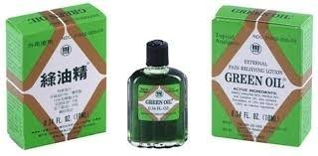
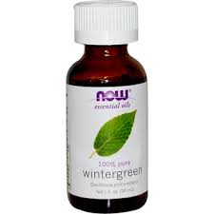
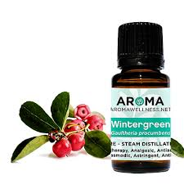

Slide 6
Pathophysiology

Slide 7
Unpredictable GI absorption (2-4 hours, but can be longer – up to 12 hours)
In the intestinal wall, liver, and red blood cells, aspirin is hydrolyzed to free salicylic acid, which reversibly binds to albumin

Slide 8
Toxicity results primarily from salicylate interference with aerobic metabolism by uncoupling of mitochondrial oxidative phosphorylation.
Inhibition of the Krebs cycle increases production of pyruvic acid and increases conversion to lactic acid.

Slide 9
Metabolic rate increase → metabolic acidosis
Tissue glycolysis → hypoglycemia and ketosis

Slide 10
Clinical feautures

Slide 11
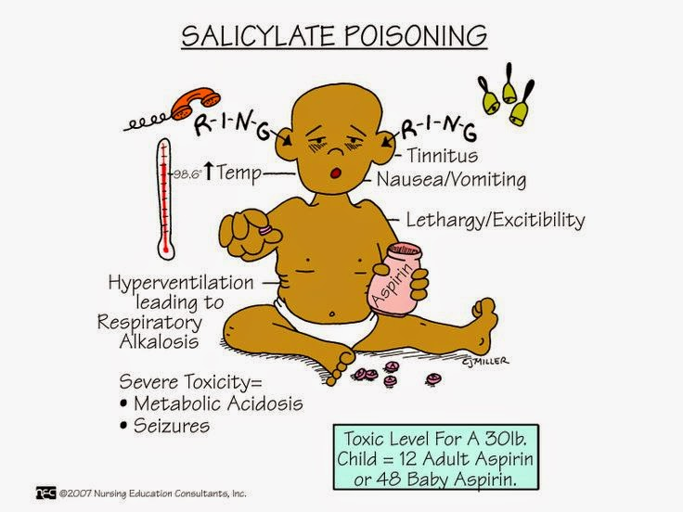
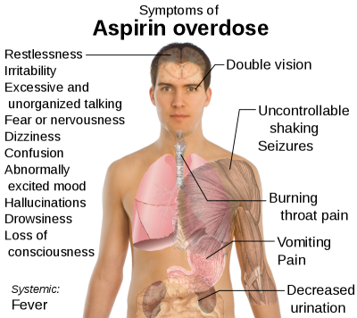
Clinical Features

Slide 12
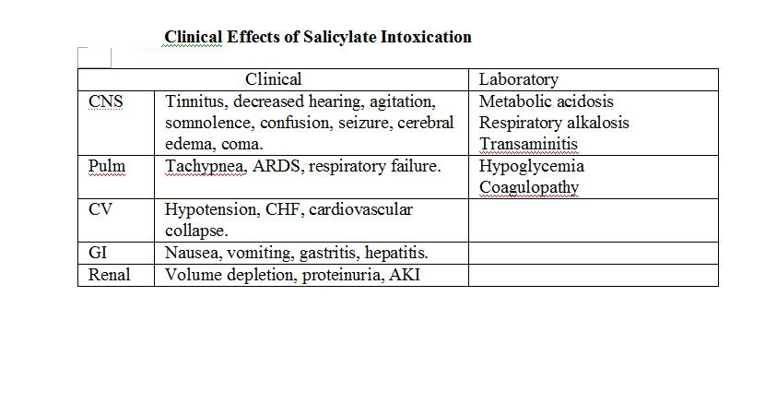

Slide 13
Differential diagnosis

Slide 14
Sepsis
CNS infection
Withdrawal syndromes
Alcoholic or diabetic ketoacidosis

Slide 15
Diagnosis

Slide 16
Diagnostic keys
The serum salicylate concentration
^{acid-base status}
^{potassium}

Slide 17
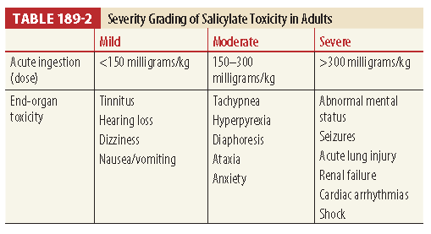
Toxic dose of aspirin is 200 to 300 mg/kg, and ingestion of 500 mg/kg is potentially lethal.
Five mL of oil of wintergreen contains 7 g of aspirin and can be deadly to a toddler

Slide 18
Management
Specific treatment of salicylate toxicity has two main objectives:
Correct fluid deficits and acid-base abnormalities
Increase excretion
Intubation is indicated for patients with refractory shock, pulmonary or cerebral edema, or other manifestations of severe salicylate poisoning.
Electrolyte values are helpful to guide replacement and to assess renal function necessary to excrete salicylates.
Serum salicylate levels should be repeated until they are decreasing to measure the effectiveness of treatment and to guide the decision for dialysis.
Notes:
Pre and post intubation management NAHCO3 and RR

Slide 19
Activated Charcoal ?
no evidence of benefit

Slide 20
Intravenous Fluids
Correct Potassium depletion.
Maintain urine output of 2 to 3 mL/kg/hr.
Avoid excessive fluid administration ( why ? )
Should contain dextrose, and the serum glucose level should be frequently monitored to prevent hypoglycemia.
Notes:
Pulmonary and cerebral edema

Slide 21
Urine Alkalinization
Advisable in patients with:
salicylate levels greater than 35 mg/dL
Significant acid-base disturbance
Increasing salicylate levels
Urine pH of 7.5 to 8.0 is necessary to increase excretion.
Sodium bicarbonate (1-2 mEq/kg) can be administered during 1 to 2 hours. ( how ? )
Potassium depletion must be corrected ( why ? )
Notes:
1.5 to 2 of maintenance

Slide 22
Forced diuresis ?
Forced diuresis does not significantly increase salicylate excretion and may potentiate cerebral and pulmonary edema.
Notes:
Also dehydration which increase aspirin toxicity

Slide 23
Hemodialysis ?
Coma, seizure
Renal, hepatic, or pulmonary failure
Pulmonary edema
Severe acid-base imbalance
Deterioration in condition
Serum salicylate concentration ≥ 100 mg/dL after acute ingestion
Serum salicylate concentration ≥ 40 mg/dL after chronic ingestion
Rapidly rising serum salicylate level
Failure to respond to conservative treatment

Slide 24
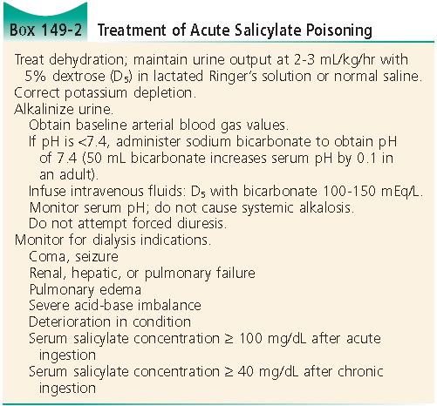

Slide 25
Disposition
A patient may be discharged from the ED if serial declining salicylate levels.
Hospital admission is required for pulmonary edema, CNS symptoms, seizures, acidosis, electrolyte disorders, dehydration, renal insufficiency, or increasing serum levels during serial testing.
Overdosed of enteric-coated or modified-release preparations of aspirin should be treated and observed for approximately 24 hours, with serial serum salicylate concentrations.

Slide 26
CONT…
Consultation with a clinical toxicologist is recommended.
The mortality rate for chronic salicylate intoxication is 25%, compared with a mortality rate of 1% after acute salicylate intoxication.
With any case of intentional overdose, psychiatric evaluation is essential.

Slide 27
THANK YOU

