Slide 1
Cocaine and Other Sympathomimetics

Slide 2
PERSPECTIVE
Cocaine, amphetamines, and derivatives of amphetamines are called sympathomimetics.
These agents cause central nervous system (CNS) stimulation and a cascade of physiologic effects.

Slide 3
CLINICAL EFFECTS OF SYMPATHOMIMETICS

Slide 4
PRINCIPLES OF DISEASE
Pathophysiology of Cocaine
Acute cocaine use causes release of dopamine, epinephrine, norepinephrine, and serotonin.
most important effects are adrenergic stimulation by norepinephrine and epinephrine.
Norepinephrine causes vasoconstriction by stimulating alpha-adrenergic receptors on vascular smooth muscle.

Slide 5
PRINCIPLES OF DISEASE
Pathophysiology of Cocaine
Epinephrine increases myocardial contractility and heart rate through stimulation of beta₁-adrenergic receptors.
In addition to causing catecholamine release, the reuptake of these stimulatory neurotransmitters from synaptic clefts is inhibited, altering the normal balance between excitatory and inhibitory tone in the CNS.

Slide 6
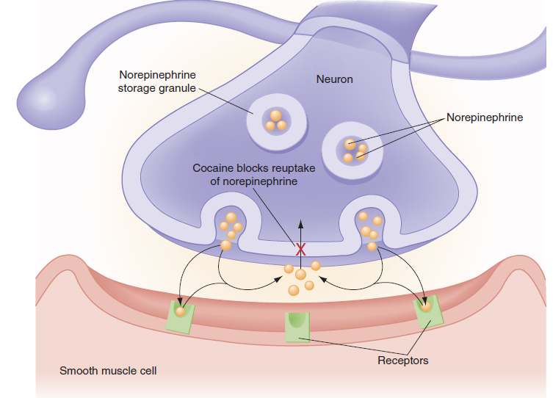
How cocaine increases sympathetic tone by increasing neurotransmitters in the synapse.

Slide 7
PRINCIPLES OF DISEASE
Pathophysiology of Cocaine
Cocaine also is a local anesthetic agent, slowing nerve impulses from neuronal pain fibers by blocking the inward movement of sodium across cell membranes (phase 0 of the action potential).
Sodium channel blockade across myocardial cells, similar to the class IA antidysrhythmic agents, is responsible for the occasional conduction abnormality with acute cocaine toxicity.

Slide 8
PRINCIPLES OF DISEASE
Pathophysiology of Cocaine
Cocaine metabolism occurs in the liver and the plasma.
In the liver, primarily to the active metabolite norcocaine, which potentiates the parent drug.
In the plasma, to ecgonine methyl ester via pseudocholinesterase (plasma cholinesterase).

Slide 9
PRINCIPLES OF DISEASE
Pathophysiology of Cocaine
Ecgonine methyl ester may be protective because it is a vasodilator.

Slide 10
PRINCIPLES OF DISEASE
Pathophysiology of Cocaine
Benzoyl ecgonine is a metabolite found in the plasma and is the metabolite identified by urine toxicology screens.
The use of ethanol with cocaine may form coca ethylene, a metabolite that may potentiate the drug's stimulatory effects.

Slide 11
Cocaine Pharmacology by Route of Administration

Slide 12
CLINICAL FEATURES
excitation of the sympathetic nervous system.
Patients with moderate toxicity are alert and awake but may have diaphoresis, tachycardia, mydriasis, and hypertension without organ damage.
A more severely intoxicated patient may present agitated, combative, and hyperthermic.
Signs and symptoms of end-organ damage may be present, including acute hypertensive emergencies.

Slide 13
Patients may present with focal, acute pain syndromes; circulatory abnormalities; delirium; or seizures.
The clinical presentation depends on the dose, route of administration, and time to presentation after drug use.

Slide 14
Patients who are “speed balling,” using IV heroin and cocaine together, may be initially sedated, and administration of naloxone may reveal the underlying cocaine intoxication.
Mortality is high with temperatures greater than 41.1°C.

Slide 15
Initial assessment and treatment should focus on rapidly fatal complications
Hyperthermia
hypertensive emergencies
cardiac dysrhythmias.
Seizure

Slide 16
Hyperthermia
agitation with delirium increases the risk of hyperthermia.
Vasoconstriction and dehydration can compromise cooling, resulting in life-threatening hyperthermia with core temperatures exceeding 106 F (41.1 C).
Delay in recognition result in death.
Increased motor tone can release intramuscular (CK) with rhabdomyolysis and renal and electrolyte complications.

Slide 17
Hypertensive Emergencies
sequelae include
aortic dissection
pulmonary edema
myocardial ischemia and infarction
intracranial hemorrhage, strokes
infarction of the anterior spinal artery.

Slide 18
Hypertensive Emergencies
Vasospasm can compromise perfusion to various organs. Intestinal infarctions and mesenteric ischemia can occur, particularly in body packers with large oral ingestions. Other local ischemic events include retinal vasospasm, renal infarctions, and placental insufficiency and infarction in the gravid uterus.

Slide 19
Cardiac Dysrhythmias
may not be noted until cardiac output abruptly diminishes, and the patient suddenly loses consciousness.
sinus tachycardia is most common
atrial fibrillation and other supraventricular tachycardias

Slide 20
Cardiac Dysrhythmias
Torsades de pointes or wide-complex tachycardias from blockade of fast sodium channels on the myocardium may deteriorate into poorly perfusing or fatal ventricular rhythms.
Hyperkalemia from rhabdomyolysis and myocardial ischemia can also cause dysrhythmias.

Slide 21
Other Complications
People who binge with continuous use causes catecholamine depletion, dehydration, and poor nutrition.
After the acute effects of cocaine have subsided, these patients with “cocaine washout” are profoundly sleepy but arousable and oriented, with normal vital signs or a mild sinus bradycardia.

Slide 22
Other Complications
“crack dancing,” a transient choreoathetoid movement disorder
DVT is reported with cocaine use, probably secondary to effects on coagulation.
oropharyngeal burns from the high temperature required to volatilize the drug.

Slide 23
Other Complications
Pneumothorax, pneumopericardium, and pneumomediastinum occur from inhalational barotrauma.
Intranasalcocaine use is associated with sinusitis and naso palatine necrosis or perforation.

Slide 24
Other Complications
Transdermal injection of cocaine, or “skin popping,” has similar types of complications.
Intravenous users have a high risk of infection with blood-borne viruses, local abscesses, and systemic bacterial infections, including botulism, and endocarditis.

Slide 25
DIAGNOSTIC STRATEGIES
Urine drug screening is unlikely to change treatment because it measures a cocaine metabolite (benzoyl ecgonine) that is typically present for 3 days after last use.

Slide 26
DIAGNOSTIC STRATEGIES
Urine drug screening may be beneficial in
(1) to document possible abuse
(2) to confirm cocaine as the unknown substance in body packers
(3) to differentiate paranoia from drug-induced or psychiatric causes.
ECG
sinus tachycardia ,wide complex tachycardia
ECG screens for dysrhythmias and conduction abnormalities from ischemia, hyperkalemia, or, more precipitously, QRS

Slide 27
DIAGNOSTIC STRATEGIES
Cyclic antidepressants and cocaine share class Ia antidysrhythmic effects.
Accurate diagnosis of chest pain is problematic. ST segment elevation is confounded by the presence of early repolarization.
Serial ECGs may be helpful.

Slide 28
DIAGNOSTIC STRATEGIES
Creatine kinase (CK)
serum CK-MB fraction, troponin I, and troponin T are more specific in patients with atherogenic coronary disease.

Slide 29
DIAGNOSTIC STRATEGIES
Severe, persistent headache despite normalization of blood pressure may occur with a SAH and warrants head CT and, if the scan is negative, lumbar puncture.
Urinalysis should be checked for myoglobin, which indicates rhabdomyolysis.

Slide 30
DIFFERENTIAL CONSIDERATIONS
Sedative-hypnotic withdrawal
Amphetamines and its derivatives
Heatstroke.
Infection should be considered in all hyperthermic patients.

Slide 31
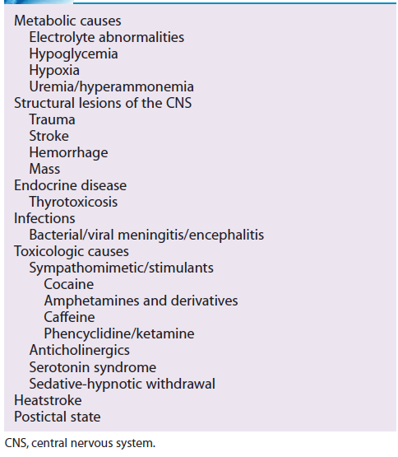
DIFFERENTIAL DIAGNOSIS OF AGITATED DELIRIUM

Slide 32
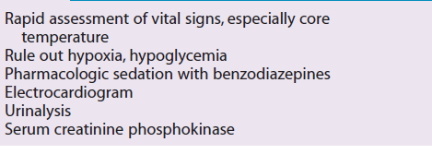
INITIAL EVALUATION OF PATIENTS WITH SYMPATHETIC STIMULATION

Slide 33
MANAGEMENT
After initial airway assessment
physical restraints to obtain complete vital signs and to secure IV access.
Empirical therapy with IV dextrose and thiamine or assessment with a bedside blood glucose monitor.
IV benzodiazepines may be necessary

Slide 34
Pharmacologic Sedation
In adults, IV diazepam can be administered in increments of 10 mg every 5 minutes until sedation is achieved.
In wildly agitated patients in whom 20 to 30 mg of diazepam has no notable effect, the increments may be increased carefully by 20 mg each subsequent dose with close monitoring.

Slide 35
Hyperthermia
rapid cooling.
Patients who sustain elevated core temperatures greater than (41 C) for more than 20 minutes are likely to stabilize transiently, then develop fatal multisystem organ failure, often heralded by DIC.
Patients should have continuous monitoring of core temperature with a rectal probe.

Slide 36
It is crucial to reduce core temperature to (38.8? C) within 20 minutes.
Cooling blankets are insufficient. Ice water, wet sheets with large fans, and packing the entire body in ice with continuous monitoring of core temperature can be used.
These patients often require aggressive fluid resuscitation.
Hyperthermia

Slide 37
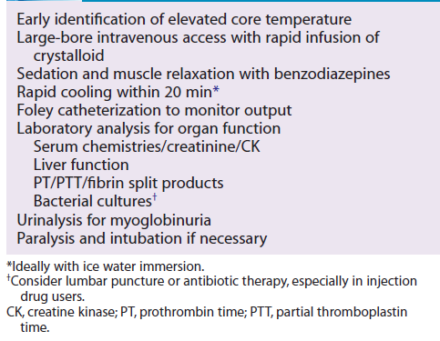
MANAGEMENT OF STIMULANT-INDUCED HYPERTHERMIA

Slide 38
Hypertensive Emergencies
Benzodiazepines restore the CNS inhibitory tone on the peripheral nervous system.
With evidence of end-organ damage, IV nitroglycerin or nitroprusside can be used.

Slide 39
Hypertensive Emergencies
Phentolamine, a direct alpha-adrenergic antagonist, is the antihypertensive of choice.
It can be titrated slowly using repeat IV doses of 1 to 5 mg with blood pressure monitoring.

Slide 40
Hypertensive Emergencies
Beta Blockers may cause paradoxical hypertension with cocaine.
Beta Blockers use in cocaine-related chest pain syndromes should be avoided.

Slide 41
Dysrhythmias
atrial or ventricular.
Atrial fibrillation and supraventricular tachycardias are likely due to sympathetic stimulation and often respond to benzodiazepines. Beta-adrenergic antagonists should be avoided.
When the cause of a wide-complex tachycardia from cocaine is unknown, an empirical sodium bicarbonate, 1 to 2 mEq/kg IV bolus
treats sodium channel blockade and potential cardiotoxicity from hyperkalemia.

Slide 42
Dysrhythmias
Lidocaine
may increase seizure risk and mortality and is therefore reserved for patients with ventricular dysrhythmias for whom bicarbonate therapy has failed and who have already received benzodiazepines
most useful for ventricular dysrhythmias with cocaine-associated MI.
Amiodarone
is not well studied, but may be beneficial for ventricular dysrhythmias.

Slide 43
Cocaine-Related Chest Pain
chest radiograph to identify
aspirated foreign bodies
pneumothorax or pneumomediastinum from inhalational barotrauma.
Fever and shortness of breath should prompt consideration of pneumonia, pulmonary infarction, or endocarditis with septic pulmonary emboli in IV drug abuse.

Slide 44
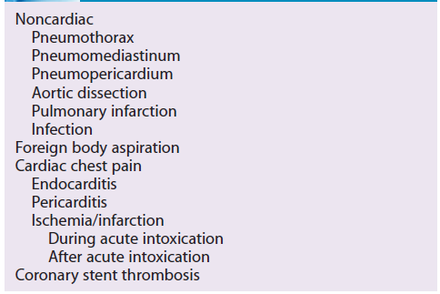
CAUSES OF STIMULANT-INDUCED CHEST PAIN

Slide 45
Cocaine-Related Chest Pain
Cocaine induces coronary vasoconstriction and increase myocardial oxygen demand.
Platelet aggregation is enhanced through prothrombogenic and antifibrinolytic pathways.

Slide 46
Cocaine-Related Chest Pain
Patients with positive serum enzymes for MI have significant angiographic stenosis

Slide 47
Cocaine-Related Chest Pain
18% still have significant disease by angiogram.
Other predictors of significant disease in this group included elevated cholesterol and prior diagnosis of coronary disease or MI.
Patients with a history of coronary stent placement are at a high risk of thrombosis with cocaine use

Slide 48
Cocaine-Related Chest Pain
benzodiazepines decrease myocardial oxygen demand by limiting peripheral stimulation and should be given early.
Aspirin and nitrates also should be administered. In patients meeting ECG criteria for MI with persistent chest pain and hypertension and a clear history of acute cocaine intoxication,
coronary vasodilation with IV phentolamine (1 mg) given slowly should be considered.

Slide 49
Cocaine-Related Chest Pain
Morphine sulfate also can be used to treat pain.
Patients with persistent chest pain and ST segments strongly suggestive of MI can be considered for percutaneous intervention in the catheterization laboratory or thrombolytic therapy, assuming there are no contraindications such as uncontrolled severe hypertension.

Slide 50
Cocaine-Related Chest Pain
beta-adrenergic antagonists, including labetalol, are contraindicated during acute cocaine toxicity

Slide 51
Cocaine-Related Chest Pain
Patients with cocaine-related chest pain without other risk factors who have normal ECGs and cardiac enzymes are at low risk for myocardial infarction.

Slide 52
Cocaine Body Packers
Before crossing international borders, “body packers” ingest cocaine that has been wrapped tightly into condoms or other latex products and sometimes coated in wax.
Each packet can contain approximately 10 g of cocaine, and packers may swallow as many as 150 packets.
Body packers are likely to know the exact number of packets they ingested.

Slide 53
Cocaine Body Packers
A body packer may present without symptoms to the ED.
The body packer should be placed immediately on continuous cardiac monitoring, with large-bore IV access.
An abdominal radiograph may confirm foreign bodies
When uncertainty persists, a contrast study is warranted.

Slide 54
Cocaine Body Packers
When evidence of cocaine toxicity is manifest, rapid transportation to the operating room may be the only way to save these patients.
Benzodiazepines, neuromuscular blockade, or sodium bicarbonate administration may be required en route.

Slide 55
Cocaine Body Packers
CT and contrast abdominal radiographs may fail to detect isolated packets that contain potentially fatal quantities of cocaine.
Endoscopic retrieval is discouraged because of concern over packet rupture during the procedure.

Slide 56
Body Stuffers
A “body stuffer” is an individual who attempts to conceal evidence of cocaine possession by swallowing the drug while pursued by law enforcement officials.
These are usually unplanned events with generally small quantities of drug intended for personal use.

Slide 57
DISPOSITION
can be discharged after the acute intoxication resolves. These patients may be extremely sleepy from catecholamine depletion, and it is best to discharge them with a responsible adult.
Patients who develop complications should be
amitted to the intensive care unit for further treatment.

Slide 58
DISPOSITION
Patients with chest pain who are acutely intoxicated and who show dynamic changes on the ECG, dysrhythmias, or congestive heart failure or patients requiring vasodilators or reperfusion should be admitted.
These patients require further evaluation of the extent of preexisting reversible ischemia and intervention to encourage cessation of drug use.

Slide 59
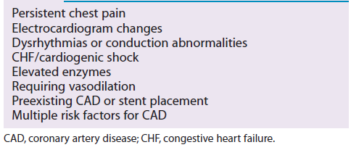
ADMISSION CRITERIA FOR COCAINE-RELATED CHEST PAIN

Slide 60
DISPOSITION
After a 12-hour monitored observation period, patients with a benign clinical course and negative serum enzyme markers can be discharged.

Slide 61
DISPOSITION
Body packers need to be observed until all packets have passed.
Ideally, these patients have had three packet-free stools, a reliable packet count consistent with the ingestion, and a negative contrast radiographic study.

Slide 62
OTHER STIMULANTS
Amphetamines
Enhance release of catecholamines from presynaptic nerve terminals
Usually taken as pills, but occasionally are crushed and injected.
CNS stimulation results in nearly identical sympathomimetic effects to those from cocaine, but not with the same frequency or intensity.

Slide 63
OTHER STIMULANTS
Amphetamines
Patients are at risk for
Hyperthermia
hypertensive emergencies
Dysrhythmias
myocardial ischemia
hyperkalemia associated with rhabdomyolysis.
do not block sodium channels and only minimally affect presynaptic reuptake of catecholamines.

Slide 64
OTHER STIMULANTS
Amphetamines
Although urine drug screens can identify amphetamines, they are of little utility in treating an intoxicated patient.
The management follows the same guidelines as for cocaine, although the duration of toxicity tends to be longer for amphetamines.

Slide 65
Methylenedioxymethamphetamine
Methylenedioxymethamphetamine (MDMA—“Ecstasy,” XTC, Adam) is a chemically modified amphetamine originally taken orally at all-night dance parties, or “raves.” Patients describe the euphoria allowing “closeness to others,” so it is sometimes called the “love drug.”

Slide 66
Methylenedioxymethamphetamine
MDMA
life-threatening hyponatremia
may alter release of endogenous stores of vasopressin.
urine samples with a relatively high urine sodium level, similar to SAIDH.
Unless seizures or other neurologic events are present, patients can be treated supportively with fluid restriction.

Slide 67
Methylenedioxymethamphetamine
Normal saline or other crystalloids may worsen the hyponatremia because these patients are likely to retain more free water than sodium.
Their fluid intake should be restricted unless severe hypovolemia exists, and they should be treated with hypertonic saline for neurologic impairment.

Slide 68
Methylenedioxymethamphetamine
In contrast to other amphetamines, chronic MDMA use causes potentially irreversible neurologic damage to serotoninergic neurons.

Slide 69
Methamphetamine
Methamphetamine, known as “crank” and “crystal meth,” is a fat-soluble, smokable, designer amphetamine.
Complications from methamphetamine use are similar to those from other sympathomimetics.

Slide 70
Methamphetamine
The duration of action can be significantly longer, however, with some paranoid delusions persisting for 15 hours.

Slide 71
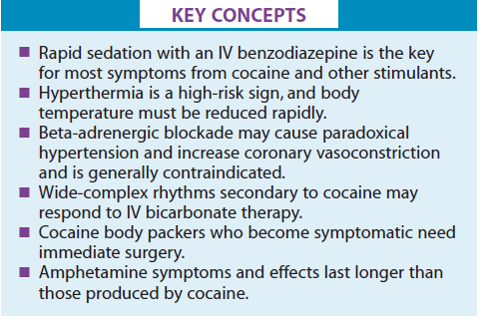

Slide 72
THANK YOU

