Slide 1

Introduction to the 3rd year

Slide 2
First Semester
Second Semester
Medicine
Surgery
Radiology
Community medicine
Research (Theory)
Ethics
Research (Project)
Informatics
Forensic and toxicology

Slide 3

Internal Medicine
(MED 341)
Students should check every course organizer for main references
1-Credit : 10 Hours
2-Marks distribution:
a-MCQs: Mid-term: 20 Final: 30
b-OSCE: Final 30
c-Longcase: 15
d-DXR: 5
Total= 100

Slide 4
Medicine Teaching
Lectures
Bed-side teaching (BST)
Case-Based learning (CBL)

Slide 5
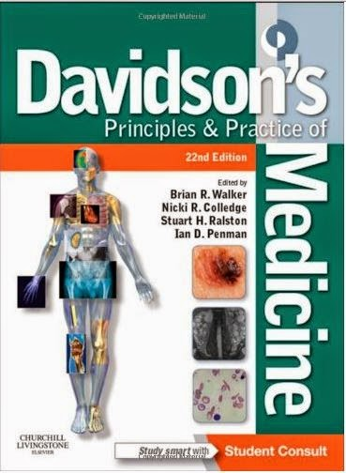
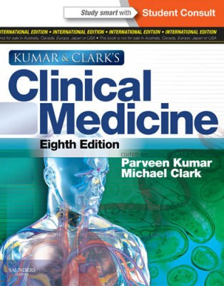
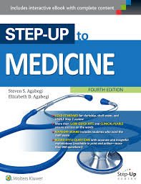
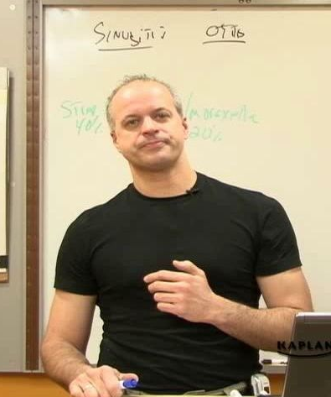
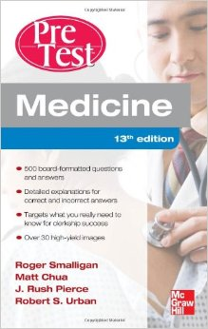

References
Textbook
Short textbook
Theory
Review (notes)
MCQs

Slide 6
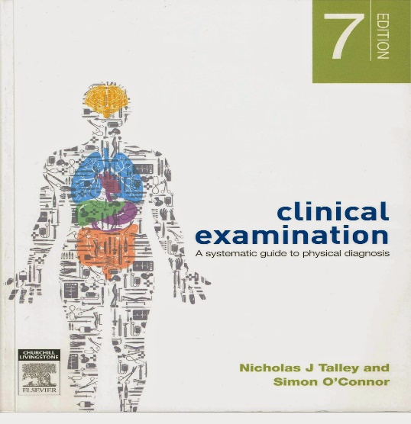
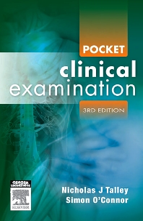
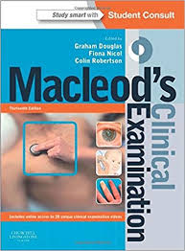


References
Hx AND Px
(Talley)
- Du’aa 429 booklet
- Summer clinical skills notes
https://drive.google.com/drive/folders/0B0kXGsUOtp6qQnJ4VEZobW1lRm8?usp=sharing

Slide 7

General Surgery
(SURG 351)
Students should check every course organizer for main references
1-Credit : 8 Hours
2-Marks distribution:
a-MCQs: Mid-term: 20 Final: 20
b-OSCE: Mid-term: 15 Final: 40
c- logbook: 5
Total : 100

Slide 8
Surgery Teaching
Lectures
Bed-side teaching (BST)
Case-Based learning (CBL)

Slide 9
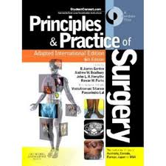
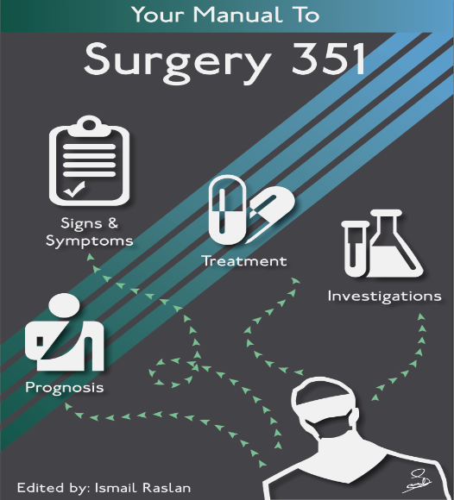
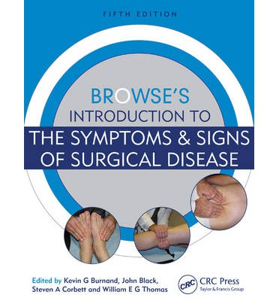
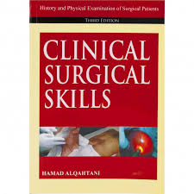

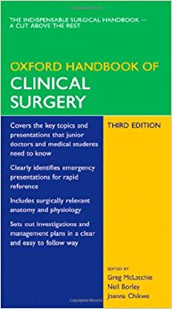
References
Theory
Hx and Px
Davidson
Raslan
Short & Notes
428 Surgery booklet

Slide 10
Research Methodology & Biostatistics (CMED 305)
1-Credit: 6 Hours
2-Marks distribution:
MCQs: 40 (mid: 15 / final: 25)
Continuous Assessment (60%):
1. Research Project (40%):
    Research protocol by supervisor (10%);
    Ethical Review Committee Clearance (5%);
    Final report by supervisor (10%); & CM unit review committee (10%);
    Oral Presentation by assigned evaluators (5%);
2. Other (20%):
    Assignments (10%)
    Quizzes (10%)
3-Refrences: slides

Slide 11
Theory part of research
24 lectures.
After some lecture there will be practical sessions in the same topic.
Quizzes.
Final exam is on the end of the first semester.
The last 6 lectures will discuss Biostatistics.

Slide 12
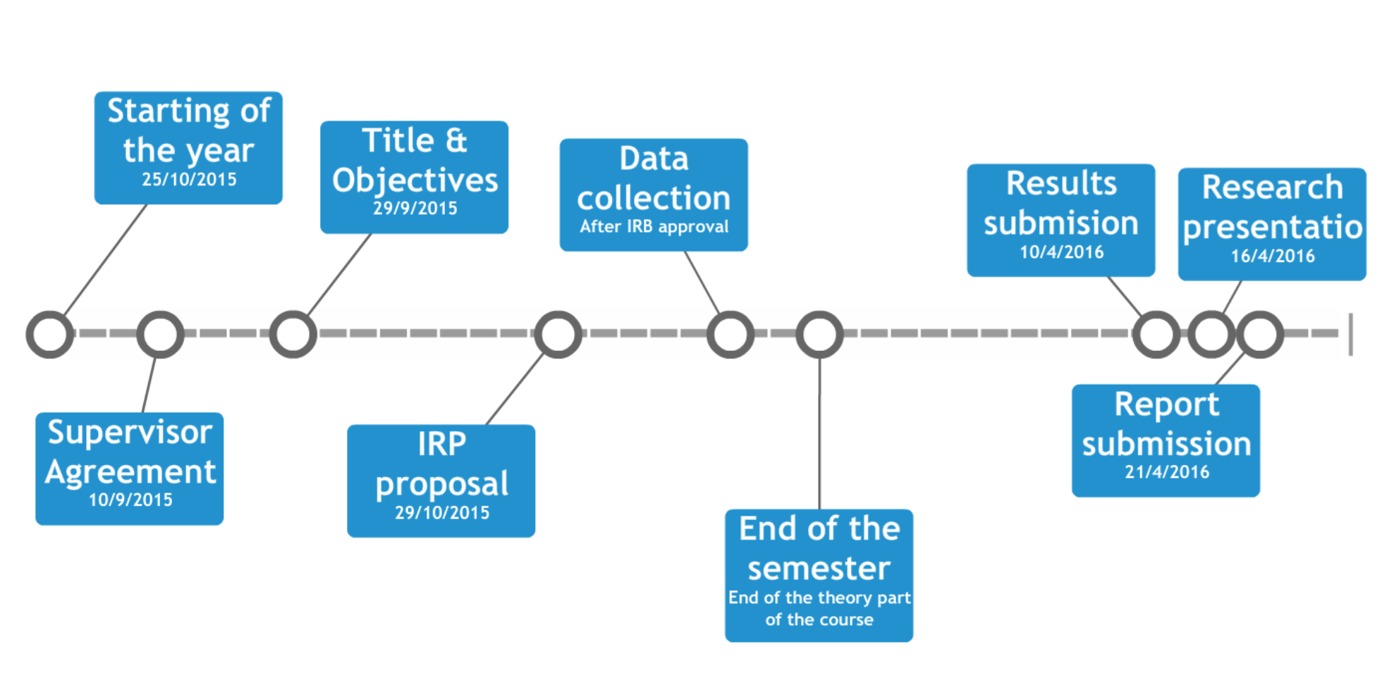

Slide 13
Community Medicine (CMED311)
1-Credit: 4 Hours
2-Marks distribution:
Mid-term Examination : 40
Final Examination: 40
Quizzes : 5
Seminar presentation : 15
3-Refrences: Slides ( &seminars)

Slide 14
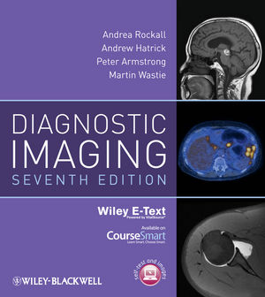
Medical Radiology and Body Imaging
(RAD 365)
1-Credit: 2 Hours
2-Marks distribution:
MCQs: Mid-term: 50 Final: 40
Quizzes: 10 (5 each)
3-Refrences: Slides
Book

Slide 15
Medical Informatics (CMED 301)
1-Credit: 2 Hours
2-Marks distribution:
MCQs: Midterm: 20 Final:40
Quizzes (online) : ?
CIS Project: ?
3-Refrences: slides

Slide 16
Medical Ethics (CMED 395)
1-Credit: 3 Hours
2-Marks distribution:
MCQs: Midterm: 30 Final:40
Ethical case: Writing: 20 Presentation: 10
3-Refrences: slides & Department Notes (on Blackboard)

Slide 17
Forensic Medicine and Toxicology
(FORM 321)
1-Credit: 2 Hours
2-Marks distribution:
50% Toxicology
50% Forensic
3-Refrences: Slides and the book

Slide 18
General notes for all subjects
Focus on clinical aspects
After studying, you may like to go through sample questions such as those in books (surgical recall, medical recall, USMLE books...etc)

Slide 19
What is:
BST (Bed-Side Teaching)?
CBL (Case-Based Learning)?
TBL (Task-Based Learning)?

Slide 20
BST: bed-side teaching
  It’s in medicine + surgery
  It is a 2-3 hours session with a doctor
  The batch is divided into 8-10 sub-groups
  Each subgroup has a leader (communicates with the doctor of the session & with the students of the group )
  The session’s contents depend on the doctor (whether he/she prefers to just talk, or go to the patient, or wants you to take history first then come to him/her... Etc)

Slide 21
Tips for starting taking history
History taking is the main course!
You can prepare the list of questions you need to ask, and take them with you to ask the patient. (or have them printed and take them with you)...
Be confidant and break the ice!
GO SYSTEMATICALLY to reach a list of differential diagnosis.
Practice makes perfect, try to practice it alone, or with one friend and let her evaluate you.
If you have spare time (e.g.: at the end of the day), try to go and take history from a random patient.
              What to do after history taking?

Slide 22
CBL: Case-Based Learning
  It’s only in medicine
  It is a 2-3 hours session with a doctor
  The batch is divided the same as in BST (same groups)
  The department will provide you all the cases at the beginning of the semester (one case per session)
  It’s very similar to PBL (you have a case and discuss it with the doctor), except that here you have no learning issues to give a presentation about next session + you must have previous knowledge about the topic discussed in the case.

Slide 23
TBL: Task-Based Learning
  It is not under any subject
  Sessions are in medical education, discussing history taking and physical examination
  No Marks, but they sign the attendance in the logbook
  Group will be divided into 3 groups, each session a group should attend, so will end up each group has took the same thing (instructions will be given by medical education)

Slide 24
Clinical skills
  In these sessions various procedures will be given (like Urinary catheterization, IV cannulation, Nasogastric tube insertion,,,)
  It is very important to attend these session ( Some of them come in surgery OSCE For sure)
  Will be in Medical education
  Group is divided into two groups (instructions will be given)
  No marks, but signed in logbook for attendance )

Slide 25
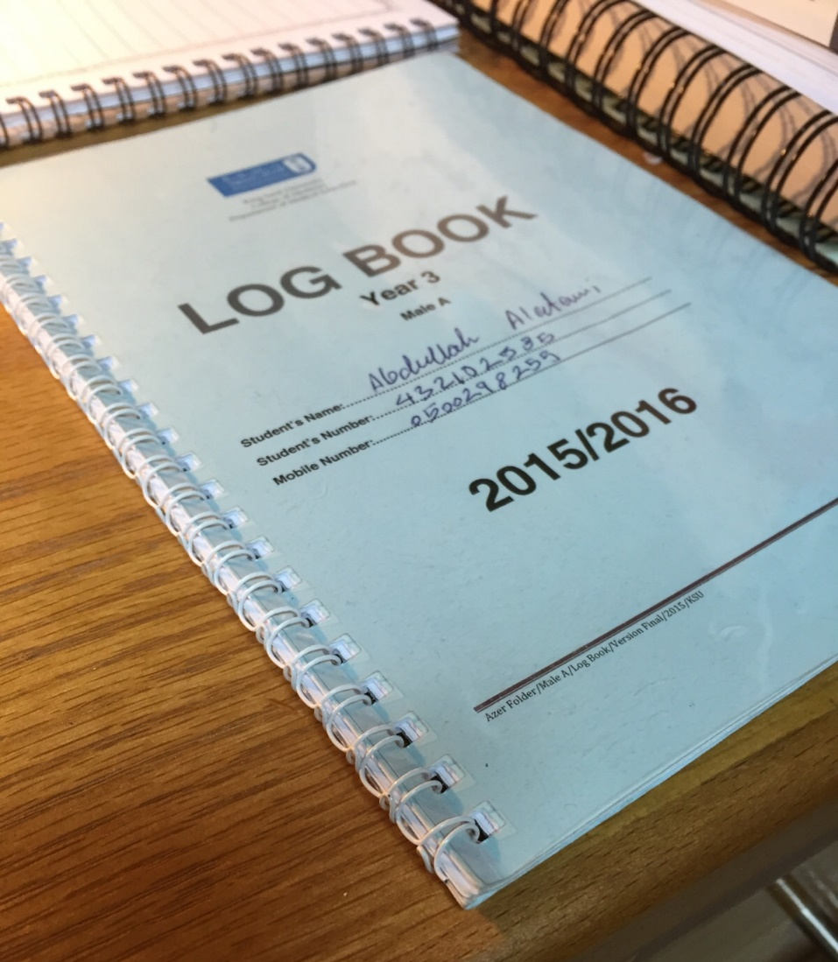
The Logbook?

Slide 26
The logbook
BST (Medicine & Surgery) + TBL + Clinical Skills
It’s a small notebook
You keep it with you so the doctor signs it at the end of a session (it is proof of attendance)
Make sure the doctor signs it, remind him/her at the end of the session before you leave
The evaluation box is not important as long as you got your attendance box signed.
5 Marks in surgery is for logbook, please be careful

Slide 27
DXR

Slide 28
DXR
It is a website that requires you to log in
In every theme in medicine, there are cases
A schedule was sent by the medical education department which contained how many cases we have to solve for every theme
DXR : 5 marks in Medicine only

Slide 29
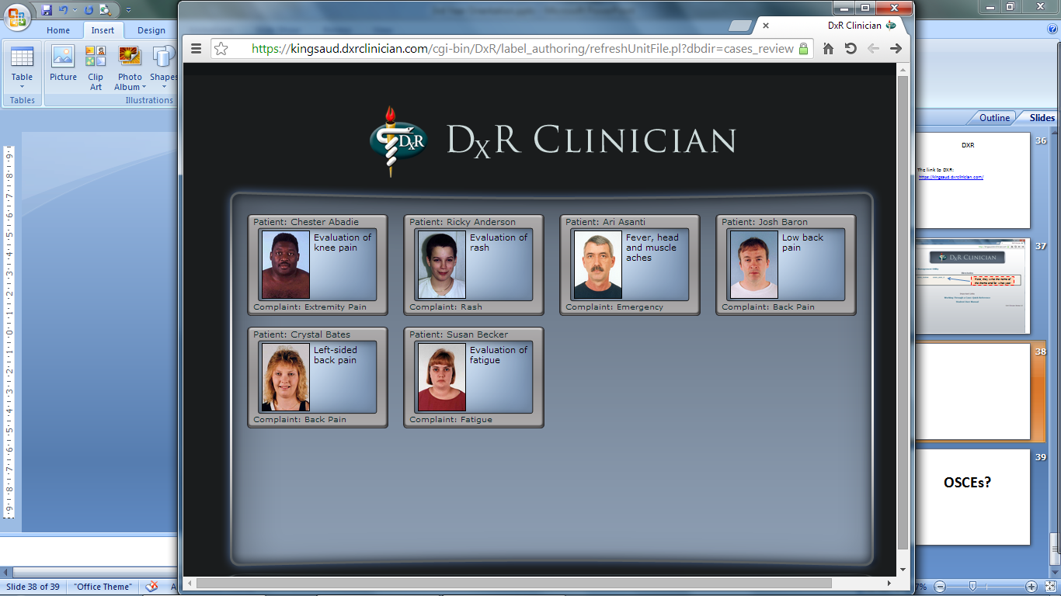

Slide 30
OSCE

Slide 31
OSCE
OSCE = Objective Structured Clinical Examination
Multiple stations (rooms)
In every station, there is a doctor who evaluates you
You are required to do a task, and sometimes answer some questions, tasks could be:
  - Take history from a patient complaining of bla bla
  - Perform a physical examination on a patient (simulated patient)
  - Perform a clinical skill (eg: insert IV cannula, insert catheter... Etc)

Slide 32
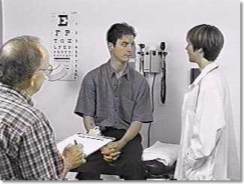
Simulated Patient
YOU!
Yes, YOU!
Evaluator (consultant usually)

Slide 33
Some golden quick tips for the OSCEs
Prepare for the OSCEs & (Longcase) from the beginning of the year, not just a few days before it!
In other words; Practice skills during the year (watch videos, apply on yourself/family/patients), throughout the year
Don’t say you know it before you actually DO IT... Because then you discover that you don’t really know it, or you know it a little bit :D
“Group practice” is a good ide
What you read is not like what you see.

Slide 34
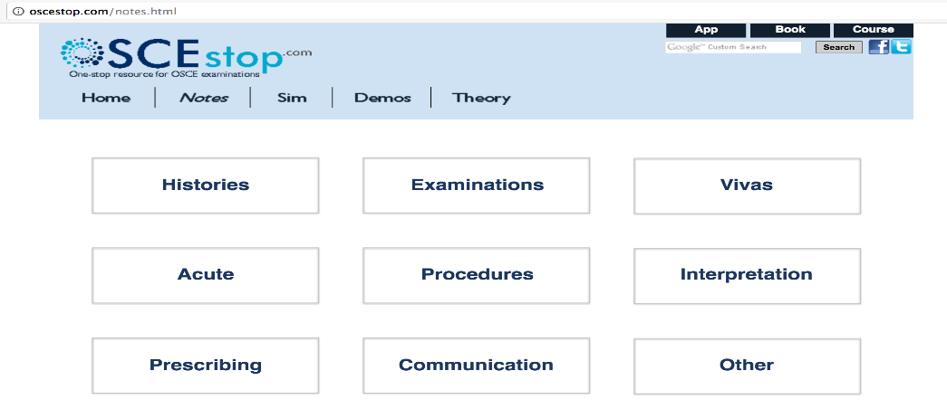
Quick Sources for the OSCE
OSCEstop.com:
Du’aa 429 booklet (medicine)
428 Surgery booklet
- Summer clinical skils notes

Slide 35
Last word
Enjoy the journey.
Form your own opinion regarding this year
The reference that we mention are just there to make things easier for you. You may explore other references and make sure you tell each other (and tell us, too) if you find new good references.
We do not expect you to absorb everything we gave you in this orientation. You can refer back to it later many times

Slide 36
Experiences are NOT Facts

Slide 37

Done by:
Mohammed Almahmoud
Presented by:
Mohammed Almahmoud
Salman AlQazlan

Slide 39
عن وحدة الجودة الاكاديمية
رؤية الوحدة:
الوصول إلى مستويات عالمية في الجودة والتميز الأكاديمي لكلية الطب.
رسالة الوحدة:
خلق وتعزيز ثقافة الجودة والتميز الأكاديمي في كلية الطب بجامعة الملك سعود من خلال متابعة جودة و رصد تطور الأنشطة الأكاديمية .
الأهداف العامة للوحدة:
دعم ومتابعة الخطة الاستراتيجية لكلية الطب.
نشر ثقافة الجودة بين منسوبي وطلاب كلية الطب.
متابعة جودة التدريس والتعليم للطلاب الجامعيين وطلاب الدراسات العليا بكلية الطب.
متابعة جودة البحث العلمي والحرص على أن يكون موافقا لأنظمة أخلاقيات البحث العالمية.
قيادة ودعم ومتابعة الاعتماد الأكاديمي لكلية الطب واستثماره كدافع للتطوير.
متابعة جودة الأعمال الإدارية الهامة والمؤثرة بكلية الطب.
اقتراح ودعم وتنظيم وتقييم جميع المبادرات الجديدة لتطوير الجودة الأكاديمية بكلية الطب.

Slide 40
YouTube Video
https://www.youtube.com/watch?v=twIXzPdgIog&t=13s

Slide 41
ليش أقيّم ؟
أقيّم عشان نرفع الجودة الأكاديمية للكلية، ورفع مستوى المقررات وجعلها مميزة، بالإضافة إلى رفع مستوى الكادر الأكاديمي لجميع المقررات وتحسين أو إزالة أي سلبيات متعلقة بالمناهج

Slide 42
ماهي التقييمات المطلوبة؟
١. أعضاء هيئة التدريس
٢. المقرر
٣. الاختبار

