Slide 1
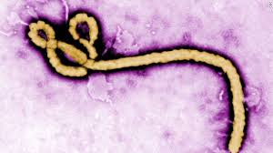
Ebola Virus Disease
Dr. Afnan Younis

Slide 2
Objectives:
Epidemiology of Ebola infection (reservoir)
Clinical picture
Mode of transmission
Risk factors
Prevention and control

Slide 3
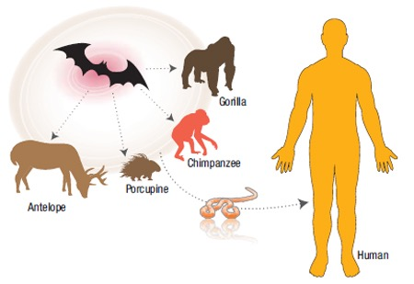
Ebola is a rare and deadly disease caused by infection with one of the Ebola virus species.
Ebola virus is from the family Filoviridae, genus Ebolavirus.
Ebola virus is animal-borne and that bats are the most likely reservoir.

Slide 4
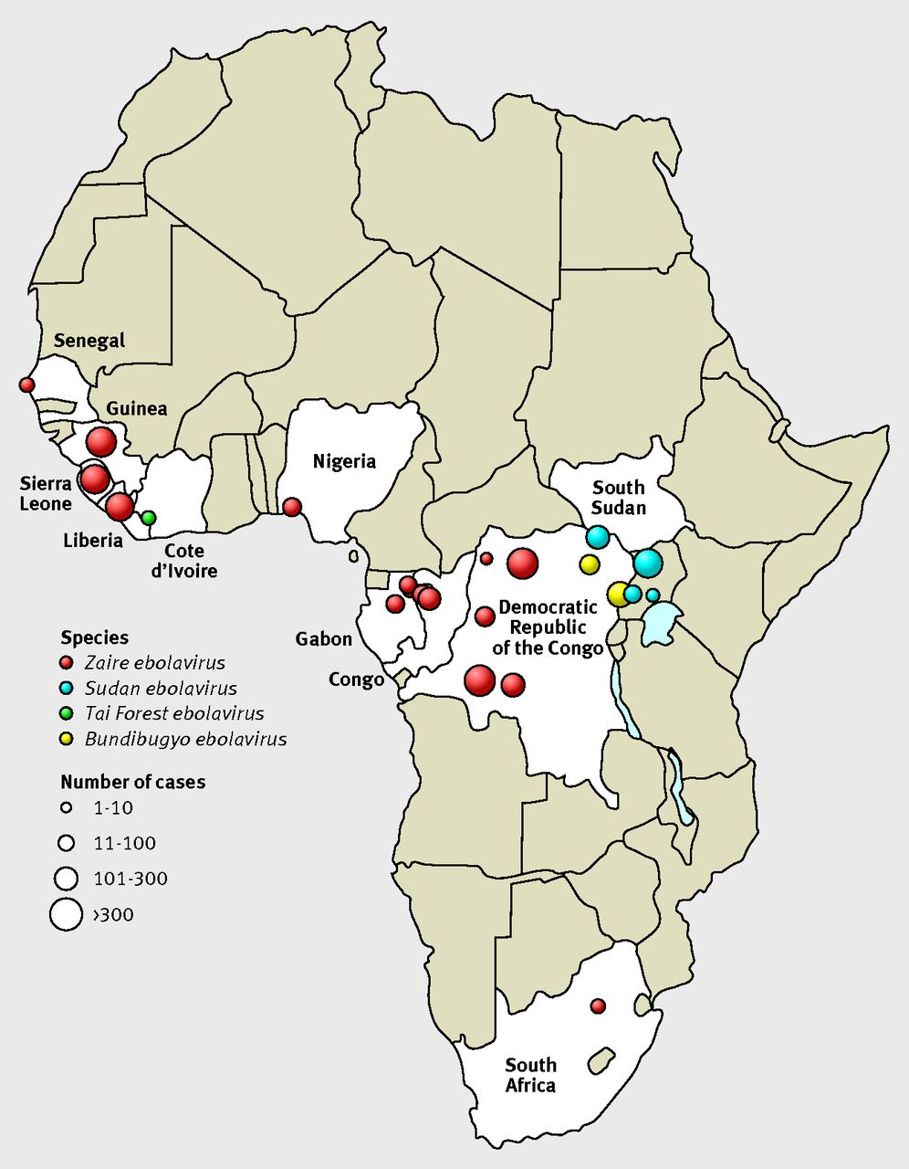
Epidemiology:
First case was found in 1976 near the Ebola River in the Democratic Republic of the Congo. Then, outbreaks have appeared sporadically in Africa.
Map of Ebola virus outbreaks 1976-2014 (CDC)

Slide 6
Transmission:
Direct contact (through broken skin or mucous membranes) with:
Blood or body fluids of a person who is sick with Ebola
Objects contaminated with the virus
Infected fruit bats or primates (apes and monkeys)
Semen from a man who has recovered from Ebola (possibility as virus can be excreted in semen even after recovery)
A person infected with Ebola virus is not contagious until symptoms appear.
Notes:
is not spread through the air or by water, or in general, by food. However, in Africa, Ebola may be spread as a result of handling bushmeat (wild animals hunted for food) and contact with infected bats. There is no evidence that mosquitos or other insects can transmit Ebola virus. Only a few species of mammals (

Slide 8
Ebola is not an airborne virus.
Can not be transmitted through food or water

Slide 9
Ebola virus can persist after recovery in many body fluids such as
Breast milk
Semen

Slide 11
Signs and symptoms:
Fever | Severe headache
Fatigue | Muscle pain
Weakness | Diarrhea
Vomiting | Stomach pain
Unexplained bleeding or bruising
Incubation period: Symptoms may appear anywhere from 2 to 21 days after exposure to the virus.
Notes:
Diagnosing Ebola can be difficult at first since early symptoms, such as fever, are nonspecific to Ebola infection.
However, if a person has the early symptoms and has had contact with Ebola they should be isolated and public health professionals notified.

Slide 12
Clinical progression of Ebola
Source: Jonathan B. Perlin, MD, PhD and HCA Clinical Excellence Knowledge Center, 2014

Slide 13
Diagnosis:
Blood tests can identify antibodies of the Ebola virus
Either unusually low or high white blood cell counts
Low platelet counts
Elevated liver enzymes
Abnormal coagulation factor levels

Slide 14
Treatment:
There is no approved treatment for Ebola
Mainly treat Symptoms and complications as they appear.
Providing intravenous fluids and balancing electrolytes (body salts)
Maintaining oxygen status and blood pressure
Treating other infections if they occur
Notes:
People who recover from Ebola develop antibodies that last for at least 10 years, possibly longer

Slide 15
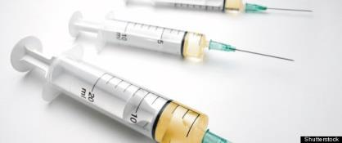
Prevention and control
There is no FDA-approved vaccine available for Ebola

Slide 16
Prevention and control
Place patient in isolation unit (doors closed, restricted movement in/out unit).
Restrict entry to only those considered essential.
All persons entering the patient room should wear personal protective equipment (PPE): gloves, gown, eye protection, face mask.
Limit the use of needles and dispose appropriately.
Diligent environmental cleaning and disinfection and safe handling of potentially contaminated materials.
Notes:
dispose in puncture-proof, sealed containers.
Environmental surfaces and equipment
Textiles and laundry
Food utensils and dishware
PPE during environmental cleaning and disinfection.

Slide 18
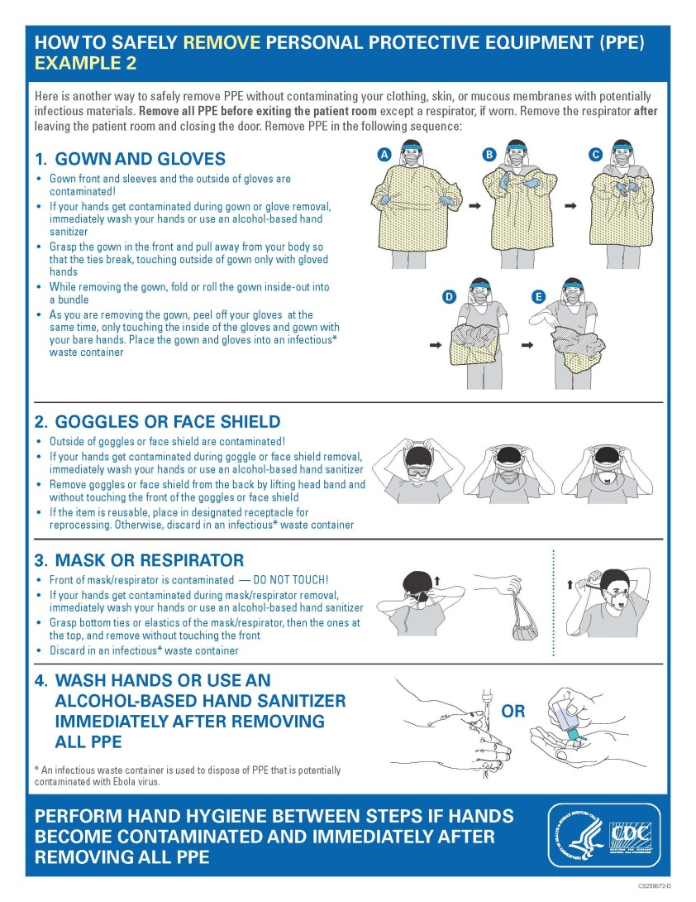

Slide 19
References:
Ebola (Ebola Virus Disease). Centers for Disease Control and Prevention website http://www.cdc.gov/vhf/ebola/. Updated October 18, 2017. Accessed November 20, 2017.
WHO, 2015. Ebola virus disease. World Health Organization, p. 1. http://www.who.int/mediacentre/factsheets/fs103/en/

