Slide 1
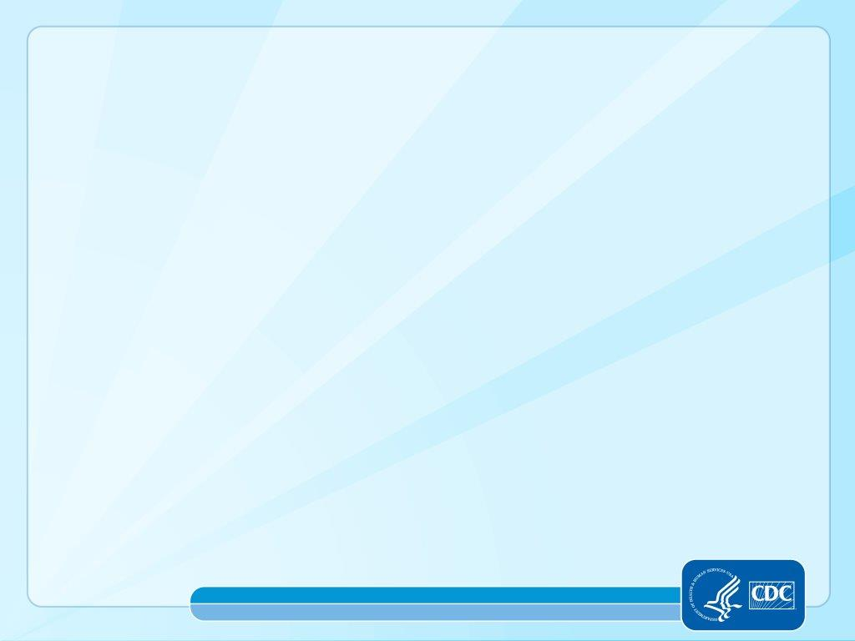

Course COMM-311
Surveillance data, Notification and reporting
Dr Armen Torchyan
Slide by: Dr. Khawater Bahkali
Family and community medicine,
KKUH
The slides was adopted from the CDC public health 101 series resources
Notes:
<WELCOME participants to the Introduction to Public Health Surveillance course and provide your background.>
GO to next slide.

Slide 2
Lecture Topics
Surveillance data management
Analyze and interpret data
Overview of the Notifiable Diseases in Saudi Arabia
Group exercise: Analysis and Interpretation of Surveillance Data
2
Notes:
SAY:
Today we will discuss the basics of surveillance and its role and use in public health. We will review the legal basis, types, attributes, and the process for conducting surveillance. Finally, we will apply what we have learned by examining some cases where surveillance was used to resolve a public health problem.
GO to next slide.

Slide 3
Learning Objectives
By the end of this session, you will be able to
Describe data to collect based on the objective of a surveillance system
Identify how to present surveillance data
Interpret surveillance data, including trends and patterns
Identify the communicable disease included in the surveillance system in the KSA
Describe the National Health Electronic Surveillance Network in KSA (HESN )
Notes:
SAY:
After completing this course, you will be able to
<READ the objectives from the slide.>
GO to next slide.

Slide 4
Topic 1
Surveillance data management
Notes:
Tell participants that you will now discuss data management, which includes categories of data, confidentiality and data quality.
GO to next slide.

Slide 5
Notes:
Explain that in general, there are 6 categories of information collected as part of NCD surveillance activities.
Read slide.
Ask: What kinds of information would you find in each of
these categories of data?
Possible answers:
o Identifying information: an individual’s name and parent or guardian if younger than 18 years old, address, and phone number.
▪ You should not collect this data at any level of the system unless you plan to follow up to intervene to
help the respondent.
▪ Identifying information will be discussed on the next slide about confidentiality.
Demographic data: age, sex, race or ethnicity
Clinical data: diagnosis, signs, symptoms, and physical measurements such as blood pressure, weight, and height
Laboratory information (tests and results): for example, chest X-rays and measured glucose values
Risk factor information includes, for example, family history of a health condition, diet, and smoking status
Source information includes name of reporting physician, clinic, hospital or laboratory; date of report: This data may be collected from busy hospital and clinic personnel; however, it is a lot of data for survey staff to enter.
Explain any concepts or types of information that participants missed when answering the question.
Explain that we will discuss risk factors in more detail later in the presentation.

Slide 6
Notes:
Say: One of the keys to data management is confidentiality. Public health professionals must ensure that all data collected as part of public health activities are kept confidential. Some surveillance systems (e.g., vital-event registries and case-based disease registries) collect identifying information. In other systems, such as surveillance based on surveys, identifying information is usually not entered into a database, ensuring

Slide 7
Notes:
Ask: Why is it important to maintain confidentiality?
Possible answer: People’s health status is private, and only they have the right to share the information with others. Also, surveillance activities often collect information which could cause harm to the person if the information were disclosed. For example, a person may not want to disclose a health condition to an employer.
Click to show ways to protect confidentiality.
Say: There are many ways to prevent identifying data from being disclosed. One of the most effective is to assign a unique combination of numbers and letters to each case or record. The identification number may be assigned before the data are collected. When the data are entered into a computer database, the identification number is entered but no identifying information is entered.
In some circumstances (e.g., if a health condition is rare or an individual lives in a small rural village), non-identifying information may be enough to infer the identity of the affected individual. This situation causes “unintentional disclosure”.
It is always important to review any data that will be shared with the public to ensure steps are taken to prevent unintentional disclosure. One way is to withhold information on the number of individuals with a particular health condition if that number is less than 5.

Slide 8
Notes:
Explain: Completeness of data is important to the quality of the data collected as part of a surveillance system.
Say: Completeness can refer to many things.
First, it can refer to the completeness of collected data in the surveillance system, or “how much missing information is there in the surveillance data”? Generally, when more than 10% of the information is missing, investigators are concerned about the ability to accurately interpret the data because they are not confident that the available data are representative of the true distribution of the health condition (or risk factor) in the population. Missing data often requires contacting the individual again, which is not always possible.
It can also refer to the completeness of reporting. The ability of a surveillance system to acquire all records of an event under surveillance also influences the quality of the data. For example, if infants born at home are not registered with appropriate government offices, their information will not be captured by vital events registration data. This will lead to an underestimation of births in an area.

Slide 9
Notes:
Explain: These tables show the completeness of data collected by two surveys, one on diabetes and one on asthma in Tanzania. The diabetes survey had 1,000 respondents. The asthma survey had 2,000 respondents.
Say: Take alook at these two tables.
Ask:AreyouconcernedthatthedatamissingfromTable1 will affect your interpretation of diabetes by sex or age? If yes, why?
Possible answer: The missing information on sex is unlikely to affect the interpretation of findings related to diabetes because only 8.6% of the data are missing. However, 17.3% of data on age are missing. Therefore, the interpretation of findings for diabetes related to age may be limited.
Ask: Are you concerned that the data missing from Table 2 will affect your interpretation of asthma by sex or age? If yes, why?
Possible Answer: More than 10% of the data are missing for sex. Even though we noted that missing data greater than 10% could limit the interpretability, this is not a strict rule. Hence, it is possible that missing data on sex would not affect the interpretation of the association between asthma and sex. One quick way to see if the data in the survey are Similar to the source population, the population from which individuals were selected for the survey, is to compare the distribution of sex in the survey to the source population. For instance, if the survey was conducted among residents of Morogoro, you could compare the sex distribution in your survey with that of Morogoro. If the proportions are similar, then the missing data are not likely to affect your findings. However, if they are different, the 10% of missing information on sex may limit interpretation of your findings.
• Explain: To see if your sample population has a similar distribution for a variable missing more than 10%, you need to assess how different your sample estimate is from the general population. If the sample estimate is more than 10% different than the estimate seen in the source population, then you need to explore ways to deal with the missing data in your sample because your original estimates may be too high or too low. Relying on this flawed information may lead to inappropriate allocation of funds for interventions that don’t address the true needs of your population.
Remember, a further examination of missing data should be done when approximately 10% or more of the data are missing. Since there is only about 6.5% of the data missing for age in Table 2, missing information is unlikely to affect interpretations about how age impacts asthma in your sample.

Slide 10
Notes:
• Say: Like completeness, lack of validity also affects the quality of data, thereby hindering interpretation of the data.
• Ask: What are some sources of errors that can threaten validity?
Click to show answers.
Possible Answers:
Survey respondents provide inaccurate information. This often occurs when the topic or issue is sensitive, and a ‘socially desirable response’ is clear. For example, someone may say he seeks monthly medical evaluations for his diabetes when, in reality, he may not have sought medical attention in years.
Data are recorded erroneously when they are being collected. For instance, the data collector might inadvertently record a respondent’s year of birth as 1997 instead of 1957.
Errors may occur when data are entered into a computer database.

Slide 11
Notes:
Explain: One approach to assessing the validity of data is to look for improbable values. Improbable values are highly unlikely or impossible values and are a result of logic errors.
Say: This table showing data on five individuals with diagnosed lung cancer has five improbable values.
Ask: What are the five unlikely values in this line list?
CLICK each time you want to make a red circle appear around an answer. They will appear in the order they are listed below.
• Possible answers:
Person A was 54 years old when she died, not 47years Old (assuming the dates of birth and death are correct).
Person C can not be both a male and female.Sex refers to an individual’s biological attributes, whereas gender refers to the way a person self-identifies.
Person C could not have received a diagnosis on 30/02/2005 since February never has 30 days.
Person D could not have died before his diagnosis date.
Person E could not have been born in 1792.

Slide 12
Topic 2
Analyze and interpret data
Notes:
Tell participants that you will now discuss analyzing surveillance data. Explain that analysis using statistical software is not the focus of this lesson.
GO to next slide.

Slide 13
Notes:
Say: Knowing the goals of surveillance before data collection begins will guide both the types of data which are collected and the kinds of analyses to be performed. Before analyzing surveillance data, it is important to make sure the analytic approach you take will be able to address the surveillance objective.

Slide 14
Notes:
Explain: Surveillance data are used to describe the distribution of a health condition or event in a community by person, place, and time. This is referred to as descriptive epidemiology.
Say: “Person” is the individual who is affected by a health condition or event. You may recall that one category of data collected in surveillance systems is demographic information.
Ask: What are some examples of person-related data?
Explain: Analyzing surveillance data by person provides further information on the groups of individuals affected, permitting identification of subpopulations that may be at high risk for NCDs.
“Place” refers to geography-related factors of the affected population.
Ask: What are examples of data related to place?
Possible Answers:
o Place of residence
o Workplace
o Place of exposure
o Place where an individual sought diagnosis or treatment
Time:
Say: Time refers to the period when an event occurred (e.g., exposure to a risk factor, symptom onset, diagnosis, report to public health officials). Investigators look for changes in rates of health conditions over time (trends).
Ask: What are some examples of time?

Slide 15
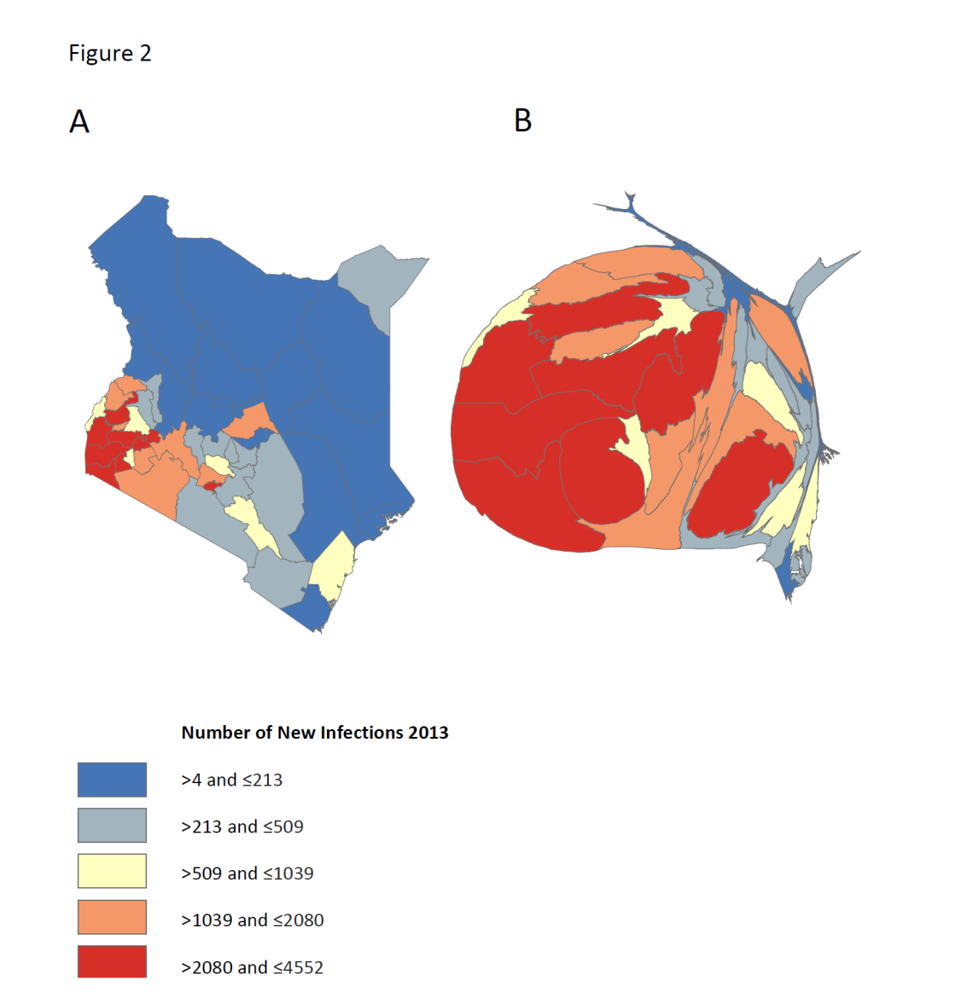
Variation within country
Number of new HIV infections in Kenya, 2013
Slide from: Tim Hallett, Imperial College London, 2014
Notes:
The slides shows how is the analysis by place is very important. The map shows the new HIV cases in Kenya, with big differences within the country regions.

Slide 16
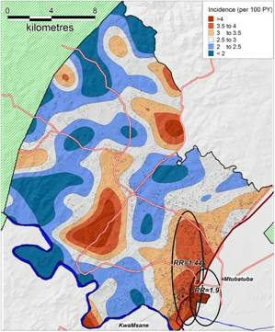
Variation Within A District
Rural KwaZulu-Natal
5.7% of study area.
1 in 3 new HIV infections
Tanser et al., CROI 2011
http://www.retroconference.org/2011/Abstracts/41395.htm
Notes:
And also a very clear differences within one district which is KwaZulu-Natal in South Africa.
KwaZulu-Natal rural area has the highest rate of HIV infection: 39 percent, according to UNAIDS in 2009.
A socio-demographic and behavioral studies found that the risk factors include
Poverty
Population growth
Geographical location and movements across borders
And
The High risk sexual behaviour

Slide 17
Risk factors
Notes:
Say: Risk factors are either modifiable or non-modifiable.
Ask: Can you give an example of a modifiable behavior?
CLICK to show the answer: lifestyle choices.
Explain: Modifiable risk factors can be changed. Usually they are associated with lifestyle choices, such as the extent of physical activity and choice of diet.
• Ask: What are examples of non-modifiable behaviors?
• CLICK to show possible.
• Explain: Non-modifiable risk factors cannot be changed. Age, family history (hereditary), race or ethnicity, and biological sex are examples. An example of a hereditary, non-modifiable risk factor is a mutation on the BRCA1 or BRCA2 gene, which increases risk for breast cancer.

Slide 18
Risk factors for infectious diseases
Overcrowding
Insufficient nutrient intake
Airborne droplet diseases
Vector-borne disease
Faecal-oral diseases
Insufficient vaccination coverage
Poor water, sanitation and hygiene conditions
Notes:
Poor hygiene is one of the leading causes of developing an airborne or contact illness. Wash hands frequently with soap and warm water,
Many medical conditions, such as polio, mumps and measles have vaccines available. Keep all vaccinations up to date to drastically reduce risk.
Raw or undercooked foods can cause salmonella and other types of food poisoning.
changes in human ecology: rural-to-urban migration resulting in high-density peri-urban slums;
increasing long-distance mobility and trade;
the social disruption of war and conflict;
changes in personal behavior; and,
The use and misuse of medical technology also pose risks, such as drug-resistant microbes and contaminated equipment or biological medicines.

Slide 19
Notes:
Say: The results of surveillance data analysis describe the distribution and occurrence of NCDs in populations.
Surveillance data should be summarized and presented in a manner that is easy for the audience to understand and interpret. The audience can include program managers and other decision makers.
Analytic results can be presented in tables, graphs, charts, and maps.
Ask: Why is it important for decision makers to understand the analysis results?
Possible answers: So that the recommendations will be implemented; so that the surveillance findings will be used; so that results will be disseminated.
Explain: Participants will see all of these forms of presentation as we move through the next section discussing analysis of data.

Slide 20
Notes:
Say: Earlier you were asked to interpret tables, graphs, charts, and maps. However, interpreting surveillance data is not always easy or straightforward.
Explain: The key to interpreting surveillance data accurately is to know the limitations of the data being used. The most common limitations to surveillance data are underreporting, representativeness and changes in case definition. These will be discussed further in the next slides.

Slide 21
Notes:
Read the information on the slide.
Explain: For notifiable (mandatory reporting) health conditions, it is the responsibility of the diagnosing physician or medical facility to report. These physicians may not be aware, or may just not participate. In addition, parents or families are responsible for reporting vital events (such as births, deaths) that occur outside of medical facilities.
Say: Periodic education should be conducted to raise awareness on the responsibilities of reporting.

Slide 22
Notes:
Read the first bullet.
Explain that one of the goals of collecting surveillance data is to be able to generalize findings to the source population.
Surveillance data that are representative of the true distribution of a disease in a population permit public health authorities to take effective measures to reduce the burden of NCDs.
When data are not representative of the true occurrence and distribution of disease in a population, estimated statistics, such as prevalence and rates, may overestimate or underestimate the true burden of disease. This may lead to implementation of prevention and control measures that may be excessive or inadequate.
Read the second bullet and sub-bullets.
Explain that collecting data from a variety of sources
can help improve representativeness.

Slide 23
Develop operational definitions of cases:
a standard description of a disease for reporting consistency to follow disease trends and recognize epidemics.
designed for surveillance purposes, not necessarily for the clinical management of patients.
clear, consistent, highly sensitive and specific. It should also include appropriate criteria for confirmation.
Notes:
• Say: Case definitions use a standard set of criteria used to ensure that all disease reporters are reporting the same condition. These definitions are periodically updated by public health officials; for example, a new test or technology may be available to diagnose a condition, and that could be included as a method of disease confirmation in the case definition.
• Explain: If public health officials review trend data and are unaware of changes in the case definition, they may erroneously conclude that the rate or prevalence of a health condition or disease was increasing (or decreasing) during a certain period when, in fact, the seeming change in rate was due to changes in the case definition.

Slide 24
Notes:
Explain how ICD codes can be used to ensure consistent case definitions.

Slide 25
The case definition usually developed as:
  The suspected or clinical case: Based on clinical diagnosis by health professionals only, with no laboratory tests.
  The probable case: Based on clinical diagnosis. Laboratory test is suggestive but not confirmatory.
  The confirmed case: Based on clinical diagnosis and confirmed laboratory investigation.

Slide 26

Topic 3
Overview of the Notifiable Diseases in Saudi Arabia
Notes:
GO to next slide.

Slide 27
Criteria for selecting and prioritizing health problems for surveillance include the following:
1. Public health importance of the problem:
  incidence, prevalence,
  severity, sequela, disabilities,
  mortality caused by the problem,
  socioeconomic impact,
  communicability,
  potential for an outbreak,
  public perception and concern, and
  international requirements.
Slide from Dr. Mohamed Nageeb’s slide, FETP Nov 2015

Slide 28
Criteria for selecting and prioritizing health problems for surveillance include the following:
2. Ability to prevent, control, or treat the health problem:
  preventability and
  control measures and treatment.
3. Capacity of health system to implement control measures for the health problem:
  speed of response,
  economics,
  availability of resources, and
  what surveillance of this event requires.
Slide from Dr. Mohamed Nageeb’s slide, FETP Nov 2015

Slide 29
In KSA The Priority Diseases include:
The most important epidemic diseases in the country
Vaccine Preventable Diseases
Environmental health related diseases.
Zoonotic Diseases
Chronic Infectious Diseases
Vector-borne Diseases
Slide from Dr. Mohamed Nageeb’s slide, FETP Nov 2015

Slide 30
The most important epidemic diseases in KSA are:
  Meningococcal meningitis
  Dengue Fever
  Rift Valley Fever
  Measles
  Emerging diseases:
    Influenza, SARS, MERS-CoV (Corona)
    Al Khorma H Virus
Slide from Dr. Mohamed Nageeb’s slide, FETP Nov 2015

Slide 31
Surveillance categories of Communicable Diseases
General Surveillance for infectious diseases.
Disease Specific Surveillance:
      EPI targeted diseases.
      Influenza
      Malaria, Hepatitis A
Diseases under surveillance by separate programs:
      AIDS,
      Malaria,
      Leishmaniasis,
      Bilharziasis,
      Intestinal parasitic disease.
Slide from Dr. Mohamed Nageeb’s slide, FETP Nov 2015
Notes:
This is one way of distributing the notifiable disease, However, the easiest way is according to the time of notification:
Within 24 hours
Within a week
Within a month

Slide 32
General (Integrated) Surveillance:
36➔41➔47 … reportable diseases are increasing
  Class I diseases, immediately reported diseases.
  Class II diseases, reported weekly to regional level and monthly to central level.
  Class III diseases, reported monthly
Slide from Dr. Mohamed Nageeb’s slide, FETP Nov 2015
Notes:
The number of reportable diseases is increasing and some daily reported diseases may become weekly after some time

Slide 33

Acute Flaccid Paralysis (AFB) (for ages < 15 years)
Chemical Poisoning
Food Poisoning
H1N1
Hemorrhagic Fever
Guillain Barre Syndrome (GBS)
Measles
MERS-CoV
Meningitis
Mumps
Neonatal Sepsis
Pertussis
Rubella
Class I:
Diseases that need immediate action: Notified immediately (within 24 H)
By HESN and fax or telephone
*diseases of high priority to Saudi health system.

Slide 34
Notes:
Letter from MOH saying that a delay has been noticed in sending some MMR notifications and their samples, and emphasize the importance of:
1- the notification within 24 hours
2. Sending the samples within 48 hours
3. Sending the complete notification form within 48 hours
3. Using either the electronic system HESN or the email

Slide 35

Class II:
    Leprosy
    Leishmaniasis
    Malaria
    Measles
    Mumps
    Puerperal sepsis
    Rabies
    Rubella
    Salmonellosis
    Scabies
    Scorpion Bites
    Shigellosis
    STD
    Syphilis
    Salmonellosis
    Tetanus, other types
    Tuberculosis
    Typhoid & Paratyphoid fever
    Whooping Cough
    Amoebic Dysentery
    Animal Bites
    BCGitis
    Brucellosis
    Chicken Pox
    Congenital Rubella
    Diarrhea
    Diptheria
    Enteric Fever
    Erysepelas
    Echinococcus Hydatid Disease
    Gonorrhea
    Hepatitis A, B, C
    HIV
    Herpes Zoster
    Herpes Simplex
    Hemolyticuraemic
    Influenza

Slide 36

Class III:
This includes:
all infectious diseases notified to the Regional Health Affairs which in turn notifies the Deputy Minister for Preventive Medicine.
It also includes reports of:
    vaccination,
    malaria,
    tuberculosis and
    other reports as specified by the Ministry of Health.

Slide 37
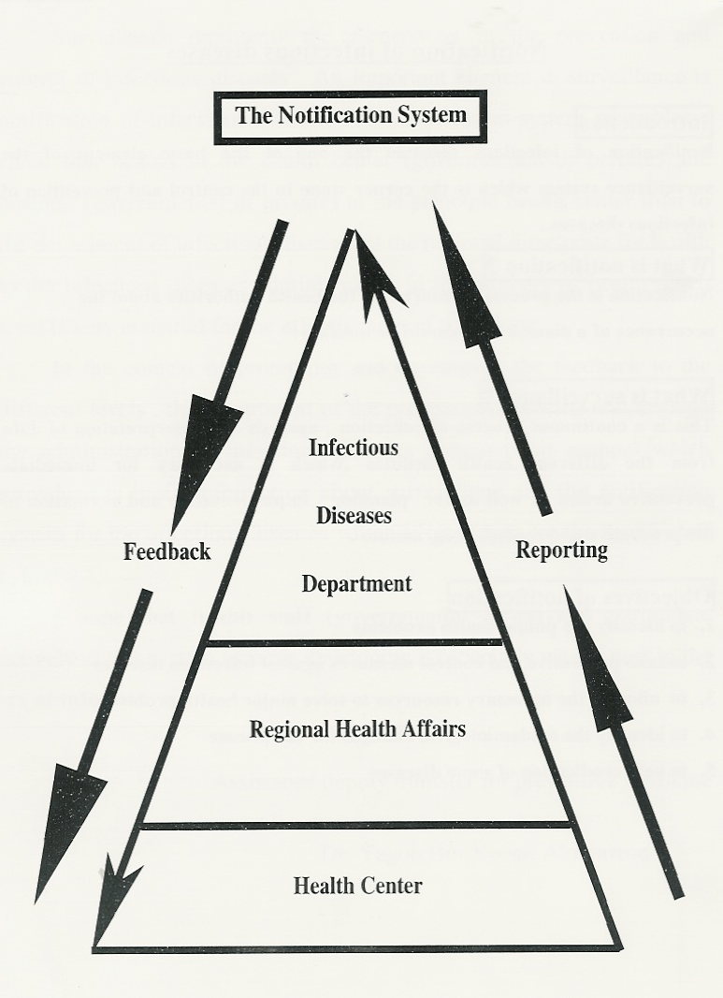
Notification Feedback:
The MOH usually responses to give the feedback for the reporting healthcare center regarding the action they should take and the results of the specimens.
However, in KKUH, all specimens are analyzed in the lab without waiting for the MOH results, except for hemorrhagic fever and polio suspected specimens.

Slide 38
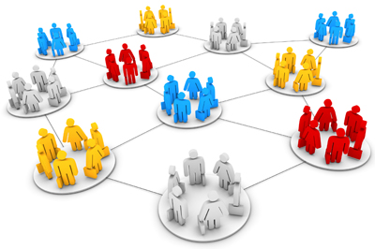
Topic 5
Group exercise: Analysis and Interpretation of Surveillance Data
Notes:
GO to next slide.

Slide 39
Lecture Summary
During this session, you learned to
Describe data collection and management based on the objective of a surveillance system
Identify how to present surveillance data
Interpret surveillance data, including trends and patterns
Identify the notifiable communicable disease included in the surveillance system in the KSA
Notes:
SAY:
During this session, you learned to
<READ the objectives from the slide.>
GO to next slide.

Slide 40
QUESTIONS?
Notes:
GO to next slide.

Slide 41
Resources and Additional Reading
Please visit:
The Centers for Disease Control and Prevention website
Division of Global Health Protection (DGHP),
Field Epidemiology Training Program,
Training Modules & Resources

