Slide 1
DXR
Abdulrahman AlZahrani

Slide 3
How to approach a patient
History
Physical Examination
Investigations
Diagnosis
Management Plan
Education
Treatment
Follow up

Slide 4
History
Personal Data
Chief complaint
History of presenting illness (OLD CARTS)
Past Medical History
Past Surgical
Medications
Family
Social
Blood Transfusion
Allergy
Sexual/Drug Abuse

Slide 5
Hypothesis
1. Cholecystitis
2. Cholangitis
3. Diverticulitis
4. Pancreatitis
5. Appendicitis

Slide 6
Physical Exam
General
Cardio
Respiratory
Abdominal
Neurology
Rheumatology

Slide 7
Investigation
1. Hematologic | Complete Blood Count (CBC)
2. Stool | Occult Blood (Guaiac)
3. X-­‐rays | Abdomen (KUB, X-­‐ray)
4. Urine| Urinalysis, Routine (UA)
5. Cardiovascular| EKG (ECG, electrocardiogram)

Slide 8
Diagnosis
Subjective (History) How the patients feels, major complaints, major symptoms.
Objective (PE and investigation) Objective findings. You should include physical exam findings. Also, include the results of any labs, X-­‐rays, studies, etc....
Assessment: How is the patient doing? How is the work-­‐up or recovery progressing?
Plan: What you are going to do.

Slide 9
Problem list:
1. Allergic to penicillin and Novocain-­‐type of anesthetics
2. high blood pressure
3. family history of cirrhosis of the liver & cancer

Slide 10
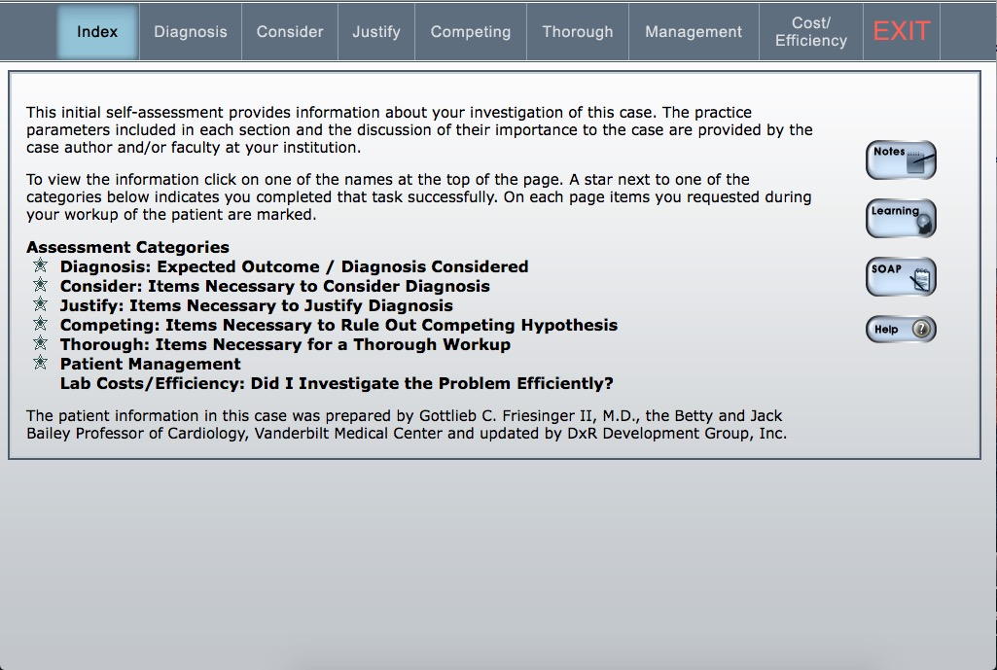

Slide 11
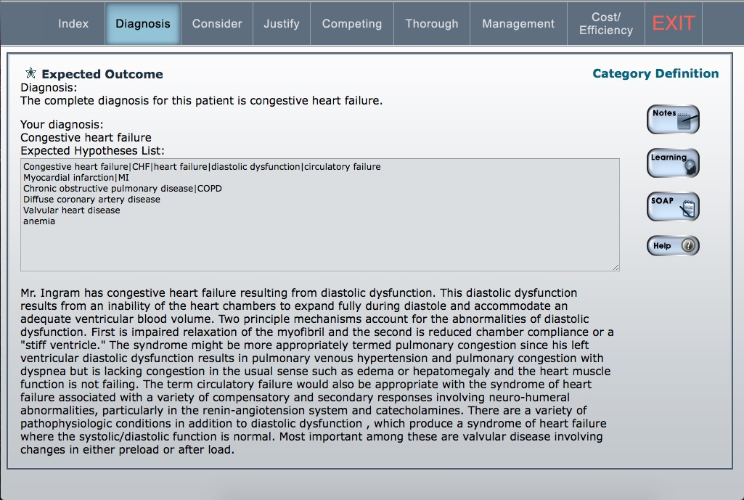

Slide 12
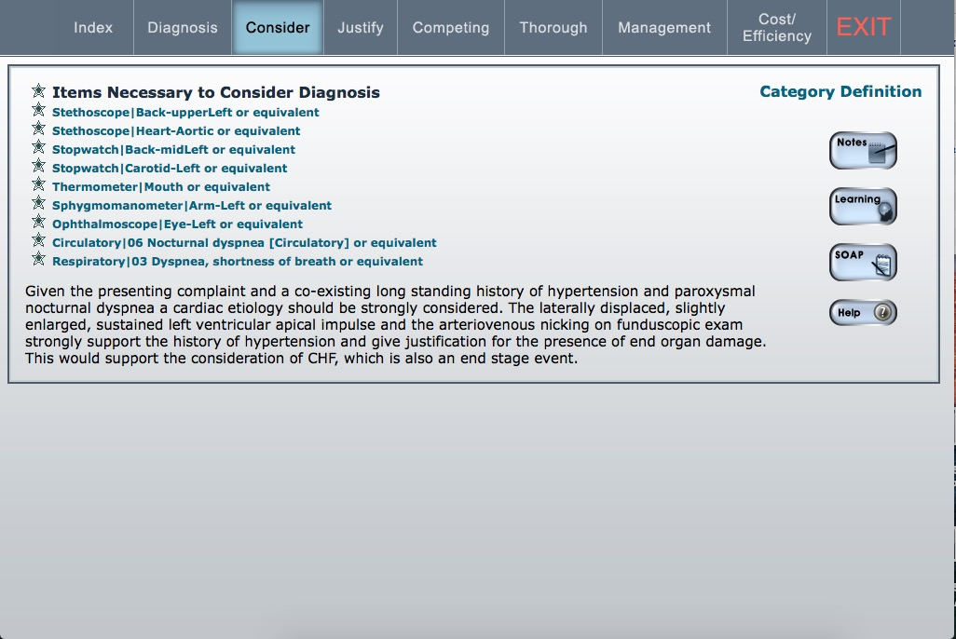

Slide 13
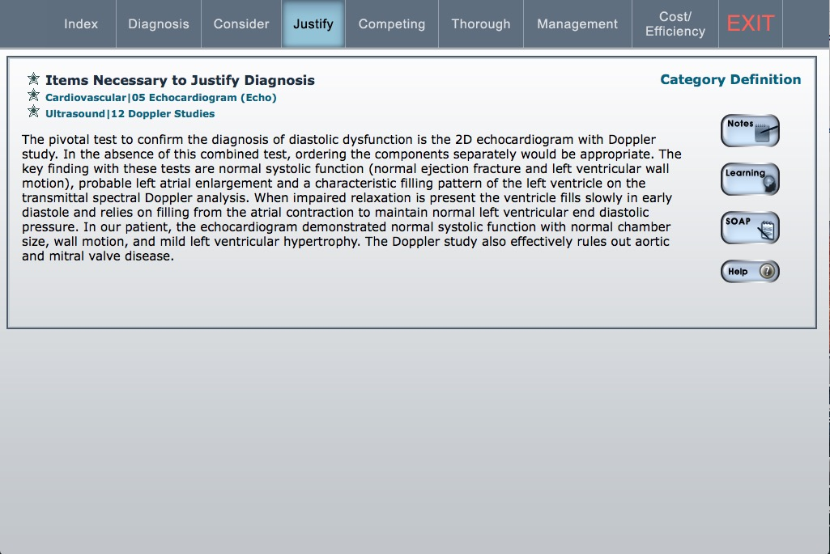

Slide 14
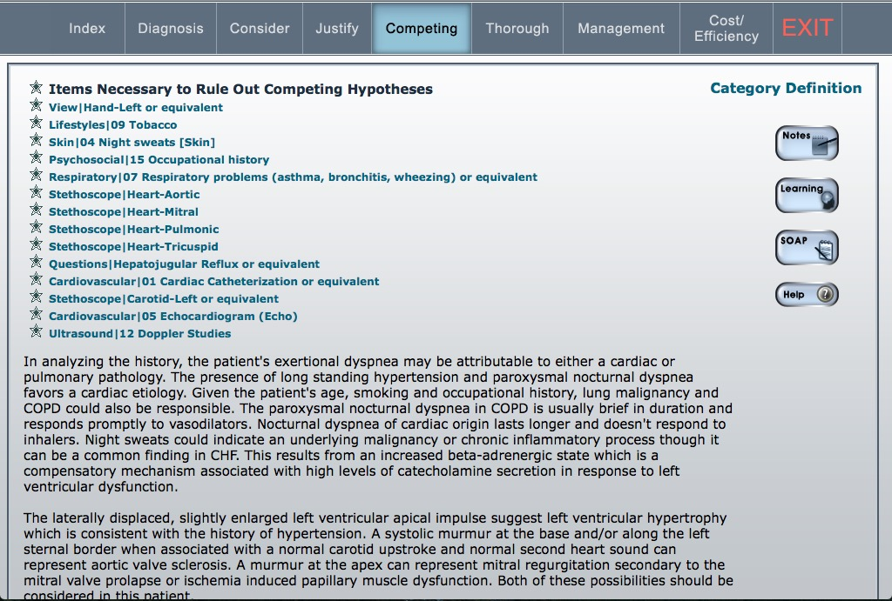

Slide 16
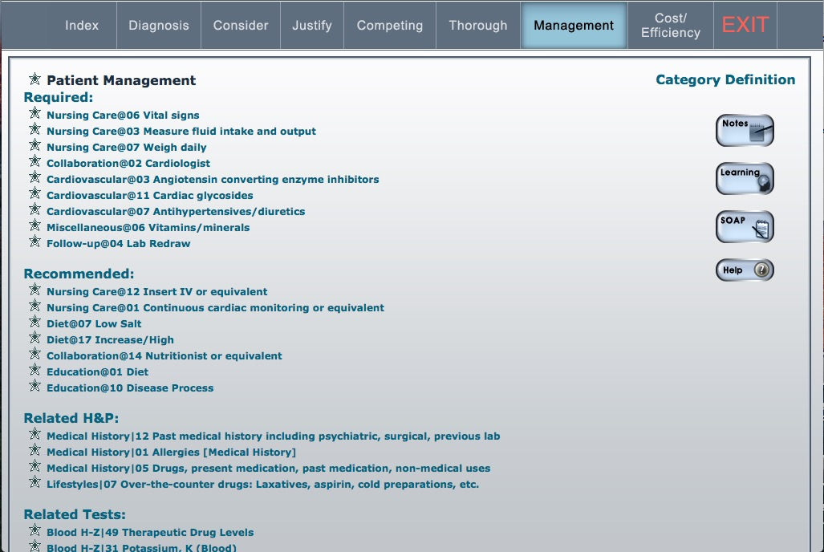

Slide 17
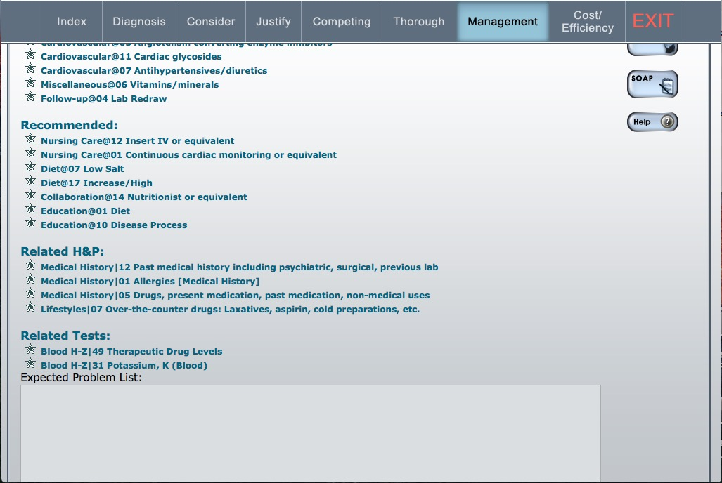

Slide 18
