Slide 1
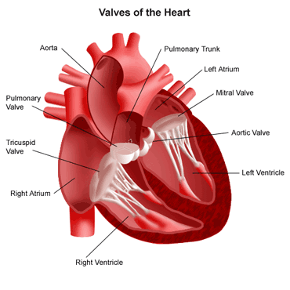
Valve Heart Diseases
Prof. Mohammed Arafah
MB,BS FACP FRCPC FACC

Slide 2
Objectives
Etiology of valve diseases
Pathogenesis .
Clinical presentation .
Clinical findings .
Investigation .
Management .

Slide 3
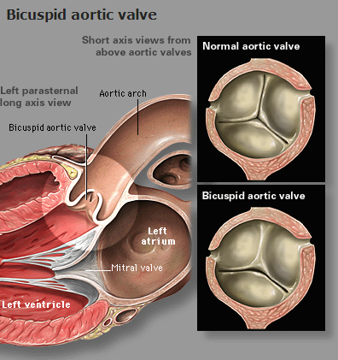
Etiology
Congenital :
- Bicuspid or unicuspid .

Slide 4
Etiology - continue
Acquired :
- Rheumatic .
- Degeneration .
- myxomatous
- calcification
- Ischaemic .
- Infective Endocarditis .
- Valve ring dilatation .

Slide 5
Pathogenesis

Slide 6
Pressure Overload :
- Aortic stenosis
Left Ventricular hypertrophy
- Mitral stenosis
Left Atriarl hypertrophy & dilatation

Slide 7
Volume Overload :
- Chronic mitral regurgitation
dilated left ventricle & left atria
- Chronic tricuspid regurgitation
dilated right ventricle & right atria

Slide 8
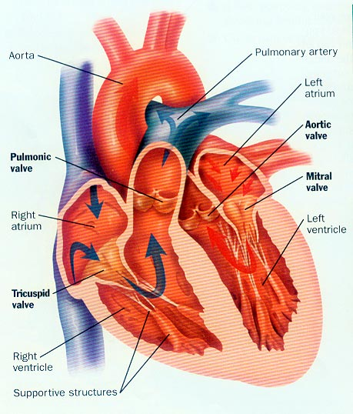
TYPES of Presentations
Acute Presentation :
- Acute mitral regurgitation due to
eg acute myocardial infarction
acute chordea tendineae rupture

Slide 9
TYPES of Presentations
Chronic Presentation :
- Chronic mitral regurgitation due to
eg RHRUMATIC fever .
Mitral valve Prolapse .
- Chronic aortic regurgitation due to
eg Bicuspid Aortic valve .

Slide 10
Clinical presentation

Slide 11
SYMPTOMS
Dyspnea , paroxysmal nocturnal dyspnea
orthopnea .
Palpitation .
Chest pain .
Dizziness , prefainting ,syncope .
Oedema , Ascites
Cough .
Fatigue
Hemoptysis
Symptoms of thromboembolic complication .

Slide 12
Clinical findings

Slide 13
Signs of Valve Diseases
Abnormal look (Down syndrome) .
Abnormal pulse ( Atrial fibrillation ) .
Abnormal Jugular Venus Pressure (JVP) .
Apex beat abnormality .
Sternal or parasternal heave .
Thrill .
Abnormal heart sound .
MURMURS .
Systolic or Diastolic .

Slide 14
INVESTIGATION
ECG .
CXR .
Echo cardiology .
M mode , 2D ,3D . 4 D . TEE .
Doppler .
24 hours monitor for heart rhythm .
MRI .
Cardiac catheterization .

Slide 15
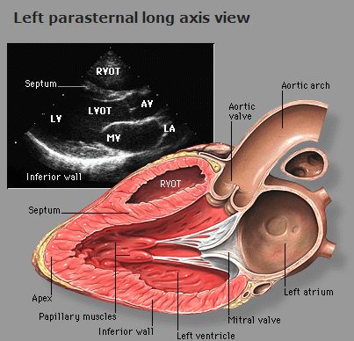

Slide 17
MITRAL STENOSIS

Slide 18
ETIOLOGY
Rheumatic Fever which is related to streptococcus infections, causing damage to the mitral valve and leading to mitral stenosis later in life.

Slide 19
OTHER LESS COMMON CAUSES OF MITRAL STENOSIS
Congenital Mitral Stenosis
Systemic Lupus Erythematosus
Rheumatoid Arthritis
Atrial Myxoma
Malignant Carcinoid
Bacterial Endocarditis

Slide 20
MITRAL STENOSIS results in several changes to the integrity of the valves:
CUSPS THICKEN
COMMISSURES FUSED TOGETHER
CHORDAE TENDINAE BECOMES
THICKENED & SHORTENED
CALCIUM DEPOSITS FORM

Slide 21
PATHOPHYSIOLOGY
In normal adults the mitral valve orifice is 4-6cm².
When the orifice is reduced to approximately 2cm², which is considered mild mitral stenosis, blood can flow from the left atrium to the left ventricle only if propelled by an abnormal pressure gradient – the hemodynamic hallmark of Mitral Stenosis.
When the mitral valve opening is reduced to 1 cm² , which is considered critical mitral stenosis, a left atrioventricular pressure gradient of approximately 20mmHg is required to maintain normal cardiac output at rest.

Slide 22
HEAMODYNAMICS Consequences of Mitral stenosis

Slide 23
SIGNS & SYMPTOMS
DYSPNEA ON EXERTION
Usually precipitated by exercise, emotional stress, infection, or atrial fibrillation, all of which increase the rate of blood flow across the mitral orifice & result in further elevation of Left

Slide 24
OTHER PRINCIPAL SIGNS AND SYMPTOMS INCLUDES:
Fatigue
Orthopnea
Paroxysmal nocturnal dyspnea
Pulmonary edema – develops when there’s a sudden ↑ in flow rate across a markedly narrowed mitral orifice.
Palpitations – owing to presence of arrhythmias
Hemoptysis – due to rupture of thin dilated bronchial veins.
Peripheral edema .

Slide 25
DIAGNOSTIC EVALUATIONS
Clinical evaluation of Mitral Stenosis begins with an in-depth history and physical exam.
ON PHYSICAL EXAMINATION
a loud S1 – due to abrupt leaflet closure
a loud S2 – due to ↑ PAP; an opening snap due to tension on valve leaflet
Diastolic rumble – due to turbulent blood flow across the stenotic valve.

Slide 26
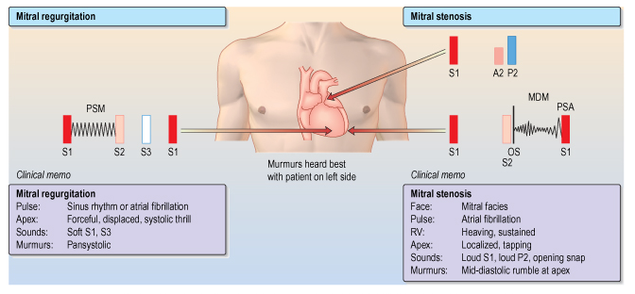

Slide 27
The Diagnostic testing used to evaluate the presence & severity of Mitral Stenosis includes:
ECG
Chest Radiograph
2D Echocardiogram
Doppler Study
TransEsophageal Echocardiography

Slide 28
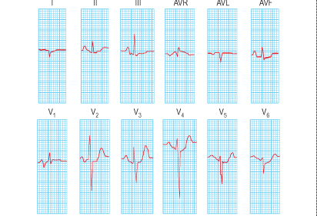

Slide 29
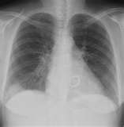

Slide 30
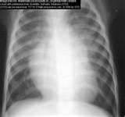

Slide 31
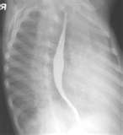

Slide 32
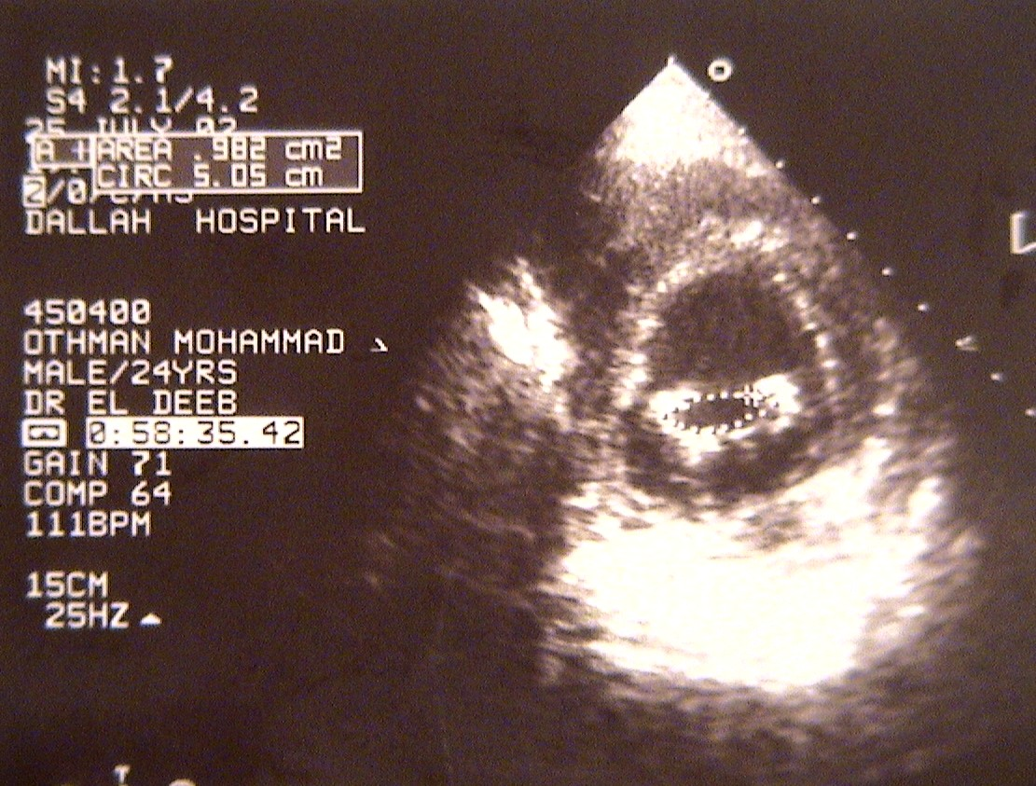
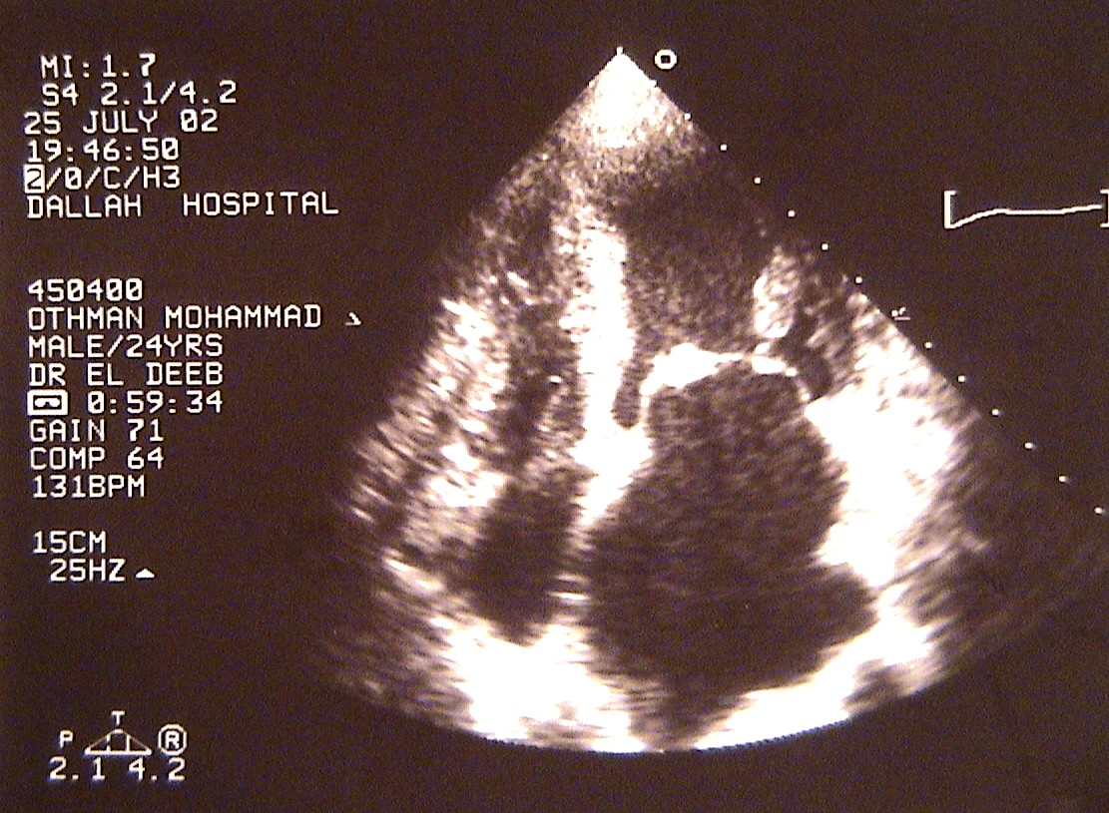
MVA–2D ECHO = 0.9cm²

Slide 33
COMPLICATIONS OF MITRAL STENOSIS
ATRIAL FIBRILLATION
LUNG CONGESTION
BLOOD CLOTS with SYSTEMIC EMBOLIZATION
PULMOARY HYPERTENSION
CONGESTIVE HEART FAILURE

Slide 34
MEDICAL MANAGEMENT
DIURETICS
DIGITALIS
ANTI-ARRYHTHMICS
ANTICOAGULANTS
ANTIBIOTICS

Slide 35
Intervention
PERCUTANEOUS TRANSVENOUS MITRAL COMMISSUROTOMY (PTMC)
SURGICAL COMMISSUROTOMY
MITRAL VALVE Replacement .

Slide 37
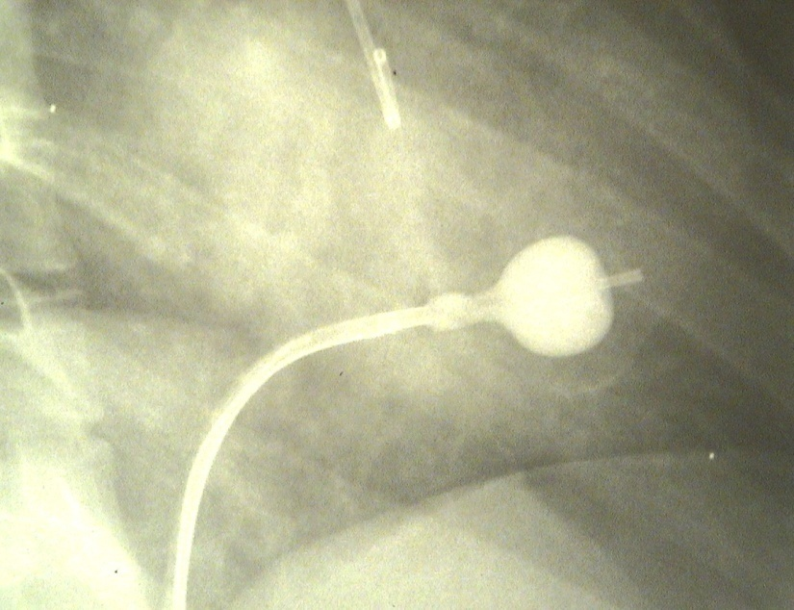
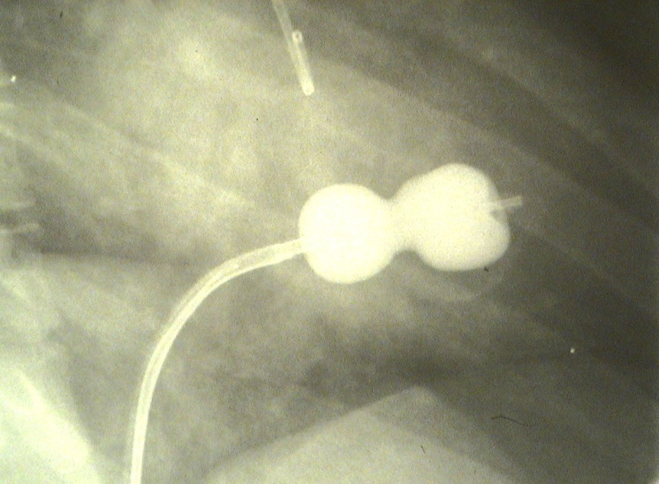
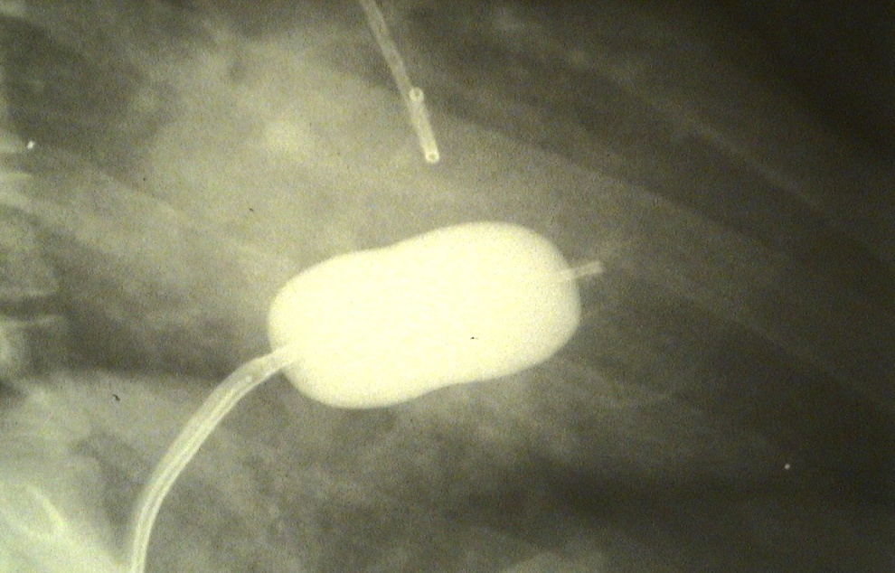

Slide 38
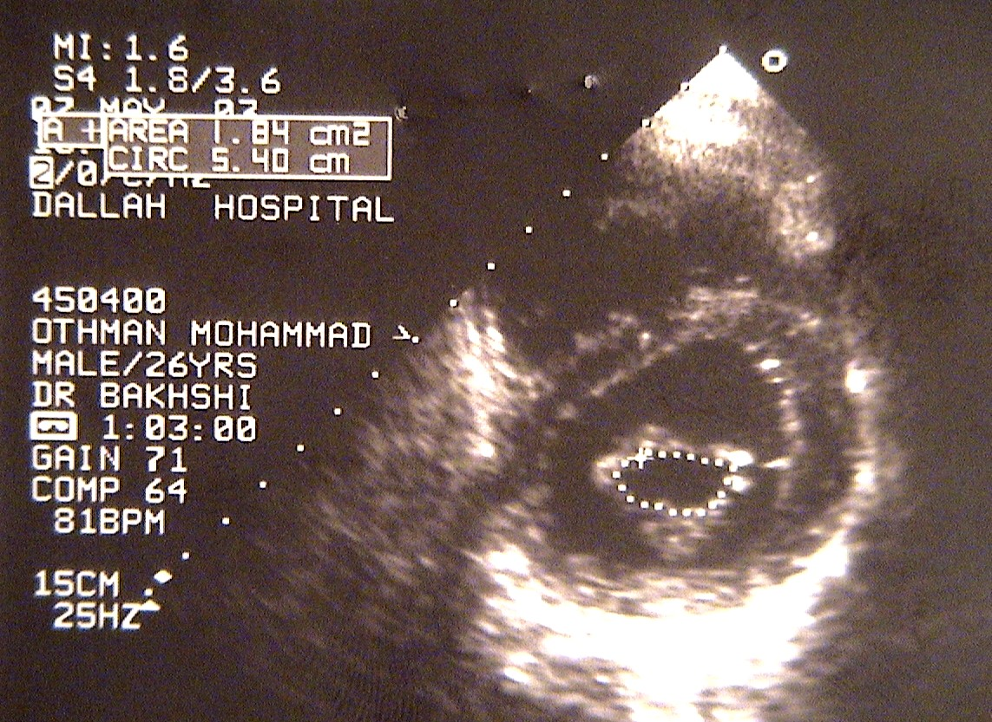
MVA = .982 cm²
MVA = 1.84 cm²
PRE-PROCEDURE
POST-PROCEDURE

Slide 39
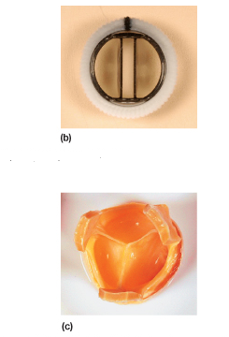

Slide 40
MITRAL REGURGITATION

Slide 41
ETIOLOGY
RHEUMATIC HEART disease .
MITRAL Valve Prolapse .
Others
- IHD
- Cardiomyopathy ( dilated , hypertrophic )
- Hypertensive heart disease
- infective endocarditis
- Myocarditis
- connective tissue disorders - (SLE)
- collagen abnormalities - Marfan's syndrome

Slide 42
SIGNS
Laterally displaced (forceful) diffuse apex beat and a systolic thrill .
Soft first heart sound .
Pansystolic murmur .
Prominent third heart sound .

Slide 44
Management of mitral regurgitation
Evidence of progressive cardiac enlargement generally warrants early surgical intervention by either mitral valve repair or replacement .
Treatment with ACE inhibitors, diuretics and possibly anticoagulants .

Slide 45
Mitral Valve Prolapse

Slide 46
Pathology
Large mitral valve leaflets, an enlarged mitral annulus, abnormally long chordae or disordered papillary muscle contraction .
Demonstrate myxomatous degeneration of the mitral valve leaflets .
Associated with Marfan's syndrome, thyrotoxicosis, rheumatic or ischaemic heart disease .

Slide 47
Symptoms
Atypical chest pain is the most common symptom .
Palpitations may be experienced because of the abnormal ventricular contraction or because of the atrial and ventricular arrhythmias .
Sudden cardiac death due to fatal ventricular arrhythmias is a very rare but recognized complication.

Slide 48
SIGNS
The most common sign is a mid-systolic click .
Produced by the sudden prolapse of the valve and the tensing of the chordae tendineae that occurs during systole .
A late systolic murmur owing to some regurgitation

Slide 49
Treatment
Beta-blockade is effective for the treatment of the atypical chest pain and palpitations .
Mitral valve prolapse associated with significant mitral regurgitation and atrial fibrillation, anticoagulation is advised to prevent thromboembolism .
Mitral valve prolapse associated with severe mitral regurgitation has a risk of sudden cardiac death.

Slide 50
AORTIC STENOSIS

Slide 52
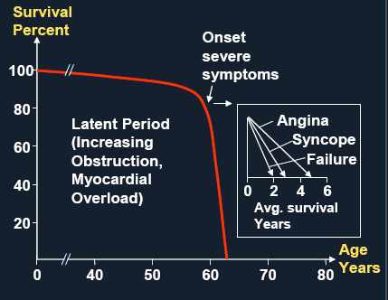

Slide 53
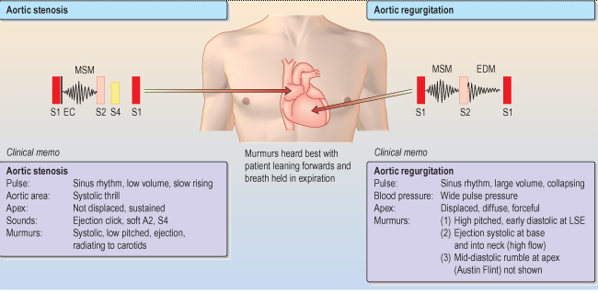

Slide 54
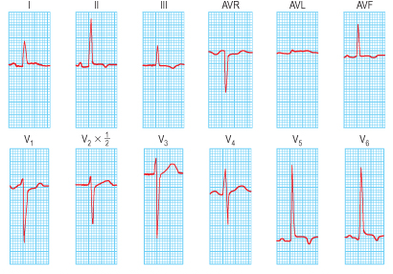

Slide 55
Treatment
In patients with aortic stenosis, symptoms are a good index of severity and all symptomatic patients should have TAVR or aortic valve replacement.
Asymptomatic patients should be under regular review for assessment of symptoms and echocardiography .

Slide 57
AORTIC REGURGITATION

Slide 59
Acute aortic regurgitation
Acute rheumatic fever
Infective endocarditis
Dissection of the aorta
Ruptured sinus of Valsalva aneurysm
Failure of prosthetic heart valve

Slide 60
Chronic aortic regurgitation
Rheumatic heart disease
Syphilis Arthritides:
Reiter's syndrome
Ankylosing spondylitis
Rheumatoid arthritis
Hypertension (severe)
Bicuspid aortic valve
Aortic endocarditis
Marfan's syndrome
Osteogenesis imperfecta

Slide 62
Treatment : Aortic valve replacement
Because symptoms do not develop until the myocardium fails and because the myocardium does not recover fully after surgery, operation is performed before significant symptoms occur.
The timing of the operation is best determined according to haemodynamic, echocardiographic or angiographic criteria

Slide 63
PULMONIC Valve Diseases
PULMONIC Valve stenosis
PULMONIC Valve Rergurgitation

Slide 64
TRICUSPID Valve Diseases
TRICUSPID Valve Regurgitation
TRICUSPID Valve stenosis

