Slide 1
Rheumatic Fever And RHD
Dr. Abdulelah Mobeirek (FRCPC)
Consultant Cardiologist KFCC

Slide 2
Lecture Outline
What is ARF And RHD?
Diagnosis
Jones Criteria & 2015 revision
Differential Diagnosis
Investigations, Management
Rheumatic Valvular Heart Disease
Prevention

Slide 3
Rhuematic Fever
Follows group A beta hemolytic streptococcal throat infection
It represents a delayed immune response to infection with manifestations appearing after a period of 2-4 weeks
Age 5-15 yrs
A multisystem disease
RHD is a long term complication og ARF
Major effect on health is due to damage to heart valves

Slide 4
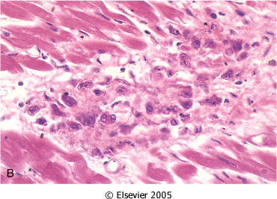
Pathologic Lesions
Ashcoff nodules
Fibrinoid degeneration of connective tissue, inflammatory cells

Slide 5
Global Burden of RHD
A leading cause of CV morbidity & mortality in young people
Total cases with RHD:20 Millions
CHF:3Million,valve surgery required in 1Million
Annual incidence of RF: 0.5 Million, nearly half develop carditis
Estimated deaths from RHD: 250,000/YR
Imposes a substantial burden on health care systems with limited budgets

Slide 6
Epidemiologic Background
The incidence of RF and the prevalence of RHD has declined substantially in Europe, North America and other developed nations
this decline has ben attributed to improved hygiene, reduced household crowding, and improved medical care

Slide 7
Epidemiologic Background
The major burden is currently found in low and middle income countries (India, middle east), and in selected indigenous populations of certain developed countries (Australia and Newzealand).
A disease of poverty and low socioeconomic status
In underdeveloped countries RHD is the leading cause of CV death during the first five decades of life

Slide 8
Epidemiologic Background
The incidence in indigenous population of Australia: 53-380 cases/100000 people/yr in 5-14 yrs age group.
In Saudi Arabia: incidence 30 cases/100000 people/yr and prevalence 310/100000 people in 6-15 yrs age group
Low risk population ARF incidence < 2/100000/yr (5-14 yrs) or all age prevalence of RHD <1/1000 population/yr

Slide 9
Diagnosis of ARF
No single test to diagnose ARF
The symptoms and signs are shared by many inflammatory and infectious diseases
Accurate diagnosis is important
Overdiagnosis will result in individuals receiving treatment unnecessarily
Underdiagnosis may lead to recurrences of ARF causing further damage, the need for valve surgery, CHF and premature death

Slide 10
Diagnosis of ARF
Diagnosis is primarily clinical and is based on a constellation of signs and symptoms, which were initially established as the Jones criteria
In 1944 Dr. TD Jones published a set of guidelines for diagnosis of ARF “Jones Criteria”
Subsequently Modified in 1965, 1984 and 1992by AHA
Revised recently -2015 by AHA

Slide 11
1992 Modified Jones Criteria

Slide 12
Carditis
Occurs in 50-70% of cases
Only manifestation of ARF that leaves permanent damage
May be subclinical
Murmurs of MR or AR may occur in acute stage while mitral stenosis occurs in late stages
Cardiomegaly and CHF may occur

Slide 13
Arthritis
Common: present in 35-66%
Earliest manifestation of ARF
Large joints: The knees and ankles, shoulders, elbows
“Migrating”, “Fleeting” polyarthritis
Duration short < 1 week
Rapid improvement with salicylates
Does not progress to chronic disease

Slide 14
Sydenham Chorea
Also known as Saint Vitus’dance
Occur in 10-30%, extrapyramidal manifestation, female predominnce
Abrupt Purposeless involuantry movements of muscles of face, neck, trunk, and limbs.
Delayed manifestation of ARF -months
Clinically manifest as-clumsiness, deterioration of handwriting,emotional lability or grimacing of face

Slide 15
Subcutaneous Nodules
Occur in 10%
Usually 0.5 – 2 cm long
Firm non-tender
Occur over extensor surfaces of joints, on bony prominences, tendons, spine
Short lived: last for few days
Associated with severe carditis

Slide 16
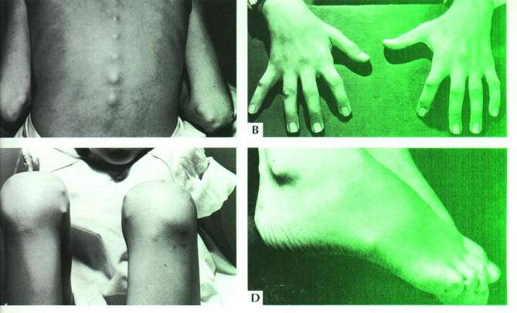
Subcutaneous nodules

Slide 17
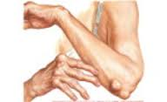
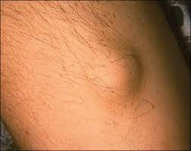
Subcutaneous Nodules

Slide 18
Erythema Marginatum
Present in <6%
Less common, but highly specific manifestation of ARF
Reddish border, pale center, round or irregular serpiginous borders, non-pruritic, transient rash
Occurs on trunk, abdomen or proximal limbs
Associated with carditis

Slide 19
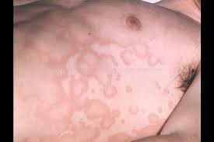
Erythrma Marignatum

Slide 20
2015 Revised Jones Criteria

Slide 21
2015 Revision of Jones Criteria
In accordance with the degree of prevalence of ARF/RHD in the population:
low risk populations have been defined as those with ARF incidence < 2:100000 school-age children or all age prevalence of RHD of < 1:1000 population per year
Children not from low risk population have been considered to be at moderate or high risk

Slide 22
2015 Revision of Jones Criteria
2. Advocated the use of Echocardiography in all cases of confirmed or suspected ARF or RHD, to diagnose valvulitis( subclinical carditis) and has been included as a major criterion to diagnose carditis
3. Aseptic monoarthritis has been included as a major criteria in moderate or high risk population

Slide 23
2015 Revision of Jones Criteria
4. Polyarthritis has been recognized as a major manifestation for moderate or high risk population
5. Fever >38.5 c, ESR >60 and or CRP > 3mg/dl for low risk population, and fever >38 and ESR >30 and or CRP > 3mg/dl for moderate or high risk population

Slide 24
Revised Jones Criteria-2015

Slide 25
2015 Revised Jones Criteria
A firm diagnosis requires
2 Major manifestations or 1 Major and 2 Minor manifestations
and
2 ) Evidence of a recent streptococcal infection.

Slide 26
2015 Revised Jones Criteria
Evidence of Preceding GAS Infection:
Increased or rising ASO titer or Anti-Dnase B titer
A positive throat culture

Slide 27
Rheumatic Fever Recurrences
Reliable past history of ARF: 2 major or 1 major and 2 minor or 3 minor manifestations sufficient for diagnosis
Presence of antecedent streptococcal infection
When minor manifestations only present exclude other causes.

Slide 28
DDX of ARF

Slide 29
Investigations

Slide 30
Investigations

Slide 31
Treatment of ARF
Bed rest
Salicylates : Aspirin
75-100 mg /kg/day given as 4 divided doses for 6 -8 weeks
Attain a blood level 20-30 mg/dl
Penicillin: Procaine Penicillin 4 million units/day x10 days
Prednisolone:2mg/kg/day taper over 6 weeks, Given when there is severe carditis
Heart Failure Treatment: diuretics, ACEI

Slide 32
Chronic Rheumatic Heart Disease
Most commonly in Mitral-70%
Frequently in Aortic-40%
Less frequently Tricuspid-10%
Rarely pulmonary valve-2%
Mitral Stenosis is more common in females(3:1), while males have higher incidence of Aortic Regurgitation

Slide 33
Mitral Stenosis
The normal MVA= 4-5 cm2
In severe ms <1.5 cm2
High LAP
The rise in LAP causes a similar rise in pulmonary capillaries, veins and artery

Slide 34
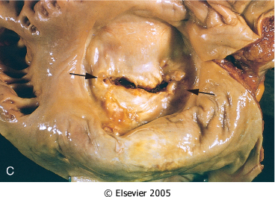
Mitral Stenosis
Notes:
Mitral stenosis with diffuse fibrous thickening and distortion of the valve leaflets, commissural fusion (arrows), and thickening and shortening of the chordae tendineae. Marked dilation of the left atrium is noted in the left atrial view

Slide 35
Clinical Features
Dyspnea
Fatigue
Palpitation
Hemoptysis (10%)
Hoarseness ( Ortner’s syndrome)
Dysphagia
Storke or peripheral embolization

Slide 36
Clinical Features
Cyanosis (Mitral facies,malar flush)
Tapping apex ( S1)
Parasternal heave
Diastolic thrill
Accentuated S1 , accentuated S2
Opening snap
Mid-diastolic rumble

Slide 37
Investigations
CXR
Straightening of the left heart border
Double density
Kerley B lines , CA in MV
ECG: LAE, P Mitrale ,RV dominance
Echodoppler

Slide 38
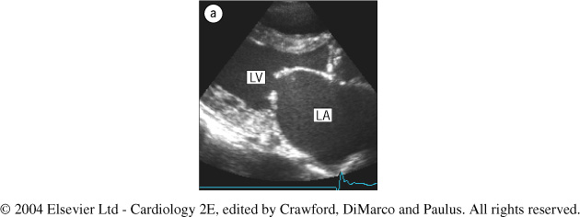
Echo In Mitral Stenosis
Notes:
Fig. 1.1 Two-dimensional echocardiography in mitral stenosis. (a) Parasternal long-axis view through a stenotic mitral valve, demonstrating typical diastolic doming of the anterior leaflet.

Slide 39
Management
B-Blockers ,CCB
Digoxin ( AF )
Warfarin
Balloon Valvuloplasty
Mitral valve replacement

Slide 40
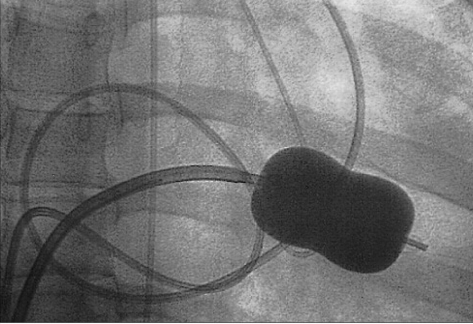
BMV
Notes:
Fig. 4.4 Inoue catheter for mitral balloon valvotomy. The balloon-tipped catheter is positioned across the stenotic valve and inflated. The narrowed orifice is subjected to the force from the transiently inflated balloon. When the procedure is successful, these forces break the scar tissue and allow greater opening of the mitral valve leaflets. This technique is a balloon commissurotomy that has evolved from the earlier extensive experience with closed and open surgical commissurotomy.

Slide 41
Mitral Regurgitation
Asymptomatic
Dyspnea , orthopnea, PND
Displaced PMI, Thrill
Soft S1,
Pansystolic murmur
Treatment is surgical

Slide 42
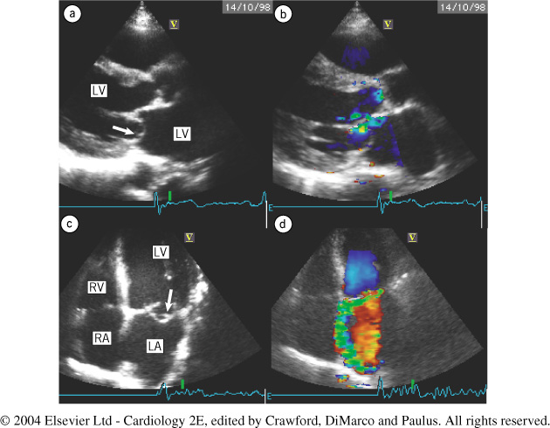
ECHO
Notes:
Fig. 1.5 Echocardiographic studies in mitral regurgitation. Parasternal long‑axis views show (a) prolapse of the posterior mitral leaflet (arrow) with corresponding flow directed along the anterior mitral leaflet towards the atrial septum. Apical four-chamber views show (c) the prolapse more clearly (arrow), and the extension of the regurgitation is more clearly visualized (d). The jet is ‘spoon shaped’, broad and thin along the wall, and it is therefore easily underestimated. LA, left atrium; LV, left ventricle; RA, right atrium; RV, right ventricle.

Slide 43
Aortic Regurgitation
Water-hammer / collapsing pulse
Wide pulse pressure
Corrigan’s sign
De Musset sign
Muller sign
Quincke’s pulse
Hill’s sign

Slide 44
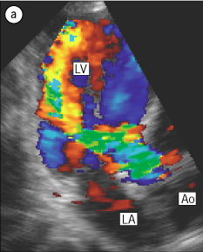
ECHO
Notes:
Fig. 1.12 Severe aortic regurgitation. (a) Apical view showing a wide jet reaching to the apex.

Slide 45
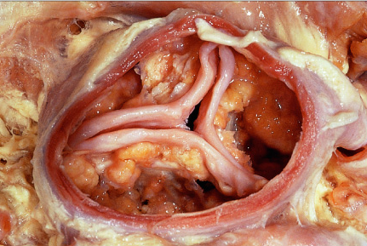
Aortic Stenosis
Notes:
Fig. 9.3 Gross pathology of degenerative aortic stenosis. The figure shows the masses of lipo-calcification on the aortic side of all three leaflets and the absence of commissural fusion.

Slide 46
Symptoms
Angina
Syncope
Dyspnea

Slide 47
Signs
Arterial Pulse wave form : Plateau
Small (Parvus)
Slow rise (Tardus)
Sustained not displaced PMI
Systolic thrill
S4

Slide 48
Signs
Late peaking of murmur
Single S2 : Soft or absent A2
Paradoxical splitting of S2

Slide 49
Aortic Valve Disease
Treatment:
Aortic valve Replacement
Transcathter Aortic Valve Replacement

Slide 50
Secondary Prevention of Rheumatic Fever (Prevention of Recurrent Attacks)
Agent Dose Mode
Benzathine penicillin G 1 200 000 U every 4 weeks* Intramuscular
or
Penicillin V 250 mg twice daily Oral
or
Sulfadiazine 0.5 g once daily for patients 27 kg (60 lb Oral
1.0 g once daily for patients >27 kg (60 lb)
For individuals allergic to penicillin and sulfadiazine
Erythromycin 250 mg twice daily Oral
*In high-risk situations, administration every 3 weeks is justified and recommended

Slide 51
Duration of Secondary Rheumatic Fever Prophylaxis
Category Duration
Rheumatic fever with carditis and 10 y since last episode residual heart disease or until age 40y ,(which- (persistent valvar disease*) ever is longer), sometimes life long prophylaxis Rhumatic fever with carditis 10 yrs or until age 21yrs
But no residual VHD (whichever is longer)
Rheumatic fever without carditis 5 y or until age 21 y, ( whichever is longer)
*

