Slide 1
Safety in Radiology
Dr. Abdullah Abu Jamea
Assistant Professor and Medical Physics Consultant

Slide 2
Safety in Radiology
Lecture Objectives:
At the end of this lecture you should be able to:
Recognize, and evaluate essential information on the biologic effects of ionizing radiation and radiation safety to ensure the safe use of x-rays in diagnostic imaging.
Know radiation quantities and units, regulatory and advisory limit for human exposure to radiation.
Know equipment for radiation protection and measurement.
Understand the fundamental principles of MRI safety
Know about contrast agents reactions and safety.
Understand how to prepare patients for radiology studies.

Slide 3
Safety in Radiology
Major Sources of Risk in Radiology:
Radiation hazard.
Radioactive materials hazard.
Magnetic field hazard.
Contrast agents hazard.

Slide 4
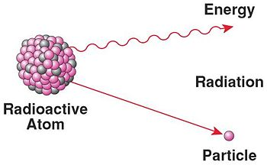
What is Radiation?
Radiation is energy emitted from a substance:
Non-ionizing: Microwave oven, Television, Radiowaves.
Ionizing: means alpha particles (α), beta (β), gamma (γ) and X-rays (among others) that are capable of producing ions.

Slide 5
Radiation Spectrum

Slide 6
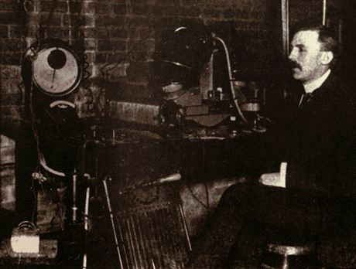
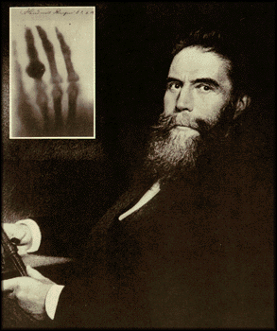
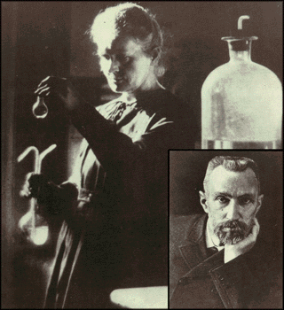
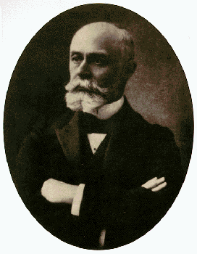
Early Pioneers in Radioactivity
Rutherford:
Discoverer Alpha and Beta rays 1897
Roentgen:
Discoverer of X-rays 1895
The Curies:
Discoverers of Radium and Polonium 1900-1908
Becquerel:
Discoverer of Radioactivity 1896

Slide 7
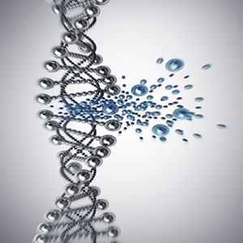
What is an X-ray?
X-rays are very short wavelength electromagnetic radiation.
The shorter the wavelength, the greater the energy and the greater the ability to penetrate matter.
Ionizing radiation such x-ray can be carcinogenic and, to the fetus, mutagenic or even lethal.
DNA damage

Slide 8
Goals of Radiation Safety
Eliminate deterministic (acute) effects.
Reduce incidence of stochastic (Chronic) effects.

Slide 9
Deterministic Effects
Acute radiation symptoms are caused by high levels of radiation usually over a short period of time.
They cannot be predicted with certainty
severity of damage increases with increasing dose above that threshold.

Slide 10
Deterministic (acute) Effects
Examples of deterministic effects:
Cataract formation.
Skin reddening (erythema).
lowering of the white blood cell count
hair loss
Bone marrow failure.
Lung Fibrosis.
Infertility.

Slide 11
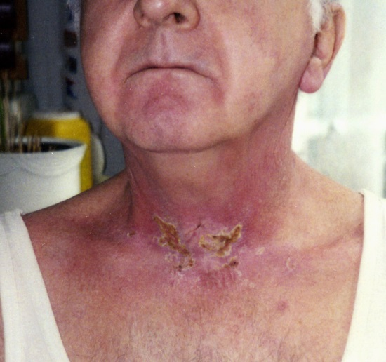
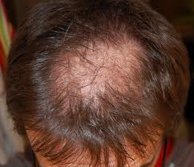
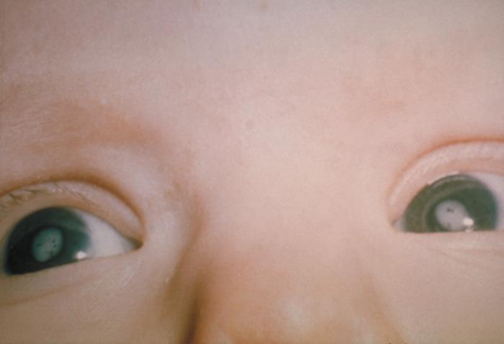
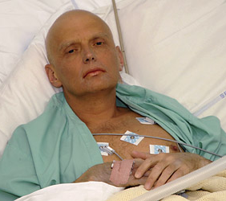
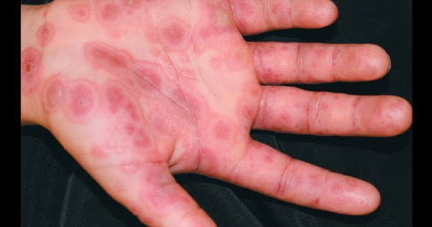
Deterministic Effects

Slide 12
Deterministic Effects
Major organs annual dose limits for preventing deterministic effects are as follows:
Threshold for deterministic effects (Gy)
 | Effects | One single absorption (Gy) | Prolong absorption (Gy-year)
testis | permanent infertility | 3.5 - 6.0 | 2
ovary | permanent infertility | 2.5 - 6.0 | > 0.2
Lens of eyes | milky of lens cataract | 0.5 - 2.0 5.0 | > 0.1 > 0.15
Bone marrow | Blood forming deficiency | 0.5 | > 0.4

Slide 13
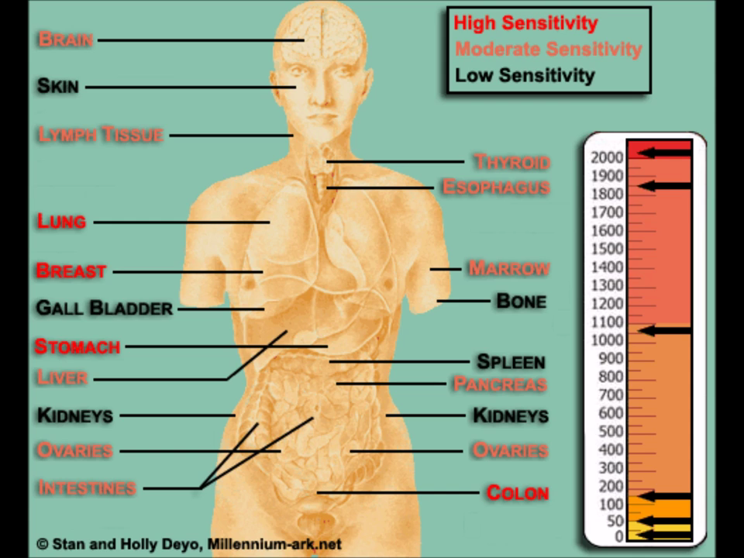

Slide 14
Deterministic Effects
Gray, Rem, rad, Curie, Becquerel and Sievert are units of radiation.
One chest x-ray 0.15 mGray.
To reach the hazardous level of 2 Gray you need 10000 chest x ray or 100 CT abdomen or 30 mins to 1 hr fluoroscopy exposure.

Slide 15
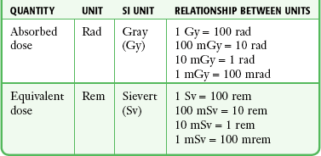

Slide 17
Stochastic (chronic) Effects
Also referred to as Probabilistic, probability of occurrence depends on absorbed dose.
Chronic radiation symptoms are caused by low-level radiation over a long period of time
The effect may (potentially) occur following any amount of exposure, there is no threshold.
Even the smallest quantity of Ionizing Radiation exposure can be said to have a finite probability of causing an effect.
Severity of the effect is not dose related.

Slide 18
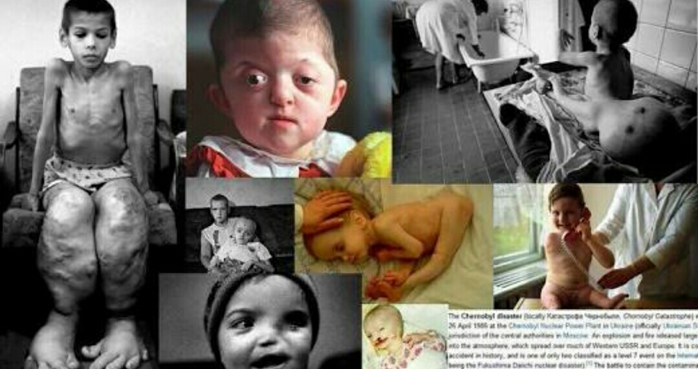
Stochastic Effects
Examples of stochastic effects:
Carcinogenic effect.
Genetic effect.

Slide 19
Radiation Exposure Levels & Effects
0.62 rem/y – average annual radiation exposure.
2 rem/y – international radiation exposure limit.
25 rem – measureable blood changes.
100 rem – onset of radiation sickness.

Slide 20
Radiation Exposure Levels & Effects
200 rem – radiation sickness with worse symptoms in less time
400 rem – approximately the lethal dose for 50% of the population in 30 days
1,000 rem – death probable within about 2weeks, effects on the gastrointestinal tract
5,000 rem – death probable within 1-2 days, effects on the central nervous system.
.

Slide 21
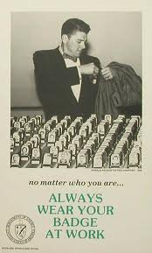
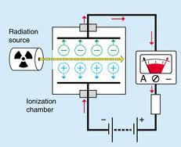
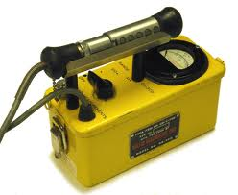
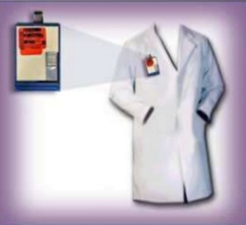
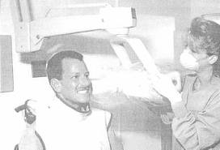
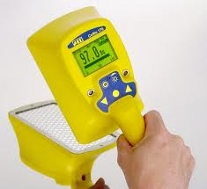
Typical Radiation Detectors
Film packet
Thermoluminescent Dosimeter (TLD)
Ionization chamber
Geiger-Müller (GM) Detector
Scintillation Detector

Slide 22
LIMITING YOUR EXPOSURE
Three basic methods for reducing exposure of workers to X-rays:
Minimize exposure time.
Maximize distance from the X-ray source.
Use shielding.

Slide 23
General Methods of Protection
Time ( Minimize)
Distance ( Maximize)
Shielding (stand behind lead protection.

Slide 24
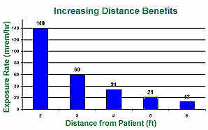
LIMITING YOUR EXPOSURE
Exposure varies inversely with the square of the distance from the X-ray tube:
www.e-radiography.net/radsafety/reducing_exposure.htm

Slide 25
LIMITING YOUR EXPOSURE
Shielding:
Operators view the target through a leaded glass screen.
Wear lead aprons. Almost any material can act as a shield from gamma or x-rays if used in sufficient amounts.

Slide 26
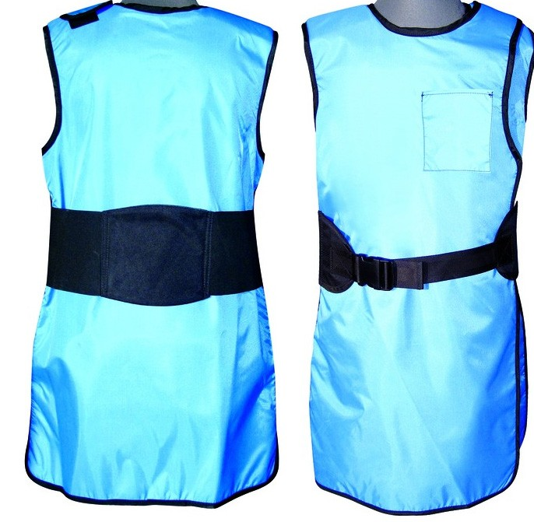
LIMITING YOUR EXPOSURE
Shielding:
Standard 0.5mm lead apron Protect you from 95% from radiation exposure.

Slide 27
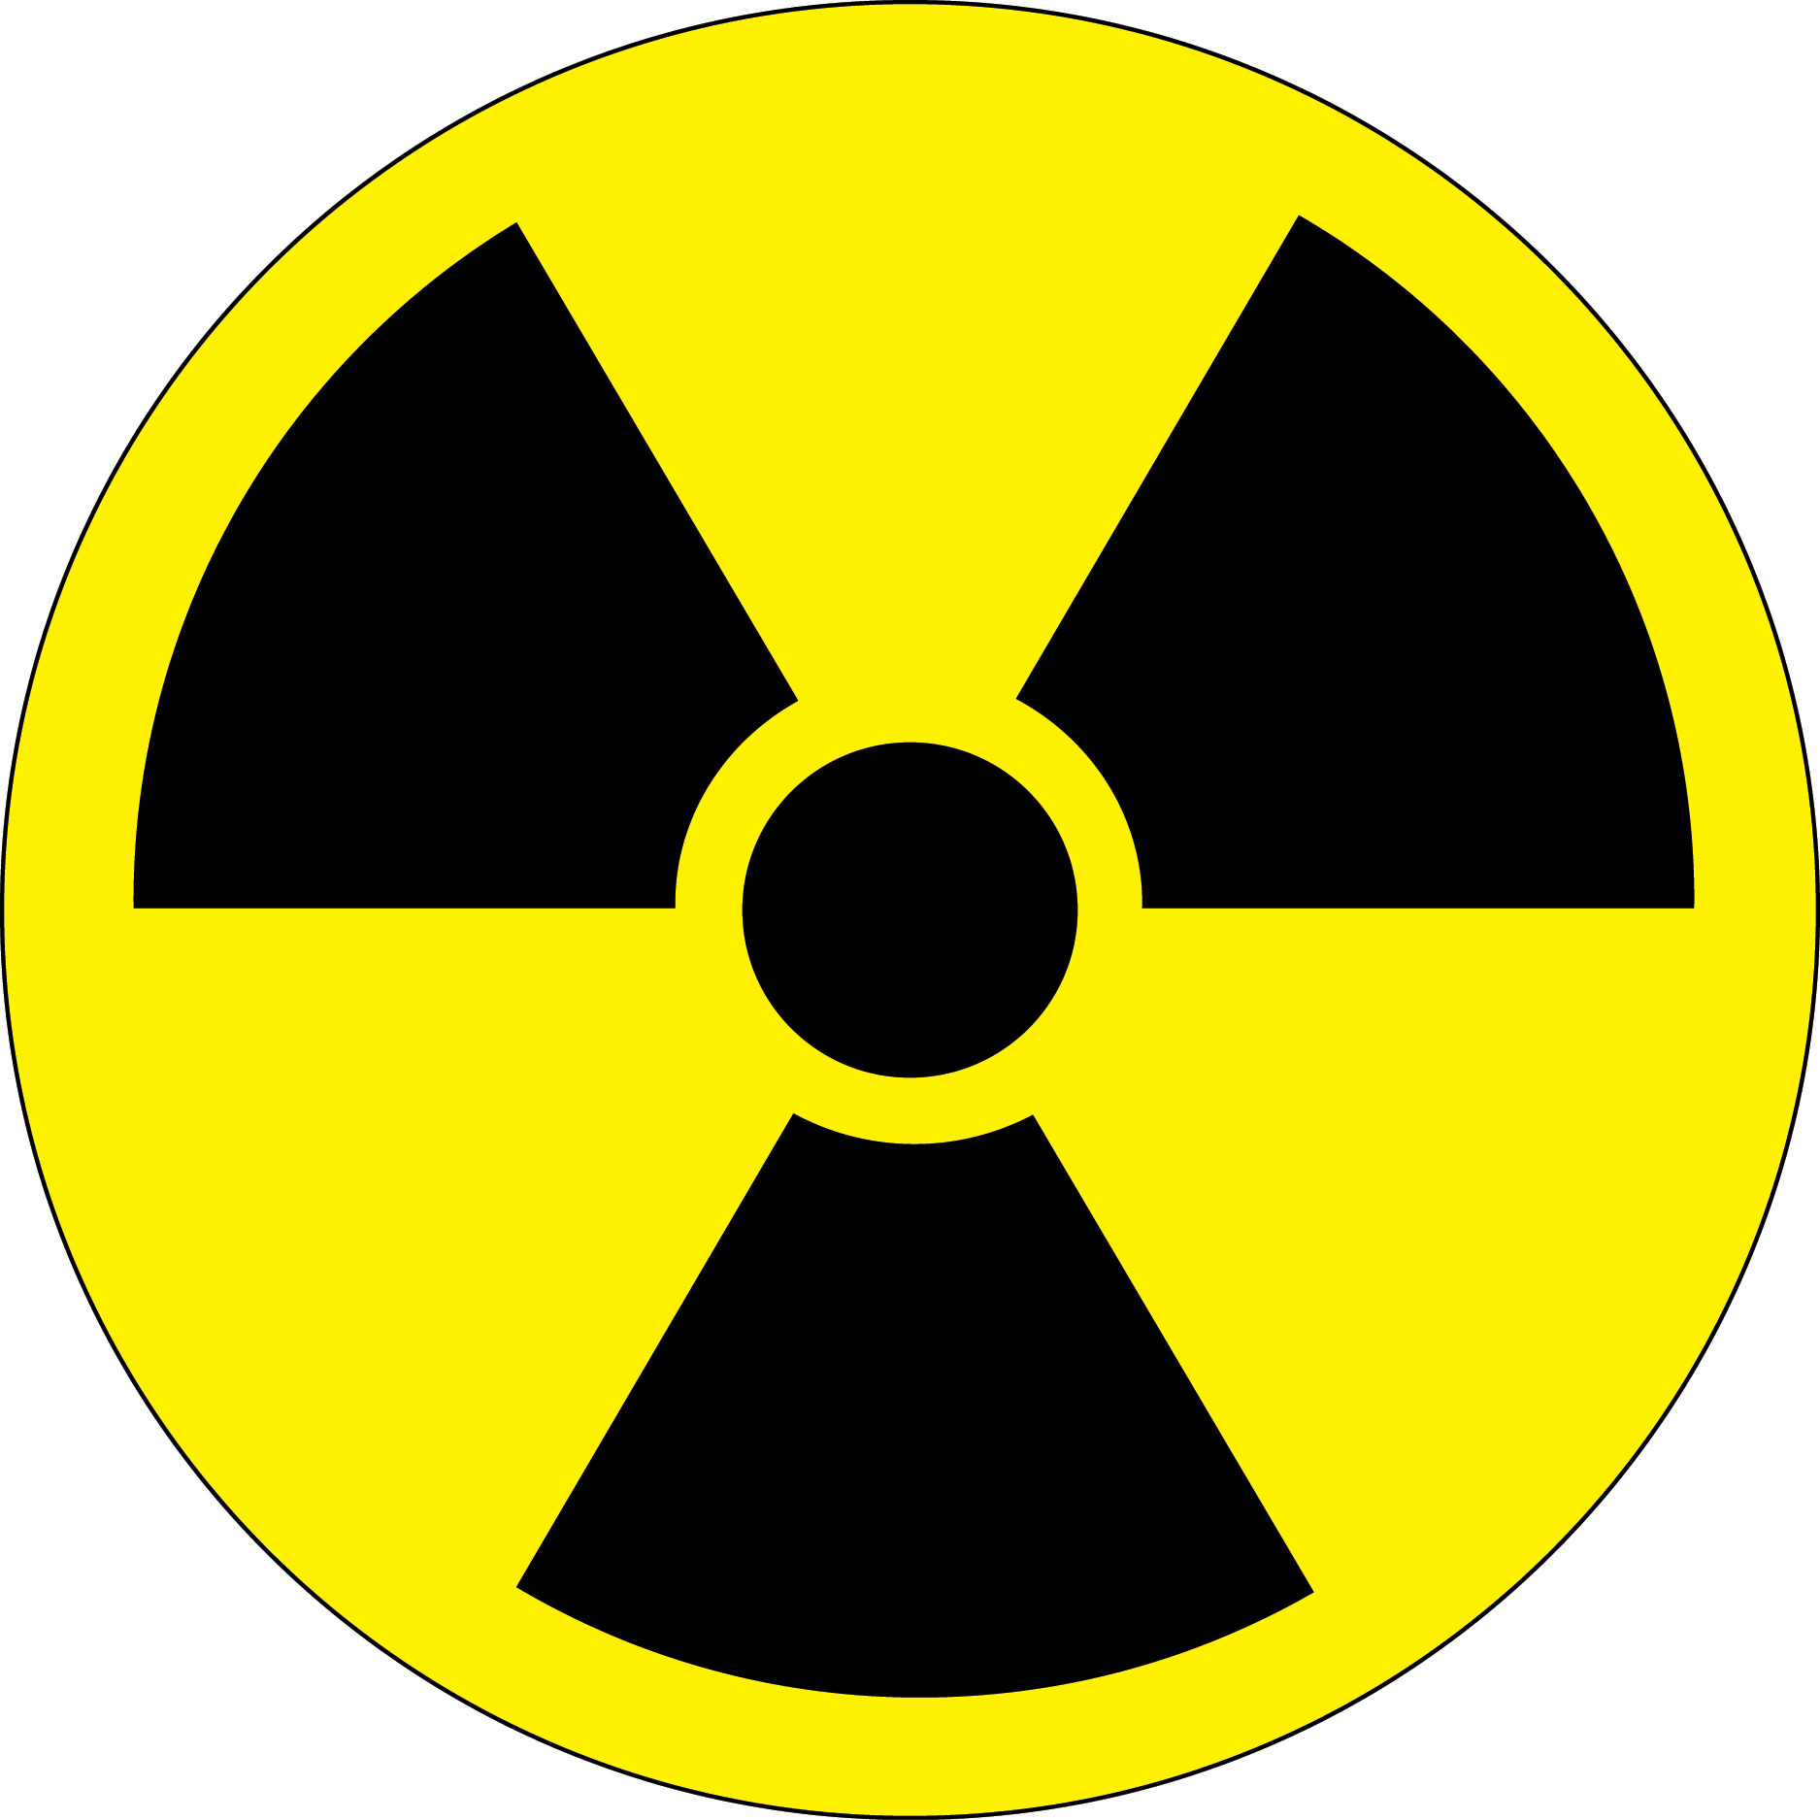
ALARA Rule
As low as reasonably achievable:
Reduce number of exams.
Reduce time of exams.
Radiation Hazard symbol displayed at places where radioactive materials are used and stored.
Use alternative (US or MRI).

Slide 28
Radioactive Materials Hazard

Slide 29
What do we mean by Radioactivity?
Radioactive decay is the process in which an unstable atomic nucleus loses energy by emitting radiation in the form of particles or electromagnetic waves.
An unstable nucleus releases energy to become more stable.

Slide 30
Where are the Sources of Radioactivity?
Naturally Occurring Sources:
Radon from the decay of Uranium and Thorium.
Potassium -40 – found in minerals and in plants.
Carbon 14 – Found in Plants and Animal tissue.
Manmade Sources:
Medical use of Radioactive Isotopes.
Certain Consumer products –(eg Smoke detectors).
Fallout from nuclear testing.
Emissions from Nuclear Power plants.

Slide 31
Radioisotopes.
Isotopes of an atom that are radioactive are called radioisotopes.
These atoms are radioactive because they have too much energy to be stable; they will release energy until they become stable
This is called radioactive decay.

Slide 32
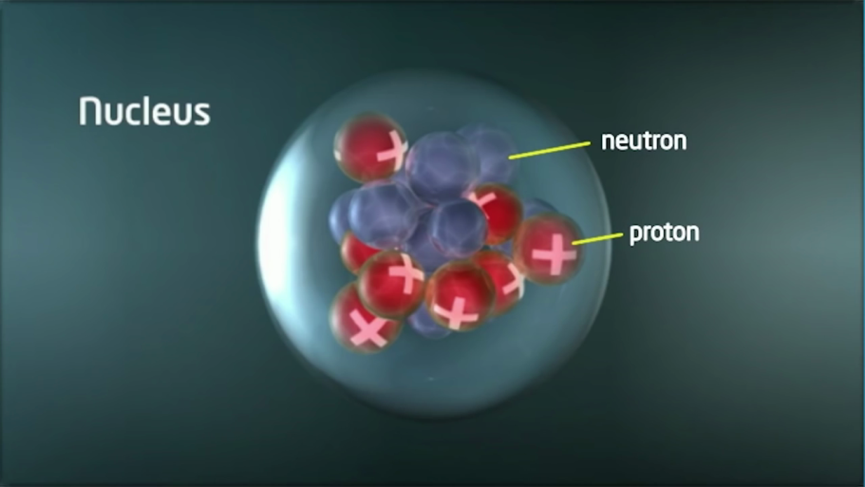

Slide 33
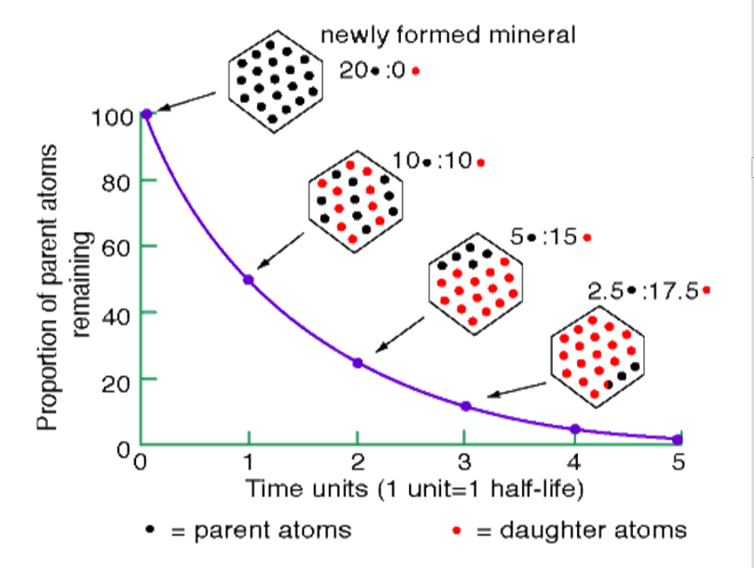
Radioactive Decay.
In the process of radioactive decay, an atom actually changes from one element to another by changing its number of protons.
The half-life of a radioactive substance is the amount of time required for it to lose one half of its radioactivity and transform into another element.

Slide 34
Medical use of Radioactive Isotopes.
Radioactive isotopes introduced into the body are distinguishable by their radiation from the atoms already present.
This permits the relatively simple acquisition of information about the dynamics of processes of uptake, incorporation, exchange, secretion, etc.

Slide 35
Radiopharmaceuticals
The most widely used radioisotope is Technetium (Tc), with a half-life of six hours.
activity in the organ can then be studied either as a two dimensional picture or, with a special technique called tomography, as a three dimensional picture (SPECT, PET).

Slide 36
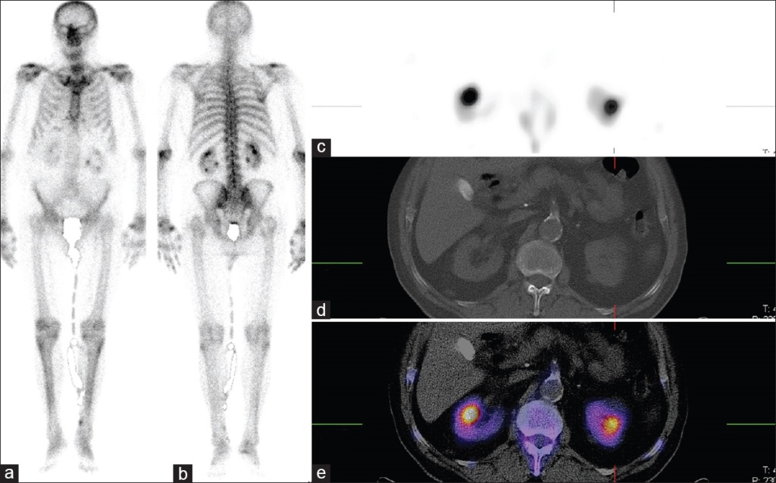
Radiopharmaceuticals

Slide 37
Handling Radiopharmaceuticals
No radioactive substance should be handled with bare hands. Alpha and beta emitters can be handled using thick gloves.
Radioactive materials must be stored in thick lead containers.
Reactor and laboratories dealing with radioactive materials must be surrounded with thick concrete lined with lead.
People working with radioactive isotopes must wear protective clothing which is left in the laboratory.
The workers must be checked regularly with dosimeters, and appropriate measures should be taken in cases of overdose.
Radioactive waste must be sealed and buried deep in the ground.

Slide 38
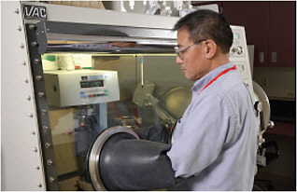
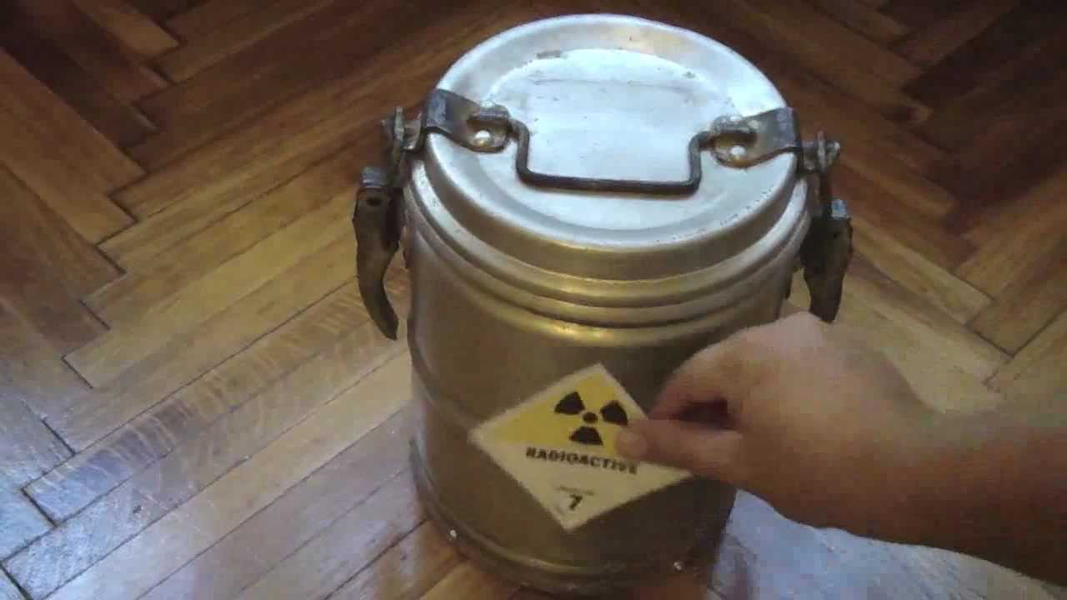
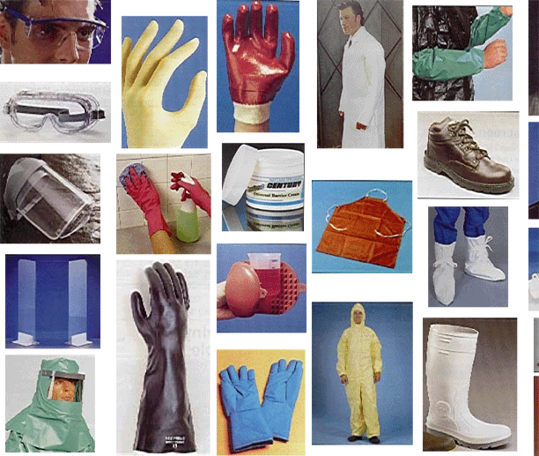
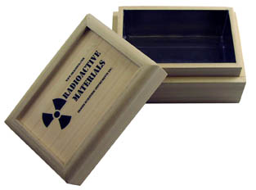

Slide 39
Spill Response
On Skin — flush completely
On Clothing — remove
If Injury — administer first aid
Radioactive Gas Release — vacate area, shut off fans, post warning
Monitor all persons and define the area of contamination.

Slide 40
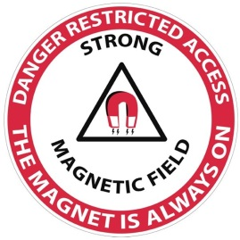
Magnetic Field Hazard

Slide 41
Magnetic Resonance Hazard
MRI is one of the imaging modality that is widely used in radiology.
There is no dangerous radiation in MRI instead it uses very high magnetic field up to 3Tesla (1 Tesla = 20000 times earth gravity).
This strong magnetic field produces powerful attractive force and torque which the magnet exerts on ferromagnetic objects, this is called missile effect. *
The missile effect can pose a significant risk to anyone in the path of the projectile, and cause significant damage to the scanner.
The effect is clearly greater for high field systems , ^{2 , 3.} .

Slide 42
Magnetic Resonance Hazard

Slide 43
Magnetic Resonance Hazard

Slide 44
Magnetic Resonance Hazard
To guard against accidents from metallic projectiles, the “5 gauss line” should be clearly demarcated and the area with that line kept free of ferromagnetic objects.
It is essential that patient with ferromagnetic surgical clips, implants containing ferromagnetic components, and persons who have suffered shrapnel or steel fragment injuries, especially to the eyes, be excluded from the imager.

Slide 45
Magnetic Resonance Hazard
A number of general precautions must be taken to ensure the safety of patients and personal working in the imaging suite.
Access to the imaging area should be limited, and signs should be displayed to warn persons with cardiac pacemaker or neuro-stimulators not to enter the area.
Credit cards and watches with mechanical parts should be left outside the imaging area to prevent magnetic tape erasure and watch malfunction.

Slide 46
Magnetic Resonance Hazard
Some implants are paramagnetic, or even ferromagnetic. These implants tend to move and align with the main magnetic field.
This results in a force and torque on the implant and the implant may become dislodged, resulting in severe injury to the patient.
Aneurysm clips are examples of implants that can result in death if displaced.

Slide 47
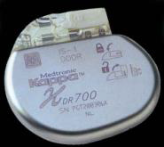
Magnetic Resonance Hazard
Some implants are paramagnetic, or even ferromagnetic. These implants tend to move and align with the main magnetic field.
This results in a force and torque on the implant and the implant may become dislodged, resulting in severe injury to the patient.
Aneurysm clips are examples of implants that can result in death if displaced.
Pacemaker and implanted cardiac defibrillator are typical examples of such devices.

Slide 48
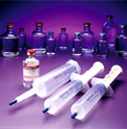
Contrast medium Hazard

Slide 49
Contrast Agents
Compounds used to improve the visibility of internal bodily structures in an image.
Since their introduction in the 1950s, organic radiographic iodinated contrast media (ICM) have been among the most commonly prescribed drugs in the history of modern medicine.
These contrast agents attenuate x-rays more than body soft tissues due to their high atomic weight.
Millions of intravascular contrast media examinations are performed each year.

Slide 50
Contrast Agents
Iodinated contrast media generally have a good safety record.
Adverse effects from the intravascular administration of ICM are generally mild and self-limited;
Reactions that occur from the extravascular use of ICM are rare.
Nevertheless, severe or life-threatening reactions can occur with either route of administration.

Slide 51
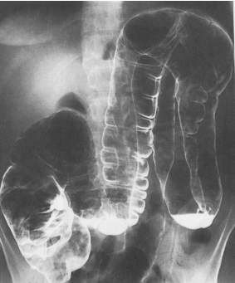
Types of Contrast Agents
Negative contrast
Organs become more radiolucent.
X-rays penetrate more easily.
Low atomic # material
Black on film
Example: air,CO2.
Commonly used to inflate a structures; distinguish colon from other structures

Slide 52
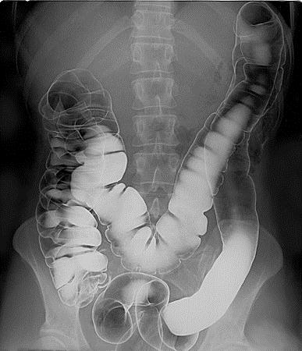
Types of Contrast Agents
Positive contrast
Substance absorbs x rays, organ become radiopaque.
High atomic # material
White on film
Most common media:
Iodinated contrast agent.
Barium sulfate.

Slide 53
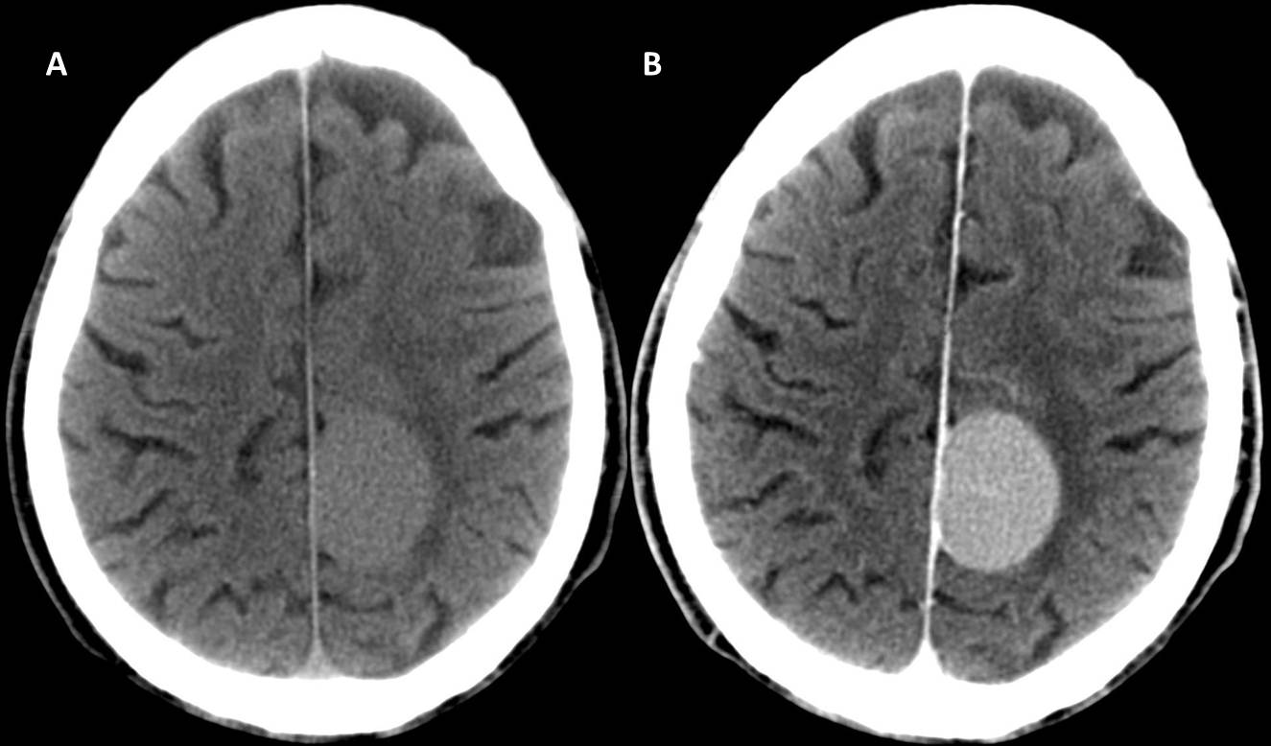
WHY IODINE?
IODINE (atomic wt 127) provides excellent radio-opacity.
Higher atomic number maximizing the photo-electric effect.

Slide 54
Classification of agents
Contrast agents are classified based on 3 properties:
The charge of the iodinated molecule (ionic or nonionic)
The molecular structure (monomeric or dimeric)
The osmolality of the injected preparation (hyperosmolal, low osmolal, or iso-ismolal relative to normal serum osmolality [275 to 290 mosm/kg])
monomeric
dimeric

Slide 55
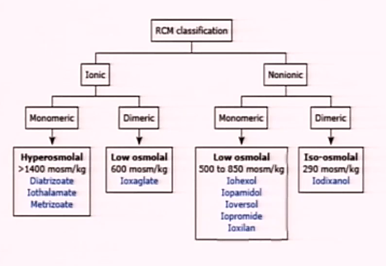
Iodinated Contrast Agents

Slide 56
Iodinated Contrast Agents
The toxicity of contrast agents decreases as osmolality approaches that of serum.
This has been accomplished by developing nonionizing compounds and then combining two monomers to form a dimer.

Slide 57
Iodinated Contrast Agents
Currently used iodinated agents are cleared almost completely by glomerular filtration.
Circulatory half life is 1–2 hours, assuming normal renal function.

Slide 58
4. Less money
More money
5. More reactions
Less reactions

Slide 59
Methods of administration of contrast material
INGESTED
ORAL: Barium sulfate suspension
RETROGRADE
AGAINST NORMAL FLOW: Barium Enema
INTRATHECAL
Spinal canal
INTRAVENOUS
Injecting into bloodstream
(anything other than oral)

Slide 60
Reaction classification
Immediate reactions: were defined as those occurring within the department (within one hour).
Delayed: as those occurring between the time the patients left the department and up to seven days later.

Slide 61
Reaction classification
The American College of Radiology has divided adverse reactions severity to contrast agents into the following categories:
Mild.
Moderate.
Severe.

Slide 62
Mild Reaction (5%)
Signs and symptoms appear self-limited without evidence of progression,
Nausea, vomiting, warmth, headache, dizziness, shaking, altered taste, itching, flushing, chills, sweats, rash, nasal stuffiness, swelling: eyes, face and anxiety.
Treatment: Observation and reassurance. Usually no intervention or medication is required; however, these reactions may progress into a more severe category.

Slide 63
Moderate Reaction (1%)
Reactions which require treatment but are not immediately life-threatening,
Tachycardia/ bradycardia, hypertension, pronounced cutaneous reaction, hypotension, dyspnea, pulmonary edema, bronchospasm, wheezing and laryngeal edema.
Treatment: Prompt treatment with close observation.

Slide 64
Severe Reaction (0.05%)
Life-threatening with more severe signs or symptoms including,
Laryngeal edema (severe), profound hypotension, convulsion, unresponsiveness and cardiopulmonary arrest.
Treatment: Immediate treatment, antiemetic drugs. Usually requires hospitalization.

Slide 65
Some Reaction Medications
Aggressive fluids.
Lasix
Dopamine
Mannitol

Slide 66
Delayed Contrast Reactions
Delayed contrast reactions can occur anywhere from 3 hours to 7 days following the administration of contrast.
It is important for anyone administering intravenous contrast media to be aware of delayed reactions.
The more common reactions include a cutaneous exanthema, pruritus without urticaria, nausea, vomiting, drowsiness, and headache.

Slide 67
Delayed Contrast Reactions

Slide 68
Delayed Reactions
- flu like symptoms
- delayed arm pain
- rash/ pruritus
- salivary gland swelling
- Steven Johnson syndrome

Slide 69
Contraindications for Contrast
Renal Failure (Check BUN & Creatinine)
Elevated levels could cause renal shutdown
Anuria (no urine production)
Asthma (possible allergies)
Hx of Contrast Allergy / Reactions
Diabetes - get a hx of medications taken
glucophage must be stopped 48 hrs before contrast injection
Multiple Myeloma

Slide 70
Contraindications for Contrast
Pregnancy (risk of fetal Thyroid toxicity).
Allergic Reaction, Pre – medication is available.

Slide 71
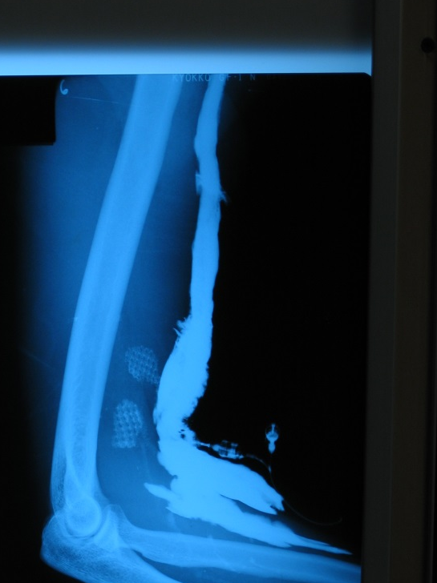
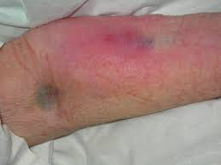
EXTRAVASATION
Contrast material has seeped outside of vessel.
Apply WARM Compress 1st 24 hours.
Cool compress for swelling.
Extravasation of Contrast into soft tissue of arm

Slide 72
MRI Contrast Agents
The Contrast used in MRI is based on paramagnetic ions eg. Gadolinium.
By themselves these ions are highly toxic so bound up in large molecules eg. DTPA.
Provides a greater contrast between normal and abnormal tissues.

Slide 73
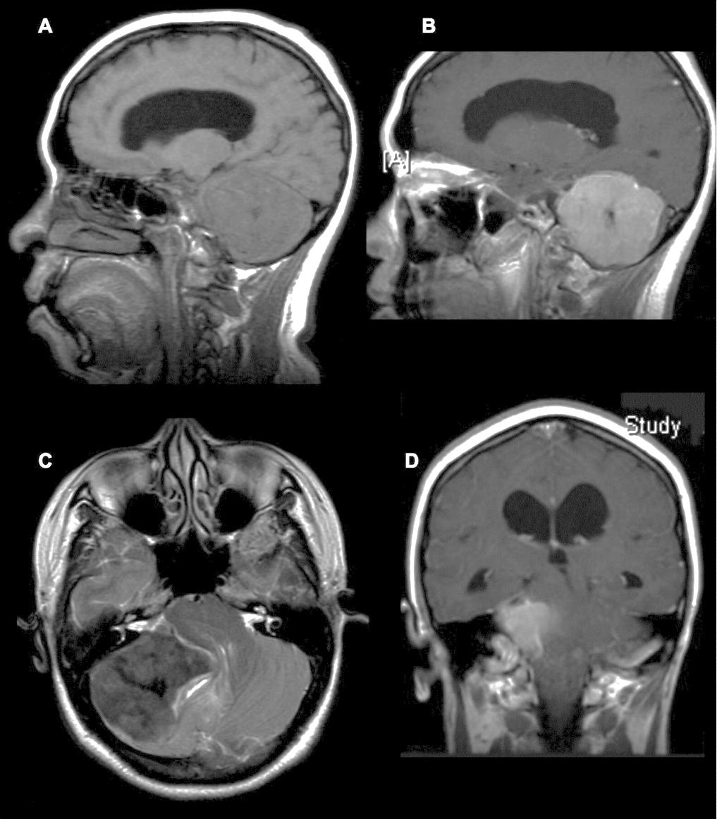
MRI Contrast

Slide 74
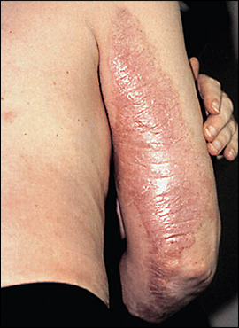
Gadolinium Side Effects
With impaired kidney function, gadolinium could lead to a serious and potentially fatal disorder called Nephorgenic Systemic Fibrosis. (NSF)

