Slide 1






AHMAD AMER Al-BOUKAI
Associate Professor & Consultant Radiologist
Radiology & Medical Imaging Department King Khalid University Hospital
A A Al-BOUKAI-4

Slide 2


Students at the end of the lecture will be able to:
Recognize the different modalities utilized in imaging the chest & cardiovascular system
Recognize the basic technical factors affecting image quality
Recognize the radiological anatomy of chest and cardiovascular system
A A Al-BOUKAI-4

Slide 3



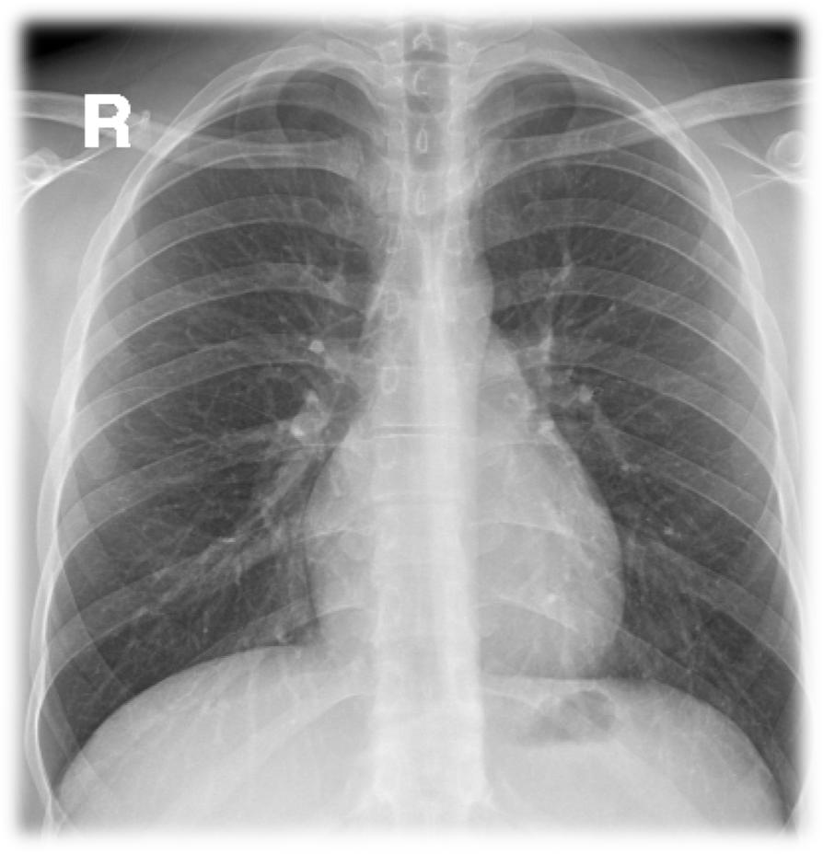
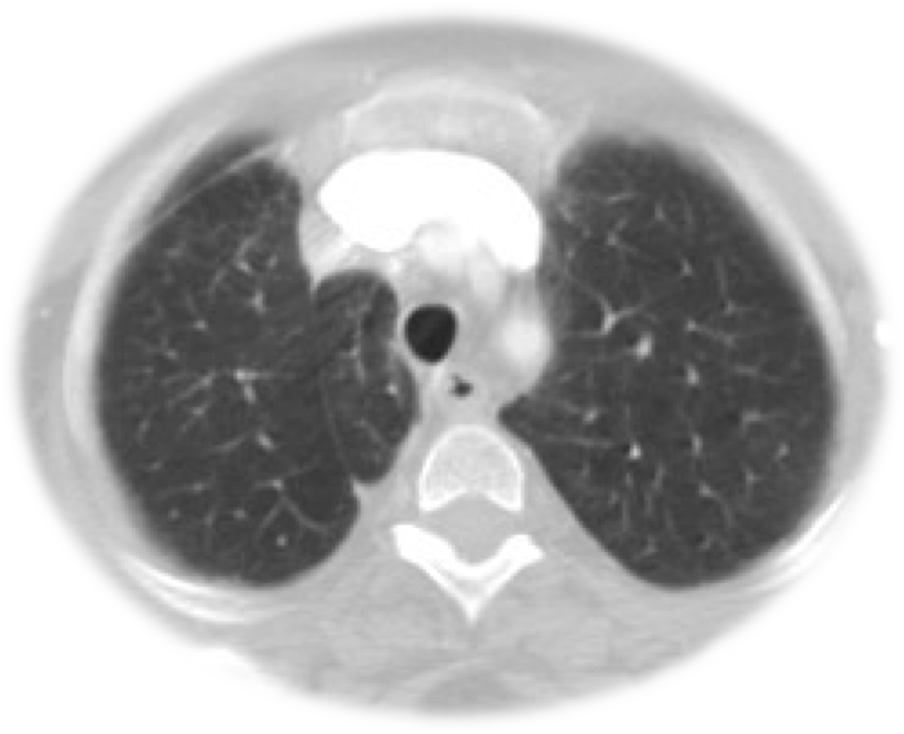
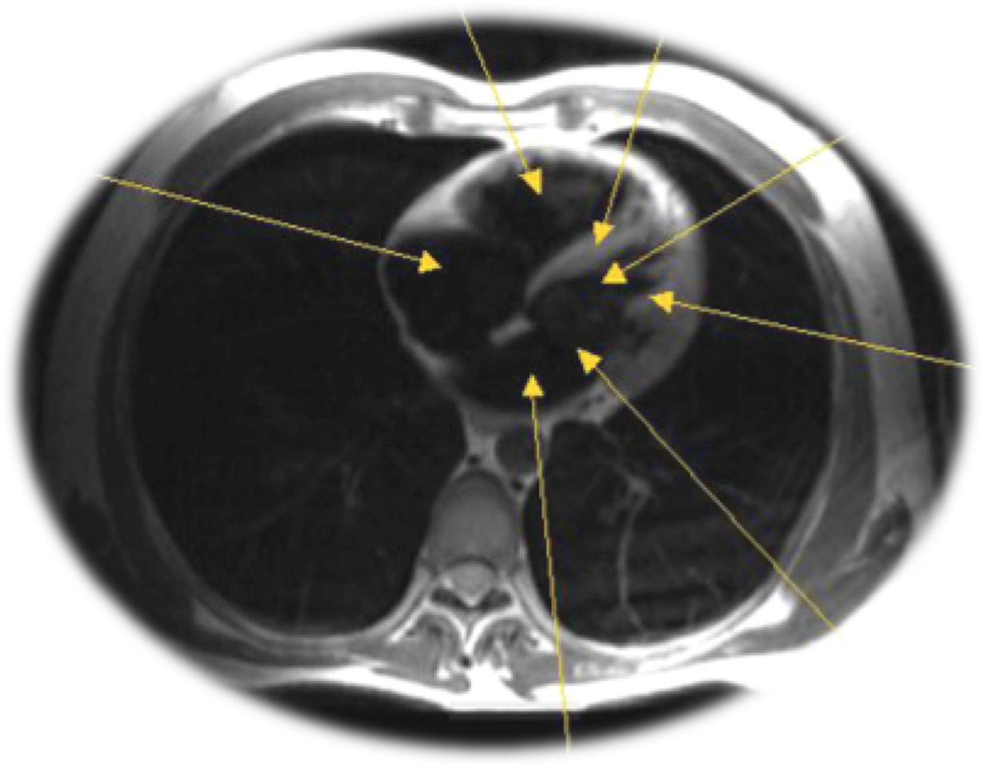
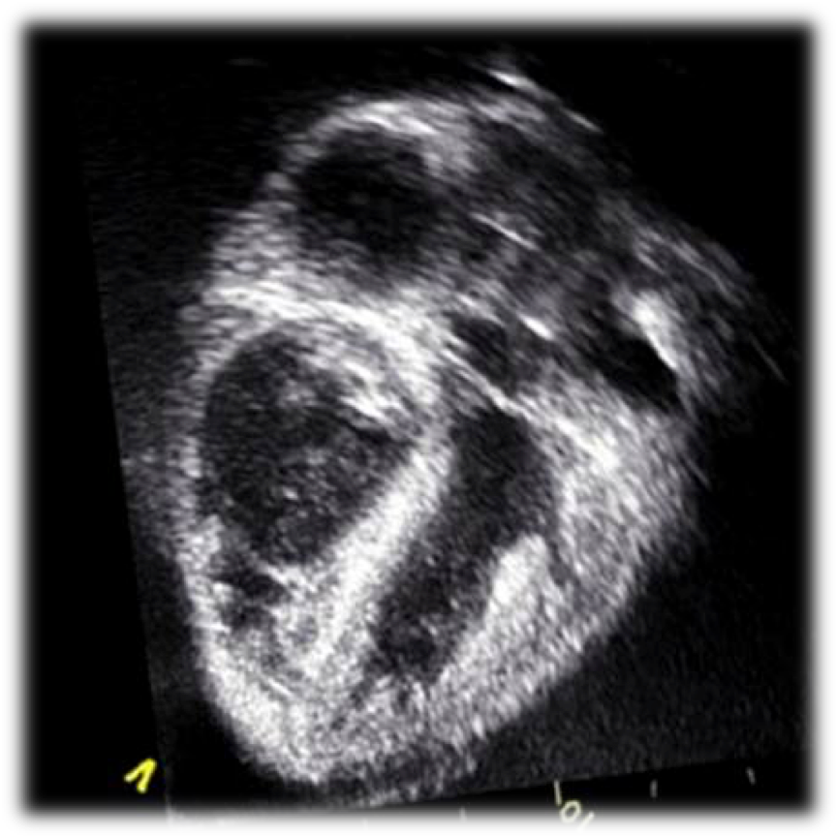

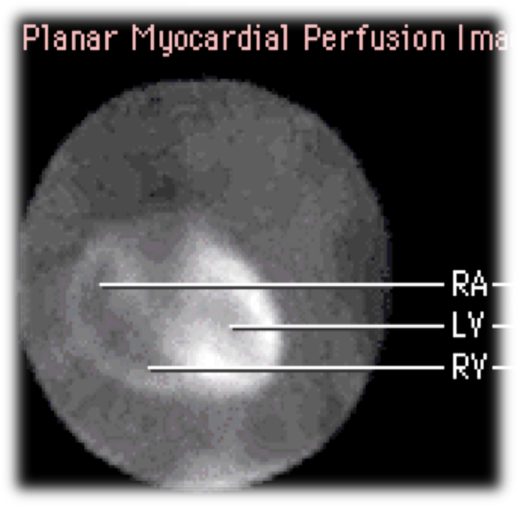

² Plain X-Ray
² Computed Tomography (CT)
² Magnetic Resonance Imaging (MRI)
² Ultrasound
² Nuclear Medicine
² Angiography
A A Al-BOUKAI-4

Slide 4

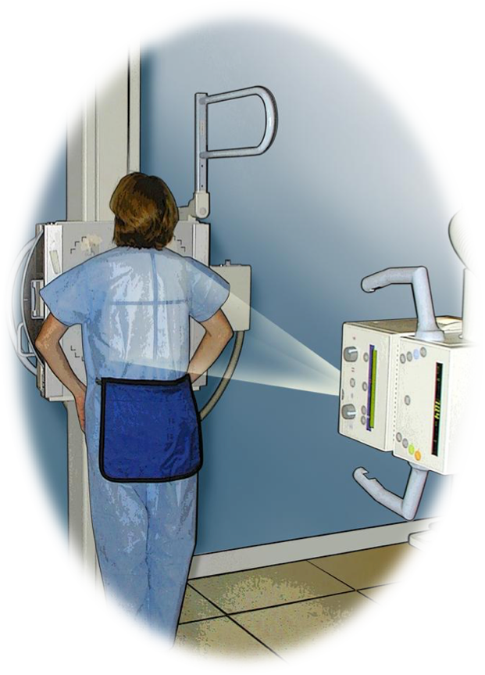

X-ray:
² Plain X-Ray
Electromagnetic radiation
The image is the result of interaction of X-ray beam and body tissue
X-rays that pass through a structure easily are least absorbed and therefore cause blackening on the radiograph (air-lung).
Whereas structure that absorbs or reflects x-ray most appear white. (bone-metallic).
Soft tissues lie in between à gray. According to thickness of these the shades of gray differ.
Projections are usually described by the path of the x-ray beam. Thus, the term PA
(poster anterior) view designates that the beam passes from the back to the front, the standard projection for a routine chest film.
The image on an x-ray film is two-dimensional. All the structures along the path of the
^{The i}b^{m}eªa^{g}m^{e is}ar^{t}e^{he}p^{r}r^{e}o^{s}j^{u}e^{lt}ctºe^{f} d^{int}o^{e}n^{ra}t^{c}o^{tio}t^{n}he^{of}s^{X}a⁻m^{ra}e^{y b}p^{e}oªr^{m}tioªn^{nd}o^{b}f ºt^{d}h^{y}e^{ti}f^{s}il^{s}m^{ue}(superimposed). Therefore, it is
•
^{X-}o^{ra}f^{y}te^{s}n^{pa}n^{s}e^{s}c^{t}e^{h}s^{ro}s^{u}a^{g}r^{h}y ªto^{st}t^{r}a^{uc}k^{t}e^{ur}a^{e}t^{à}le^{b}a^{l}sªt^{ck}t^{e}w^{n}o^{ing}viºe^{n}w^{t}s^{he}to^{ra}g^{d}a^{io}i^{g}n^{ra}in^{p}f^{h}o⁽rªm^{ir-}a^{l}t^{u}i^{n}o^{g}n^{).}about the third dimension
X-rays absorbed or reflected à white on radiograph (bone-metallic).
Soft tissues lie in between à gray.
A A Al-BOUKAI-4

Slide 5


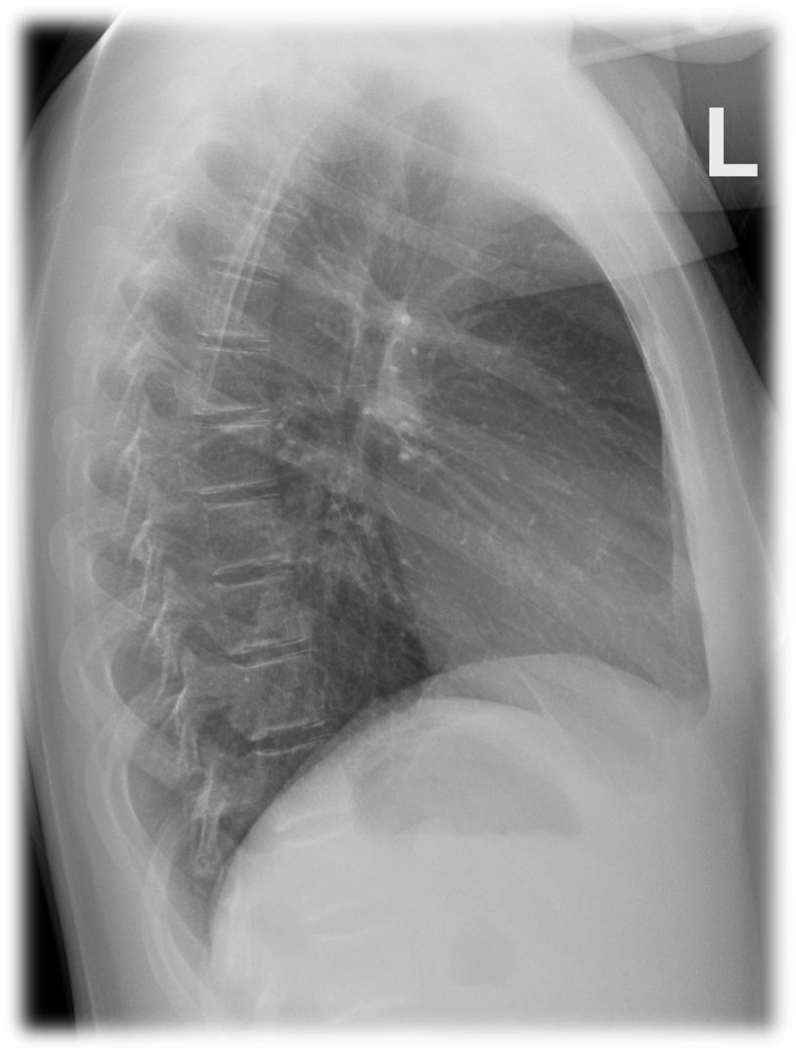
X-ray:
² Plain X-Ray
Electromagnetic radiation
The image is the result of interaction of X-ray beam and body tissue
X-rays that pass through a structure easily are least absorbed and therefore cause blackening on the radiograph (air-lung).
Whereas structure that absorbs or reflects x-ray most appear white. (bone-metallic).
Soft tissues lie in between à gray. According to thickness of these the shades of gray differ.
Projections are usually described by the path of the x-ray beam. Thus, the term PA
(poster anterior) view designates that the beam passes from the back to the front, the standard projection for a routine chest film.
The image on an x-ray film is two-dimensional. All the structures along the path of the
^{The i}b^{m}eªa^{g}m^{e is}ar^{t}e^{he}p^{r}r^{e}o^{s}j^{u}e^{lt}ctºe^{f} d^{int}o^{e}n^{ra}t^{c}o^{tio}t^{n}he^{of}s^{X}a⁻m^{ra}e^{y b}p^{e}oªr^{m}tioªn^{nd}o^{b}f ºt^{d}h^{y}e^{ti}f^{s}il^{s}m^{ue}(superimposed). Therefore, it is
•
^{X-}o^{ra}f^{y}te^{s}n^{pa}n^{s}e^{s}c^{t}e^{h}s^{ro}s^{u}a^{g}r^{h}y ªto^{st}t^{r}a^{uc}k^{t}e^{ur}a^{e}t^{à}le^{b}a^{l}sªt^{ck}t^{e}w^{n}o^{ing}viºe^{n}w^{t}s^{he}to^{ra}g^{d}a^{io}i^{g}n^{ra}in^{p}f^{h}o⁽rªm^{ir-}a^{l}t^{u}i^{n}o^{g}n^{).}about the third dimension
X-rays absorbed or reflected à white on radiograph (bone-metallic).
Soft tissues lie in between à gray.
A A Al-BOUKAI-4

Slide 6

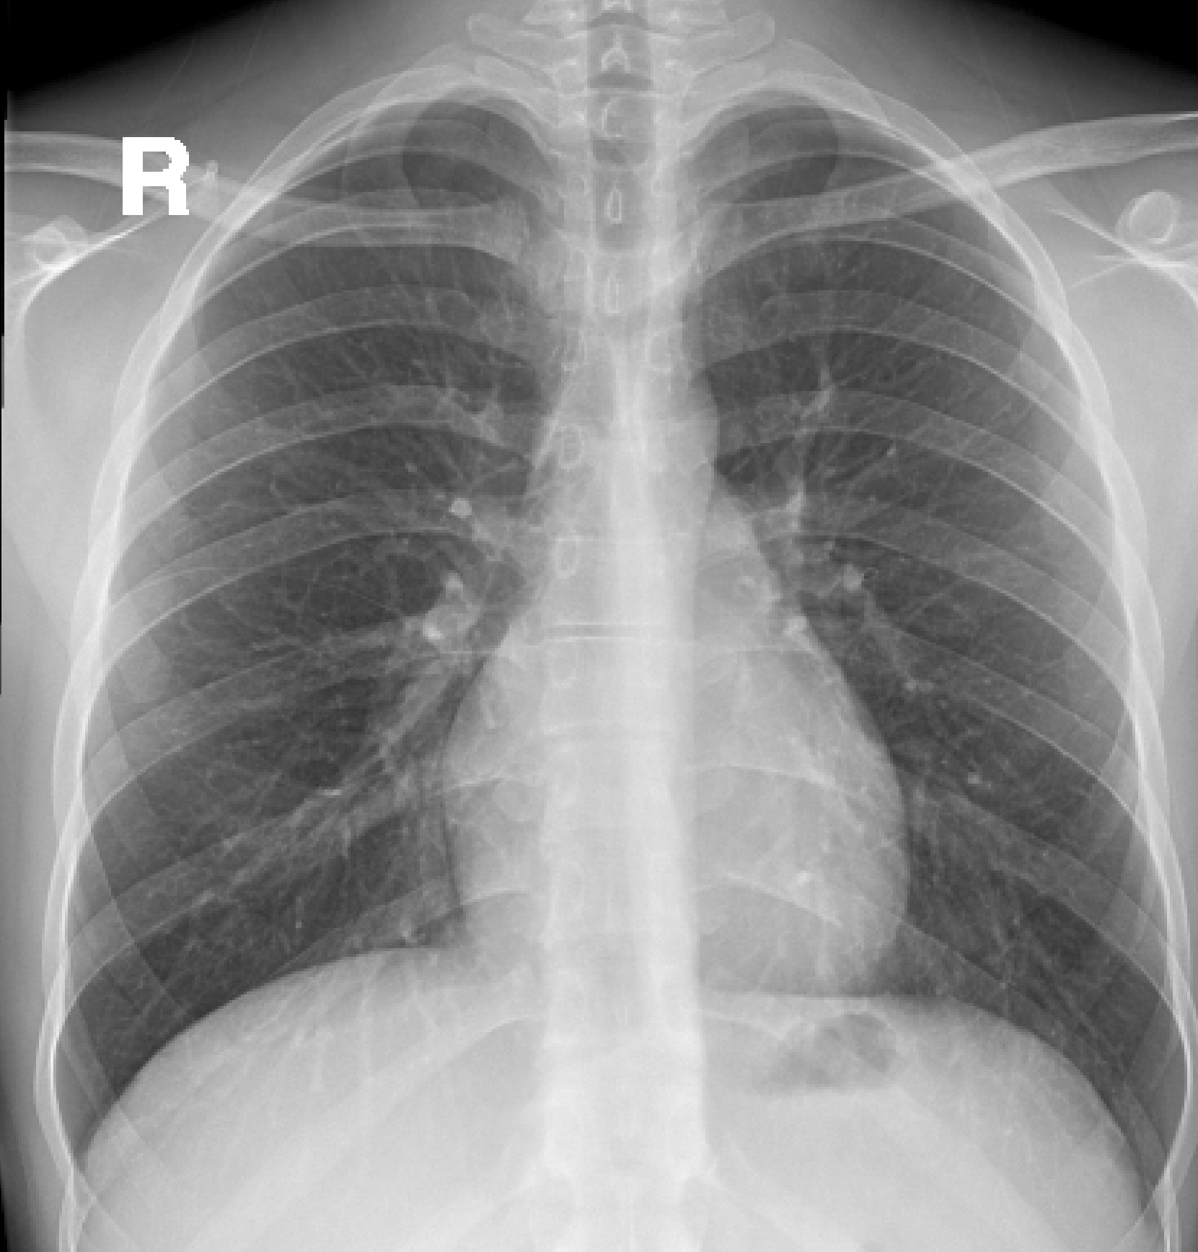





WHAT IS A GOOD CHEST X-RAY
CXRWITH ADEQUATE EXPOSURE
CXRWITH PROPER POSITIONING
CXRWITH ADEQUATE INSPIRATION
A A Al-BOUKAI-5

Slide 7
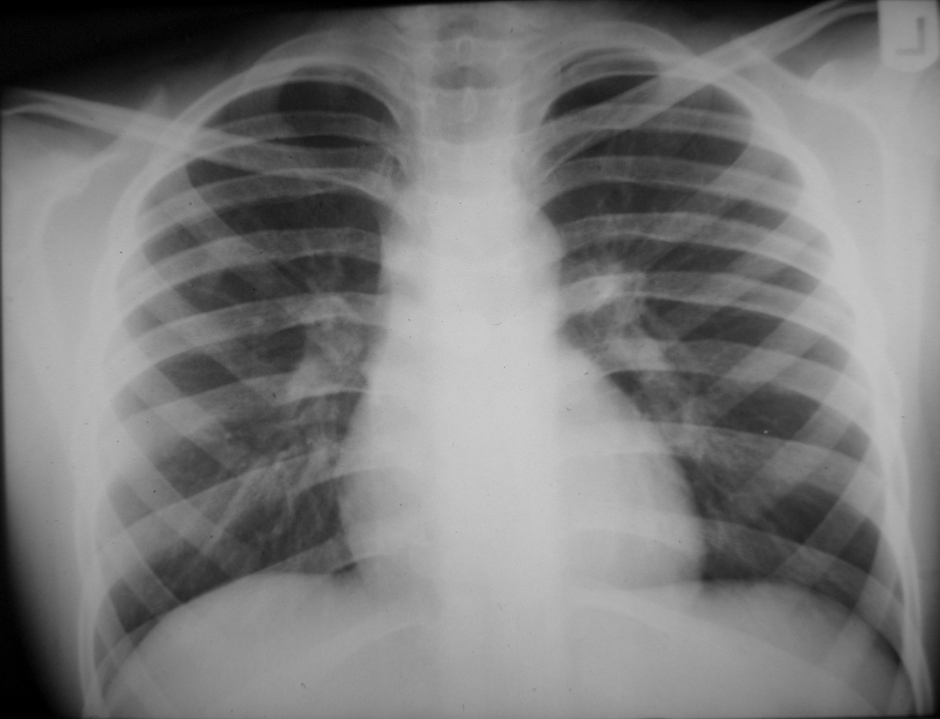
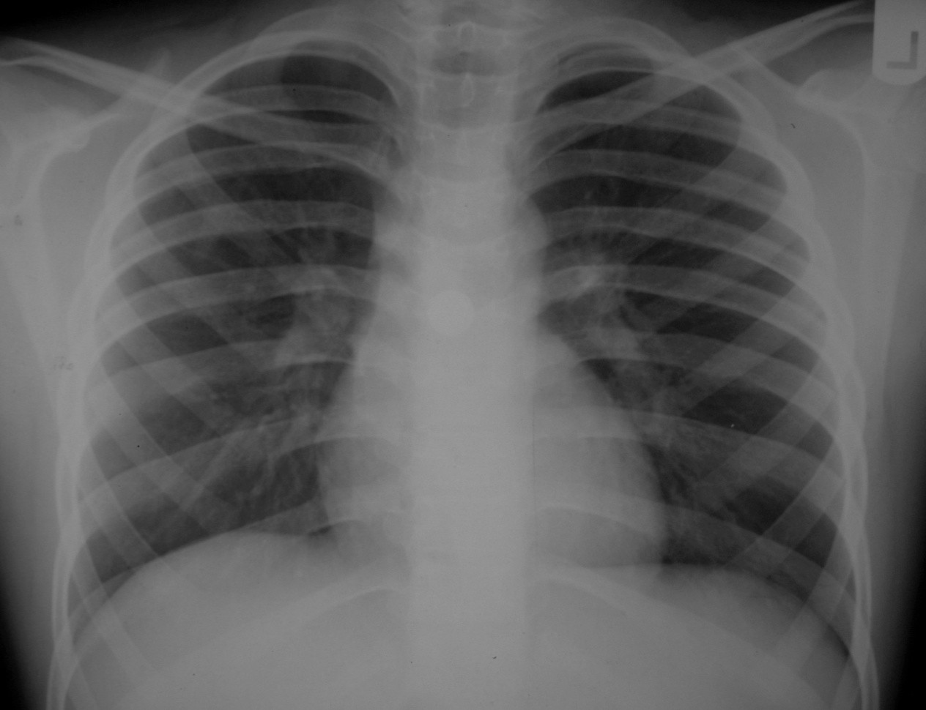

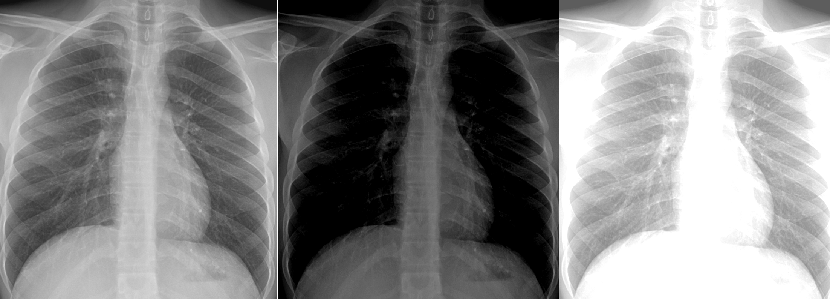
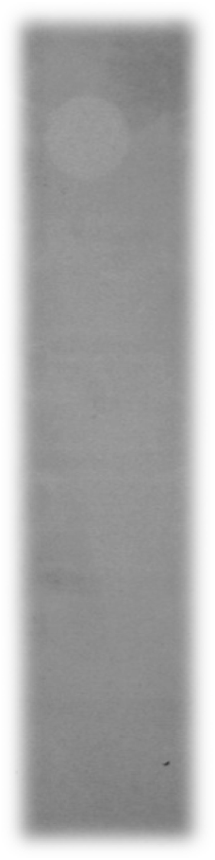

WHATIS ADEQUATE EXPOSURE?
IS
Exposure that allow visualization of lung markings even through cardiac shadow
Assessed by seeing spine through heart shadow
ADEQUATE
OVER
UNDER
A A Al-BOUKAI-6

Slide 8
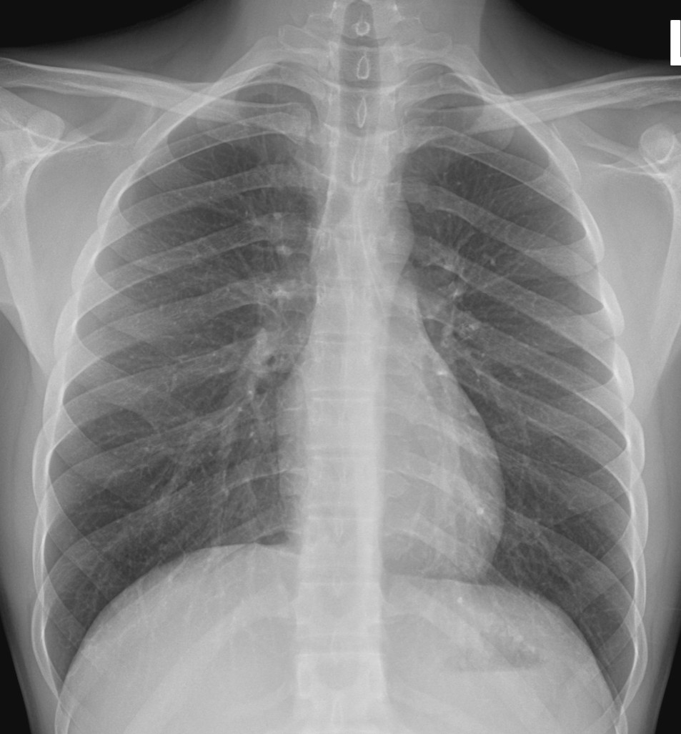
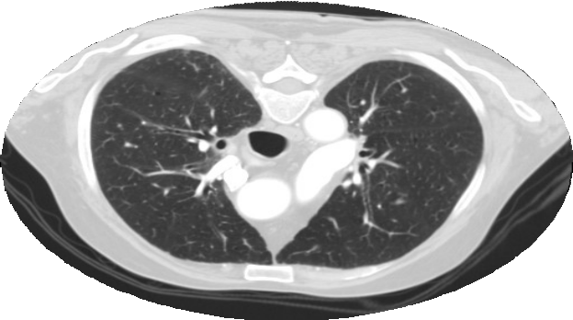


WHATIS PROPER POSITIONING?
A A Al-BOUKAI-7

Slide 9
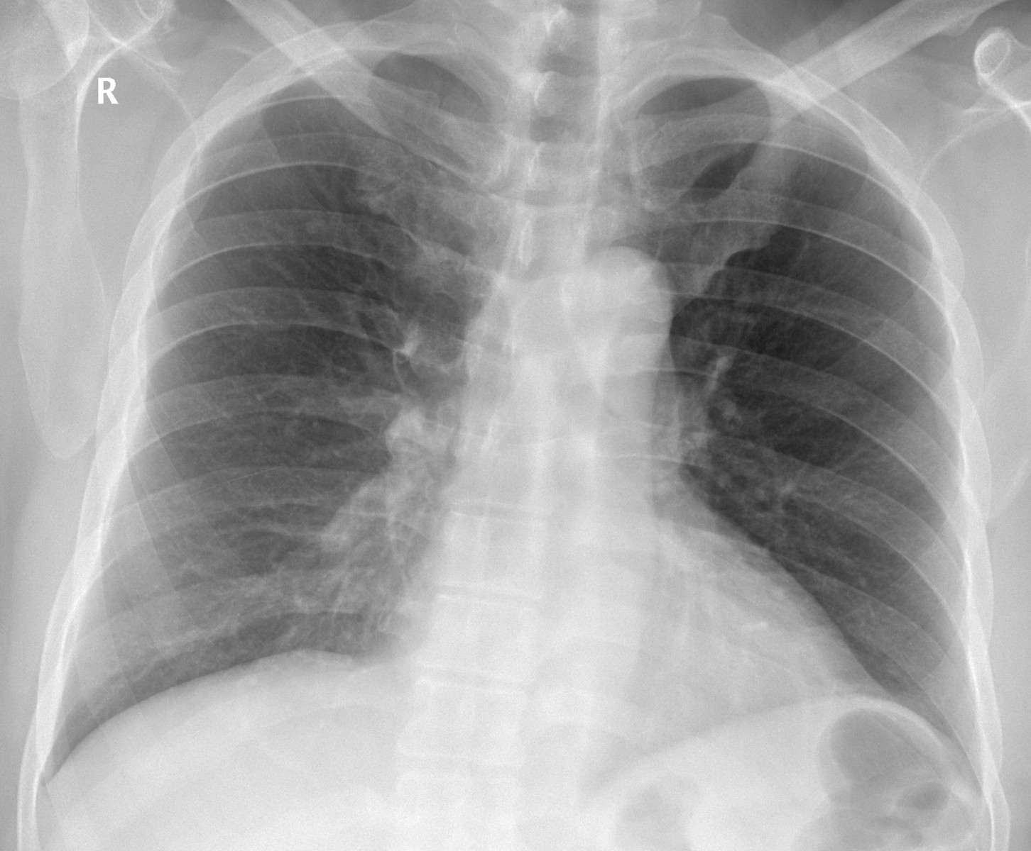
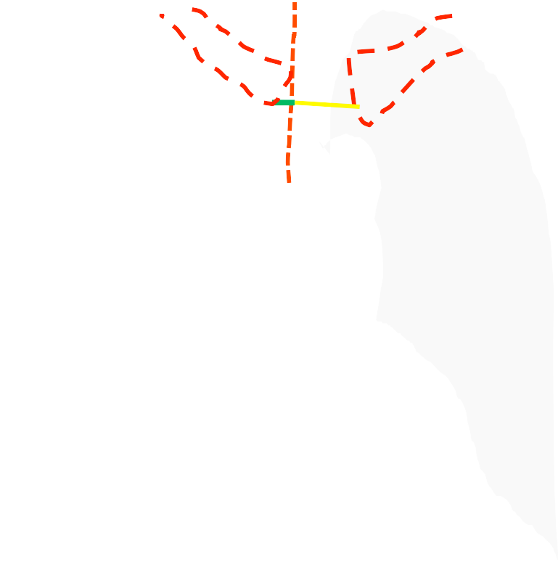
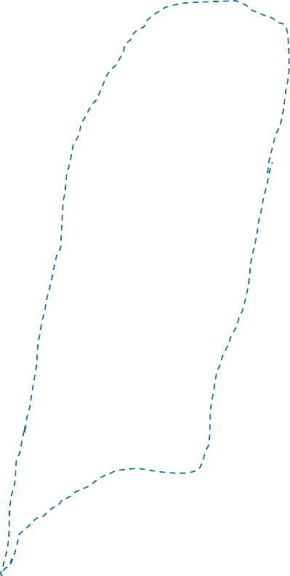
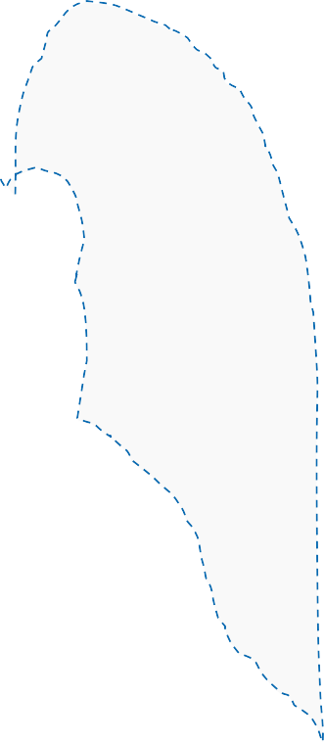
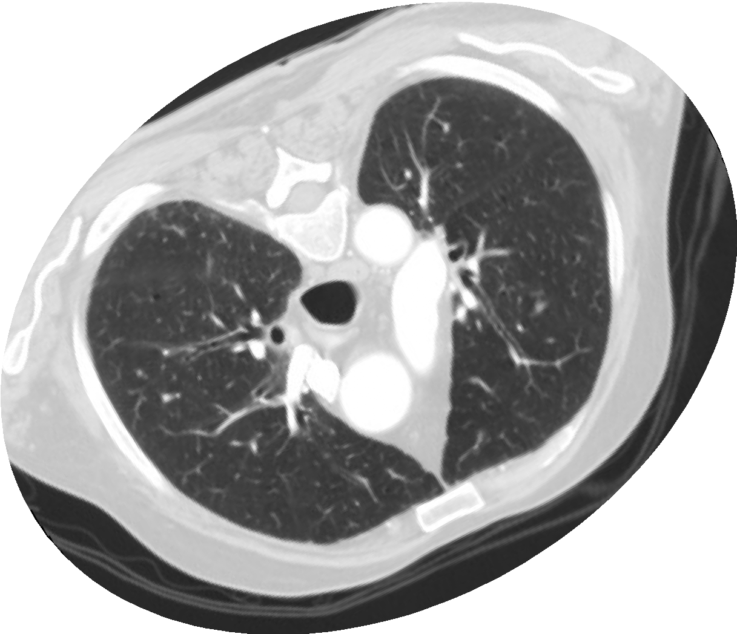




WHATIS PROPER POSITIONING?
Assessed by seeing
- Medial ends of clavicles are at equal distance from mid line (spine)
A A Al-BOUKAI-8

Slide 10
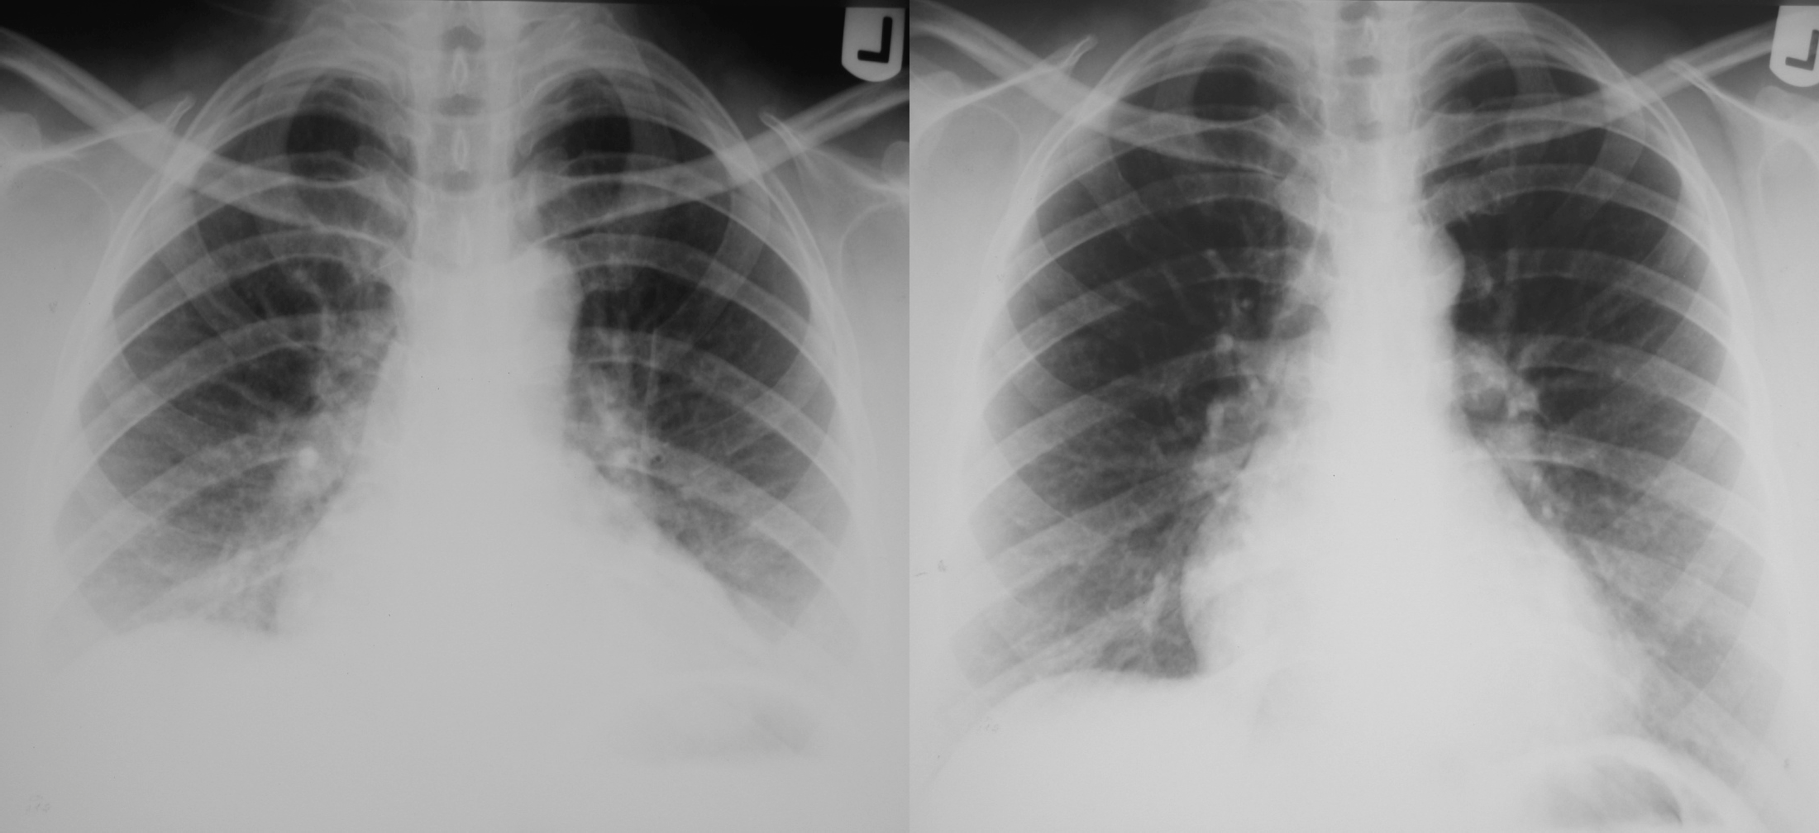

WHATIS ADEQUATE INSPIRATION?
65%
46%
Inadequate inspiration
Adequate inspiration
A A Al-BOUKAI-9

Slide 11

WHATIS ADEQUATE INSPIRATION?
Assessed by seeing
6 anterior ribs above dome of diaphragm or 9 posterior ones.
Anterior ribs are inclined inferior medial
Posterior ribs are either horizontal or inclined inferior lateral
1
2
3 1
4
2
5
3
6
4
7
5
8
9
6
10
%
65% 46
7
8
A A Al-BOUKAI-9

Slide 12

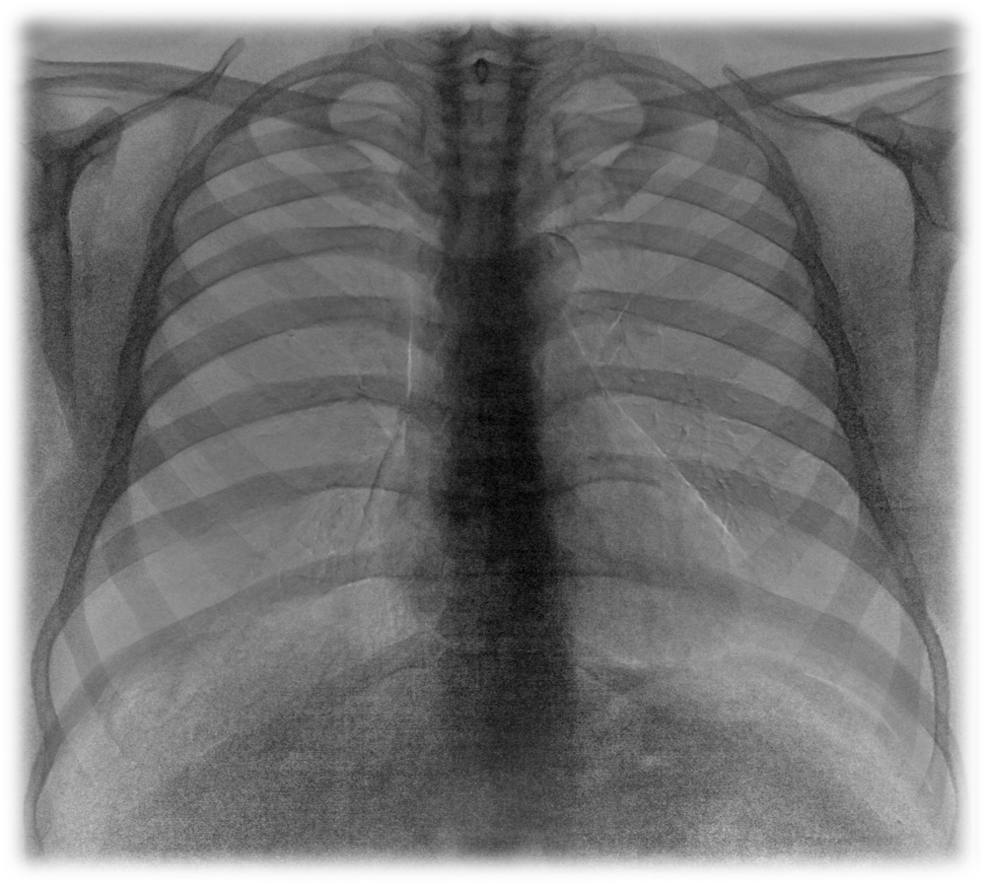
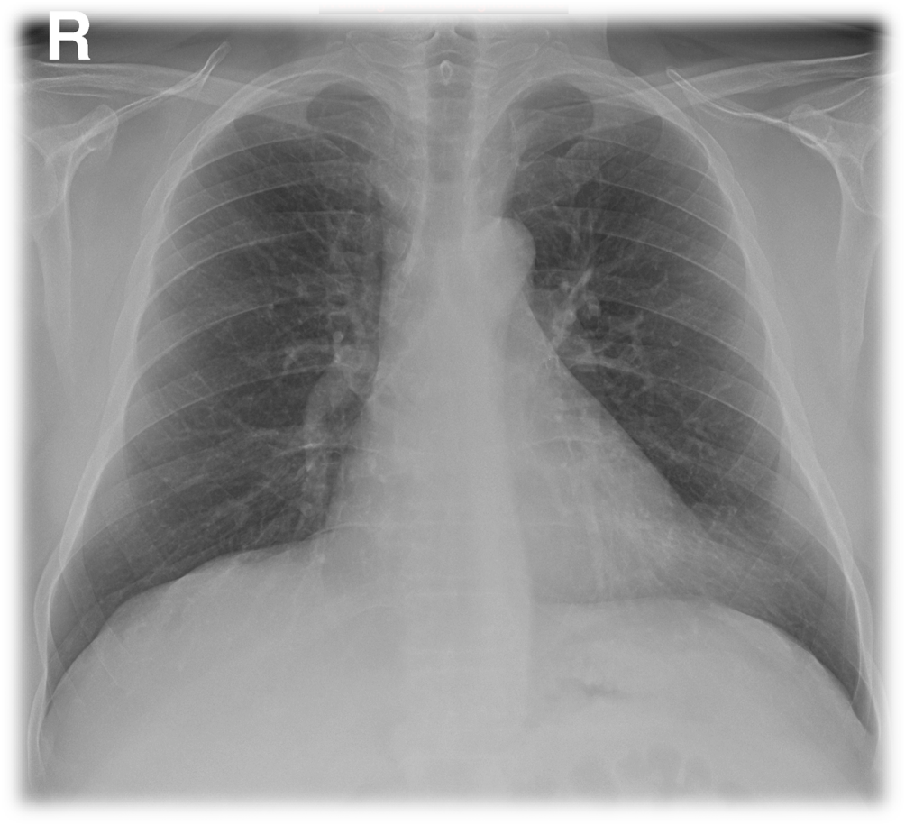
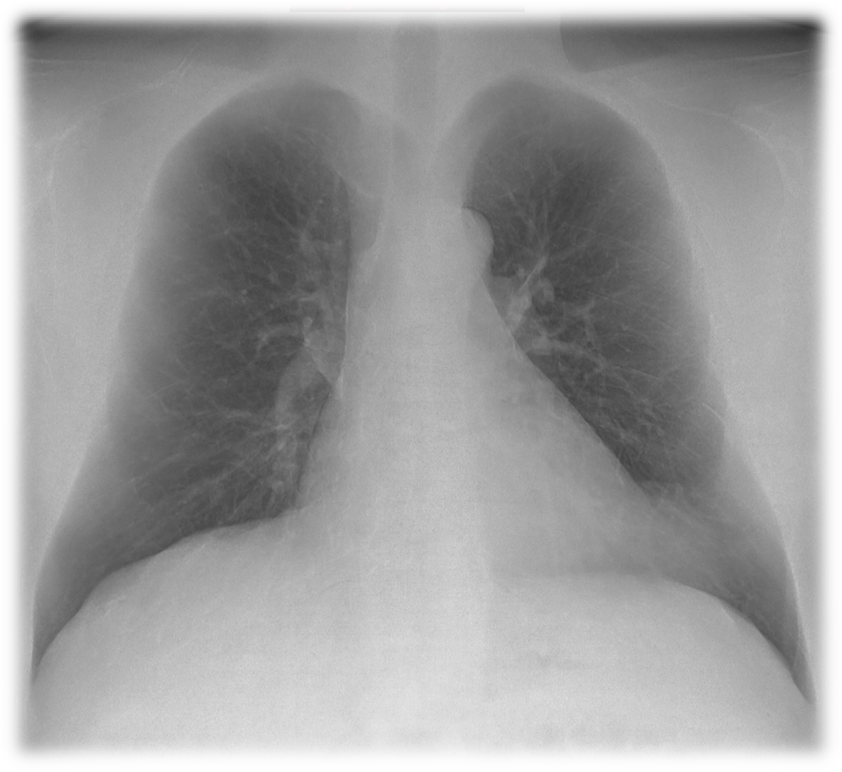

WHATIS DUAL ENERGY TECHNIQUE?

Slide 13

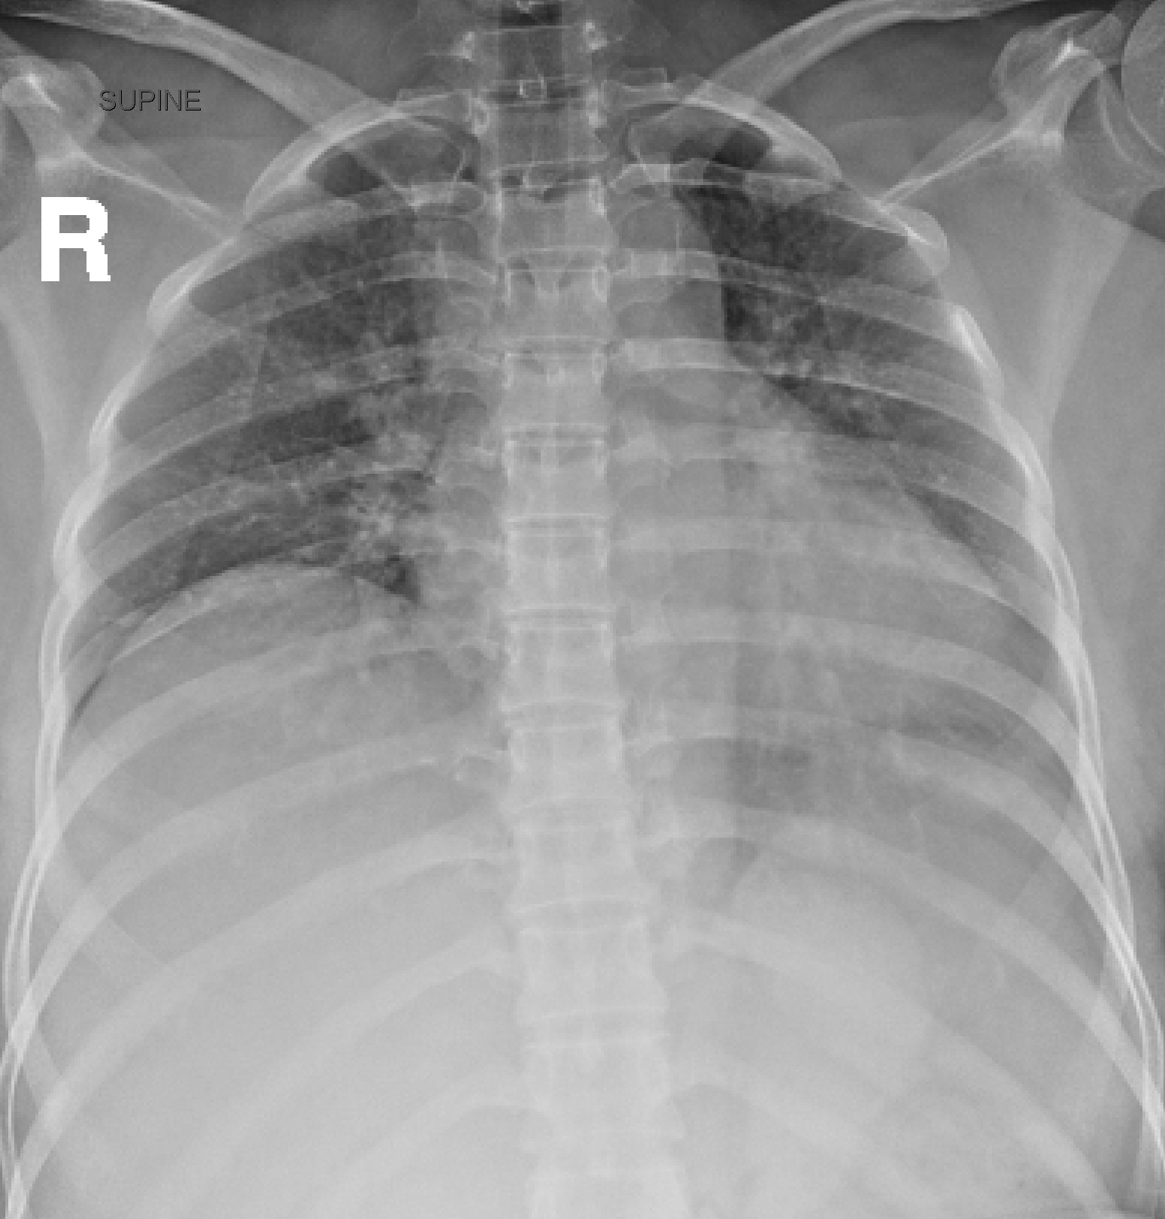
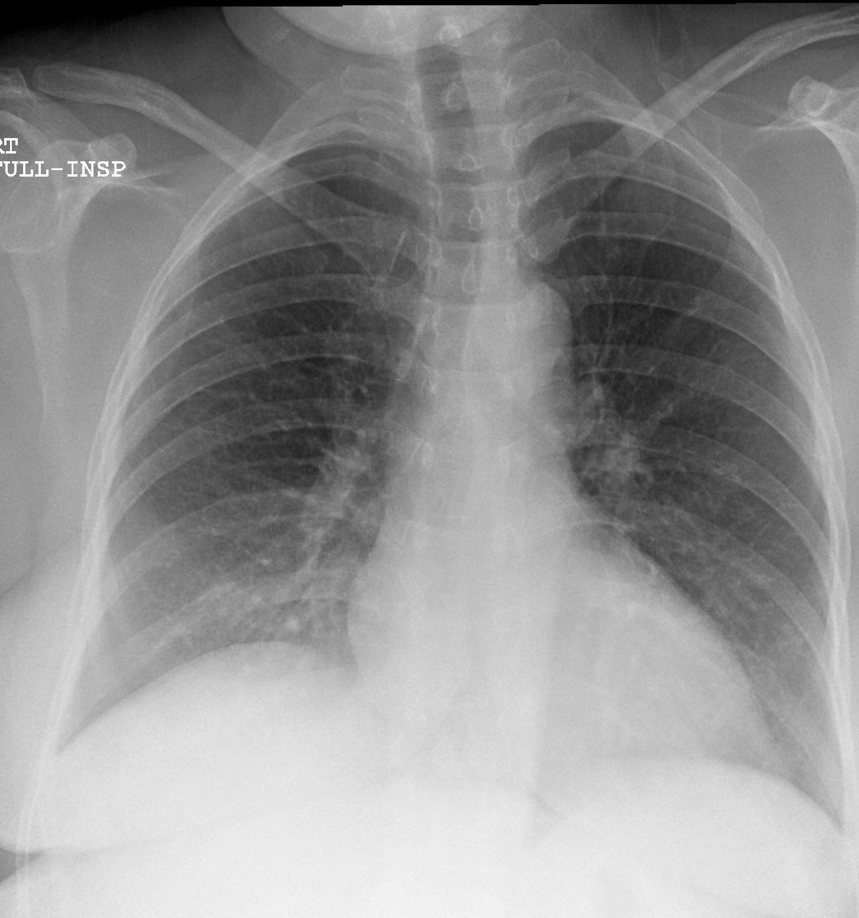

AP VS PA TECHNIQUE?
ü Scapula ü Clavicle ü Heart
AP
PA

Slide 14




CHEST X-RAY
LUNGS
MEDIASTINUM
BONY CAGE
SOFT TISSUE COMPONENT
WHAT IS A NORMAL CHEST X-RAY

Slide 15

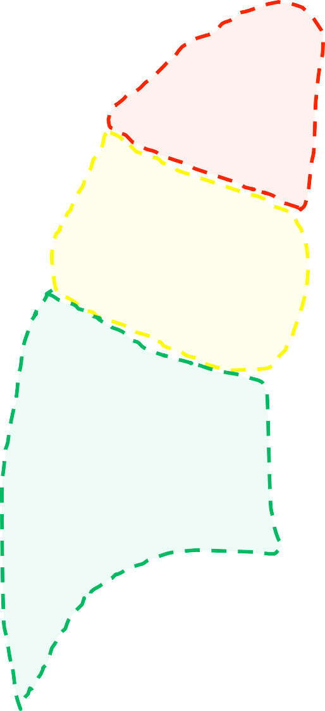
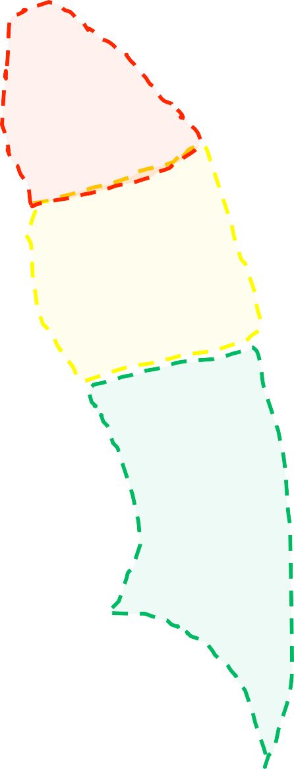


LUNGS
  Well-aerated
  Symmetrical translucency
  Clear apices & costophrenic angles
  Normal vascular distribution
Lung zones
WHAT IS A NORMAL CHEST X-RAY

Slide 16
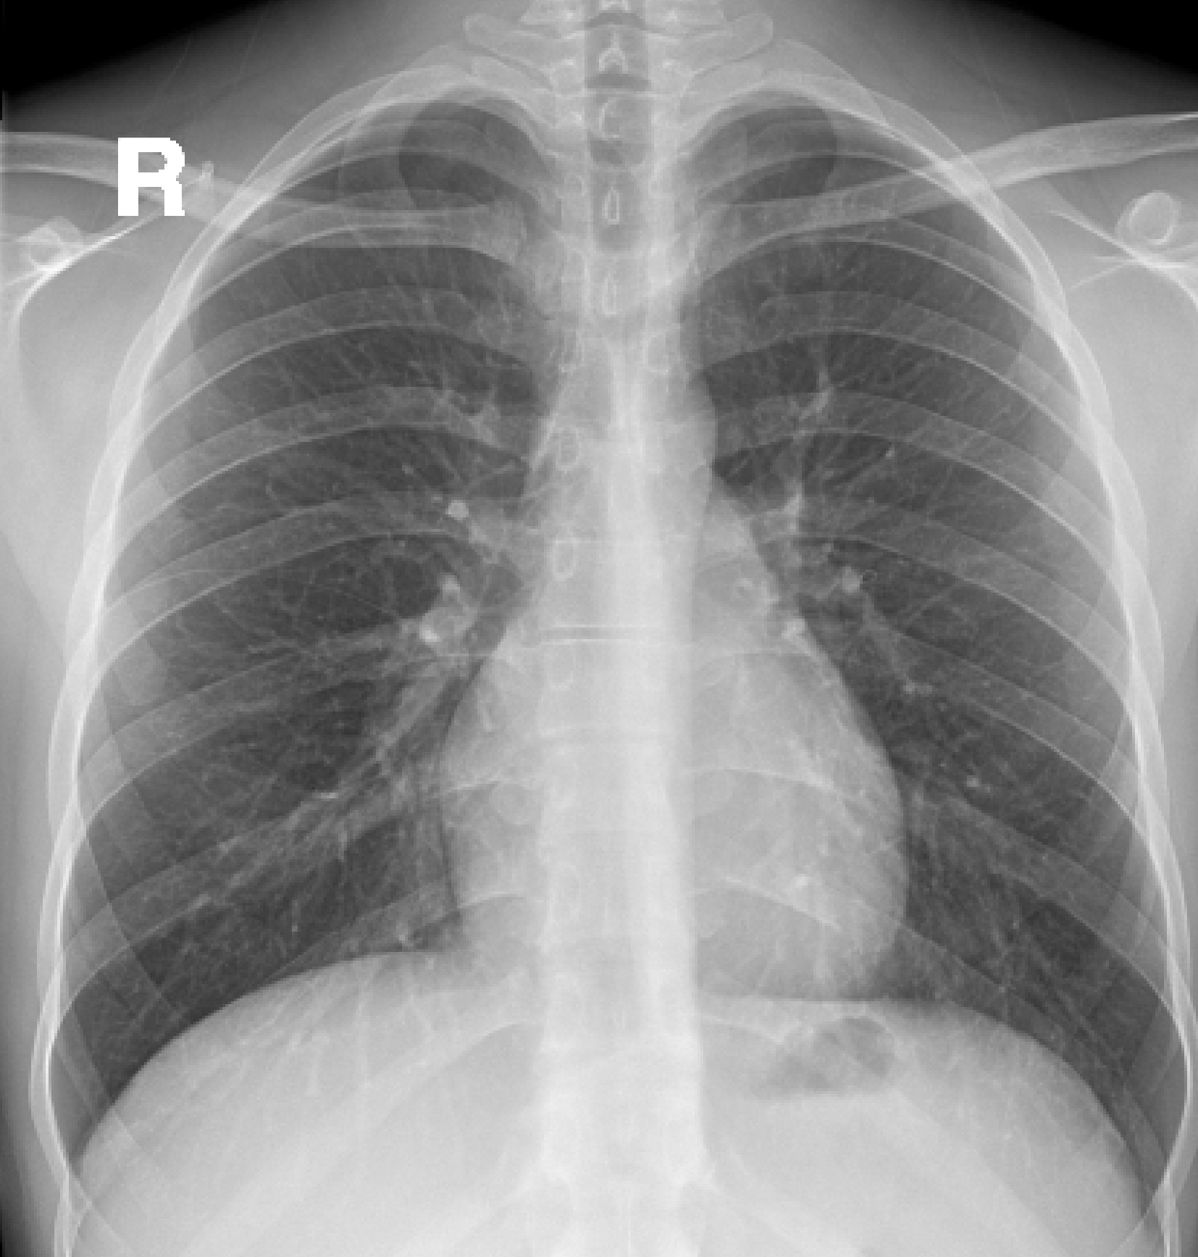
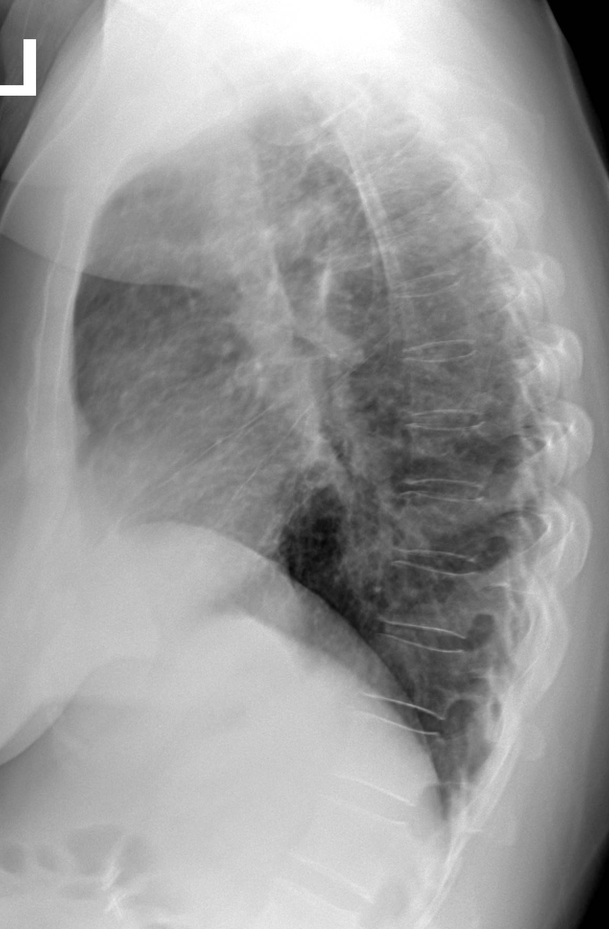
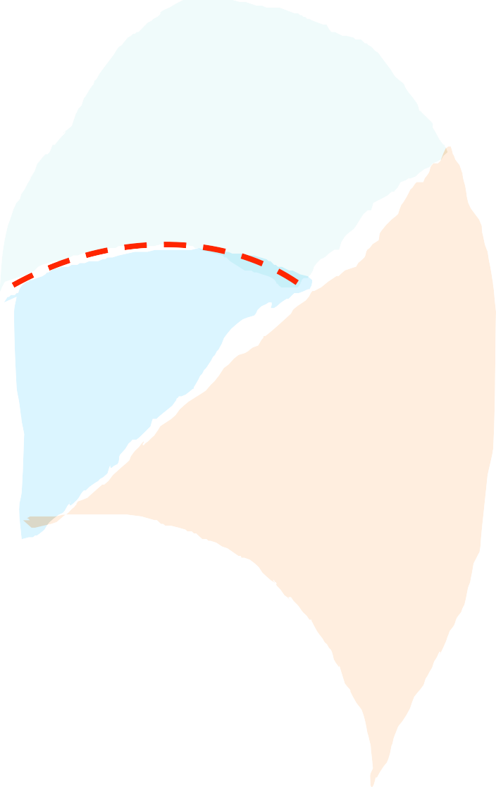








Slide 17
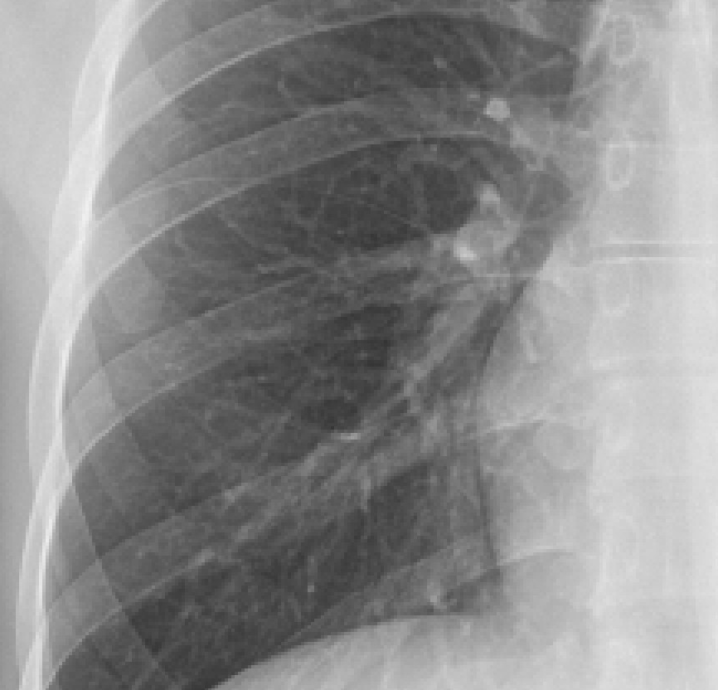


Slide 18
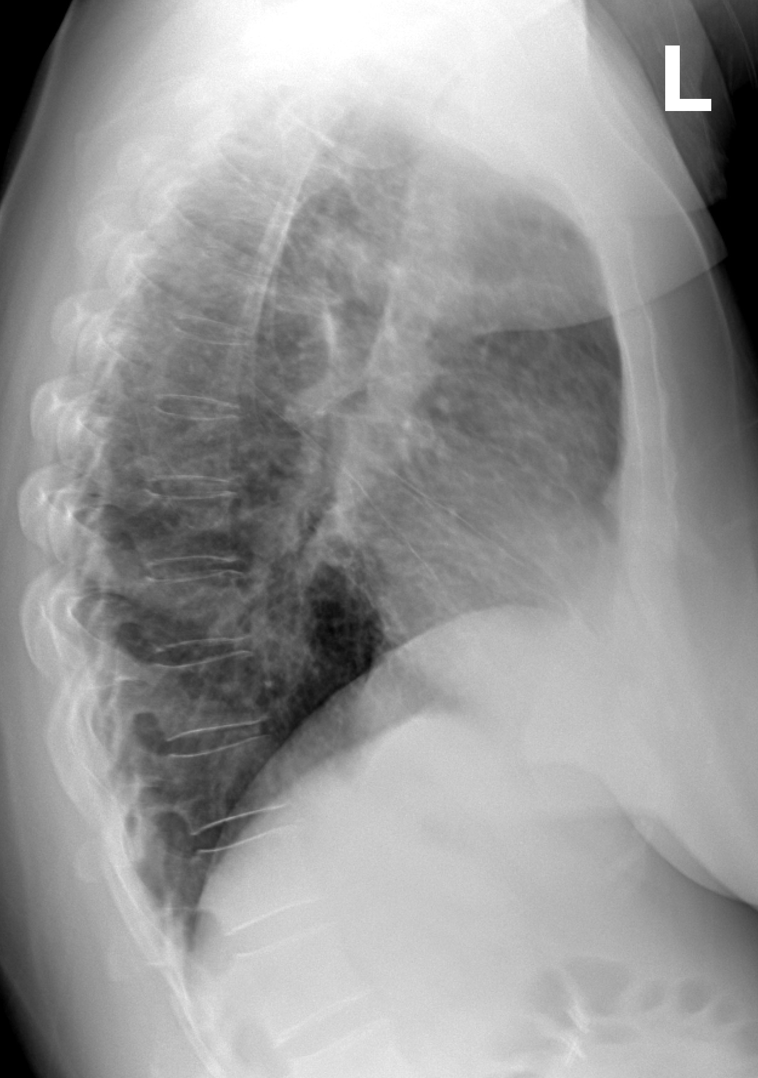
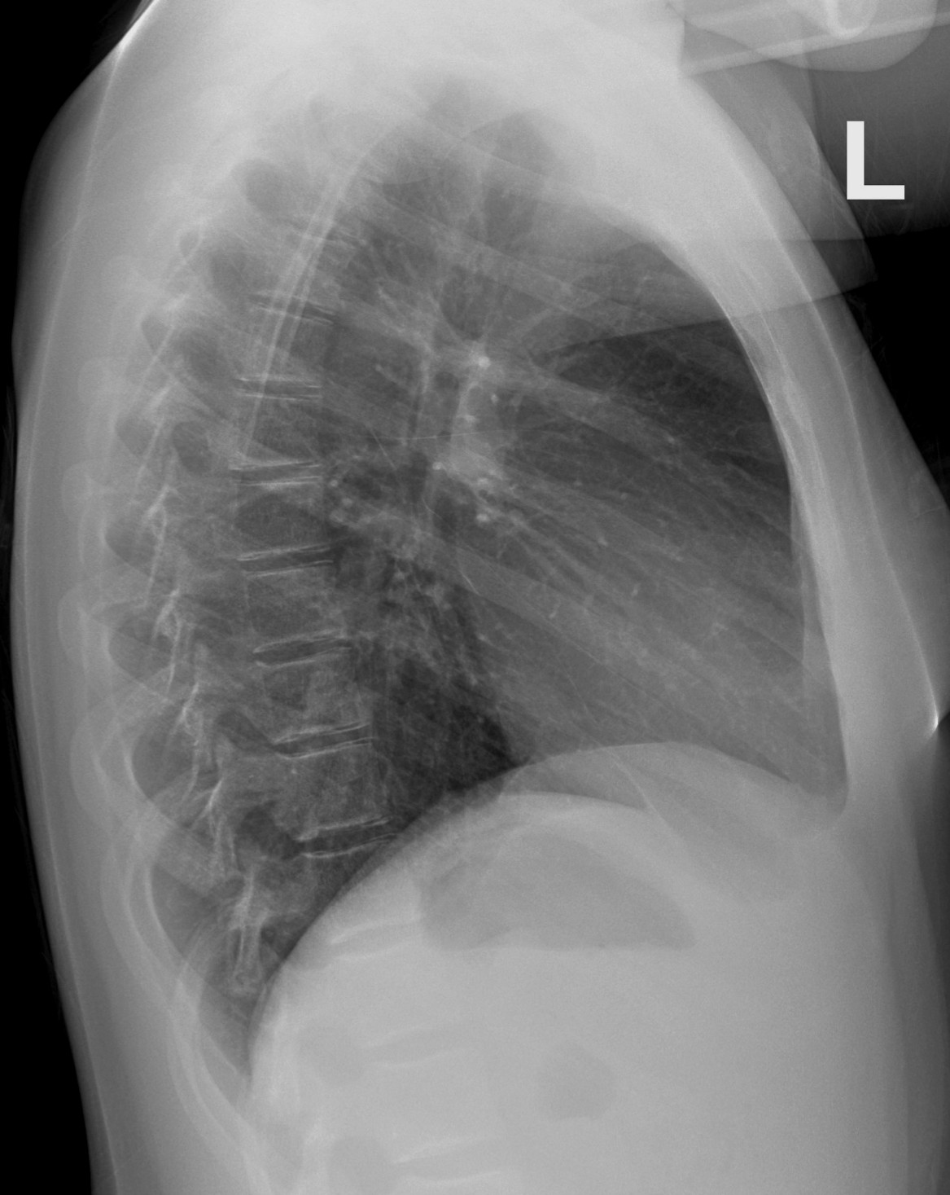

Fissures:
Oblique (major): is seen best in lateral view ( occasionally seen in PA view –not always) right is more anterior than left
Horizontal (minor): is seen in both PA and lateral view Both are formed from 2 layers
Accessory fissure has 4 layers example is Azygos fissure

Slide 19
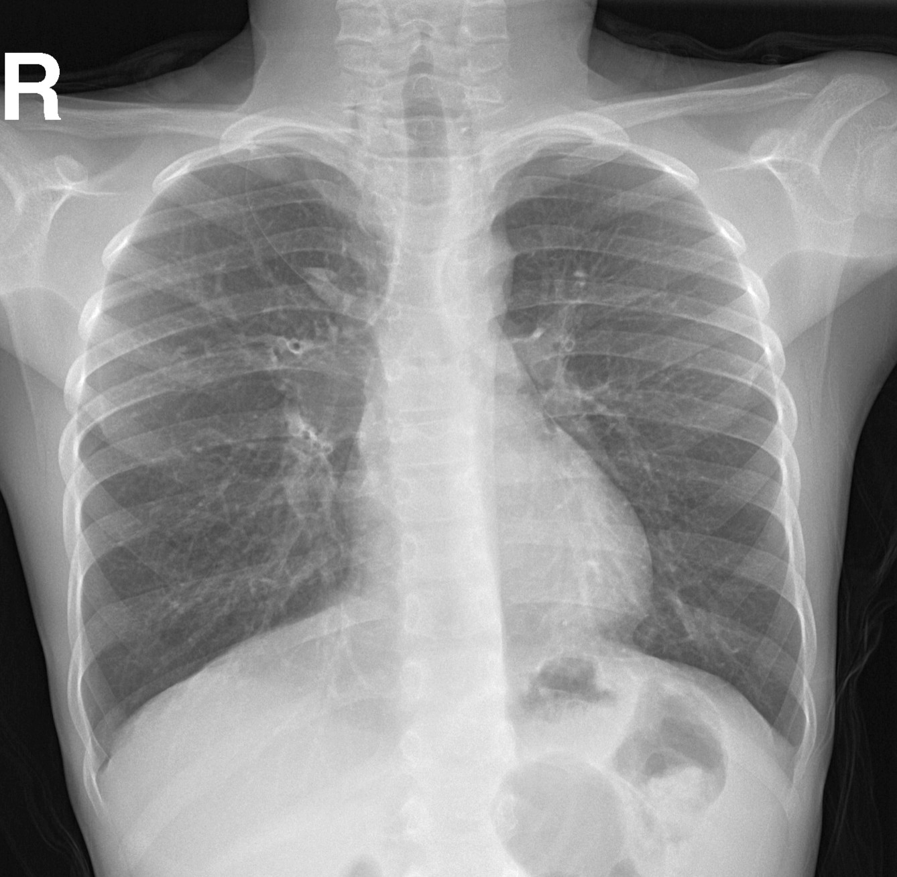
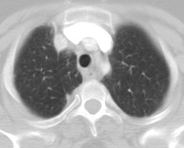
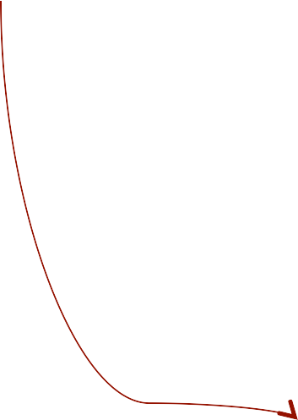
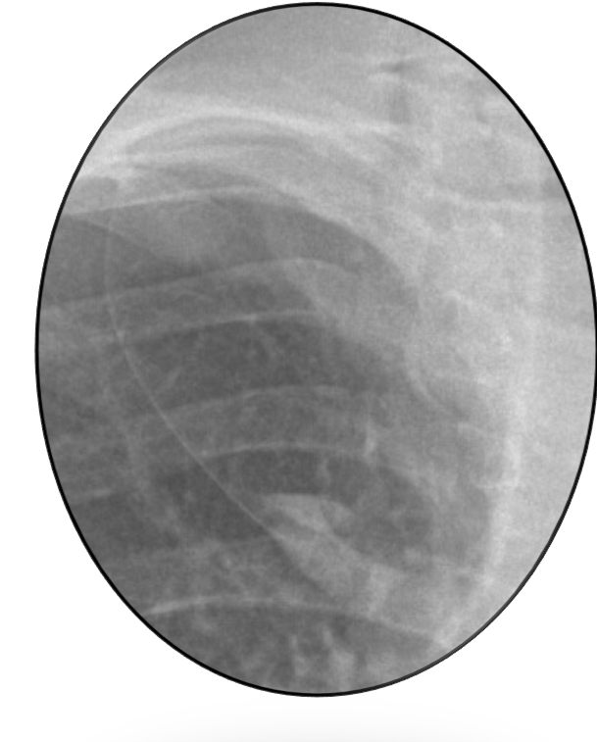
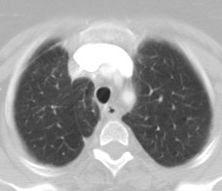

Azygos fissure

Slide 20
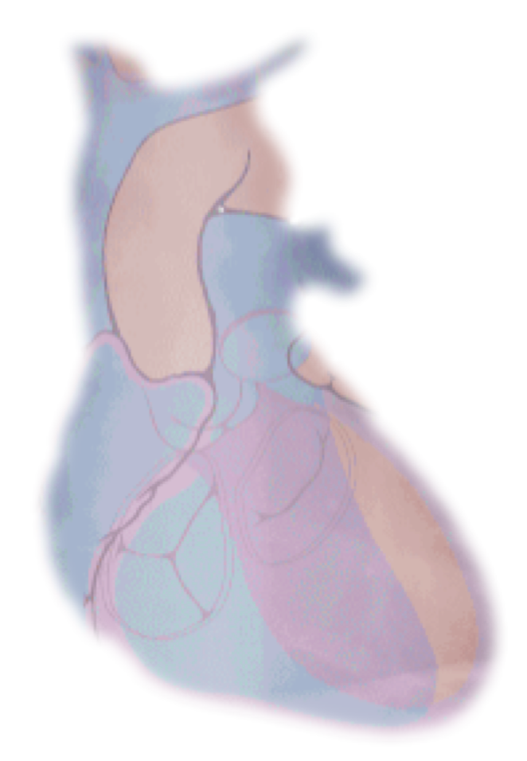


MEDIASTINUM
AO
Middle (¹/₃ RT, ²/₃ LT)
3 curves on LT, 1 curve on RT.
Homogeneous density
Anterior on lateral x-ray
Trachea central
PA
LT A
RT A
LT V
RT V
WHAT IS A NORMAL CHEST X-RAY

Slide 21


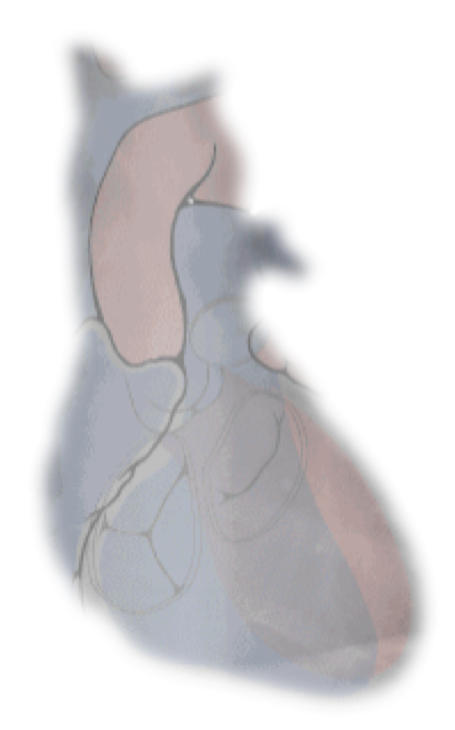
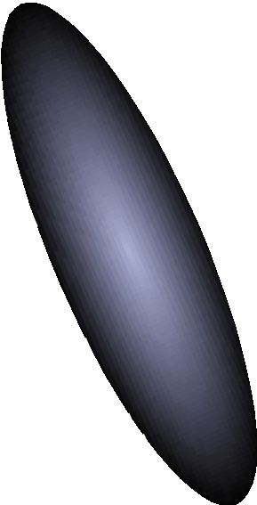

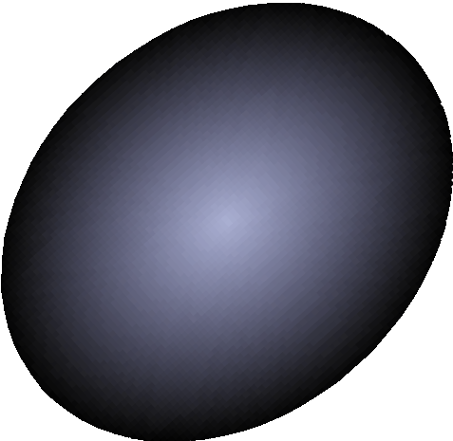

MEDIASTINUM
  Middle (¹/₃ RT, ²/₃ LT)
  3 curves on LT, 1 curve on RT.
  Homogeneous density
  Anterior on lateral x-ray
  Trachea central
LT
RT
WHAT IS A NORMAL CHEST X-RAY

Slide 22
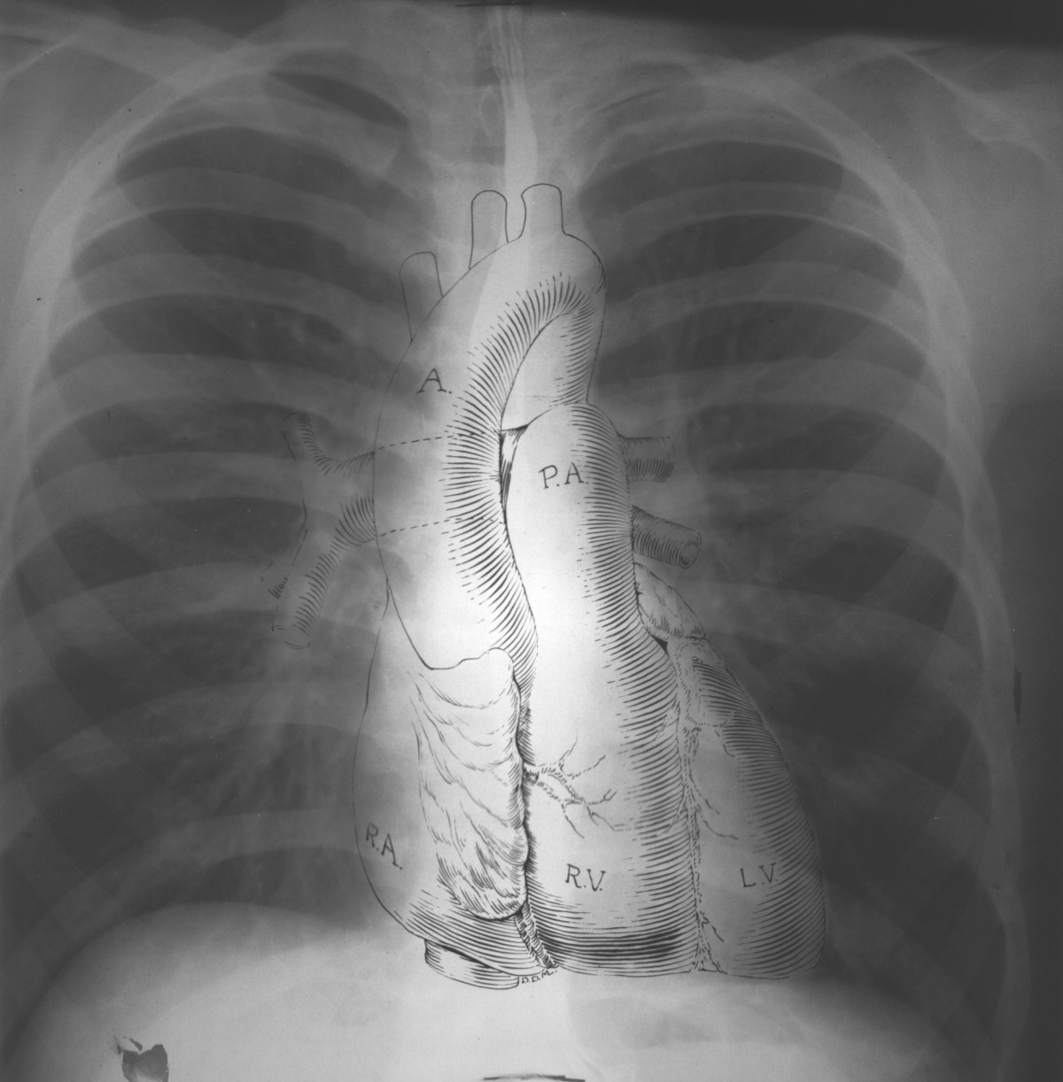





MEDIASTINUM
  Middle (¹/₃ RT, ²/₃ LT)
  3 curves on LT, 1 curve on RT.
  Homogeneous density
  Anterior on lateral x-ray
  Trachea central

Slide 23
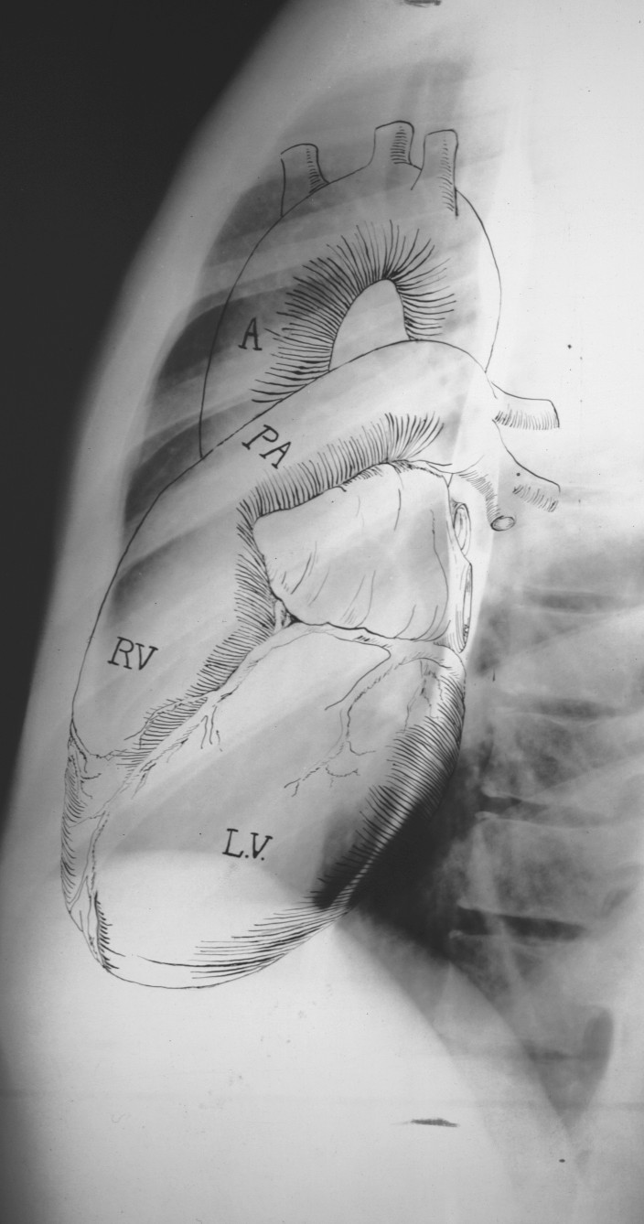





MEDIASTINUM
  Middle (¹/₃ RT, ²/₃ LT)
  3 curves on LT, 1 curve on RT.
  Homogeneous density
  Anterior on lateral x-ray
  Trachea central
LA
LV
Right Diaphragm
Left Diaphragm

Slide 24
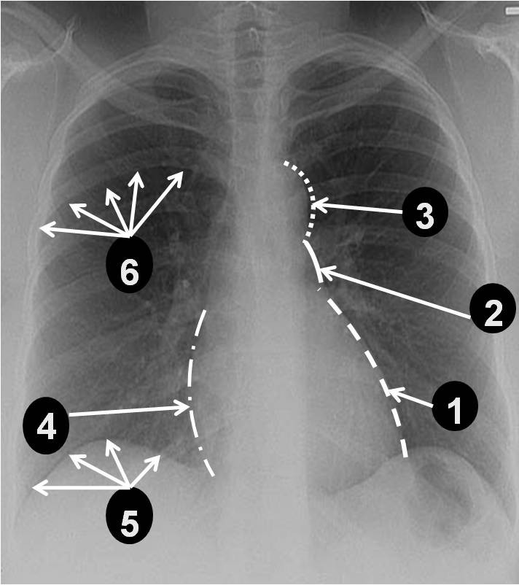
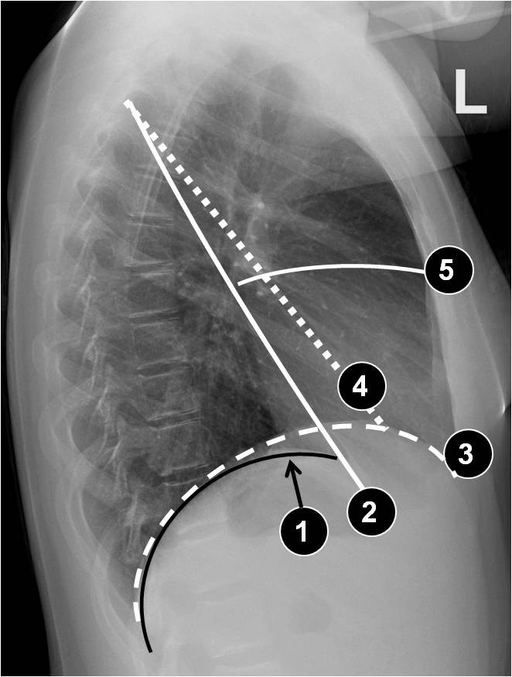


QUIZ

Slide 25



Slide 26


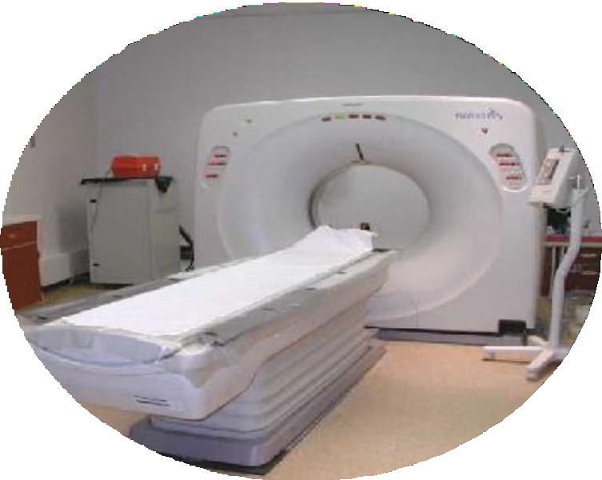
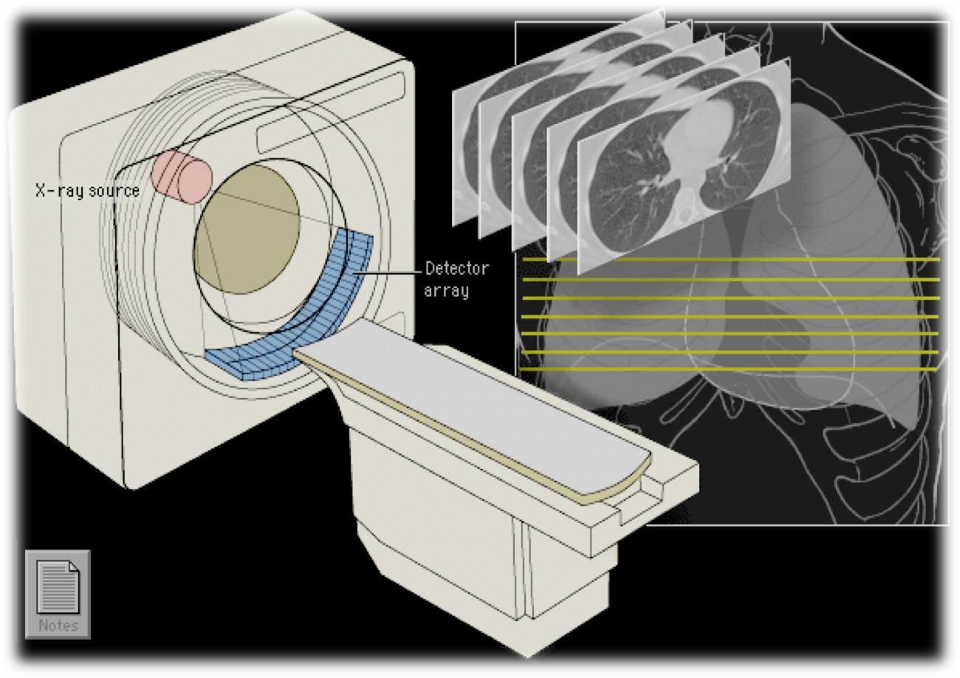

² Computed Tomography (CT)

Slide 27

² Computed Tomography (CT)
CT Scan:
Relies on x-rays transmitted through the body. It differs from conventional radiography in that a more sensitive x-ray detection system is used, the images consist of sections (slices) through the body, and the data are manipulated by a computer.
Has very small differences in x-ray absorption values
compared with conventional radiography; the range of densities recorded is increased approximately 10-fold.
So gradations of density within soft tissues can be recognized, e.g. brain substance from cerebrospinal fluid, or tumor from surrounding normal tissues.
There is major risk behind CT scan, 1barin CT scan
radiation = 200 x-ray radiation , pelvic CT radiation = 400 x- ray radiation which means don’t request a CT scan unless it is needed and We can't use it for a pregnant women unless it is necessary
Lung window is wide window to visualize lung parenchymal structures including bronchi, vessels and alveoli
Mediastinal window is narrow window to visualize mediastinal structures including major vessels, heart….

Slide 28

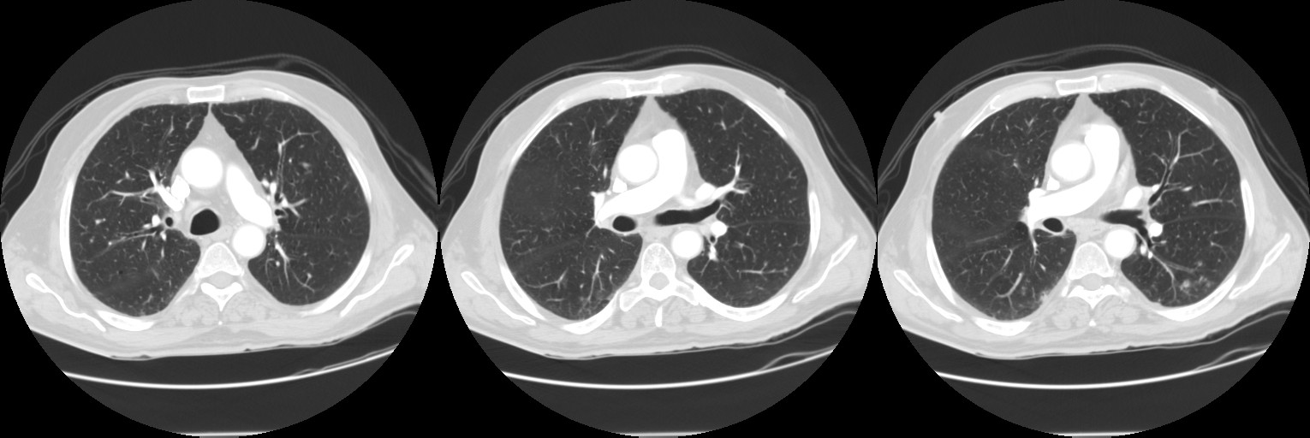

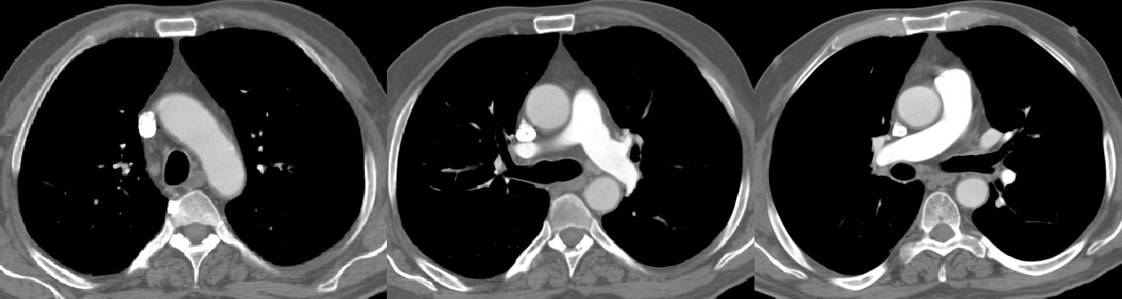

² Computed Tomography (CT)
LUNG WINDOW
WW: wide & WL: negative 1600 -600
MEDIASTINA WINDOW
WW: narrow & WL: positive 450 35

Slide 29













A
B E
C
D

Slide 30





B1= APICAL UPPER LOBE B B2=POSTERIOR UPPER LOBE B
B1+2= APICPOSTERIOR UPPER LOBE B
B1+2
B1
SVC
A
A
T
E
B1+2
B1
White hairline Lucent band White band
MAJOR FISSURE
Appears as

Slide 31



B1+2= APICPOSTERIOR UPPER LOBE B B3 = ANTERIOR UPPER LOBE B
B3
AA
PA
B3
SVC
T
RULB RMB ^{LMB}
LPA
B1+2
E
DA
MAJOR FISSURE

Slide 32


RV
OFT
RMB5
RA
AA
LB5
RMB4
LA
RMLB
E
DA
RLLB
LLLB

Slide 33

RV
OFT
RMB5
RA
AA
LB5
RMB4
LA
RMLB
E
DA
RLLB
LLLB

Slide 34




LOWER LOBE
B6
B7
B8
B6= SUPERIOR LOWER LOBE B B7= MEDIAL BASAL B
B8= ANTERIOR BASAL B
B9 = LATERAL BASAL B B10= POSTERIOR BASAL B
B9
B10
A A Al-BOUKAI-32

Slide 35







1
2
3
4
5
6
Image1: Level of trachea we could see upper lobe segmental bronchi Image 2: Level of bifurcation and right upper lobe bronchus
Image 3: Lower cut at right bronchus intermedius level (BI)
Note : segments of the lung follow distribution of segmental bronchi
Fissure could be seen as either thin hairline structure or as lucent (black) density band

Slide 36






LEVEL 1
1
E ESOPHAGUS R RIB
SCAPULA
TRACHEA
  Right Brachiocephalic vein
  Brachiocephalic artery
  Left common carotid artery
  Left subclavian artery
  Right Brachiocephalic vein
5
2
1
3
4
T
E

Slide 37



LEVEL 2
2
AA Aortic Arch T TRACHEA
1 Superior vena cava
1
A
A
T
E

Slide 38





LEVEL 3
3
AA Ascending Aorta DA Descending Aorta LB Left main bronchus
LP Left pulmonary artery PA Pulmonary trunk
RB Right main bronchus SVC Superior vena cava
AA
SVC
PA
RBT ^{LB}
LP
DA
E

Slide 39



4
AA
SVC
PA
LEVEL 4
RUB _{RB}
LB
LP
DA
AA Ascending Aorta DA Descending Aorta
LUB Left upper bronchus BI Bronchus intermedius LP Left pulmonary artery
RP Right pulmonary artery PA Pulmonary trunk
RB Right main bronchus SVC Superior vena cava
PA
LSPV Superior Pulmonary vein
AA
SVC
RP
BI
LUB
DA

Slide 40




?
RVOFT
?
RA
AA
5
6
LA
DA
LEVEL 5-6
AA Ascending Aorta (root) DA Descending Aorta
LA Left atrium LV Left ventricle
RA Right atrium (auricle) RV Right ventricle (outflow)
LIPV Left inferior pulmonary vein
LIPV
Inferior Pulmonary vein
RV
LV
RA
LA
DA

Slide 41






1
2 3
7
8
9
4
10
6
5
11
15
16
11
18 ₁₉
9
13
14
12
14
17
10
10
17
1: Rt & Lt innominate veins (brachiocephalic veins) 2: RT brachiocephalic artery 3: LT common carotid
4: LT subclavian artery 5: esophagus 6: Trachea 7: Superior vena cava 8: Aortic arch 9: Ascending Aorta 10: Descending Aorta 11: Pulmonary trunk (artery) 12: LT Pulm artery 13: RT Pulm artery 14: RT atrium 15: Pulm artery 16: Aortic root 17: Lt atrium 18: RT ventricle 19: LT ventrivle
Note : LT Pulmonary artery is seen before RT artery therefore it is higher than the right artery.
LT atrium is the most posterior chamber; RT ventricle is most anterior chamber.

Slide 42



² Magnetic Resonance Imaging (MRI)

Slide 43





² Magnetic Resonance Imaging (MRI)
Sagittal
Axial
Coronal
MRI:
Simply, hydrogen atoms (protons) in water molecules and lipids >> magnetism affects all protons causes them to line up in one direction >> magnets can be switched on and off to change the direction of the magnetic field >> whenever the water molecule spin around they give a light radio wave >> MRI machine can detect it >> show it as images
So gradations of density within soft tissues can be recognized, e.g. brain substance from cerebrospinal fluid, or tumor from surrounding normal tissues.
MRI advantages
Best for soft tissue imaging There is no ionization
It can be done for pregnant women with caution Images can be directly in any plane
MRI disadvantages
expensive
Time consuming
patients fear it and dislike it because it is a narrow place
Since it is magnetic no metals can be allowed Patient has to keep still during scanning procedure

Slide 44







² Magnetic Resonance Imaging (MRI)

Slide 45


VERTICAL LONG AXIS VIEW
² Magnetic Resonance Imaging (MRI)
The vertical long axis is for evaluating the anterior and inferior walls and apex of the le7 ventricle. An axial image through the LV and LA is chosen from the transverse localizer images and a parasagittal plane that is perpendicular to the chosen image is prescribed that bisects the mitral valve and intersects the LV apex.

Slide 46


HORIZONTAL LONG AXIS VIEW
² Magnetic Resonance Imaging (MRI)
The horizontal long axis (four chamber view) is best for evaluating the septal and lateral walls and apex of the left ventricle, the right ventricular free wall, and chamber size. The mitral and tricuspid valves are also well visualized in this plane. A perpendicular plane to the vertical long axis image is chosen which intersects the lower third of the mitral valve and the LV apex.

Slide 47


SHORT AXIS VIEW
² Magnetic Resonance Imaging (MRI)
The short axis view shows cross-sections of the left and right ventricle that are useful for volumetric measurements using Simpson’s rule. The short axis view is chosen perpendicular to long axis of LT ventricle in serial cuts.

Slide 48


AORTIC VIEW
² Magnetic Resonance Imaging (MRI)
The Aortic view ("Candy Cane" view) shows the aorta along its entire thoracic course along with some of its branches off the aortic arch. An axial image is selected and a plane is chosen that bisects both the ascending and descending aorta.

Slide 49




CORONARY ARTERIES VIEW
² Magnetic Resonance Imaging (MRI)
The coronary arteries originate from the proximal portion of the ascending aorta from the Sinuses of Valsalva. The two coronary arteries arising from the aorta are the right coronary artery (RCA) and the left main coronary artery (LM). The LM branches into the left anterior descending (LAD) and left circumflex (LCx) arteries.

Slide 50



² Ultrasound

Slide 51




² Ultrasound
Aorta
RA
LA
Mitral Valve
RV
LV
Interventricular Septum

Slide 52



² Nuclear Medicine

Slide 53


² Nuclear Medicine

Slide 54


² Nuclear Medicine

Slide 55


² Angiography

Slide 56







