Slide 2
Institutional Review Board (IRB) FORM How to write? IRB submission - Critical appraisal of the proposal-Part1
Prof. Sulaiman Al-Shammari
Professor of Family Medicine Department Family and Community Medicine College of Medicine King Saud University, Riyadh

Slide 3
IRB functions
Maintain high standards in the ethical conduct of research,
Protection of human participants,
Enabling faculty, staff and students for efficient research
Review, approve, modify or disapprove research protocols
Ensuring rules & regulations for Protection of Human Subjects
Promotes awareness of rights & welfare of study participants,
Advancing of knowledge, to facilitate highest quality of research.

Slide 4
IRB essentials
Clearly written research proposal submitted on specific institutional form in required structured manner
Consent form answering necessary items including translated version
Questionnaire and other tools including translated versions
Justified itemized budget
Time lines with tasks and responsible persons roles
Any other item required (need to check with IRB Office)

Slide 5
Content Layout – KSU IRB form
Summary
Rationale
Objectives, Hypothesis
Significance
Literature Review
Methodology: design, setting, population
Sampling & Sample Size
Data collection methods & tools
9. Pilot testing, prior experience
10. Plan of Analysis
11. Ethical considerations
12. References
13. Role of Investigators
14. Budget
15. Time lines

Slide 6
Title of the project

Slide 7
Hypotheses. Research Question. Objective.

Slide 8
Objectives

Slide 9
Background \ Justification

Slide 10
Methods

Slide 11
Methods
Study design.
Setting \ Time period.

Slide 12
Study Subjects:
Target population.
Sample size.
Sampling Technique.

Slide 13
Methods cont.
Study variables.
Outcome variables.
Statistical analysis.

Slide 14
Ethics
Approval from the department of ethics committee.
Consent form.
Ensure participants confidentiality.

Slide 15
The Title
A good title is defined as the fewest possible words that adequately describe the contents of the paper.
The title is extremely important and must be chosen with great care as it will be read by thousands, whereas few will read the entire paper
Indexing and abstracting of the paper depends on the accuracy of the title. An improperly titled paper will get lost and will never be read.

Slide 16
Titles should neither be too short nor too long as to be meaningless
Waste words (studies on, investigations on, a, an, the etc) should not be used.
Syntax (word order) must be very carefully considered
It should contain the keywords that reflect the contents of the paper.
It should be meaningful and not general
It should be concise, specific and informative
It should capture the fundamental nature of the experiments and findings

Slide 17
Examples
Action of Antibiotics on Bacteria
Action: should be defined
Antibiotics: should be listed
Bacteria: should be listed
Mechanism of Suppression of Nontransmissible Pneumonia in Mice Induced by Newcastle Disease Virus
Evaluation of the methylation status of the promoter of prostate apoptosis par-4 gene and its protein expression in Egyptian cancer patients
Effect of sunlight on leaf morphology

Slide 18
How to Prepare the Title
Make a list of the most important keywords
Think of a title that contains these words
The title could state the conclusion of the paper
The title NEVER contains abbreviations, chemical formulas, proprietary names or jargon
Think, rethink of the title before submitting the paper
Be very careful of the grammatical errors due to faulty word order
Avoid the use of the word “using”

Slide 19
Summary / abstract of proposal
Research Problem: Microbial resistance & misuse of antibiotics in children
Research Significance: Misuse can be reduced at population level
Research Objectives: To determine the KBP of parents in (setting) …on misuse of antibiotics during (time period)
Research Methodology:
Study design; study setting; sample size; sampling technique; data collection methods (e.g. questionnaire; lab investigations; measurements; data analysis plan (including software; techniques, etc)
Through this brief description (200 words in KSU IRB) capture the reader/reviewer’s interest

Slide 20
Research problem / Question
F Feasible
• Adequate # of subjects, Technical expertise, Affordable, & Manageable
I Interesting
• Getting the answer intrigues investigator, peers & community
N Novel
• Confirms, refutes or extends previous findings
E Ethical
• Amenable to be approved by IRB
R Relevant
• To scientific knowledge, clinical & health policy, and for future research

Slide 21
Background & Rationale
What is known about the topic?
What is not known about it?
Why is this research important ?
State EVIDENCE
Biological
Epidemiological
Experimental
Study will lead to;
Advancement in knowledge
Justify the target population

Slide 22
Objectives and hypothesis
Objective: S-M-A-R-T (Specific-Measurable-Achievable-Realistic-Time scaled)
To determine the relationship of dietary intake of saturated fats over past six weeks and intimal thickness of coronary artery in Saudi adults visiting PHC centers in central Riyadh in 2015
Hypothesis
It is hypothesized that > 20% of recommended saturated fat intake in Saudi adult population will be associated with 50% increased intimal thickness of coronary artery when compared to the normal intimal thickness measured by XYZ

Slide 23
significance
What will be the effect or outcome of the expected results of this study ?
A large population segment will be affected (improved health status)
The expected results will help to design specific locally applicable health educational interventions for parents that could be advised at the time of prescription to reduce misuse of antibiotics
Dietary interventions at population level to reduce saturated fat intake
Further research, trials to reduce saturated fat intake and maintain intimal thickness, and prevention strategies.

Slide 24
IRB requires consistency in Literature review
1. What is known about topic backed by the recent/relevant literature ?
2. Chronology of knowledge development (funnel phenomenon; broad to specific)
3. Are there any gaps in knowledge of the subject?
4. Which openings for research other researchers have identified?
5. How does this study intends to bridge any identified gaps/
6. References appropriately cited

Slide 25
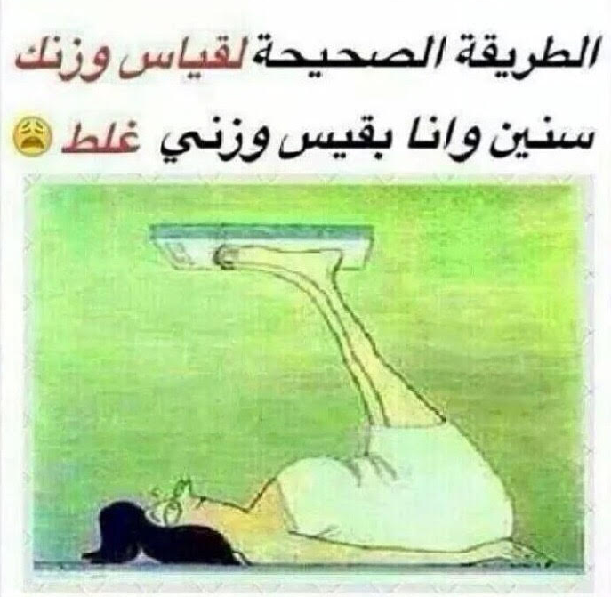
Methods: described in details
Risks to subjects are minimized
Risks are reasonable in relation to anticipated benefits
Selection of subjects is equitable
Informed consent is obtained when required
Informed consent is appropriately documented
Data and safety monitoring is adequate
Privacy and confidentiality are protected
Additional safeguards are in place for vulnerable populations

Slide 26
design, setting, & Population
Justify study design based on research question, whether observational or experimental, hospital / community based, & type of population
Inclusion/Exclusion Criteria keeping ethical guidelines
Procedures to determine eligibility and if any test will be needed
Enrollment/Randomization procedures (if experimental)
Study Procedures: Risks of Investigational Agents/Devices (side effects)
Reporting of Adverse Events/Unanticipated risk to Participants or others
Study Withdrawal/Discontinuation
Statistical Considerations
Privacy/Confidentiality Issues, Follow-up and Record Retention

Slide 27
Study procedures
Inclusion/Exclusion Criteria keeping ethical guidelines
Procedures to determine eligibility and if any test will be needed
Enrollment/Randomization procedures (if experimental)
Study Procedures: Risks of Investigational Agents/Devices (side effects)
Reporting of Adverse Events/Unanticipated risk to Participants or others
Duration of participants will stay in study; number of visits
Study Withdrawal/Discontinuation

Slide 28
Sampling and sample size
IRB requires a proposal which is scientifically sound and has statistical power
A sampling scheme is to be described to address selection bias and unnecessarily including or excluding some vulnerable population
Adequate power and number of participants to detect a meaningful/hypothesized difference

Slide 29
Data collection methods and tools
Referenced and validated questionnaire
Appropriately worded, communicated
Sensitive and Personal questions
Study team collecting data is well trained in Ethics, communication skills, data collection procedures, and in obtaining any laboratory or other tests
Length of questionnaire and tools (whether will be exhausting to patients/participants)
Compliance and follow up procedures

Slide 30
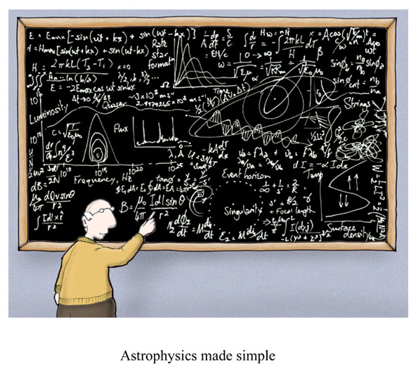
Plan of analysis
Standard definitions defining exposures, outcomes, and other variables
E.g. The primary endpoint is change in serum cholesterol levels at 30, 60, 90 and 120 days in experimental and control group.
Types of variables
Descriptive and inferential statistics
Tests of significance
Statistical considerations

Slide 31
Ethical considerations
Consent taking includes relevant information
Training for consent taking process
Confidentiality at all levels
Equitable selection of study participants
Specific method and location of enrolment is to be described
What procedures will be followed if laboratory results are not within normal limits?
How will missing data or incomplete forms be handled
Quality assurance methods

Slide 32
Other important items
References need to be provided for all facts, figures, and evidence
PI is responsible for the study conduct and all procedures
Role of Investigators : clear responsibilities and roles
Budget justifiable with duration / by year
Time lines and task management details

Slide 33
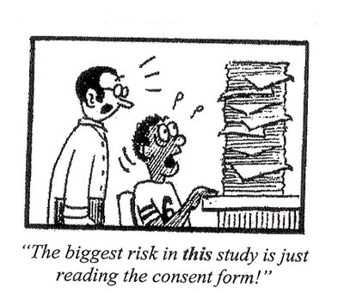
IRB Decision
APPROVED
MODIFY / REVISE
REJECT

Slide 34
Problems with approvals / delays
Insufficient information upon which to determine risk/benefit
Benefit > Risk not made explicit
Study Design Inadequate
Informed consent Issues
Privacy/confidentiality Issues Not Addressed
Selection of Subjects Not Equitable or Described
Research and Clinical Care Difficult to Distinguish
Unethical Study
Administrative Details Not Addressed Appropriately
Response format is ambiguous

Slide 35
Thank you..
Any Questions??

Slide 36
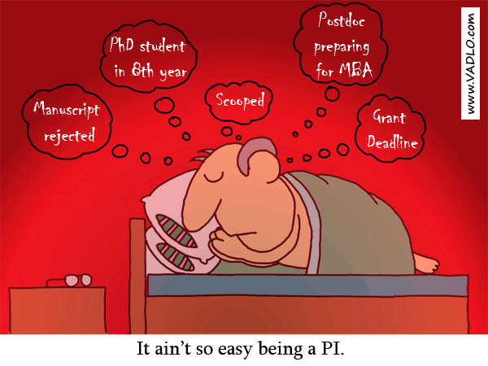

Slide 37
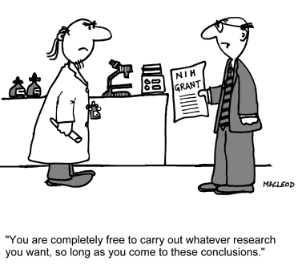
TEMPTATION: ETHICAL OR UNETHICAL ?

Slide 38
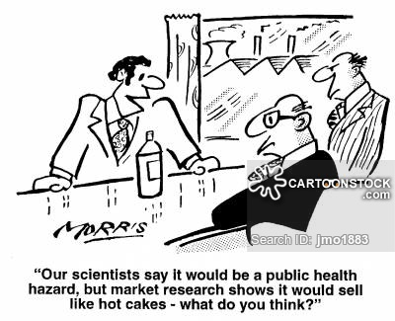

Slide 40
