Slide 1
ETHICS OF BIOMEDICAL RESEARCH: ISLAMIC PERSPECTIVES
PROF. JAMAL S. AL-JARALLAH Professor and Consultant Department of Family and Community Medicine Chairman ,Clinical Ethic Committee College of Medicine &KSUMC, KSU
1438

Slide 2
“THE VALUE OF RESEARCH DEPEND AS MUCH ON ITS ETHICAL VERACITY AS ON THE NOVELTY OF ITS DISCOVERIES”
WILLMAN,2011,P: 267

Slide 3
IDEA
PUBLICATION

Slide 4
"The best of people are those that bring most benefit to the rest of mankind.“
Prophet Mohammad,PBUH.

Slide 5
WE WANT TO:
APPRECIATE OF THE IMPORTANCE OF ETHICS IN RESEARCH
UNDERSTAND THE PRINCIPLES OF RESEARCH ETHICS
APPRECIATE THE ETHICAL REQUIREMENTS OF RESEARCH

Slide 6
CONTENT
RESEARCH .. AND… PRACTICE..A DISTINCTION
RESEARCH AND ..ETHICS
SOURCES OF RESEARCH ETHICS
ISLAMIC SOURCES/ PRICIPLES
OTHER SOURCES
ETHICAL REQUIREMENTS OF RESEARCH
ETHICS RELATED TO THE RESEARCHER
CONCLUSIONS

Slide 7
WHAT IS RESEARCH?
CAREFUL STUDY OF A GIVEN SUBJECT
A PROCESS TO DISCOVER NEW KNOWLEDGE

Slide 8
RESEARCH AND MEDICAL PRACTICE
Research:
A class of activities designed to develop or contribute to generalizable knowledge
A careful and detailed study into a specific problem, concern, or issue using the scientific method
Practice:
A class of activities designed soleley to enhance the wellbeing of individual patient. Diagnosis, preventive treatment or therapy.

Slide 9
CLASSES OF RESEARCH

Slide 10
RESEARCH
EXPERIMENTAL
NON-EXPERIMENTAL

Slide 11
RESEARCH
QUANTITATIVE
QUALITATIVE

Slide 12
RESEARCH
BASIC
APPLIED

Slide 13
CLINICAL RESEARCH
THERAPEUTIC
NON-THERAPEUTIC

Slide 14
PHASES OF CLINICAL RESEARCH

Slide 15
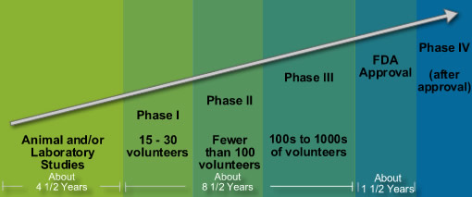
C L I N I C A L
PRECLINICAL
Tolerability
Pharmacokinetics
Pharmacodynamics
Effectiveness
Dosage, Safety
Comparison
Effectiveness
Side effects
Comparison
Side effects

Slide 16
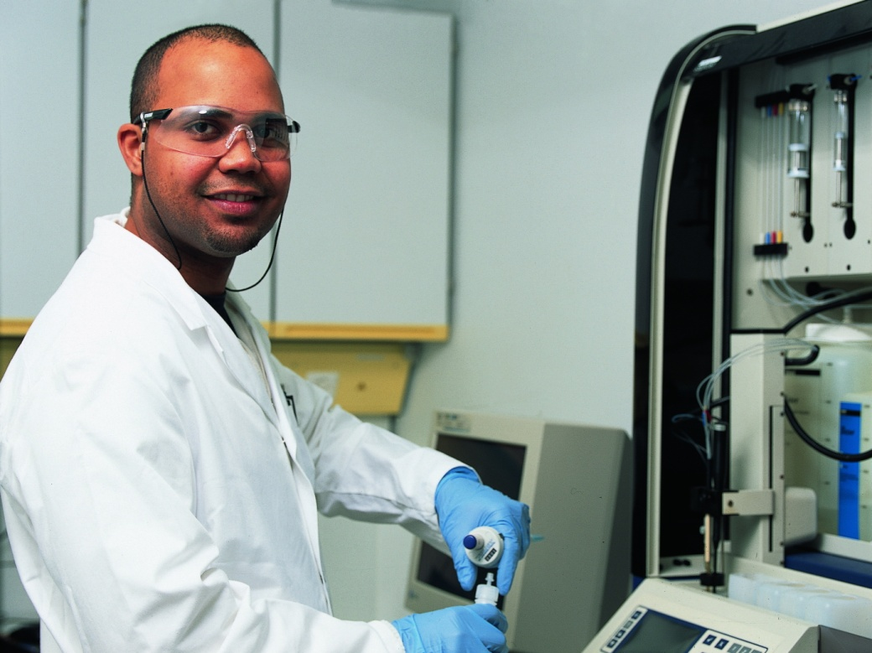
RESEARCH AND ETHICS

Slide 17
WHY BOTHER ABOUT ETHICS IN RESEARCH ?

Slide 18
WHY ?
PROTECTION OF PARTICIPANTS
SAFEGAURD AGAINST EXPLOITATION
ENSURE RESPECT OF INDIVIDUALS, DIGNITY,COFIDENTIALITY AND PRIVACY
ENSURE GOOD CLINICAL PRACTICE IN RESEARCH
SAFEGAURD AGAINST VIOLATIONS IN RESARCH AND RESEARCH MISCONDUCT

Slide 19
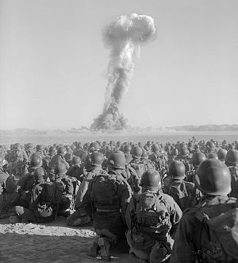
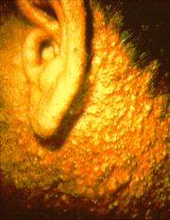
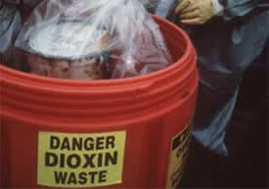
HORRENDOUS EXPIREMENTS

Slide 20
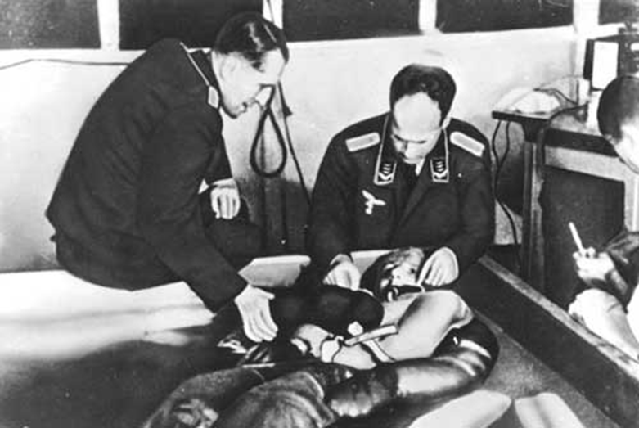
Prisoners of war

Slide 21
تجاوزات في البحوث الطبية

Slide 22
NUREMBERGE CODE
INFORMED CONSENT
QUALIFIED RESEARCHER
APPROPRIATE RESEARCH DESIGN
FAVIORABLE RISK/BENEFIT RATIO
PARTICIPANT FREEDOM TO STOP

Slide 23
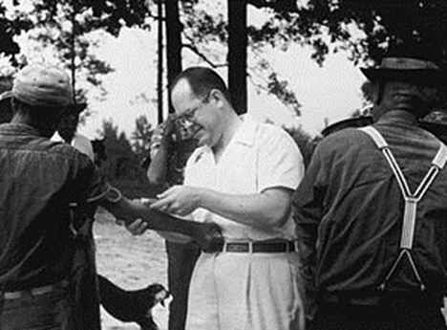
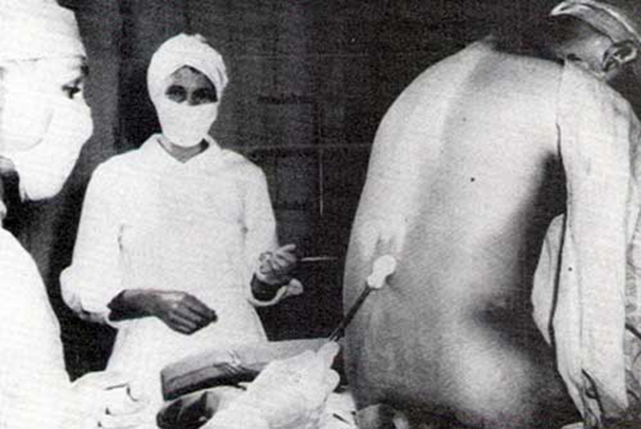
تجاوزات في البحوث الطبية
TUSKEGEE SYPHLIS STUDY
CONTINUED FOR HOW LONG?
1932-1972

Slide 24
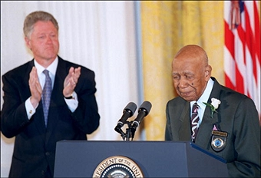
1997

Slide 25
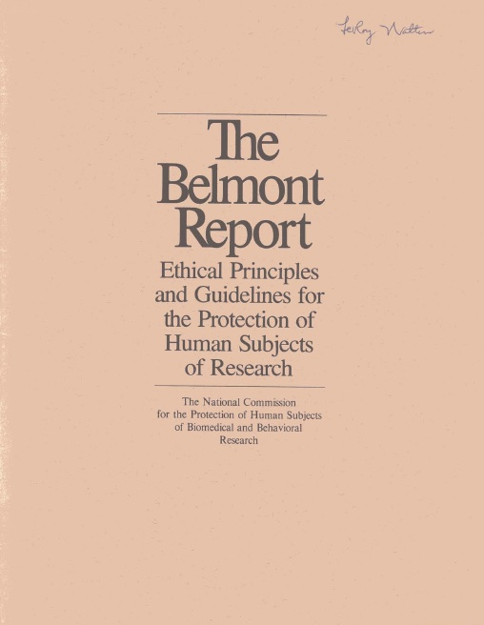
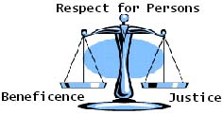
1978
RESPECT OF HUMAN
INFORMED CONSENT
BENEFICENCE……….BENEFIT/RISK
JUSTICE … SUBJECTS SELECTION

Slide 26
SOURCES OF RESEARCH ETHICS

Slide 27
IS RESEARCH HALAL OR HARAM?

Slide 28
GENERAL ISLAMIC PRICIPLES RELATED TO RESEARCH ETHICS
Devotional purposes
Purposes of the law
Best interest
Preventing and eliminating harm
Consequences
Protecting rights
Duty of care and caring
Observing Moral principles and virtues
Good treatment/dealing withpeople
Observing Fighi Principles
أولاً : تحقيق الجانب الايماني والقصد التبعدي
ثانياً : تحقيق وحفظ مقاصد الشريعة الإسلاميه
ثالثاً: تحقيق المصلحة
رابعاً :دفع الضرر ورفعه
خامساً :تقدير المآلات
سادساً:حفظ الحقوق
سابعاً :تحقيق واجب الرعاية
ثامناً :قواعد أخلاقية يجب مراعاتها
تاسعاً :حسن الخلق في التعامل مع الناس
عاشراً : مراعاة القواعد الفقهيه

Slide 29
PURPOSES OF ISLAMIC SHAREA
PROTECTION OF RELIGION
PROTECTION OF HUMAN LIFE
PROTECTION OF THE MIND
PROTECTION OF PROGENY
PROTECTION OF PROPERTY

Slide 30
IS RESEARCH HALAL OR HARAM?
EVERY THING IS PERMISSIBLE….
الأصل في الأشياء الإباحة

Slide 31
IS IT OBLGATORY ?
مالايتم الواجب إلا به فهو واجب
فرض كفاية
IF AN OBLIGATION CANNOT BE COMPLETED EXCEPT WITH SOMETHING,THAT (SOMETHING) BECOME OBLIGATORY

Slide 32
TWO MAJOR PRINCIPLES
THE ACCRUEMENT OF BENEFITS جلب المصالح
THE WARDING OFF OF HARM درء المفاسد
Notes:
32

Slide 33
FIVE GRAND PRINCIPLES
INTENT IS ALL-IMPORTANT IN ACTION
الأمور بمقاصدها
CERTAINITY CANNOT BE REMOVED BY
DOUBT
اليقين لايزول بالشك
HARSHIP ENGENDERS FACILITATION
المشقة تجلب التيسير
HARM SHOULD BE REMOVED
لاضرار ولا ضرار
CUSTOM IS THE RULE
العادة محكمة
Notes:
33

Slide 34
The care Principle
"You all a shepherd who is responsible for all of his herd”
”كلكم راع وكلكم مسؤول عن رعيته“

Slide 35
Research ethics guidelines and regulations

Slide 36
International
WHO Good Clinical Practice Guidelines
ICH Good Clinical Practice
ICH Guidelines on control groups
TDR Operational Guidelines for Ethics Committees
UNAIDS Guidance Document on HIV vaccine trials
CIOMS GUIDELINES

Slide 37
European
Convention on Human Rights and Biomedicine, Council of Europe
Explanation to Convention on Human Rights and Biomedicine
Convention on Data Protection, Council of Europe
Data Protection Directive, European Union
Directive on good clinical practice in the conduct of clinical trials, EU
Nuffield Council Report
European Group Ethics: Ethical Aspects of Clinical Research in Developing Countries
Ethical Conduct for Research Involving Humans

Slide 38
US
Belmont Report
US Federal Guidelines
NBAC report: Ethical and policy issues in international research: Clinical trials in developing countries
Others
Ethical guidelines for Biomedical Research on Human Subjects of the Indian Council of Medical Research
Canada's Tri-Council's Policy Statement

Slide 39
ARE THESE ISLAMIC ?

Slide 40
ETHICAL REQUIREMENTS

Slide 41
ETHICAL REQUIREMENTS
Scientific Value
Scientific validity
Respect of Potential and enrolled subjects.
Favourable risk-benefit ratio
Fair subject selection
Independent Review
informed consent
( JAMA. 2000;283(20):2701-2711. doi:10.1001/jama.283.20.2701)

Slide 42
Observance of sharia principles and law
Observance of the local laws/policies

Slide 43
ETHICAL REQUIREMENTS
SCIENTIFIC VALUE:
Responsible use of finite resources
Avoidance of exploitation
Not to expose human being to potential harms without some possible social or scientific benefit
Prioritization
SCIENTIFIC VALIDITY:
Use accepted scientific principles and methods to produce reliable and valid data.

Slide 44
FAIR SUBJECT SELECTION
Selection of subjects so that stigamatized and vulnerable individuals are not targeted for risky research
(JUSTICE)
FAVOURABLE RISK – BENEFIT RATIO
Minimizing Risk
Enhancement of Potential benefits
“Non- Maleficence , Beneficence”

Slide 45
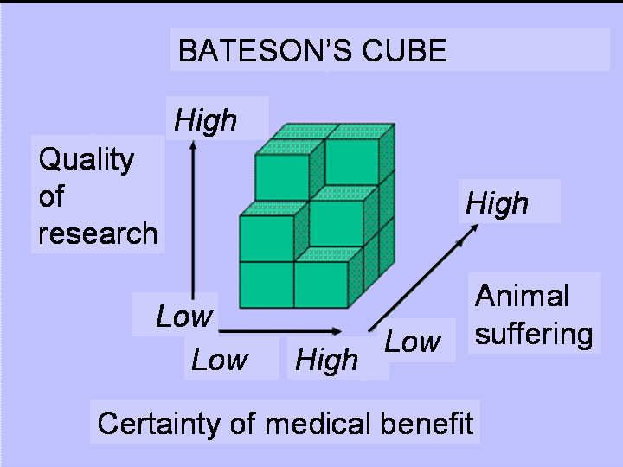

Slide 46
RESPECT FOR SUBJECTS
- Permitting withdrawal
Protecting privacy
New risks or benefits
Result of clinical research
Maintaining welfare of subjects
“Autonomy and rights”
INFORMED CONSENT

Slide 47
”لايجوز لأحد التصرف في ملك الغير إلا بإذنه“
“NO ONE IS ALLOWED TO ACT UPON THE PROPERTY OF AN INDIVIDUAL UNLESS HE TAKES HIS PERMISSION”

Slide 48
INFORMED CONSENT
Informed consent is consent given by a competent individual who received the necessary information, who has adequately understood the information, and who after considering the information, has arrived at a decision without been subject to coercion, undue influence or inducement or intimidation.
Guidelines for CIOMS

Slide 49
INFORMED CONSENT
Is a process by which an individual voluntairly expresses his or her willingness to participate in a particular study, after having been informed of all aspects of the study that are relevant to the decision to participate

Slide 50
INFORMED CONSENT
INFORMATION
UNDERSTANDING/COMPREHENSION
CONSENT/VOULTAIRNESS

Slide 51
شروط الاذن CONDITIONS OF INFORMED CONSENT
أن يكون الإذن صادراً ممن له الحق,
RIGHT
أن يعطي الإذن وهو على بينة وإدراك
(البصيرة)
COGNIZANCE
أن يكون الآذن أهلاً للإذن والأهلية تعتبر بوجود أمرين أحدهما: البلوغ والثاني العقل
CAPACITY
الاختيار , وعدم الإكراه
VOLUNTAIRENESS
أن يكون الاجراء مأذون بها شرعا
LAWFULL PROCEEDURE

Slide 52
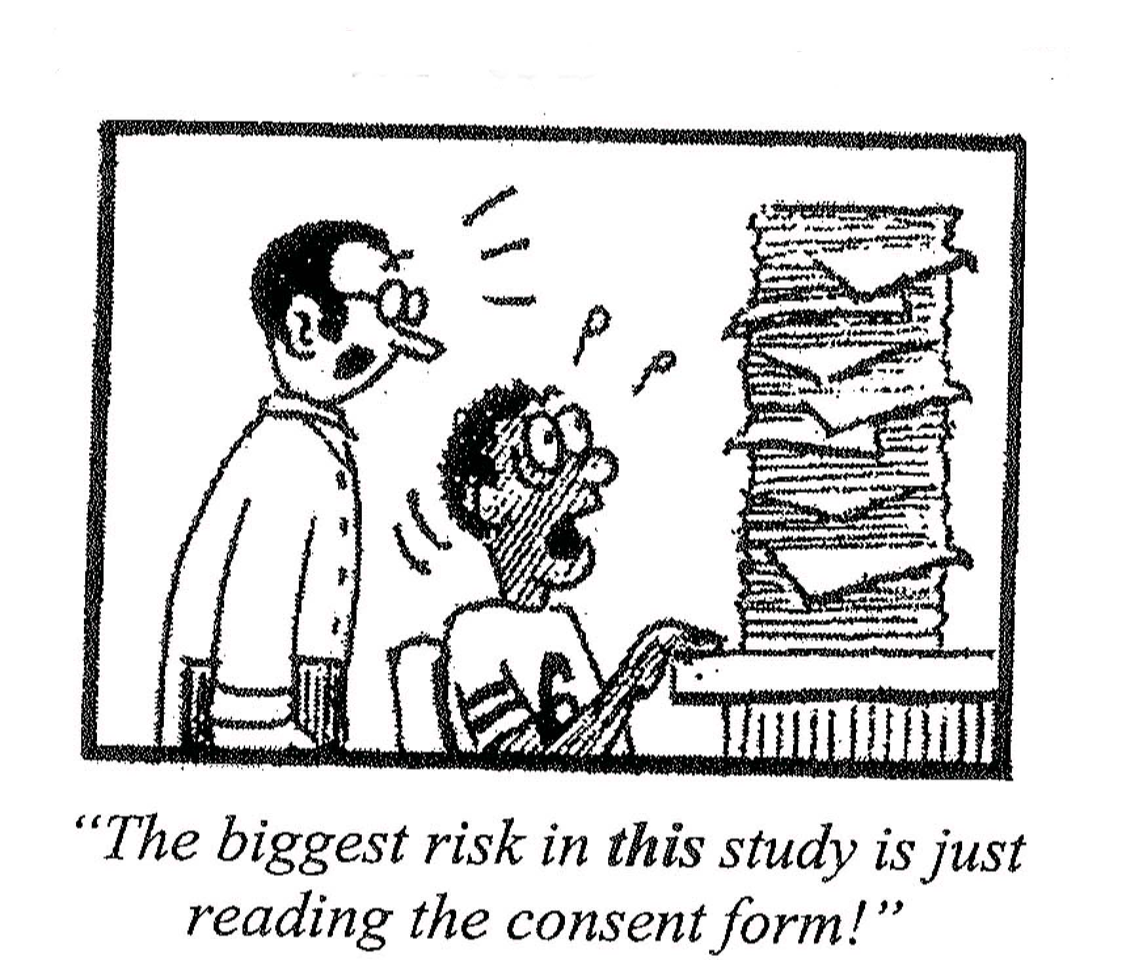
ELEMENTS OF INFORMED CONSENT (IC)

Slide 53
ESSENTIAL ELEMENTS
A statement that the study involves research
A description of any reasonably foreseeable risks or discomforts to the subject.
A description of any expected benefits to the subject or to others.
A disclosure of appropriate alternative procedures or courses of treatment, if any

Slide 54
ESSENTIAL ELEMENTS
Assurance of confidentiality
A statement about compensation
Contact details
Assurance of voluntairness of particpation

Slide 55
ADDITIONAL ELEMENTS
Unforseeable risks
Termination of participation
Additional costs
Consequences of withdrwal
Significant new findings
Number of participants

Slide 56
IC READIBILITY
LANGUAGE:
LANGUAGE OF PARTICIPANTS
EXPLANATION/ INTERPRETATION
SIMPLE LANGUAGE
LEGIBILITY
AVOID MEDICAL JARGON

Slide 57
WAIVER OF INFORMED CONSENT
Minimal risk
Rights and welfare of participants protected
Research not possible without a waiver
Appropriate information provided
FHI, Research Ethics Training Curriculum

Slide 58
Observance of sharia principles and law
INDEPENDENT REVIEW
Proposed subject population
Review design
Risk – Benefit Ratio
“Conflict of interest”
Observance of the local laws/policies

Slide 60
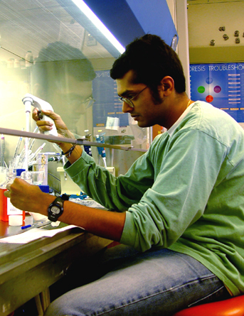
THE RESEARCHER VIRTUES
SINCERITY/FAITHFULNESS
OBSERVANCE OF ALLAH
INTEGRITY/HONESTY

Slide 61
INTEGRITY/HONESTY
ORIGINALITY OF THE STUDY
REVIEW OF PREVIOUS STUDIES
TRUTHFULNESS ABOUT THE BENEFITS & RISKS
SCIENTIFIC CAPABILITY
SCIENTIFIC INTEGRITY
IMPARTIALITY
APPOROPRIATE RESEARCH TEAM
OBSERVING RIGHTS OF COLLABORATORS

Slide 62
RESEARCH ON SPECIAL (VULNERABLE)GROUPS
A “vulnerable participant” is any individual who lacks the ability to fully consent to participate in a study.
http://www.virginia.edu/vpr/irb/sbs/resources_guide_participants_vuln.html

Slide 63
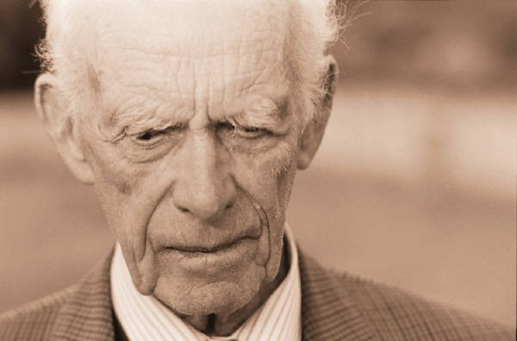
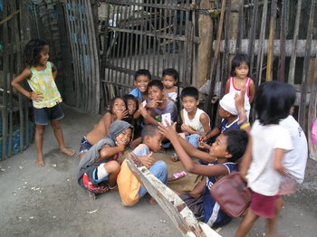
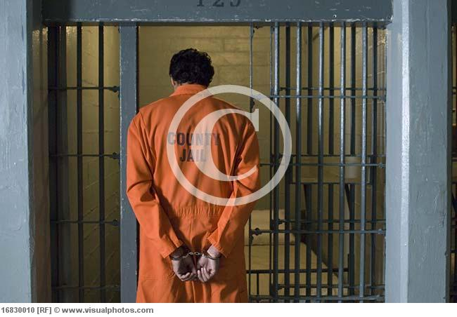
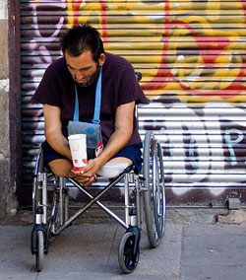
VULNERABLE GROUPS

Slide 64
Types of vulnerability
PHYSICAL
SOCIAL
COGNITIVE/COMMUNICATIVE
ECONOMIC
INSTITUTIONAL

