Slide 1

CMED 305 course Orientation
&
Introduction to Research methods:
Why do we need research?
Dr.Shaik Shaffi Ahamed Ph.D.,
Associate Professor
Department of Family & Community Medicine
College of Medicine, King Saud University
September, 2017

Slide 2
Introduction to Course
Course Objectives
The overall objectives of this course are to enable students understand & learn the basic elements of research, its design and conduct an epidemiological study to answer a specific research question of interest.

Slide 3
Learning Methods for the course
  Course Units: ~ 6 academic credits
  Learning methods over the academic year include
  lectures ( ~ 28 contact hours),
  tutorials (~ 30 contact hours), &
  research group works with supervisor ( ~ 38 hours).
    Self initiative and learning is needed from students for a good outcome

Slide 4
Course Concepts taught in lectures & tutorials
How to formulate a research question and development of a study protocol
Designing of an epidemiological study
Ethics in research and avoiding plagiarism
Biostatistics concepts and skills in data management & analysis
Data interpretation, presentation of study findings

Slide 5
Focus on the entire process of concepts taught in lectures & tutorials to link with a research topic.

Slide 6
Group Meetings with Research Supervisor
The Research Supervisor, who is a faculty or expert in the research & specific topic of interest, will help you to learn subject concepts as well as to formulate the research question, supervising:
-the development of protocol,
-monitor the conduct the study,
-using appropriate scientific & ethical methods

Slide 7
Supervisor Selection
Based on your topic of interest
Initiated during the first week of classes & to complete at the most by the end of first 2 weeks of the first semester.
Important points for selection of supervisor are:
  availability,
  time commitment,
  conforming to schedule, and
  communication methods.
  Change in topic and supervisor is time constrained and usually results in affecting grades, incomplete work, missing deadlines; hence careful selection of topic and supervisor is important.

Slide 8
Supervisor Agreement Form
It is in your manual; Copy, fill it as a group, and explore your interest and supervisor
Copy it and get it signed and submit at the Support Staff at Department of Family & Community Medicine 2nd floor
Ms Sharmina for Female groups
Mr. Bader / Mr. Ali for Male groups

Slide 9
Formation of Research Group
5-6 students per group.
Males and females will make separate groups.
The supervisor - supervisee relationship needs to be strengthened with mutually accepted expectations on both sides.
The supervisor provides quality time, while students are expected to observe discipline, give respect and express maximum learning attitude.

Slide 10
List of Potential Departments for Selecting Research Supervisors
Anatomy;
Anesthesia;
Cardiac Sciences;
Dermatology;
Emergency Medicine;
ENT;
Family & Community Medicine.
Medical Education;
Medicine;
Obs-Gynecology;
Ophthalmology;
Orthopedics;
Pathology;
Pediatrics;
Pharmacology;
Psychiatry;
Physiology;
Radiology;
Surgery;
Sections & Centers of Research at KSU

Slide 11
Source of data for research study
Preference should be given for primary data
-- From Community ( general population)
-- From outpatients and inpatients of any hospital
-- From the schools and colleges
-- From Government organizations and Industries
For secondary data --- ????????????
-- From Medical records,
Registries of Cancer and Diabetes etc.,

Slide 12
Read Your Manual Carefully
All information in details is present in Manual
Responsibilities of supervisors and students
Guidelines to develop protocol and report
Guidelines for collaboration within and outside KSU
Assessment Methods
Evaluation forms that will be used by supervisors and Ethical Review Committee

Slide 13
Submission Dates and Deadlines
Title of document / Form | Dates
Supervisor Agreement Form | September 28, 2017
Study title, question, objectives, hypothesis, and study design | October 12,2017
Protocol Submission for Ethical Review Committee | November 26,2017
Evaluation by Supervisor (Form A) | November 26,2017
Final report submission and power point presentation | April 30, 2018
Evaluation by Supervisor (Form B) | April 30, 2018

Slide 14
Assessment of Students & Marks Distribution
I. Examinations (40%)
  1. Midterm: 15%
  2. Final exam: 25%
II. Continuous Assessment (60%)
1. Research Project (40%):
    Research protocol by supervisor (10%);
    Ethical Review Committee Clearance (5%);
    Final report by supervisor (10%); & CM unit review committee ( 10%);
    Oral Presentation by assigned evaluators (5%);
2. Other (20%):
    Assignments (10%); Quizzes (10%) – in Research methodology & Biostatistics

Slide 15
Introduction to Research methods:
Why do we need research?
Session Objectives
What is a Research ?
Why is medical research important ?
How to start a research project ?
What is a criteria of a researcher and a research project ?
What is the outline of a research protocol ?

Slide 16
What is “Research”
Research is an Endeavour to discover answers to intellectual and practical problems through the application of scientific method.
Research is the systematic process of collecting and analyzing information (data) in order to increase our understanding of the phenomenon about which we are concerned or interested.

Slide 17
SCIENTIFIC METHOD
Scientific method is the systematic collection of data (facts) and their theoretical treatment through proper observation, experimentation and interpretation.

Slide 18
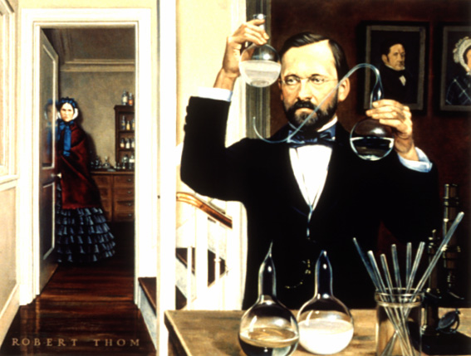
Research Experiments in Laboratories
France 1822
Pasteur ; the chemist who transformed medicine
Notes:
Proof that microbes are reproduced from parent organisms, and do not result from spontaneous generation, came from careful experiments in makeshift laboratories of France's famed chemist and biologist, Louis Pasteur (1822-1895), at the Ecole Normale, Paris.
Behind him are portraies of his father and mother, which he painted during his youth. Mme. Pasteur waits patiently for him to complete an observation." On the table is a replica of the experiment of Lizaro Spalanzani. Pasteur is holding one of his "Swan-necked" flasks. This painting by Robert A. Thom appeared in "Great Moments in Medicine" published by Parke Davis & Company, in 1966. The text quoted is from the same source. Both are reproduced with the permission of Parke Davis & Company.

Slide 19
Pace of Change in Medicine
Changing patterns of diseases
Demographic transition & longevity
Variation in patient population and clinical care in various geographical regions differs for many reasons

Slide 20

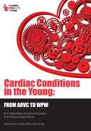
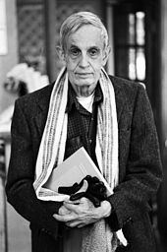


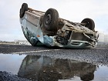
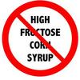

Slide 21
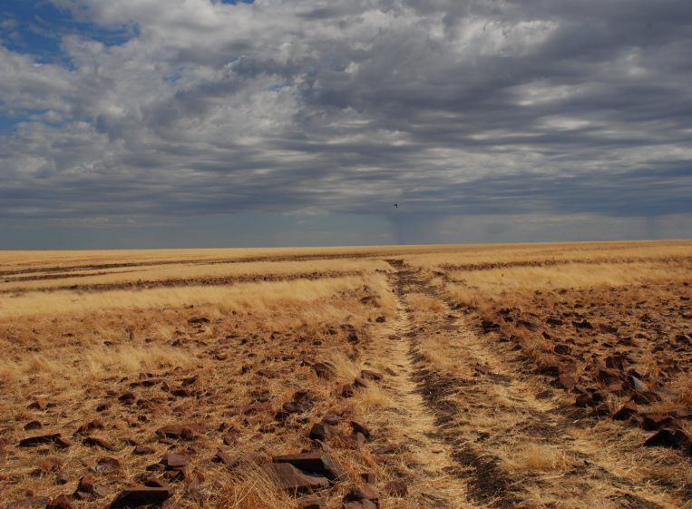

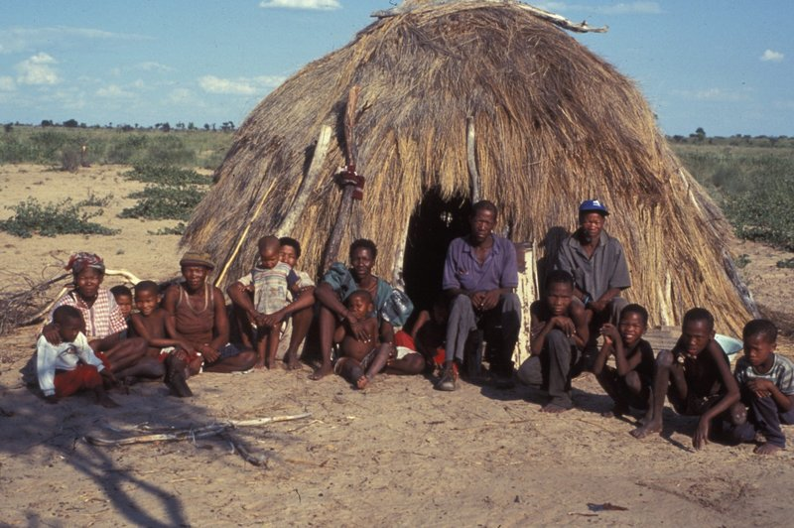
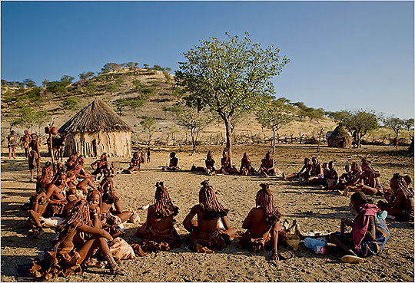

Slide 22
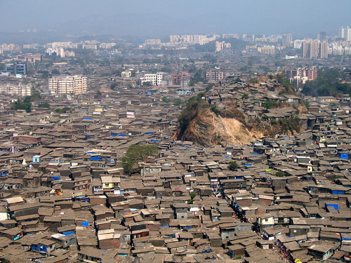
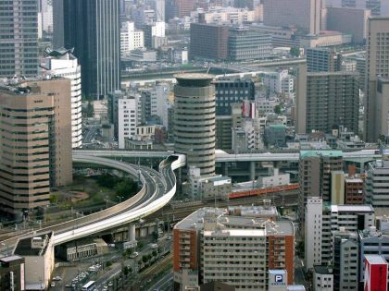
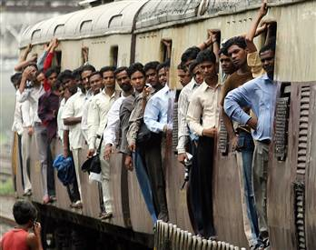

Slide 23
MODEL OF THE RELATIONSHIP BETWEEN DIFFERENT TYPES OF RESEARCH
Epidemiological
Biomedical
Policy making,
planning,
Management
evaluation
Health
systems
research
Statistical
Behavioral
Social &
economic

Slide 24
Causal model of risk factors for CVD
Morbidity and Mortality
(Stroke, MI)
Biological Risk Factors
(Hypertension, Blood Lipids, Homocysteine)
Genetic Risk Factors
(Family History)
Behavioral Risk Factors
(Cigarette, Diet, Exercise)
Environmental Factors
(Socioeconomic Status, Work Environment)
Notes:
24
24

Slide 25
Preventable Causes of Disease
BEINGS
Biological factors and Behavioral Factors
Environmental factors
Immunologic factors
Nutritional factors
Genetic factors
Services, Social factors, and Spiritual factors
[JF Jekel, Epidemiology, Biostatistics, and Preventive Medicine, 1996]
Notes:
25
With attention on the application to control,
The BEINGS acronym for remembering categories of preventable causes of disease:
Biological factors: infectious agents, allergens, vaccines
Behavioral factors: smoking, drinking, exercise, diet, health-seeking behavior
Environmental factors: polutants and contamination, as well as ticks, air conditioning systems
Immunologic factors: natural immunity, acquired immunity
Nutritional factors: obesity, malnutrition, dis-equilibrium in diet
Genetic factors: genetic susceptability
Services: access to care
Social factors: family support
Spiritual factors: belief system

Slide 26
Clinical Research
Clinical research involves working with human subjects to answer questions relevant to their well-being

Slide 27
‘How To Do’ Research
Start with defining the question
Write down a clear aim
Divide the problem into smaller, answerable questions

Slide 28
‘How To Do’ Research
Develop hypotheses
Decide what data is needed to test the hypotheses
Refine the above and check the line of thought

Slide 29
Good Research
CLEAR
  Essential for both the problem and the answer
ACCURATE
  Exactness and precision come from hard work and responsible effort
RELIABLE
  If repeated will the answer be the same?

Slide 30
CRITERIA OF A GOOD RESEARCH
Purpose clearly defined.
Research process detailed.
Research design thoroughly planned.
High ethical standards applied.
Limitations openly revealed.
Adequate analysis for decision maker’s needs.
Findings presented unambiguously.
Conclusions justified.

Slide 31
Getting Started
Learn your subject
Read, Read, Read
Start general and then focus
Begin with the problem

Slide 32
Stages in Creativity
SENSE
  Realize the need for a study
PREPARE
  Gather relevant information
INCUBATE
  Think through the problem
ILLUMINATE
  Imagine possible solutions

Slide 33
Researcher Qualities
Knowledgeable
Observant
Logical
Open-minded
Honest
Motivated
Independent
Flexible
Curious
Eager to learn
Persistent
Tolerant
Novel

Slide 34
RESEARCH PROCESS
Review the literature
Review
Concepts
And
theories
Design
Research
(Including
Sample
Design)
Analyse
Data
(Test
Hypothesis
if any)
Formulate
hypothesis
Collect
Data
(Execution)
Interpret
and
report
Define
Research
Problem
Review
Previous
Research
findings
I
III
IV
V
VI
VII
II

Slide 35
THERE ARE ONLY A HANDFUL OF WAYS TO DO A STUDY PROPELY BUT A THOUSAND WAYS TO DO IT WRONG ---
Sackett (1986)

Slide 36
Protocol Development
Research Question
Hypotheses
Objectives
Background
Design
Subjects
Variables
Data Collection
Quality control
10. Data Management
11. Sample size
12. Plan of Analysis
13. Ethical issues
14. Budget
15. Report results
16. Institution capacity
17. Administration
18. Work Plan

Slide 37
References
Stephen B Hulley. Designing Clinical Research. Chapter 1 . Getting Started: The Anatomy and Physiology of Clinical Research . Pages 3-15. 3rd Edition . Wolters Kluwer Health Lippincott Williams and Wilkins 2007
Daniel P Schuster & William J Powers. Translational and Experimental Clinical Research. Introduction: The value of Translational and Experimental Clinical Research. Pages: xv-xxi Lippincott Williams and Wilkins 2005

