Slide 1
Portal Hypertension
Mazen Hassanain

Slide 2
Causes
Cirrhosis
Non-cirrhosis

Slide 3
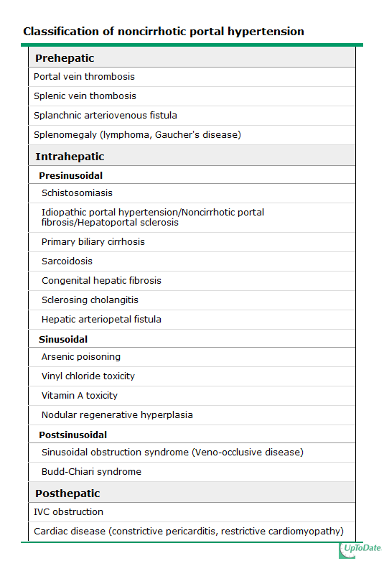

Slide 4
Symptoms
Asymptomatic
Complications
Gastroesophageal varices
Ascites
Splenomegaly
Underlying disease

Slide 5
Bleeding prevention
Approximately one-third of all patients with varices will develop variceal hemorrhage
A major cause of morbidity and mortality in patients with cirrhosis
AASLD RECOMMENDATIONS — Recommendations for prevention of variceal bleeding have been issued by the American Association for the Study of Liver Diseases

Slide 6
Treatment of bleeding
Initial therapy: hemodynamic resuscitation, prevention and treatment of complications
Prophylactic antibiotics, preferably before endoscopy (although effectiveness has also been demonstrated when given after).
Suggest intravenous ceftriaxone (1 g IV) or Cipro (400 mg IV BID)
UGD should be performed for diagnosis and possible treatment
Octreotide (50 mcg bolus followed by 50 mcg/hour by intravenous infusion) where terlipressin is unavailable

Slide 7
continue
Salvage treatment
TIPS (transjugular intrahepatic portosystemic shunt)
Surgery in well preserved liver function who fails emergent endoscopic treatment and has no complications from the bleeding or endoscopy.
The choice of surgery usually depends upon the availability, training, and expertise of the surgeon. Although a selective shunt has some physiologic advantages, it may significantly exacerbate marked ascites.

Slide 8
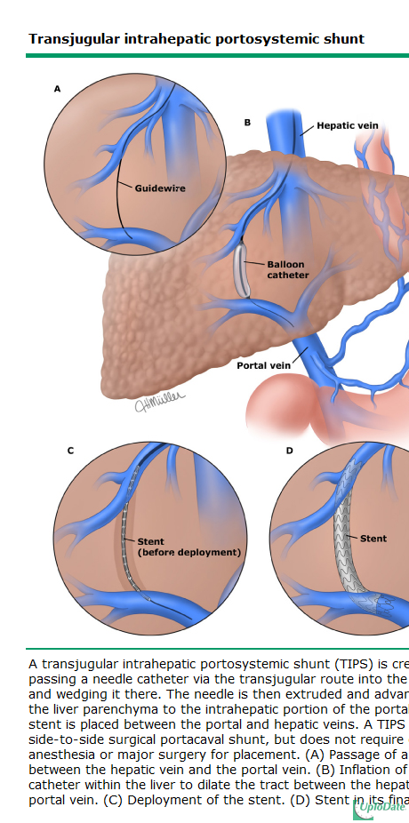

Slide 9
Liver Resection
Indications:
Benign:
Tumor
Adenoma
Malignant:
Primary:
HCC
CC
Mets:
CRCLM

Slide 10
Liver Resection
Outcomes
Benign
Malignant
What's resectable
How much liver
Can we do anything else

Slide 11
HCC vs. CRCLM
Background liver
Associated morbidities
Transplant options

Slide 12
Liver Resection
Complications
Liver Failure
Bleeding
Bile leaks
Infection (wound, deep abscess)
General complications

Slide 13
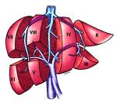
Liver Resection
Types of resections

