Slide 1
Arterial Disease -ILOS
Describe pathophysiology of arterial disease
Describe investigations available for assessment of arterial disease
Describe the etiology, clinical features, investigations & management of chronic LL ischemia
Explain the differentiating features & significance of critical limb ischemia
Describe etiology, presenting features & management of acute limb ischemia
Desribe reperfusion injury & its management
Describe the etiology, presenting features & management of aneurysmal disease
Describe the pathogenesis & management of Diabetic foot
Describe the etiology, clinical features, investigations & management of Carotid artery atherosclerotic disease.

Slide 2
Arterial System
Conveys oxygenated blood to tissues
Responds to sympathetic and humoral stimuli that maintain BP
Shunts blood from non working to working organs
Contains 30% of blood volume
Normal systolic pressure <140 mmHg
Arterial capillary pressure 25 mmHg
High pressure /low volume system

Slide 3
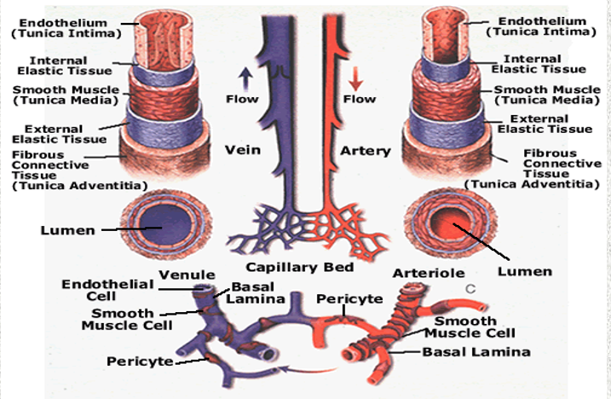
Blood Vessel Structure

Slide 4
Arteries
Elastic arteries : Aorta & Beginning of its large branches
preponderance of elastic fibers in media
Muscular arteries : medium sized arteries, distributing arteries
exhibit smooth muscles in their walls
Small arteries : major site of autonomic regulation of blood flow

Slide 5
Endothelium
Permeable to water & small inorganic ions
Transports a little bit of blood protein by pinocytosis
It can contract to regulate the capillary flow
It produces some of the subendothelial connective tissue
It makes substances :
Prostacyclin (to keep its surface slippery)
Von Willebrand’s factor
Endothelin ( a vasoconstrictor peptide)
Endothelial derived relaxation factor

Slide 6
Vascular Smooth Muscle
Has LDL receptors
It can get into the intima through holes in internal elastic membrane
Both are important in atherogenesis

Slide 7
Arteriosclerosis
Generic term for three patterns of vascular disease which all cause thickening and inelasticity of arteries.
Atherosclerosis : Occlusive
characterized by formation of intimal fibro fatty plaques
with central core rich in lipids
affects large and medium sized arteries
major cause of organ ischemia

Slide 8
Monckenberg’s medial calcific sclerosis – Non Occlusive
characterized by calcifications in the media of muscular arteries
medium sized muscular arteries of persons 50yrs or older
calcifications are irregular medial plates that create nodularity
on palpation
easily visualized on X-ray
don’t encroach on vessel lumen – less clinical importance

Slide 9
Arteriosclerosis :
disease of small arteries and arterioles – small vessel sclerosis
Associated with HTN & DM which cause luminal narrowing
and down stream ischemic injury
2 variants – hyaline and hyperplastic

Slide 10
Atherosclerosis
Patchy sub intimal thickening/plaques(Atheroma) in medium or large muscular arteries that reduce the blood flow
Characterized by
lipid deposition
chronic inflammation (inflammatory cells)
fibrosis
smooth muscle cells & connective tissue

Slide 11
Large arteries : plaques – compromise blood flow – Ischemia
encroach on media – weaken vessel wall – aneurysms
Small arteries : occlude lumen – compromise blood flow – ischemia
Atheromatous plaques – disrupt blood - thrombus

Slide 12
Risk Factors
Non Modifiable
Age
male gender
after menopause in females
familial predisposition
Genetic abnormalities
Modifiable – major Factors
Smoking
HTN
DM
Hypercholesterolemia
Minor risk factors
sedentary life style
obesity
stress full & competitive life style
type A personality
high carbohydrate intake
elevated homocysteine

Slide 13
What Happens During Atherosclerosis

Slide 14
Clinical consequences & complications
Disruption of laminar flow
Ischemia
Thrombus formation
Clinically silent until complications emerge

Slide 15
Treatment & Prevention
Primary Prevention - modifiable risk factors – lifestyle
Secondary prevention
Cholersterol lowering drugs – Statins
low dose Aspirin – minimize the risk of thrombus formation
CAD – Beta blockers, ACE-I. Angiotensin receptor antagonists
Treatment
Endarterectomy
Percutaneous Angioplasty
Bypass procedures

Slide 16
Arterial Diseases
Arteries
Occlusive Disease
Aneurysms
Entrapment syndromes
Veins
Thrombosis
Valvular insufficiency (Reflux)
Post thrombotic syndromes
Lymphatics
Lymphedema

Slide 17
Atherosclerosis : the major cause of PVD
Atherosclerotic plaques produce symptoms - two mechanisms
Hemodynamic insufficiency resulting from diminished blood flow as a result of progressive luminal narrowing
Plaque rupture or erosion producing embolization or thrombosis

Slide 18
Others causes of Arterial Disease
Aneurysms (hereditary or acquired)
Trauma/Radiation
Infection
Functional Spasms( Raynaud’s syndrome)
Vasculitis
Anatomic abnormalities

Slide 19
Peripheral Arterial Disease (PAD)
Chronic
Slow gradual luminal stenosis secondary to plaque enlargement
Collateral development compensates
Symptoms proportional to disease burden
Exertional symptoms appear first
Acute
Sudden occlusion in the absence of adequate collaterals
Embolism
Thrombosis
Injury

Slide 20
Chronic PAD of lower Extremities
Aorto iliac
Femoro popliteal (SFA most common)
Tibials (especially in diabetics)

Slide 21
Presentation of PVD
Asymptomatic 20-50% diagnosed by ABI Screening
Atypical leg pains 40-50%
Intermittent Claudication
10-35%
Critical limb ischemia –limb threating ischemia – 1-2%
Rest pain
Ulcers
Gangrene

Slide 22
Clinical features-Intermittent Claudication
Derived from the Latin - to limp
Pain with exertion
Cramp like pain in group of muscles
Relieved by short rest –two to five minutes
reproducible

Slide 23
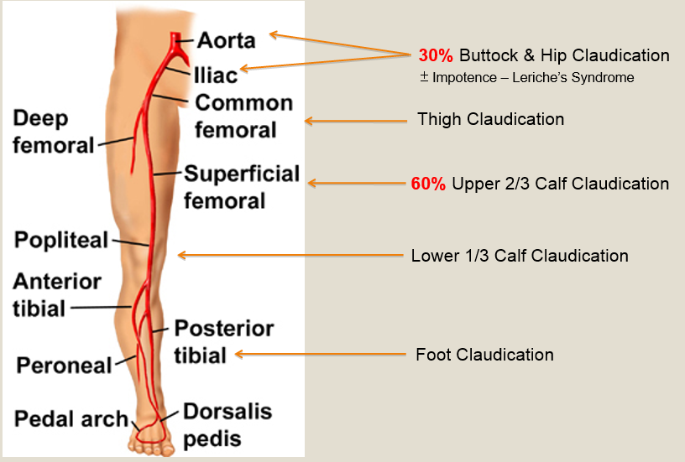

Slide 24
Clinical Features – Critical limb ischemia
Pain at rest in foot, worse at night
Improves with dependent position
Ischemic ulcers
gangrene

Slide 25
Other associated Symptoms & Signs
Impotence
Weakness / decreased mobility
Skin changes
Toe nail changes
Muscle wasting
Leriche’s Syndrome
- Bilateral lower limb
Claudication
- Impotence
- Absent/Diminished
Peripheral Pulses
bilateral lower limbs

Slide 26
Arterial Ulcers
often located on toes or foot
pale and with necrotic floor,
irregular margins
painful
Surrounding ischemic features

Slide 27
Evaluation of PAD
History
Physical Examination
Diagnostic Testing
Non invasive
ABI
Segmental Pressure
Volume Plethysmography
Duplex US
Minimally invasive
CTA
MRA
Invasive
Contrast Angiography

Slide 28
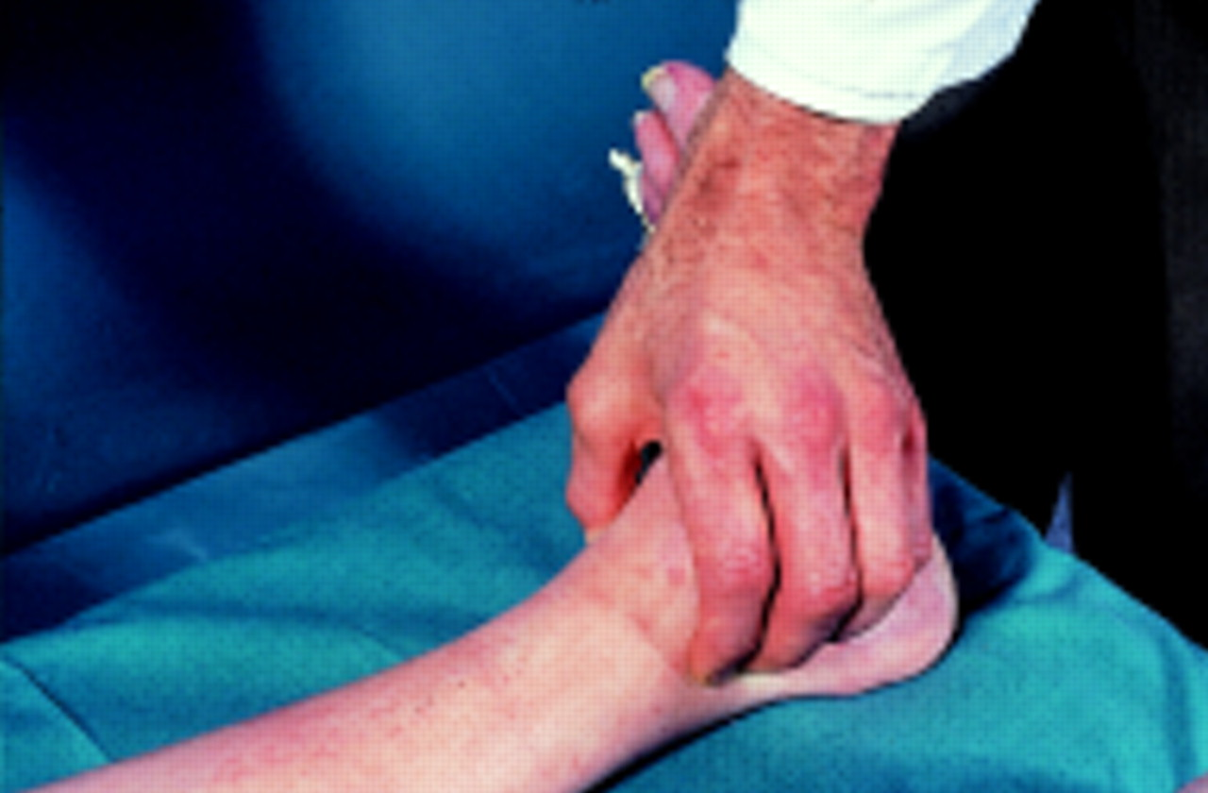
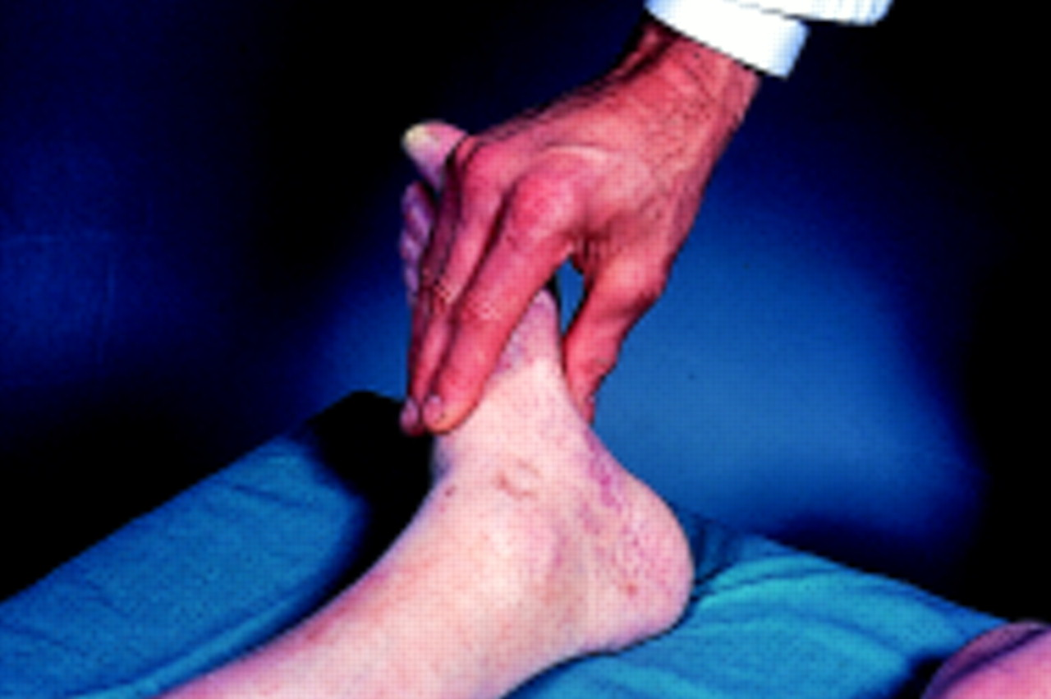
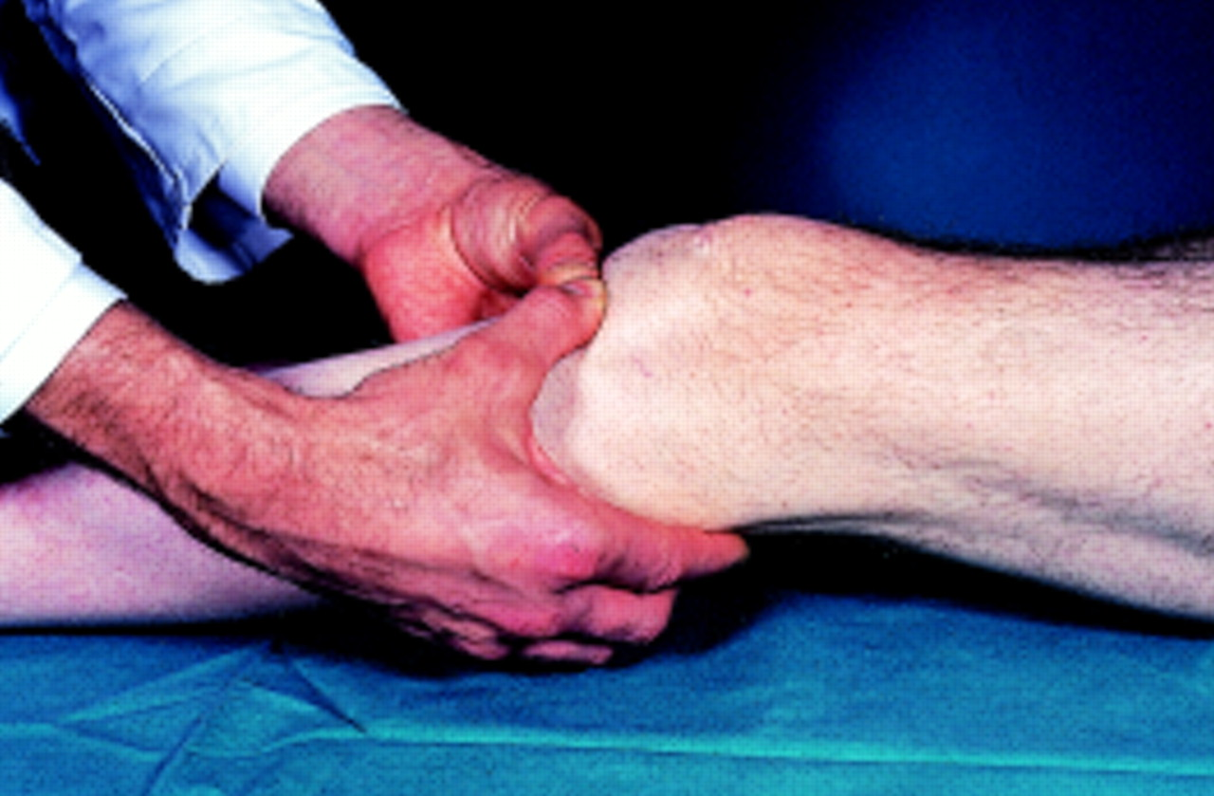
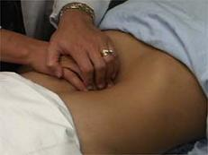
Physical Examination
Inspection
Palpation
Auscultation
Buerger’s test
Pulses

Slide 29
Buerger’s Test
Ischemic Angle
Venous guttering
Venous Refilling
Dependent Rubor
(hyperactive hyperemia)

Slide 30
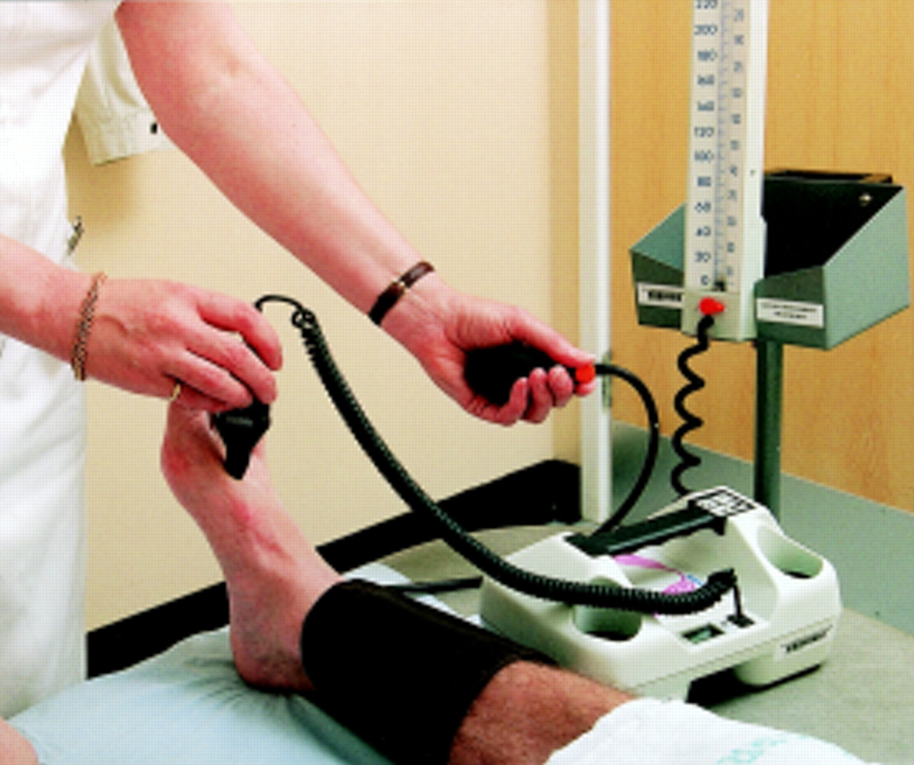
ABI : Ankle Brachial Index & Toe pressure
Ratio of
Higher of the Ankle Systolic pressure ( Dorsalis pedis or Post tibial )
Higher arm systolic pressure (right or left arm)
ABI Clinical Significance
>0.97 Normal (usually 1.1)
0.4-0.8 claudication
0.2-0.4 rest pain
0.1-0.4 ulceration .gangrene
<0.1 Acute ischemia
May need to repeat with exercise
Toe pressure : 2/3 of Systolic pressure

Slide 31
Segmental Doppler pressure & Volume Plethysmography
Segmental Doppler Pressures
Use to determine level & severity of PVD
Doppler cuff placed at proximal & distal thigh, calf & ankle
20 mm of Hg or more reduction in BP between arterial segments of same leg or compared to same level on contralateral leg
Plethysmography
Measures arterial volume changes in the limb segment below the cuff, using a standardized volume of air in the cuff & then measuring pulsatile pressures

Slide 32
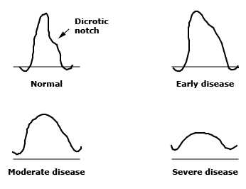
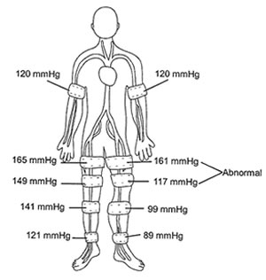
Segmental Doppler pressure & Volume Plethysmography
Variations in the contours of the pulse volume recording with segmental volume plethysmography reflect the severity of peripheral vascular disease. Mild disease is characterized by the absence of a dicrotic notch. With progressive obstruction, the upstroke and downstroke become equal, and with severe disease, the amplitude of the waveform is blunted.

Slide 33
Duplex Ultrasound
Can accurately localize and quantify lesions
Can differentiate between stenosis and occlusions, measure flow velocities in bypass grafts
Requires experienced personnel

Slide 34
Invasive Vascular Investigation
Contrast Angiography
Gold standard
Radiation exposure
Use of Iodinated contrast
Invasive procedure
NOT for diagnostic purposes
Used for planning therapy after decision to intervene has been made
CT angiogram
MRA

Slide 35
Chronic PAD: Treatment
PAD is a marker of diffuse atherosclerosis
PAD identifies a need for risk factor intervention
Claudication is a life style limiting problem
Be aggressive if ischemia is limb threatening
Risk/benefit decision
Anti platelets
Statins
ACE inhibitors

Slide 36
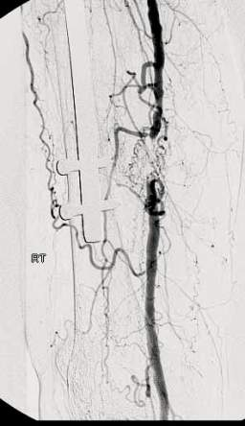
Intermittent Claudication
Generally not limb threatening
Usually represents single level disease
ABI – 0.7
Modify Risk factors - progression to limb threatening ischemia
Exercise:45-60mnts 3xweekly for 12weeks
Risk factor modification especially smoking
Pharmacotherpy? Good in theory, poor in practice
Revascularization indication: intolerable life style limitation in good risk patients

Slide 37
Claudication and smoking
Risk factor for progression to limb threatening ischemia
Shortens walking distance
Cessation will double walking distance

Slide 38
Critical or limb threatening ischemia
Rest pain or tissue loss
Usually multilevel disease aorto-iliac, femoral, popliteal, tibial arteries
ABI typically <0.4
Nearly absolute indication for revascularization

Slide 39
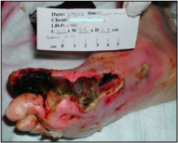
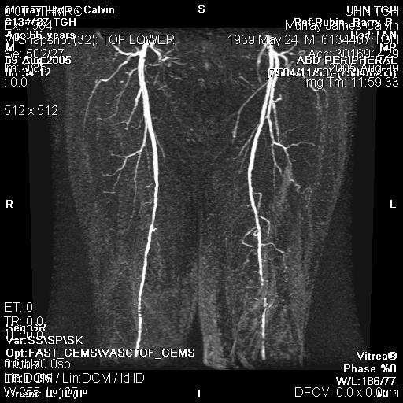
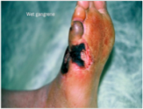
Critical or Limb threatening ischemia

Slide 40
Diabetes and PAD
Risk factor for limb threatening ischemia
Higher likelihood of tibial artery disease
Neuropathy predisposes to foot wounds
Severe deep space foot infections
Wound healing poorer at any given ABI vs non-diabetics
Vascular calcification may artificially elevate ABI
Dismal prospects for limb salvage if combined with renal failure

Slide 41
Lower extremity revascularization endovascular options
Balloon angioplasty /stenting
Most commonly applied to aortoiliac segment
Favorable lesions - short concentric stenosis
Unfavorable lesions- long eccentric stenosis or occlusion
Atherectomy rarely

Slide 42
Lower extremity revascularization surgical option

Slide 44
Lower extremity PAD (ABI) is a marker for heavy systemic atherosclerotic disease burden – treat risk factors
Primary treatment for claudication - exercise, stop smoking
Limb threatening ischemia - revascularization

Slide 45
Carotid Artery Disease

Slide 46
Carotid Artery Disease
Clinical Presentation:
Asymptomatic
Symptomatic
Amaurosis Fugax
TIA – Transient Ischemic Attacks
Stroke

Slide 47
Carotid Artery Disease
Investigations :
Non invasive :
Carotid Duplex
Minimally Invasive:
CT
MRI
Invasive:
Carotid Angiogram

Slide 48
Carotid Artery Disease
Management :
Symptomatic :
<50-60% Stenosis – Risk factor modification & Best Medical treatment
60-70% stenosis & above – Carotid Endarterectomy
Carotid Stenting

Slide 49
Definition
Acute Limb Ischemia (ALI) is sudden decrease in limb perfusion causing a potential threat to limb viability.
Presentation is normally up to 2weeks following the acute event.

Slide 50
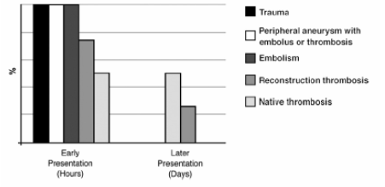
Timing of presentation

Slide 51
Pathophysiology
Nerves : are most sensitive ischemia
Skin & Bone : relatively resistant to ischemia
Muscle : major structural component of extremity, local and systemic manifestations of ischemia –reperfusion injury.
Critical Tissue Ischemic times
Muscle – 4hrs
Nerve - 8hrs
Fat - 13hrs
Skin - 24hrs
Bone - 4days

Slide 52
Pathophysiology
Acute Arterial Occlusion
Sudden decrease blood supply
Functional change Anatomical change
Circulation Skin
Peripheral nerve Muscle

Slide 53
History
Leg symptoms in ALI relate to Pain or Function
Duration and intensity of Pain and presence of Motor or Sensory changes
Previous H/O PVD – claudication, Aneurysm or Heart disease and atherosclerotic risk factor

Slide 54
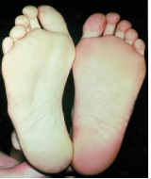
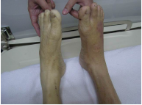
Physical Examination
6 Ps :
Pain
Pallor
Pulselesness
Paresthesia
Paralysis
Poikilothermia

Slide 55
Investigations
Basic Laboratories
Doppler US
Duplex US
CTA
MRA
Angiography

Slide 56
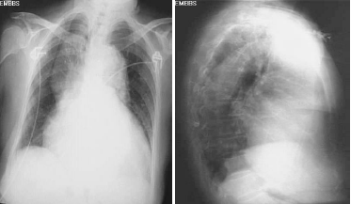
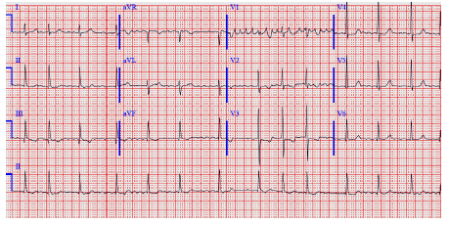
CXR & ECG

Slide 57
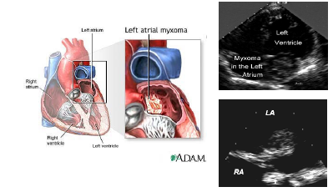
Echocardiography

Slide 58
ABI : Ankle Brachial Index
Ratio of
Higher of the Ankle Systolic pressure ( Dorsalis pedis or Post tibial )
Higher arm systolic pressure (right or left arm)
ABI Clinical Significance
>0.97 Normal (usually 1.1)
0.4-0.8 claudication
0.2-0.4 rest pain
0.1-0.4 ulceration .gangrene
<0.1 Acute ischemia

Slide 59
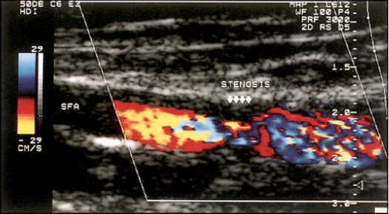
Duplex US

Slide 60
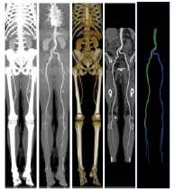
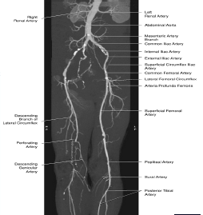
CTA

Slide 61
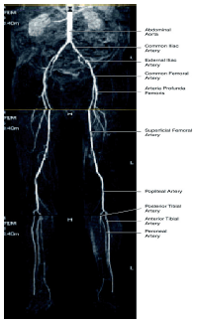
MRA

Slide 62
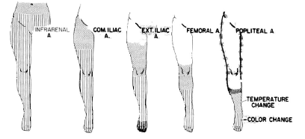
Site of occlusion
Peripheral pulse – Area of pain – Area of ischemia

Slide 63
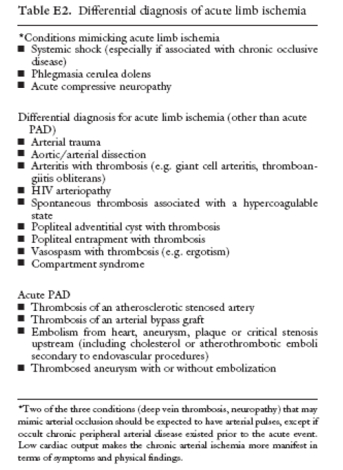

Slide 64
Etiology
Arterial embolism
Acute arterial thrombosis
Arterial injury
Acute arterial dissection

Slide 65
Arterial Embolism
Embolic occlusion of a previously unobstructed vessel generally results in the most severe forms of acute ischemia
Suspected in patients with
acute onset , no intermittent claudication
risk of embolism
unilateral abnormal finding

Slide 66
Source of Emboli
Cardiogenic 80%
Atrial Fibrillation 50%
Myocardial infarction 25%
other 5%
Non Cardiac 10%
Aneurysmal disease 6%
Proximal artery Atheroma 3%
Paradoxical emboli 1%
Other or idiopathic 10%

Slide 67
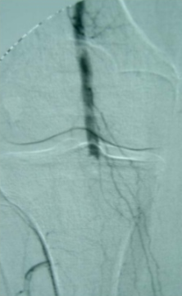
Arteriographic findings
meniscus sign
lack of collaterals
absence of atherosclerosis

Slide 69
Acute Arterial Thrombosis
Generally occurs in vessels affected by pre existent atherosclerosis
Ischemia is often less severe than with acute embolism
Location of occlusion may play a role in the severity of limb ischemia

Slide 71
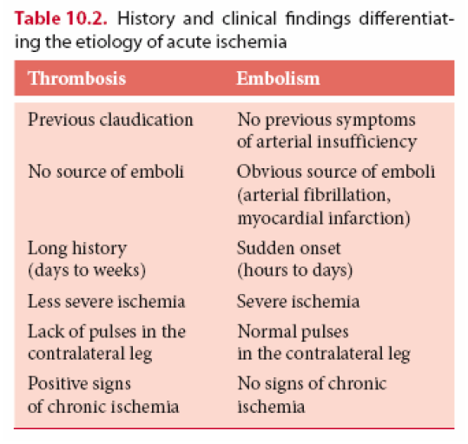

Slide 72
Acute Embolism
Acute Thrombosis

Slide 73
Aortic Dissection

Slide 74
Thoraco abdominal dissection
MRA reveals dissection flap extending below the renal artery

Slide 75
Severity of Ischemia
Reversible
Mild : pain, pallor, poikilothermia
Moderate : paresthesia, paresis
Severe : analgesia, paralysis, muscle tenderness
Irreversible
Fixed staining skin, muscle rigor

Slide 76
Severity of Ischemia

Slide 77
Management
Systemic Anticoagulation
Revascularization
Surgical Revascularization
Endovascular
Thrombolysis
Percutaneous Mechanical Thrombectomy

Slide 78
Systemic Anticoagulation
Goals of Anticoagulation
Decrease risk of thrombus propagation
prevent recurrent embolization
Unfractionated heparin
Bolus dose 80 units /kg
continuous infusion 18 units /kg/hr
Immediate after diagnosis
blood investigation and sampling before start
hold only if early angiography available

Slide 79
Revascularization
Surgical revascularization
Endovascular procedures
Thrombolytic therapy – Cather directed thrombolytic therapy
(CDT)
Percutaneous mechanical thrombectomy

Slide 80
Comparison: Surgery & Endovascular Procedures
3 RCT studies : Rochester, STILE, TOPAS
Limits by different in protocol and case mix
Only Rochester show advantage of CDT in event free survival but
late end points favor surgery
Underlying Vascular Disease in CDT group mostly treated
with endovascular
PTA is not durable as bypass except for discrete lesions only

Slide 81
Advantage of CDT over Surgery
Reduced mortality rate
Less complex surgical procedure
lower pressure reperfusion
further defined underlying lesions by angiography
Disadvantage of CDT
high risk of persistent /recurrent ischemia
Risk of amputation

Slide 82
In Class 1, 11a CDT offer lower risk opportunity for arterial revascularization
Potentially to follow by surgery as needed

Slide 83
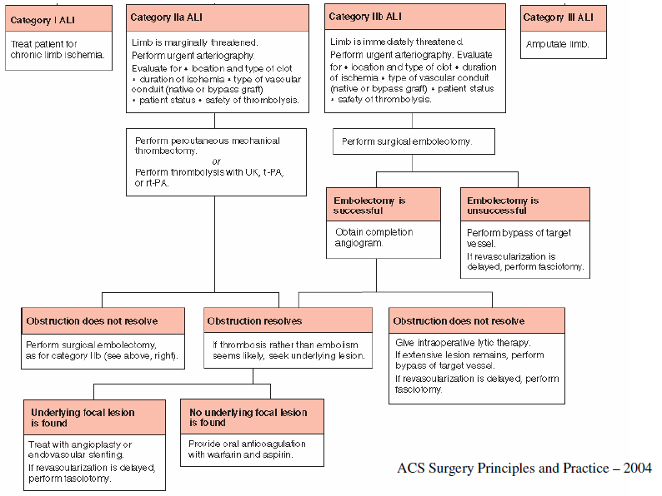

Slide 84
Immediate revascularization is indicated for
Class 11b
Pt. with rapid sensory and motor deficits
Treatment of ischemic have priority over complex and time consuming investigations

Slide 85
Surgical Revascularization
Ideal treatment for arterial embolism
Rapid diagnosis
identified source of emboli
rapid systemic coagulant
surgical embolectomy
Embolectomy
timely operation is the goal
preoperative preparation should be minimal

Slide 87
Groin incision
Landmark : midpoint from Pubic Symphysis to ASIS

Slide 93
Technical consideration

Slide 94
Technical Consideration
Goals : Inflow Vessel
Forceful Pulsatile Blood flow

Slide 95
Out Flow Vessel
Several passes until no further thrombus is extracted
Avoid forceful attempt to pass catheter
Always examine extracted thrombus

Slide 96
Heparinized saline infusion after embolectomy
Assess adequacy of revascularization
completion angiography
clinical examination
ABI/PVR
intravascular Us
Additional step if incomplete removal
intra-operative thrombolysis

Slide 97
Thrombolysis
No role of systemic thrombolysis
Catheter directed thrombolysis
less invasive
reduced mortality
Initial treatment of choice for class 1 and class11a
Advantages :
reduced risk of endothelial trauma
clot lysis in small branch vessels
gradual low pressure perfusion

Slide 98
Technique in Thrombolysis
Perform angiography
Access from remote to interventional site
Pass guide wire through clot
Place multiple side hole catheter
Infuse lytic agent
Serial follow up angiograms
If no progress perform surgical intervention
Success
ful thrombolysis follow by treatment of any underlying lesion

Slide 99
Thrombolytic agents
Streptokinase
Urokinase
Tissue plasminogen activator (TPA)

Slide 100
Contraindication to thrombolysis
Absolute
CVA (include TIA) with in 2months
active bleeding diathesis
recurrent GI bleed with in 10 days
Neurosurgery with in 3months
intracranial trauma with in 3 months

Slide 101
Contraindication to thrombolysis
Relative
CPR with in 10 days
Major non vascular surgery or trauma with in 10 days
Uncontrolled HTN ( Systolic BP>180, Diastolic BP>110)
Intracranial Tumor
Recent Eye Surgery

Slide 102
Contraindication to thrombolysis
Minor
Hepatic Failure
Bacterial Endocarditis
Pregnancy
Active diabetic proliferative retinopathy

Slide 103
Percutaneous Mechanical Thrombectomy
Percutaneous Aspiration Thrombectomy
Percutaneous Mechanical Thrombectomy
Combination with CDT
Speed up clot lysis
Reduces dose of thrombolysis

Slide 104
Management of graft thrombosis
At least one attempt to salvage graft should be done
Goal in graft thrombosis treatment
Remove clot
correct underlying lesion that caused thrombosis
Cause of thrombosis
progress of atherosclerosis of inflow/outflow artery
lesion intrinsic to graft
venous graft stenosis, intimal hyperplasia in prosthetic graft

Slide 105
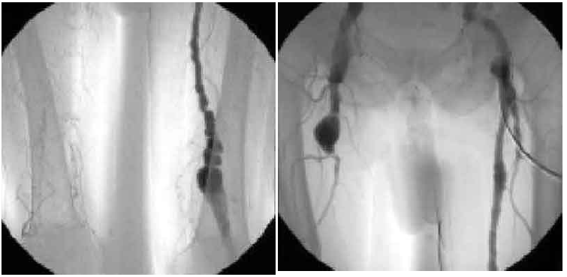
Management of thrombosed Aneurysm
Initial arteriography

Slide 106
Management of thrombosed aneurysm
If distal target vessel patent and present
treat with bypass graft
If no distal vessel run off
Regional thrombolysis
Identified run off in 90% of cases and successful revascularization

Slide 107
Amputation
Incidence of major amputation up to 25%
10% irreversible ischemia
10-15% amputation after revascularization

Slide 108
Ischemia Reperfusion Syndrome
Triad :
Hyperkalemia, Metabolic Acidosis and Myoglobinuria
Pathophysiology
increase capillary permeability
local edema and compartment hypertension
( Compartment Syndrome )
regional venule obstruction and nerve dysfunction
capillary and arteriolar obstruction
muscle and nerve infarction

Slide 109
Compartment syndrome
Clinical presentation
pain out of proportion
paresthesia
edema
Compartment pressure >20mmHg
clear indication of fasciotomy

Slide 110
Compartment syndrome

Slide 111
Compartment syndrome

Slide 112
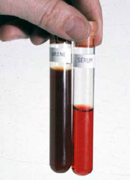
Rabdomyolysis
Pathophysiology
tubular necrosis by myoglobulin precipitate
tubular necrosis due to lipid peroxidation and
renal vasoconstriction
Clinical Features
Tea colored urine
Elevated serum creatinine
positive myoglobin assay

Slide 113
Rhabdomyolysis
Therapy
primarily hydration
alkalinizing urine
eliminate source of myoglobin

Slide 114
Aneurysms
Aneurysmal arterial dilatation – an increase in vessel diameter >50% in relation to adjacent normal arterial segment.
For practical purpose in case of infra renal abdominal aorta a measurement of >3cms in axial diameter is diagnostic of AAA
Normal infra renal aortic diameters
Males – 2-2.4cms
Female – 1.6-2.2cms

Slide 115
Distribution of Aneurysms
Aorta – 90-95%
Peripheral
popliteal
Femoral
Visceral
splenic artery
Prevalence
AAA of >3cms – 5-8.4%
lower in females – 1.5%
Disease of western nations
Extremely rare in Asian population – Genetic cause

Slide 116
Types of Aneurysms
True Aneurysms
Involving all the tree layers of
the arterial wall

Slide 117
False Aneurysm
Disruption of arterial wall with presence of blood flow out side of normal layers of arterial wall.
Wall of false aneurysm is composed of compressed surrounding tissue

Slide 118
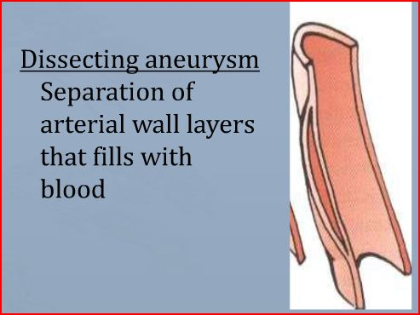

Slide 119
Etiology
Degenerative
Complex process
Involves some degree of
Calcification
Atherosclerosis pathology
Degenarative - Matrix Metallo Proteins (MMPs)
Disease process a complex process with strong possibility of genetic and environmental interaction
Inflammatory
Thick inflammatory wall with fibrotic process in retroperitoneum
Associated with other inflammtory conditions
takayasu’s disease
Giant cell arteritis
PAN, Behcet’s disease

Slide 120
Infection
primary
secondary
Congenital
Tuberous Sclerosis
Marfans & Ehler Danlos
Aortic Coarctation
Post Dissection
Traumatic – false aneurysms

Slide 121
Risk Factors
Old age 65yrs+
Male : Female 4:1
White race
Positive family history
Smoking
HTn
Hyperlipidemia
PAD & CAD

Slide 122
AAA sequele
Natural history
Gradual or sporadic expansion
Growth rate of 0.3 – 0.5 cms /yr
Complications
Rupture
Throboembolic events
Compression of adjacent structures

Slide 123
Risk of Rupture depends upon Size
<5cm - <5%/yr
5-6cm – 10%/yr
6-7cm – 15-20%/yr
>7cm - .20%/yr
Risk of death from aneurysm surgery -5%

Slide 124
AAA Presentation
Asymptomatic – incidental finding on physical examn or radiological Test
Symptomatic – Abdominal or back pain (due to leak or rapid expansion)
Rupture – 35% intial presentation, triad of abdominal / back pain, hypotension, pulsatile mass

Slide 125
AAA Detection
Physical examination – not sensitive
48% were diagnosed clinically
Physical examination missed 38% of cases diagnosed radiologically

Slide 126
Ultrasound
Highly sensitive and specific
Used for screening, diagnoses and monitor AAA until it reaches a size when repair is considered

Slide 127
CT sensitive and specific
Used for pre operative assessment of AAA

Slide 128
Angiogram – not reliable
False negative - normal lumen size due to thrombus formation

Slide 129
Medical Management of AAA
Smoking Cessation
Exercise therapy
B-blockers - < rate of expansion
ACE inhibitors < rupture rate
Doxycycline – against chlamydia & suppress expression of MMPs
Statins - < expansion and MMPs in aortic wall

Slide 130
Indications for surgery
Risk of rupture > surgical risk
Size >5cms in female
>5.5cms in male
Symptomatic
Ruptured
Rapid expansion >5mm in 6months
Observation with US every 6 months if asymptomatic and < 5cms
Contraindications – life expectancy <1yr, terminal disease, significant co-morbidities, advanced age and severe dementia.

Slide 131
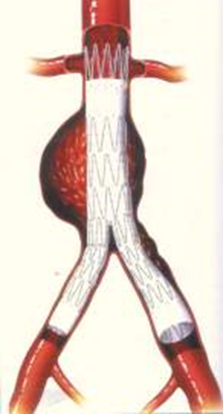
Treatment - Surgical
Surgical options
Open surgery with graft replacement
Endovascular aneurysm repair
Mortality
elective open repair – 5%
EVAR – 1%

Slide 132
Rupture AAA
Emergency
Clinical diagnosis – classic diagnostic triad- 50%
sudden onset back pain
shock
pulsatile mass
US in emergency or CT if stable
ABC – Cross match
Emergency repair
100% mortality if untreated
OR mortality rate 50%
Total mortality - 905

