Slide 1
Epidemiology of Diabetes mellitus
Dr Armen Torchyan, Dr. Hafsa Raheel
Prof Ashry Gad
Department of Family & Community Medicine
King Saud University

Slide 2
Learning Objectives
At the end of the presentation the students should be able to ;
Understand Global prevalence of diabetes
Understand the Epidemiology of diabetes in KSA
List the risk factors of diabetes
List complications of diabetes
Discuss preventive measures within the framework of NCDs
Know preventive programs in KSA towards DM

Slide 3
Diabetes Mellitus
Definition
A metabolic disorder of multiple aetiology characterized by chronic hyperglycaemia with disturbances of carbohydrate, fat and protein metabolism resulting from defects in insulin secretion, insulin action or both.

Slide 4
Main types of diabetes
Type 1 (5-10%) – due to autoimmune b-cell destruction, usually leading to absolute insulin deficiency. Usually affects younger age group (not always)
Type 2 (90 - 95%) – due to a progressive loss of β-cell insulin secretion frequently on the background of insulin resistance. Usually older age group (not always).
Gestational diabetes - diabetes diagnosed in the second or third trimester of pregnancy that was not clearly overt diabetes prior to gestation
Specific types of diabetes due to other causes - e.g., neonatal, maturity-onset diabetes of the young, diseases of the exocrine pancreas, drug- or chemical-induced diabetes.
Impaired glucose tolerance (IGT) and impaired fasting glycaemia (IFG) - intermediate conditions in the transition between normal blood glucose levels and diabetes (especially type 2).

Slide 5
Symptoms
Increase frequency of Urine (pee)
Specially nocturnal
Increase thirst
Weight loss
Increase appetite
Blurred vision
Tingling hands and feet
Easy fatigability
Dry skin
Slow healing wounds
CDC, 2018

Slide 6
Diabetes
Fasting plasma glucose 2-h plasma glucose* HbA1c | ≥ 7.0 mmol/L (126 mg/dl) or ≥ 11.1 mmol/L (200 mg/dl) or ≥ 6.5%
Impaired glucose tolerance (IGT)
Fasting plasma glucose 2-h plasma glucose* | <7.0 mmol/L (126 mg/dl) and ≥ 7.8 and <11.1 mmol/L (140 mg/dl and 200 mg/dl)
Impaired fasting glucose (IFG)
Fasting plasma glucose 2-h plasma glucose* | 6.1 to 6.9 mmol/L (110 mg/dl to 125 mg/dl) and (if measured) <7.8 mmol/L (140 mg/dl)
Gestational diabetes (GDM)
One or more of the following: Fasting plasma glucose 1-h plasma glucose** 2-h plasma glucose | 5.1–6.9 mmol/L (92–125 mgl/dl) ≥ 10.0 mmol/L (180 mg/dl) 8.5–11.0 mmol/L (153–199 mg/dl)
Venous plasma glucose 2 hours after ingestion of 75 g oral glucose load ** Venous plasma glucose 1 hour after ingestion of 75 g oral glucose load

Slide 7
Key facts
The number of people with diabetes has risen from 108 million in 1980 to 422 million in 2014.
The global prevalence of diabetes* among adults over 18 years of age has risen from 4.7% in 1980 to 8.5% in 2014.
Diabetes prevalence has been rising more rapidly in middle- and low-income countries.
Diabetes is a major cause of blindness, kidney failure, heart attacks, stroke and lower limb amputation.
In 2015, an estimated 1.6 million deaths were directly caused by diabetes. Another 2.2 million deaths were attributable to high blood glucose in 2012**.
Almost half of all deaths attributable to high blood glucose occur before the age of 70 years. WHO projects that diabetes will be the seventh leading cause of death in 2030.
Healthy diet, regular physical activity, maintaining a normal body weight and avoiding tobacco use are ways to prevent or delay the onset of type 2 diabetes.
Diabetes can be treated and its consequences avoided or delayed with diet, physical activity, medication and regular screening and treatment for complications.
* Defined as FBG ≥ 7 mmol/L, or on medication for raised blood glucose, or with a history of diagnosis of diabetes.
** High blood glucose is defined as a distribution of FBG in a population that is higher than the theoretical distribution that would minimize
risks to health (derived from epidemiological studies). High blood glucose is a statistical concept, not a clinical or diagnostic category

Slide 8
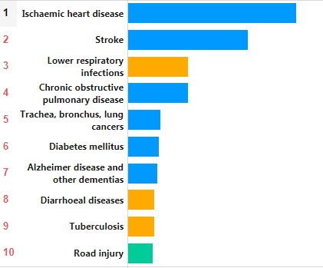
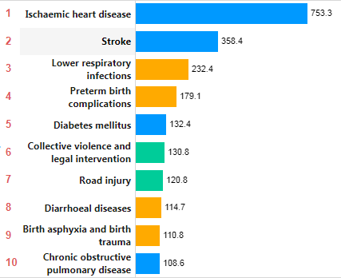
Top 10 causes of death
World, 2015
EMRO, 2015
Crude death rates (per 100,000)
Global Health Observatory (GHO) data

Slide 9
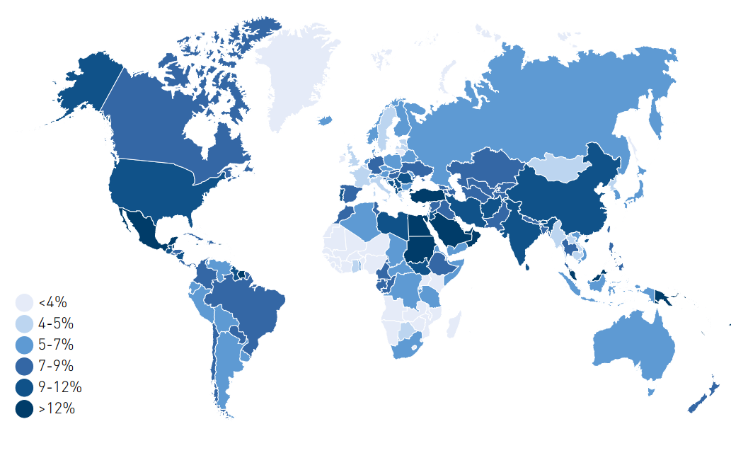
Estimated age-adjusted prevalence of diabetes in adults (20-79 years), 2017
Source: IDF 2017

Slide 10
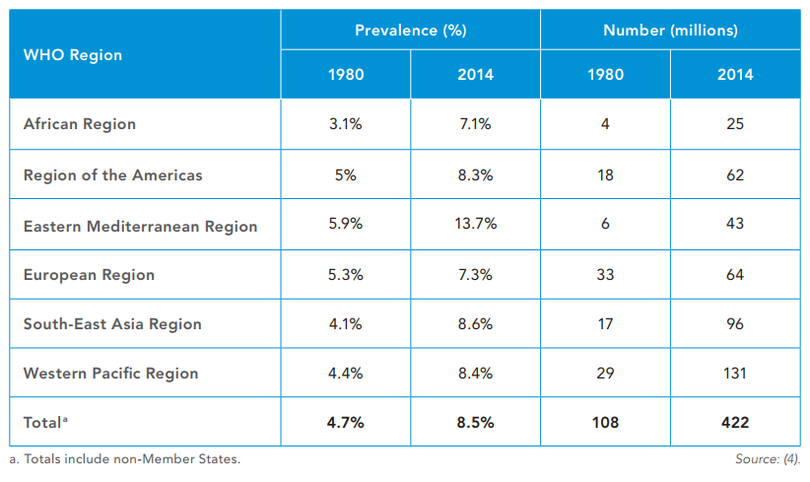
Estimated prevalence and number of people with diabetes (adults 18+ years)
Source, WHO 2016

Slide 11
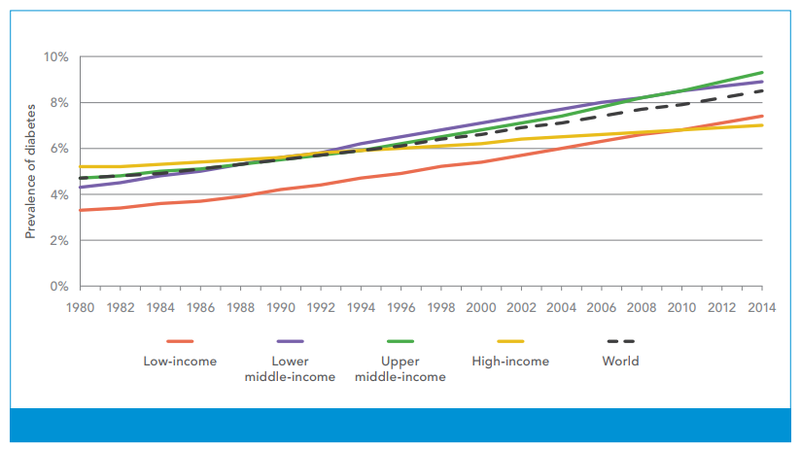
Trends in prevalence of diabetes, 1980–2014, by country income group
Source, WHO 2016

Slide 12
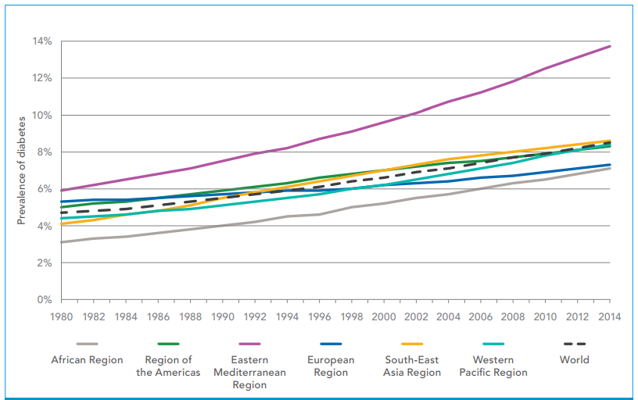
Trends in prevalence of diabetes, 1980–2014, by WHO region
Source, WHO 2016

Slide 13
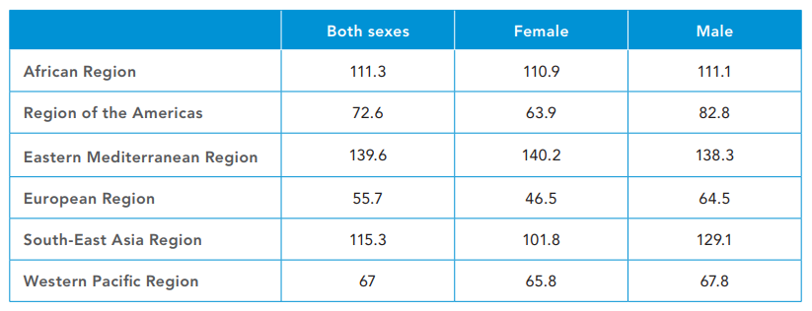
High blood glucose age-standardized mortality rates per 100000 by WHO region, age 20+, 2012
Source, WHO 2016

Slide 14
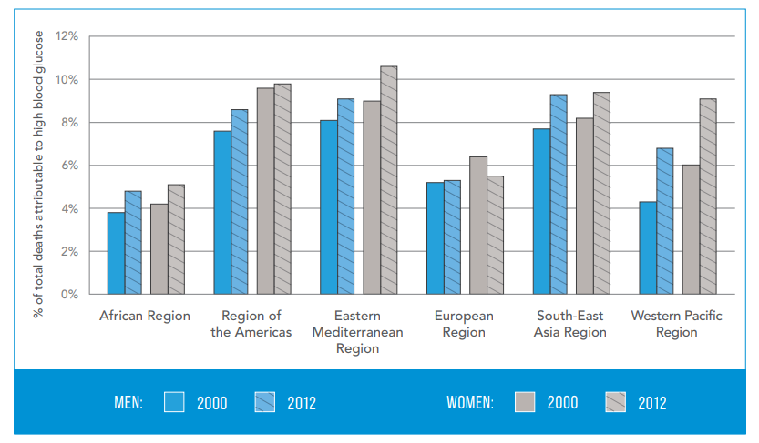
Percentage of all deaths attributable to high blood glucose for adults aged 20–69 years, by WHO region and sex, 2000 and 2012
Source, WHO 2016

Slide 15
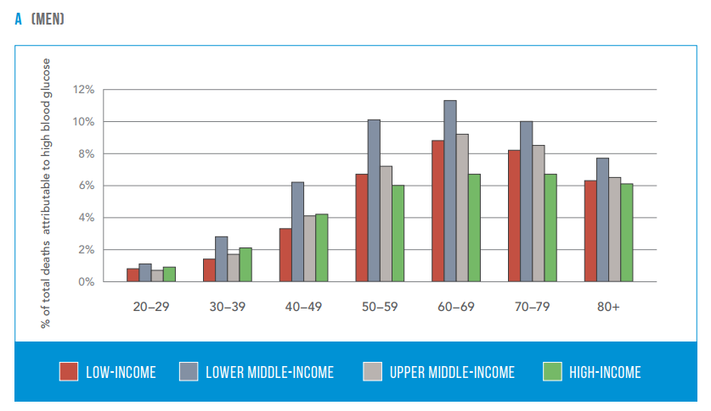
Percentage of all-cause deaths globally attributed to high blood glucose in men, 2012
Source, WHO 2016

Slide 16
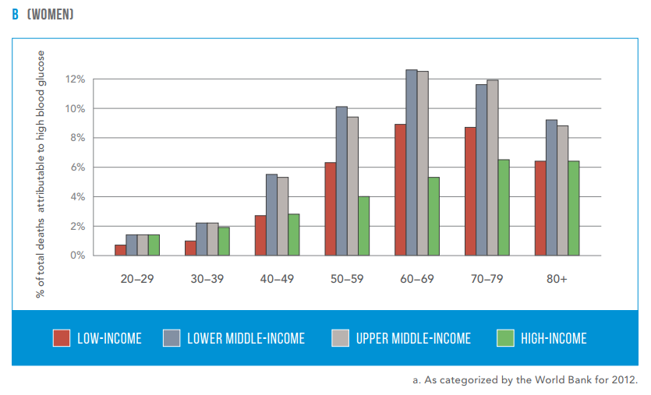
Percentage of all-cause deaths globally attributed to high blood glucose in women, 2012
Source, WHO 2016

Slide 17
Diabetes prevalence (% of population ages 20 to 79)
Rank | Country | % | Year
1 | Tuvalu | 27.25 | 2017
2 | Nauru | 24.07 | 2017
3 | New Caledonia | 23.36 | 2017
4 | Kiribati | 22.66 | 2017
5 | Mauritius | 22.02 | 2017
6 | Solomon Islands | 18.68 | 2017
7 | Saudi Arabia | 17.72 | 2017
8 | Papua New Guinea | 17.65 | 2017
9 | Egypt | 17.31 | 2017
10 | United Arab Emirates | 17.26 | 2017

Slide 18
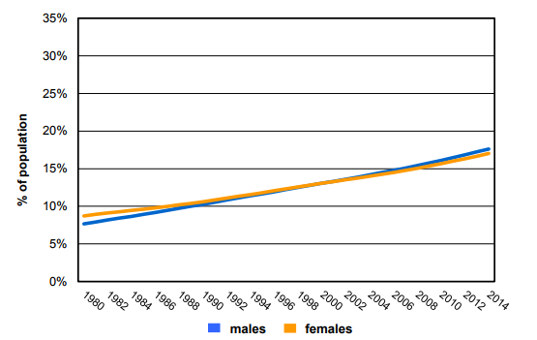
Trends in age-standardized prevalence of diabetes in Saudi Arabia
WHO Diabetes country profiles, 2016.

Slide 19
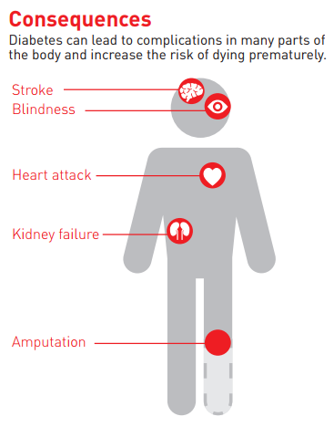
Common diabetes complications
Loss of vision
End-stage renal disease
Cardiovascular events
Lower extremity amputations
Source, WHO 2016

Slide 20
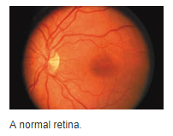
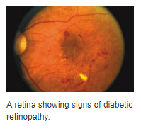
Loss of vision
Diabetic retinopathy caused 1.9% of moderate or severe visual impairment globally and 2.6% of blindness in 2010.
Studies suggest that prevalence of any retinopathy in persons with diabetes is 35% while proliferative (vision-threatening) retinopathy is 7%.
However, retinopathy rates are higher among: people with type 1 diabetes; people with longer duration of diabetes; Caucasian populations; and possibly among people of lower socioeconomic status
Source, WHO 2016
Source, AAO 2018

Slide 21
End-stage renal disease
Pooled data from 54 countries show that at least 80% of cases of end-stage renal disease (ESRD) are caused by diabetes, hypertension or a combination of the two.
The proportion of ESRD attributable to diabetes alone ranges from 12–55%.
The incidence of ESRD is up to 10 times as high in adults with diabetes as those without.

Slide 22
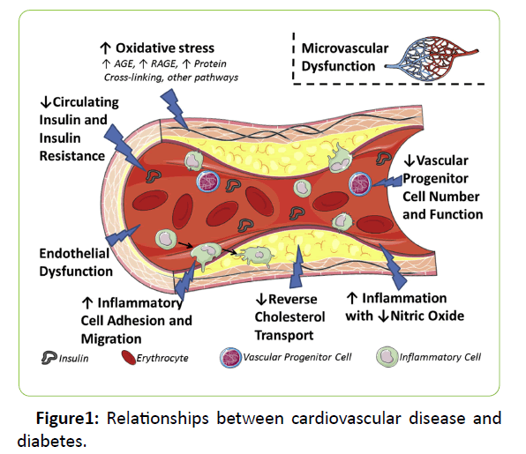
Cardiovascular events
Adults with diabetes historically have 2-3 times higher rate of cardiovascular disease (CVD) than adults without diabetes.
The risk of cardiovascular disease increases continuously with rising fasting plasma glucose levels, even before reaching levels sufficient for a diabetes diagnosis.
Almost 7 in 10 people with diabetes over age 65 will die of some type of heart disease. About 1 in 6 will die of stroke.
Source, iMedpub

Slide 23
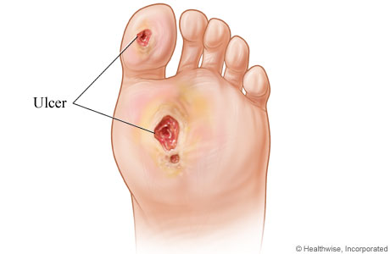
Lower extremity amputations
Diabetes appears to dramatically increase the risk of lower extremity amputation because of infected, non-healing foot ulcers.
Rates of amputation in populations with diagnosed diabetes are typically 10 to 20 times those of nondiabetic populations.
Encouragingly several studies show a 40% to 60% reduction in rates of amputations among adults with diabetes during the past 10–15 years in western countries.

Slide 24
Risk factors

Slide 25
Genetic factors
May play a part in development of all types; autoimmune disease and viral infections may be risk factors in Type I DM.
Twin studies

Slide 26
Family history
Compared with individuals without a family history of type 2 diabetes, individuals with a family history in any first degree relative have a two to three-fold increased risk of developing diabetes.
The risk of type 2 diabetes is higher (five- to six fold) in those with both a maternal and paternal history of type 2 diabetes .
The risk is likely mediated through genetic, anthropometric (body mass index, waist circumference), and lifestyle (diet, physical activity, smoking) factors.

Slide 27
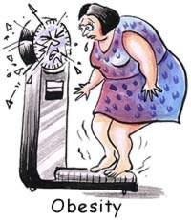
Obesity
Contributes to the resistance to endogenous insulin.
RR risk of DM in females (ref. BMI < 22)
22-23 3.0
24-25 5.0
> 31 40.0
(Colditz & al, Ann Int Med, 1995, 122; 481-6)

Slide 28
The risk of impaired glucose tolerance (IGT) or type 2 diabetes rises with increasing body weight.
The Nurses’ Health Study demonstrated an approximately 100-fold increased risk of incident diabetes over 14 years in nurses whose baseline body mass index was >35 kg/m2 compared with those with BMI <22 .
The risk of diabetes associated with body weight appears to be modified by age.
Obesity acts at least in part by inducing resistance to insulin-mediated peripheral glucose uptake, which is an important component of type 2 diabetes

Slide 29
Fat distribution
The distribution of excess adipose tissue is another important determinant of the risk of insulin resistance and type 2 diabetes.
The incidence of type 2 diabetes are highest in those subjects with central or abdominal obesity, as measured by waist circumference or waist-to-hip circumference ratio.
Intra-abdominal (visceral) fat rather than subcutaneous or retroperitoneal fat appears to be of primary importance.

Slide 30
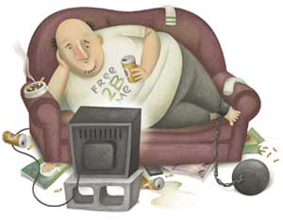
Physical inactivity.
Prolonged TV watching is associated with a significantly increased risk of type 2 diabetes. Men who watched TV more than 40 h per week had a nearly threefold increase in the risk of type 2 diabetes compared with those who spent less than 1 h per week watching TV.

Slide 31
Diet

Slide 32
A number of dietary factors have been linked to an increased risk of type 1 diabetes, such as low vitamin D consumption; early exposure to cow's milk or cow's milk formula; or exposure to cereals before 4 months of age. However, none of these factors has been shown to cause type 1 diabetes.
Consumption of red meat, processed meat, and sugar sweetened beverages is associated with an increased risk of diabetes
Fruits, vegetables, nuts, whole grains, and olive oil is associated with a reduced risk.
It is important to recognize that most studies have used food frequency questionnaires to capture dietary patterns and that none of the food stuffs examined can be considered in isolation. For example, higher meat intake always means more saturated fat intake, relatively lower fruit and vegetable intake, and frequently, higher BMI (body mass index).

Slide 33
Smoking
Several large prospective studies have raised the possibility that cigarette smoking increases the risk of type 2 diabetes. In a meta-analysis of 25 prospective cohort studies, current smokers had an increased risk of developing type 2 diabetes compared with nonsmokers (pooled adjusted RR 1.4, 95% CI 1.3-1.6).
A definitive causal association has not been established, a relationship between cigarette smoking and diabetes mellitus is biologically possible based upon a number of observations:
Smoking increases the blood glucose concentration after an oral glucose challenge.
Smoking may impair insulin sensitivity.
Cigarette smoking has been linked to increased abdominal fat distribution and greater waist-to-hip ratio that may have an impact upon glucose tolerance.

Slide 34
Infections
A range of relatively rare infections and illnesses can damage the pancreas and cause type 1 diabetes.

Slide 35
Pregnancy
Pregnancy causes weight gain and increases levels of estrogen and placental hormones, which antagonize insulin.

Slide 36
Medications
Drugs that are known to antagonize the effects of insulin:
Thiazide diuretics,
Adrenal corticosteroids,
Oral contraceptives.

Slide 37
Physiologic or emotional stress
Causes prolonged elevation of stress hormone levels (cortisol, epinephrine, glucagon and growth hormone), which raises blood glucose levels, placing increased demands on the pancreas.

Slide 38
Prevention

Slide 39
Prevention
Type 2 diabetes is largely preventable.
Multisectoral, population-based approaches are needed to reduce the prevalence of modifiable diabetes risk factors – such as overweight, obesity, physical inactivity and unhealthy diet – in the general population.
A combination of fiscal policies, legislation, changes to the environment and raising awareness of health risks works best for promoting healthier diets and physical activity.
Diabetes can be delayed or prevented in people who are overweight and have impaired glucose tolerance (IGT). Diet and physical activity interventions are more effective than medication.

Slide 40
Prevention – type 2 diabetes
Not modifiable factors
Genetics
Ethnicity
Age
Modifiable factors
being overweight or obese
unhealthy diet
insufficient physical activity
smoking

Slide 41
HEALTHY DIET AND PHYSICAL ACTIVITY
Saturated fatty acid intake - less than 10% of total energy intake (and for high risk groups, less than 7%);
Dietary fibre - minimum daily intake of 20 g through regular consumption of wholegrain cereals, legumes, fruits and vegetables.
Free sugars - less than 10% of total energy intake
Further reduction to 5% could have additional health benefits
Children and youth aged 5–17 - at least 60 minutes of moderate- to vigorous-intensity physical activity daily.
Adults aged 18–64 - at least 150 minutes of moderate-intensity aerobic physical activity (for example brisk walking, jogging, gardening) spread throughout the week, or at least 75 minutes of vigorous-intensity aerobic physical activity throughout the week, or an equivalent combination of moderate- and vigorous-intensity activity.
Older adults - the same amount of physical activity, but should also include balance and muscle strengthening activity tailored to their ability and circumstances.

Slide 42
Prevention – type 2 diabetes
Population-based prevention
A life-course approach to preventing diabetes
Improving early childhood nutrition
Supportive environments for physical activity
Settings-based interventions
Fiscal, legislative and regulatory measures for healthy diet
Education, social marketing and mobilization
Preventing diabetes in people at high risk
Intensive behavioral interventions for people with IGT
Pharmacological interventions for people with IGT

Slide 43
A life-course approach
Taking a life-course perspective is essential for type 2 diabetes prevention.
Early in life, when eating and physical activity habits are formed and when the long-term regulation of energy balance may be programmed, there is a critical window for intervention to mitigate the risk of obesity and type 2 diabetes later in life.
Recognize the increasing risk that comes with advancing age, and the need to identify the unique needs for risk reduction in older adults.

Slide 44
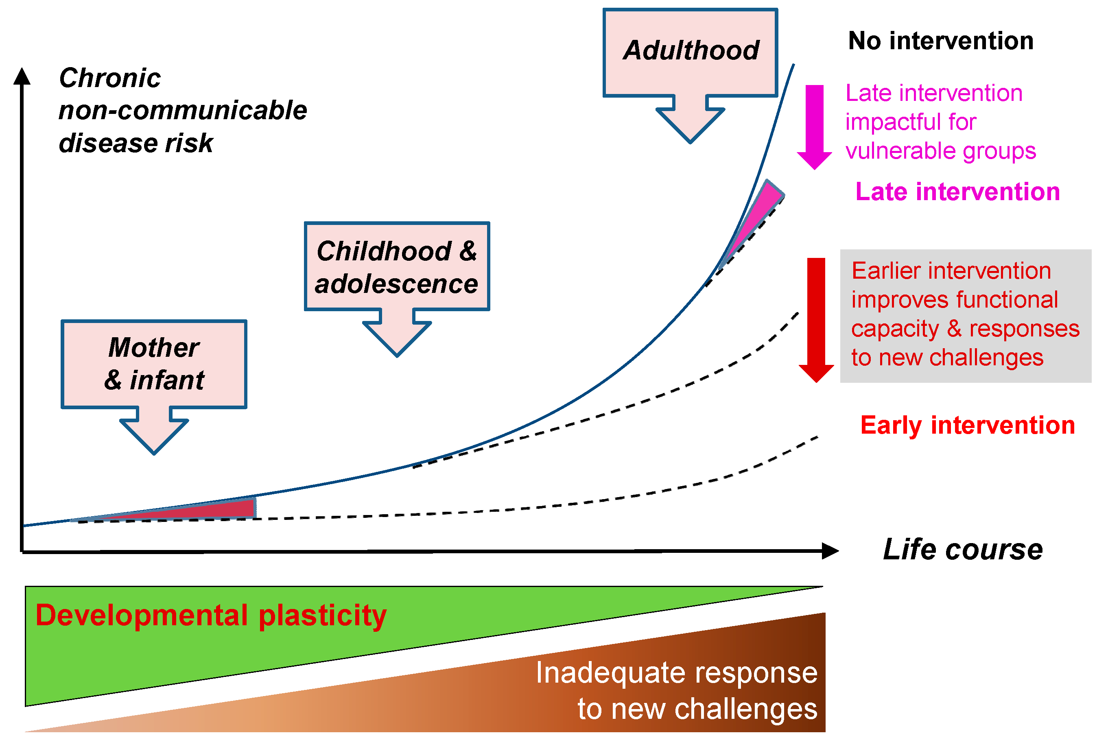
Baird et al, 2017

Slide 45
Improving early childhood nutrition
Strategies to improve early childhood nutrition aimed at improving maternal health and nutritional status and infant and young childfeeding practices, focusing on the first 1000 days from a woman’s pregnancy to her child’s second birthday.
promoting the nutritional well-being of pregnant women;
promotion of breastfeeding, including the implementation of the Code of Marketing of Breast Milk Substitutes
exclusive breastfeeding up to 6 months of age
breastfeeding until babies are 2 years of age or more
a variety of safe, nutritious and adequate foods at 6 months of age to complement breastfeeding
preventing the consumption of foods that are high in energy, fats, sugars and sodium
facilitating physical activity

Slide 46
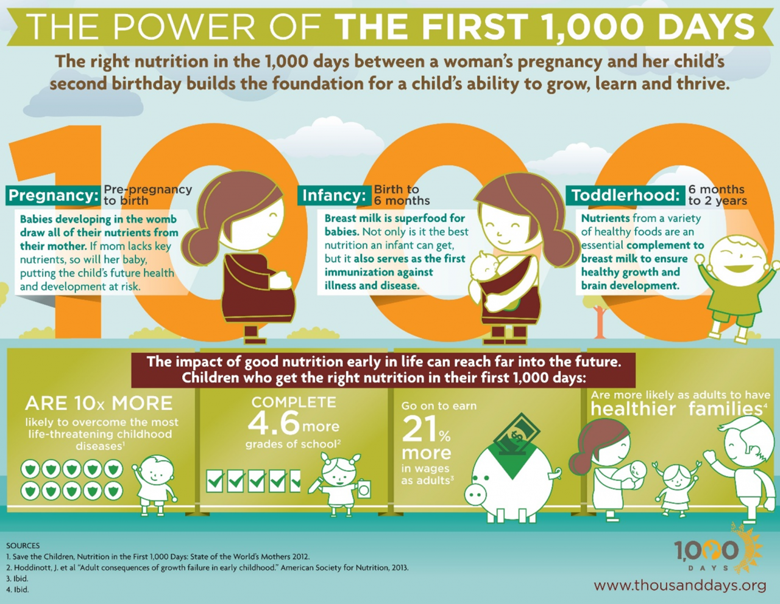

Slide 47
Supportive environments for physical activity
The physical or built environment plays an important role in facilitating physical activity for many people.
Urban planning and active transport policies can ensure that walking, cycling and other forms of non-motorized transport are accessible and safe for all.
The physical environment can also provide sports, recreation and leisure facilities, and ensure there are adequate safe spaces for active living for both children and adults.
The poorest groups in society, especially women, may have less time and fewer resources to participate in leisure-time activity, making policy interventions that target active transport and incidental physical activity throughout the day much more important.
Promotion of stair use – including placement of physical activity promotion messages on stairs – as part of a workplace programme has been shown to increase awareness and use of stairs.
The sports sector can encourage regular structured activities, especially among children and adolescents, and can strengthen the link between physical activity, sports and health.
Partnerships with communities, the private sector and nongovernmental organizations can also contribute to developing facilities for physical activity.

Slide 48
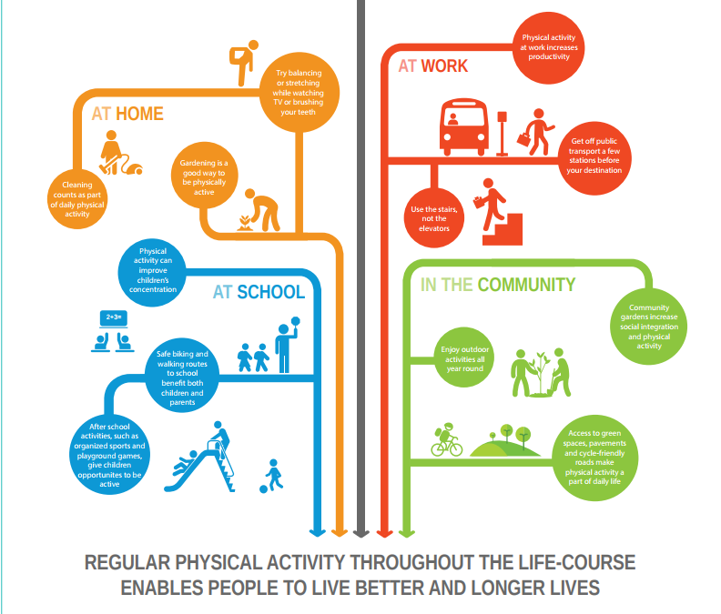
WHO, 2015

Slide 49
Settings-based interventions
Interventions reach families and communities where they live, study, work and play.
Should be comprehensive, make use of existing programmes when possible and focus on actions that do not require additional resources.
A whole-of-school approach that focuses on improving both diet and physical activity.
Successful school-based physical activity interventions should result in consistent improvements in the knowledge, attitudes and behaviour of children and, when tested, in physical and clinical outcomes.
Worlplace interventions addressing diet and physical activity can be effective in changing behaviours and health related outcomes.
Healthy eating messages in cafés and restaurants have been shown to stimulate consumption of healthy food − provided that healthy food items are made available.
Workplaces can help develop environments that are conducive to physical activity at work and provide incentives and opportunities for active commuting to and from work.
Workplaces may offer their employees free or discounted vouchers for physical activity facilities.

Slide 50
Fiscal, legislative and regulatory measures for healthy diet
Fiscal measures
Policies that increase the price of foods high in fat, sugar and salt can decrease their consumption.
Trade and agricultural policies that promote healthy diets
in 2000 Fiji banned the supply of high-fat mutton flaps under the Trading Standards Act.
Changes in agricultural subsidies to encourage fruit and vegetable production can be beneficial in increasing their consumption and improving diet.
Regulation of marketing of foods high in sugars, fats and salt.
Marketing of foods and non-alcoholic beverages influences children’s knowledge, attitudes, beliefs and preferences.
Nutrition labelling is a regulatory tool that can guide consumers towards healthier food choices. Nutrition labelling comprises nutrient declarations and supplementary nutrition information

Slide 51
Education, social marketing and mobilization
Consumer awareness and knowledge of healthy diet and physical activity can be achieved through sustained media and educational campaigns.
These campaigns have greater impact and are more cost-effective when used within multicomponent strategies.
For example, a social marketing campaign in Tonga using netball has resulted in increased participation both in netball and leisure-time physical activity by women.

Slide 52
Preventing diabetes in people at high risk
Intensive interventions that change people’s diet, increase physical activity and lead to the loss of excess body weight can prevent type 2 diabetes in people with impaired glucose tolerance, with or without impaired fasting glucose.
Diabetes Prevention Program (DPP) in the USA
Finnish Diabetes Prevention Study (DPS)
Chinese Da Qing Study
These studies showed that active intervention, lasting 2 to 6 years, could have extended benefits for glycaemic and cardiovascular outcomes that last for 10 to 20 years.
Seversal pharmacological interventions (for example, metformin and acarbose) have also been shown to prevent or delay type 2 diabetes but, in the majority of studies, this is not as effective as changes in diet and physical activity, and the effect dissipates after discontinuation of the medication.

Slide 53
Global efforts

Slide 54
Global action plan for the prevention and control of non-communicable diseases 2013-2020
The WHO had nations sign:
GLOBAL ACTION PLAN FOR THE PREVENTION AND CONTROL OF NONCOMMUNICABLE DISEASES 2013-2020
From the goals
Halt the rise in diabetes and obesity.
A 25% relative reduction in the overall mortality from cardiovascular diseases, cancer, diabetes, or chronic respiratory diseases
Notes:
For more information the link is the source:
http://apps.who.int/iris/bitstream/10665/94384/1/9789241506236_eng.pdf?ua=1&ua=1

Slide 55
Sustainable development goals by the UN
The Sustainable Development Goals (SDGs)
A collection of 17 global goals set by the United Nations.
The third goal is : Good health and well being
Notes:
https://en.wikipedia.org/wiki/Sustainable_Development_Goals

Slide 57
Saudi Efforts in preventing and controlling diabetes
There are multiple sectors serving people with diabetes in Saudi Arabia both in the private and public sectors at primary, secondary, and third level preventions.
Examples:
Saudi Charitable Association of Diabetes
The Ministry of Health
National Guard Health Affairs
The Saudi Society of Endocrinology and Metabolism[under the umbrella of the Saudi Commission for Health Specialties.]
We will zoom on the most prominent entity, the Ministry of Health.

Slide 58
Saudi Ministry of Health
Health Programs General Department
Support and development unit
Age groups unit
Screening unit
Chronic Illnesses unit
Diabetes Program
Notes:
Source: Accessed 7 Feb. 2018 by Marwah Hassounah
Saudi Ministry of Health website [ Arabic version]
Health Programs General Department- Organizational Chart
Page was last updated: 20 December 2017
URL
https://www.moh.gov.sa/depts/Non-Communicable/Pages/organization.aspx

Slide 59
Notes:
The actual organizational chart from the source
https://www.moh.gov.sa/depts/Non-Communicable/Pages/organization.aspx

Slide 60
National Diabetes Prevention and Control Program
Twitter account:
@NDPCP_MOH
Notes:
URL:
http://www.ndpcp-moh.com/AboutProgram/whatIsProgram

Slide 61
The program’s goals
Suggest research pertaining to diabetes
Work on creating a national registry for diabetes in Saudi Arabia
Suggest collaborations and coordination efforts on a local level, Gulf region level, and international level to achieve set goals.
Suggesting preventive and curative diabetes programs, as well as overlook their execution and development.
Create sub-committees to follow up on created programs.
Study reports form sub-committees, finalize them, and develop recommendations.
Take decisions and develop recommendation in issues raised to the program.
Notes:
Source:
National Diabetes Prevention and Control Program Website
Page title: Program goals]
Accessed 7 Feb 2018
[Arabic]
http://www.ndpcp-moh.com/AboutProgram/Goals

Slide 62
http://www.ndpcp-moh.com/
Notes:
You can click on this link and go to the website.
The library tab has very nice infographic sheets for providers and patients for various diabetes health education material
Also the centers tab has a search tool to find specialized diabetes clinics in the kingdom’s regions.

Slide 63
References
Baird J, Jacob C, Barker M, Fall CH, Hanson M, Harvey NC, et al. Developmental Origins of Health and Disease: A Lifecourse Approach to the Prevention of Non-Communicable Diseases. Healthcare. 2017;5(1).
Global report on diabetes. World Health Organization 2016
http://www.diabetesatlas.org/content/global-burden.
Al-Madani A. Diabetes Complications in the Gulf Countries. Presentation.
Ibtihal Fadhil. RA/ NCD/ Health promotion and Protection /EMRO/WHO Diabetes and Other Non-Communicable Diseases / EM Regional Perspective. First BA Regional Workshop on the Epidemiology of Diabetes and Other Non-Communicable Diseases , Bibliotheca Alexandrina. 5-13 January 2009.
WILD S, ROGLIC G, GREEN A, SICREE R, KING R. Global Prevalence of Diabetes. Estimates for the year 2000 and projections for 2030. DIABETES CARE 2004; 27 (5):1047-53.

Slide 64
NT, Nguyen XM, Lane J, Wang P. Relationship between obesity and diabetes in a US adult population: findings from the National Health and Nutrition Examination Survey, 1999-2006. Obes Surg 2011; 21:351.
Colditz GA, Willett WC, Rotnitzky A, Manson JE. Weight gain as a risk factor for clinical diabetes mellitus in women. Ann Intern Med 1995; 122:481.
Biggs ML, Mukamal KJ, Luchsinger JA, et al. Association between adiposity in midlife and older age and risk of diabetes in older adults. JAMA 2010; 303:2504.
DeFronzo RA, Ferrannini E. Insulin resistance. A multifaceted syndrome responsible for NIDDM, obesity, hypertension, dyslipidemia, and atherosclerotic cardiovascular disease. Diabetes Care 1991; 14:173.
Friedman JE, Dohm GL, Leggett-Frazier N, et al. Restoration of insulin responsiveness in skeletal muscle of morbidly obese patients after weight loss. Effect on muscle glucose transport and glucose transporter GLUT4. J Clin Invest 1992; 89:701. Mokdad AH, Ford ES, Bowman BA, et al. Prevalence of obesity, diabetes, and obesity-related health risk factors, 2001. JAMA 2003; 289:76.
Helmrich SP, Ragland DR, Leung RW, Paffenbarger RS Jr. Physical activity and reduced occurrence of non-insulin-dependent diabetes mellitus. N Engl J Med 1991; 325:147.
Nguyen
Del Prato S, Bonadonna RC, Bonora E, et al. Characterization of cellular defects of insulin action in type 2 (non-insulin-dependent) diabetes mellitus. J Clin Invest 1993; 91:484.

Slide 65
Thank You

