Slide 1
Myopathy

Slide 2
Introduction

Slide 3
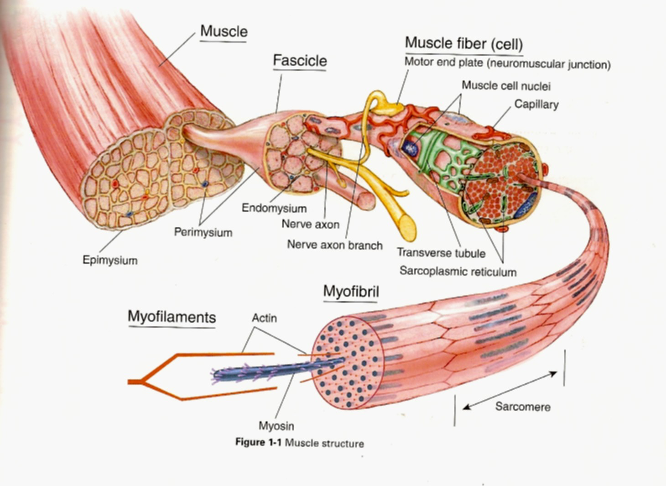
Normal Muscle

Slide 4
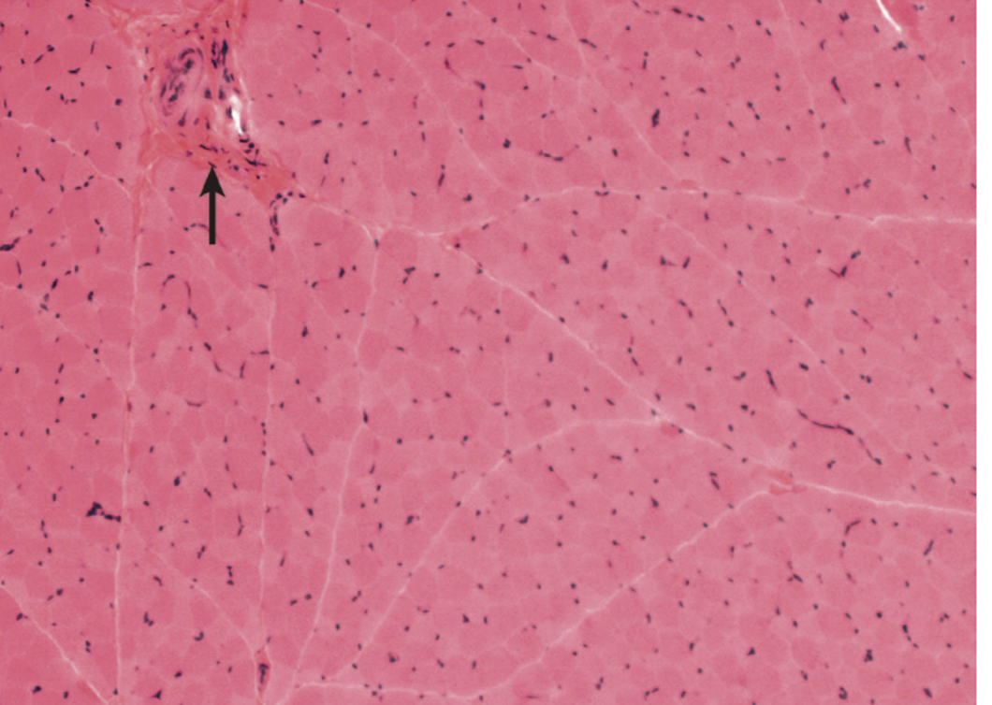
Normal Muscle

Slide 5
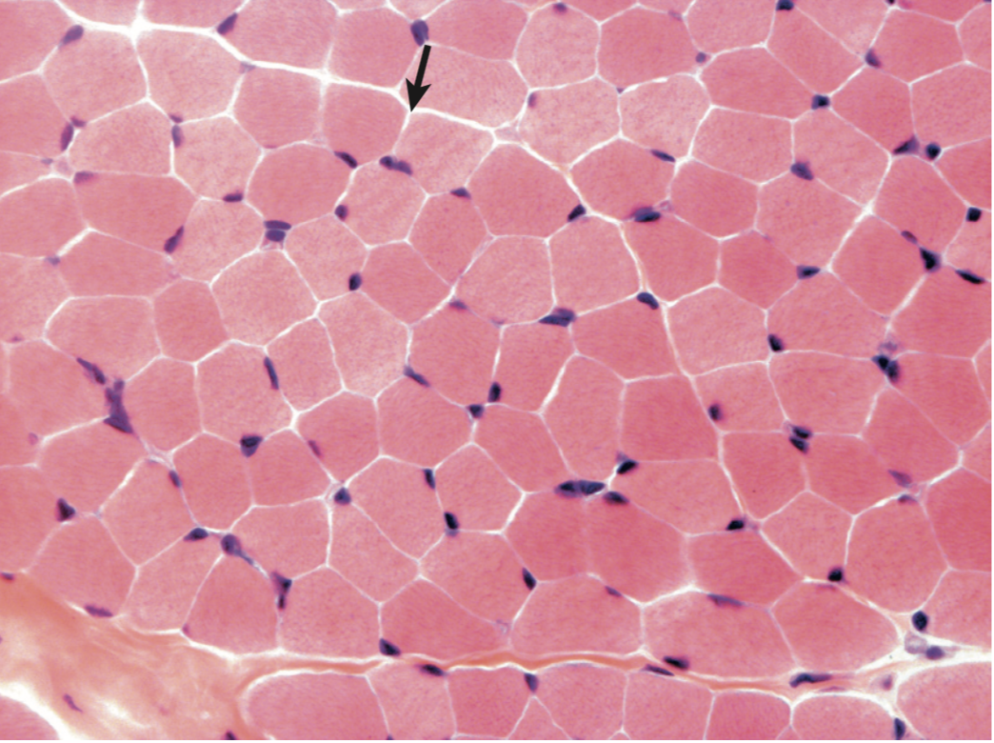
Normal Muscle

Slide 6
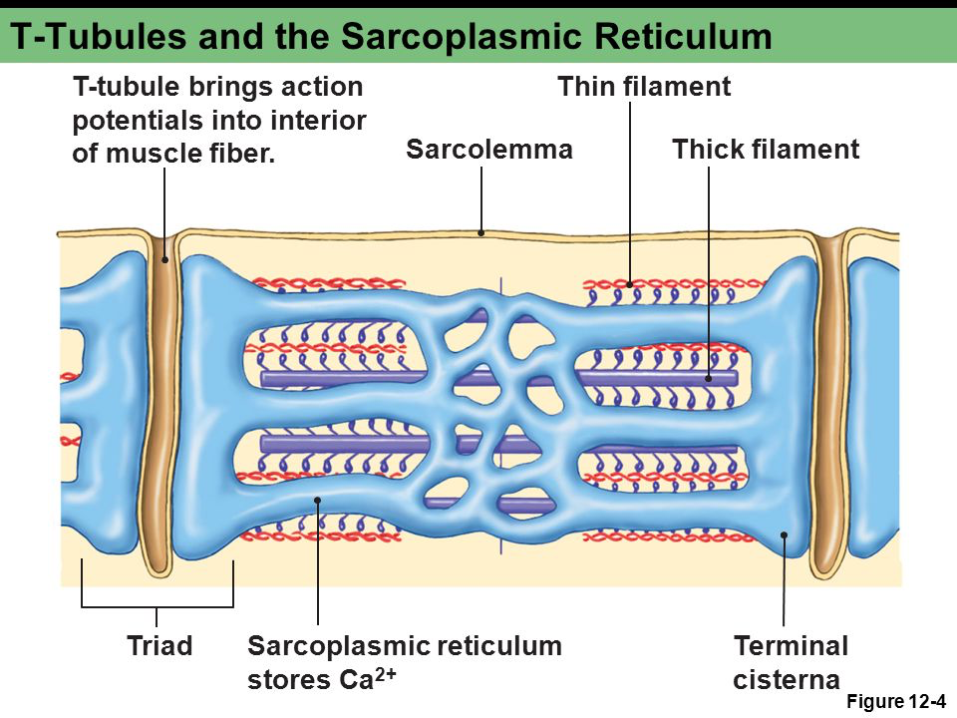
Normal Muscle

Slide 7
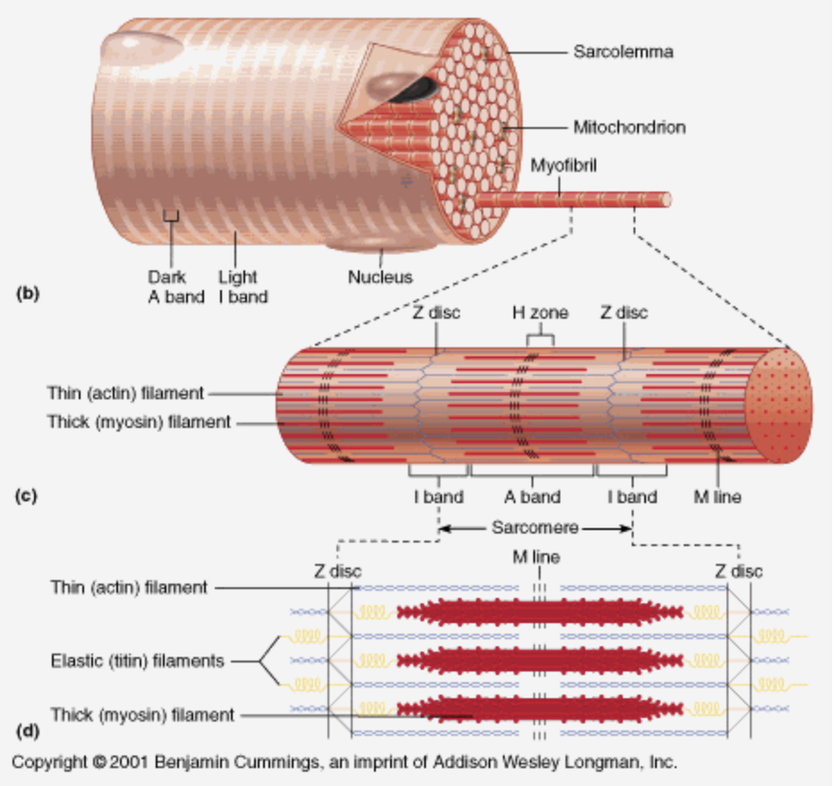
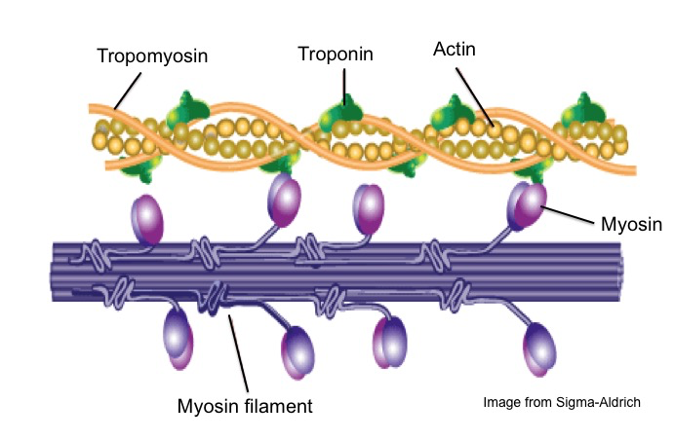

Slide 8
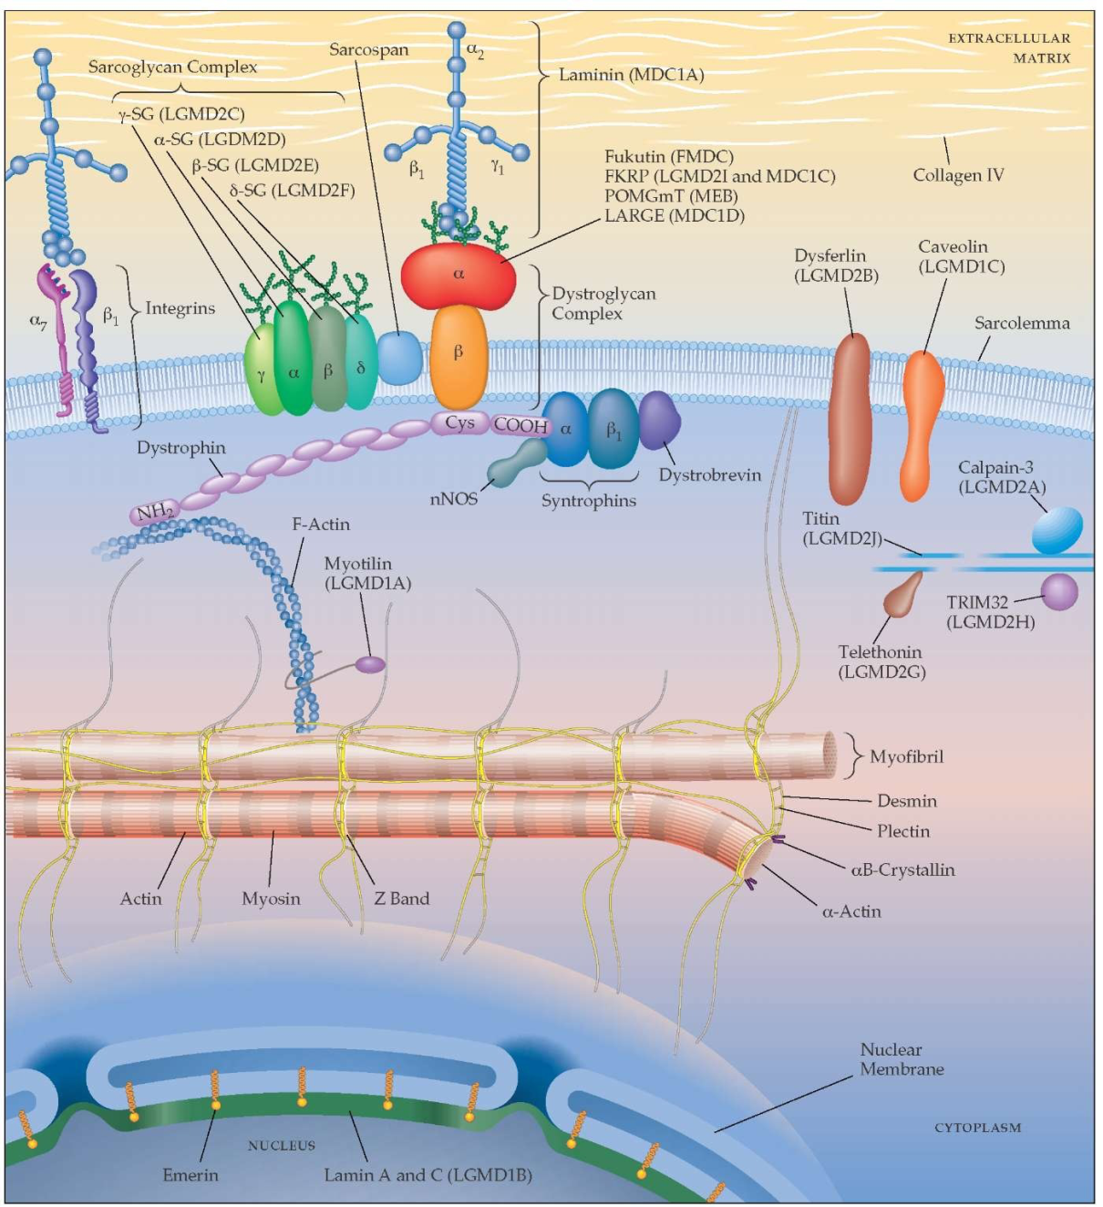
Normal Muscle

Slide 9
Myopathy definition
Myopathies are disorders affecting the channel, structure, or metabolism of skeletal muscle

Slide 10
The Big Picture
Airplane view of the Disease !

Slide 11
The Big Picture
Confirm localization in the Muscle
Determine is it Hereditary or Acquired
Hereditary
Acquired
Determine genetic diagnosis (if possible)
Provide targeted therapy if applicable
Provide supportive care
Genetic Counseling
Primary Muscle disease
Secondary to systemic disease/toxins
Treat muscle disease (if treatment available)
Supportive care
Treat systemic disease/toxins

Slide 12
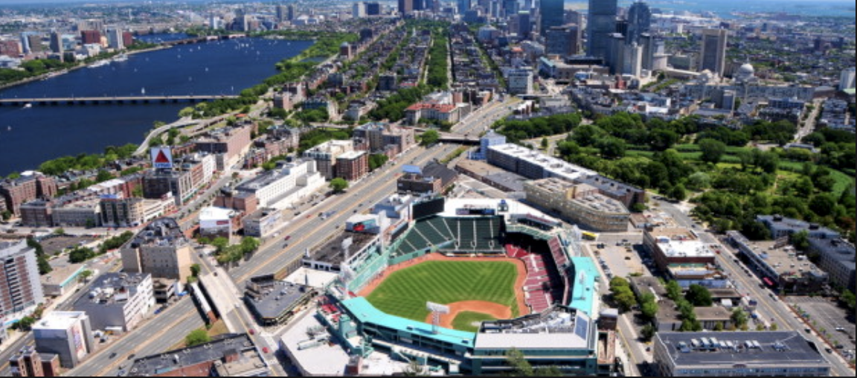
Skyscraper view of the Disease !

Slide 13
History in Myopathy
What do we want to know ?
1- Does the patient have weakness? (discussed later)
2- Positive and Negative symptoms of Myopathy? (discussed later)
3- Age of the patient when first developed symptoms? ( some myopathies unlikely to develop after a certain age limit- e.g. Duchene muscular dystrophy does not start after childhood- certain myopathies unlikely to develop before a certain age – sIBM before 40 years of age)
4- What was the onset of the myopathy? ( chronic –likely inherited, acute/subacute – likely acquired)

Slide 14
5- distribution of weakness ? Certain myopathies have unique distribution; e.g. sIBM- usually starts in quadriceps and then to deep flexors hand + foot dorsiflexors in asymmetric fashion.
Be carful sometime patient come to you late when the weakness is diffuse try to establish where the disease started
6- Cardiac or Respiratory involvement?
7- Pharyngeal Muscle involvement?
8- Systemic symptoms?
9- Is patient coping with disease or not ? E.g. depression, anxiety..
10- what is his limitations in terms of activities of daily living? E.g. Can he feed himself, can he dress by himself…etc

Slide 15
8- Is patient coping with disease or not ? E.g. depression, anxiety..
9- what is his limitations in terms of activities of daily living? E.g. Can he feed himself, can he dress by himself…etc
10- Detailed family history
11- detailed medications/toxin history

Slide 16
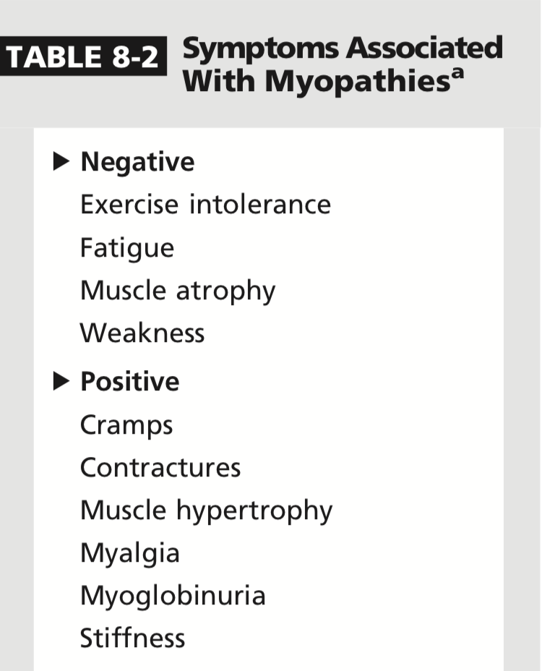
History in Myopathy

Slide 17
History in Myopathy
Weakness:
What is the first thing you want to know when the patient say they are weak ?
1- Are they really describing weakness ( people describe many things as weakness; fatigue, pain, numbness…etc)
TRUST YOUR PATIENT BUT VERIFY

Slide 18
History in Myopathy
To verify weakness by hx:
Ask about how the weakness affecting their ACTIVITIES OF DAILY LIVING
Difficulty with using arms to wash hair/difficulty w combing hair/reaching above head -----
Difficulty with going up and down the stairs/ standing from sitting position-----
PROXIMAL UPPER LIMB WEAKNESS
PROXIMAL LOWER LIMB WEAKNESS

Slide 19
History in Myopathy
To verify weakness by hx:
Difficulty with opening door knops, opening jars-----
Difficulty with walking due to tripping over toes , liffting their lower limb high and slapping it----
DISTAL UPPER LIMB WEAKNESS
DISTAL LOWER LIMB WEAKNESS

Slide 20
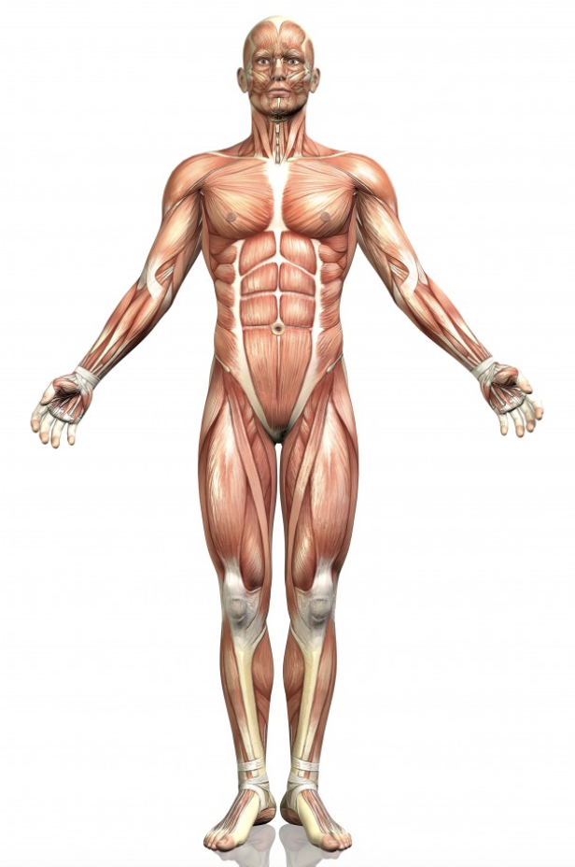
History in Myopathy
?
Motor system is not upper and lower limbs only !
Occulo-facial-bulbar axis
Axial (neck/diaphragm/spine/abdominal/scapular) axis
Appendicular axis (upper and lower limbs)

Slide 21
History in Myopathy
2- Distribution of weakness ?
Proximal > distal weakness : Acquired/inherited
Distal>proximal weakness: Acquired (e.g. Inclusion Body Myositis) Inherited (e.g. myotonic dystrophy type1)
Facial-Scapular-peroneal : inherited (FSHD)
Occulopharyngeal weakness : inherited ( OPMD)

Slide 22
History in Myopathy
True or False:
Myopathy is always proximal more than distal weakness
F

Slide 23
History in Myopathy
3- symmetrical weakness or asymmetrical ?
True or false:
Inherited myopathies are always symmetrical
F
FSHD inherited asymmetrical
IBM acquired asymmetrical

Slide 24
History in Myopathy
Temporal profile ?
Chronic slowly progressive myopathy +/- family hx +/- consanguinity----
Subacute onset in previously healthy person with fast progression
INHERITED MYOPATHY
ACQUIRED MYOPATHY
EXCEPTIONS EXIST !

Slide 25
Getting Closer, Street view !

Slide 26
Inherited Myopathy
Chronic, slowly progressive, +/- family history +/- consanguinity
Pattern of Weakness
Limb-Girdle
Pattern of inheritance
X-Linked
AD
AR
-onset <10 years of age
Myotonia
LGMDs2
Pompe’s
Yes
Duchenne
No
Becker
Yes
DM2
No
LGMDs1

Slide 27
Inherited Myopathy
Chronic, slowly progressive, +/- family history +/- consanguinity
Pattern of Weakness
Limb-Girdle
Distal >proximal Weakness
Myotonia
Yes
DM1
No
1- Inherited Distal myopathies (e.g. Laing, Welander, miyoshi..etc.)
2- Inherited IBM

Slide 28
Inherited Myopathy
Chronic, slowly progressive, +/- family history +/- consanguinity
Pattern of Weakness
Limb-Girdle
Distal >proximal Weakness
Scapuloperoneal weakness
Facial weakness & asymmetrical
Yes
FSHD
No *
1-Pompe’s
2-LGMD2A

Slide 29
Inherited Myopathy
Chronic, slowly progressive, +/- family history +/- consanguinity
Pattern of Weakness
Limb-Girdle
Distal >proximal Weakness
Scapuloperoneal weakness
Ptosis & Ophthalmoparesis
1- Mitochondrial cytopathy
2- OPMD

Slide 30
Getting Really Close

Slide 31
Inherited Myopathy
1- Abnormality in structural proteins ( Dystrophinopathies, LGMD)
2- Abnormality in Mitochondria (Mitochondrial Cytopathies)
3-Abnormality in Glycogen/fat metabolism (Fat/glycogen storage diseases)
4-Abnormality in mRNA splicing (Myotonic dystrophy)
5- Abnormality resulting in toxic protein (FSHD)

Slide 32
Inherited Myopathy
1- Abnormality in structural proteins:
Dystrophin:
cytoplasmic protein that stabilize the cell during contraction.
Mutation in Dystrophin gene, usually X-inked, cause 2 muscular dystrophies:
1- Duchenne: severe, childhood onset (<10 y/o), calf pseudohypertrophy, contractures, initially Limb-girdle pattern, later diffuse weakness, +/-respiratory system and cardiac muscle involvement with very high CK (50-100xnormal
2- Becker’s: Less severe, onset in teens or adulthood ( >10 y/o),limb girdle, calf pseudohypertrophy, +/-cardiac involvement +/- respiratory, very high ck
True or false
We need to screen asymptomatic Dystrophinopathy patients for cardiac disease
T

Slide 33
Inherited Myopathy
1- Abnormality in structural proteins:
Limb Girdle Muscular Dystrophies(LGMD):
Inherited group of muscular dystrophy that share Limb-girdle pattern of weakness but have variable involvement of other muscle groups.
Divided to 2 groups based on inheritance:
1- LGMD1 (AD) group
2- LGMD2 (AR) group
LGMD2 is more common than LGMD1
The most common LGMD2 in western world is LGMD2A (Calpainopathy)

Slide 34
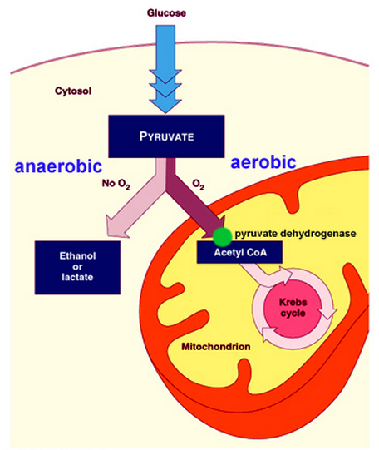
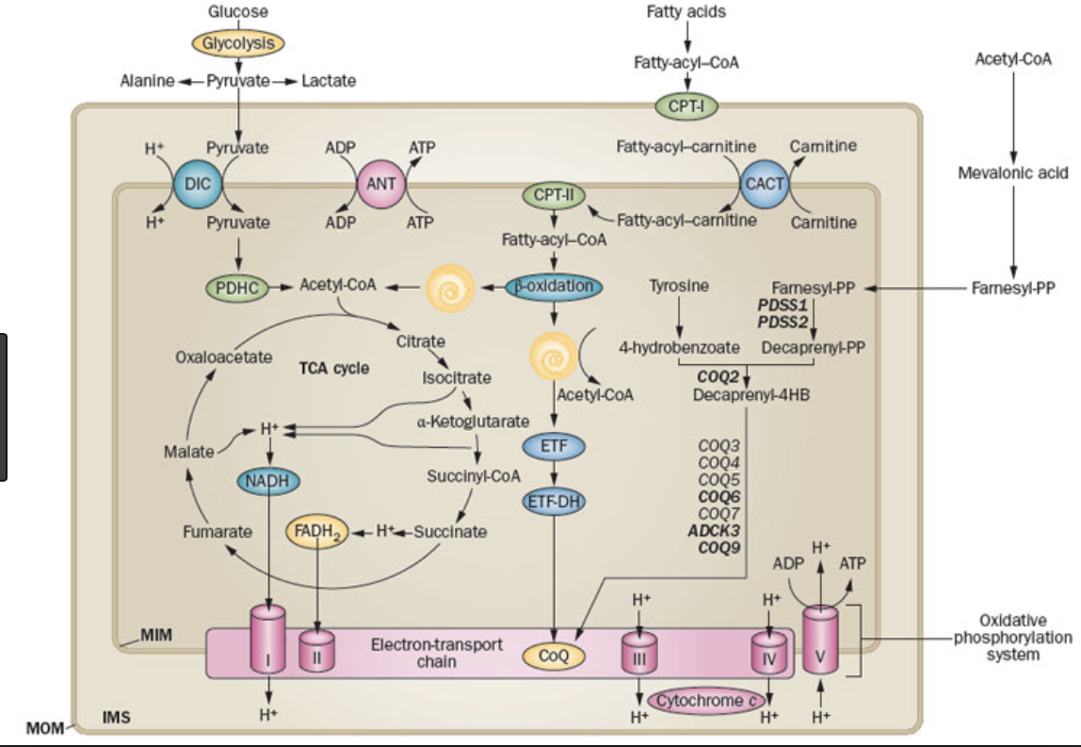
Inherited Myopathy
Glycolysis
2- Abnormality in Mitochondria (Mitochondrial Cytopathies):
Mitochondria are intracellular organelles responsible for aerobic energy production (present in all mammalian cells).
Mitochondrial cytopathies result from primary dysfunction of the mitochondrial respiratory chain.
Some components in the respiratory chain encoded by nuclear DNA and some encoded by mitochondrial DNA
34 ATP
2 ATP

Slide 35
Inherited Myopathy
2- Abnormality in Mitochondria (Mitochondrial Cytopathies):
Mitochondria cytopathies may result from either nuclear DNA or mitochondrial DNA mutation.
Mitochondrial cytopathies affect systems with high energy need:
1-CNS (seizures, encephalopathy, stroke like, optic neuropathy, Depression, fatigue)
2-PNS (myopathy, neuropathy), 3-cardiac (cardiomyopathy, conduction defects)
4-Endocrine ( Hypo-T/ParaT/Growth hormone, DM, Gonadal failure)
5-GI ( Dysmotility, hepatic failure)
There is a lot of distinct complex syndromes with combination of the above.

Slide 36
Inherited Myopathy
3-Abnormality in Glycogen/fat metabolism (Fat/glycogen storage diseases)
Hereditary myopathies caused by specific enzymatic defect in carbohydrate or fat metabolism.
Divided to 2 groups :
1- Episodic weakness group
2- Static Weakness group

Slide 37
Inherited Myopathy
3-Abnormality in Glycogen/fat metabolism (Fat/glycogen storage diseases)
1- Episodic weakness group
Episodes of exercise intolerance with muscle contractures/stiffness and pain. In severe cases may result in Rhabdomyolysis. 2 diseases :
A- Mcardle (glycogen metabolism defect)
B-CPT II deficiency ( Fat metabolism defect)

Slide 38
Inherited Myopathy
3-Abnormality in Glycogen/fat metabolism (Fat/glycogen storage diseases)
1- Episodic weakness group
A- Mcardle: (AR)
Enzyme defect- muscle glycogen phosphorylase which normally breaks glycogen (Glycogenolysis)
Attacks happen in short term high intensity exercise
In the 1st minutes of exercise Mcardle patients have energy crisis due to blocked muscle glycogenolysis and low availability of extramuscular fuels.(cause muscle symptoms and tachycardia)
In 6-8 minutes extramuscular fuels supplies become available and the patient feels less exertion and heart rate normalize (2nd wind phenomena)
CK high between attacks
They have cramps

Slide 39
Inherited Myopathy
3-Abnormality in Glycogen/fat metabolism (Fat/glycogen storage diseases)
1- Episodic weakness group
B- Carnitine Palmitoyltransferase II (CPTII) deficiency (AR)
Enzyme defect- CPTII which normally transport long chain FA to mitochondrial matrix
Attacks happen with prolonged exercise and fasting
No cramps
CK between attacks normal.

Slide 40
Inherited Myopathy
3-Abnormality in Glycogen/fat metabolism (Fat/glycogen storage diseases)
2- Static Weakness group
Pompe disease (AR):
Enzyme defect- Acid maltase which lead to accumulation of glycogen in lysosomes of skeletal, cardiac and smooth muscles.
Adult onset phenotype: Weakness (onset 3rd or 4th decade) in truncal and proximal muscles ( can present initially with respiratory insufficiency)
CK elevated
Can measure Acid maltase enzymatic activity
Muscle biopsy
Treatment enzyme replacement Therapy

Slide 41
Inherited Myopathy
4-Abnormality in mRNA splicing (Myotonic dystrophy)
Myotonic Dystrophy 1
AD from expantion of triplet repeat (CTG) on the myotonic dystrophy protein kinase (DMPK) gene.
Myotonic Dystrophy 2
AD from expantion of triplet repeat (CCTG) on the Zinc Finger protein 9 (ZNF9) gene.

Slide 42
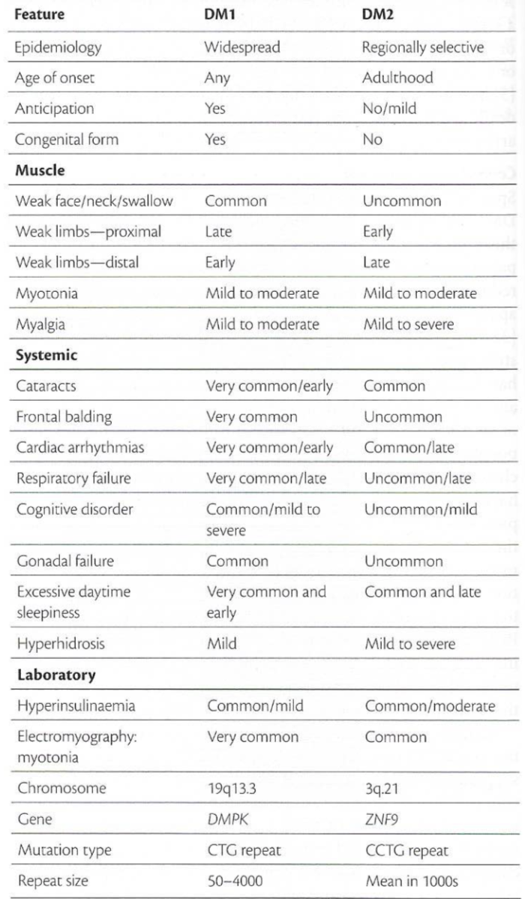
Inherited Myopathy
4-Abnormality in mRNA splicing (Myotonic dystrophy)

Slide 43
Inherited Myopathy
4-Abnormality in mRNA splicing (Myotonic dystrophy)

Slide 44
Inherited Myopathy
4-Abnormality in mRNA splicing (Myotonic dystrophy)

Slide 45
Inherited Myopathy
4-Abnormality in mRNA splicing (Myotonic dystrophy)

Slide 46
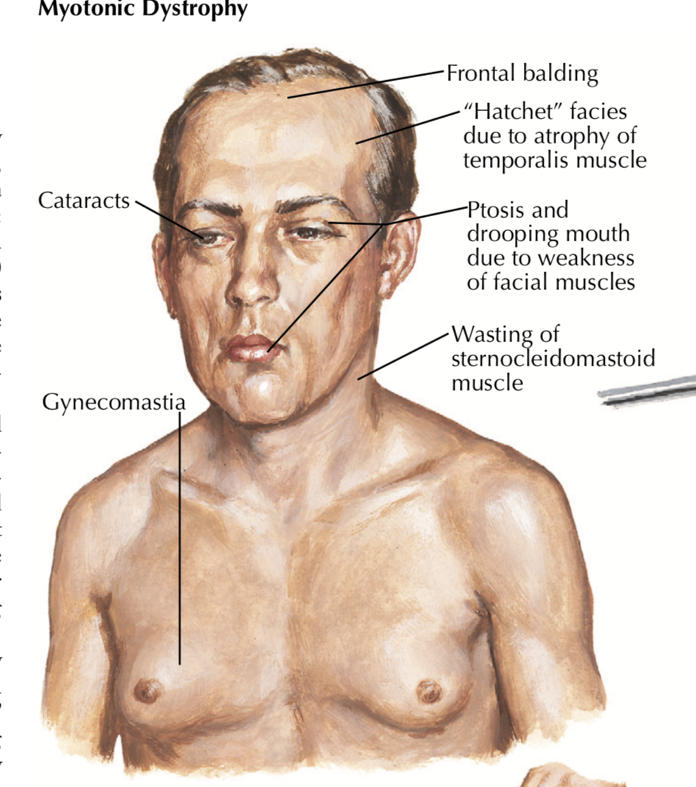
Inherited Myopathy
4-Abnormality in mRNA splicing (Myotonic dystrophy)

Slide 47
Inherited Myopathy
4-Abnormality in mRNA splicing (Myotonic dystrophy)
True or false
We need to screen asymptomatic Myotonic dystrophy patients for cardiac disease
T

Slide 48
Inherited Myopathy
4-Abnormality in mRNA splicing (Myotonic dystrophy)

Slide 49
Inherited Myopathy
4-Abnormality in mRNA splicing (Myotonic dystrophy)
True or False:
Myotonia on EMG only happen in Myotonic Dystrophy
F

Slide 50
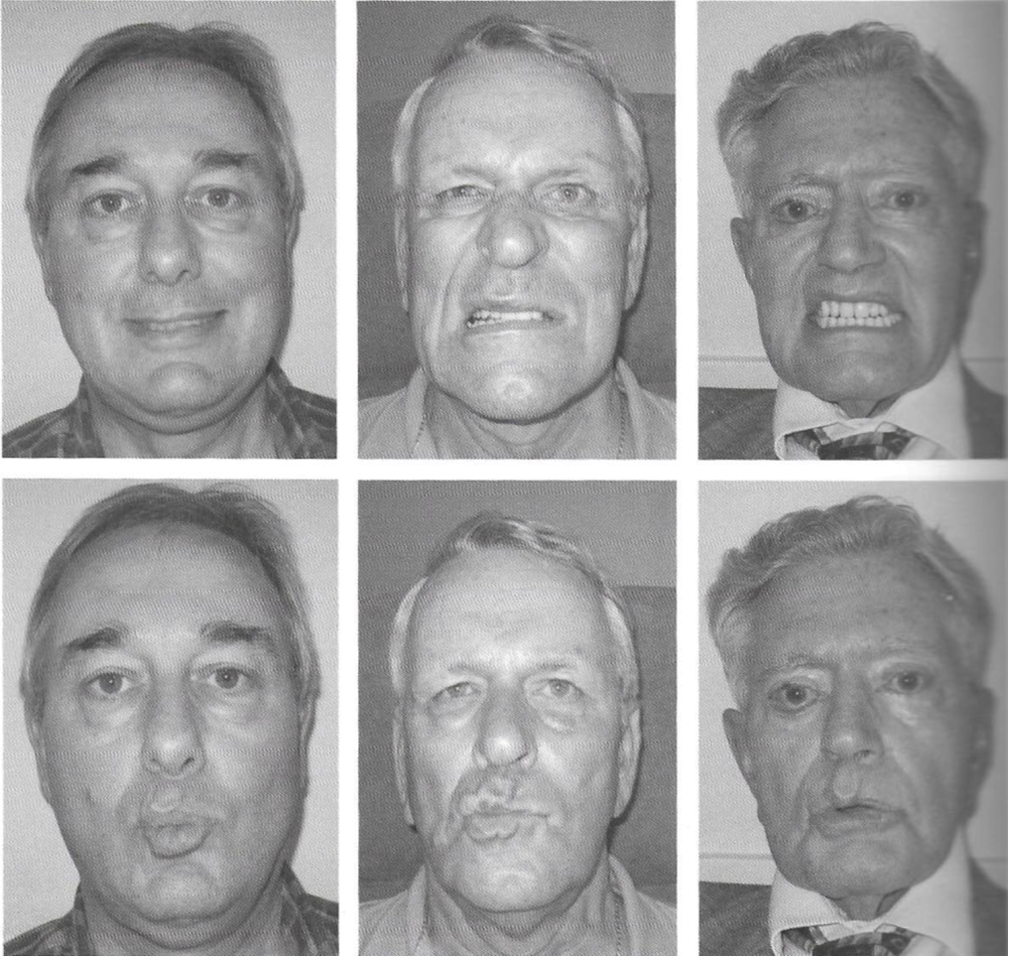
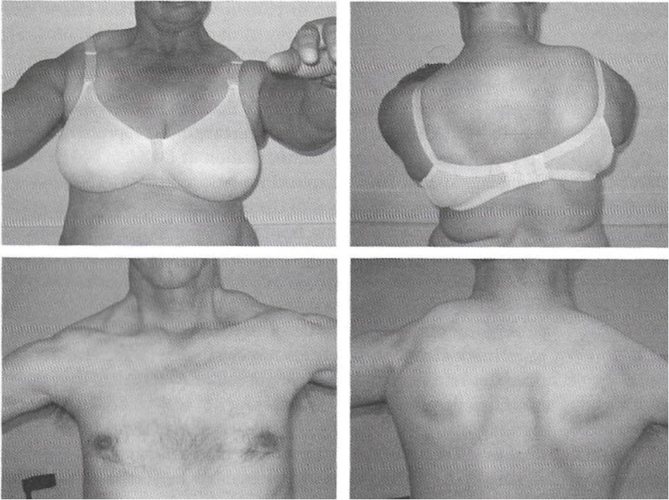
Inherited Myopathy
5- Abnormality resulting in toxic protein (FSHD)
Autosomal dominant.
ASYMMETRICAL facial-scapulo-peroneal weakness.
True or false
We need to screen asymptomatic FSHD patients for cardiac disease
F

Slide 51
Acquired Myopathy
Inflammatory Myopathy:
1- Polymyositis
2-Dermatomyositis
3- Sporadic IBM

Slide 52
Polymyositis
Diagnostic Criteria:
1- Subacute (weeks to months) symmetrical limb girdle weakness.
2- elevated serum CK
3- EMG finding of irritable myopathy
4- Muscle biopsy consistent with polymyositis
5- Order anti-JO1 (ILD)
Treatment : Immunosuppression, screen for malignancy & ILD

Slide 53
Dermatomyositis
Diagnostic Criteria:
1- Subacute (weeks to months) symmetrical limb girdle weakness.
2- Skin changes consistent with dermatomyositis
3- elevated serum CK
4- EMG finding of irritable myopathy
5- Muscle biopsy consistent with Dermatomyositis
6- Increased risk of malignancy
7- increased risk of interstitial lung disease(ILD)
8-5- Order anti-JO1 (ILD)
Treatment : Immunosuppression, screen for malignancy & ILD

Slide 54
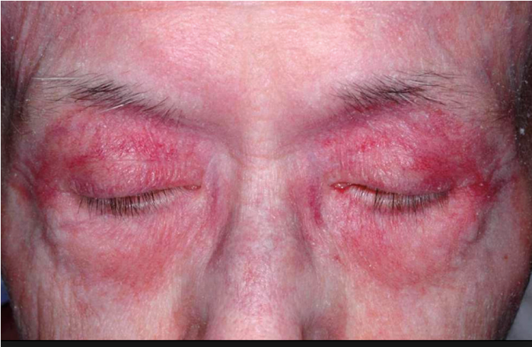
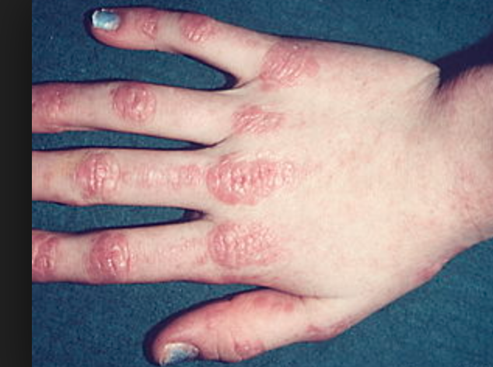
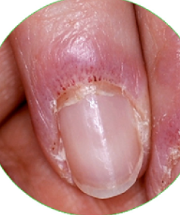
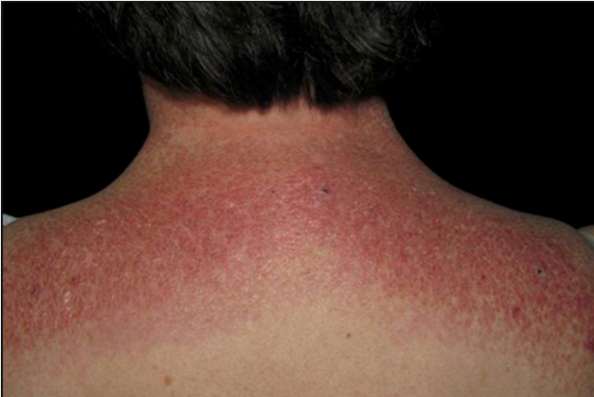
Dermatomyositis

Slide 55
Inclusion Body Myositis
Diagnosis:
Insidious onset of proximal and distal asymmetrical weakness (wrist and finger flexors, quadriceps and ankle dorsiflexion), Severe dysphagia develops
EMG: irritable myopathy
Biopsy suggestive of IBM
Severe dysphagia develops
Treatment: supportive

Slide 56
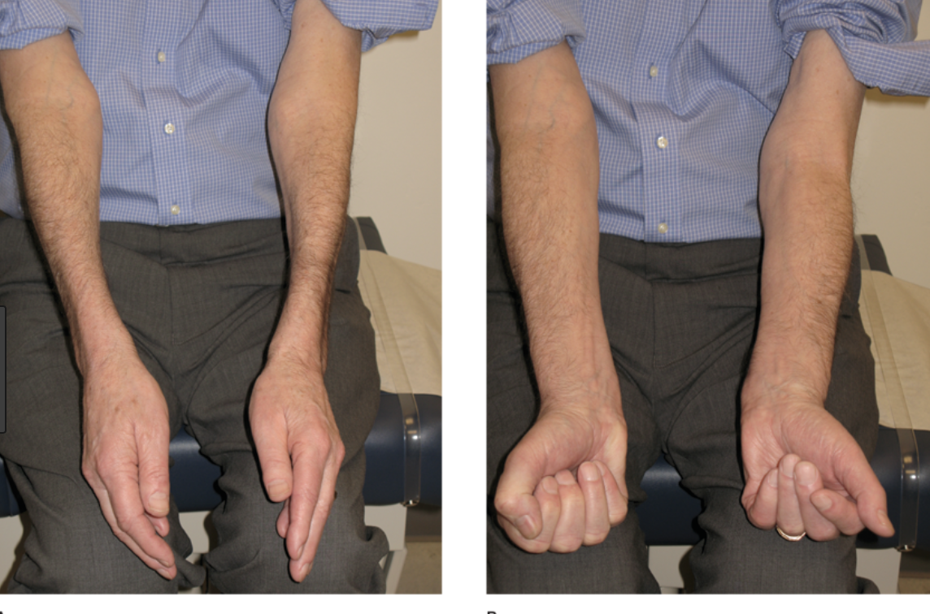
Inclusion Body Myositis

