Slide 1
Multiple sclerosis
DR. Abdulkader Daif. MD
Consultant and professor of Neurology
KKUH, KSU

Slide 18
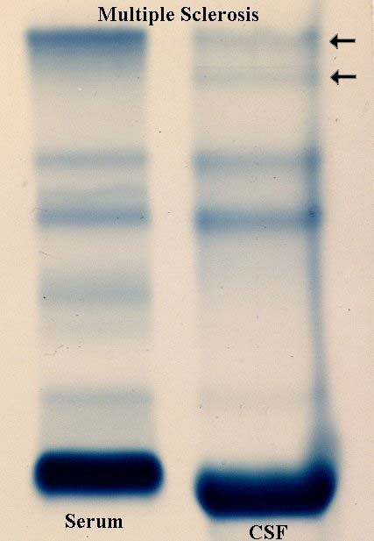
CSF OCB are not specific to MS!
Lupus 25%
Sarcoidosis 51%
Behcet’s dz 8%
Syphillis
CJD
Whipple’s disease
Lyme disease
Vaculitidies
Devic’s disease
Healthy siblings of MS patients
adapted from a lecture by Peter Riskind MD PhD 11/19/05
Notes:
18

Slide 20
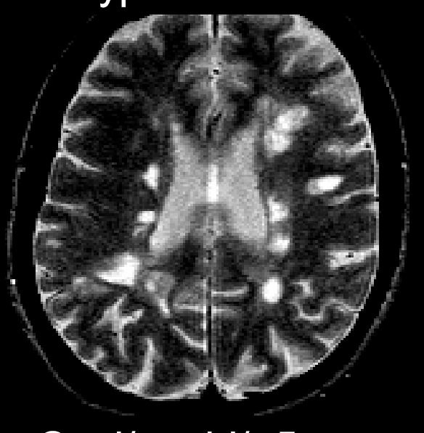
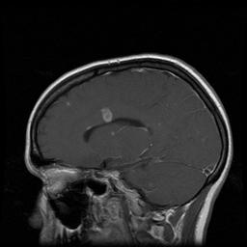
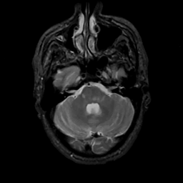
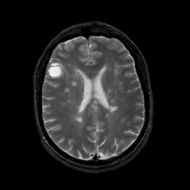
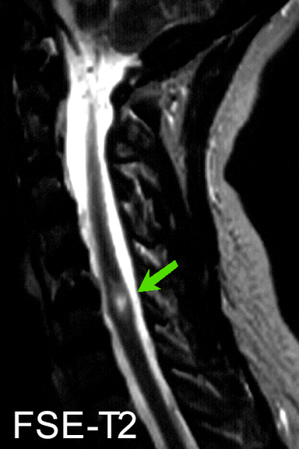
MRI - Dissemination in Space
3 of the following:
9 T2 or 1 Gd+
3 Periventricular
1 Infratentorial
1 Juxtacortical lesion
Notes:
20

Slide 21
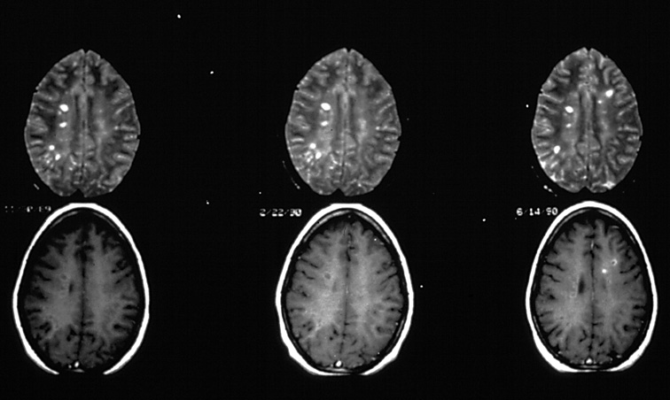
MRI - Dissemination in Time
Gd
Gd
> 3 months
T2
T2
> 1 month
> 1 month
CIS
Polman, 2005
Notes:
21

Slide 22
Differential Diagnosis
Metabolic: SCD (B12 def), Adrenomyeloneuropathy
Connective Tissue Diseases: Sjogren’s, SLE
Infectious: HIV, HTLV1, Lyme disease, Syphillis
Structural: Chiari malformation, spinal cord compression
Genetic: ataxias, paraplegias, mitochondrial
Neoplastic: CNS lyphoma, paraneoplastic
“MS variants”: ON, TM, ADEM, NMO
Other: Neurosarcoidosis, CNS vasculitis
Psychiatric
Notes:
22

Slide 32
Acute relapse
Drug Therapy
  Corticosteroids
    Treat acute exacerbations by reducing edema and inflammation at the site of demyelination
    Do not affect the ultimate outcome or degree of residual neurologic impairment from exacerbation

Slide 33
DISEASE-MODIFYING THERAPY
STARTING — A number of immunomodulatory agents, including interferon beta preparations, glatiramer acetate, natalizumab, alemtuzumab, ocrelizumab, dimethyl fumarate, teriflunomide, and fingolimod, have important beneficial effects for patients with relapsing-remitting multiple sclerosis (RRMS):
●A decreased relapse rate
●A slower accumulation of brain lesions on MRI

